Slide 1
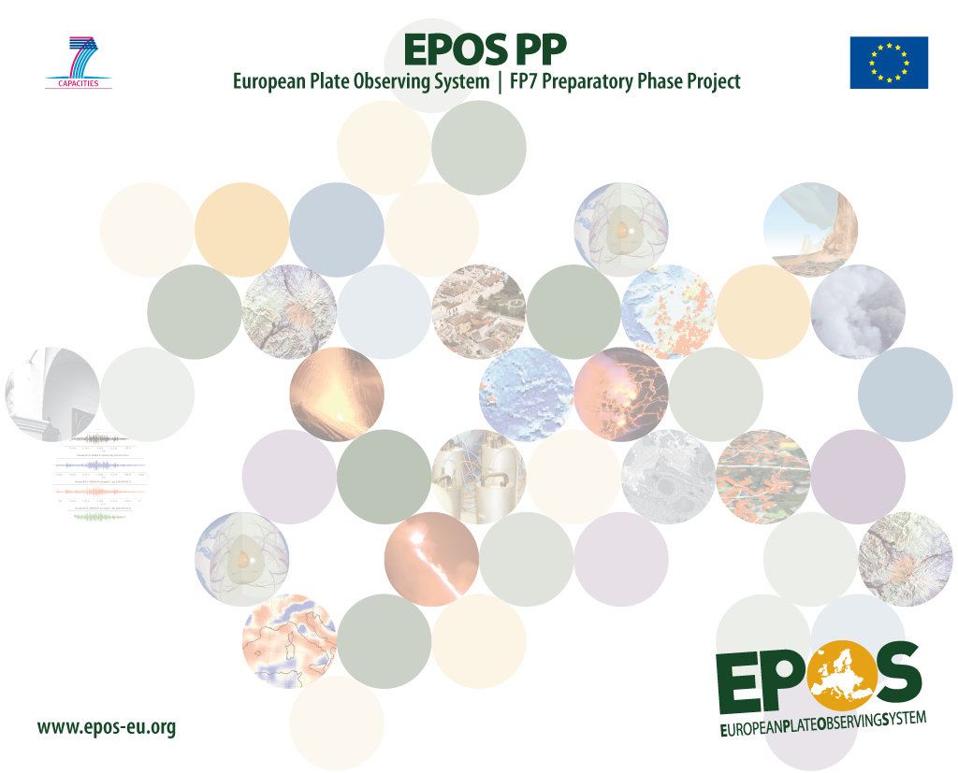
Daniele Bailo, Keith Jeffery
EPOS
use of CERIF for data-intensive science
CRIS2014 May 2014 Rome
Notes:
EPOS is the ESFRI RI for Solid Earth Science.
It participates in ENVRI and COOPEUS

Slide 2
Data intensive Science
EMPIRICAL
SCIENCE
THEORETICAL
SCIENCE
COMPUTATIONAL
DATA INTENSIVE
-1000
0
1800
2000
2014
[2009, Hey, Tony - The Fourth Paradigm]
DATA INTENSIVE SCIENCE
Synthesizes experiment, theory, and computation with statistics
Is about data and the computational systems needed to manipulate, visualize, and manage large amounts of scientific data
Notes:
THOUSAND YEARS AGO
science was empirical describing natural phenomena
LAST FEW HUNDRED YEARS
theoretical branch using models, generalizations
LAST FEW DECADES
a computational branch simulating complex phenomena
TODAY
data intensive science, synthesizing theory, experiment and computation with statistics ►new way of thinking required!

Slide 3



“Data Intensive Science” Challenges
“The goal is to have a world in which all of the science literature is online, all of the science data is online, and they interoperate with each other“
[Tony Hey et al, Microsoft Research ]
INTEROPERABILITY(of systems)
“Data integration is crucial […] for progress in large-scale scientific projects, where data sets are being produced independently by multiple researchers [and] for better cooperation among governments”
[Alon Halevy et. Al Google ]
INTEGRATION (of data)

Slide 4
“Data intensive Sciences” communities
Well established best practices and e-Infrastructures:
Astrophysics
Material science
Synchrotrons facilities
…
…and in Solid Earth Science?

Slide 5







Solid Earth Science
Scattered community
Multidisciplinary community
Societal impact:
  Geo-Hazards
  Geo-Resources
  Environmental changes
NEW to data-intensive science
(almost)

Slide 6
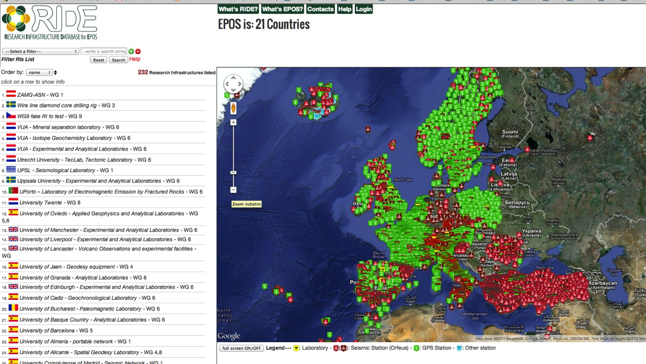
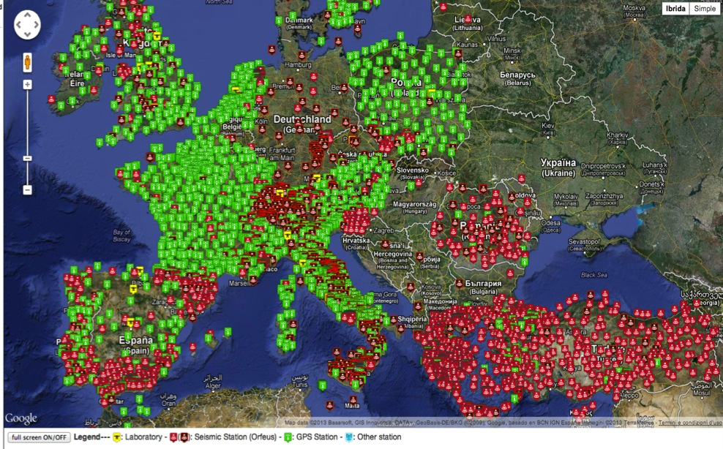
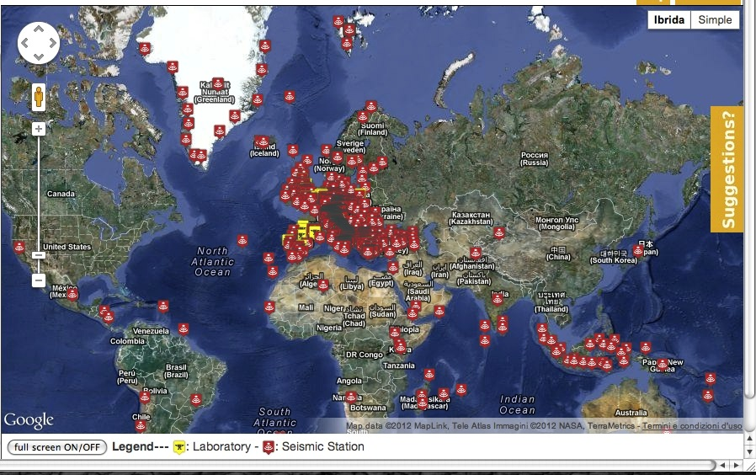
“Numbers” of solid earth science
MAP OF:
- Seismic/GPS stations
Laboratories
- etc….
Diversity in data type and formats
http://www.epos-eu.org/ride/
Research Infrastructure
LIst
244 Research Infrastructures
138 Institutions
22 countries
2272 GPS receivers
4939 seismic stations
464 TB Seismic data
1.24 PB Total Storage
828 instruments in 118 Laboratories

Slide 7
The long “Heavy” tail
growth ~ 0.5 PB/year
& data diversity (type & formats)
Earth Sciences

Slide 8
Multi-disciplinary research

Slide 9

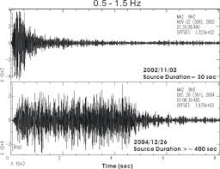
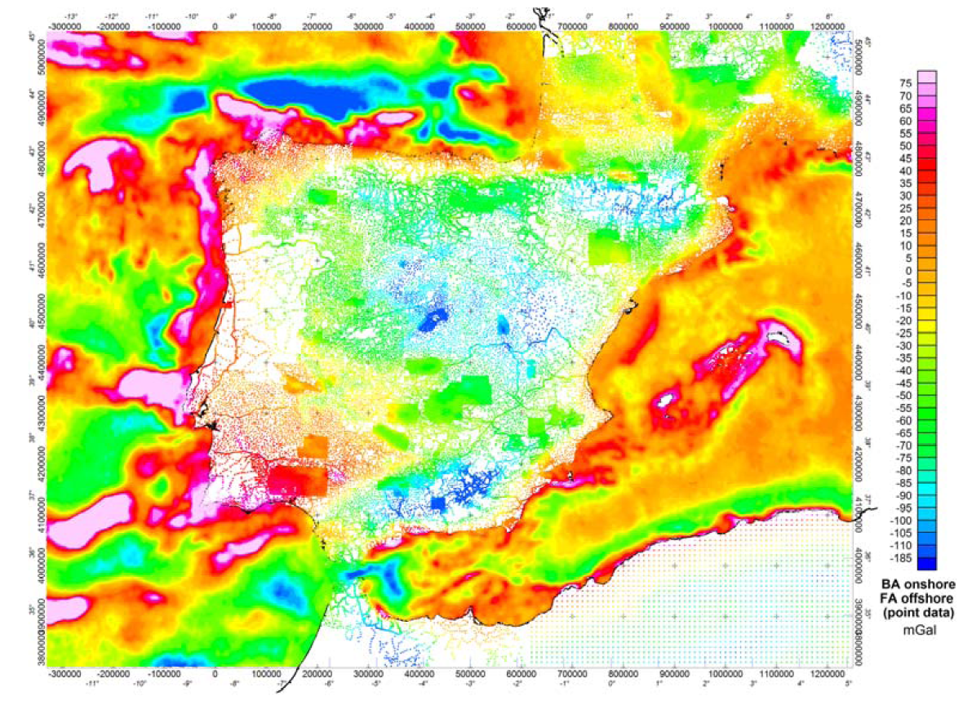
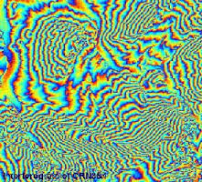
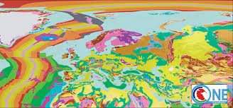
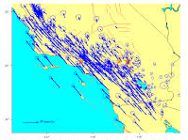
Scientist Work
Scientist willing to perform inter-disciplinary reasearch
Seismic waveform +
SAR interferograms +
Hazard maps +
Geological maps +
Velocity maps (GPS) =
---------------------
NEW SCIENCE!

Slide 10
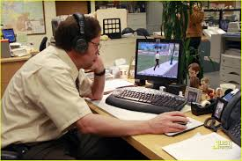








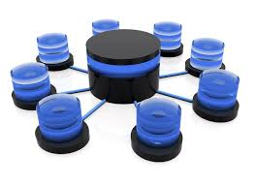
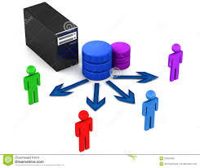

Data is obtained by:
Lots of emails
Lots of phone calls
Lots of log-in, passwords

Slide 11
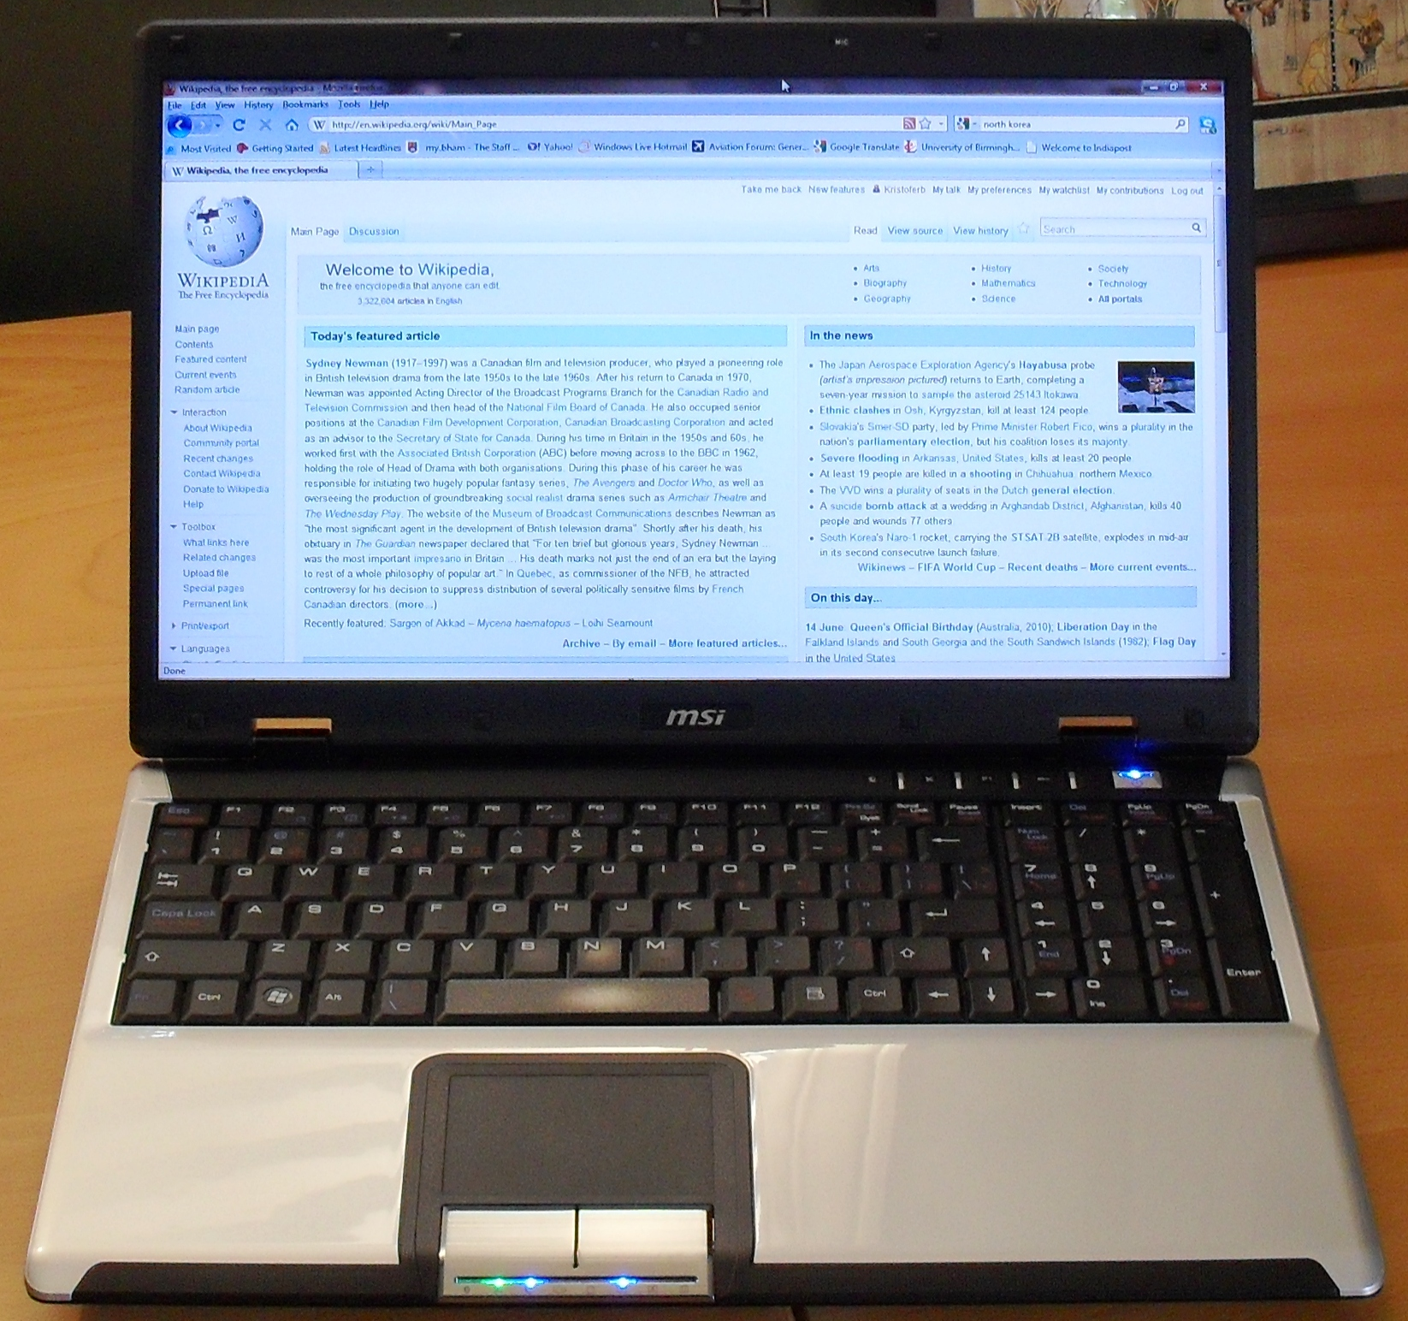
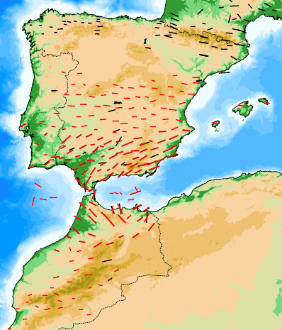
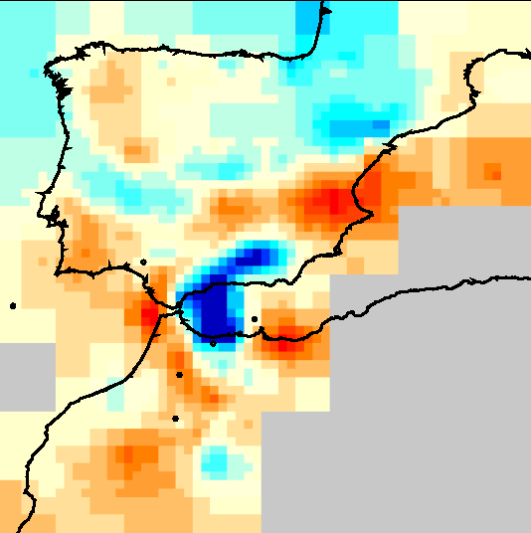



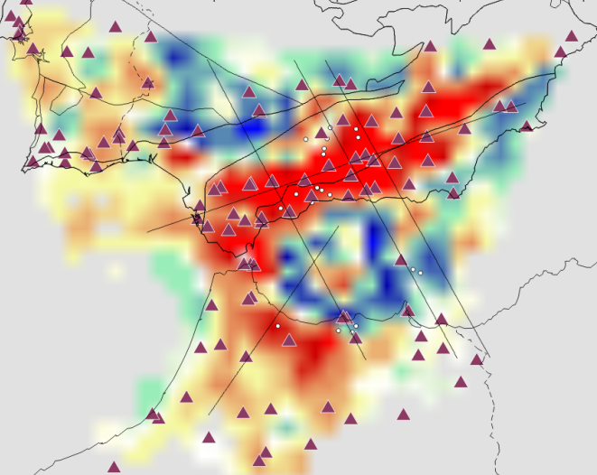
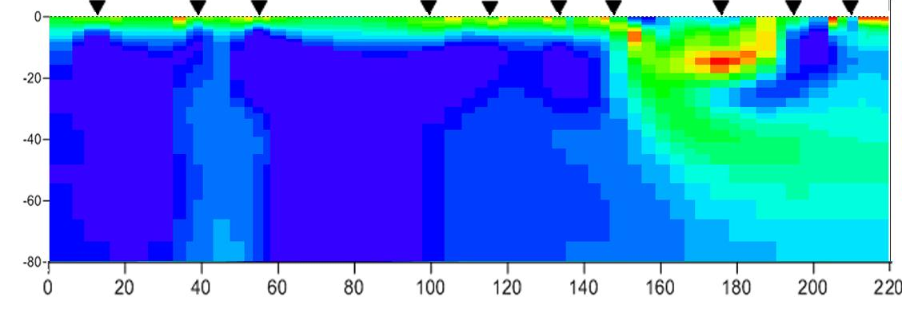
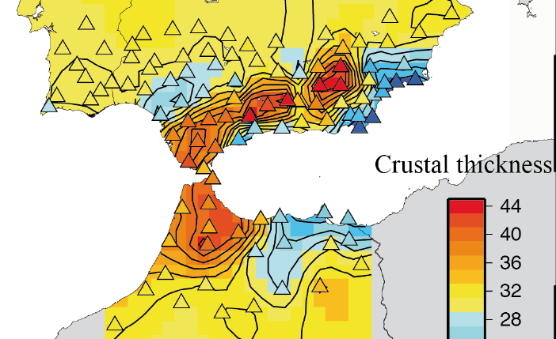
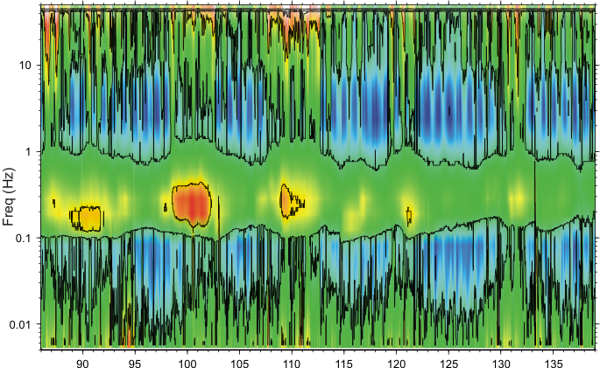
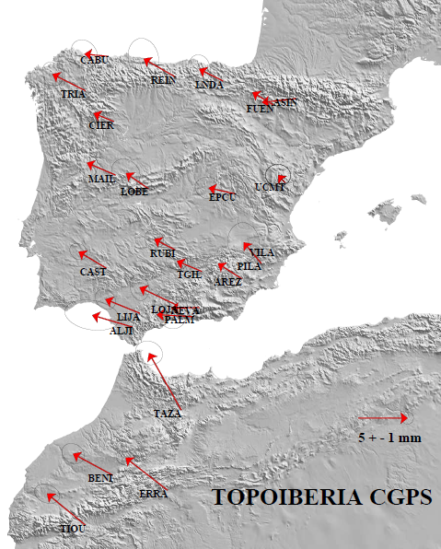
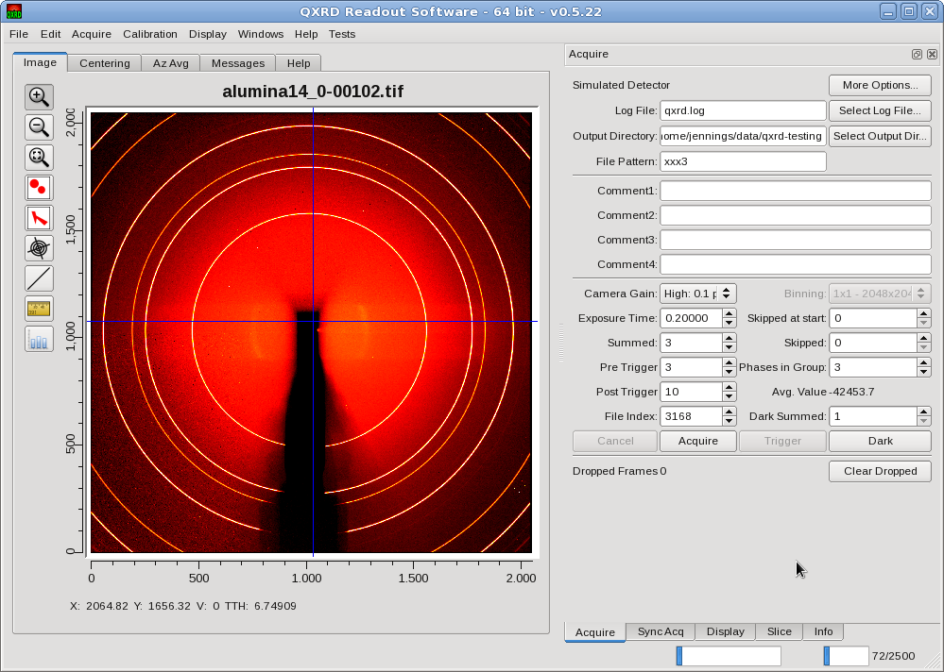

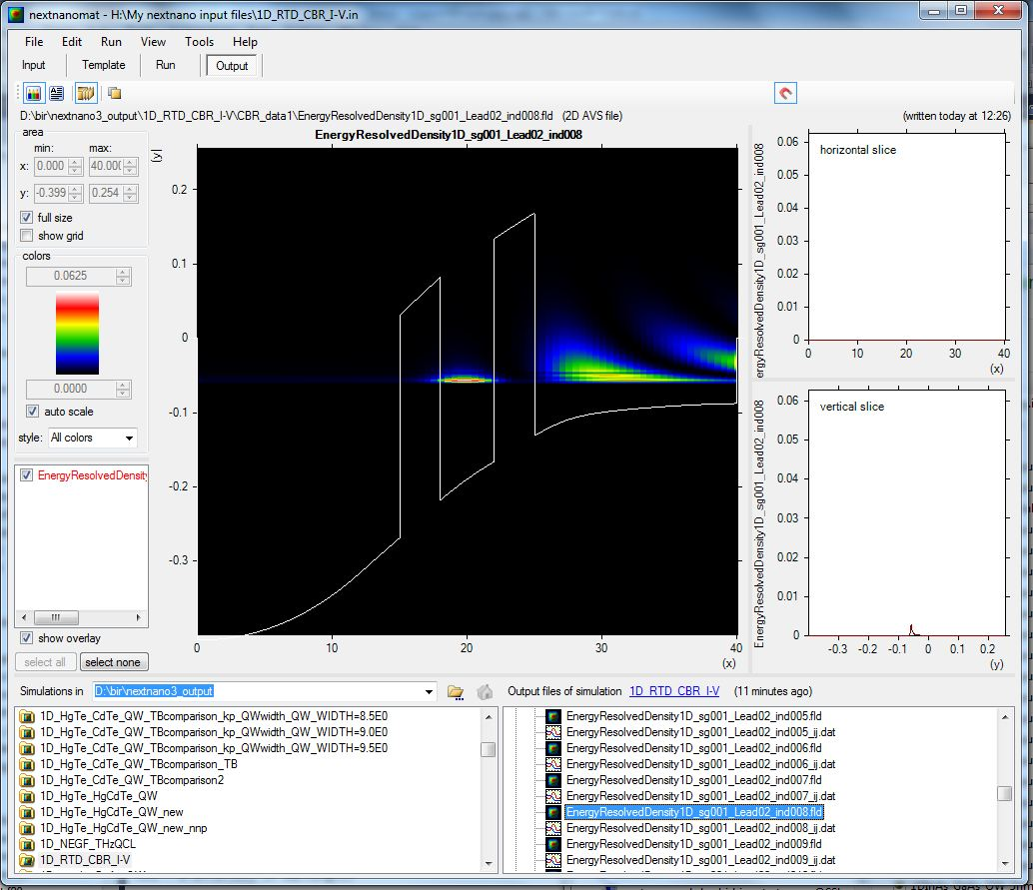

…Once you have the data…
ASCII, UTF-8,
EBCDIC, UTF-16…
Different format,
encoding & OS
Different data types
Different software

Slide 12
Wrapping-up
Doing all the above manually using multiple
portals is:
Complex
Expensive (time consuming)
Error prone
…we can do better…

Slide 13

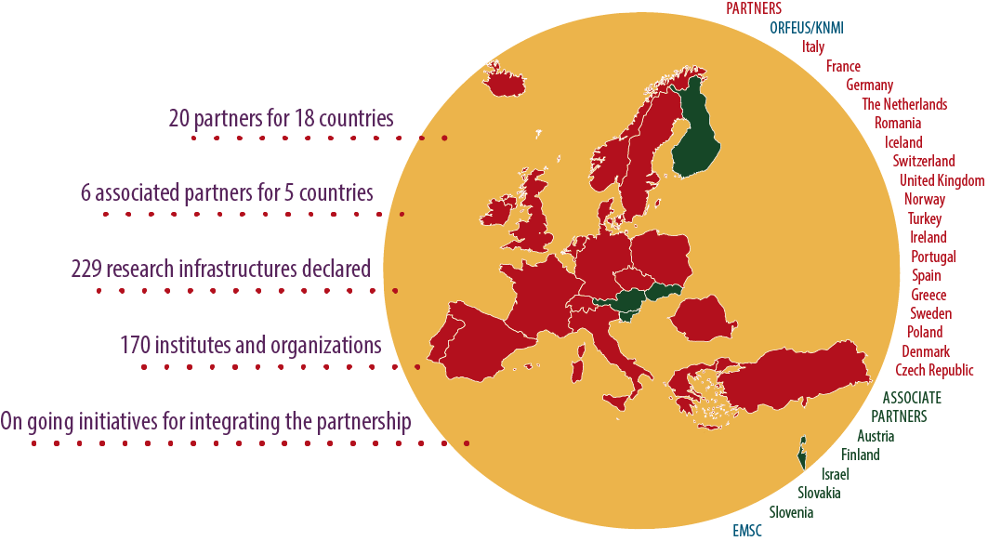
EPOS Vision
The European Plate Observing System (EPOS):
represents a scientific vision and approach in which innovative multidisciplinary research is made possible
for a better understanding of the physical processes controlling earthquakes, volcanic eruptions, unrest episodes and tsunamis as well as those driving tectonics and Earth surface dynamics.
long-term plan to facilitate integrated use of data, services, models and facilities from mainly distributed existing, but also new research infrastructures, for solid Earth science.
EPOS Timeline
Notes:
One of the first result of the interaction between the EPOS PP Management and the Advisory Board has been the definition of a roadmap starting from the EPOS Mission.

Slide 14
Overcoming complexity

Slide 15

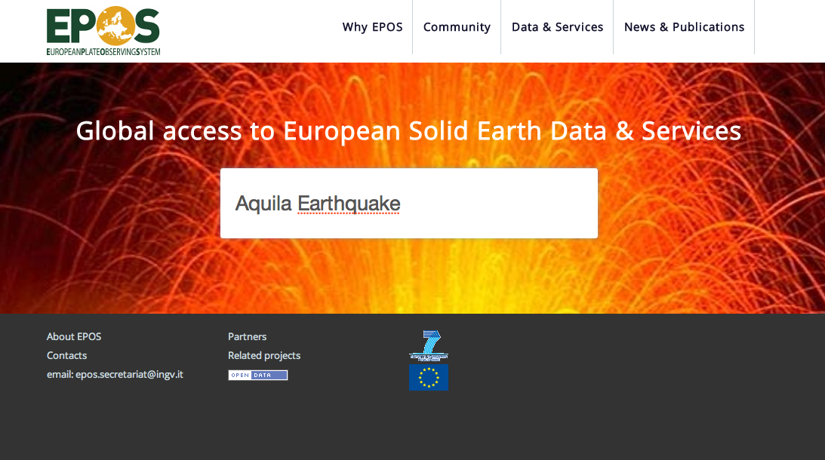
Scientist at work

Slide 16
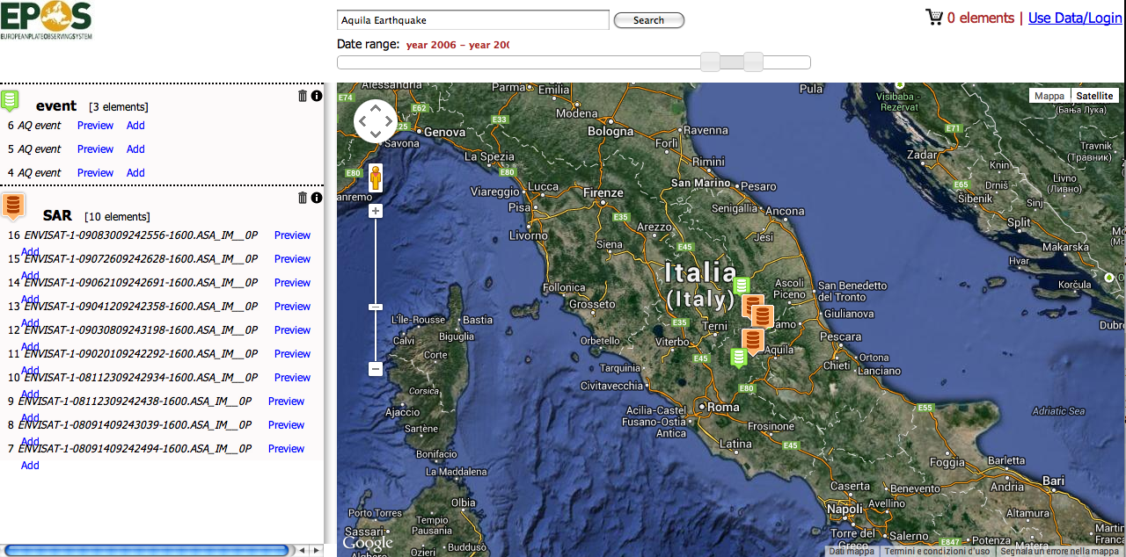


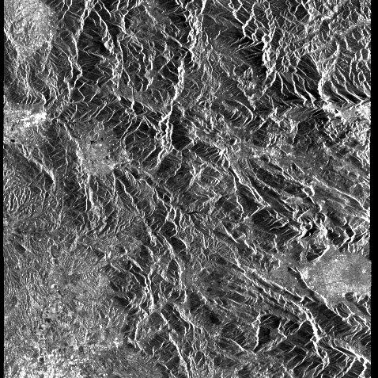


Scientist at work
ENVISAT_987987998_
Sicily North East Coast
Switch to advanced search
Accelerometric Data
Lipari Islands M:2.2
2013.08.23 - add | show | info
Sicily North East Coast M:2.1
2013.08.21 - add | show | info
Sicily North East Coast M:2.3
2013.08.18 - add | show | info
SAR Data
ENVISAT_987987998_
add | show | info
square
ENVISAT_43287987998_6
add | show | info
square
Geodetic DAta
Rynex ad098098
2009.04.09 - add | show | info
Rynex ad098098
2009.04.09 - add | show | info
Rynex ad098098
2009.04.09 - add | show | info
Notes:
Aggiungere show

Slide 17
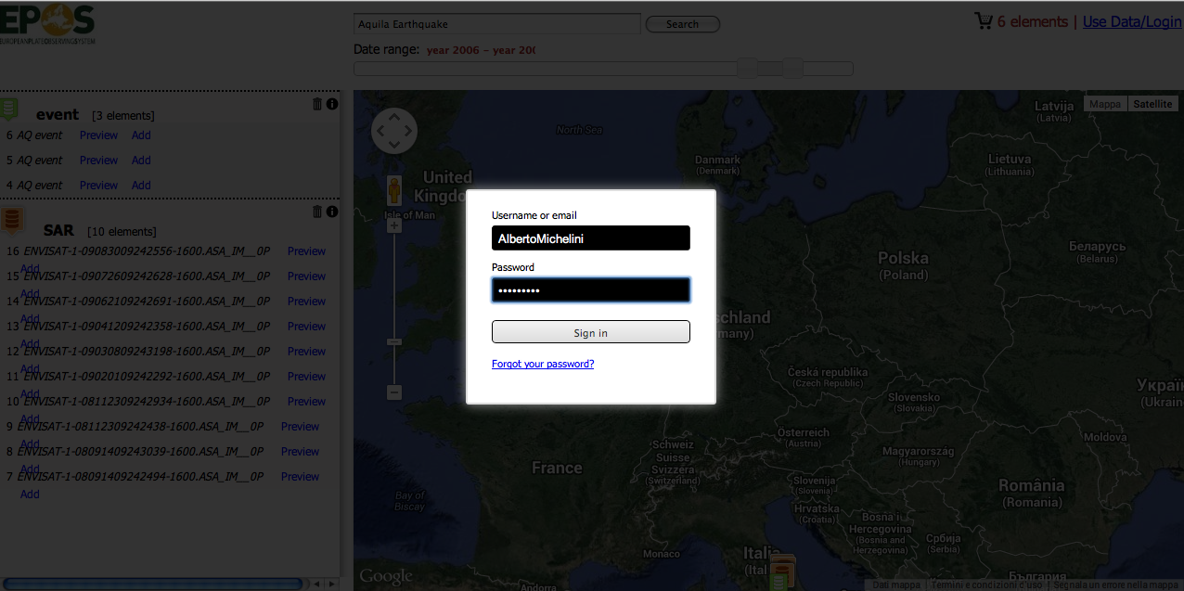
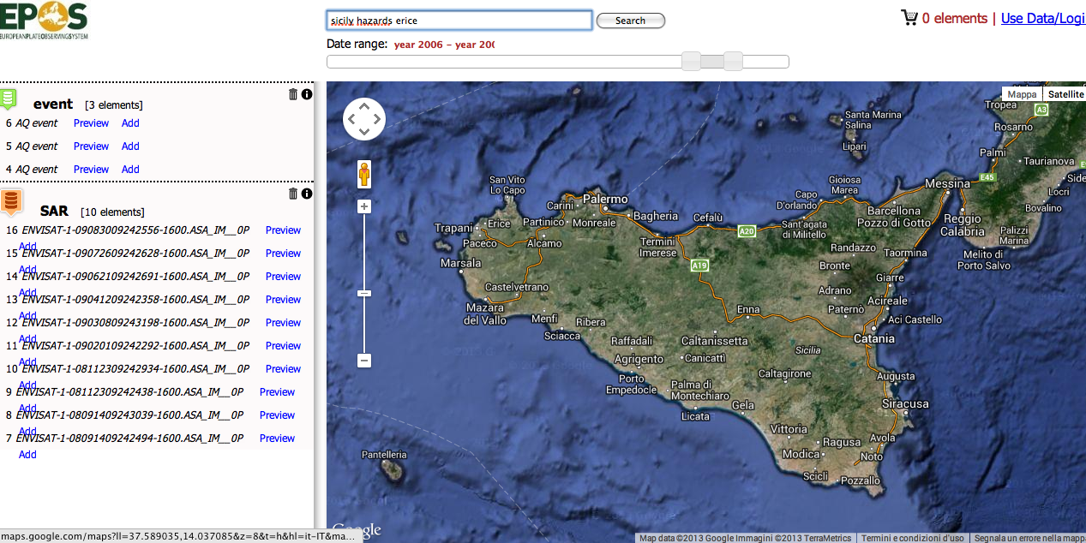


Scientist at work
Sicily North East Coast
Latest Earthquakes
Lipari Islands M:2.2
2013.08.23 - Info
Sicily North East Coast M:2.1
2013.08.21 - Info
Sicily North East Coast M:2.3
2013.08.18 - Info
Shakemaps
Sicily North East Coast
2013.08.15 - Download
Sicily sea
2013.05.14 - Download
Hystorical Earthquakes
Siracusa Aea - Imax: 11MCS
1693.01.11 - Infos
Documents & other resources
Civil protection: Sicily hazards
2013.02.01 - Link
Hystory of Sicily Hearthquakes
2013.02.01 - Link

Slide 18
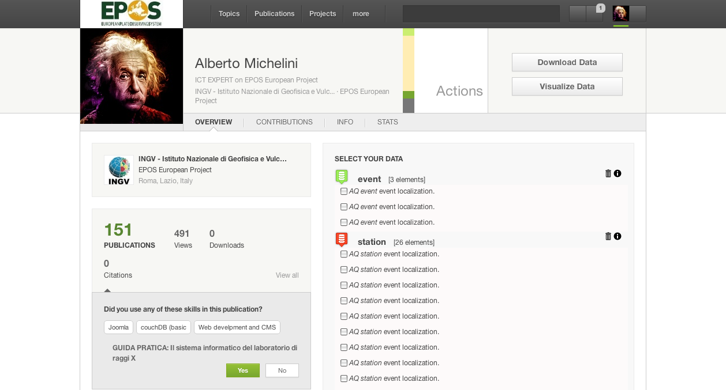
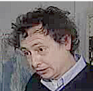
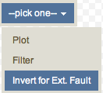
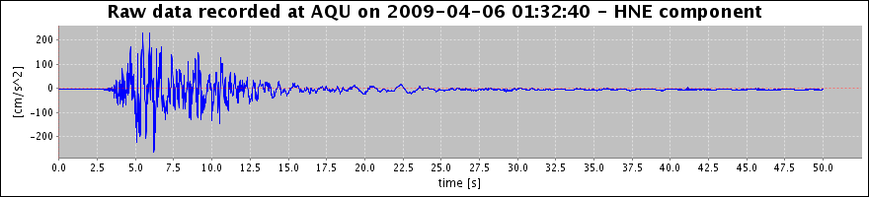

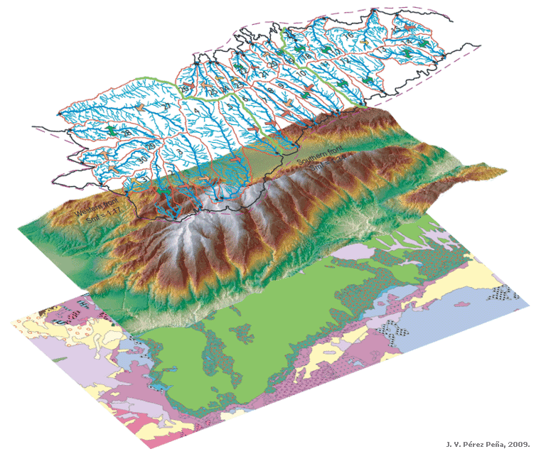
Scientist at work
Bulk Actions
Accelerometric Data:
SAR Data:
Accelerometric Waveforms
Filter
Accelerometric Data
MI05 07-04-09 17:47 5.5
AQV 06-04-09 01:32 6.3
AQG 06-04-09 01:32 6.3
AQA 06-04-09 01:32 6.3
AQK 06-04-09 01:32 6.3
PCB 09-04-09 19:38 5.2
AQV 07-04-09 21:34 4.5
AQM 06-04-09 02:37 5.1
AQU 06-04-09 01:32 6.3
PCB 09-04-09 00:53 5.4
GSA 07-04-09 17:47 5.5
PCB 13-04-09 21:14 5.0
Hi-Pass
Remove | Show
Low-Pass
Remove | Show
Band-Pass
Remove | Show
Remove | Show
Remove | Show
Remove | Show
Remove | Show
Remove | Show
Remove | Show
Remove | Show
Remove | Show
Remove | Show
SAR Data
ENVISAT-1-09083009242556-1600.ASA_IM__0P
ENVISAT-1-09072609242628-1600.ASA_IM__0P
ENVISAT-1-09062109242691-1600.ASA_IM__0P

Slide 19
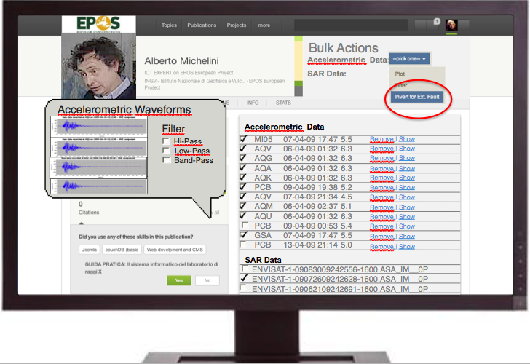
Scientist at work
Then… what can the scientist do?
  Integrate use of SAR, GPS, Accelerometric Data, etc.
  Use different codes and languages (python, fortran, any other…)
  Perform heavy processing online (use of HPC resources)
  Compare results (e.g. focal mechanism catalogues)
  Compare different data
  Save data in personal area
  …and more… (even download the data)

Slide 20
Scientist at work
Download
Visualization
Processing
Modeling

Slide 21
EPOS e-Infrastructure

Slide 22

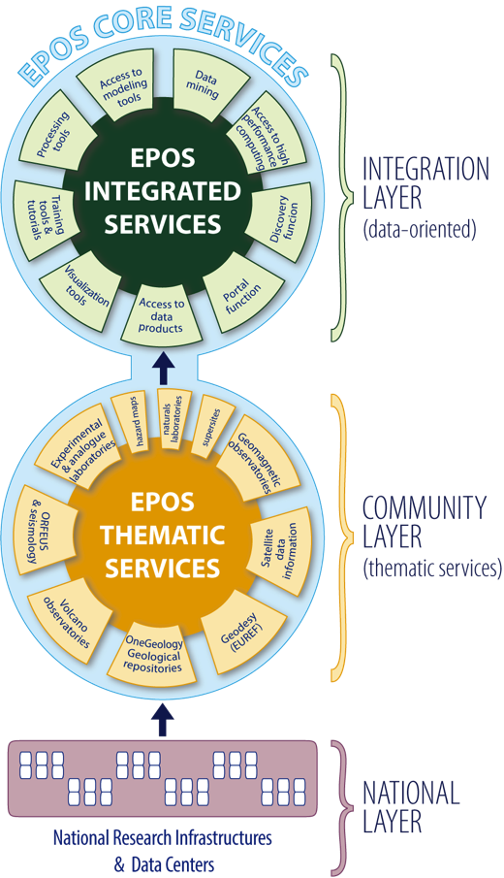
EPOS services
The EPOS Integrated Core Services will provide access to multidisciplinary data, data products, synthetic data from simulations, processing and visualization tools, ....
Not just data access but EPOS means to integrate, analyze, compare, interpret and present data and information about Solid Earth
Thematic Core Services are infrastructures to provide data services to specific communities (they can be international organizations, such as ORFEUS for seismology)
National Research Infrastructures and facilities provide services at national level and send data to the European thematic data infrastructures.
Notes:
FROM THE BOTTOM:
3. National RI, alrady operational, provide services at national level. Some of them send already data to european organization
2. We want to promote a community buliding action to move from this scattered set of Ris to THEMATIC CORE SERVICES, i.e. RI to provide data to specific communities (geodesy, seismology) . They’ll EUROPEAN disciplinary integrated nodes
1. Integration layer, the EPOS infrastructure which will be able to integrate all the data from different THEMATIC. Access … (leggi slide)

Slide 23
Compatibility layer
ICS/TCS comunication
Metadata catalogue+APIs
Web Services
Open Access
COMPATIBILITY LAYER
Notes:
FROM THE BOTTOM:
3. National RI, alrady operational, provide services at national level. Some of them send already data to european organization
2. We want to promote a community buliding action to move from this scattered set of Ris to THEMATIC CORE SERVICES, i.e. RI to provide data to specific communities (geodesy, seismology) . They’ll EUROPEAN disciplinary integrated nodes
1. Integration layer, the EPOS infrastructure which will be able to integrate all the data from different THEMATIC. Access … (leggi slide)

Slide 24
Compatibility layer
EPOS ICS
COMPATIBILITY
LAYER
EPOS Metadata Catalogue
COMPATIBILITY L.
wrapper
wrapper
wrapper
WEB SERVICES
TCS (WGs)
National
Facility
Institutional
facilities

Slide 25
Metadata is the key

Slide 26
e-Infrastructure Metadata Model
Complete cohort of researchers, research managers, innovators, media
User Model
interaction with data, processing, persons
Processing Model
providing what the user requires
Data Model
representing research
Resource Model
representing ICT
Complete ICT environment for research
Notes:
Resources: 1. data providers, 2. internal to ics, 3. other outside epos delivery framework.
We describe: instruments, data storage resources, data processing and visualization
Data model: 3 layers. Ongoing work: metadata collection, data taxonomy
Processing model: 1.description of the functions available in each processing environment, 2. protocols to connect to them, 3. algorthms which deal with the composing of the processing
User model: how a suer interacts with the system: iaaa, interaction workflow, multilinguality

Slide 27
3-layer metadata model
Anticipates data.gov domains
Discovery (DC) and (CKAN, eGMS)
Web portal, Spatio-Temporal Search
Generate
Contextual (CERIF metadata model)
Search for instruments, software, models...
Point to
Detailed (community specific)
domain-specific data with detailed metadata
domain specific - geographically distributed data

Slide 28
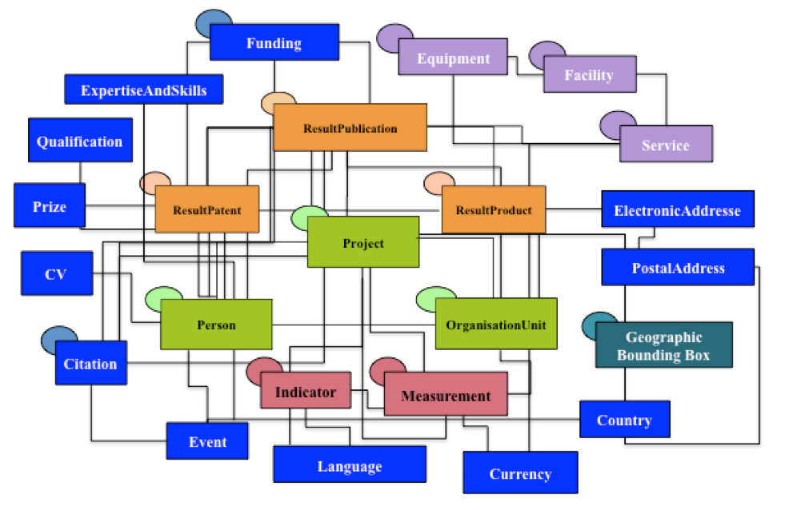
Contextual (CERIF metadata model)
(http://www.eurocris.org/)
Common European Research Information Format
Metadata Entities and Relations
To be used as metadata engine at contextual level
CERIF-XML exchange format and APIs
Compatibility Layer

Slide 29
CERIF in EPOS

Slide 30
Requirements
Handle complexity of EPOS ecosystem
→ users, fundings, equipment…
Handle and manage datasets
  → Mapping of different metadata structures
Handle and manage web services
  → Mapping of different webservices APIs (and params)

Slide 31
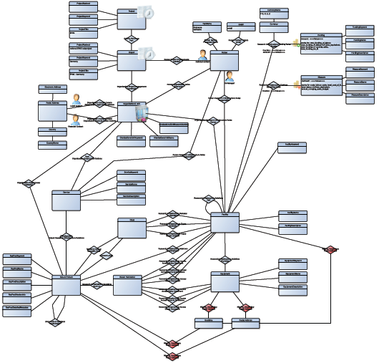
Managing overall complexity
person
project
funding
organisation
Facility & equipment
dataset

Slide 32
Managing datasets: Data Taxonomy
Level 0: raw data, or basic data (example: seismograms, Raw & Rinex GNSS, GNSS data streams...)
Level 1: data products coming from nearly automated procedures (earthquake locations, daily and RTK solutions ....)
Level2: data products resulting by scientists’ investigations (crustal models, strain maps, GNSS time-series)
Level 3: integrated data products coming from complex analyses or community shared products (hazards maps, deformation models....)
Level 4: software, code…

Slide 33
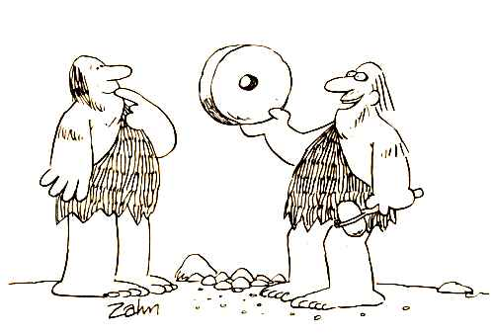
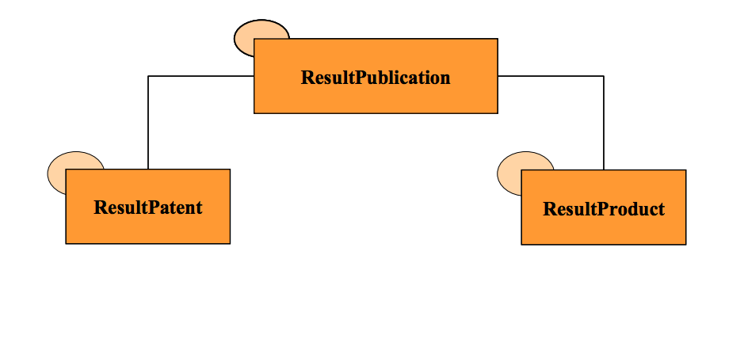
Managing datasets: Cerif4datasets
WE DON’T WANT
to reinvent the wheel
Cerif4Datasets strategies & ideas
  cfResultProduct for datasets
  Import and map metadata
  ….
ONGOING WORK

Slide 34
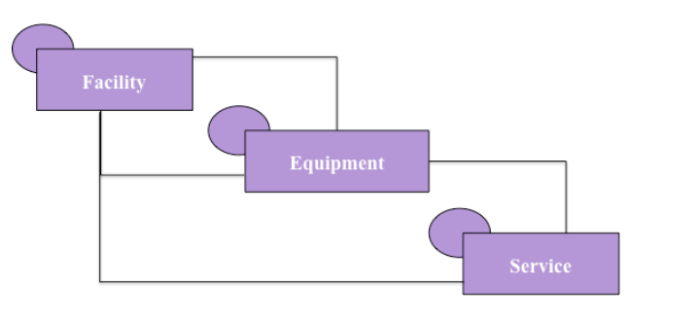
Managing (web) Services
cfService
In CERIF FDM 1.3 defined as
“A service is an exchange for money or other commodities where an enduser receives for money from a supplier.”
In EPOS use
“a method of communications between two electronic devices over a network.”
Example:
http://www.epos.org/dataset/SeismicEvent/12345?lat=…

Slide 35
Managing (web) Services
Requirement: map user requests into
Web service url
Web service query parameters
http://www.epos.org/dataset/SeismicEvent/12345?lat=XX&lon=
ONGOING WORK
1
2

Slide 36
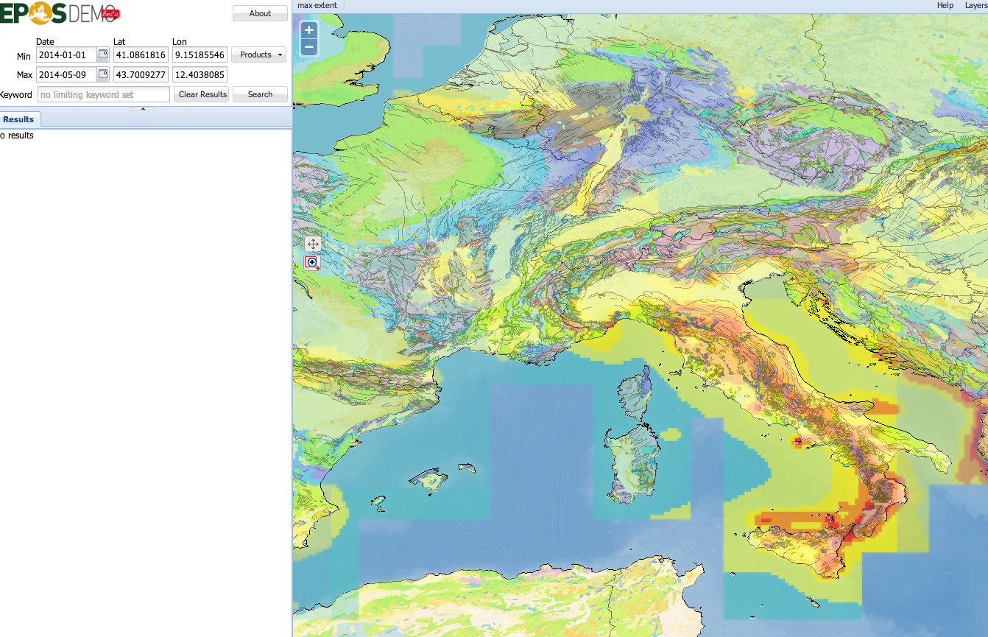


Request workflow
All seismic, geological and
GPS data in the selected area

Slide 37
Request workflow
REQUEST
RESPONSE
EPOS GUI or APIs
4
User
request
mapping
(user2cerif)
response
mapping
(cerif to
APIs MD)
1
CERIF+SOFTWARE
Cerif
request
mapping
(cerif2webs.)
3
2
Compatibility Layer
response
mapping
(resource
metadata
To cerif)
EARTHQUAKE
WEB SERVICE
GPS
WEB SERVICE
GEOLOGICAL
WEB SERVICE
SERVICE
MAPPING
METADATA
MAPPING

Slide 38
Seismology example
REQUEST
RESPONSE
4
User
request
mapping
(user2cerif)
CERIF-XML request
CERIF-XML response
response
mapping
(cerif to
APIs MD)
1
Map request
Build XML
CERIF catalogue query
and WS params mapping
(cfService)
Mapping into CERIF
cfResultProduct
Cerif
request
mapping
(cerif2webs.)
CATALOGUE
3
2
response
mapping
(resource
metadata
To cerif)
Build WS
request
Parse XML
quakeML request
quakeML XML response
SEISMOLOGICAL EVENTS
WEB SERVICE
SERVICE
MAPPING
METADATA
MAPPING

Slide 39
Example
After this process the catalogue contains a collection of tuples
<METADATA X DIGITAL OBJECT ref. (PID)>
Enable us to SELECT, RETRIEVE data, PROCESS,…
CATALOGUE
SEISMOLOGY
RESOURCES
…
RESOURCES
GEOLOGY
RESOURCES
GPS
RESOURCES
HAZARD MAPS
RESOURCES

Slide 40
Data intensive science
This model enable us to :
Collect different data-sets
Fine tune over their metadata (deep discovery)
… set up links with visualization and processing services (external to EPOS)

Slide 41
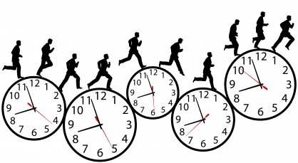
…Time is running out…

Slide 42
Additional topics
Persistent identifiers (PIDs)
Online data processing and visualization
Modeling and processing workflows
Data staging
Synergies with other projects
… and more…

Slide 43
Ongoing work

Slide 44
EPOS Prototype
WEB INTERFACE (GUI)
COMPATIBLITY LAYER
CERIF CATALOGUE
ONEGEOLOGY
SEISMOLOGICAL SERVICES
FUTUREVOLC
National Ris
Or Services

Slide 45
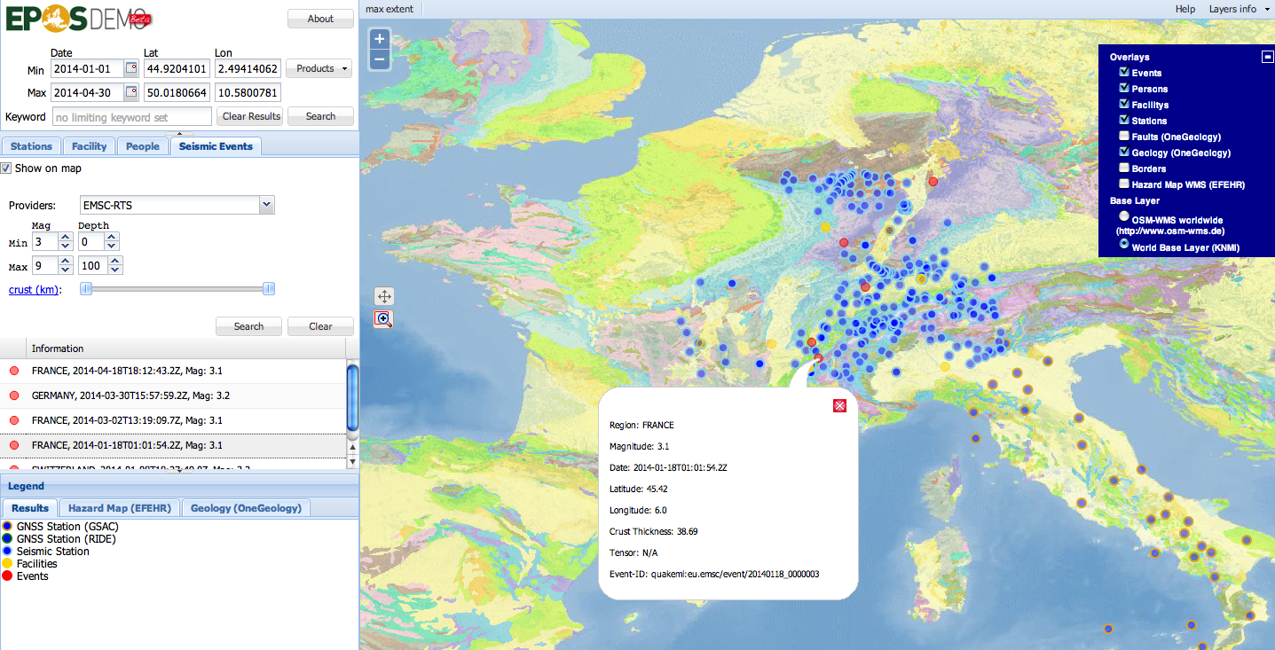
EPOS Demonstrator Seismology & Geology and Geodesy
http://epos.cineca.it

Slide 46


EPOS APIs:
CERIF XML (Acknowledgement: N.Houssos)
RDF export (ENVRI interoperability)
OAI-PMH, CKAN, opensearch…
and other standards
CERIF XML APIs
RDF
OAI-PMH
…
CERIF CATALOGUE

Slide 47
EPOS/CERIF & DATA INTENSIVE SCIENCE

Slide 48
Homogeneus access,
Download, visualization,
processing
1Pb + 0,5Pb/y
of heterogeneus data and services
from communities

Slide 49
FUTURE WORK
Suggestion to all of us (CRIS community):
Improve CERIF tools
Lowering entry barriers
Some ideas:
Web service simple example
Mapping tools
CERIF toolkit, software + docs
DB of projects using CERIF
- DREAM: one-click install CERIF GUI with tools

Slide 50
TAKE HOME MESSAGES
  Solid Earth Community is now getting in into the data intensive challenge
  EPOS promotes integration of data and services
  EPOS is both a community action and a e-ICT project
  Metadata is the key to integration and interoperability
  Catalogue-based architecture seems to be the best to face the complex challenges of data intensive science and integration
  CERIF-based catalogues ensures:
    Managing of complex heterogeneous scenarios
    Managing of datasets
    Managing of web services
  FUTURE WORK: improve CERIF usability

Slide 51
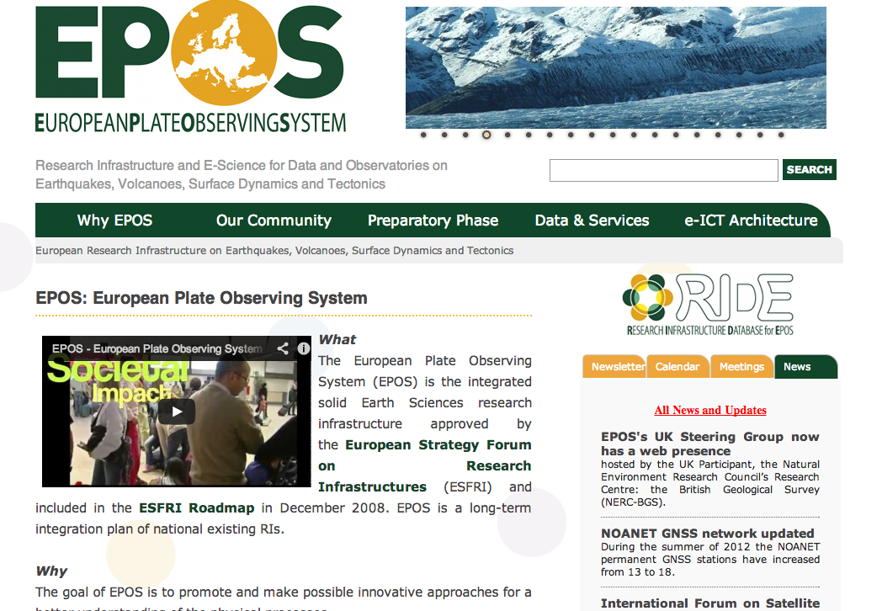
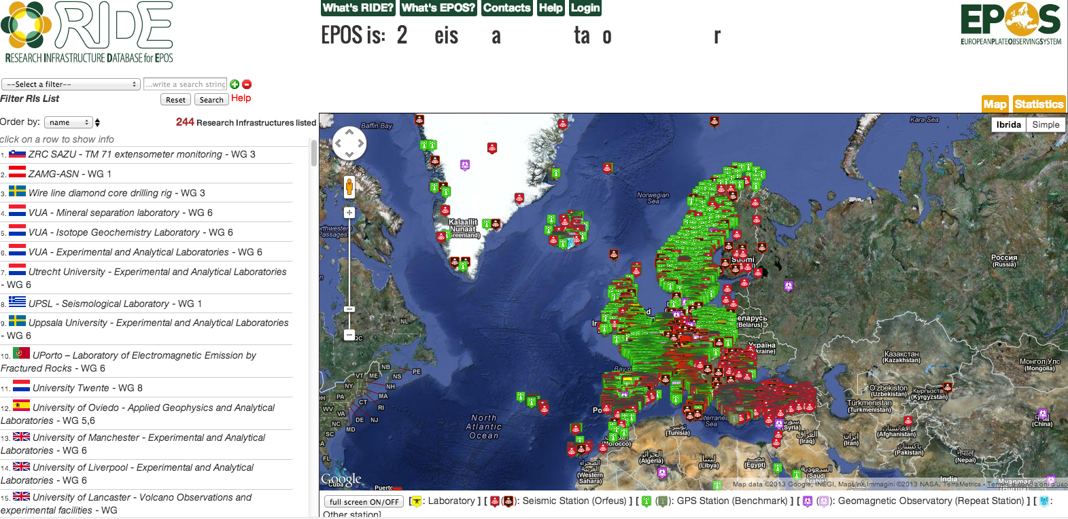
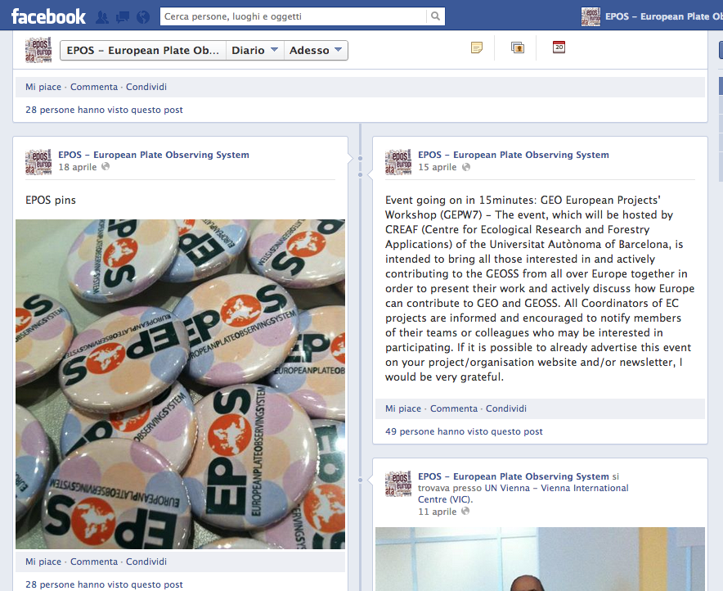
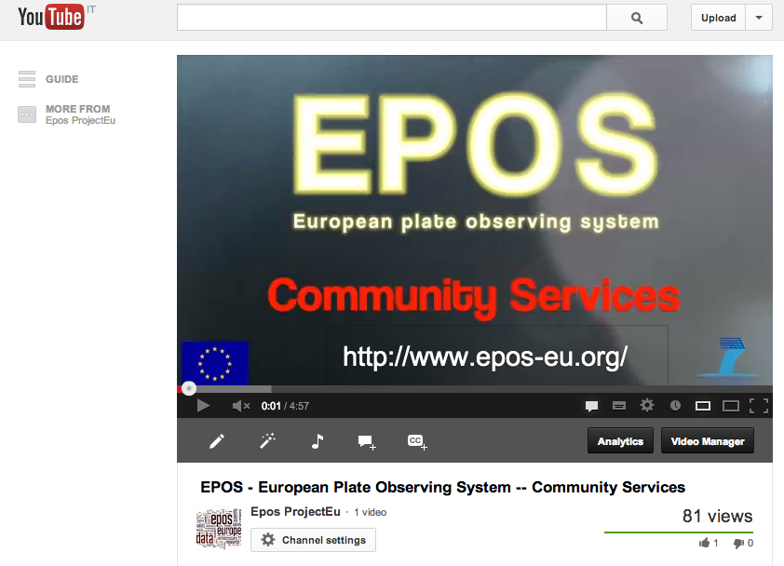
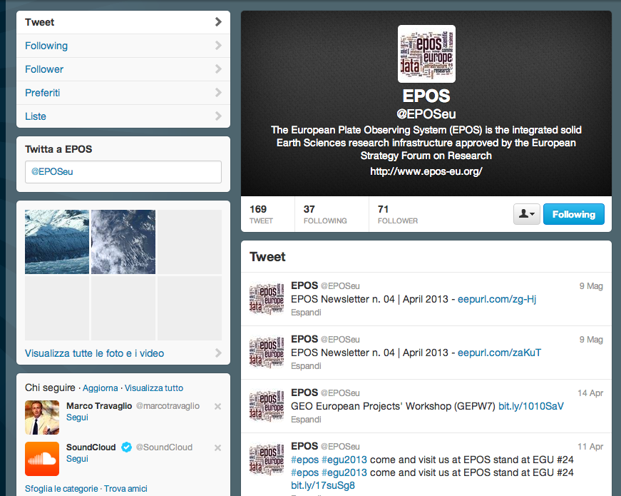



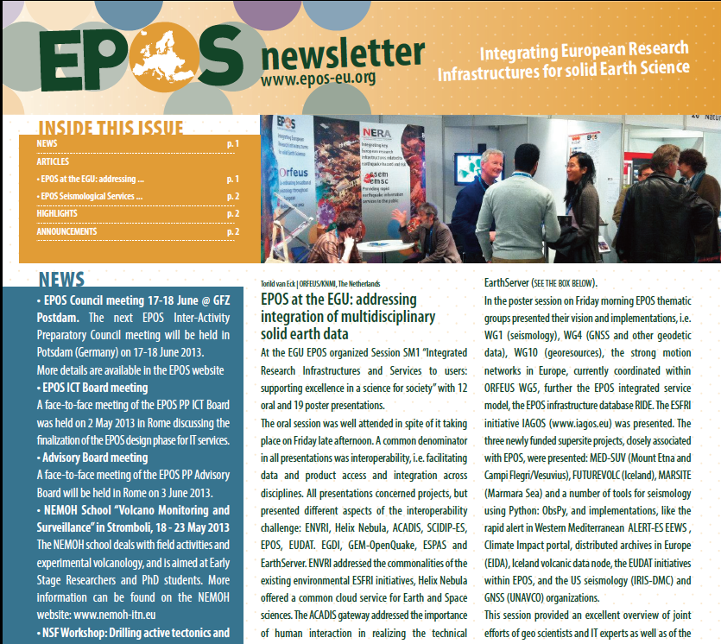
Thank You
WebSite
R.I.D.E.
Epos Social
www.epos-eu.org
www.epos-eu.org/ride
facebook
youtube
twitter
Newsletter
Acknowledgements:
Frieder Euteneuer (GFZ – Germany)
Massimo Fares (INGV – Italy)
Luca Trani (KNMI – The Netherlands)
Damian Ulbricht (GFZ – Germany)
www.epos-eu.org/newsletter

Slide 52
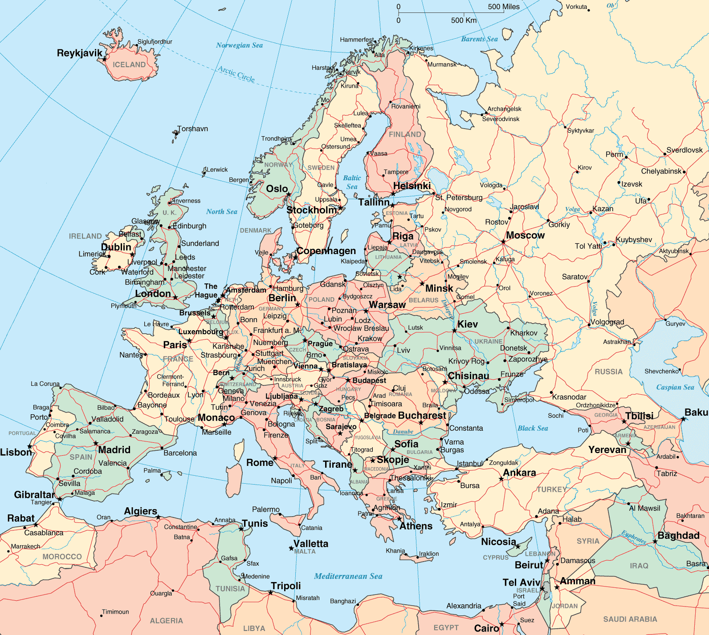
National Network
Source Model Repository
Other services
National Network
National Network
Waveform data (ORFEUS/EIDA)
TCS WG1
….
EPOS Integrated Services
National Network
National Network
National Network
Legend
GPS thematic service
National Network
ICS
European & Thematic
National Network
National Network
National RI

Slide 53








National RI & Thematic Services
WG1 - Seismology
WG2 - Volcanology
WG3 – Geological Data
WG4 – GNSS Data
WG6 – Analytical and
Experimental Laboratories
WG8 – Satellite Data
WG 9 – Geomagnetic Observ.
WG10 - Infrastructures
for Georesources

Slide 54
Thematic Services: an example
Data Products,
analisys & visualization
Raw and standardized Data
Processing and modeling
EPOS “COMPATIBILITY LAYER”

Slide 55
How to be “EPOS interoperable”
Metadata organization
Creation of a compatibility layer
Thematic service etc.
EPOS INTEGRATED SERVICES
Properietary Metadata
COMPATIBILITY LAYER
EPOS Metadata

Slide 56
Integrated Services organization
Centralized or Distributed?
Central Hub
Metadata Catalogue,
System manager
Data mining Access to data products
Training Tutorial Dissemination tools
Links to processing, visualization tools
Connectivity & access to HPC resources
Portal Functions (discovery functions)
Centralized
Distributed

Slide 57

WEB SERVICES

Slide 58
EPOS e-Infrastructure challenges
Overcome complexity of
  Users (role, authorities, responsibilities, preferences)
  Usage (ownership, permissions, conditions…)
  Data products (maps, files, time series… )
Semantics (“lat”, “latitude” or “latlon”?)
Managing interaction with other Infrastructures (HPC, web services…)

