Slide 1
Contextual Metadata
- the FRIS modelling context -
euroCRIS seminar 2013

Slide 2



Information Modeling in the FRIS context
The project team
Leen Van Campe
Geert Van Grootel
Kris Maison
Pieter De Leenheer
Research Director & Co-Founder
Patrick Derde
Enterprise Architect

Slide 3





Framework
Impuls Financing Program for the universities
Concept note on research output monitoring
Goals
Implementation of a management environment for integrated research information within the institutions
Connectivity with the FRIS gateway infrastructure
  Reporting obligations
  Content providing
    FRIS Research Portal
    FRIS linked open data store
  Integration with FRIS master data service
    Organization, Person, Journal, Project,…

Slide 4
The ecosystem concerned
Realizing integrated research information start from very different environments ranging from:
Large ERP systems with integration path tot output
Large ERP systems without integration path to output
Individual applications for the different lines of business integrating with CRIS system
Home brewed application stack flanked by output management environment
Almost all output management environments are based on or implementations of repository software

Slide 5
Challenges
Achieve alignment of business concept, their meaning an representation within an Institution
  Does the Business Concept “Person”, represent by the Business Term ”Person” have the same meaning as the Business Term “Human Being”
Achieve the same alignment across institutes
Have formal modeled relations between the Business Concepts, Meanings and Representation.
Define the Business Concepts of concern for the FRIS ecosystem
Formally model the relations between the Business Concepts and their representation at the level of the data. →connect the database schemes formally with the conceptual layer
Manages all required Classifications and Code Sets
Do all the above in a collaborative way
Make sure the models at every level are machine readable

Slide 6
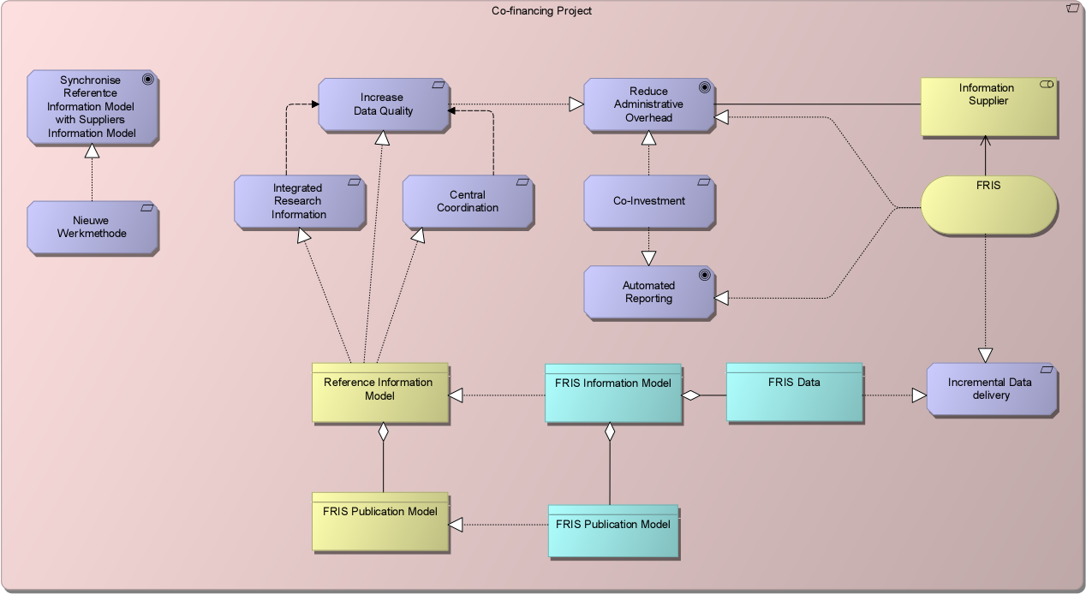
Impuls Financing Project
New
Methodology

Slide 7
Principles
  Answering these challenges requires a modelling stack that implements the following principles
    Model Driven Meta Data Management
    Pattern Driven Meta Models
    Organization Specific Information Delivery

Slide 8
  Model Driven Meta Data Management
  Model Driven Meta Data Management
  Statement:
    Consistent management of meta data for the Flanders Research Information Space is supported by conceptual models.
  Rationale
    Meta data is data about the data and is expressed in description elements which are visualized as labels. These labels have a meaning. In order to be consistent in the definition of the meaning of describing attributes the use of models is a powerful instrument to avoid ambiguity and redundancy.
  Implications
    All meta data should be able to be defined by means of the model elements and the relationships between each other.

Slide 9
  Pattern Driven Meta Models
  Pattern Driven Meta Models
  Statement
    Models developed to define meta data will be a variation of more generic models. We call these models Patterns.
  Rationale
    Patterns enable consistency in the development of the specific models used to manage the meta data definitions. These models are abstract, but very useful for the team that has to manage and govern the meta data the Flanders Research Information Space within a international context.
  Implications
    A set of Patterns must be developed and governed by some key stakeholders that have extended modeling skills. These patterns are not used for communication with the different information providers.
    Patterns will be modeled in ArchiMate 2.0

Slide 10
  Organisation Specific Information Delivery
  Organisation Specific Information Delivery
  Statement
    All institutions that deliver information to FRIS can do this in their own representation.
  Rationale
    Research Institutions have their own information systems that are the source for information sharing. EWI wants to avoid that delivery organizations need to know the technical conceptual structure of a common canonical data and information model .
  Implications
    Organization specific delivered data must be transformed to the canonical data and/or information model.
    Transformation rules must be managed on top of the meta data management
Principles are guiding consistent decision making.

Slide 11
FRIS information requirements
Achieving the goals of seamless information interchange and interoperability in the FRIS context reconciling the different views on the integrated research information requires a methodological approach.
Obvious needs
  Standardization of the interchange format is unavoidable
    Standard of choice: CERIF
  Semantic agreement
    Agreement and management
      Meaning
      Representation
The FRIS principles rephrased
  Syntactic and semantic alignment is realized at the systems interface.
  Institutions are responsible for their semantic management and the mapping to the agreed FRIS semantics.

Slide 12
FRIS responsibilities on semantic management
Development and deployment of a suitable methodology for information modeling.
  Design high level conceptual models
  Evaluate existing object models against the FRIS conceptual model
  Organize the mapping between the institutional models on the FRIS standard exchange model
Deployment of an suitable infrastructure
  Collaborative management of information models
  Collaborative management of classification schemes and code sets
  Machine readable classification schemes and codes sets
  Machine readable information models including business rules supporting automated validation of exchanged information.
Organize the management of the information models, classifications, code sets by developing suitable governance models and their implementation via workflows

Slide 13
The FRIS modeling stack
The FRIS modeling stack consist essentially of standards implemented in different products dividing the stack in two layers
The meta mode layer
  Principles, Guidelines, Governance Structures
  High level conceptual models
  Governance models
    Standard language: Archimate 2.0
    Product of choice : BizzDesign’s Architect
The information modeling layer
  Information models
  Information templates
  Classification schemes
  Codes Sets
  Data base scheme
  Business rules
  Governance implementation via workflows
    Standard: SBVR
    Product of choice: Collibra’s Data Governance Center

Slide 14
Patterns for Data Management and Data Governance
  Business Term Model Pattern
The pattern is derived from the SBVR.
The ‘Business Term Model Pattern’ is a means to manage the distinction between a ‘Business Term’ and what is represented by the term.
Business people are expressing themselves by means of business terms which have meaning in a certain context.
A‘business term’ points to a ‘business concept’
Getting grip on the ‘Business Concepts’ is essential in order to be able to manage a glossary with Business Terms.
Most organizations like to have 1 business term for 1 concept and the concept of ‘business term’ and the concept of ‘Business Concept’ are than seen as the same thing.
From point of view of managing business semantics we must distinguish these two fundamental different concepts.
Notes:
“Patterns are generally accepted generic solutions for a specific type of problem that exists in reality in various flavors. In what follows we present the patterns that will be used by EWI as means to manage ‘FRIS data’ and ‘FRIS meta data’ in a consistent way”

Slide 15
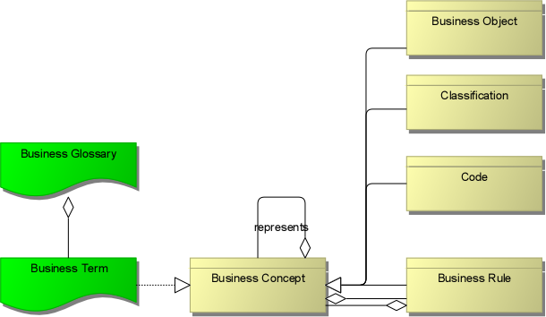
Model Pattern for a Business Term

Slide 16
Definitions
    Business Term
      A Business Term is the name of a Business Concept. It is the representation of a Business Concept by means of a word or ‘ordered set’ of words. A Business Term is used to refer to a Business Concept and its meaning

Slide 17
Definitions
    Business Concept
      A Business Concept is whatever can be thought of by the business. Normally each Business Concept has an unambiguous meaning expressed by an unambiguous definition.
      A Business Concept can be taxonomically classified in various sub classifications e.g. Business Object, Classification, Business Rule, Code.
      A Business Concept is represented
      by a Business Term

Slide 18
Definitions
    Business Object
      A Business Object is a Business Concept, concrete or abstract, that has the capability to influence behavior of a Business System. Typical examples are Person, Organization, Project, Location, Instruction, Account, etc.
      A Business Object is represented by
      a Business Term

Slide 19
Definitions
    Classification
    A Classification is a Business Concept that organizes and manages business information by defining (hierarchical) structures that provide classification categories that apply to one or more Business Concepts and groups of Business Concepts that apply to multiple Business Concepts
    A Classification is represented by a Business Term

Slide 20
Definitions
    Code
    A (technical) Business Concept that is an identifier of a Business Concept.
    A Code is used to 'identify' or to 'refer to' a Business Concept.
    A Code is represented by a Business Term
    e.g. BE identifies the concept “Belgium”

Slide 21
Definitions
    Business Rule
A formula that defines or constrains some aspect of business.
Intended to assert business structure or to control or influence the behavior of the business.
Describe the operations, definitions and constraints that apply to an organization.
Can apply to people, processes, corporate behavior and computing systems in an organization, and are put in place to help the organization achieve its goals.
May be informal or even unwritten, writing the rules down clearly and making sure that they don't conflict is a valuable activity.
When carefully managed, rules can be used to help the organization to better achieve goals, remove obstacles to market growth, reduce costly mistakes, improve communication, comply with legal requirements, and increase customer loyalty.
A Business Rule is represented by a Business Term

Slide 22
Information Model Pattern
The Information Model Pattern defines the generic structure
    Goal:
      Helps to detect the type of metadata surrounding a Business Object
      A business object is a concrete or abstract thing which exists in reality and is of importance for a defined business.
      In this case the business is Flanders Research Information.
      The business objects we can think of are ‘Person’, ‘Organization’, ‘Project’ and ‘Publication’.
      When replacing the abstract term “Business Object” by the more concrete terms ‘Person’, ‘Organisation’, ‘Project’ and ‘Publication’ we have a template to define meta-data for the specific object to be described.

Slide 23
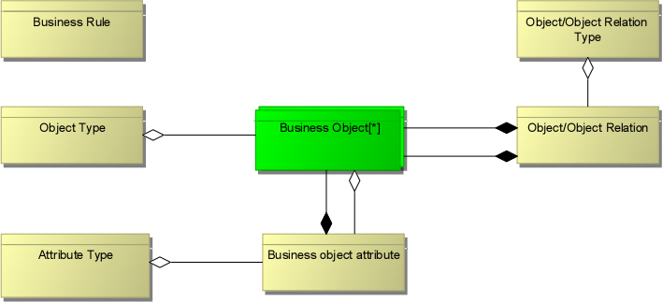
Meta Data Model Pattern
The meta data model pattern will be used to describe the conceptual FRIS Business Object Model.
This is the high level conceptual data architecture which represents the fundamental business objects and the relations between each other and the environment and the principles guiding its design and evolution (TOGAF 9.1 ISO 42010, IEEE 1471).

Slide 24
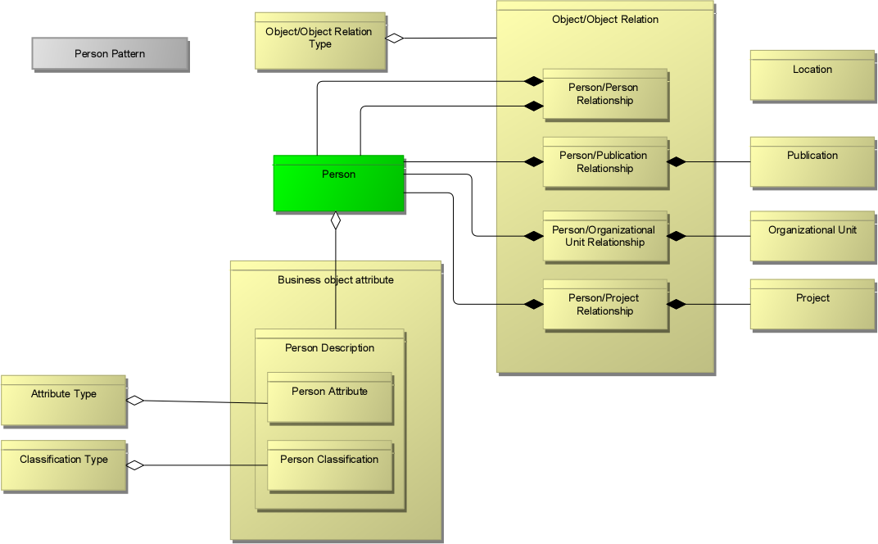
Meta Model Pattern applied to the Business Concept Person

Slide 25
The use of the Information Model Pattern
cfPers-Pers
cfPers-ResPubl
cfResPubl
cfPers
cfPers-OrgUnit
cfOrgUnit
cfPers-Project
cfProj
cfPers.cfGender
cfPers.cfBirthDate

Slide 26
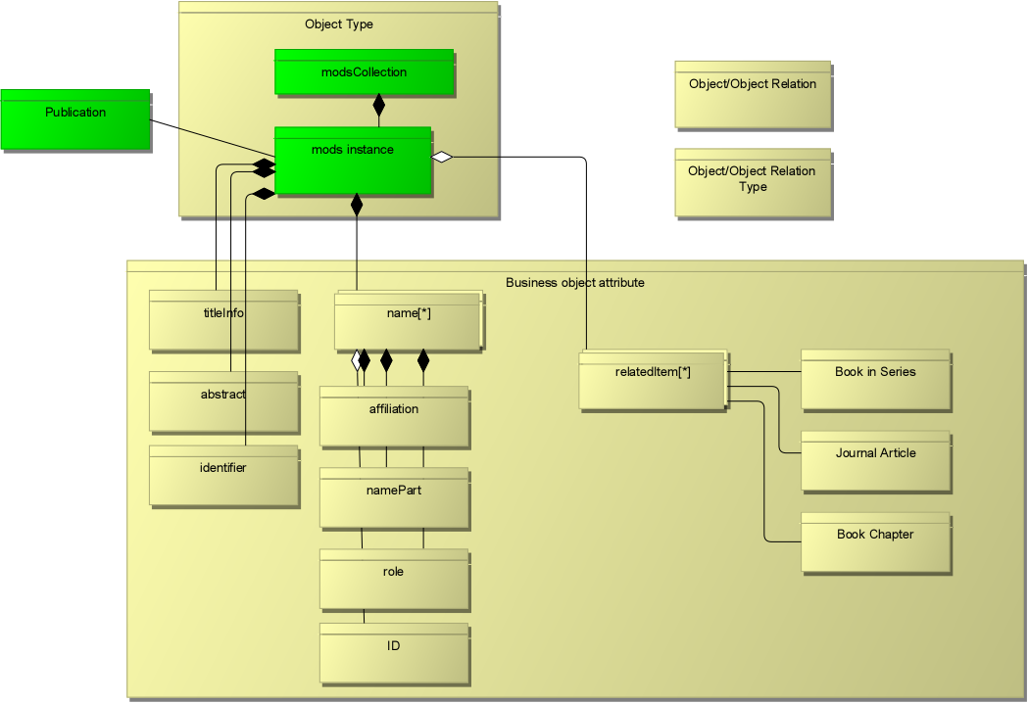
Meta Model Pattern: an application
Evaluation of a MODS based model: SSH-VABB

Slide 27
Information Model Pattern: an application
The Mods model template shows the following
Only two of the Business Concepts can be considered Business Objects
  ModsCollection
  ModsInstance
All other Mods elements form a taxonomy of business concepts which are at the level of Business Object attributes
The Mods Business Concept Identifier does not relate unambiguously to a ModsInstance
In essence this translates to the fact that, in ER-modeling terms the Mods template recognizes only an entity equivalent to the Business Object “Publication”
From the FRIS viewpoint, the mods template fails to register the Business Object: Person and Organization
Potential Business Object –Business Object relation are not modeled as such since “RelatedItems” are Business Attributes.

Slide 28
Information Model Pattern: an application

Slide 29
Information Model Pattern: an application
The results of the Information Model Pattern approach allows the FRIS information architects to evaluate the relevance and usability of models like Mods by:
Clearly distinguish the Business Objects concerned in the model
Evaluate the possible mapping scenario’s to the FRIS Business Object model
  Mapping of Mods Concepts to FRIS Business Object en Business Object attributes.
  Mapping to FRIS Classification Objects
  Mapping to FRIS Code Value sets
Evaluate the mapping risks in term of ambiguity, redundancy, reciprocity

Slide 30
Code Definition Pattern
A Code pattern is a system of symbols (letters, numbers, shapes, sound, etc. ) used to represent assigned meanings of concepts. Just like a ‘Term’ is a word or set of words used to represent meanings of concepts.
Codes often are used for
  easy communication,
  easy input in digitalized systems,
  information exchange between different systems,
  enabling semantic interoperability between systems,
  enabling integrated analysis between interoperating businesses,
  Etc.
A Code is a systematic representation of the meaning of concepts.
Notes:
As defined in the “Business Term Model Pattern” there are different types of Business Concepts.
Codes refer to these concepts. And so, a code can be created to ‘identify’ a Business Object, to ‘Classify’ Business Objects, but also to enable easy communication of business input and business output

Slide 31
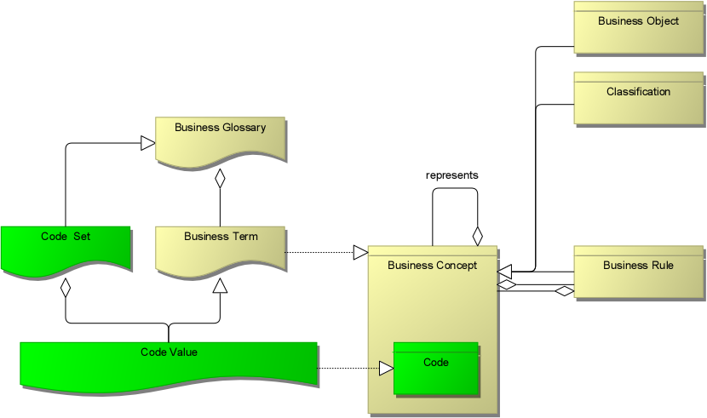
Code Definition Pattern

Slide 32
Code Definition Pattern
Definition
“A Code is a (Technical) Business Concept that is an identifier of a Business Concept.”
Eg.
‘Country Code’ is the Business Concept used to identify the Business Object ‘Country’ .
‘Scientific Domain Code’ is the Business Concept used to identify a Classification Hierarchy of Scientific Domains

Slide 33
Code Definition Pattern
  Code Value
    A Code Value is the representation of a Code.
    A Code Value is a special type of Business Term
    ‘Code Value’ is the name used to refer to a ‘Business Term’ in case the Business Concept that is represented is a ‘Code’
    . From a modelling perspective a ‘Code Value’ is a specialisation of ‘Business Term’.
Eg.
‘BE’ is a Code Value representing ‘Belgium’ according to Country Code ISO-3166 ISO-2

Slide 34
Code Definition Pattern
    Code Set
      A Code Set is a set of Code Values that are allowed values for concepts of a specific type, according to a specific management community.
      A Code Value can be element in more than one Code Set.
        The challenge is to manage which Code is exactly represented by the Code Value in the Code Set.
        Difficulty in managing this aspect is often the cause of ambiguity in the definition and use of code values.
      A Code Set is a special type of Business Glossary.
      A Code Set can be the aggregation of multiple Code Value Sets. A typical example is ISO-3166 Country Code

Slide 35
Model Pattern overview
The meta model consist of the following model patterns
Business Term Model Pattern
Information Model Pattern
Codification Definition Pattern
Object Classification Model Pattern
These patterns sofar seem to suffice

Slide 36
The Patterns

Slide 37
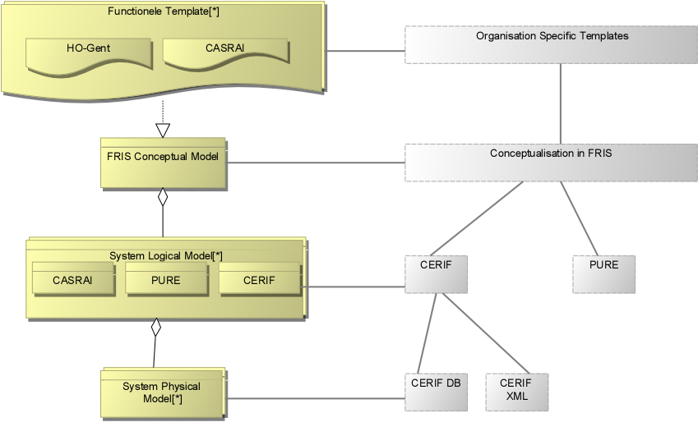
The FRIS Model Type Stack
CERIF conceptual model

Slide 38
Template examples
  CASRAI profiles: Academic CV
  Meta model of Templates types
    Grouping
      Sub-Grouping
        Record Type
  Publication Templates
  OrgUnit Service Exchange Template
  PURE

Slide 39
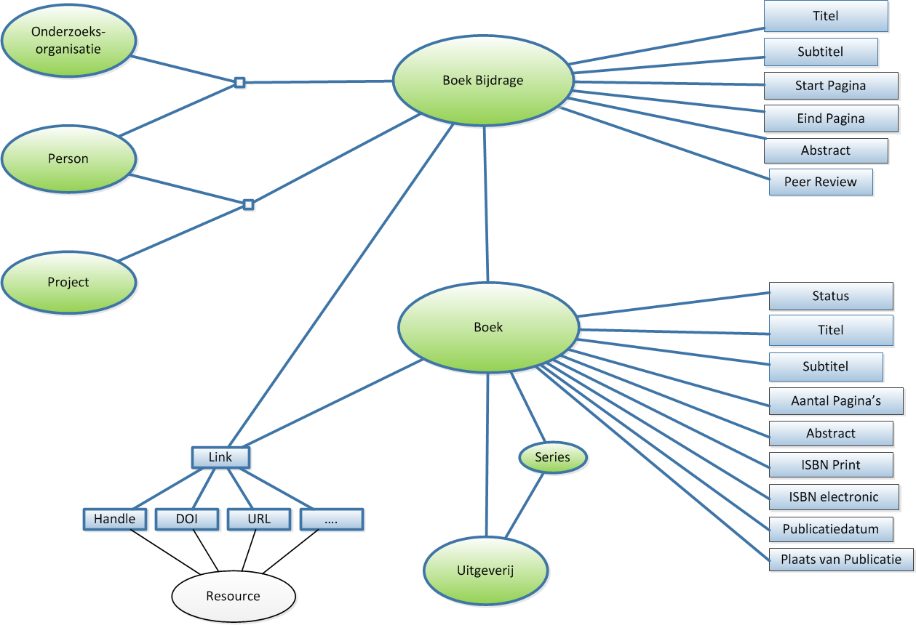

Slide 40
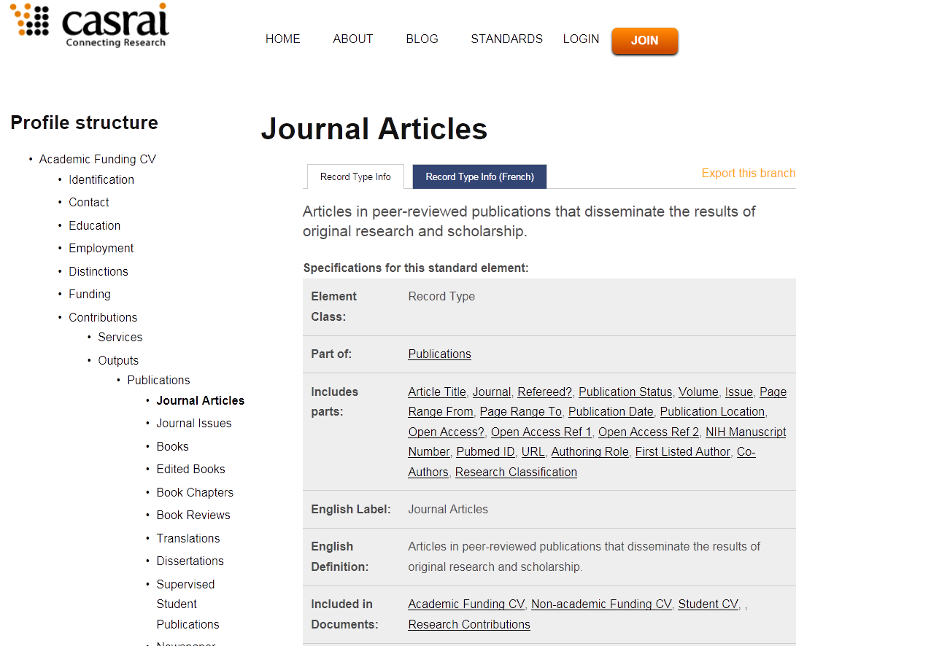

Slide 41
Stack Part 2: How is it done in reality
Stack Part 2: Modeling in the Data Goverance Center
The Data Governance Center (DGC) Operation Model

Slide 42
5 Modeling Concepts in DGC Operating Model
Notes:
Should we have a separate item for FACT TYPE (apart rom RELATION)?

Slide 43
DGC Asset Types
Notes:
Note to myself: for now 4 main asset types: but this should be better categories because assets could belong to different viewpoints
Question: Community, Individual, Resource, Event belong where ???

Slide 44
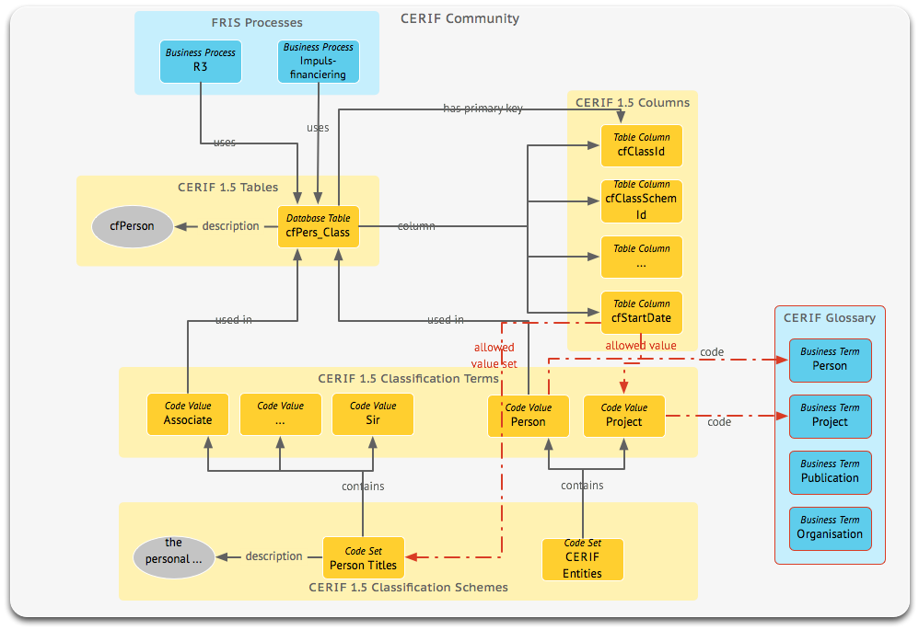

Slide 45
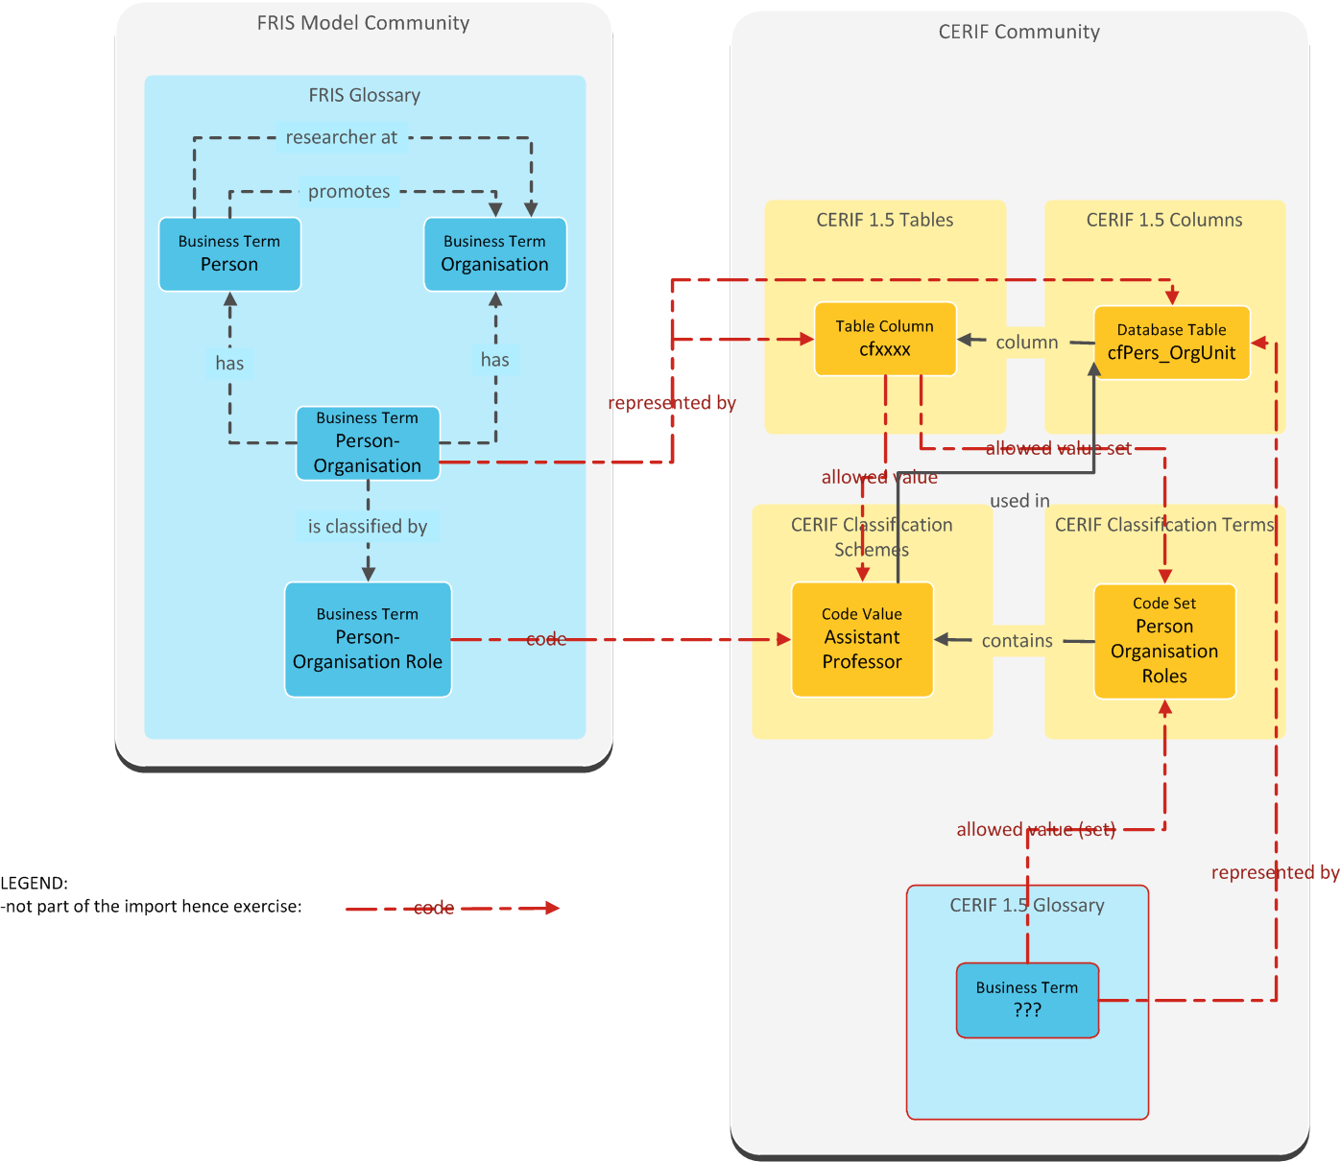

Slide 47
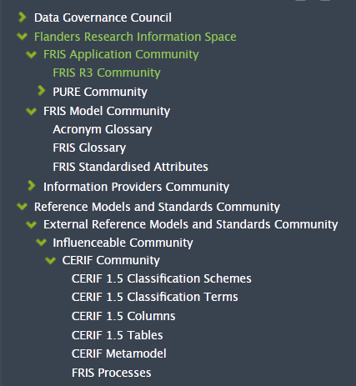
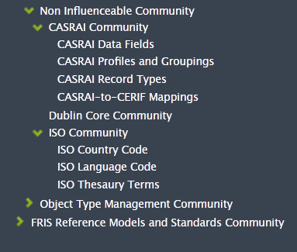
FRIS Communities

Slide 48
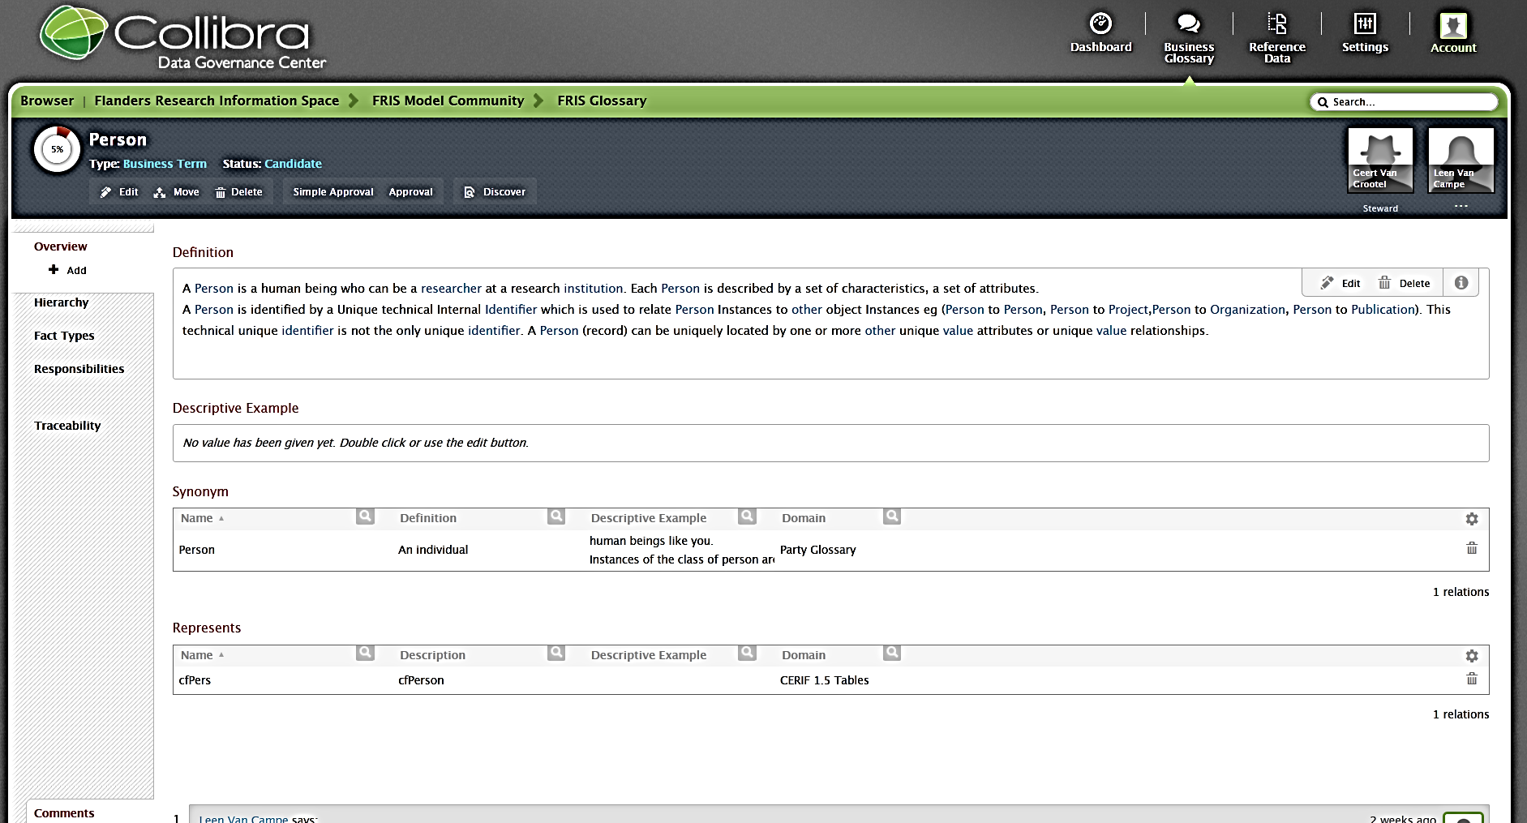
An example: Person

Slide 49
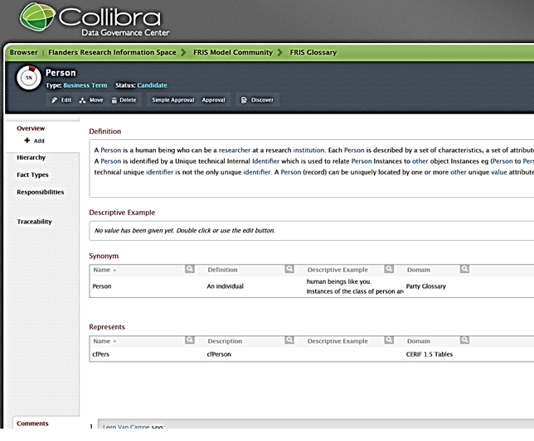

Slide 50
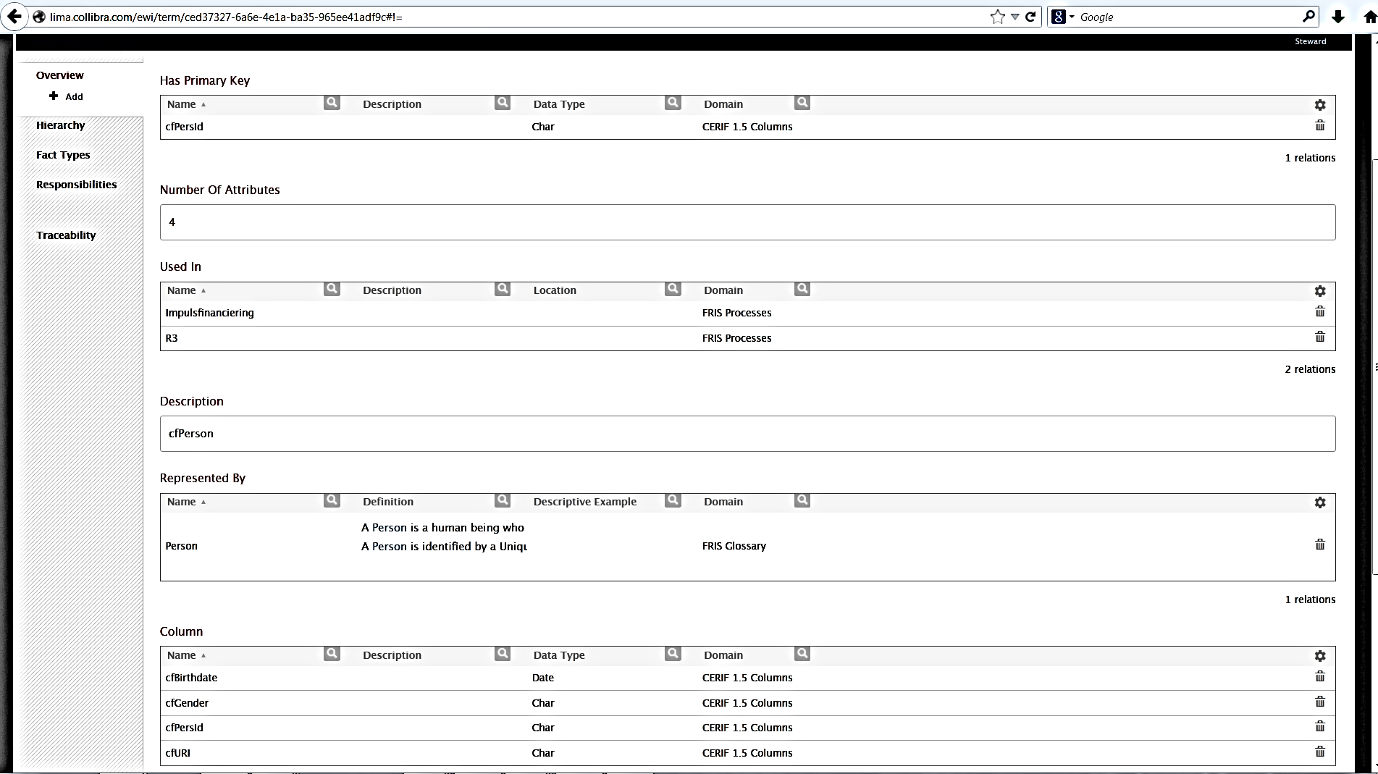
cfPers

Slide 51
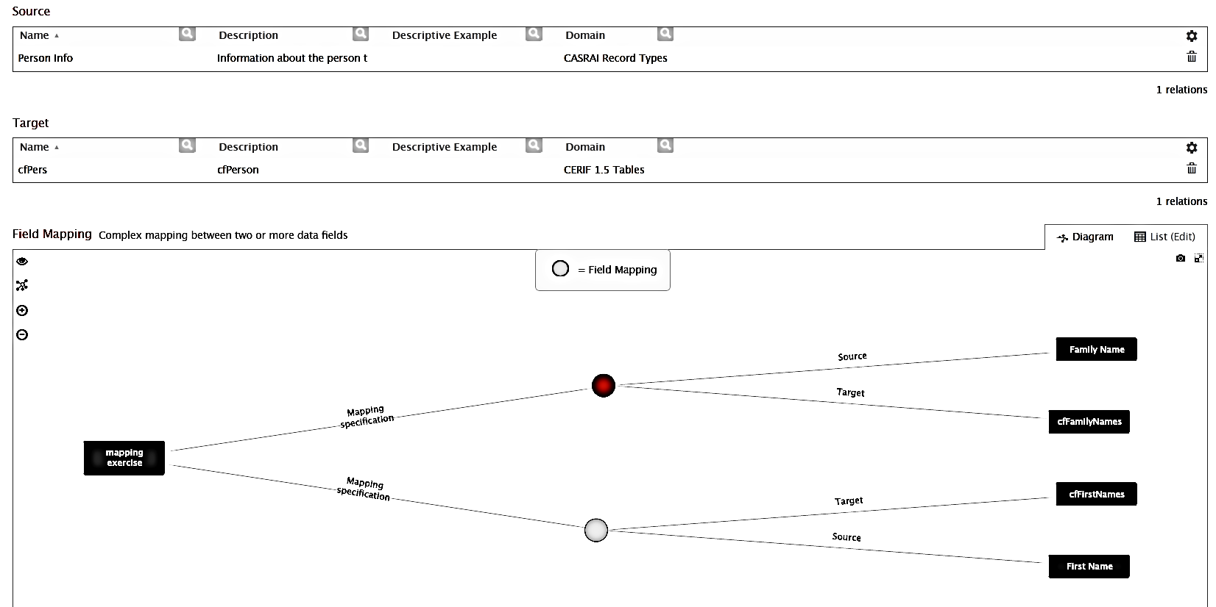
Mapping example:
CASRAI: Family Name → CERIF: cfFamilyNames
CASRAI: First Name → CERIF: cfFirstName

Slide 52
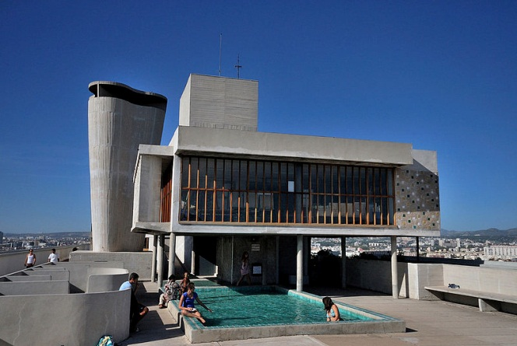
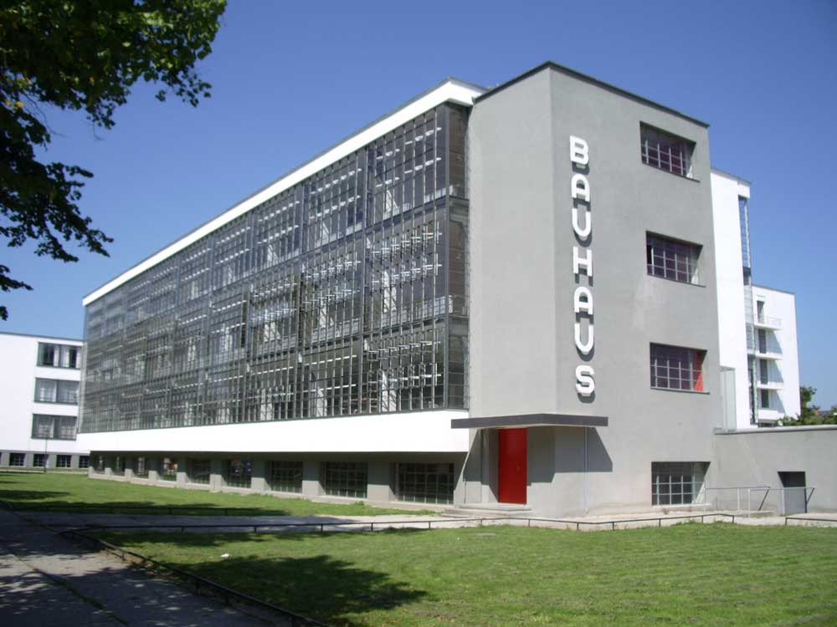
To create architecture is to put in order. Put what in order? Function and objects.
Le Corbusier
Architecture begins where engineering ends.
Walter Gropius

