Slide 1
Curating research in 2020
Session 2: Horizon2020: Views of Strategic Partners (Requirements, Opportunities, Vision)
10th EuroCRIS Strategic Seminar 10-11 Sept 2012, Brussels

Slide 2
Overview
APA’s role
Requirements
Opportunities
Vision
Reality check
Route forward
Where are we now?

Slide 3
APA
The Alliance for Permanent Access is the principal forum for developing policy and practice for continuing access to digital resources of lasting value. By promoting long term access we seek to ensure the long term viability of scientific knowledge and provide a sustainable basis for the continuing exchange of ideas. We do this by articulating the needs and views of our members. Through collaborative action between our members we influence policy, encourage tools development and promote knowledge exchange across Europe

Slide 4
Strategy/Policies
the promotion of digital preservation by any means, including policy actions and the establishment of an e-infrastructure covering scholarly publications, research datasets and software, in collaboration with publishers, researchers and users;
to have funding provision in place to achieve (1);
to work with partners to develop generic mechanisms for accreditation of services and training that provide permanent access;
to develop a ‘quality mark’, publish criteria so that services can achieve this mark, and after appropriate scrutiny award this mark to service providers;

Slide 5
Requirements
raising tide of data…
“A fundamental characteristic of our age is the raising tide of data – global, diverse, valuable and complex . In the realm of science, this is both an opportunity and a challenge.”
Report of the High-Level Group on Scientific Data, October 2010
“Riding the Wave: how Europe can gain from the raising tide of scientific data”
Who pays?
Why?
Notes:
5
5

Slide 6
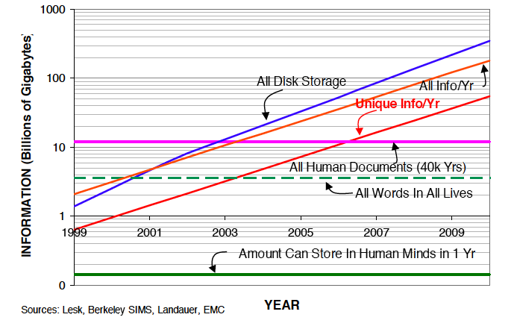

Slide 7
Raising tide of data…
Notes:
7
7

Slide 8
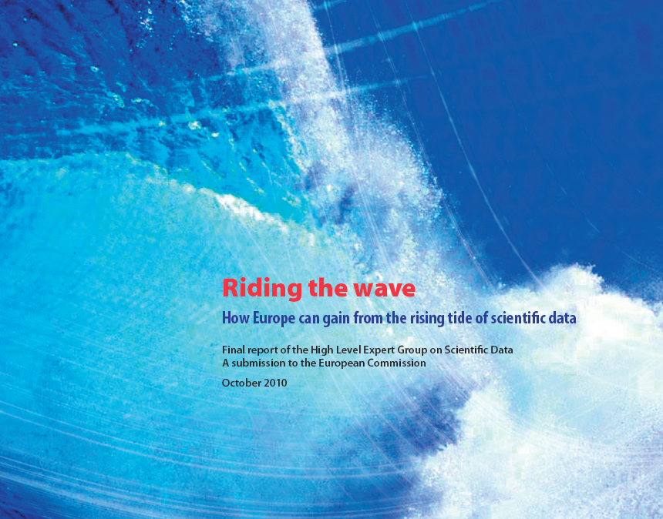
Opportunities

Slide 9
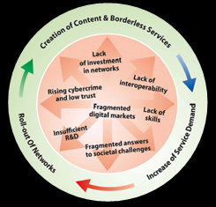
Digital Agenda for Europe
the policy context
DAE is one of the flagships of "Europe 2020: a strategy for smart, sustainable and inclusive growth"
Notes:
9
The Digital Agenda for Europe is about generating growth, by simulating a virtuous cycle of removing bottlenecks to new services and innovation, to stimulate demand and increase incentives for the new investments in infrastructures and our capacity to innovate.
In other words – we need to make the virtuous circle work. Attractive content and services stimulate demand, which creates the business case for investment in faster networks.
We have seven pillars in the Digital Agenda for Europe. These areas were chosen because they address the biggest ICT related challenges which businesses and citizens face today. They are also the areas where coordinated efforts at EU level could have the greatest impact.
To exit definitely from the economic crisis requires that we have a long term capacity to grow and to service our existing levels of expenditure and dept. We need a trigger to growth otherwise Europe will decline and Europeans will see their levels of wealth falling year by year.
No digital agenda = no long-term exit strategy.

Slide 10
Digital Agenda for Europe
the policy context
“The Digital Agenda for Europe outlines policies and actions to maximise the benefit of the digital revolution for all. Supporting research and innovation is a key priority of the Agenda, essential if we want to establish a flourishing digital economy.”
Neelie Kroes,
Vice-President of the EC, responsible for the Digital Agenda
Data is the new gold.
“We have a huge goldmine… Let’s start mining it.”
Neelie Kroes
Notes:
10
10

Slide 11
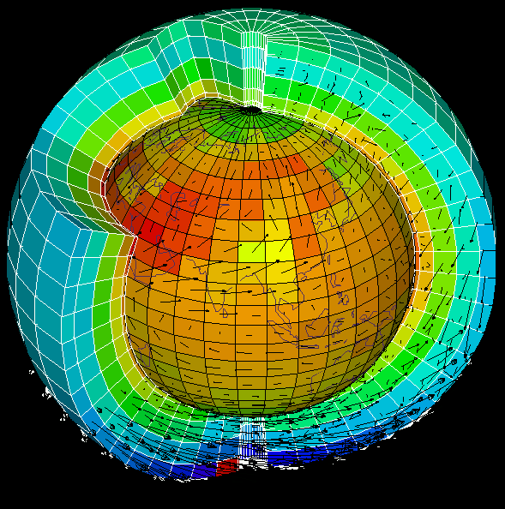
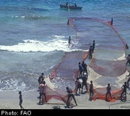
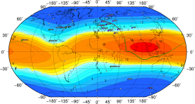
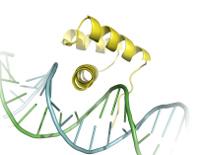
Data e-Infrastructure
Geo
Earth
Climate
biology
astro
scientific data infrastructure
distributed computing/software infrastructure
network infrastructure, GÉANT
Notes:
Launching the seeds for a flexible, reliable open and yet, high-performance scientific Data e-Infrastructure.

Slide 12
Vision 2030
high-level experts group on Scientific Data
“Our vision is a scientific e-Infrastructure that supports seamless access, use, re-use and trust of data. In a sense, the physical and technical infrastructure becomes invisible and the data themselves become the infrastructure – a valuable asset, on which science, technology, the economy and society can advance.”
High-Level Group on Scientific Data
“Riding the Wave: how Europe can gain from the raising tide of scientific data”
Notes:
12
12

Slide 13
Vision 2030
(1) All stakeholders, from scientists to national authorities to general public are aware of the critical importance of preserving and sharing reliable data produced during the scientific process.
All member states ought to publish their policies and implementation plans on the conservation and sharing of scientific data, aiming at a coordinated European approach.
Legal issues are worked out so that they encourage, and not impede, global data sharing.
The scientific community is supported to provide its data and metadata for re-use.
Every funded science project includes a fixed budget percentage for compulsory conservation and distribution of data, spent depending of the project context.
IMPACT IF ACHIEVED
Data form an infrastructure, and are an asset for future science and the economy.

Slide 14
Vision 2030
(2) Researchers and practitioners from any discipline are able to find, access and process the data they need. They can be confident in their ability to use and understand data and they can evaluate the degree to which the data can be trusted.
Create a robust, reliable, flexible, green, evolvable data framework with appropriate governance and long-term funding schemes to key services such as Persistent Identification and registries of metadata.
Propose a directive demanding that data descriptions and provenance are associated with public (and other) data.
Create a directive to set up a unified authentication and authorisation system.
Set Grand Challenges to aggregate domains.
Provide “forums” to define strategies at disciplinary and cross-disciplinary levels for metadata definition.
IMPACT IF ACHIEVED
Dramatic progress in the efficiency of the scientific process, and rapid advances in our understanding of our complex world, enabling the best brains to thrive wherever they are.

Slide 15
Vision 2030
(3) Producers of data benefit from opening it to broad access and prefer to deposit their data with confidence in reliable repositories. A framework of repositories work to international standards, to ensure they are trustworthy.
Propose reliable metrics to assess the quality and impact of datasets.All agencies should recognise high quality data publication in career advancement.
Create instruments so long-term (rolling) EU and national funding is available for the maintenance and curation of significant datasets.
Help create and support international audit and certification processes.
Link funding of repositories at EU and national level to their evaluation.
Create the discipline of data scientist, to ensure curation and quality in all aspects of the system.
IMPACT IF ACHIEVED
Data-rich society with information that can be used for new and unexpected purposes.
Trustworthy information is useable now and for future generations.

Slide 16
Vision 2030
(4) Public funding rises, because funding bodies have confidence that their investments in research are paying back extra dividends to society, through increased use and re-use of publicly generated data.
EU and national agencies mandate that data management plans be created.
IMPACT IF ACHIEVED
Funders have a strategic view of the value of data produced.

Slide 17
Vision 2030
(5) The innovative power of industry and enterprise is harnessed by clear and efficient arrangements for exchange of data between private and public sectors allowing appropriate returns for both.
Use the power of EU-wide procurement to stimulate more commercial offerings and partnerships.
Create better collaborative models and incentives for the private sector to invest and work with science for the benefit of all.
Create improved mobility and exchange opportunities.
IMPACT IF ACHIEVED
Commercial expertise is harnessed to the public benefit in a healthy economy.

Slide 18
Vision 2030
(6) The public has access and can make creative use of the huge amount of data available; it can also contribute to the data store and enrich it. All can be adequately educated and prepared to benefit from this abundance of information.
Create non-specialist as well as specialist data access, visualisation, mining and research environments.
Create annotation services to collect views and derived results.
Create data recommender systems.
Embed data science in all training and academic qualifications.
Integrate into gaming and social networks
IMPACT IF ACHIEVED
Citizens get a better awareness of and confidence in sciences, and can play an active role in evidence based decision making and can question statements made in the media.

Slide 19
Vision 2030
(7) Policy makers can make decisions based on solid evidence, and can monitor the impacts of these decisions. Government becomes more trustworthy.
Policy makers are able to make decisions based on solid evidence, and can monitor the impacts of these decisions. Government becomes more trustworthy.
IMPACT IF ACHIEVED
Policy decisions are evidence-based to bridge the gap between society and decision-making, and increase public confidence in political decisions.

Slide 20
Vision 2030
(8) Global governance promotes international trust and interoperability.
Member states should publish their strategy, and resources, for implementation, by 2015.
Create a European framework for certification for those coming up to an appropriate level of interoperability.
Create a “scientific Davos” meeting to bring commercial and scientific domains together.
IMPACT IF ACHIEVED
We avoid fragmentation of data and resources.

Slide 21
Trust
Issue | Vision 2030 | Short | Medium | Long
authenticity of data | Scientists can establish the authenticity of the data they use | ● Standardised system for provenance and related evidence in repositories. ● Standardised way to capture reputation of data producers and holders | ● Adoption of machine readable provenance in major repositories ● Capture of reputation of producers and holders (see Social networking) | ● 80% of repositories of scientific data have adequate machine readable evidence ● Automated ways to evaluate evidence of authenticity
validity of data | Users and systems will be able to evaluate the reputation of the data they use. | Annotation system for datasets, with efforts to formalise annotation language | Ranking system to allow systems to produce rankings of levels of trust (akin to Page rank but based on reputation rather than links) | Systems can choose datasets which are most trustworthy and can evaluate the risks involved in using less trusted data.
certification of repositories | People can make a judgement about which repositories can be trusted | International system of repository certification created | Certification demanded by EU and national funders | 80% of major repositories of scientific data are certified
global trust issues | Users can deal with the global datasets with the same confidence as European sources | Discussions with US, China, etc | MOU with international agencies on common standards | International agreement so that users have evidence of authenticity for world-wide scientific data
Complexity of the system | People can trust that the ever more complex tangle of systems are doing the right thing | Simplify interfaces and entanglement. | Move towards autonomic, self-configuring, self-healing, self-optimising and self-protecting systems, with appropriate monitoring. | Systems have survived many generations of changes in technologies and architectures.

Slide 22
Reality check
What could jeopardise the vision | Counter by:
Lack of long term investment in critical components such as persistent identification | Identify new funding mechanisms Identify new sources of funding Identify risks and benefits associated with digitally encoded information
Lack of preparation | Ensure the required research is done in advance
Lack of willingness to co-operate across disciplines/ funders/ nations | Apply subsidiarity principle so we do not step on researchers’ toes Take advantage of growing need of integration: within and across disciplines
Lack of published data | Provide ways for data producers to benefit from publishing their data
Lack of trust | Need ways of managing reputations Need ways of auditing and certifying repositories Need quality, impact, and trust metrics for datasets
Not enough data experts | Need to train data scientists and to make researchers aware of the importance of sharing their data
The infrastructure is not used | Work closely with real users and build according to their requirements Make data use interesting – for example integrating into games Use “data recommender” systems i.e. “you may also be interested in...”
Too complex to work | Do not aim for a single top down system Ensure effective governance and maintenance system (c.f. IETF)
Lack of coherent data description allowing re-use of data | Provide “forums” to define strategies at disciplinary and cross-disciplinary levels for metadata definition
From Riding the Wave

Slide 23
Standards
OAIS
Audit and certification
INSPIRE
Domain specific – IVOA
Semantic web
ISO/W3C/OASIS

Slide 24
Route forward
Short term
Put in place short –term funding
Agree on services and tools
Build up the economic case
Enlist specific communities
Medium term
Medium term support in place
Collect evidence
Extend communities
Long term
Secure funding, tools and infrastructure
Being outside is the exception

Slide 25
Where are we now – view from APA
Finding out what is needed
PARSE.Insight (www.parse-insight.eu)
ODE (www.ode-project.eu)
Building common understanding and a “Virtual Centre of Excellence”
APARSEN (www.aparsen.eu)
Putting sustained infrastructure in place to help preservation
SCIDIP-ES (www.scidip-es.eu)
Audit and Certification (www.iso16363.org and www.tdr.org)
Underpinned by APA www.alliancepermanentaccess.org

Slide 27
Infrastructure
Persistent ID resolver
RepInfo Registry
Authenticity tools
Processing Context
Certification
Orchestration/Brokering
Knowledge Gap Manager
Persistent ID resolver
RepInfo Registry
Authenticity tools
Processing Context
Certification
Orchestration/Brokering
Knowledge Gap Manager
Discipline repositories
Discipline repositories
Translators
Thesauri
Cross-references
Translators
Thesauri
Cross-references
Repositories
Users
Automated systems
Repositories
Users
Automated systems
Storage
Compute Resource
Local Authentication
Local Authorisation
Resource Registries
Process ID
Scheduler
Shibboleth
FUTURE
Storage
Compute Resource
Local Authentication
Local Authorisation
Users may be unable to understand or use the data e.g. the semantics, format, processes or algorithms involved
Non-maintainability of essential hardware, software or support environment may make the information inaccessible
The chain of evidence may be lost and there may be lack of certainty of provenance or authenticity
Access and use restrictions may not be respected in the future
Loss of ability to identify the location of data
The current custodian of the data, whether an organisation or project, may cease to exist at some point in the future
The ones we trust to look after the digital holdings may let us down
WAN
LAN
Router
Switch
Cable
Interconnects
Gateways
Management
WAN
LAN
Router
Switch
Cable
Notes:
Network infrastructure:
Individual islands of connectivity e.g. individual countrie
EU puts in infrastructure GEANT (JANET in UK etc) to connect these (NOTE THAT THE INFRASTRUCTURE COMPONENTS NAMED HERE ARE ONLY INDICATIVE)
The network supplies services to isolated organisations,
each with its own resources such as CPU and storage
EU funds EGEE, UK funds various GRID project to connect these
3) On these resources are used by repositories
1) the individual repositories need to be used in an integrated way
2) EU and JISC fund broad e-Research infrastructure
In the future there will be some similar interconnected repositories and we need to transfer information from now to the future
However there are many difficulties/threats to this transfer
To counter these threats we need to put in place components to support preservation
Many, if not all, of this preservation infrastructure is also useful to support the current e-Research infrastructure, particularly where in multidisciplinary research one needs to be able to use unfamiliar information resources.

Slide 28
APA CONFERENCE 6-7 Nov , ESA/ESRIN (Rome)

Slide 29
END

Slide 30
Values
acting independently to promote permanent access.
embracing a consultative, innovative and open approach.
promoting coherent and evidence-based policy making for permanent access
sharing best practice and knowledge transfer with our members to support their priorities.
engaging in a collaborative manner with all stakeholders to comprehend and respond to their needs.
supporting developments of standards and generic approaches to digital preservation.
maintaining vendor neutrality to protect the impartiality of our advice.
acting with good governance, and transparent and accountable to our members

Slide 31
Objectives
to have permanent access regarded as part of Europe’s core scientific e-infrastructure.
to have permanent access encouraged and funded by those who commission research within Europe and by those who perform research within the APA.
to have standards and services developed and sanctioned by the Alliance utilized across Europe.
to expand our membership to provide adequate representation, ‘political weight’ and adequate take-up.
to develop a sound, representative and sustainable Alliance.
to ensure that policies on data preservation and access are harmonized across all stakeholders
to ensure there is adequate training for data producers, re-users and those looking after the data

Slide 32
Usability
Issue | Vision 2030 | Short | Medium | Long
information virtualisation | Data can be used by automated systems to provide answers to users questions | Agreement on standardised scientific objects within large domains (e.g. EO, Chemistry etc) | Agreement between domains on standardised scientific object types | ● Adequate descriptions of data become available (Rep. Info.) ● Applications can pick up machine readable descriptions of data and use that to import and process the data
semantic and structural-standardised objects (APIs) | Applications can transparently adapt to read and process data from any source | Agreement amongst developers of science applications of standard APIs | As above | ● As above
storage virtualisation | Physical storage is transparent to users, able to deal with massive amounts of data (and metadata) without loss. | Investigate and encourage Cloud storage systems, DuraCloud etc. Encourage research in storage virtualisation. | ● Work with commercial storage suppliers and suppliers of consumer electronics and computer operating systems ● make storage systems more intelligent e.g. rule based policies | ● Ensure fair market in storage systems ● add automated content addressable indexing to storage systems
management virtualisation | Policies to be applied to data is available for inspection and applied to data | Investigation of automated systems such as iRODS and commercial offerings | Increased level of support for automation in management | ● Intelligent management systems become available which can be trusted and can explain their actions to users
Support for autonomous system | Autonomous systems can derive answers to questions | Use of virtualised information | Agreement on funding mechanisms for processing power needed | ● Standardisation of autonomous systems framework

Slide 33
Interoperability and Usability
Issue | Vision 2030 | Short | Medium | Long
discovery and navigation | Data from any data source can be discovered using intelligent reasoning | Aggregation of search capabilities | Intelligent cross-aggregation search capabilities developed | ● Questions are answered using data from anywhere that has relevant information
automated processing support | Autonomic systems are available for providing answers to questions | Semantic query systems integrate with data systems | Complex interplay of query systems is manageable and self-organising | ● Complex questions can be answered and explanations provided
Workflows and workspaces; data services; interoperability of workflows | Workflows can be shared and built on | Agreement on workflow interfaces across Open Source and commercial systems | ● Implementations of common workflow interfaces ● demonstrations of interoperability | ● Automatic creation of workflows for answering complex questions
synergies between different e-infrastructure domains | No artificial barriers exist between different domains | ● Set up “Science Davos” annual meeting ● Identify common concerns and functionalities, while respecting “principle of subsidiarity”. Note the common functionality overlaps with many of the items in other parts of these tables | ● Implementation of common infrastructure elements so that various domains can interoperate. | ● Very broad set of domains are interoperable
global dimension | Data, services and workflows from around the world can be harnesses with ease | ● Hold discussions with various national bodies setting up infrastructures to exchange ideas of components and infrastructures | ● Agreements reached in basic infrastructure components OR gateways between different infrastructures are implemented with a common set of concepts | ●

Slide 34
Sustainability
Issue | Vision 2030 | Short | Medium | Long
stakeholders and funders
business cases research assets | A viable method for sustaining vital digitally encoded information is available | ● Short term funding is made available to ensure that important data is not lost ● Selection of critical datasets | ● Agreement on mixed funding model to spread funding streams ● Hierarchy of repositories to allow dataset migration | Adequate plans in place for confidence in long term future of data`
selection of what to preserve | Important scientific datasets are preserved | ● Selection criteria for important data are agreed across Europe | ● Registry of important data is maintained | ● 80% of important datasets are being preserved
New EU funding schemes | EU has funding instruments to support very long term facilities where necessary | ● Design new instruments for long term funding of small capabilities (e.g. PI system) [perhaps investment of capital sum to fund facility from income generated] | ● Obtain agreement for set up of new instrument ● New instrument ready for use | ● Long term facilities in place
Who pays vs Who decides | It is clear who pays for sustainability and what the potential value of the information may be. [Public pays either directly through taxes – national or EU contributions – or indirectly (advertising costs)] | ● Investigate options for funding with sufficient granularity e.g. multiple sources of funding for different data | ● Have agreements in place for a variety of datasets | ● 80% of vital datasets have guaranteed funding streams

Slide 35
Education
Issue | Vision 2030 | Short | Medium | Long
Researchers | ● Researchers know how to access and appropriately use the widest possible set of scientific data (and assess the results) | ● Increasing multi-disciplinary work ● Creation of curriculum elements for data scientists | ● All university degrees contain data science elements ● On-line training available to public
schools/ undergraduate/ general public | ● General public able to make appropriate use of scientific data using autonomous tools and able to assess results | ● General awareness raising | ● Science data integrated into school curricula
Data curators | ● Large numbers of well trained data curators | ● Definition of data curator curriculum | ● Set up graduate courses in Universities | ● Internationally recognised qualifications in data curation

Slide 36
Publication and Access
Issue | Vision 2030 | Short | Medium | Long
Recognition of/Incentives for: deposit of data (as well as publications), including annotation and curation of data | Data publication is recognised in the same way as publication of papers in career development | ● Create data publication citation index ● Agree with multi-domain users on persistent identifier system requirements | ● Put in place long-term funding for persistent identifier ● Data publication is taken into account in career progression
data access/IPR issues - legal barriers | Access rights are preserved and respected as long as needed. | ● Agreement on access rights ontologies | ● Preservation and use of access rights associated with digital objects | ● Consistent use of access rights
global dimension; reciprocity in data access policies | Data can be found and accessed from around the world | ● Number | ● Number | ● Number

