Slide 1

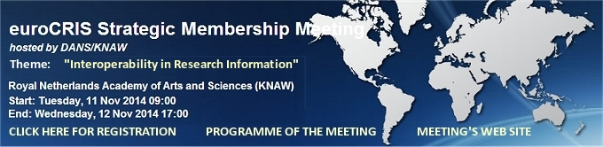
Going Dutch: Aggregating Research Information and
Research Data Services
Peter Doorn, director DANS
Strategic Membership Meeting
Interoperability in Research Information
11-12 November 2014, Amsterdam
Data Archiving and Networked Services

Slide 2
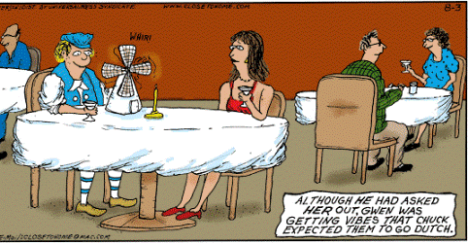

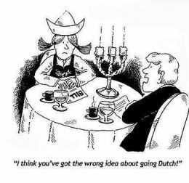
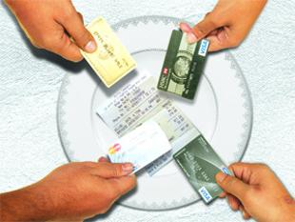

Slide 3

Contents
What is DANS?
  DANS and Research Data Netherlands
Aggregating Research Information
  NARCIS
  What can you do with it?
Research Data Services
  EASY
  RDM / Dataverse
Where do we come from and where do we go to:
  New DANS Strategy 2015-2020
  Challenges of an interoperable research information ecosystem
Our wish list for Santa Claus (Sinterklaas)

Slide 4

What is DANS?
First predecessor dates back to 1964 (Steinmetz Foundation), Historical Data Archive 1989
Institute of Dutch Academy and Research Funding Organisation (KNAW & NWO) since 2005
Mission: promote and provide permanent access to digital research information
Happy to host the EuroCRIS secretariat

Slide 5
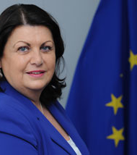

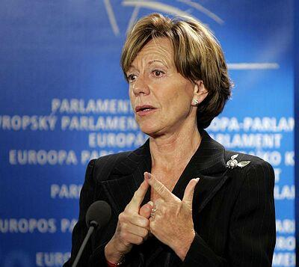
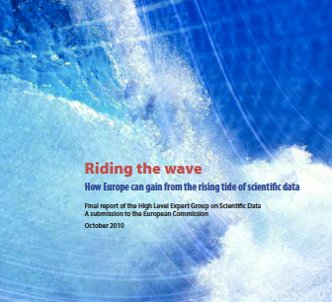

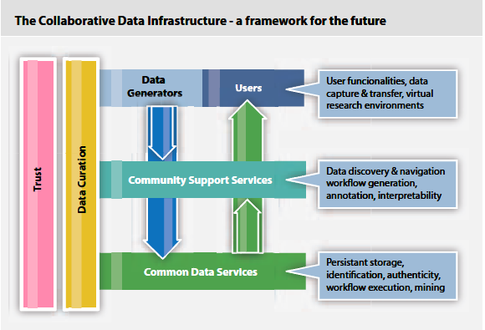
Riding the wave (Oct. 2010)
The oil of science !
Data is hot !
More bang for bucks
Máire Geoghegan-Quinn
Neelie Kroes
1st recommendation: Develop an international framework for a Collaborative Data Infrastructure

Slide 6
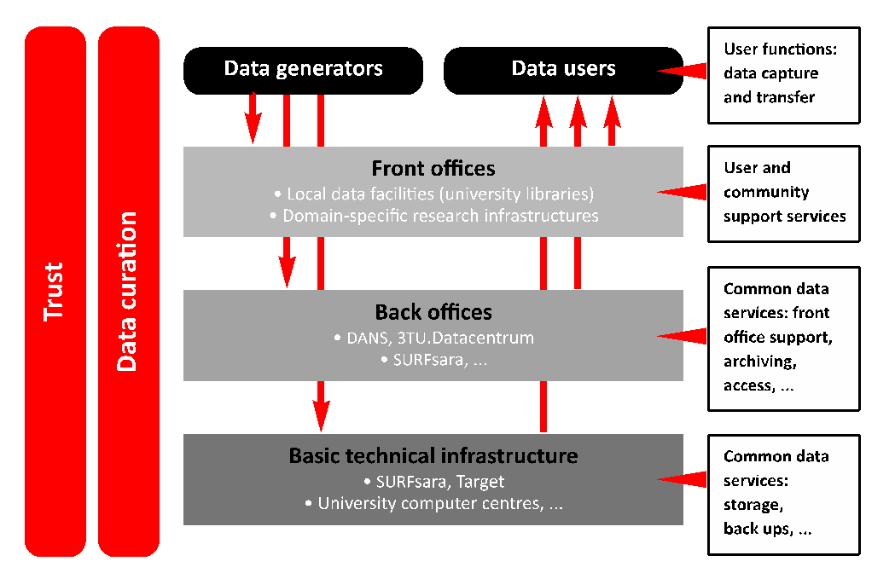
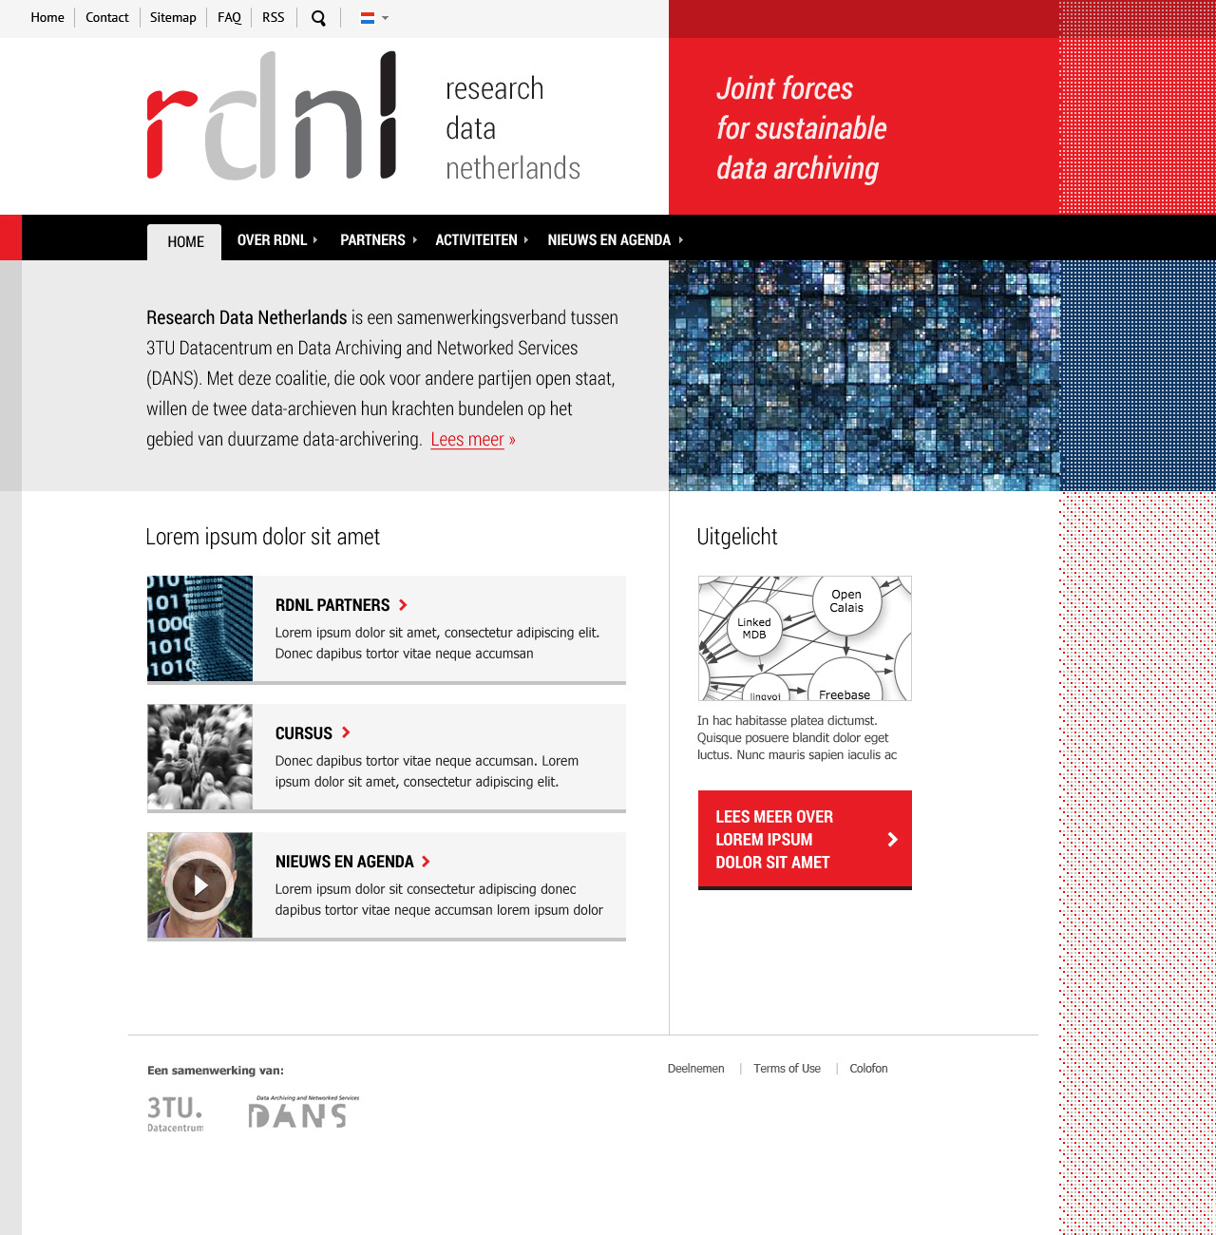
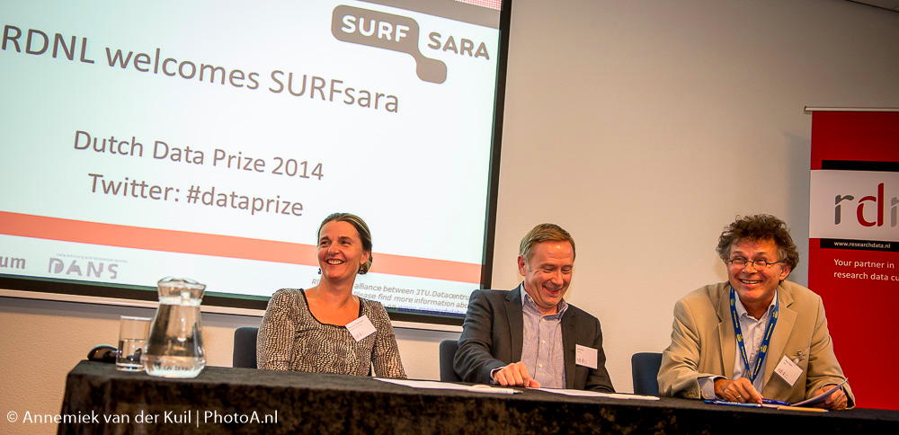

Research Data Netherlands
www.researchdatanetherlands.nl
Mission: the promotion of sustained access and responsible re-use of digital research data
Cooperation of DANS, 3TU.Datacentre and SURFsara (training, Dutch Data Award)
Towards a collaborative data infrastructure

Slide 7
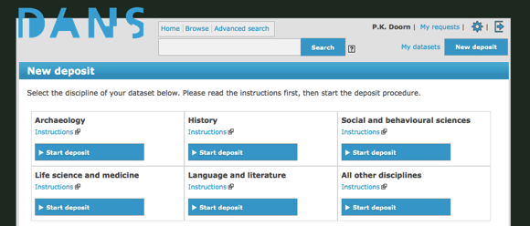
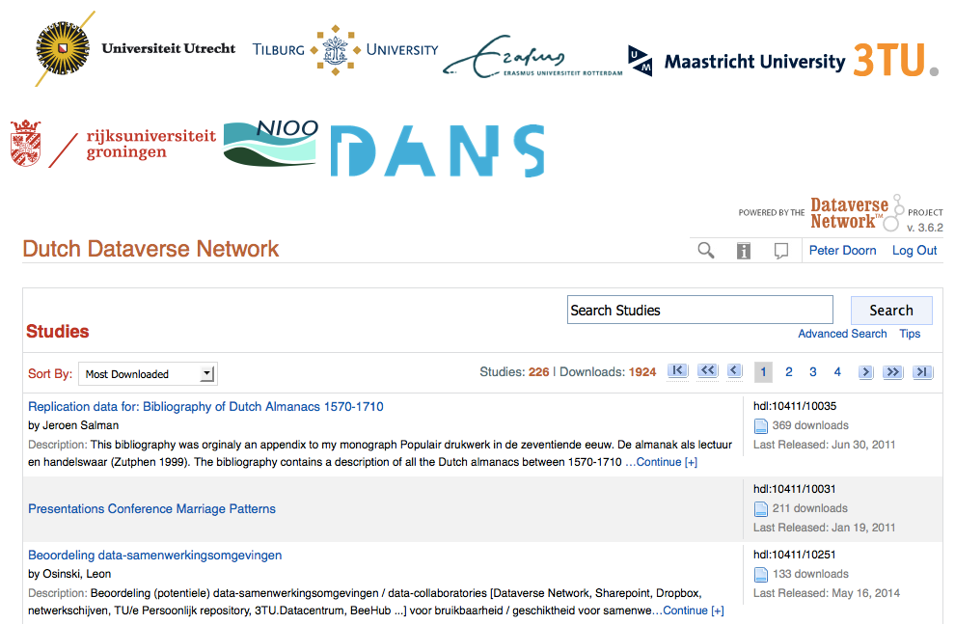
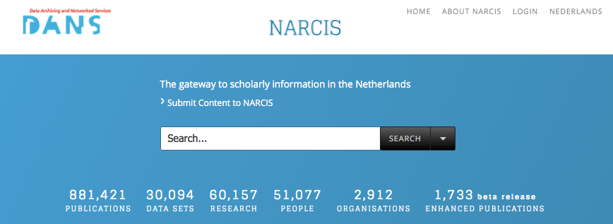
Our services
EASY: Electronic Archiving System for self-deposit
New service from May 1st onward: Dutch Dataverse
NARCIS: Gateway to scholarly information In the Netherlands

Slide 8
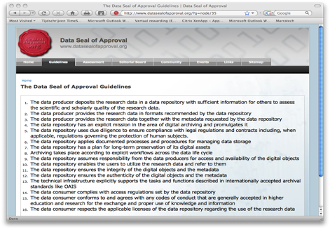

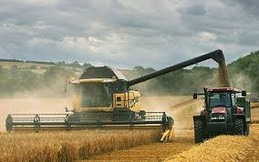
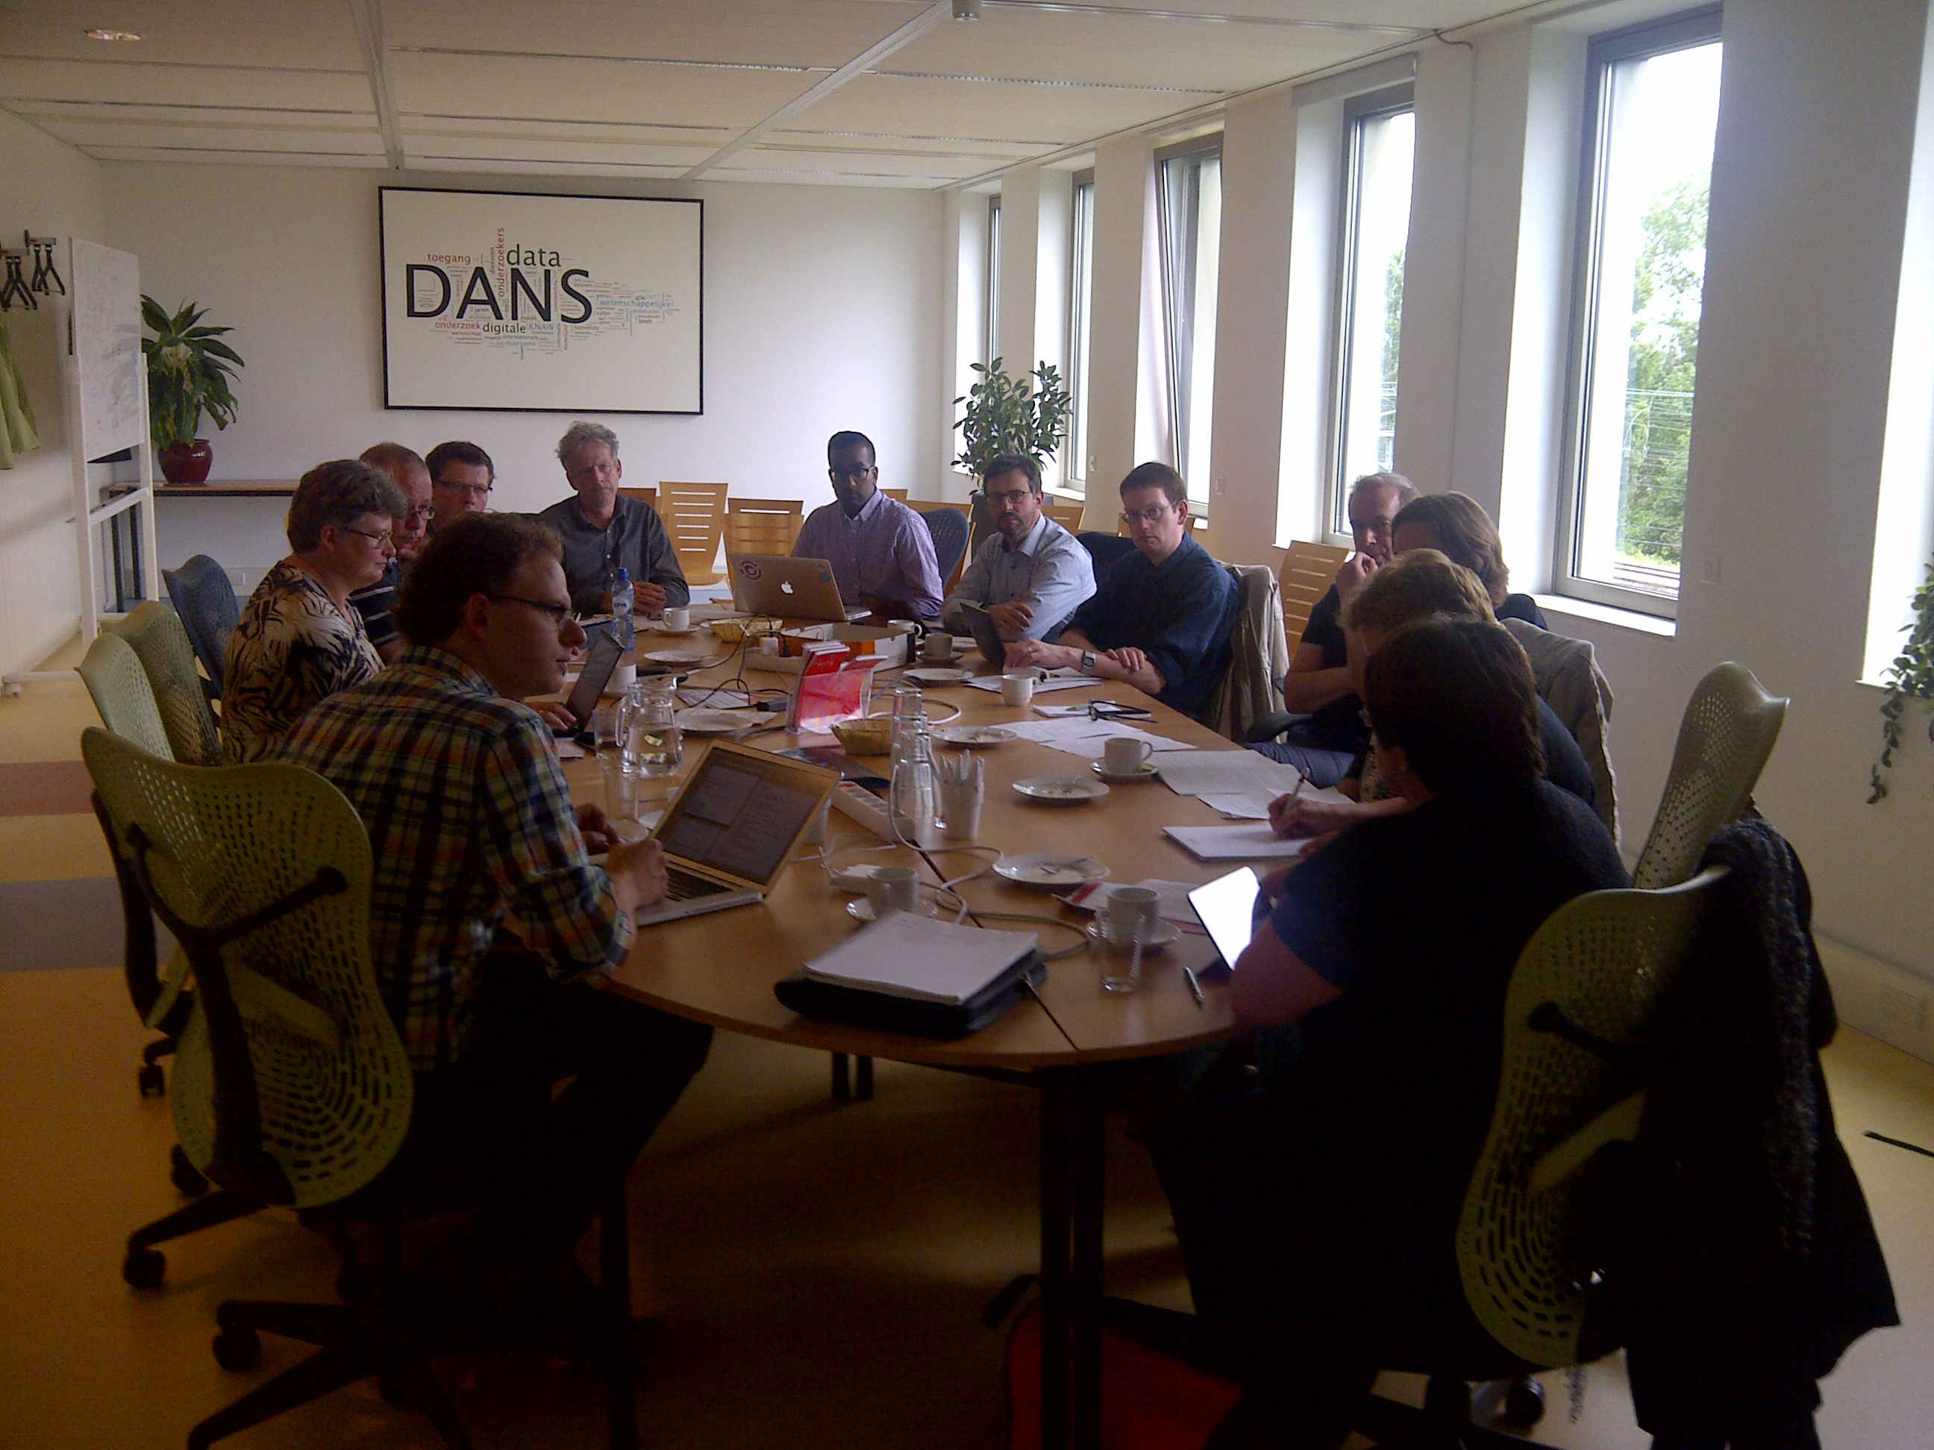
Additional services
Persistent Identifier
URN:NBN resolver
Common metadata harvester
Training & Consultancy

Slide 9
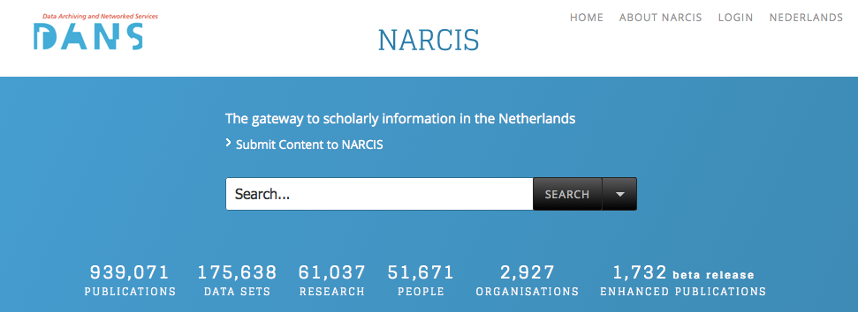
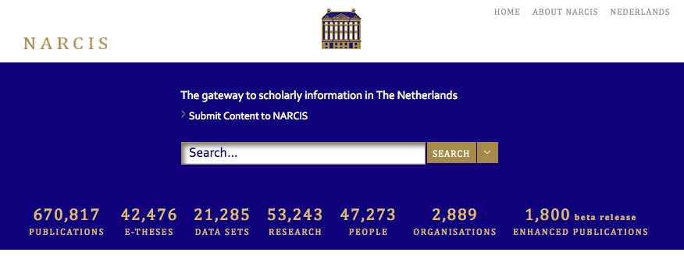
NARCIS.nl: Access to Research Information, e-Publications, Data Sets and more
November 2014
49% without The Language Archive
40% | 52% | 725% | 17% | 9% | 1% | -4%
Growth
September 2012

Slide 10
What can you do with it?
Searching information: policy makers, journalists, researchers
Linking information sources: publications, data, information on current research
Provide information to other aggregators (OpenAire, Google Scholar, etc.)
Mining the content: analyse the research system
Measuring Open Access

Slide 11
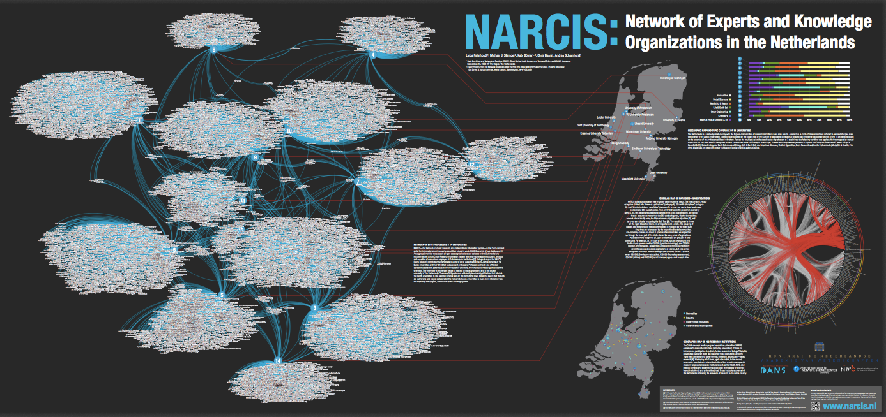
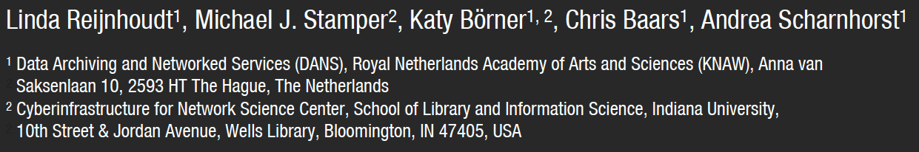
Mining the NARCIS content

Slide 12
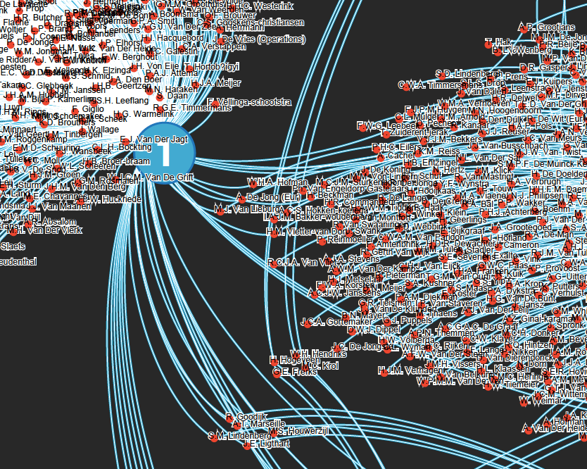
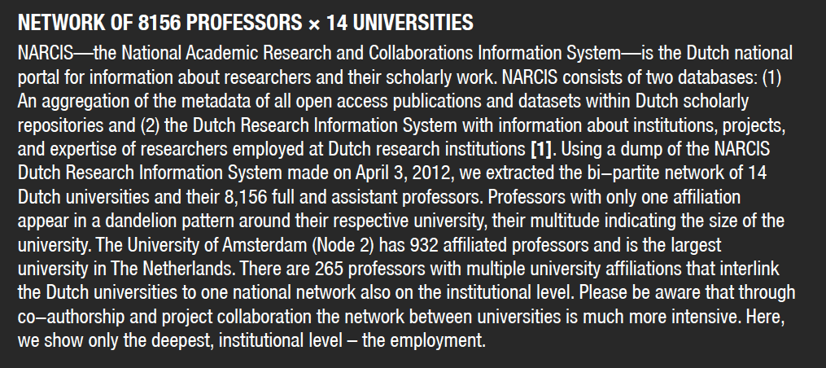
Network of 8156 professors x 14 universities

Slide 13
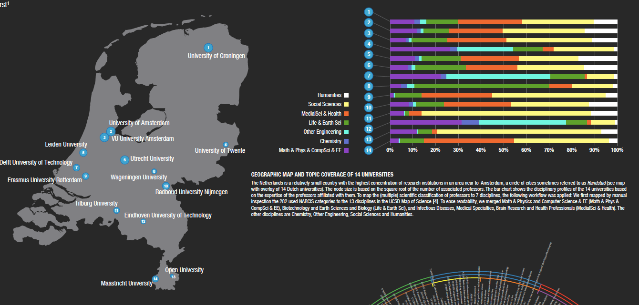
Geographic map and topic coverage of 14 universities

Slide 14
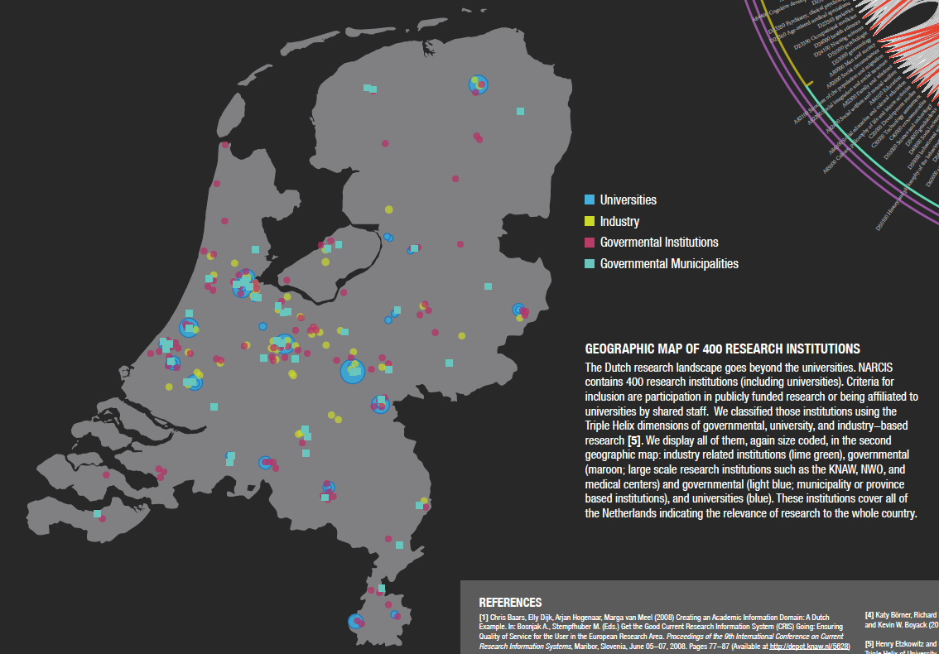
Geographic Map of 400 research institutions

Slide 15
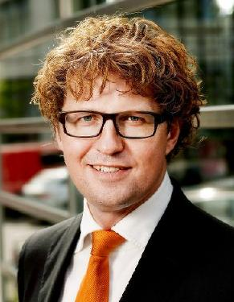
Dutch State Secretary for Science Sander Dekker pleads for Open Access
Open access is a moral obligation and crucial for society
Open access is inevitable
Preference for golden road
60% Open Access within 5 years (2018) and 100% within 10 years (2023)
Measure the progress

Slide 16
Open/closed access according to publication type
November 2014: 41% Open Access in NARCIS

Slide 17
Open/closed access according to institution

Slide 18
Open/closed access by year of publication

Slide 19


But there are limitations…
Completeness of information?
Quality of information?
No distinction between green and gold open access

Slide 20
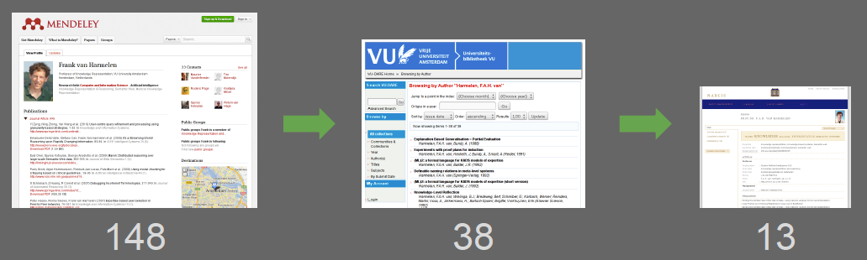
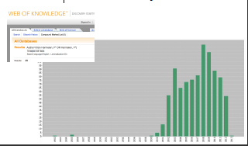
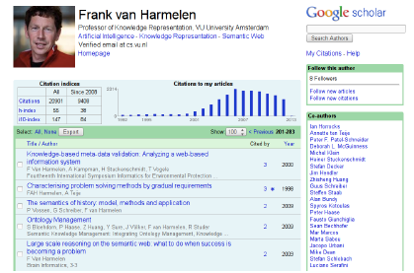
Example: Publications by Prof. Frank van Harmelen of Free University, Amsterdam
Frank’s
Mendeley
VU CRIS
NARCIS
Google knows more than Frank himself!
Web of Science
Google Scholar
43
283 !!
(after Christophe Gueret, 2/2013)

Slide 21
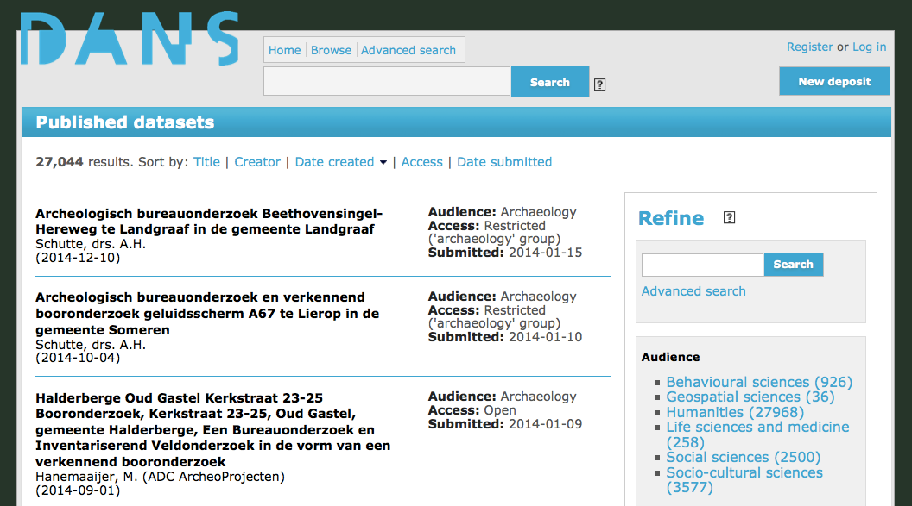
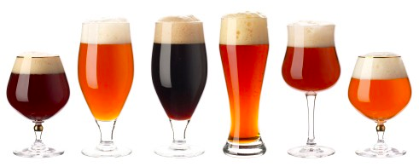
Research Data Services: the EASY long-term Electronic Archiving System
>28.000 datasets archived
Metadata in 6 varieties
http://easy.dans.knaw.nl

Slide 22
Datasets accessible via DANS (EASY/NARCIS)
November 2010: 1 million data files
March 2013: 2 million data files (25,000 data sets)

Slide 23
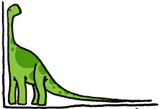
Datasets in DANS archive according to size
The long tail of research data
1,8% of datasets > 2 GB
2,8% of datasets > 1 GB

Slide 24
Reuse of datasets from DANS archive 2005-2013

Slide 25
Data access by discipline (DANS archive)
* Without archaeology

Slide 26
Yearly downloads per discipline, 2007-2013

Slide 27


Increased awareness of need for Data Policies
Dutch Academy (KNAW) “supports the free movement of data and results. Taking into account variations across and within scientific disciplines, free availability of data should be the default”.
Dutch Universities are developing data policies
Dutch research funding organisation NWO: Data Management Plans (DMP’s) and data sharing are becoming requirements for funding
Science Europe: Research Data Working Group recommends members to develop open data policies
EU research funding programme Horizon 2020: DMP and open data access standard, opt-out possible
EU Vice-President Neelie Kroes: “Data is the oil for science” (Riding the Wave report, 2010)
RECODE recommendations: develop and implement explicit policies requiring timely open access to research data as the default position

Slide 28
Supporting Research Data Management (RDM)
RDM: How you organize, structure, store, and care for the information used or generated during a research project:
  How a researcher deals with information on a day-to-day basis over the lifetime of a project
  What happens to data in the longer term – what the researcher does with it after the project concludes
Research funding & performing bodies are taking an increasing interest in what happens to research data
  Rising requirements to make research data publicly available at the end of a project
  Data Management Plans (DMP) increasingly required as part of a grant application

Slide 29
Variations on a theme…
How do they require it?
via project proposal
at evaluations
at performance interviews
via code of conduct
What do they require?
which criteria?
retention period?
including archiving?
data sharing?
eligible for funding?
including software?
in which repository?
Who requires RDM?
funders, national and international, public and private
research organisations, national and international
universities
journals (DAP)
How strict?
demand
strong recommendation
advice
How comprehensive?
data management plan or paragraph
once or periodically?

Slide 30
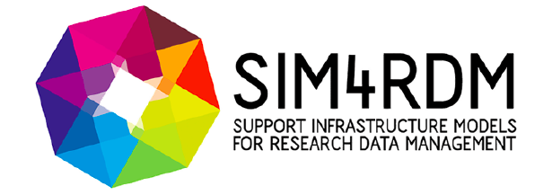
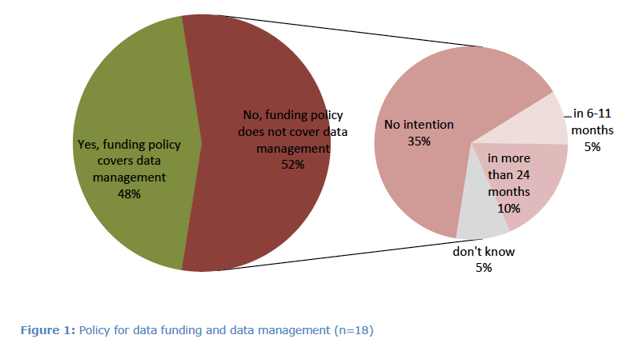
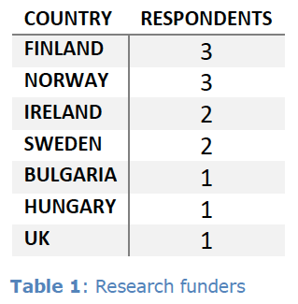
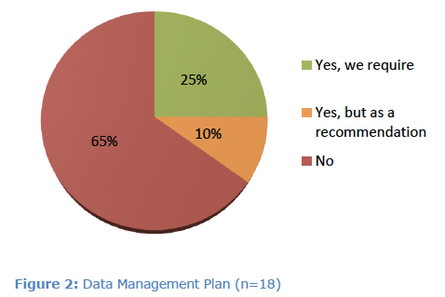
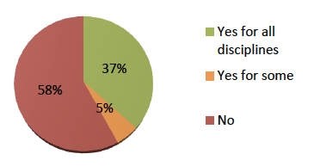
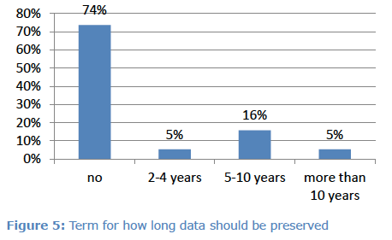
SIM4RDM Landscape Study (N = 18; 2013)
http://sim4rdm.eu/docs/project-outputs/sim4rdm-landscape-report
Authors: Wilma Mossink, Magchiel Bijsterbosch, Joeri Nortier

Slide 31

Dutch Dataverse Network
Dataverse software developed by IQSS, Harvard University
www.thedata.org. Dutch: https://dataverse.nl/dvn/
World-wide use, over 50.000 datasets stored
Create your own Dataverse (open source) or use one of IQSS’s Dataverses
Responsibility for maintenance and durability
2008: initiative for a Dutch Dataverse Network by Utrecht University and others (Tilburg, …)
May 2014: national service hosted by DANS as support for Research Data Management
Now: 9 institutions as users, more to follow

Slide 32

Codata-EuroCRIS & DANS/RDNL
International Council for Science / Committee on Data for Science and Technology (ICSU/Codata): to strengthen international science for the benefit of society by promoting improved scientific and technical data management and use. www.codata.org/
2012: EuroCRIS intends to cooperate more closely with CODATA in data interoperability, global information commons, open access to research datasets, and the relationship of research data availability to e-government data initiatives.
The Netherlands, through Research Data Netherlands, is a new CODATA member since last week.
Simon Hodson, Codata director: “It would be good to feed back any areas for collaboration with EuroCris”.

Slide 33
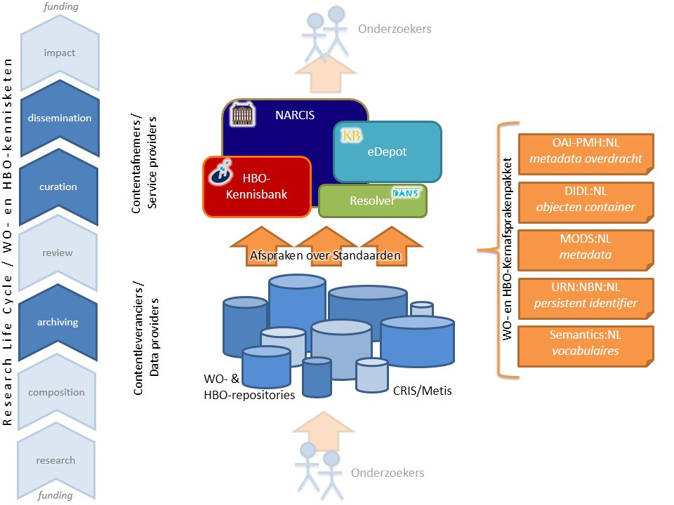
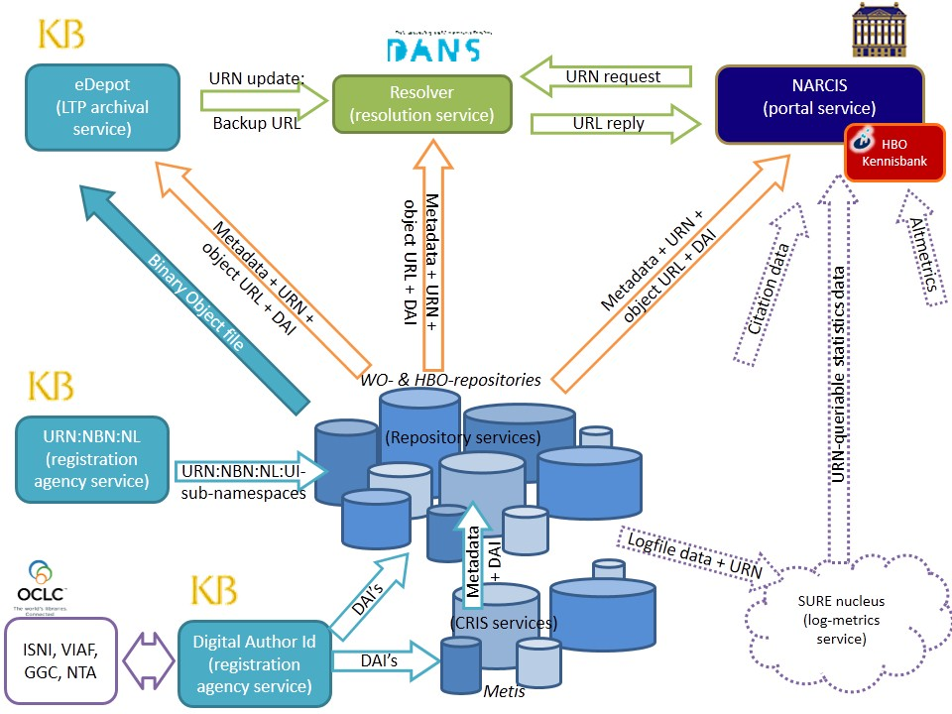
Where do we come from?
Agreements & Architecture from the past are getting outdated

Slide 34
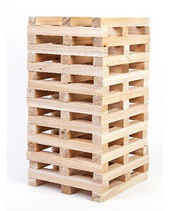

The research information infrastructure
Application Profiles Used
OAI-PMH (transfer)
DIDL (structure)
Remote Open Access (work in progress)
MODS (metadata)
DAI-extension (metadata extension)
GAL-extension (metadata extension)
WMP-extension (metadata extension)
DSpace to MODS (metadata mapping)
Metis to MODS (metadata mapping)
Persistent Object Identifiers (identification)
Author Identifiers (identification)
SRU (transfer) (expected!)
KE Usage Statistics Guidelines (SURE statistics) (transfer & format)
Enhanced Publications (format and transfer)
Vocabularies Used
Publication Types: info:eu-repo
Object types: info:eu-repo
Access Rights: Eprints Access Rights Vocabulary Encoding Scheme
Access Rights: info:eu-repo (additional expressions)
Versions: info:eu-repo
Identifier Namespaces Used
Digital Author Identifier: info:eu-repo
Persistent Object Identifier: URN:NBN:NL:UI
Grant Agreement Identifiers: info:eu-repo
Services Used
DAI-API
URN:NBN Resolver API
SURE-Statistiscs API

Slide 35
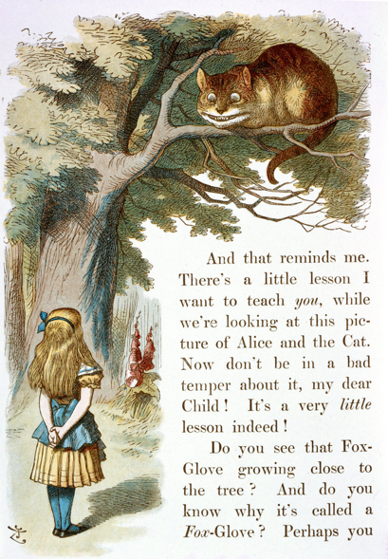

Which way to go?
Where should we go from here?
"Would you tell me, please, which way I ought to go from here?"
"That depends a good deal on where you want to get to," said the Cat.
"I don't much care where –" said Alice.
"Then it doesn't matter which way you go," said the Cat.
"– so long as I get somewhere," Alice added as an explanation.
"Oh, you're sure to do that," said the Cat, "if you only walk long enough."

Slide 36
DANS strategic vision 2015-2020
Mission: promoting and providing permanent access to research data
  long-term archiving of research data from finished projects
  support data management during current research
  software sustainability (conditional)
Focus: humanities and social sciences data & tools
  Supra-disciplinary functions (Narcis, DataVerse)
  Federated data infrastructure: RDNL
  Building block in international data infrastructure
Data research supporting basic services
Linking research data sets, publications and research information: improving interoperability

Slide 37

Sketch of our future scholarly ecosystem
Repositories
CRIS
Dutch Dataverse
URN
DOI
DAI
ORCID
NARCIS
Retrieval
Handle
DOI
Mass
ingest
ingest
EASY archive management & workflow
Input
OpenAire
VIVO
Download
3TU
SURFsara
URN
DOI
DAI
ORCID
Expose information and metadata as Linked Data
NL-CERIF for better interoperability

Slide 38
To be improved
Provenance / work flow (CRIS – Repository)
Quality control & completeness
Identifiers
Links
Opportunities:
  Dutch universities are implementing PURE/Converis as follow-up to METIS-based CRIS’s
  NL-CERIF: selection of applicable elements
  Edustandaard organisation to manage the agreements, concepts, standards and architecture
  State Secretary wants Open Access (success monitoring)
  Europe wants OpenAire to aggregate all Horizon 2020 project information and research outputs

Slide 39
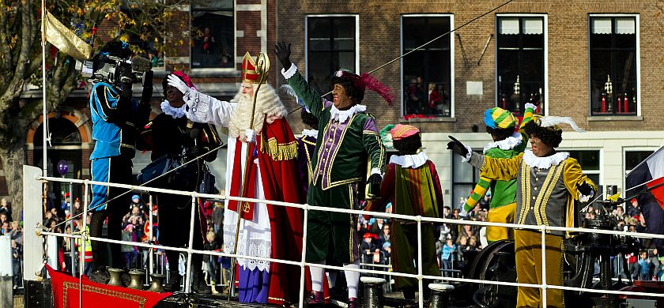
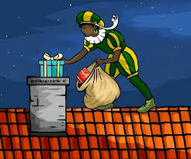
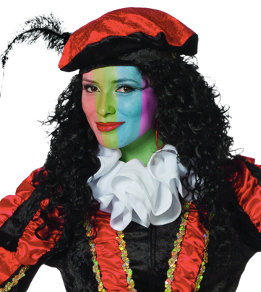

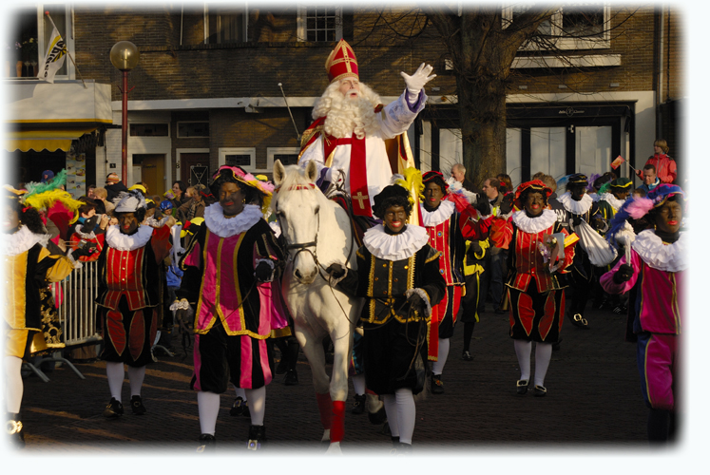
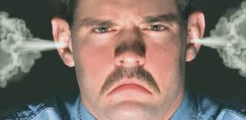
A Dutch Treat: Sinterklaas en Zwarte Piet

Slide 40
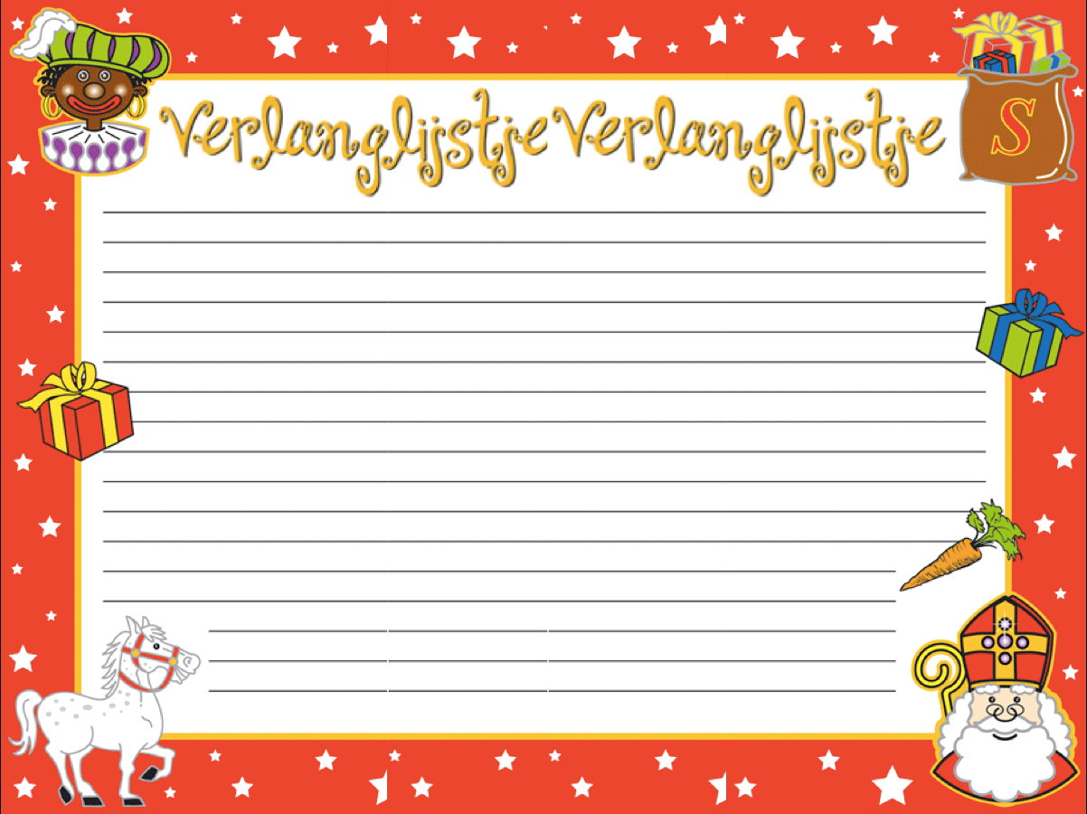
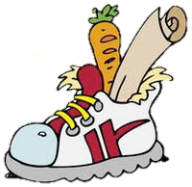
Provide identifiers (DOI/URN; DAI/ORCID)
Better workflow ➔ more complete and better information
  Implement common vocabulary, rich in semantics, in the new CRIS’s
  Export CRIS information to NL-CERIF
  Link research information & publications to projects
  Comply with agreed standards (eg. NL-CERIF)
Information providers responsible for the data quality (greater efficiency)

Slide 41
Additional wish list:
  provide information on (European) funding/grants
  provide information on green/gold Open Access
  provide identifiers to other research outputs (data, software)
Strengthen existing voluntary agreements!
Notes:
NB: ook vermelden hoeveel is betaald voor publiceren en welke licentie (cc-by, cc-0).

Slide 42


Thank you for your attention
www.dans.knaw.nl
www.narcis.nl
peter.doorn@dans.knaw.nl
@pkdoorn
The work DANS does summarized in a 4 minute video, introduced by Neelie Kroes
http://youtu.be/HJbo-OAaJ1I

