Slide 1

The “Organisation Profile Document” – Enabling data autodiscovery
Adrian Cox
University of Southampton
9th June 2016

Slide 2
How did the OPD evolve?
Emergence of equipment databases as impact of Wakeham Review, 2010, and launch of revised EPSRC Equipment Funding Guidelines
SES consortia database adoption of linked open data techniques being developed through HE community website data.ac.uk
EPSRC funded UNIQUIP Project “Defining standards for the publication of research facilities and equipment data”
EPSRC enthusiasm to explore an approach for delivery of a national equipment portal offering lightweight and sustainable architecture – resulting in equipment.data
Notes:
RCUK (EPSRC) drive to increase access and utilisation of research facilities/equipment. Requirement to take stock of current equipment.

Slide 3

What is equipment.data?
An EPSRC project funded to deliver a “national equipment portal” for the HE sector, http://equipment.data.ac.uk (Joint EPSRC/Jisc funded from 1st April 2015)
The service provides an aggregation and search facility for all published UK HE equipment datasets along with support for publishing and workflow queries
Fundamental to success is the low entry requirement.
Note: From 1st July 2016 service will be hosted and supported by Jisc

Slide 4

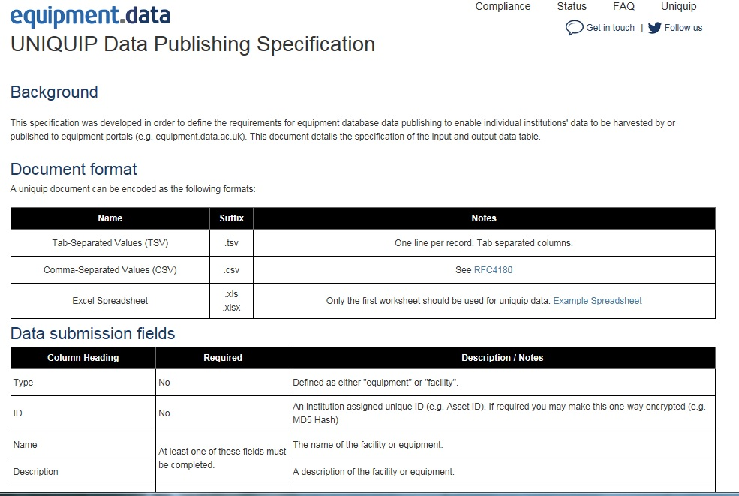
A simple specification makes it easy to contribute
Notes:
Established sector consensus on UNQUIP Data Publishing spec. Now being embedded across sector (inc proprietary systems e.g. PURE)
Fundamentally systems is acknowledged in UUK “Diamond Review” including recommendation on future use now being adopted by RCUK.

Slide 5
The OPD and Autodiscovery:
 | Bronze | Silver | Gold
Data is on the internet and in an acceptable format. | ✔ | ✔ | ✔
Description of dataset is provided by a remotely hosted OPD |  | ✔ | ✔
The OPD is discovered via autodiscovery. |  |  | ✔
The OPD/dataset has a recognised and supported open licence (e.g. CCO, ODCA or OGL) |  |  | ✔

Slide 6
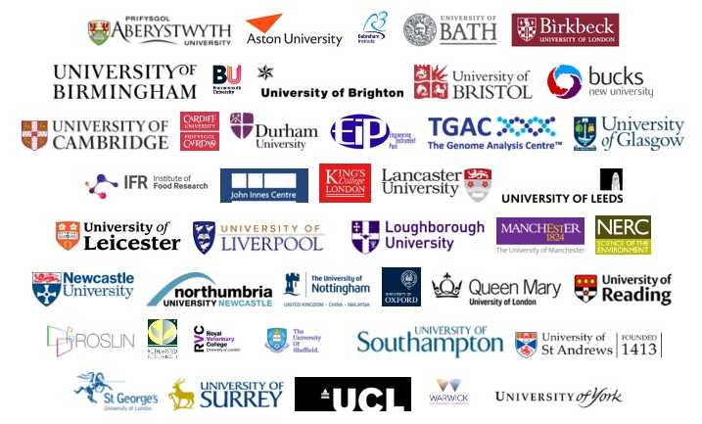
To date 43 organisations publish 11,488 pieces of equipment and growing!!!
Notes:
Self explanatory…. 43 and counting!!

Slide 7
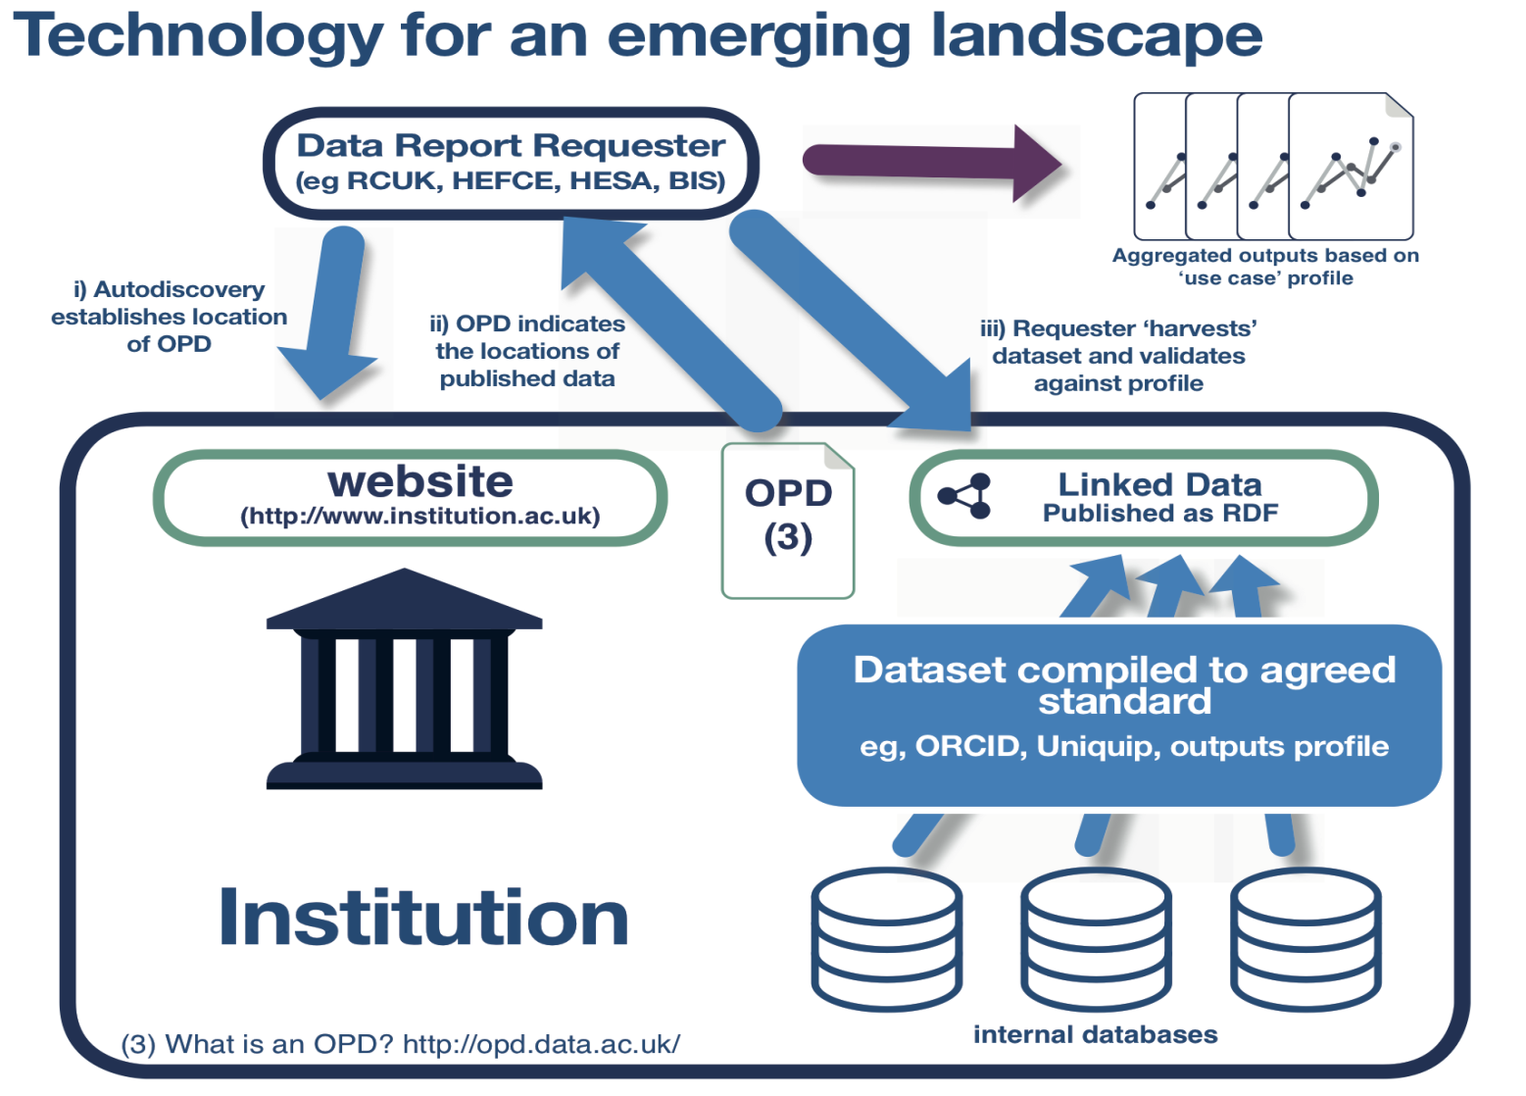
How do we discover published data?
OPD location discovered from “home page header link” http://opd.data.ac.uk/docs/auto
OPD provides “catalogue” of datasets
Web crawler programme harvests data (to data profile)
Published Open Data

Slide 8
Home page header link……..
<link rel="openorg" href="http://www.example.ac.uk/profile.ttl"/>

Slide 9
Enabling autodiscovery - What is an Organisation Profile Document (OPD)?
# Aberystwyth University OPD
# John Roberts; Research, Business, and Innovation
# Updated April 2016
@prefix skos: <http://www.w3.org/2004/02/skos/core#> .
@prefix owl: <http://www.w3.org/2002/07/owl#> .
@prefix dcterms: <http://purl.org/dc/terms/> .
@prefix oo: <http://purl.org/openorg/> .
@prefix foaf: <http://xmlns.com/foaf/0.1/> .
@prefix vcard: <http://www.w3.org/2006/vcard/ns#> .
@prefix dcat: <http://www.w3.org/ns/dcat#> .
@prefix org: <http://www.w3.org/ns/org#> .
@prefix geo: <http://www.w3.org/2003/01/geo/wgs84_pos#> .
@prefix lyou: <http://purl.org/linkingyou/> .
<>
a oo:OrganizationProfileDocument ;
dcterms:license <https://creativecommons.org/publicdomain/zero/1.0/> ;
foaf:primaryTopic <https://www.aber.ac.uk/#org> .
<https://www.aber.ac.uk/#org>
a org:FormalOrganization ;
skos:prefLabel "Aberystwyth University" ;
skos:hiddenLabel "AU" ;
vcard:sortLabel "Aberystwyth University" ;
foaf:phone <tel:+441970623111> ;
foaf:mbox <mailto:research@aber.ac.uk> ;
foaf:logo <https://www.aber.ac.uk/css/images/aber-uni-logo.svg> ;
foaf:homepage <https://www.aber.ac.uk/> ;
dcterms:location <https://en.wikipedia.org/wiki/Aberystwyth> ;
owl:sameAs <http://id.learning-provider.data.ac.uk/ukprn/10007856> ;
owl:sameAs <http://gtr.rcuk.ac.uk/organisation/E4757A6E-7326-472B-9979-B47D77A65446> ;
owl:sameAs <http://dbpedia.org/page/Aberystwyth_University> ;
foaf:isPrimaryTopicOf <https://en.wikipedia.org/wiki/Aberystwyth_University> ;
foaf:based_near <https://www.aber.ac.uk/#based_near_point> .
<https://www.aber.ac.uk/#based_near_point>
a <geo:Point> ;
geo:lat "52.417765" ;
geo:long "-4.065255" .
<https://www.aber.ac.uk/en/research/equipment/equipmentData.xml>
oo:organization <https://www.aber.ac.uk/#org> ;
oo:corrections <mailto:jtr2@aber.ac.uk> ;
oo:contact <mailto:research@aber.ac.uk> ;
Machine Readable Version
Notes:
The OPD is essentially an rdf ttl file.
So what does it include? 2 distinct elements 1) The Who and where, and “) What data. Additionally for each dataset the owner and license.
Use of Unique institutional ID validates and provides link in other datasets e.g. GtR.

Slide 10
# OPD for the University of St Andrews # Written by Patrick McCann, Research Computing, The Library # Based on documentation at http://opd.data.ac.uk # January 2016 @prefix owl: . @prefix foaf: . @prefix oo: . @prefix dcterms: . @prefix geo: . @prefix skos: . @prefix org: . @prefix xtypes: . @prefix lyou: . @prefix vcard: . <> a oo:OrganizationProfileDocument ; dcterms:license ; foaf:primaryTopic . a org:FormalOrganization ; skos:prefLabel "University of St Andrews" ; skos:hiddenLabel "St Andrews University" ; vcard:sortLabel "St Andrews, University of" ; foaf:phone ; #TODO:1 Add an email address - recommended field, but no single address listed on contacts page foaf:logo ; foaf:homepage ; owl:sameAs ; owl:sameAs ; owl:sameAs ; foaf:isPrimaryTopicOf ; foaf:based_near ; vcard:adr ; foaf:account ; foaf:account ; foaf:account ; foaf:account ; foaf:account ; foaf:account ; foaf:account ; lyou:business ; lyou:depts ; lyou:about ; lyou:events ; lyou:search ; lyou:press ; lyou:news ; lyou:jobs ; lyou:contact ; lyou:about-leader ; lyou:about-executive ; lyou:legal-data-protection ; lyou:legal-environment ; lyou:legal-equality ; lyou:legal-foi ; lyou:legal-ict ; lyou:legal-website ; lyou:contact-staff ; lyou:ict-support ; lyou:research ; lyou:legal-ethics ; lyou:business-ktp ; lyou:academic-depts ; lyou:support-depts ; lyou:conference-facilities ; lyou:courses ; lyou:undergraduate ; lyou:undergraduate-courses ; lyou:undergraduate-courses-entry-requirements ; lyou:undergraduate-prospectus ; lyou:postgraduate ; lyou:postgraduate-taught ; lyou:postgraduate-taught-courses ; lyou:postgraduate-taught-courses-entry-requirements ; lyou:postgraduate-taught-prospectus ; lyou:postgraduate-research ; lyou:postgraduate-research-courses ; lyou:postgraduate-research-courses-entry-requirements ; lyou:postgraduate-research-prospectus ; lyou:opendays ; lyou:events-graduation ; lyou:about-parents ; lyou:international-students ; lyou:uk-ico-publication-scheme ; lyou:research-funders-policies ; lyou:research-data-management-planning ; lyou:research-data-active-storage ; lyou:research-data-catalogue ; lyou:research-data-policy ; lyou:research-data-access ; lyou:research-data-secure-access . a ; geo:lat 56.341205 ; geo:long -2.793016 . a vcard:Address ; vcard:postal-code "KY16 9AJ" ; vcard:country-name "United Kingdom" ; vcard:street-address "College Gate, North Street" ; vcard:locality "St Andrews" . a foaf:OnlineAccount ; foaf:accountName "uniofsta" ; foaf:accountServiceHomepage . a foaf:OnlineAccount ; foaf:accountName "univofstandrews" ; foaf:accountServiceHomepage . a foaf:OnlineAccount ; foaf:accountName "uniofstandrews" ; foaf:accountServiceHomepage . a foaf:OnlineAccount ; foaf:accountName "15683" ; foaf:accountServiceHomepage . a foaf:OnlineAccount ; foaf:accountName "uniofstandrews" ; foaf:accountServiceHomepage . a foaf:OnlineAccount ; foaf:accountName "user20577780" ; foaf:accountServiceHomepage . a foaf:OnlineAccount ; foaf:accountName "UofStAndrews" ; foaf:accountServiceHomepage . a ; oo:organization ; dcterms:subject ; dcterms:license . oo:organization ; oo:corrections ; oo:contact ; dcterms:subject ; dcterms:conformsTo ; dcterms:license . dcterms:conformsTo ; dcterms:subject ; oo:contact ; oo:corrections ; oo:organization .

Slide 11
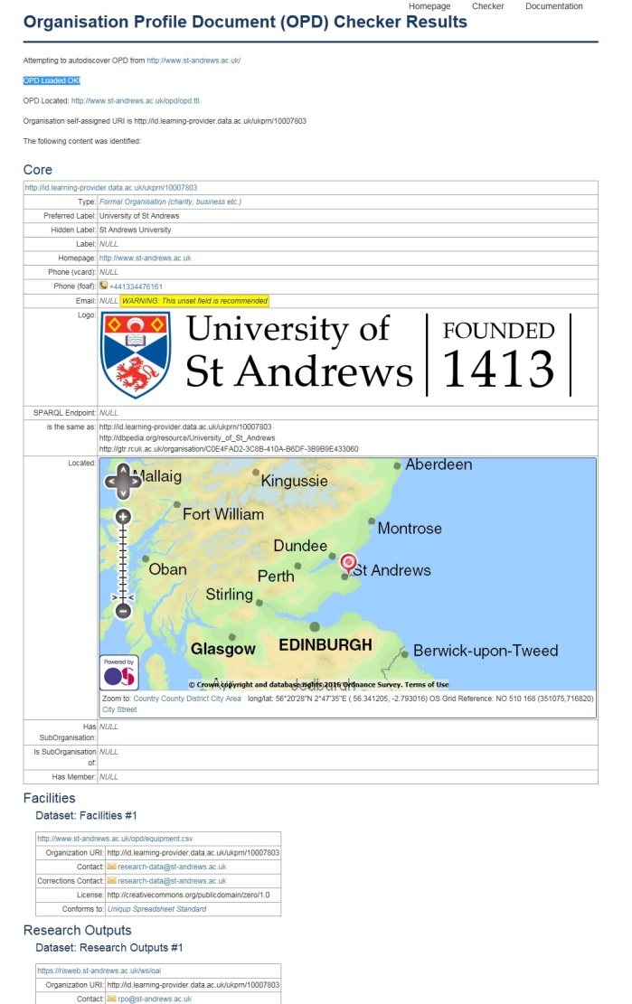
Human Readable Version!

Slide 12
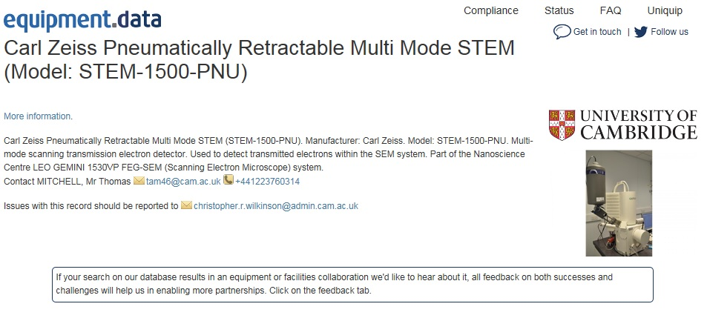
Typical search result…

Slide 13
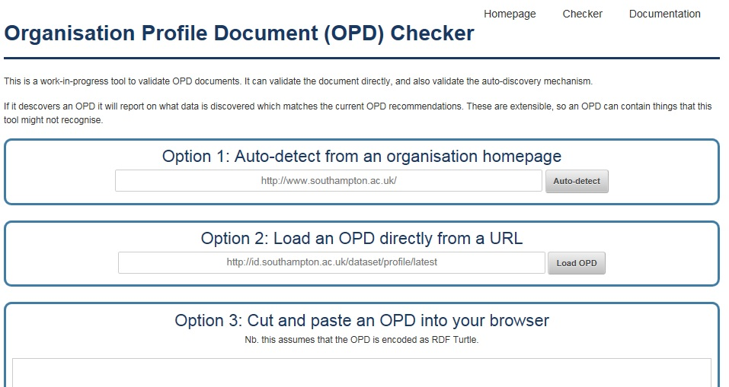
http://opd.data.ac.uk/checker
Notes:
Option 1 identifies if organisation has autodiscoverble OPD
Option 2 Silver. URL of OPD is known
Option 3 Tests/validates paring of OPD script ttl file. Ideal if writing an OPD suing the “workshop”.

Slide 14
Exploiting the OPD infrastructure....
Data contribution to NCUB “Intelligent Brokerage Tool” – konfer.online
Extending the OPD to cover Research Data Management (RDM) Jisc Research Data Spring project, working with the Digital Curation Centre (DCC)
UK Research Data Discovery Service – Phase 2 Technical contributor role
Regional consortia equipment search facilities
Potential use in BIS/RCUK replacement grant system

Slide 15
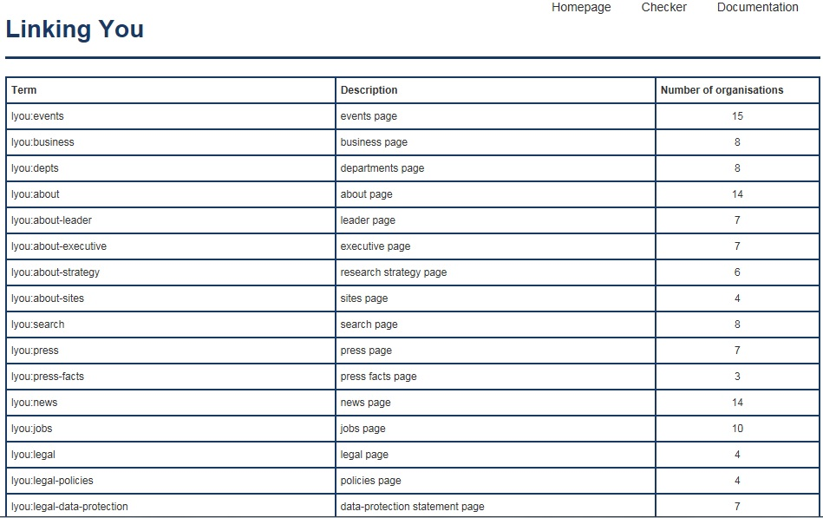
Infrastructure exploitation....

Slide 16

How the OPD can support “research outputs” discovery

Slide 17
What could this mean for the OPD?
Improved infrastructure adoption through wider use of OPD
Data provenance when displayed through wider data aggregations e.g. Research outputs
Enhanced contribution to national information portals such as RCUK’s Gateway to Research and NCUB konfer.online
International adoption opportunities – creating opportunities for wider community data aggregations e.g. Research infrastructure.

Slide 18
What are the challenges?
Establishing recognised standard – W3C Working Group to be coordinated
Embedding across entire sector:
  Through policy mandate – RCUK cross-council policy on publishing of OJEU value equipment and above, may accelerate wider adoption
  Use in wider data discovery encourages broader adoption and improves
  Use by regional and national university consortia will improve curation and ownership
Structure of future content – a role for CASRAI perhaps?
Institutional management and governance of OPD – Who is responsible?

Slide 19
Want to discuss further?
Get in touch…
Adrian Cox
Project Manager
A.J.Cox@soton.ac.uk Tel. 02380 598586
Chris Gutteridge
Web Developer
cjg@ecs.soton.ac.uk Tel 02380 594833
Sign up to the equipment.data newsletter at:
http://equipment.data.ac.uk/newsletters/
Notes:
AC – for more information on strategic issues, policy and engagement in wider developments
CG – technical advice on developing OPD and wider LOD development aspects

