Slide 1

Data and classification governance, key to semantic interoperability of CRIS systems in inter-organizational contexts
Sadia Vancauwenbergh
2016-06-09

Slide 2
Research Information
industry
research institutions
editors
Investment
opportunities
Research organisation
publications
libraries
patents
products
researchers
data centres
projects
government
research data
equipment
facilities
researchers
financers
Notes:
Verscheidene informatieobjecten
Informatie zit verspreid bij verschillende stakeholders (ongeveer 33 (vaak in operationele processen))
Informatie wordt gezocht door verschillende stakeholders
Breng deze informatie op transparante manier samen in één virtuele onderzoeksinformatieruimte = FRIS
Er is een zeer sterke behoefte aan raadplegen van databanken, vinden van onderzoekers, projecten … (zie bevraging e-onderzoek, nov 2007)

Slide 3
CRIS
industry
research institutions
editors
Investment
opportunities
Research organisation
publications
libraries
patents
products
researchers
data centres
projects
government
research data
equipment
facilities
researchers
financers
Notes:
Verscheidene informatieobjecten
Informatie zit verspreid bij verschillende stakeholders (vaak in operationele processen)
Informatie wordt gezocht door verschillende stakeholders
Breng deze informatie op transparante manier samen in één virtuele onderzoeksinformatieruimte = FRIS
Er is een zeer sterke behoefte aan raadplegen van databanken, vinden van onderzoekers, projecten … (zie bevraging e-onderzoek, nov 2007)

Slide 4
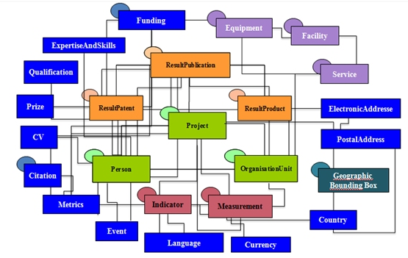
CERIF 1.6
Almost unlimited flexibility for modelling RI
  Base, result, infrastructure and 2nd level entities: 293
  Attributes for metadata and multilinguality: 1814
  Time-stamped / classification-referenced relations: 665

Slide 5
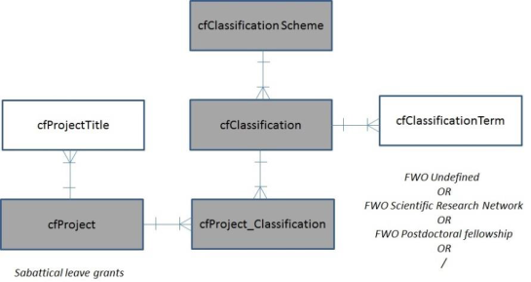
Caveats
Semantic mismatches
  Terminology:
  same concepts, differents meanings and vice versa
  → at the inter- and intra-organizational level
FWO Undefined
OR
FWO Scientific Research Network
OR
FWO Postdoctoral fellowship
OR
/
Sabbatical Leave Grant

Slide 6
CRIS needs & drivers
Correct, actual, complete research information
  Maximum reuse of research information
  By connecting data silo’s
  Reducing system costs
CRIS services & applications
  Administrative reduction or research reporting
  Increased strategic intelligence
  Efficient & effective policy monitoring
  More information services
TRUE Semantic interoperability is a MUST

Slide 7
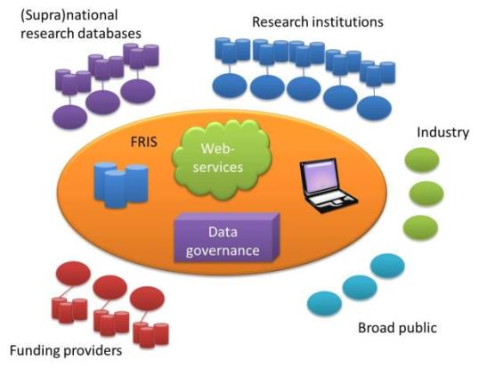
Semantic interoperable CRIS
Flanders Research Information Space (FRIS)

Slide 8
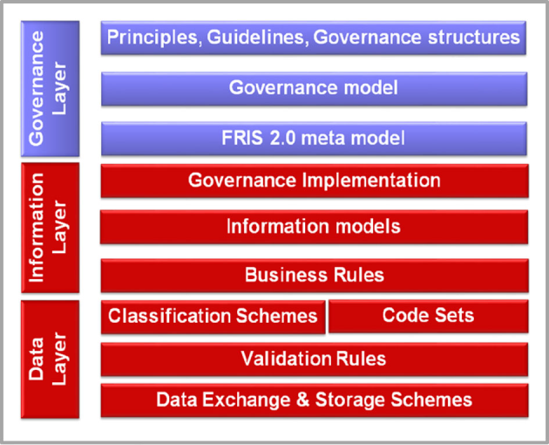
1. Installation of a governance structure
Notes:
Introducing model driven formal semantic management at the business level

Slide 9
2. Involvement / creation of a business layer
Recording of business concepts and meanings
Business
Application
Technology
Notes:
FRIS – Enterprise Information Architecture

Slide 10
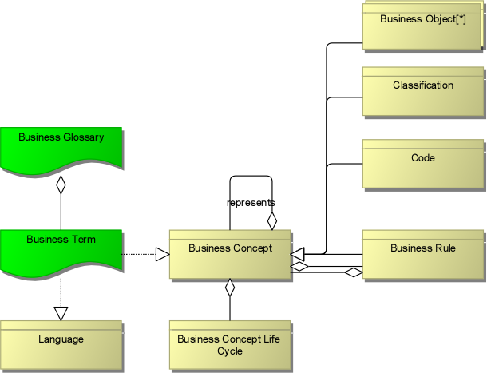
2. Involvement / creation of a business layer
Semantics (not) (yet) in place
Notes:
Metamodel driven and organisation driven models, with fixed pattern with regards to relations

Slide 11
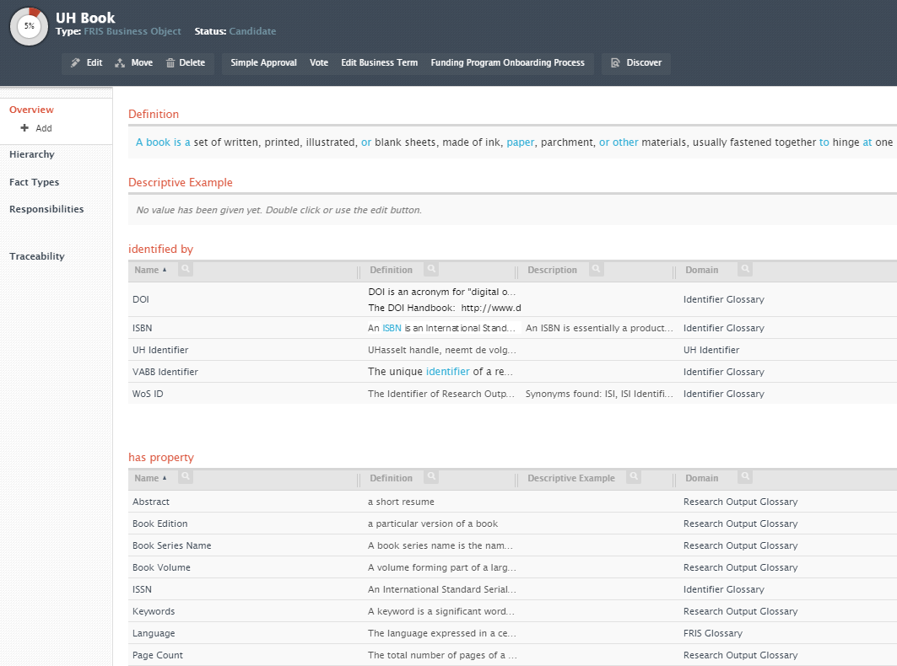
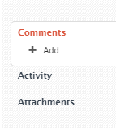
Notes:
Syntactic and semantic alignment is realized at the systems interfaces.

Slide 12
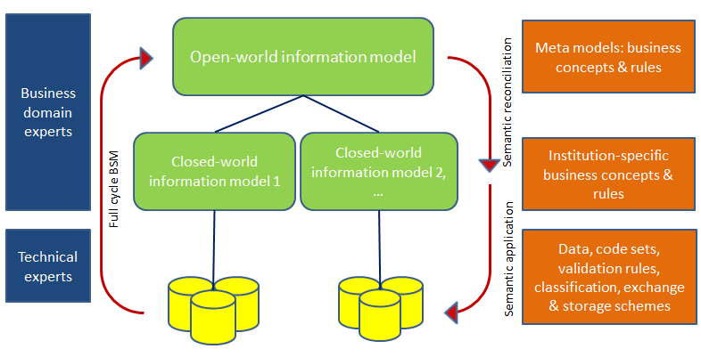
3. Inter-organizational semantic alignment
  Definition of required business concepts on the meta-level
  Collaborative, machine-readable manner
  Full-cycle business semantics management

Slide 13
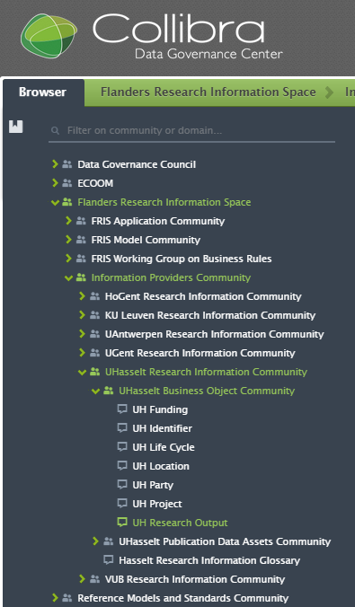
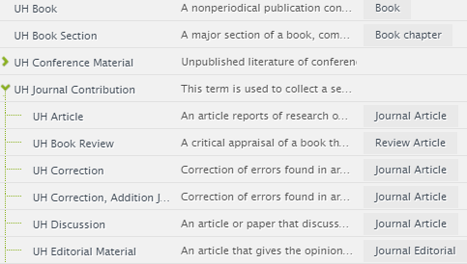
Notes:
Providers are responsible for their semantic management and the mapping to the agreed FRIS semantics.

Slide 14
Classification governance for financial codes
Research funding:
  given to persons, projects, consortia,…
  obtained via many funding sources
    organisations, programs, grants
  identified by financial codes classification
  without classification governance:
    semantic mismatches
      terminology and meaning
      decentral maintenance of code lists
FRIS-portal
Project
database

Slide 15
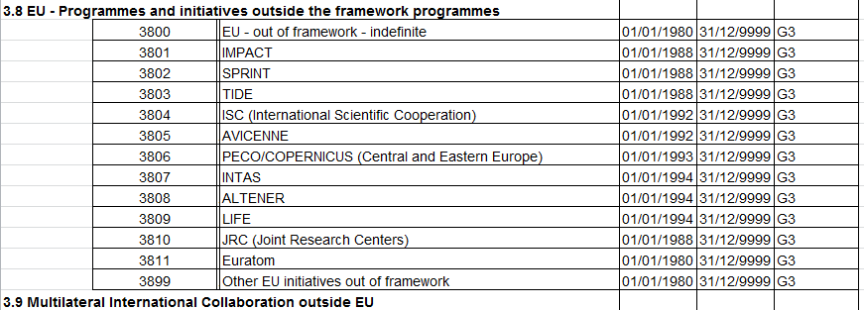
Extract Generation 1 financial code list

Slide 16
Implementation of classification governance
Revisiting the financial information model & code list
  No hierarchy, autonumbering
  More granularity, in line with reporting obligations
Governance tool
  Roles & responsibilities
  Central maintenance of code lists in DGC, incl. allowed value
  Semantics and examples
  Workflows for creating/editing existing codes
  Full view on remarks & comments
  Concordance tables
Automated, collaborative & machine-readable

Slide 17
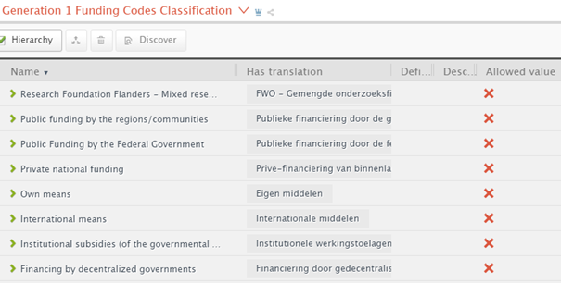
  Central maintenance of code lists in DGC, incl. allowed value

Slide 18
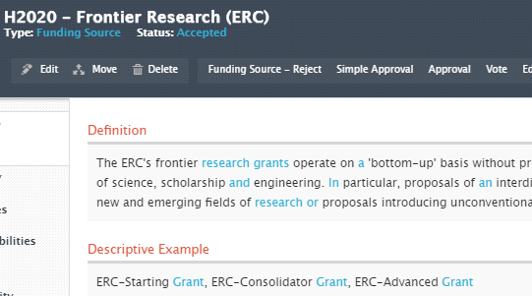
  Semantics and examples

Slide 19
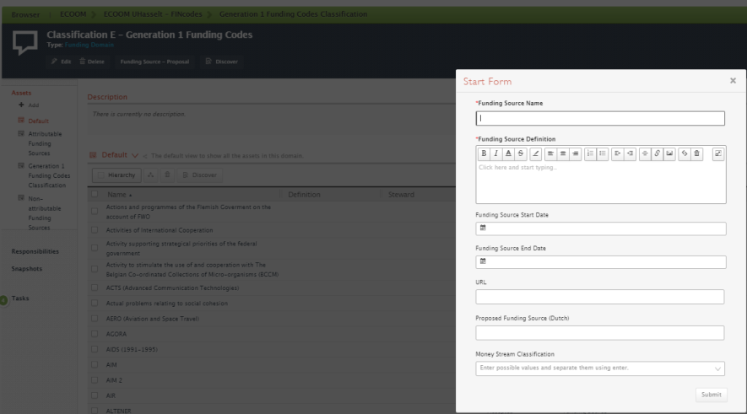
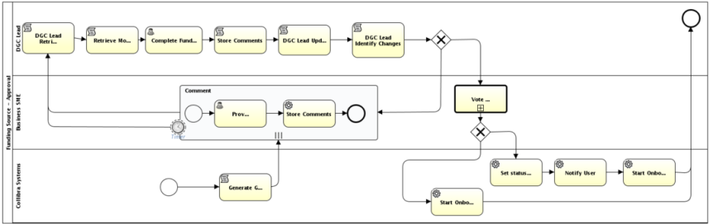

Slide 20
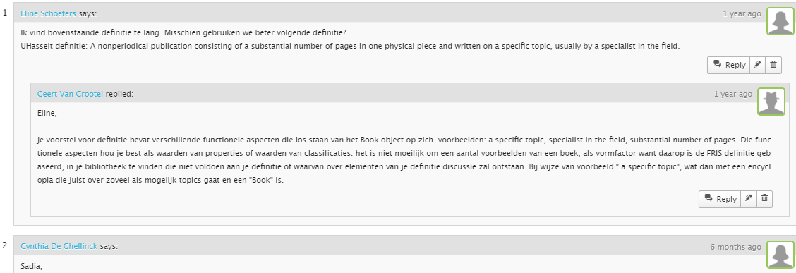
  Full view on remarks & comments

Slide 21
Implementation of classification governance
Revisiting the financial information model & code list
  No hierarchy, autonumbering
  More granularity, in line with reporting obligations
Data governance tool
  Roles & responsibilities
  Central maintenance of code lists in DGC
  Semantics, examples and allowed value lists
  Workflows for creating/editing existing codes
  Full view on remarks & comments
  Concordance tables
Automated, collaborative & machine-readable

Slide 22
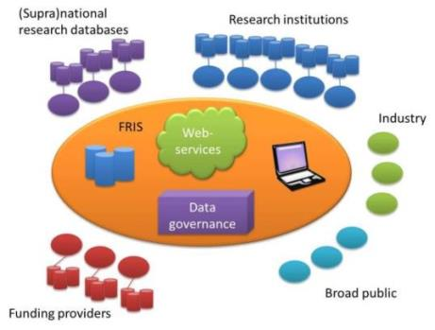
Conclusion
Data and classification governance,
key to true semantic interoperability of CRIS systems in inter-organizational contexts

Slide 23
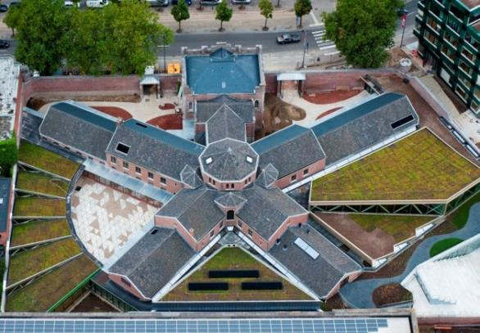
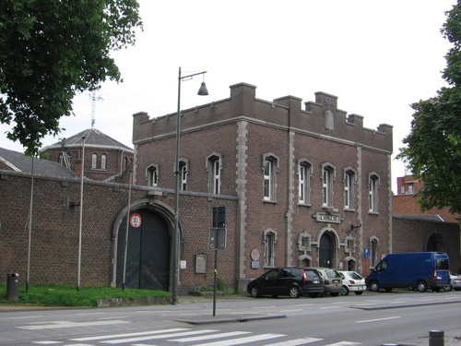
Acknowledgements
Flanders Government, Department Economy, Science and Innovation (EWI)
ECOOM project team
  Hanne Poelmans
  Helen Cheng

Slide 24
