Slide 1
Philipp Fondermann Elsevier
Peter van der Togt Wageningen University & Research Centre
How Wageningen University and Research Center managed to influence Researchers Publishing Practice towards more Quality, Impact and Visibility
Notes:
PHILIPP
Wageningen University and Research Center (WUR) is one of the most prestigious research institutions in the world in life sciences.
One of the `drivers` of this success story is a comprehensive Quality Management exercise based on Research information from an integrated CRI system, that managed to influence researchers publishing behaviour towards more quality, impact and visibility.
So first WUR`s highly efficient research quality management exercise is introduced
Furthermore the paper portrays the charming strategy WUR applied to ensure Acceptance and Use of the system in favour of data quality and -quantity

Slide 2
Wageningen University and Research Center - Facts & Figures
10.000
BSc&MSc students
employees
6.500
630
159
1880
professors
PhD-students
million euro annual budget
1925
Academic staff
Notes:
Peter
Wageningen University & Research Centre, located in the centre of the Netherlands, consists of two parts: Wageningen University, founded in 1917 and a collection of former state institutes. Both university and institutes where originally funded by the Ministry of Agriculture, nowadays by the Ministry of Economic Affairs.
The University is growing rapidly from 5200 in 2007 to 10.000 BSc and MSc-students nowadays.
40% of the MSc–students are international students

Slide 3
Wageningen`s rise in rankings
Notes:
Peter
Wageningen University & Research Centre is performing very well on both national and international rankings.
For the 11th time in a row Wageningen University is ranked as the best University of the Netherlands. This ranking is mainly focussed on the quality of Education and Student Facilities.
On international rankings the reputation of Wagening UR is recognized as well, with a number one position in the QS-TopUniversities-ranking for Agriculture & Forestry and the number 16 position in the Times Higher Education Ranking for Life Sciences and an overall position of 47

Slide 4
Quality Management enrolling in a 4-phase Cycle
measure Quality Criteria
interprete Facts & Figures
make Management Decisions
define Quality Criteria
Notes:
PHILIPP
The Quality Management exercise for research is inspired by advanced concepts, that unfold in 4 phases roughly:
agree on Quality Criteria, that are SMART and in line with the institutions overall development strategy.
measure Quality based on the agreed criteria; preconditions are (1) Business Processes ensuring that relevant data`s delivered and (2) an integrated IT infrastructure supporting those processes.
interprete results by putting them into relation to reference figures, like targets, benchmarks, resources invested.
make educated Management decisions f.e. by strengthening strengths and weakening weaknesses.
This way the cycle runs in itself forcing the institution into an ongoing agile process of measuring, adjusting & improving.

Slide 5
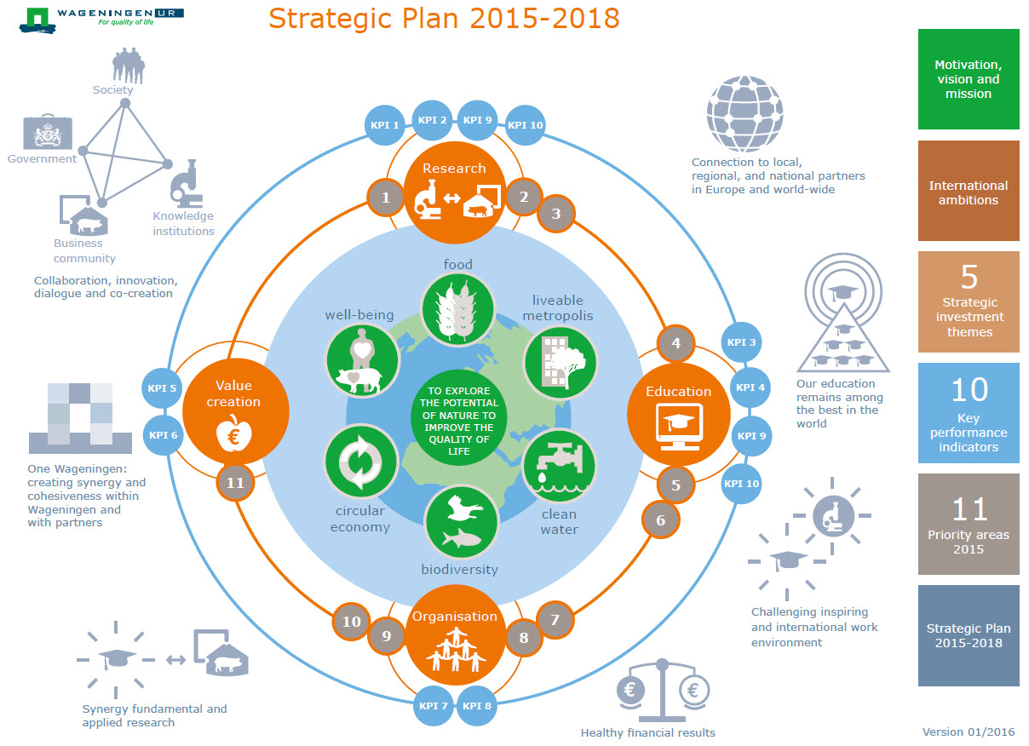
Refereed Articles in JRC ranked Journals
Notes:
PETER
The strategic goals of WUR are redefined every 4 years.
The process is initiated by Top Management
A so called `Writing Team` assembles and consolidates input from various sources like
strategy working groups,
strategy meetings with employees,
discussions with stakeholders
what was sent onewageningen@wur.nl.
See on this slide the Synopsis of the actual Strategic Plan: an interactive PDF published and accessible for everybody on the institutions homepage.

Slide 6
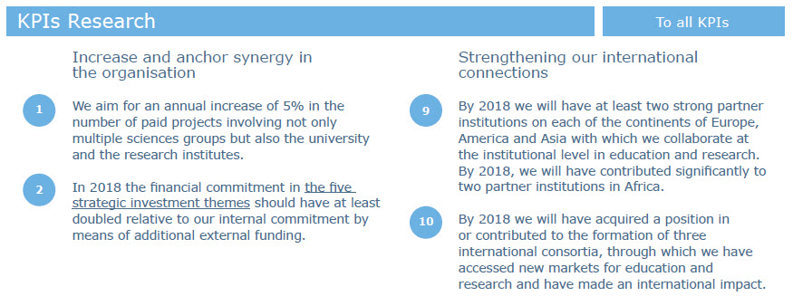
KPI`s for Research
Notes:
PETER
See on this slide a Zoom on the KPI`s for research.
One of the goals pursued is to increase international visibility of WUR by winning or defending high ranks in international rankings relevant for the field of life science.
[Peter] To achieve these goals, measures have to be defined and implemented.

Slide 7
picture taken from: http://universitypost.dk/article/tenure-track-stairway-professor-heaven Tenure Track
Notes:
PETER
In 2009 Wageningen established a tenure track for newly appointed staff members.
One of the assessment criteria was Quality and Impact of research output (we`ll talk about how that was measured in a minute).
Not to leave people alone with this task and to support researchers to publish in high quality journals, courses and seminars are organised for researchers and PhD-students. On request, library staff advises individual research groups on how to improve their publication strategy.
Because tenure track was only mandatory for new staff members, there was not a lot of resistance; on the contrary because of improved career opportunities a large number of the existing staff even volunteered for the tenure track.

Slide 8
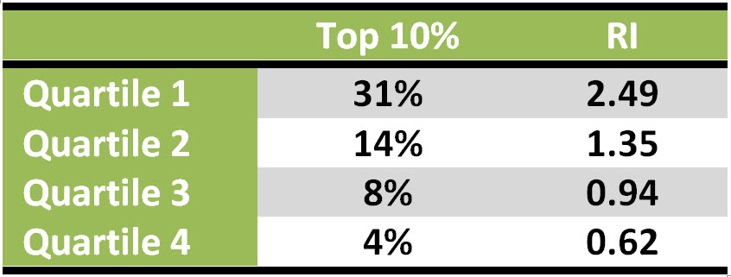
Relation between JCR-ranking and Impact
2005-2013: Q1(n=12901); Q2 (n=4640); Q3(n=1951); Q4(n=960)
Notes:
PETER
As many universities, Wageningen UR started to evaluate groups by counting the number of refereed articles. Around 2005 the first Bibliometric reports where made manually by using the Essential Science Indicators. After doing a pilot in MS Access, Wageningen decided to implement this analysis in the repository. Interpreting the results of this analysis learned us that publishing in high impact journals was correlating strongly with improvement of the scientific impact.
In this figure you see the avarage impact of Wageningen UR output over the periode 2005 to 2013 for refereed articles published in journals ranked on impact factor in different catagories (n=20.452).
Quartile 1 journals are top 25% highest Journals. Quartile 4 the lowest 25% journals.
Top10%-papers are belonging tot the 10% most cited papers in their field.
Relative impact: Field and age weighted Impact.
An world average institute could expect 10% Top10% papers and a Relative Impact of 1.
We see that with publishing in journals of a higher quartile, doubles the top 10% papers. The Relative Impact shows the same trend.

Slide 9
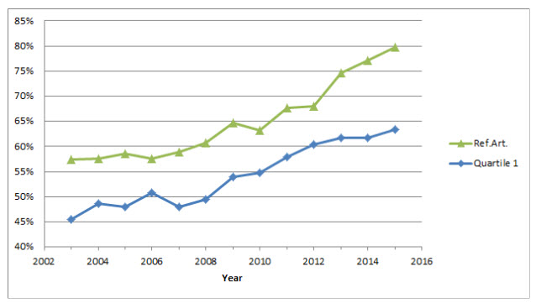
Percentage of refereed Articles of total Output
Year | Ref.Art.
2004 | 1986
2009 | 2522
2015 | 3615
Notes:
PETER
Because Quartile 1 papers perform so much better, Wageningen UR decided that Scientific Staff joining the tenure track had to publish Refereed articles in Quartile 1 journals. This resulted in a rise of the number of Refereed articles from 1986 in 2004 to 3615 in 2015. In the same time we see a decrease in the number of book chapters and conference proceedings.
In this figure you see that in 2003 57% of the total scientific output are Refereed articles, in 2015 this is almost 80%.
In the same time the % of Q1 articles rises from 45 to 63%.
This results in a rise of 68 procent of the total number of Q1 articles from the moment Wagening UR started the Tenure Track, 2009 to 2015

Slide 10
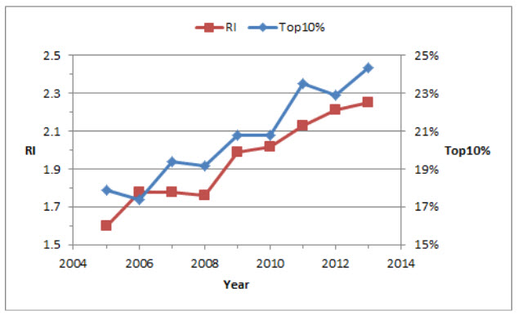
Development RI & Top 10% in time for refereed Articles
Notes:
PETER
In this figure you see that the average impact of the Wageningen UR refereed articles is rising.
The Relative Impact is going up from 1.8 in 2005 to 2.4 times world average in 2013.
The % of Top10% papers is going up from 18% in 2005 to more than 24% in 2013.
We can conclude that Wageningen UR managed to publish more Refereed Articles and at the same time the impact per paper is rising.

Slide 11
System Use is a Data-Quality-critical Issue
Notes:
PHILIPP
That all Researchers of an institution actually use a CRI system and maintain their profile adding data manually constantly is an absolutely Data-Critical Issue.

Slide 12
System Use is a Data-Quality-critical Issue
Publications

CRIS
Notes:
PHILIPP
Contemporary commercial CRI systems include a number of mechanisms ensuring to `populate themselves` with data to a certain extent without the researchers contributing.
Primarily publications can be regularly harvested from online sources and mapped to internal authors automatically.

Slide 13
System Use is a Data-Quality-critical Issue
Activities
Prices
Innovation
Press Clippings
Curriculum Vitae
Datasets
Publications

CRIS
Notes:
PHILIPP
But still the amount of data in a CRIS to a huge extent relies on the user`s willingness to add data manually, primarily when it comes to content types like
patents
spin-offs
prices
several forms of external academic engagement
promotion of young scientists.
There are 2 keys to this:
User Acceptance
User Education
Because time is limited, we`ll omitt Acceptance and talk about Users Education only.

Slide 14
Education & Assistance ensured by `Super-Users`
Notes:
PHILIPP
Many institutions in order to educate users of a CRIS run centralised strategies, which means that one or more persons from central administration `tour` the organisation to spread the news and encourage staff to make a proper use of the application.
WUR relied on a decentralised strategy based on by a network of `super-users`.
This approach profits from the fact, that Science Managers with regional responsibility (like Deans or Institutes Heads) have the same interest in Research Intelligence than central Administration.
So there`s one or more persons in all organisational units, who are in charge of collecting and assembling data for reports anyway and did that long before central administration ramped-up a CRIS.
Job titles may differ (lecturer, PhD, assistant to the institute's head, secretary) but their role always is something that could described as Research Information Manager (RIM).

Slide 15
Train-the-Trainer Education for `Super-Users`
Notes:
PETER
The Wageningen UR network of trained publication registry employees was established already during the 1990’s. In most cases it was secretaries in charge of registering the output of their group.
With the implementation of Metis in 2002 a 4-hour-education was mandatory for new Metis users; during these courses users learned about the different publication types, how to handle full texts and how to register this information.
With the introduction of Pure, that replaced Metis in late 2015, all the Metis users had to visit 2,5-hour-educations to get familiar with the most important differences between Metis and Pure.

Slide 16
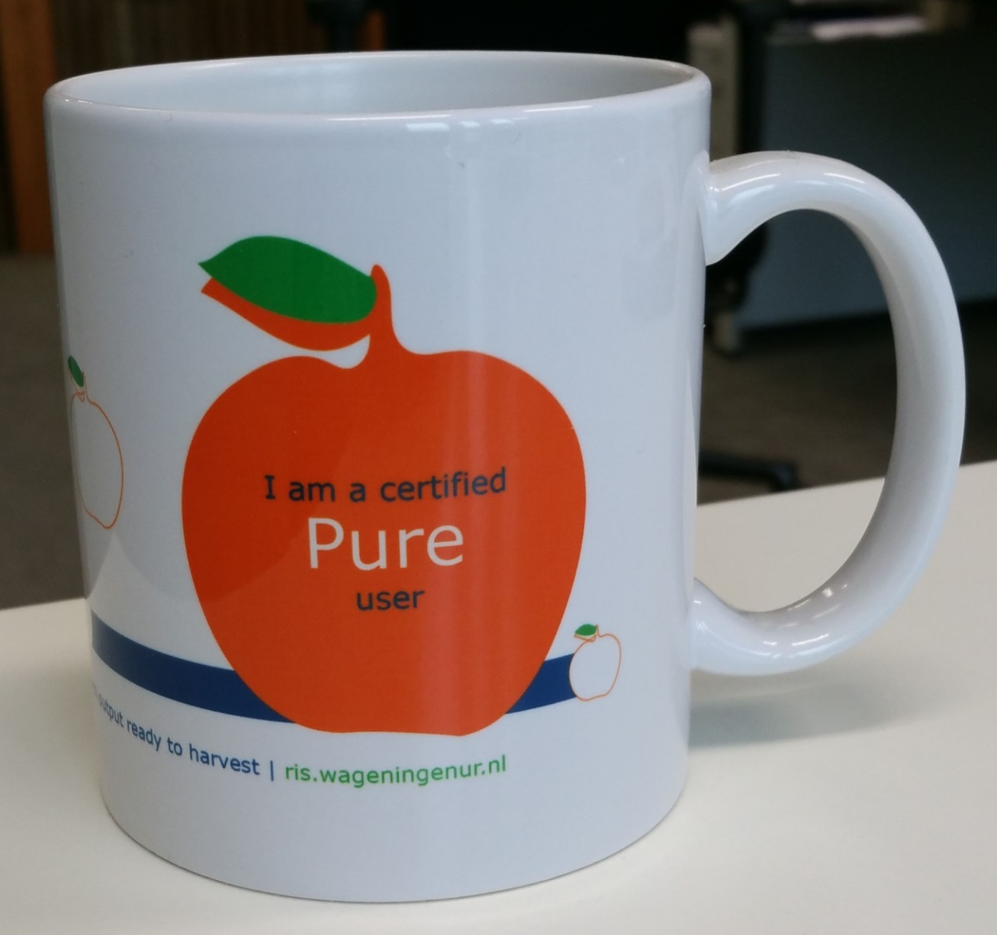
The much sought-after Super User Designer-Mug strictly limited to 250 pieces
Notes:
PETER
All attendees, 97% of the former Metis users, that followed the Metis-to-Pure training received the ‘I am a certified Pure user‘ mug.
This was a way to show our gratitude, but also to but also a way to raise the Pure awareness within the research groups.

Slide 17
Thank You very much for Your Attention!
p.fondermann@elsevier.com
peter.vandertogt@wur.nl
Notes:
Thanks for your kind attention!
Find more details in the Proceedings Paper available on the EuroCRIS repository.

Slide 18
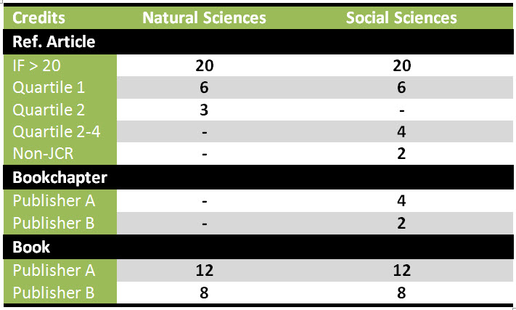
Scores gained in Tenure Track

