Slide 1

National planning
for
Open Research
euroCRIS 2017, 30 May 2017
Dr Patricia Clarke, Health Research Board Ireland

Slide 2
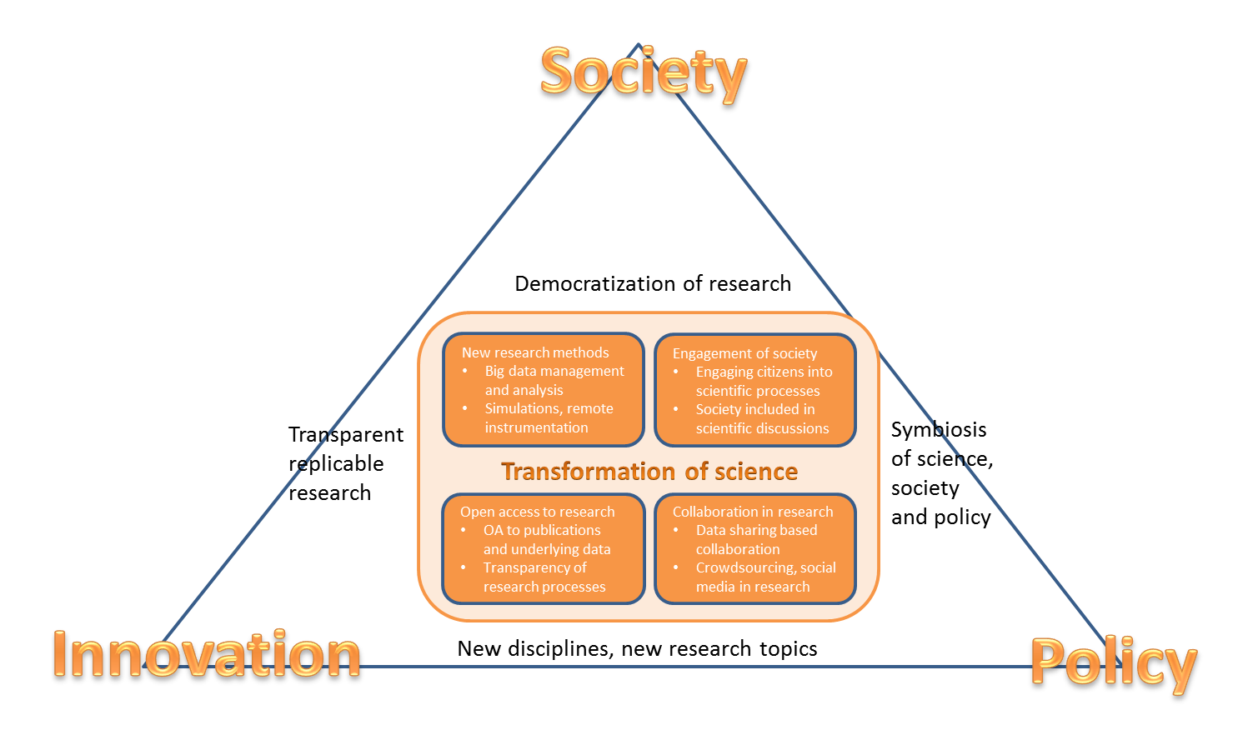
Open Science
A changing research process
Collaborative working
New ways of diffusing and sharing knowledge using new digital tools
Focus on sharing knowledge as early as possible
Great opportunities

Slide 3

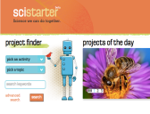











Open Science – It's real!
Data-
intensive
Citizen
science
Open tabbooks/
workflow
Open code
Analysis
services and standards
Open data
Data-gathering
Publication
Pre-print
Open
annotation
Conceptualisation
Review
Open
access
Science
blog
Alternative
reputation
systems
Collaborative
bibliographies

Slide 4

Developing the Open Science Agenda
Extensive stakeholder consultation
Public consultation (July-Sept 2014), Validation workshops (Oct-Dec 2014) and Final report (Feb 2015)
Strong support by Member States and Competitiveness Council
Policy debate & Council Conclusions 'data-driven economy' May 15
Presidency conference Open Science & Council Conclusions 'open science' May 16
European Open Science Agenda
Broad consensus on five policy action lines
High Level Expert Groups on 8 Action Lines
Open Science Policy Platform
Embedded in the Digital Single Market strategy

Slide 5
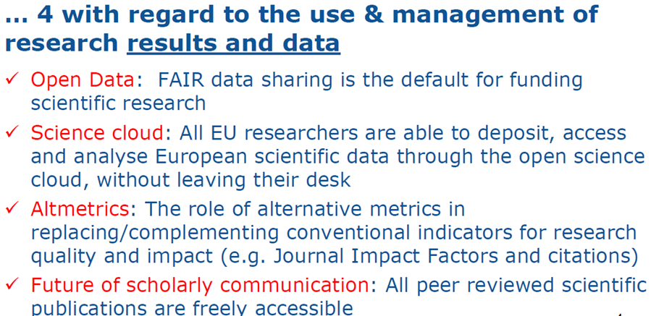
8 Top Level Policy Ambitions

Slide 6
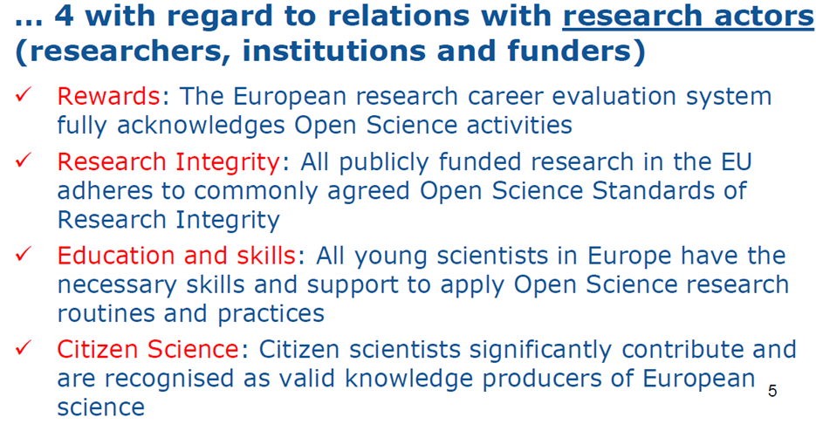
8 Top Level Policy Ambitions

Slide 7
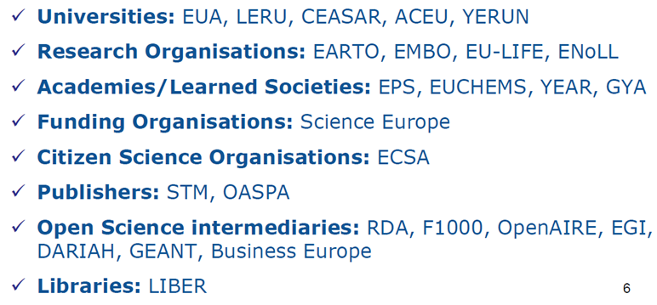
EU Open Science Policy Platform
EC Advisory Body - high level stakeholders representatives
Policy formulation: help identify issue to be addressed and provide recommendation on policy actions required
Policy implementation: review best practices, draw policy guidelines and foster uptake

Slide 8

Open Science Policy Platform
ERA & framework conditions for actors:
European Charter for researchers
Code of conduct for Research Integrity
Charter for Access to Research Infra
…
European Commission
European Open Science Agenda:
OA publishing models
FAIR open data
Open Science Cloud
Alternate metrics
Rewards & careers
Education & skills
Citizen Science
Research integrity
advice
Open Science
Policy Platform
context
DSM & framework conditions for data:
Copyright - TDM
Data Protection
Free Flow of Data
…
opinions
Wide input from stakeholders:
ad-hoc meetings and workshops
e-platform with wider community
reports and independent experts
  EG on open science cloud
  EG on altmetrics
  EG on alt. business models for OA publishing
  EG on FAIR open data

Slide 9
2017 Focus: Open Access (publications)
  From FP7 to H2020: OA to publications
  from pilot to underlying principle
  Obligation to provide OA, either through the Green or Gold way in all areas (deposition mandatory either way)
  Allowed embargoes: 6/12m
  Gold open access costs eligible for reimbursement as part of the project budget while the project runs & post-grant support being piloted through OpenAIRE
  Authors encouraged to retain copyright and grant licences instead

Slide 10
2017 Focus: Open Access (data)
Competitiveness Council:
1.Make research data produced by H2020 open by default
2.Encourage MS to Promote data stewardship and implement data management plans
3.Encourage MS and Commission to follow FAIR principles in research programmes and funding mechanisms
Follow-Up by Stakeholders, EC and MS:
1. As of 2017, Open Data is the default option under H2020. Data Management Plans will be mandatory
2. Evaluation of MS advances on Open Data will be necessary
3. Evaluation of MS advances on Open Data will be necessary; Expert Group on FAIR data will advise DG RTD in course of 2017

Slide 11


2017 Focus: European Open Science Cloud
Innovative Funding & Business Models
RECOMMENDATIONS INCLUDED IN THE GOVERNANCE MODEL
OBJECTIVES OF GOVERNANCE
ACTORS & ROLES:
EOSC MEMBERS
EOSC FUNDERS
DECISION
STRUCTURE & FLOWS
GOVERNORS
ASSOCIATES
SECURITY ASPECTS & BUSINESS CONTINUITY
USERS
RULES OF PARTICIPATION
SECRETARIAT
INTERNATIONAL AGREEMENTS
LOGISTICS & OPERATIONS (PROCUREMENT)
Funding Models
Business Models

Slide 12
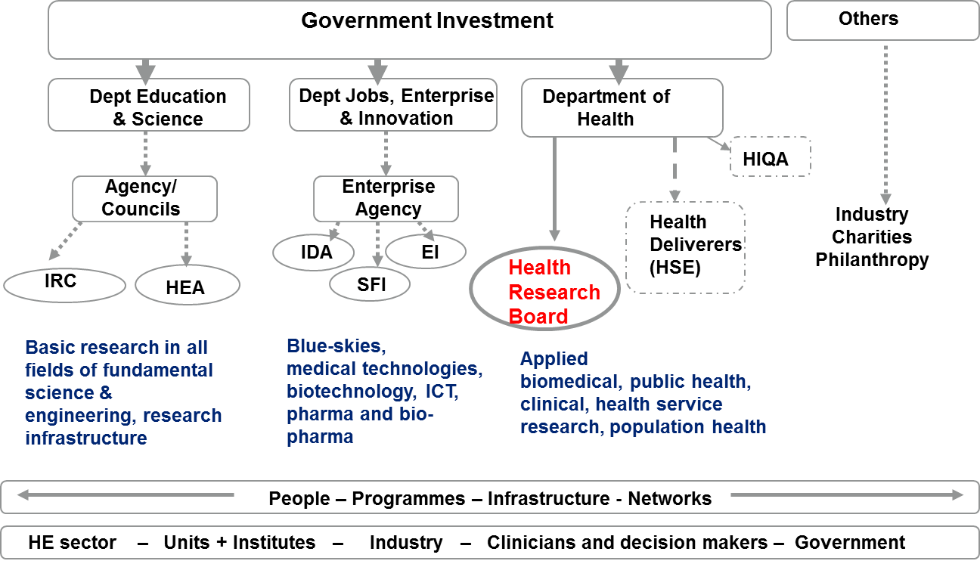
The Irish Health Research Landscape

Slide 13


National Agenda
Priority 4.7 identifies the need to “support national and European Open Science policies and principles”.
Why?
develop common awareness of requirements
make best use of capacity that exists within the Irish system
avoid duplication of efforts and inconsistences between the research performing and research funding organisations
ensure timely and efficient implementation of the agenda in Ireland.

Slide 14
Building on National Open Access approach
National Open Research Forum
  Formal secretariat
  Expanded membership
  Larger agenda
  Link to national policy agenda
National Steering Committee for Open Access Policy

Slide 15
National Open Research Forum
Operation and delivery
Membership and Tasks
Develop a draft Vision for the Open Science agenda for Ireland
Revise the National Open Access principles
Develop National Principles for Open Research Data in Ireland
Assess the current capacities and capabilities in Ireland to deliver on Open Science from the:
    human resources perspective
    current infrastructure and future infrastructure needs.
5. Identify demonstrators and examples of good practice

Slide 16
Thank you
Further information:
pclarke@hrb.ie

