Slide 1

Data Pilot
DIT
DIT Library Services
Yvonne Desmond
yvonne.desmond@dit.ie
euroCRIS Spring Membership Meeting, May 29-31, Dublin, Ireland

Slide 2
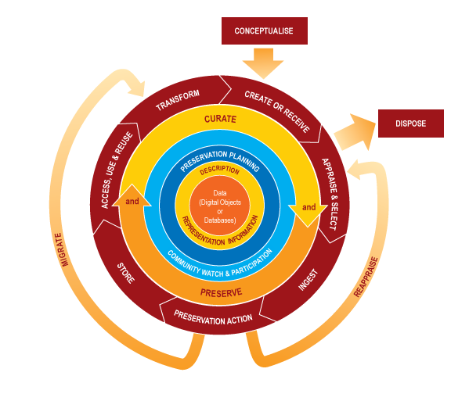
The Data Lifecycle

Slide 3
Research Data Management is the planning, organisation and preservation of the evidence that underpins all research conclusions. Good data management ensures data is safely stored, findable and can be used to reproduce findings.

Slide 4
Drivers
Good Professional Practice/Research Integrity
Funder mandates and requirements
Supports collaboration through data sharing and re-use
Reduces redundancy in research
Reduces the risk of data loss
Increased efficiency in research process
Validated and replicable research
Increased sharing and re-use (increased possibilities for collaboration)
Increased citations/impacts

Slide 5










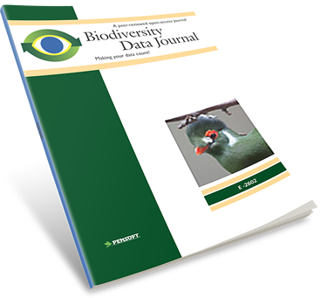










Many different players implementing in different ways…
PURR
Notes:
This solution has gotten a lot of traction over the last 5 years–
there are lots of initiatives, lots of different ideas about exactly how it should work, lots of players in this space– both new and established.

Slide 6
Researchers’ Attitudes
Wellcome Survey
  95% of respondents generated data...52% made it available in 5 years
  Full dataset, subset, linked to paper
  Proved quality,
  Visibility
  Validity
  Collaboration across platforms
Van den Eynden, Veerle et al. (2016) Towards Open Research: Practices, experiences, barriers and Opportunities. Wellcome Trust. https://dx.doi.org/10.6084/m9.figshare.4055448

Slide 7
Discoverability
Clear evidence to back conclusions
Can be cited/can be downloaded
Can be replicated/reproduced
  Data needs to be reproducible…is about achieving a similar result under different conditions
  Data need to be repeatable… is about sameness…same results in same conditions
Tracked by Altmetrics

Slide 8

Approve but don’t do it!
Want publications out of the data
Concerns over human data
Do not trust others to use the data appropriately
Fear of data vultures
Lack of time/funding
Data secondary to publications

Slide 9
“Data publication” has multiple meanings for researchers…
Available in a repository
Associated with a traditional paper
Associated with a data paper
Notes:
* Data publication can mean any of a few different things- at least two- sometimes to the same researcher.

Slide 10
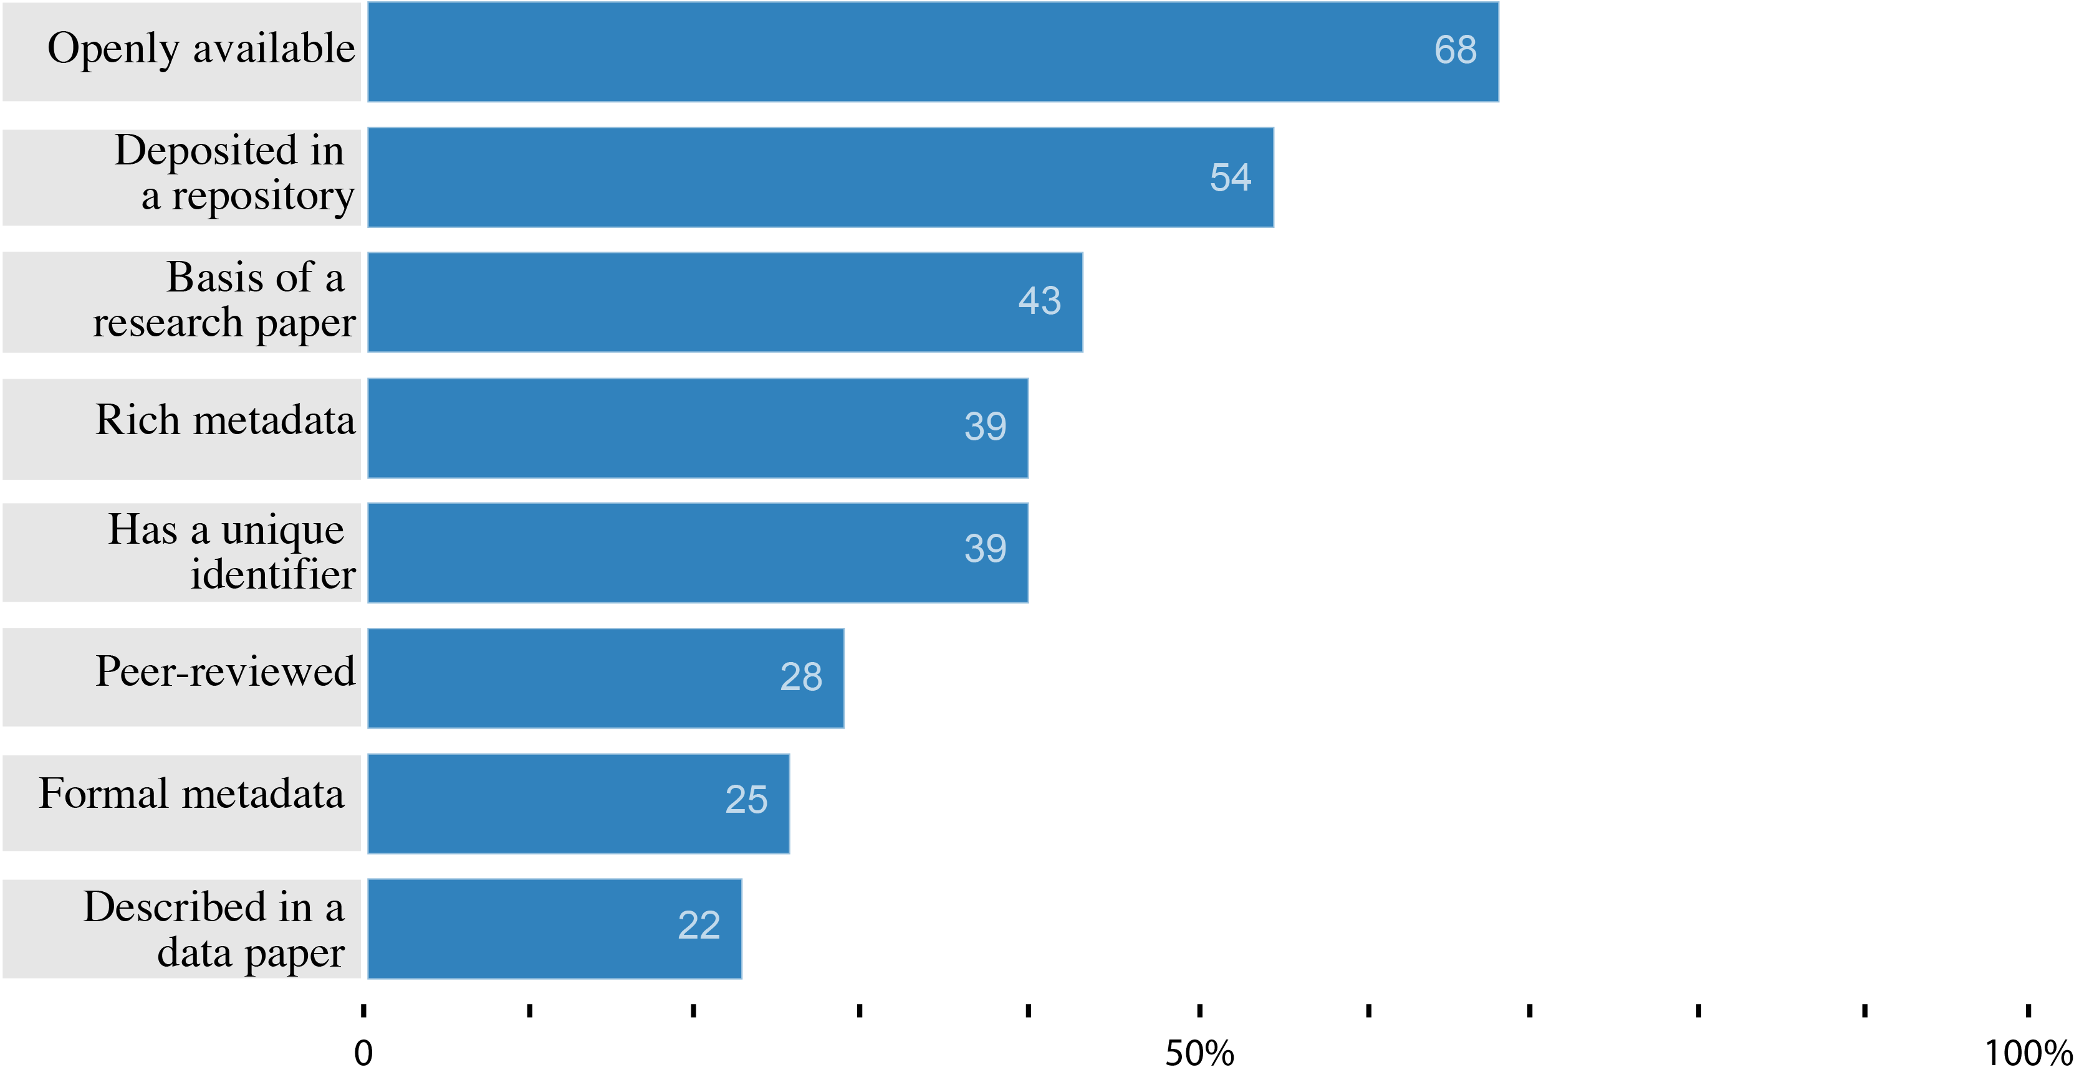
How would you expect a published dataset to differ from a shared one?
Researchers do not immediately understand or value data publication.
Survey of 249 Researchers University of California (2015): link between data and the publication
Notes:
* here's what they said:
*
* firstly, not an overwhelming majority on any item– nothing much higher than 2/3
* most popular is the not-**exclusively**-scholarly sense that it's just available
* peer review, which is fundamental to some models of data publication and certainly to scholarly publication is expected by less than 1/3.
* this is a jumble of parts; are respondents flailing around or are they assembling them together into coherent ideas or definitions of data publication?

Slide 11
What’s in it for the DIT researcher?
Research output (first rate-not second rate resource)
Big data can be linked to Arrow
Cited and downloaded
Ready made citation on Arrow
Link data and publications together
Evidence for conclusions
Feeds into research integrity
Data papers - describes datasets, rational, methodology without offering any analysis or conclusion…growing trend

Slide 12

DSRH data video

Slide 13

What needs to be done?
Researchers need to improve, enhance and professionalise their data management skills to deal with the challenge of producing the highest quality shareable and reusable research outputs in a responsible and efficient way.
Need to change a mind-set….cultural shift

Slide 14
Too hard to do with pre-existing data?
Lack of funding
Time/Resources
Need for data documentation
Coding has to be prepared
Intellectual property
Sensitive data
Many perspectives/different disciplines
Funding, incentives, training, infrastructure may help to deal with this

Slide 15

No additional resources
No additional staffing

Slide 16
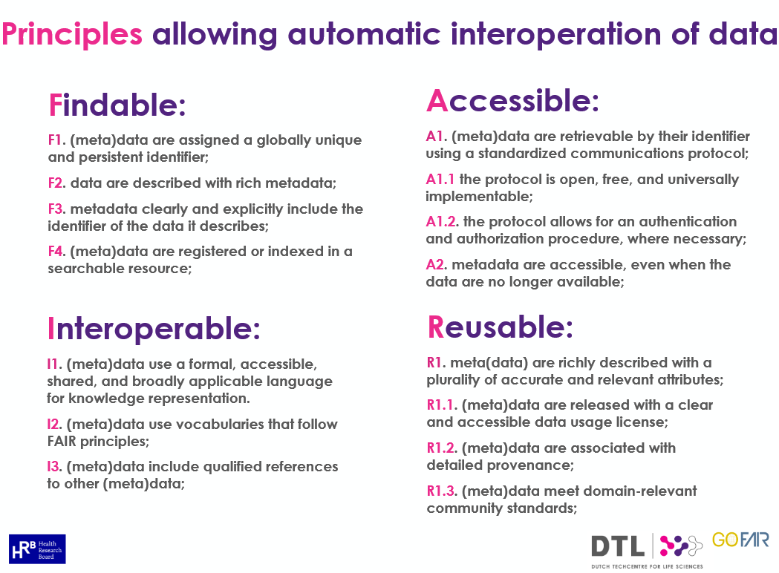

Slide 17
The Art of the Possible for DIT
Bit harder
Easy
Really hard
Really, really
hard

Slide 18
Which Definition of Data do we use?
“units of information observed, collected or created during the course of research. Not limited to scientific data but includes social sciences statistical data used or produced in the course of academic research whether it takes the form of text, numbers, images, audio, video models, analytic code or forms as yet unknown.
  Digital Commons
Or
“that which is collected, observed or created in digital form for the purposes of analysing to produce original research results”
  Dublin Institute of Technology
Or
“the recorded factual material commonly accepted in the scientific community as necessary to validate research results”
  Oxford University

Slide 19
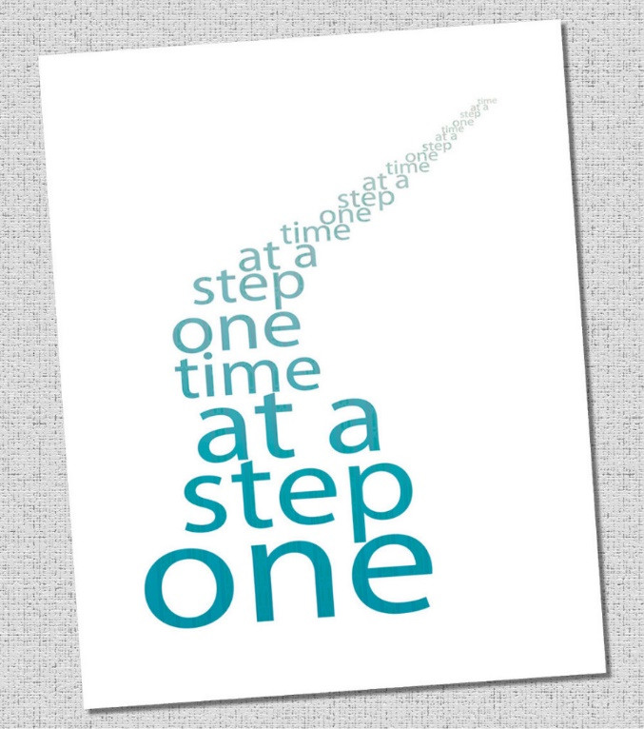
DIT Strategy
Active participation in National Developments
Data Audit of Research Institutes/Group
Start the conversation with researchers
Training/ guidance/ tutorials
No “unfunded institutional mandate”
Evolve to institutional strategy
Provide incentives
Include for promotions
Achieve change from bottom up

Slide 20
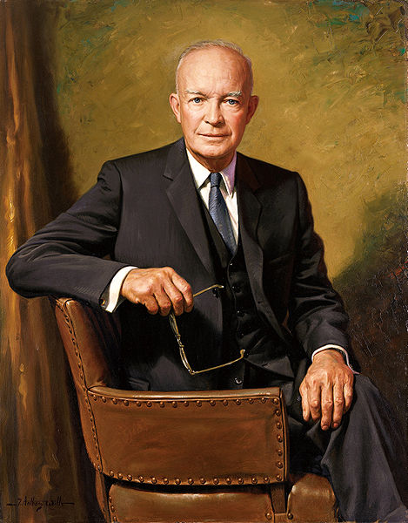
Step 1
‘In preparing for battle, I have always found that plans are useless but planning is indispensable.’
Dwight D. Eisenhower
Notes:
A final thought on the subject of plans and planning.
A research project isn’t – or shouldn’t be – a battle, but President Eisenhower’s words nevertheless have some relevance in this context. It is almost inevitable that unexpected events will arise – it’s very rare that everything goes exactly as anticipated. But although this means you may often have to adapt your plan on the fly, this makes having created a plan in the first place more essential, not less. If you’ve thought through all the relevant issues, you’re less likely to be taken by surprise – and you’ll be better placed to respond when the unexpected does crop up.
Public domain image, from http://commons.wikimedia.org/wiki/File:Dwight_D._Eisenhower,_official_Presidential_portrait.jpg

Slide 21
Promote Data Documentation
Research design
Why and how data collected
Details content and structure
Coding and changes
Explains labels acronyms
Uses popular formats/standards
Rights/licenses/ownership
Technical information

Slide 22
Data Management Plans
DCC session so can assess good plans
Designate champions
Use the DMP (online tool)
Customise templates for own use
Liaise with Ethics Committee/Postgraduate Office
Embed in Research Process in DIT
Link to Research Integrity
Mandatory for internal funding
Train guide and support

Slide 23
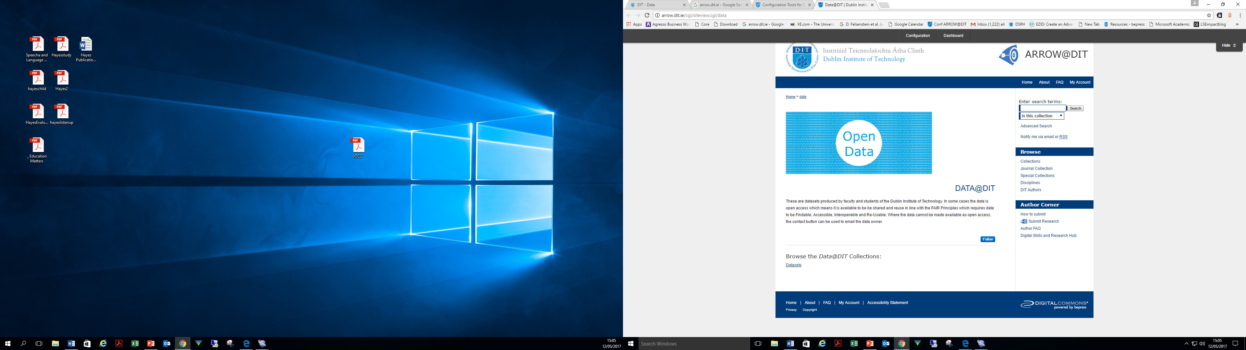
Arrow Portal
Step 2:
What’s the structure?
  Research Group
  Subject Discipline
  Themes
Link data and publications
Creative Commons License ( Data that does not have an explicit open license is not open)
Mix of OA and Managed Access Data, Metadata only?
Quality control?

Slide 24
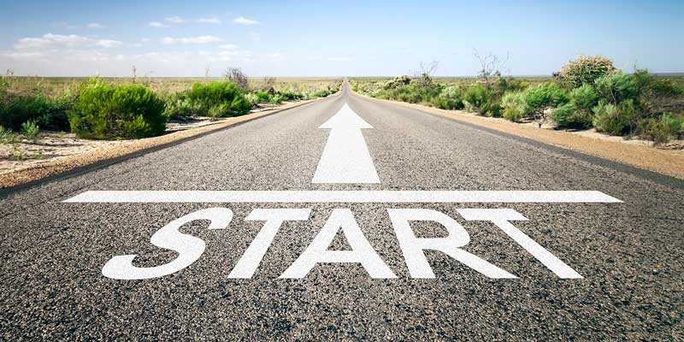
Roadmap
Make data findable and accessible
  Start with data documentation
  Data management plans for projects/postgrads
  Promote benefits of publishing open access data
  Promotional and instructional campaign
  Sessions with students, researchers and anyone who will listen!
  Encourage national solutions for infrastructure
  Encourage national solutions for interoperability
  Similar approach to what was done for Open Access Publications, may be a harder sell!

Slide 25

Yvonne Desmond
Yvonne.desmond@dit.ie

