Slide 1

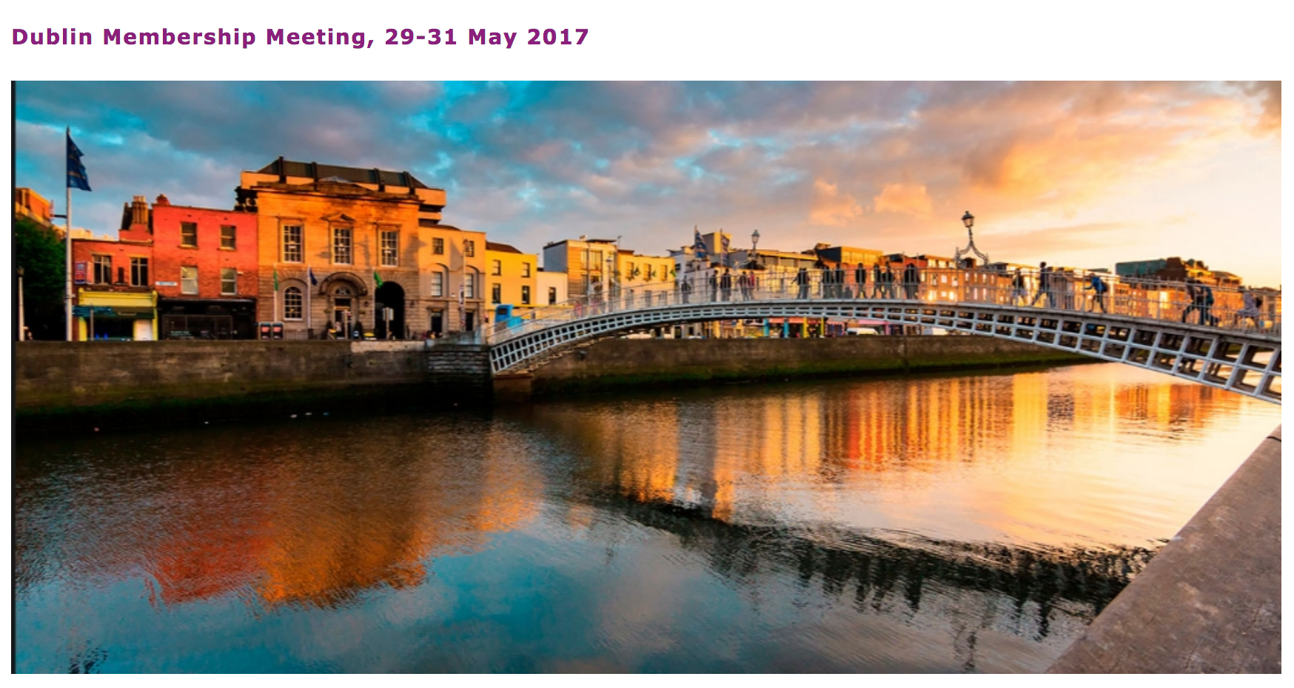
Fifteen years of research information in Ireland
Niamh Brennan, Trinity College Dublin with slides from Dr Celia Gallagher, late of the IUA
niamh.brennan@tcd.ie

Slide 2
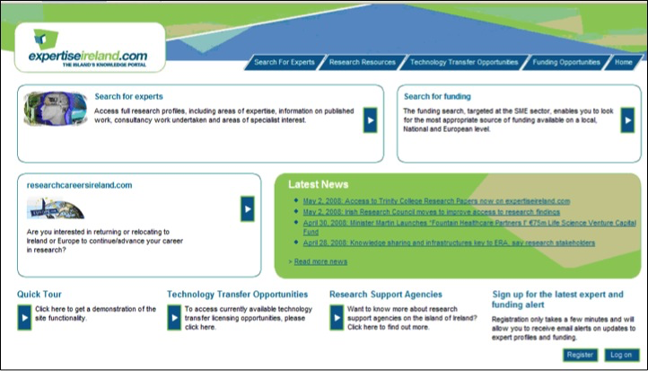

Slide 3
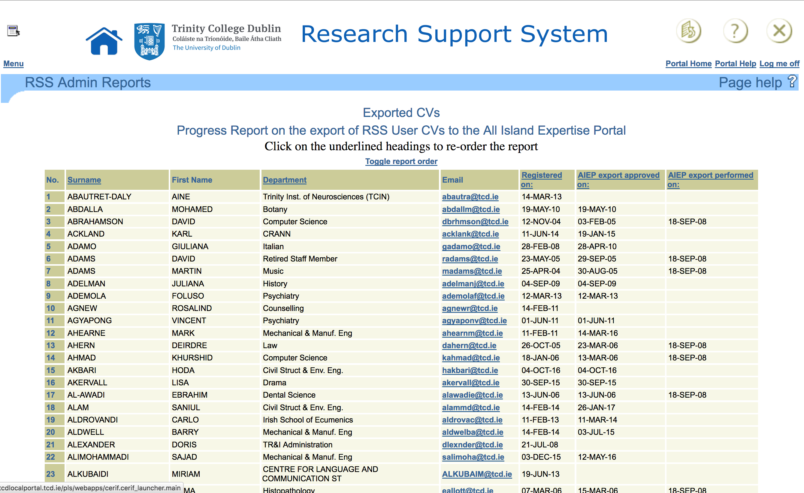

Slide 4
A research database will be part of an integrated management system to help monitor our progress in research and scholarship and to help manage their support.”
-TCD Strategic Plan, Chapter 5: Strategy to Realise our Vision of Trinity, Action 18, p26

Slide 5

Strategic decision to develop world-class research system in Ireland
Increase research capacity, quality and output
Develop 4th Level Ireland
Double PhD output, structure training, develop careers, encourage mobility
Estimated additional cost of €1.88 billion to 2013
Spending predicted of €2.7 billion to 2008 to implement strategy
Provision for:
    350 PI’s
    1050 Postdocs
    3500 PhD Students

Slide 6
Investment in Irish Research from 2002-:
Over previous 10 years expenditure on Higher Education R&D quadrupled
It had passed the OECD & EU-25 average HERD intensity ratio
between 2004 and 2006 the number of Researchers in Higher Education in Ireland increased by 13%

Slide 7
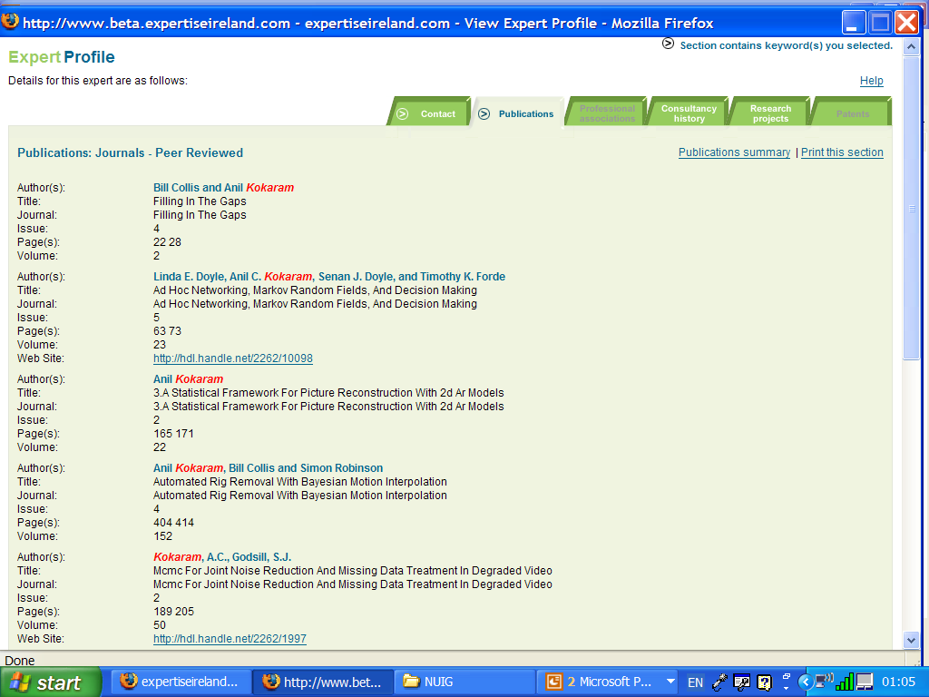
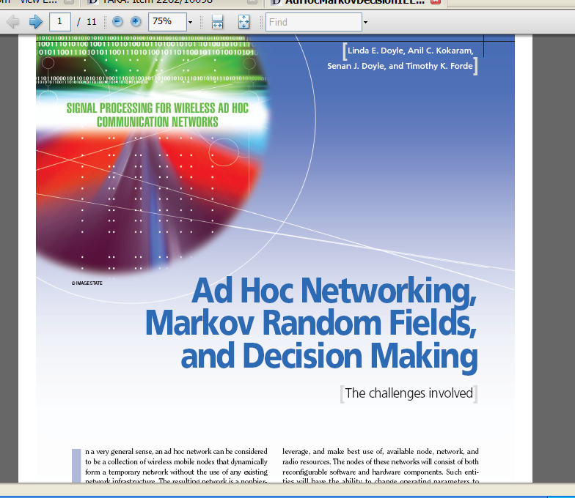
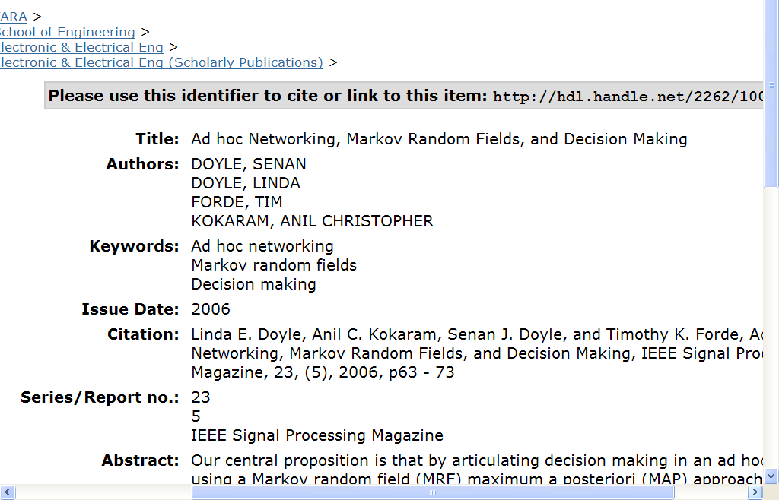
IEEE Signal Processing Magazine

Slide 8
Users, Stakeholders
and Building Blocks
Government
Higher Education Sector
General Public
National Research Platform
Researcher Mobility Portal
4th Level Ireland
Industry
Media
National Research Data Project
Institutional Repositories
expertiseireland.com data
Notes:
Ghjelgsbdh,

Slide 9
Background
expertiseireland.com – admired by other countries, including Australia - Limited focus
Many disparate systems of information
Many related sectoral projects
Web presence of Irish Research is very fragmented
This limits our international visibility

Slide 10
Objectives of a National Research Platform – Senior User Working Groups
Highlight the extent and quality of Ireland’s research effort, and serve to attract the best researchers to Ireland
Promote the research expertise, capabilities and innovation of the higher education and public research sector in Ireland
Provide a platform to increase collaboration between industry and academia and in particular to allow development agency staff to facilitate such collaboration in key strategic areas
Promote networking to make it easier for academics to set up interdisciplinary, inter-institutional and international research

Slide 11
Explore and develop collaborative or contract opportunities that are of interest to industry and that may draw industry investment (direct or indirect)
Provide Assessment/Benchmarking of research output to stakeholders
Provide a platform for industry users to address specific research and innovation needs
Promote the technology offers from the higher education and public research system and enhance the take up of licensing opportunities

Slide 12
Attract post graduate students to double the number of PhD students
Increase the base of information on the national research effort available to IDA Ireland executives in their marketing of Ireland for high tech foreign direct investment
Generate bi-lateral agreement between the research entity and the companies that generate research activities, develop technologies or design products

Slide 13
What do people want to see on the Platform?
Health research –
Clinicians
Clinical Researchers
Marine
Agriculture
Additional Publication information –
citation information, links to full text such as for TCD
More detailed project information - previous and existing Industry and academic collaborators, project outputs, PI, international significance of research
expertiseireland.com data
Other publicly funded research

Slide 14
Project Opportunity
Bring focus and order to the current situation and to create single web based locus through which the national research effort can be accessed and quantified in a structured and intelligible manner.

Slide 15
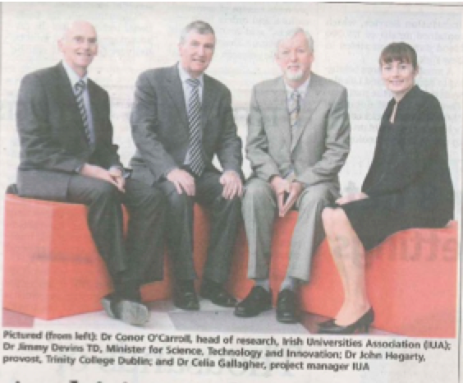
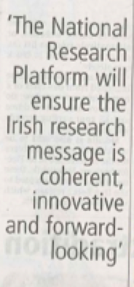
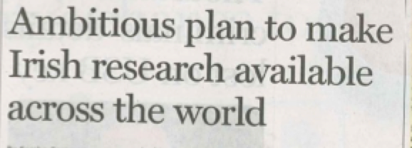

Slide 16


Slide 17
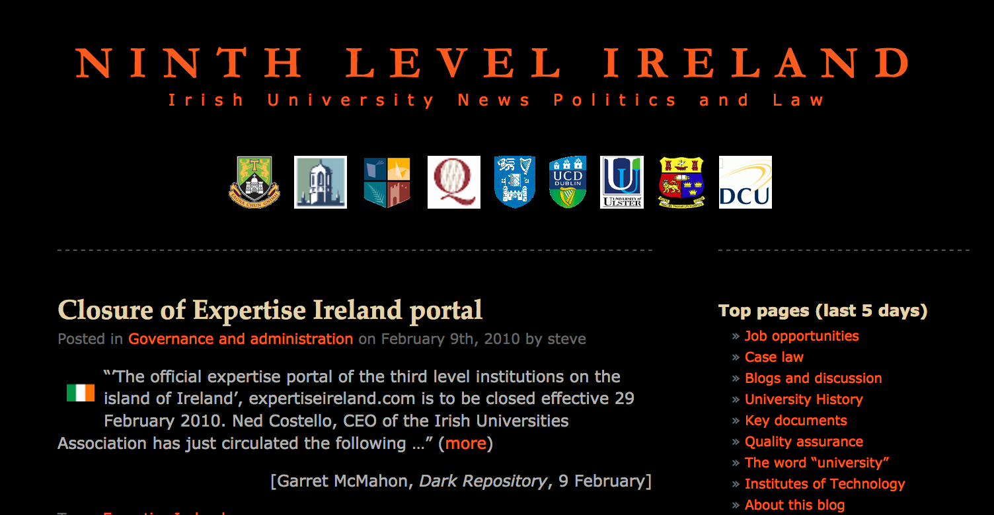

Slide 18
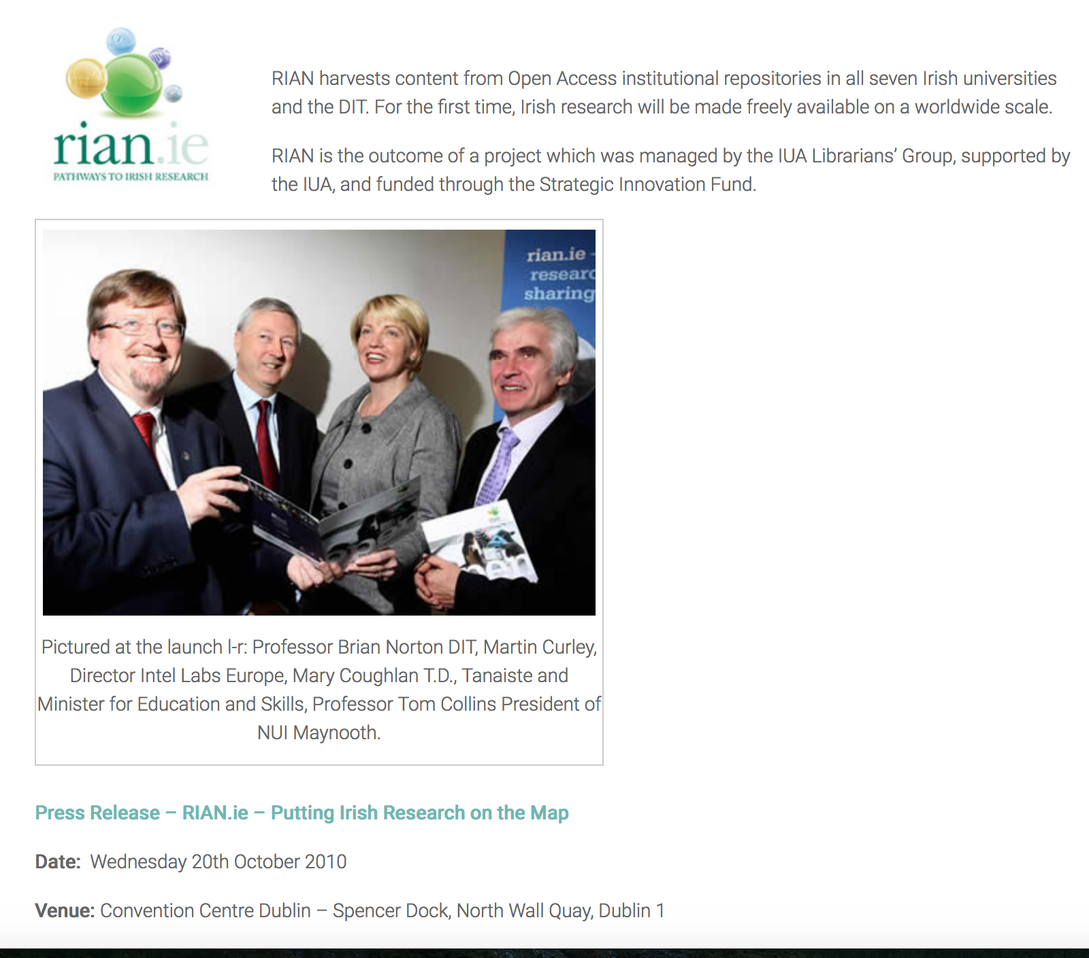

Slide 19










Ireland’s Open Access Repository Network
Connaught /
Ulster Alliance
(ITS, LKIT, GMIT)
Harvested
HSE
DKIT
Harvested
DBS
DCU
RCSI
NUI G
TCD
Marine I
DIT
NUI M
UCD
Greater discoverability
Higher impact
All research outputs
Teagasc
UL
WIT
MI
UCC
Searched
Ireland’s OA Repository network: 18+ institutions
All universities, many other research institutes
National Open Access Portal: RIAN (http://rian.ie ) – RIAN: Higher Education Authority- funded

Slide 20
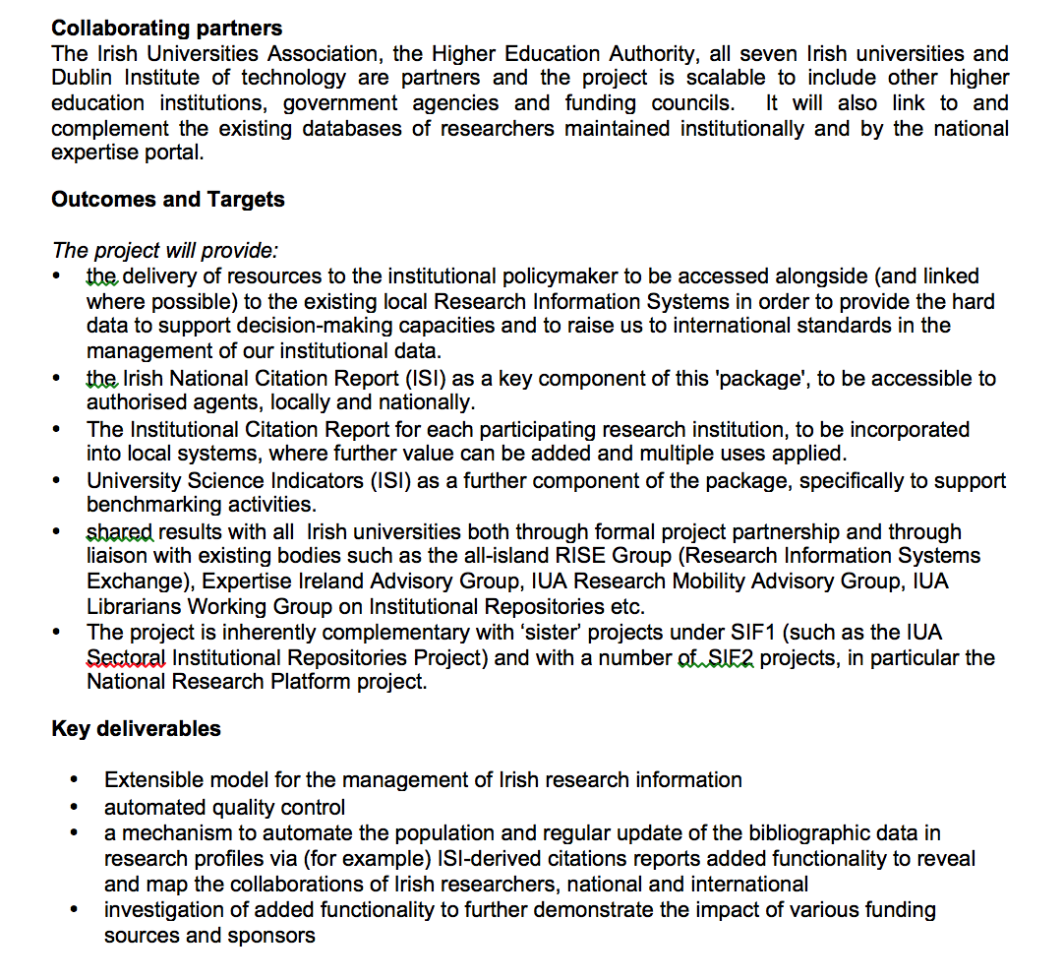

Slide 21




Ireland’s HEA supporting research & teaching
Business Intelligence, Bibliometrics
Media & a/v archives
Library-based digital resources
Institutional
repositories
Proposed National Research Platform
National Academy for Teaching & Learning
Notes:
The HEA intends supporting work towards linking open access research resources (in RIAN) and open access teaching and learning resources (through the NDLR). This is an exciting concept which has the potential to reinforce the impact and use of Irish Open Access content and support our researchers, lecturers and students at all levels
Media archives & repositories
National Research Platform
Subject Repositories
Digital Archives & digitisation project sites
Library and cultural institution-based resources

Slide 22
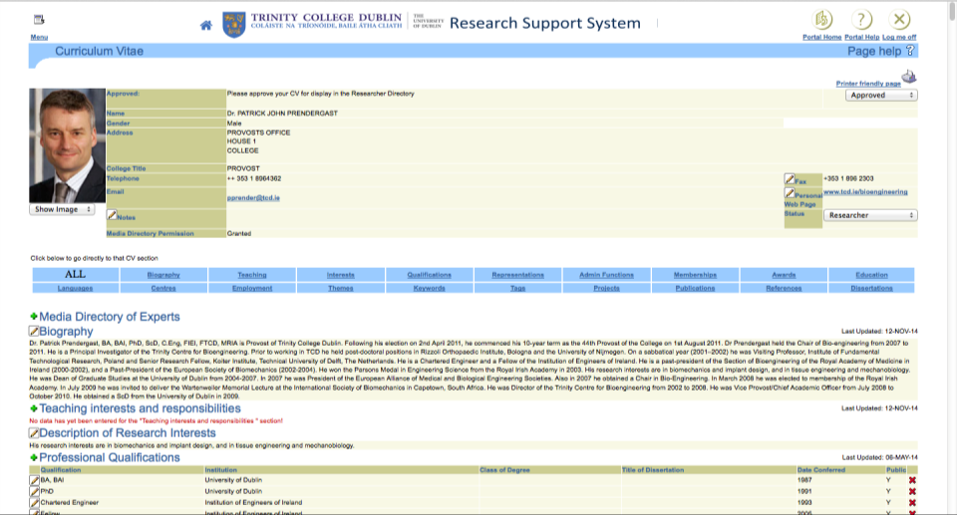
CURRENT RESEARCH INFORMATION SYSTEM
- CV-driven
- Fully integrated with complementary systems
- initial population from Human Resources records
- updated & enhanced ‘live’ by researcher, ORCID-’enabled’;
- mediated input on-demand (Library-based service)

Slide 23
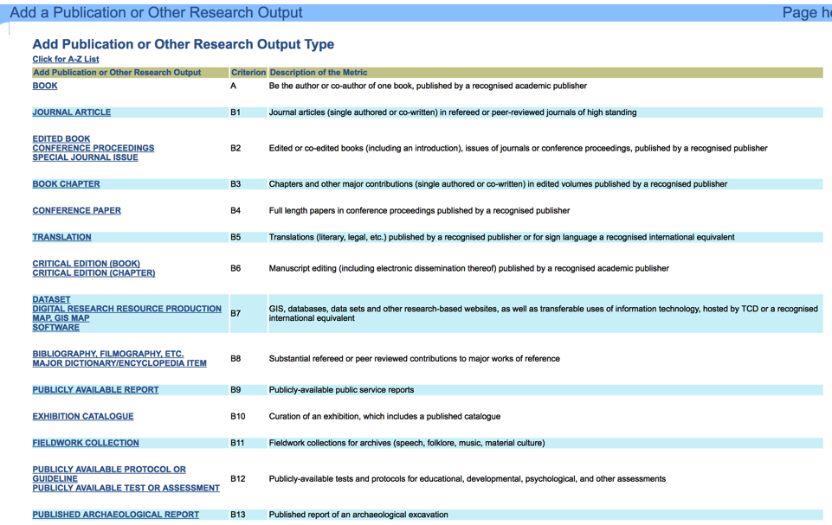
Research output types included in the TCD CRIS & institutional repository (for reporting and metrics purposes).

Slide 24
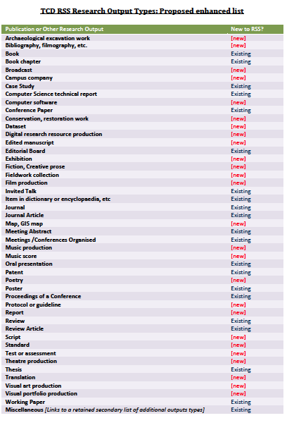
New Research
Output Types
Included in the
CRIS (Research Support System) &
Incorporated into TARA

Slide 25
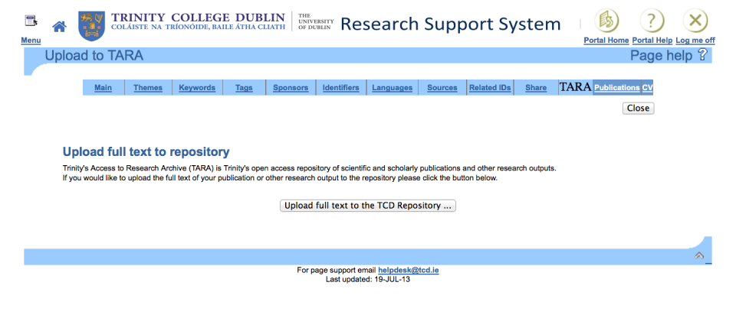

Slide 26
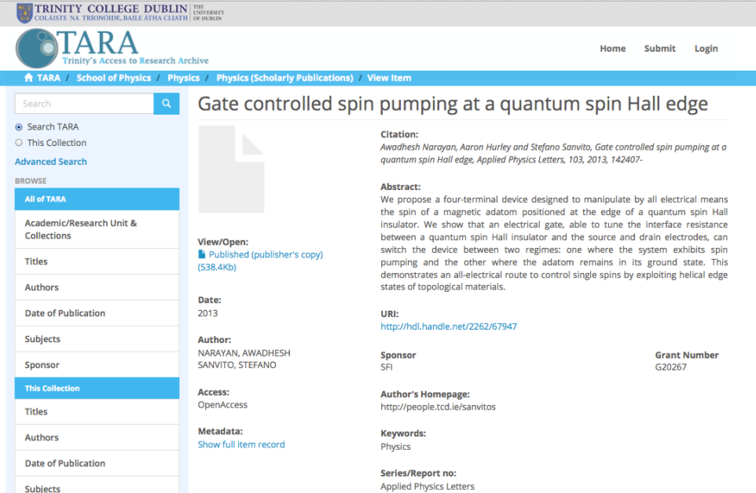
Repository with Added Value
Link to Researcher’s Profile

Slide 27
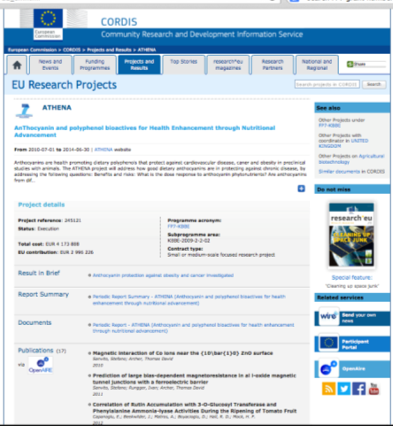
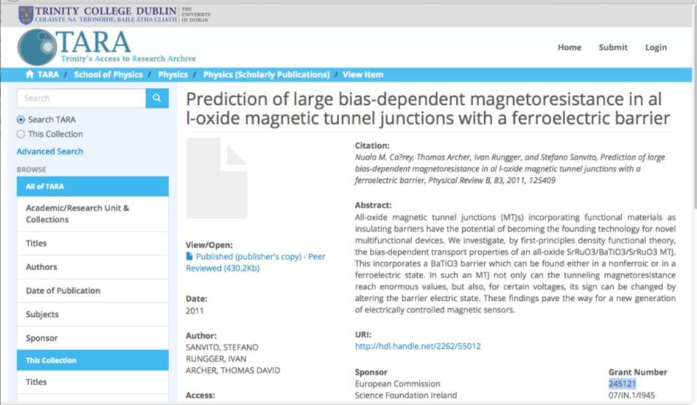
Automatic compliance with funders’ open access mandates

Slide 28
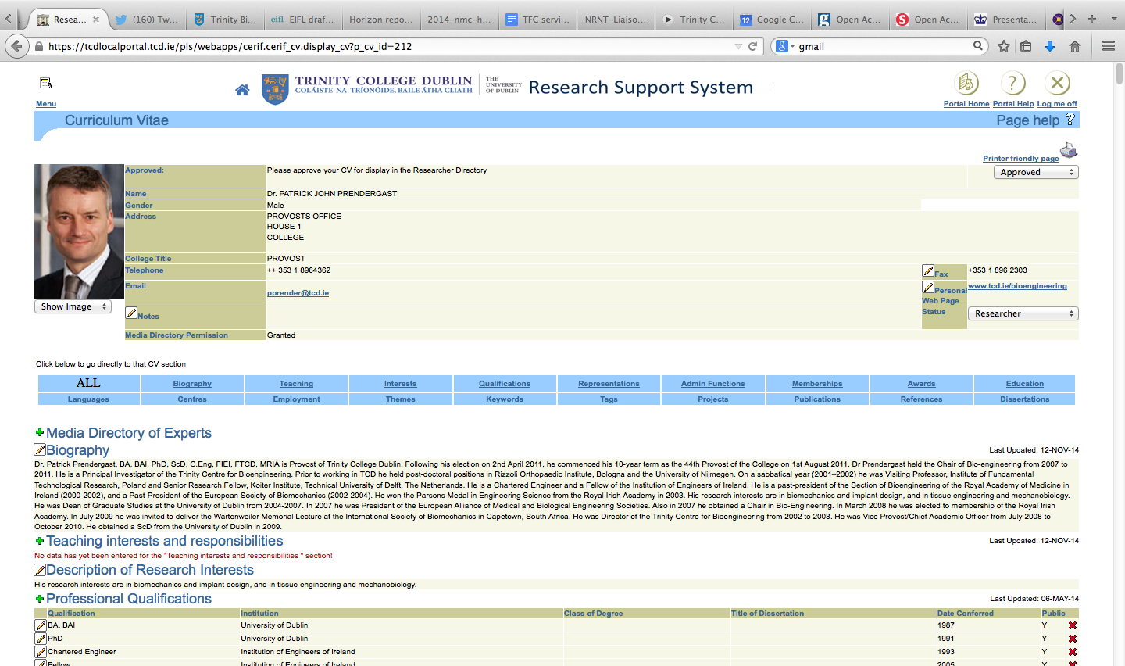
CURRENT RESEARCH INFORMATION SYSTEM
- CV-driven
- Fully integrated with complementary systems
- initial population from Human Resources records
- updated & enhanced ‘live’ by researcher,
- mediated input on-demand (Library-based service)

Slide 29
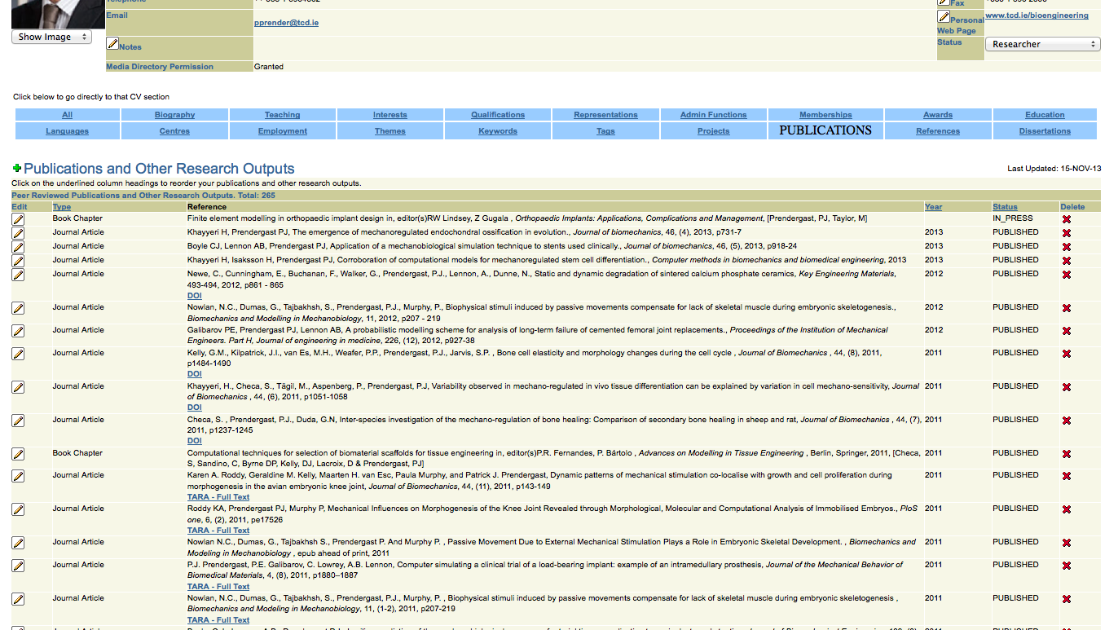
Bibliographic records:
- Started with our institutional Citation Report from ISI
- Now: APIs available from Web of Science, PubMed, Others
- Specifically requested by researchers

Slide 30
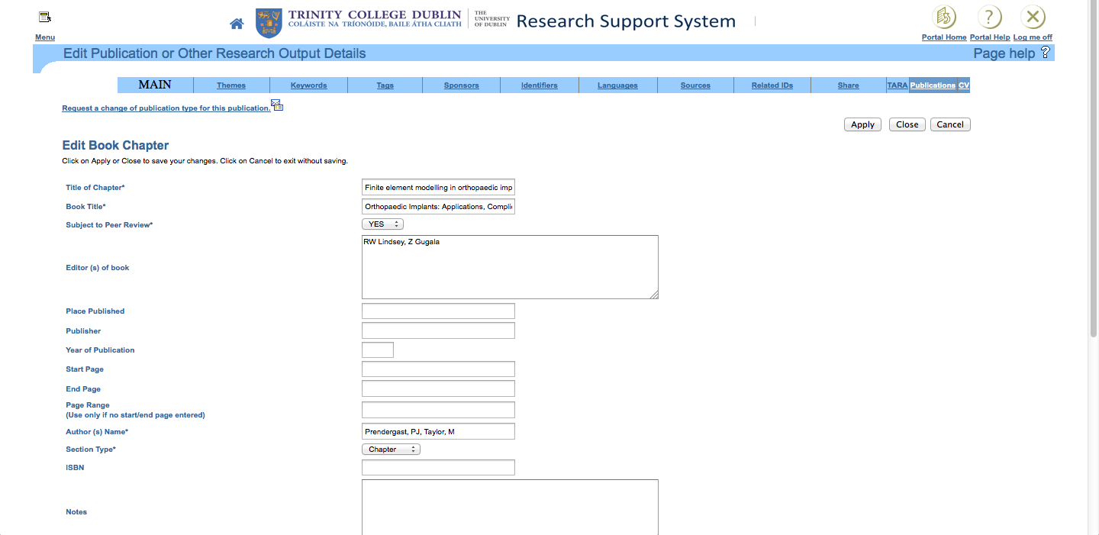

Slide 31
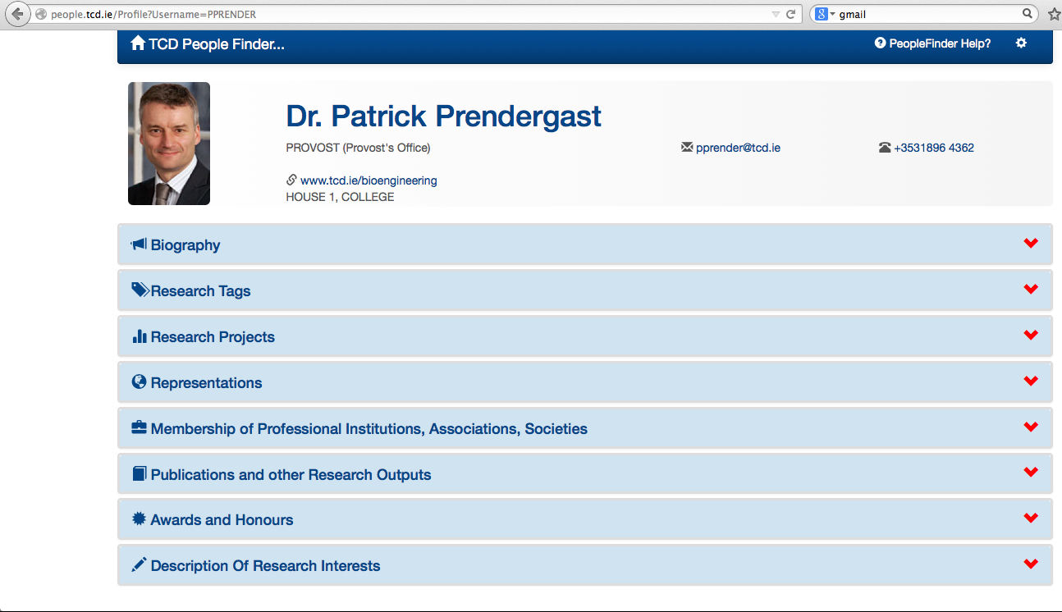
Personal URL/Research Webpage

Slide 32
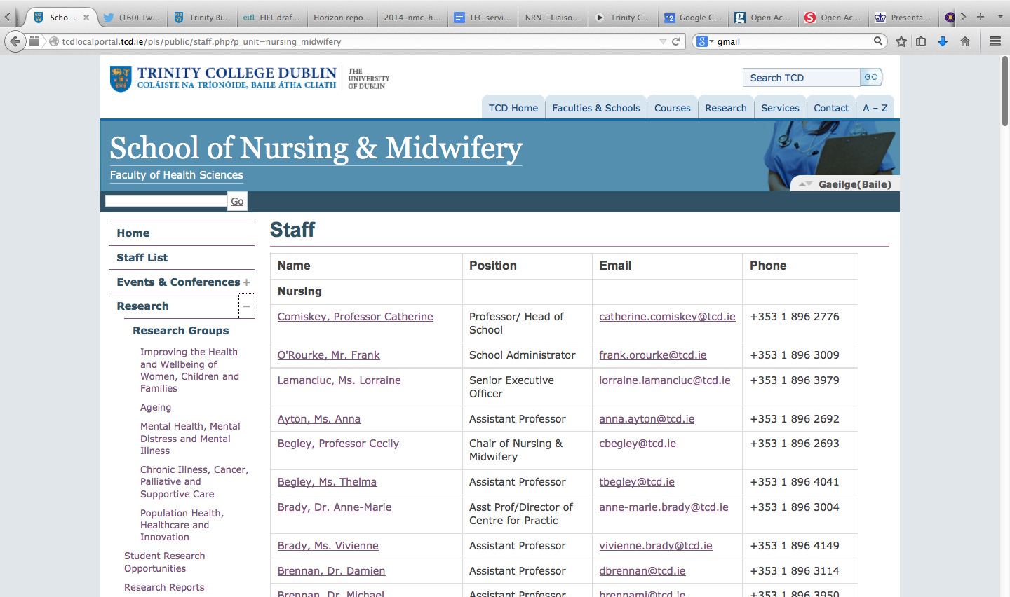
Live feed on to School webpages
Notes:
32

Slide 33
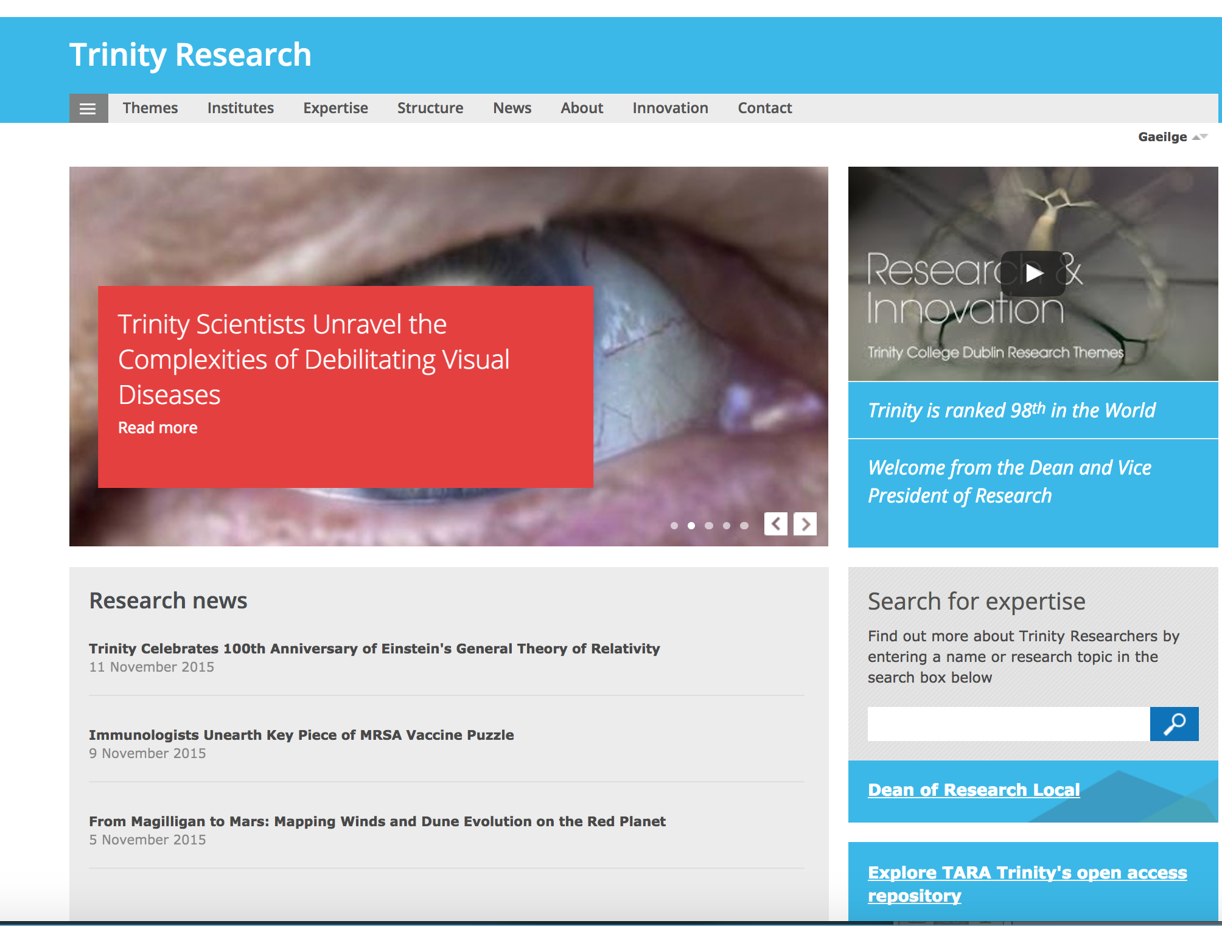

Slide 34
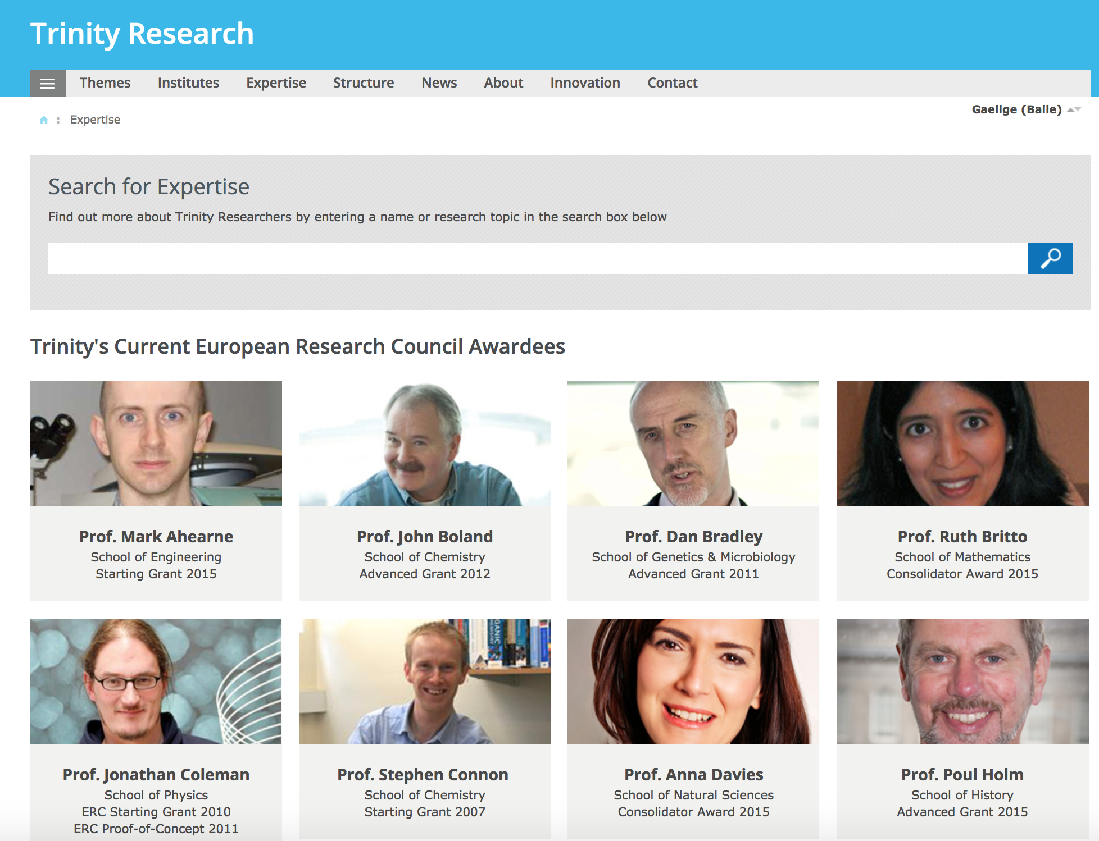

Slide 35
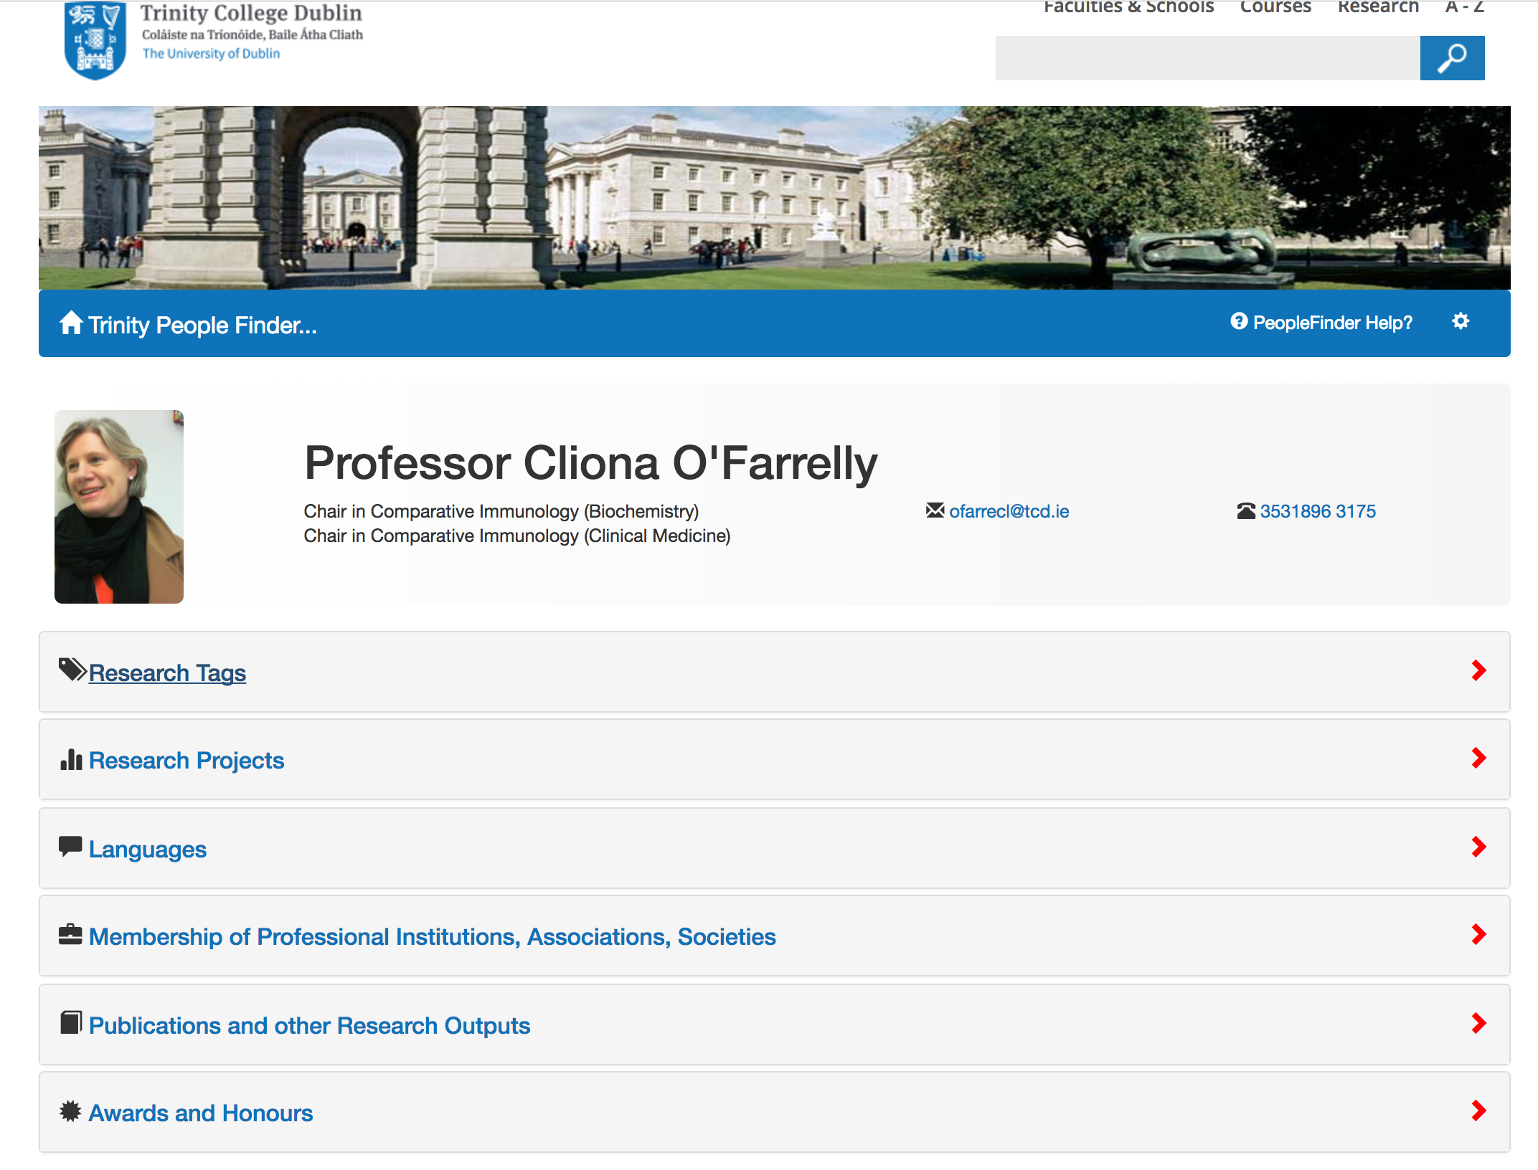

Slide 36
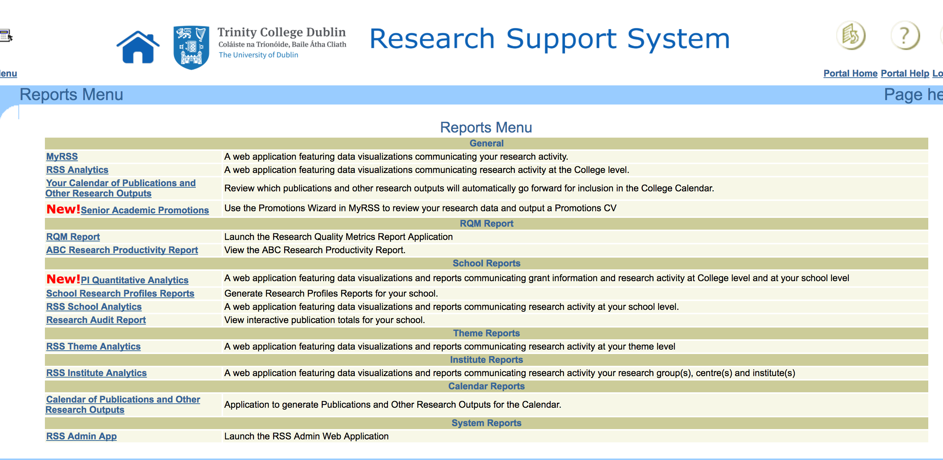

Slide 37
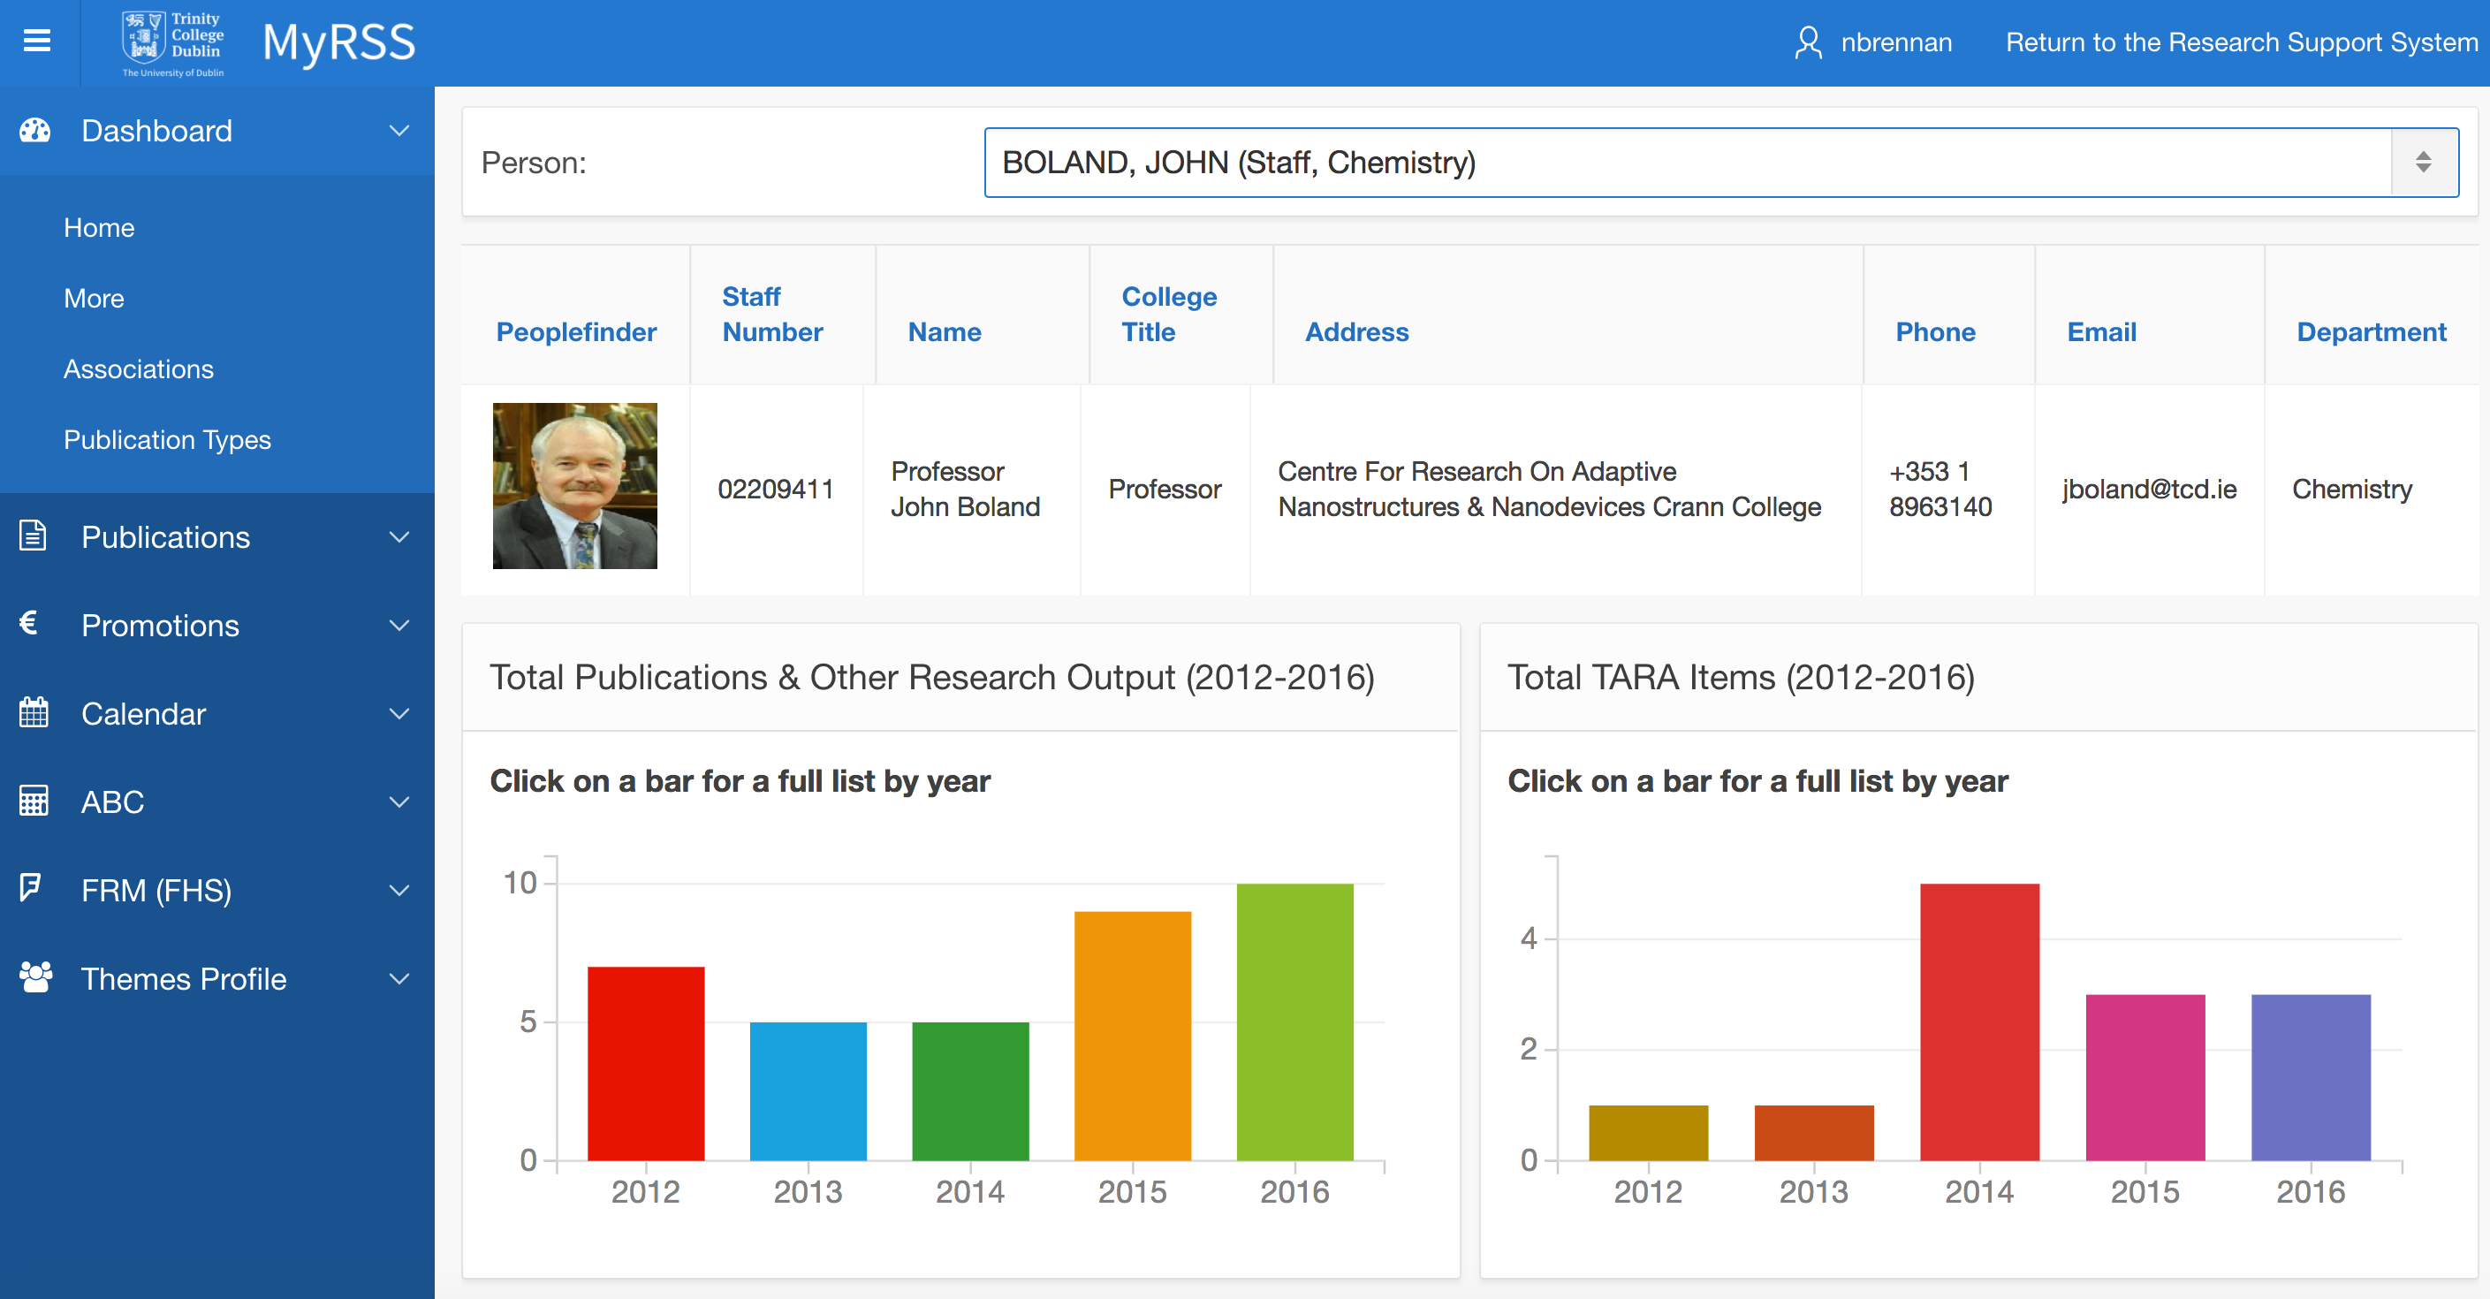

Slide 38
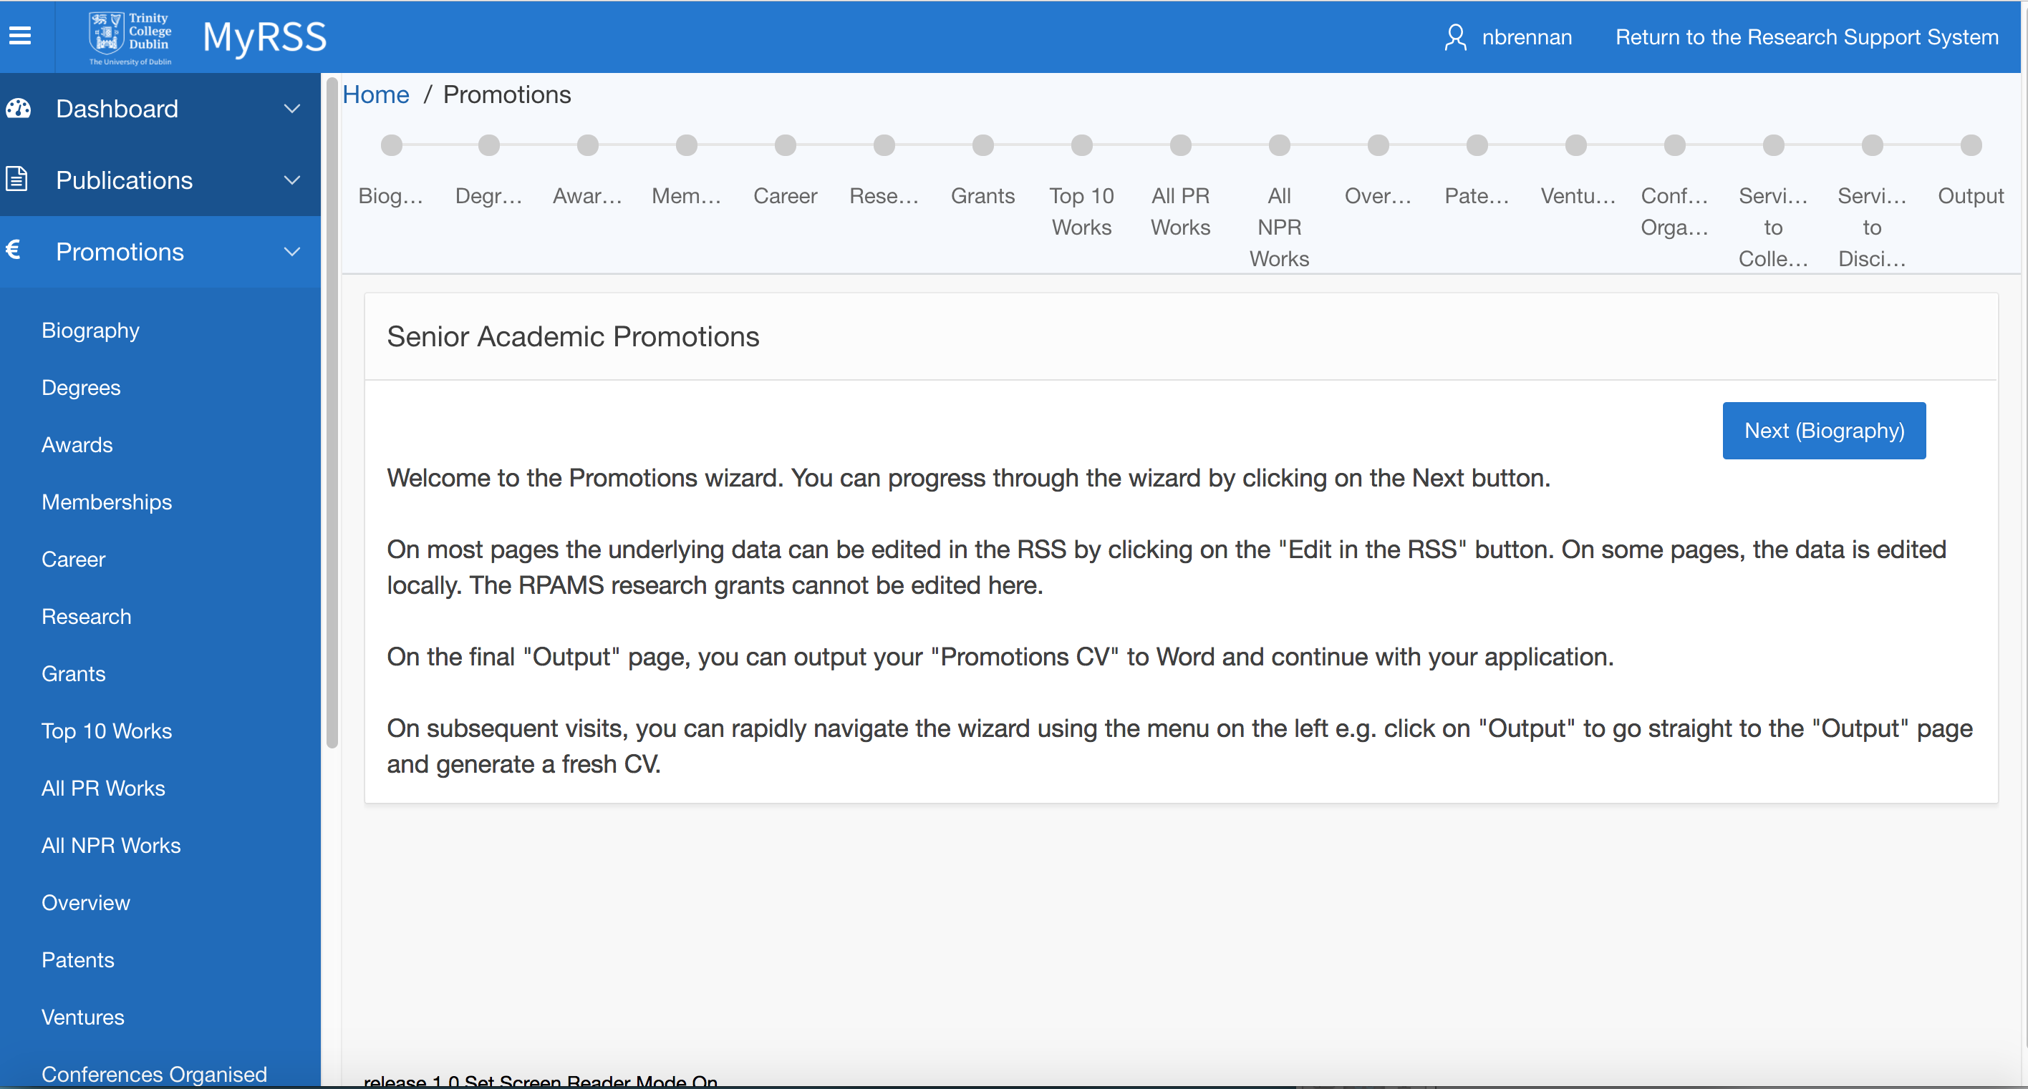

Slide 39
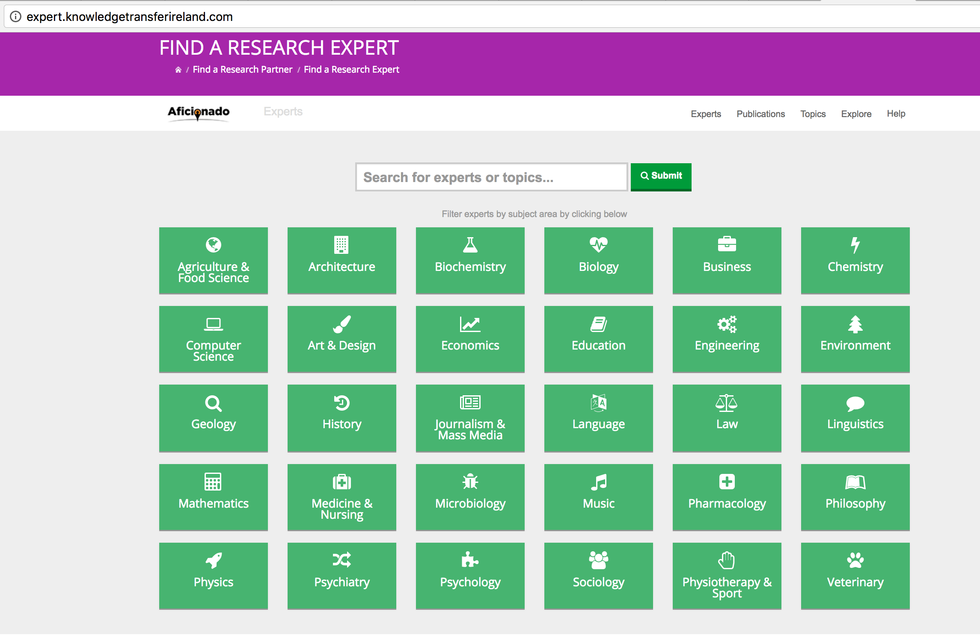
Knowledge Transfer Ireland

Slide 40
Early days
Milestones
Fragmentation → National Research Platform on ice;
Policies lag → the roadmap
New horizon:
  Compliance and monitoring
  Impact agenda
  Arts and Humanities fight back
Innovation 2020

Slide 41
A National CRIS – voting with our feet?
How about a backend only?
Front end – nice to have but not essential.

Slide 42
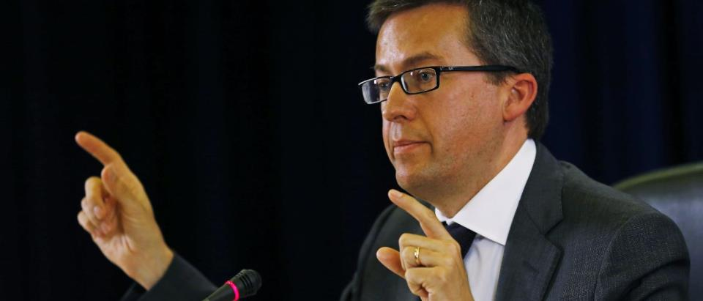
Carlos Moedas, Commissioner for Research, Science and Innovation
2017: ‘…opening up by default all scientific data produced by future projects under the €77 billion Horizon 2020 research and innovation programme, to ensure that the scientific community can re-use the enormous amount of data they generate.’
- http://europa.eu/rapid/press-release_IP-16-1408_en.htm

Slide 43
Researchers’ comments
‘How much time will this take?’
‘I need someone to summarise this – especially for interdisciplinary work’
‘How do I get to what I need to have without spending too much time?’
‘There are too many resources – I need guidance’
‘I need boilerplate text with language describing the standards plus guidance and direction to the templates.’
‘The biggest problem is the metadata piece. I don’t have time to figure out what the DMP needs.’
‘Am I supposed to upload to only one repository?’
‘Everything in the data management plan parallels the research ethics procedures; this needs to be aligned at the institutional level.’
‘Need to reduce duplication’
Concerns about the additional effort mirror Austrian report

Slide 44
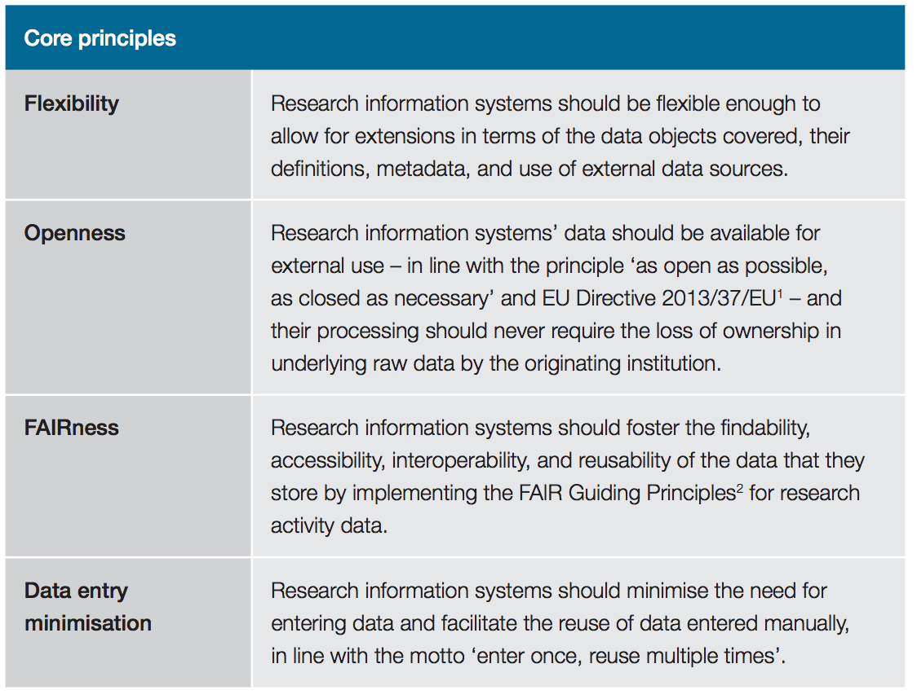


Slide 45
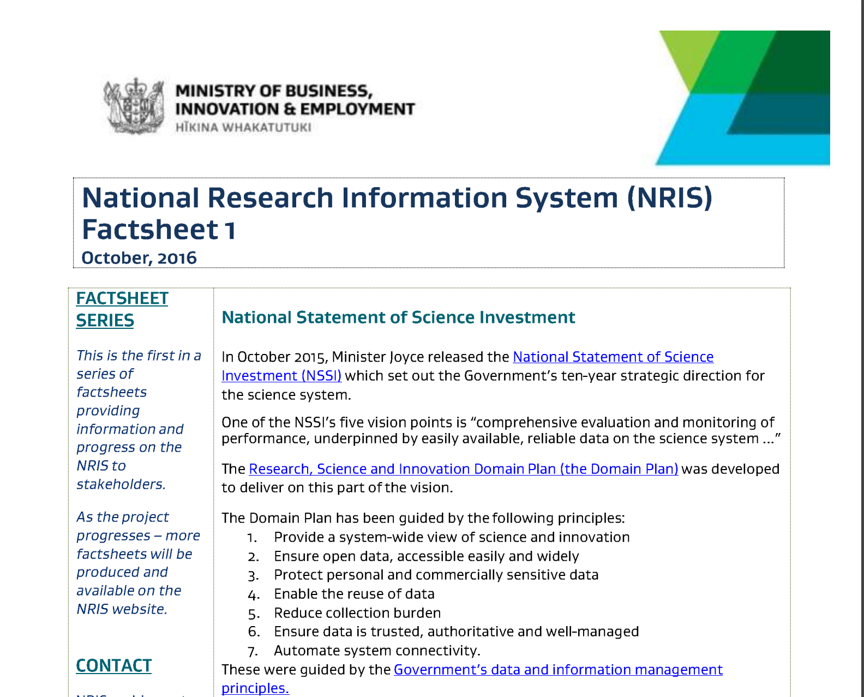

Slide 46
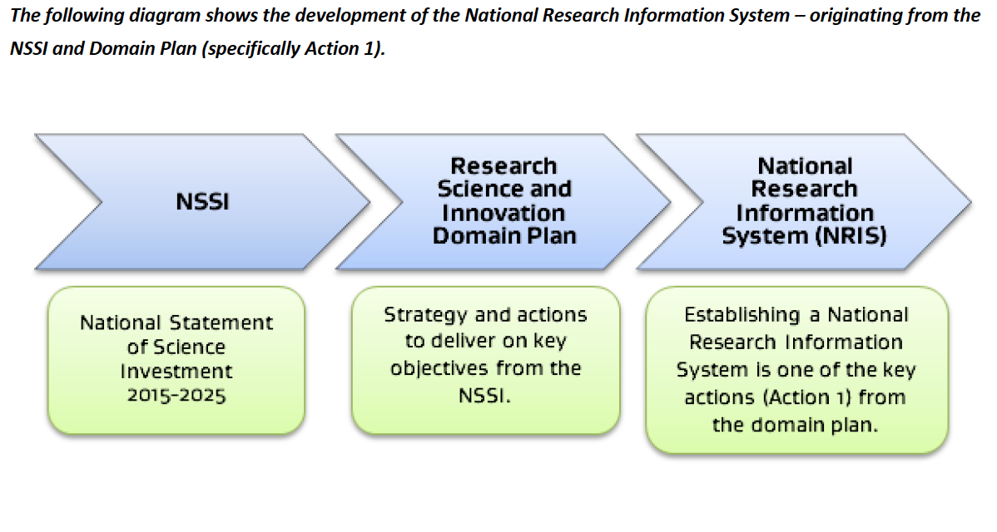

Slide 47
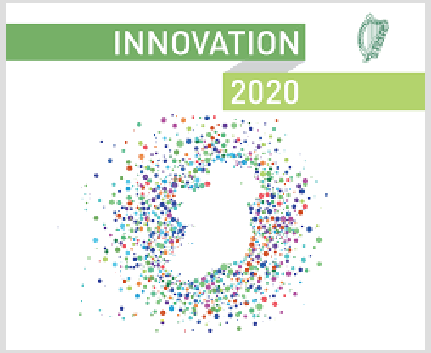
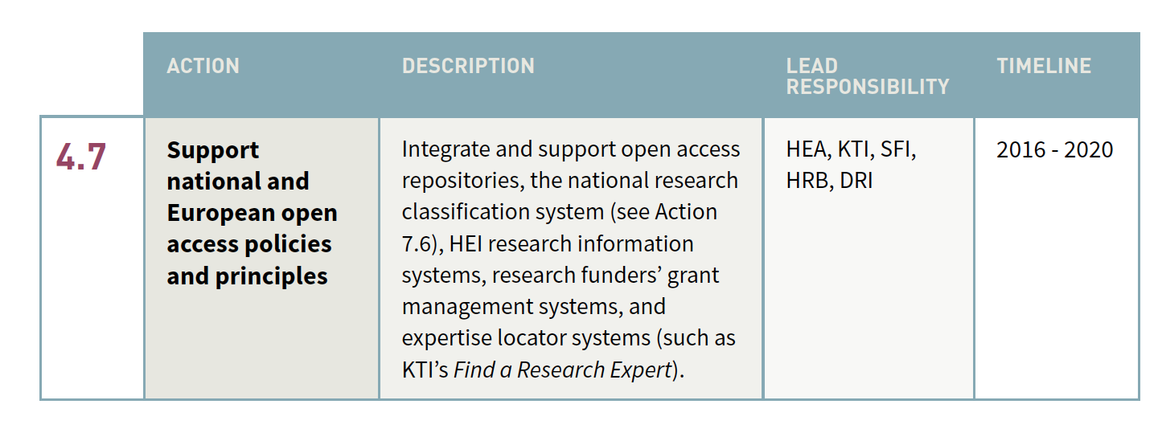

Slide 48

https://www.youtube.com/watch?v=H5ceUEPZZKE

