Slide 1

euroCRIS Business Session
Membership Meeting Dublin
:
Ed Simons
Membership Meeting
Dublin, May 30th 2017

Slide 2
Structure of Business Session
International Organisation for Research Information
eurocris.org
(very) Short introduction of the euroCRIS organisation (“What is euroCRIS”?)
Reports of the Secretetary and the Treasurer
(new) Developments going on within/by the euroCRIS organisation:
  Web Site
  Strategy
  Communication
  Projects
  External Relations
  Academic Affairs
.Presentation of Task Groups
CRIS-IR
CERIF and Architecture
Inidcators
Best Practice DRIS
Standards (NEW TG)

Slide 3
What is euroCRIS?
An international not-for-profit association of experts and users of research information and research information systems (CRIS).
Main activities:
  Development and governance of CERIF, a standard data model and exchange format for research information, and promotion of its use.
  Promotion of community building and cooperation between stakeholders (organisations) in the Research Information Domain. To fulfill this function, euroCRIS regularly organises international events: Membership Meetings and Conferences
Upcoming events:
  Strategic Membership Meeting, Bratislava, November 2017
  CRIS2018 International Conference, Umea, Sweden, June 2018.
International Organisation for Research Information
eurocris.org

Slide 4
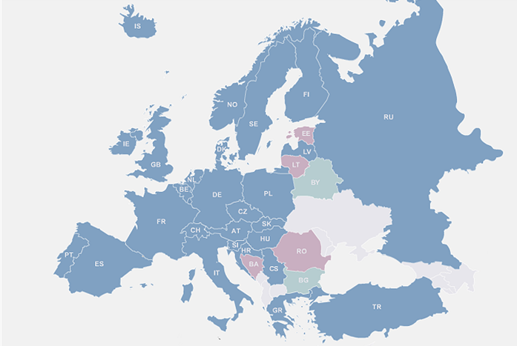
euroCRIS: Membership
International Organisation for Research Information
eurocris.org
Members outside of Europe:
Australia – Brazil – Canada – China - Colombia – Iran – Israël - Japan - Malaysia – Nigeria – Pakistan – South Korea - USA
200+ members from 45 countries (mainly Europe)

Slide 5
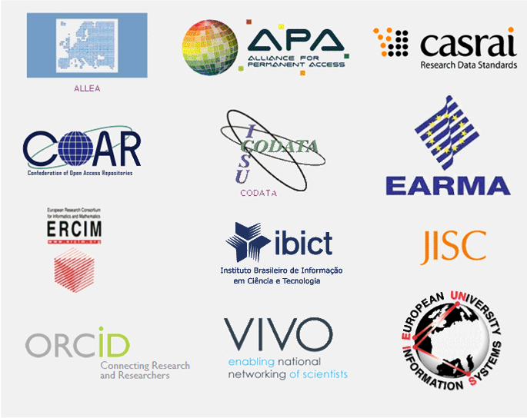

euroCRIS: Strategic Partners
International Organisation for Research Information
eurocris.org
In preparation:

Slide 6
euroCRIS Board (with definition of task)
International Organisation for Research Information
eurocris.org

Slide 7
www.eurocris.org
International Organisation for Research Information
eurocris.org

Slide 8
Structure of Business Session
International Organisation for Research Information
eurocris.org
(very) Short introduction of the euroCRIS organisation (“What is euroCRIS”?)
Reports of the Secretary and the Treasurer
(new) Developments going on within/by the euroCRIS organisation:
  Web Site
  Strategy
  Communication
  Projects
  External Relations
  Academic Affairs
.Presentation of Task Groups
CRIS-IR
CERIF and Architecture
Inidcators
Best Practice DRIS
Standards (NEW TG)

Slide 9
Web site developments in 2017
International Organisation for Research Information
eurocris.org
Creation of special “private” sections for Members in general and Task Groups in particular with information and functionality only accessible for (TG) members.
Functionality will include:
  On line discussion around posted topics, including uploading of documents to discuss
  Access to specific member information
  Mailing list functionality
  Periodic digital newsletter, sent by mail to the members.
For this a member login function will be created.

Slide 10
International Organisation for Research Information
eurocris.org

Slide 11
Strategy and Communication
International Organisation for Research Information
eurocris.org
The euroCRIS Board is in the process of formulating a new Strategy Plan and a new Communication plan.
.

Slide 12
Projects euroCRIS participates in
International Organisation for Research Information
eurocris.org
euroCRIS Participation in EU Projects
  HolaCloud
  VRE4EIC.
P-O-P Project in The Netherlands, aimed at implementing CERIF for exchanging information between the system of the national funder (NWO), the national Dutch research information database (NARCIS) and the CRISs of the institutions.
JISC Researdh data sharing Services Project (UK): CERIF-ication of the database
.

Slide 13
External Relations
Extension of Cooperation with Strategic Partners:
  A (MoU) has recently been signed between euroCRIS and DURASPACE.
  Equally a MoU is currently being concluded and will be signed in the next few weeks between euroCRIS and OCLC.
  As a first result of the last mentioned MoU, euroCRIS and OCLC have decided to jointly organise a worldwide survey on the use and functionality of CRISs and Repositories.
  At the Strategic Membership Meeting in Athens, last November, an inititative to work out and formulate a shared view on the benefits if not necessity of a European Research Information Infrastructure and how to realise this, has been agreed upon by CASRAI, EARMA, euroCRIS, JISC, OpenAIRE, ORCiD and Science Europe. First version is in preparation.
  At a recent working lunch (at the EARMA Conference in Malta) of the euroCRIS president with representatives of the EARMA Board, the latter have expressed the wish and intention to more closely work together with euroCRIS in the future.
A euroCRIS delegation has paid a consultancy visit to Brasil, last November, aimed at supporting IBICT, the Brazilian Institute for Information on Science and Technology, in the setup of a national Brazilian CRIS ecosystem.
Contacts in the same direction are going on with Colombia.
.
International Organisation for Research Information
eurocris.org

Slide 14
Academic Affairs
The euroCRIS Board, and more specifically the Executive for Academic Affairs (Miguel-Angel Sicilia) is exploring the possibility to define and organise trainings and courses in research information, aimed at various target groups.
In this respect some first drafts have already been developed, more specifically for a module “Working with Research Information” aimed at research managers and a full “Research Information” module as part of a Masters course.
.
International Organisation for Research Information
eurocris.org

