Slide 1

Standardisation of Classification
Schemes for Evaluative and Monitoring
Purposes – Services of the DFG
Christian Fischer, Jürgen Güdler, Holger Hahnen
Bonn, 13 May 2013

Slide 2

Description
The DFG's mission statement
Needs assessment for standardisation
Specific classification systems vs. standardisation
An approach to standardisation and a service of the DFG

Slide 3
Description
The DFG's mission statement
Needs assessment for standardisation
Specific classification systems vs. standardisation
An approach to standardisation and a service of the DFG

Slide 4
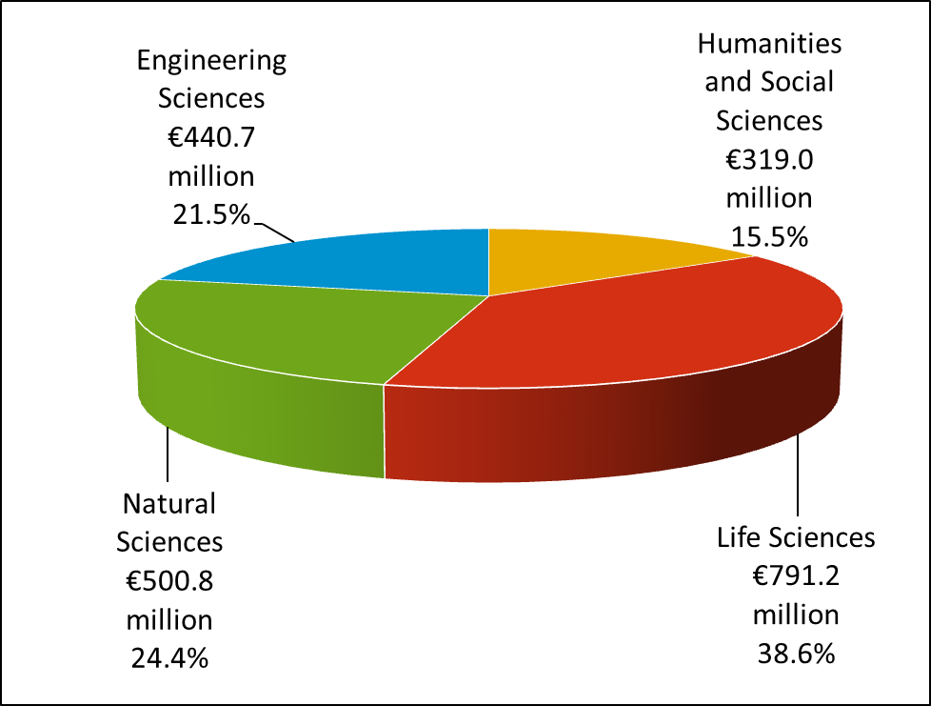
The DFG's mission statement
The DFG
Member-driven organisation (universities, non-university research institutions, scientific organisations)
serves all branches of science
and the humanities
fosters scientific excellence through competition
supports international cooperation
in research
advises political and social decision-makers
Funding in 2012, by scientific discipline

Slide 5
Description
The DFG's mission statement
Needs assessment for standardisation
Specific classification systems vs. standardisation
An approach to standardisation and a service of the DFG

Slide 6
Needs assessment for standardisation
In focus: the German Research Foundation (DFG)
Need for standardisation in
  scientific disciplines
  institutions (universities, research institutions etc.)
  research instrumentation
  countries and regions
  and much more…
Internal and external demand for standardised data for
  internal management
  research information systems
  raising the profile of universities and research institutions
  evaluation and monitoring
  and much more…

Slide 7
Description
DFG in profile
Needs assessment for standardisation
Specific classification systems vs. standardisation
An approach to standardisation and a service of the DFG

Slide 8
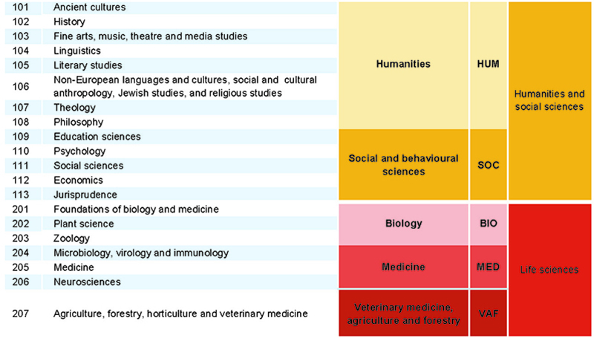
Specific classification systems vs. standardisation
The situation at the DFG
Classification by
  Review Board (48)
  Research Area (14)
  Scientific Discipline (4)
Example of the DFG's subject classification system
Review Boards
  Defined by 209 subjects
  Regular changes every 4 years due to review board elections

Slide 9
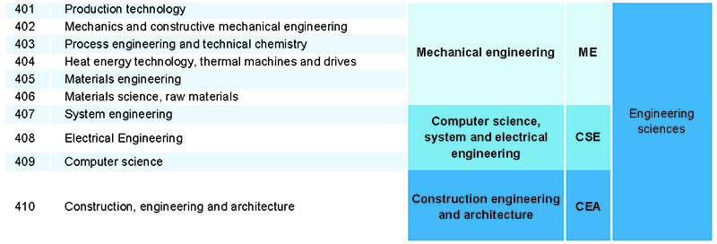
Specific classification systems vs. standardisation
The situation at the DFG
Classification by
  Review Board (48)
  Research Area (14)
  Scientific Discipline (4)
Example of the DFG's subject classification system
In essence, the DFG's subject classification system is an organisationally based classification for the organisation of research proposals.

Slide 10






Specific classification systems vs. standardisation
Other commonly used subject classification systems
  DFG Instrumentation Category Key (scientific instrumentation, equipment, systems and devices)
  Subject classification system of the Federal Statistical Office of Germany (DESTATIS)
  Health Research Classification System (HRCS)
  Federal government's planning system for R&D project funding
  ISCED fields of education and training
  OECD field of science and technology
  and many more…

Slide 11

Specific classification systems vs. standardisation
Aggregation for comparability of disciplines
Humanities and
social sciences
=
Humanities and
social sciences
4
4
Social and
behavioural sciences
≠
Linguistics and cultural studies
14
11
Education sciences
=
Education sciences
48
80
General education and
history of education
≈
General education
209
642

Slide 12
Description
DFG in profile
Needs assessment for standardisation
Specific classification systems vs. standardisation
An approach to standardisation and a service of the DFG

Slide 13

An approach to standardisation
The object of classification
  Ways of classifying an object:
    Research area of project
    Research area of people
    Research area of institution
    Research area of publications
Project
People
Institution
Publi-cation

Slide 14
An approach to standardisation
    The institution as a classification object
The institution
Relevant infrastructural unit (with own address) at which research takes place
DFG institution database
More than 21 000 entries for German institutions
  Full address of institution
  Subject classification of institution (using Federal Statistical Office classification)
  Link to institution's website
  Link to GEPRIS (DFG projects at the institution)
  Link to HRK Higher Education Compass (information on PhDs for the subjects of a faculty / department)
  Overview of subordinate institutions

Slide 15
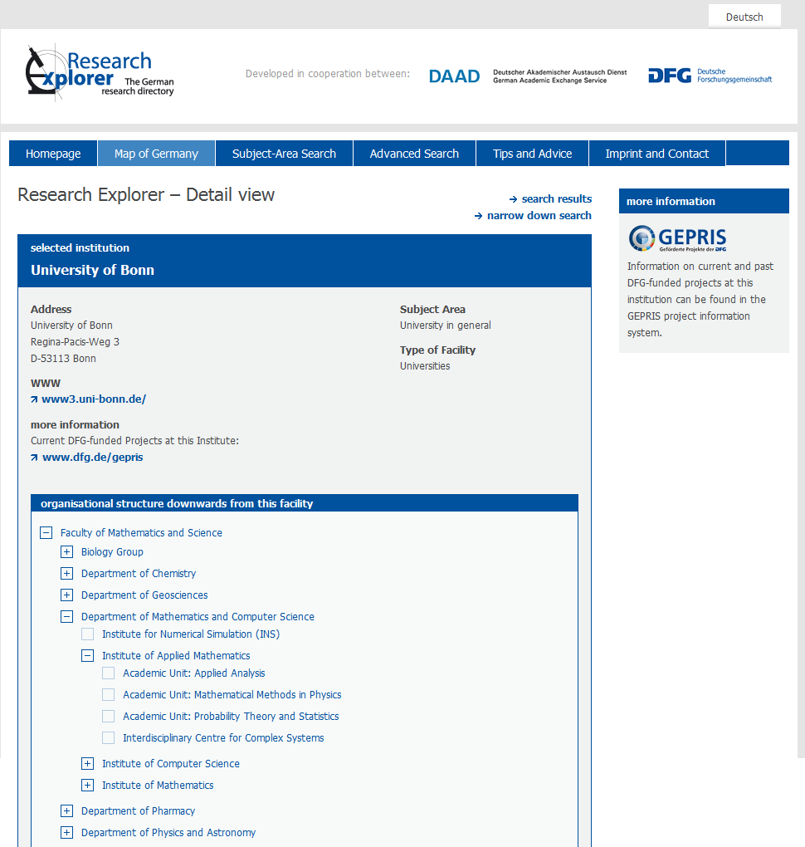
An approach to standardisation
    Research Explorer: open access to the institution database

Slide 16

An approach to standardisation
    Research Explorer: open access to the institution database

Slide 17
An approach to standardisation
    Process for creating a new, institution-based standard
Data in DFG institution database
Data held by university
University X
University X
Faculty 1
Faculty 1
  Address
  Website
  Persons at institution (DFG projects)
  DFG-classified projects at institution
  DESTATIS classification
  …
  Staff statistics
  Financial statistics
  Publication statistics
  Academic discipline
  …
Institution A
Institution A
Institution B
Institution B
…
…
…
…

Slide 18

An approach to standardisation
    First application of this principle in medicine
  First application of this principle in the
  DFG-Förderatlas 2012
  Main chapter for university medical institutions
  Comparison of funding volumes in relation to personnel levels
Data sources:
  research funding volumes (DFG)
  staff statistics (Medizinischen Fakultätentag)
  Englisch Edition:
  www.dfg.de/fundingatlas

Slide 19
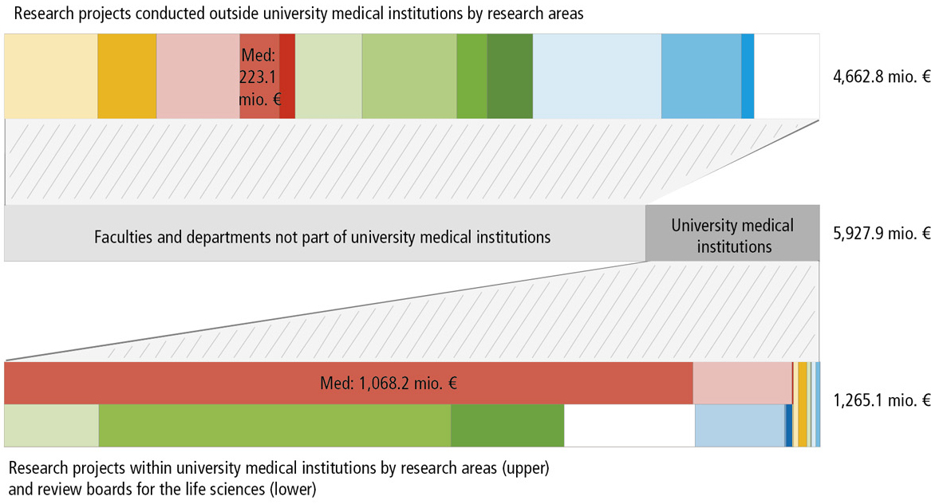
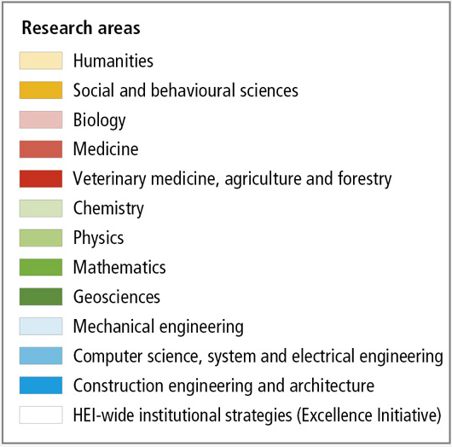
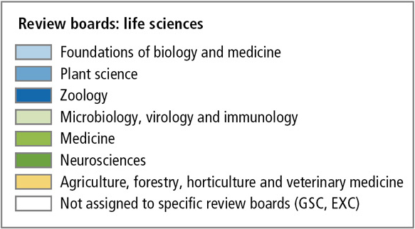
An approach to standardisation
    First application of this principle in medicine - results
Source: www.dfg.de/fundingatlas

Slide 20

An approach to standardisation
    Pilot project with the University of Münster
Aim: Data standards for sharing data (evaluation, monitoring, etc.)
Common unit: The institution
Prerequisite: Definition of the unit 'institution'
Agreement needed on:
  different hierarchies of institutions
  number of institutions
  institution codes
Current pilot project: University of Münster

Slide 21
Outlook
The institution-based approach is one approach to the standardisation of subject classification
Successful implementation of this approach by the DFG for one subject area: medicine
Pilot project for implementation at a major university: Münster
If pilot project is successful, approach may be expanded to member universities and other universities

Slide 22
Thank you for your attention
Further information
about the DFG: www.dfg.de/en
about Funding Atlas: http://www.dfg.de/fundingatlas
about all funded projects: www.dfg.de/en/gepris
about German research institutions: www.dfg.de/en/rex

