Slide 1
SICA2: a Regional Integrated CRIS for Andalusian Universities and Research Institutes Beatriz Barros & Miguel-Ángel Aguirre Secretaría General de Universidades, Investigación y Tecnología Junta de Andalucía
EUROCRIS: Autumn membership meeting
Madrid, November 5th 2012

Slide 2
Summary
SICA in a nutshell
SICA2 a Current Research Information System
Normalized Curriculum Vitae
New features:
Open Access Repository
Knowledge based Social Network
The experience of 1 year with the new version, 11 with the previous one…

Slide 3
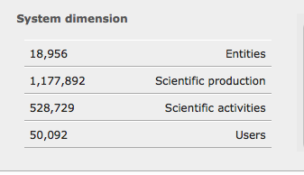
Summary

Slide 4
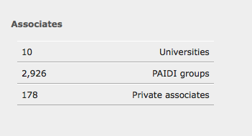
Summary

Slide 5
SICA in a nutshell
SICA is a centralized CRIS in the Spanish region of Andalusia
Since 2001 SICA gives CV services to a huge researchers community
It also answers to the demands of:
Policy managers
Institution supervisors
Productive Sector Agents
Society at large

Slide 6
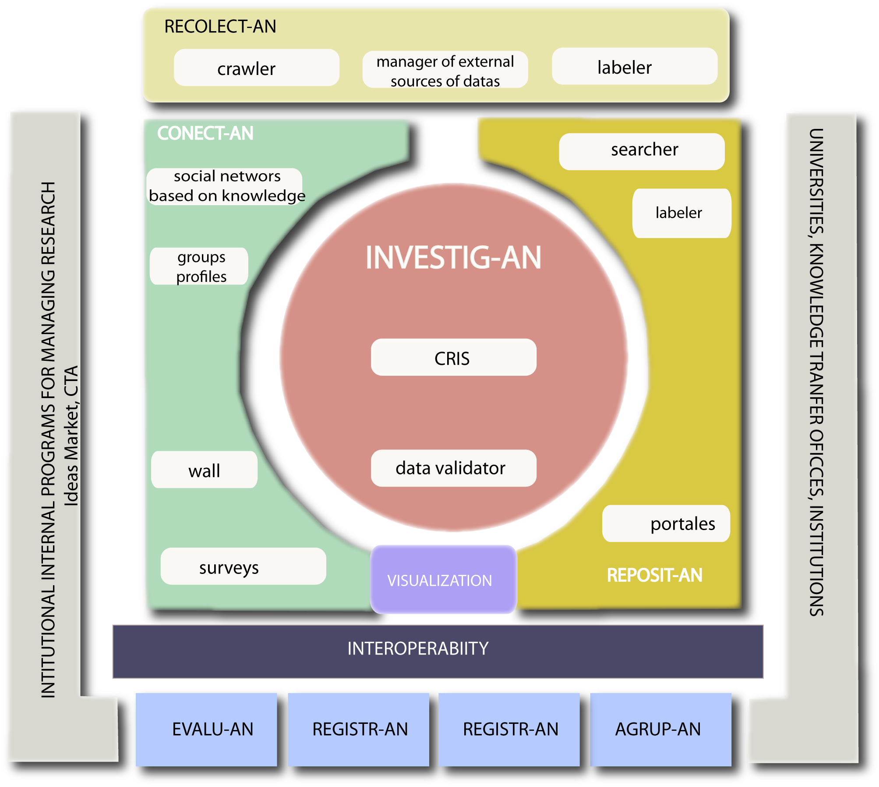
SICA2 a Current Research Information System

Slide 7
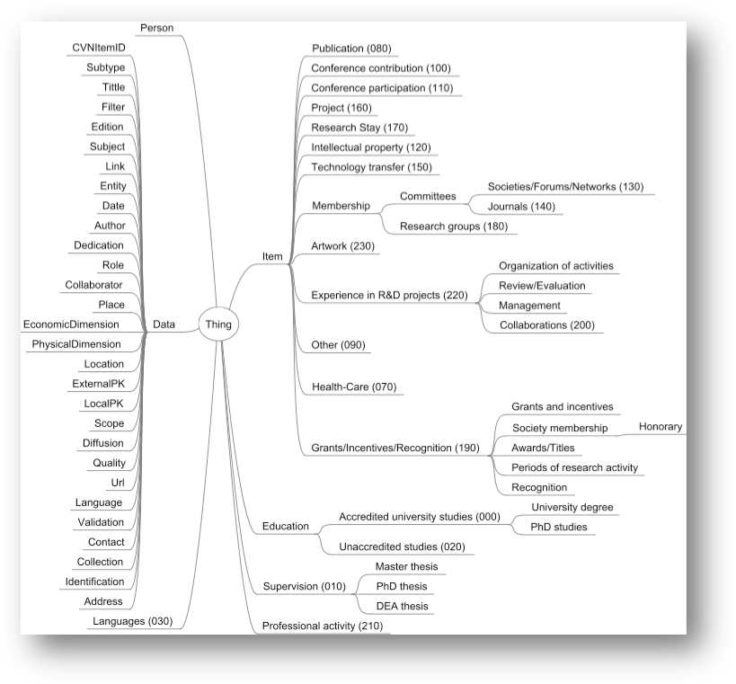

Slide 8
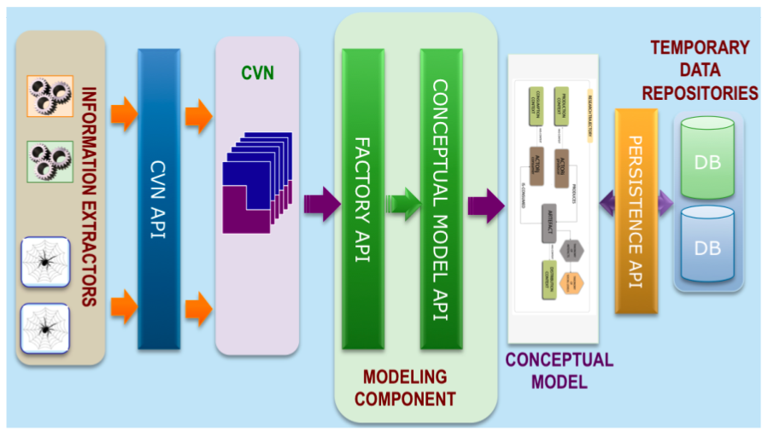
CVN API

Slide 9
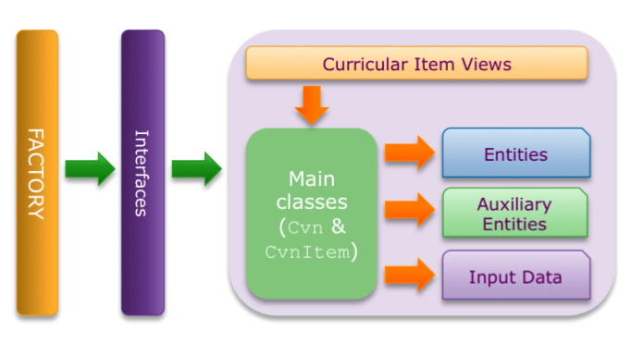
CVN API

Slide 10
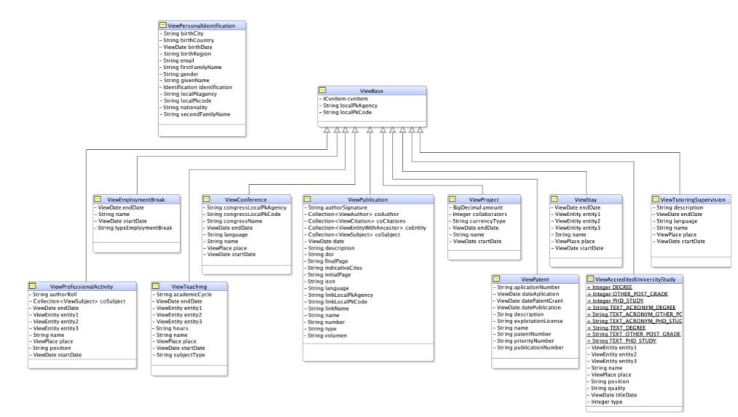
Available at http://sisob.lcc.uma.es/deliverables

Slide 11
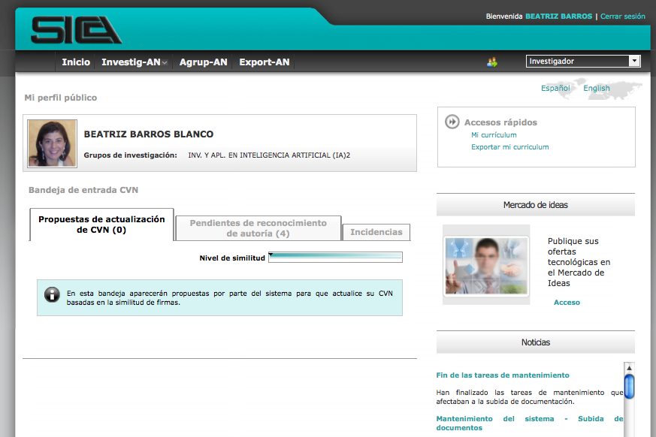

Slide 12
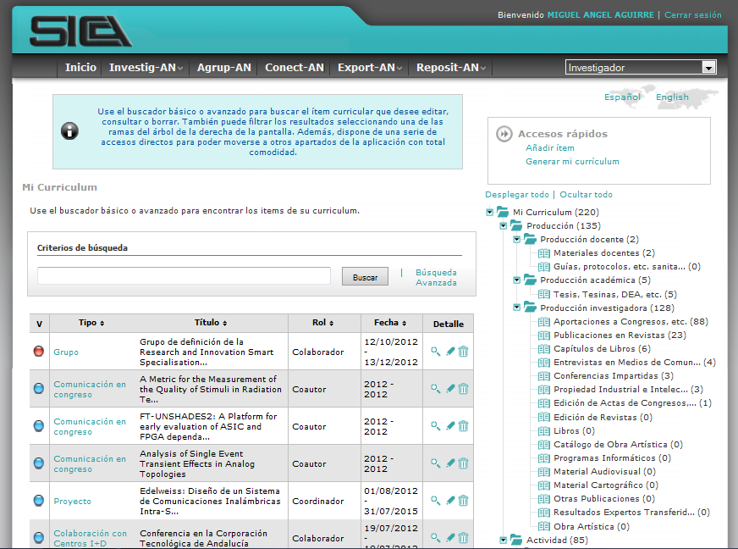

Slide 13
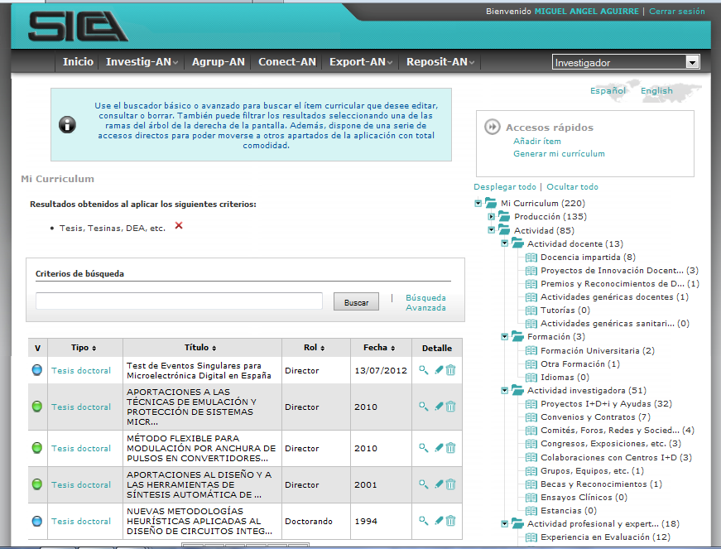

Slide 14
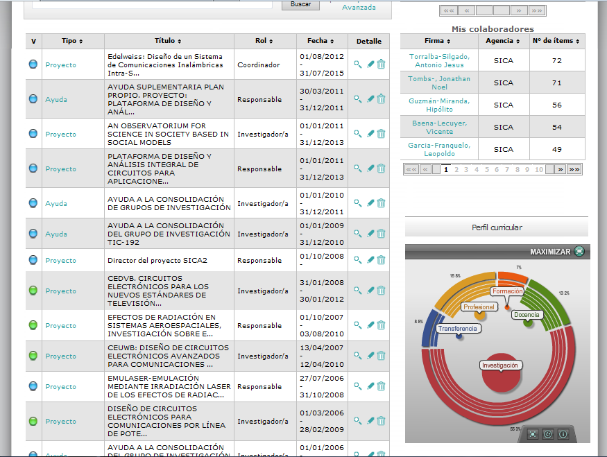

Slide 15
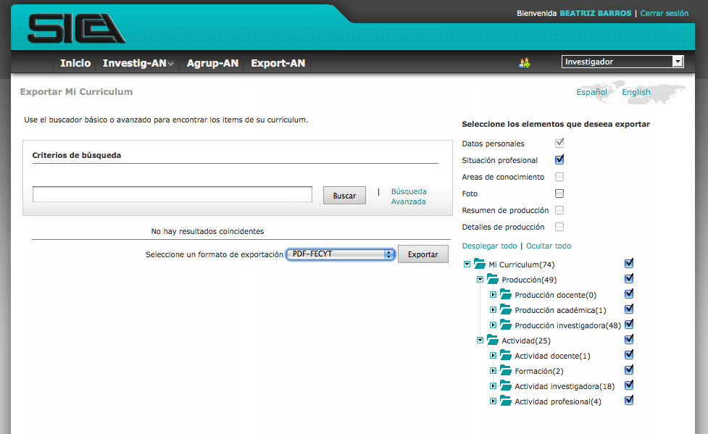
Interchange format

Slide 16
Social Network: Conect-An
Social networks based on the scientific activity
Networks based on the knowedge
Thematic
Colaborative
Citation
Followers
Followed
Entities
Knowledge areas

Slide 17
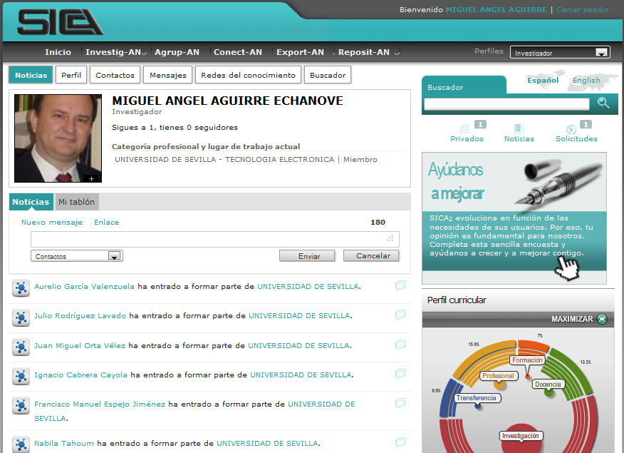

Slide 19
Reposit-AN: Open Access Repository
OBJECTIVES:
Colect and disseminate the scientific production to the society.
Increase the visibility and the impact of the Andalusian Scientific production, at national and international level.
Searching portal for the actual scientific documents.
Andalusia region is a member of the COAR

Slide 20
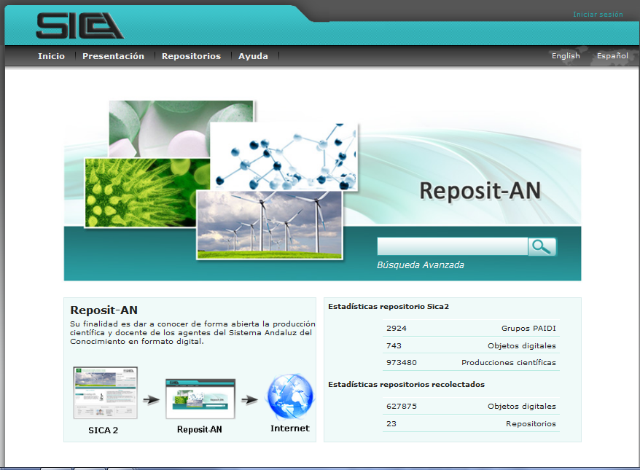

Slide 21
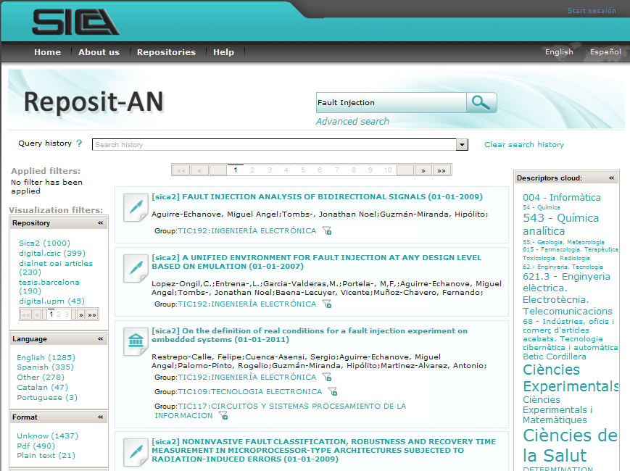

Slide 23
Institución

Slide 24
Thanks for your attention
Questions? Comments?
sica2.cica.es
sisob.lcc.uma.es
Beatriz Barros bbarros@lcc.uma.es
Miguel Angel Aguirre miguel.aguirre.ext@juntadeandalucia.es

