Slide 1
CRIS community in Germany: Establishing the DINI working group „Research Information Systems“ (AG FIS) a cooperation with euroCRIS
Dr. Barbara Ebert, Leuphana University Luneburg Regine Tobias, KIT Karlsruhe

Slide 2
Gliederung
Rationale
CRIS Community building in Germany – 2011/2012
Research Information Management in Germany
About DINI
Establishing the working group „Research Information Systems“
Upcoming activities

Slide 3
Increasing demand/ implementations of CRIS
→ Experiences and Best Practice
→ Variations of IT solutions
→ European initiatives to standardise and /or exchange data (euroCRIS, OpenAIRE...)
German Research Council: Recommendations for documentation (Drs. 1656-11)
→ Standards of data curation
Harmonissation of reporting systems
Service-oriented and adequate research administration
3
Notes:
3
Drs. 1656-11 vom 11.11.2011: Bewertung und Steuerung von Forschungsleistungen

Slide 4
Initial spark: DINI - iFQ Workshop “Research Information Management in Germany“ Karlsruhe, Nov 2011
Policies and strategies, case studies
Europe: Current Research Information Systems, euroCRIS
Institut für Forschungsinformation und Qualitätssicherung (iFQ), KIT-Bibliothek, DINI
Survey of research information management in Germany
Actors´ viewpoints: Ministry, Universities, Research Council, Funders

Slide 5
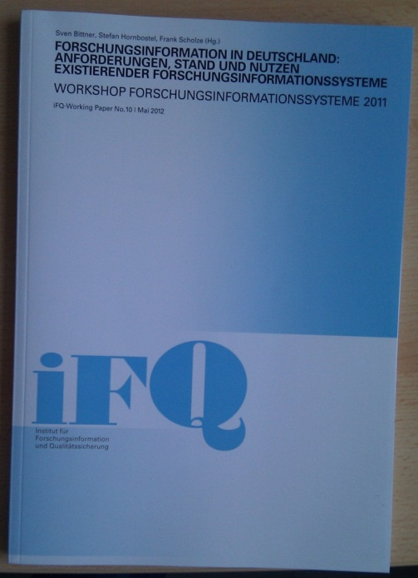
Result of workshop
Encore! => Forum for German community
Include European perspective from the start
Promote standardization in Germany
Kick-off for further workshops/events
Sven Bittner, Stefan Hornbostel, Frank Scholze (Hrsg.): Forschungsinformation in Deutschland: Anforderungen, Stand und Nutzen existierender Forschungs-informationssysteme. Workshop Forschungsinformationssysteme 2011,
iFQ-Working Paper No. 10, Mai 2012

Slide 6
Who can organize exchange & standardization? Selected actors in the Federal Republic of Germany
BMBF – Federal Ministry of Education & Research
Rectors Conference Hochschulrektorenkonferenz
University Administrators´ Working Group (Kanzlerarbeitskreis)
Research Council (Wissenschaftsrat)
Alliance MPG, FhG, Leibniz, Helmholtz
DFG Deutsche Forschungs-gemeinschaft
DINI - German Initiative for Network Information

Slide 7
DINI – German Initiative for Network Information
Founding organisations
AMH - Consortium of German University Media Centers
dbv - German Library Association, Section 4: Academic Universal Libraries
ZKI e. V. - Association of German University Computing Centers
Mission
To advance the improvement of the information and communication services and the necessary development of the information infrastructures at universities as well as on regional and national levels.
Agreements for the distribution of tasks among infrastructure facilities
Joint development of standards and recommendations

Slide 8
Selected DINI activities
DINI working groups
E-Publishing (E-Pub)
Promoting Open Access structures
DINI certificate for OA repositories (German, English, Spanish)
Kompetenzzentrum Interoperable Metadaten (KIM)
Virtual Research Environments (vForum)
E-Framework
E-Learning
Videokonferenztechnologien und ihre Anwendungsszenarien (VIKTAS)
Research Information Managemet fits right in

Slide 9
Establishing DINI AG FIS
Going public at DINI
Sept 2012
Formal consent of Board
Launch website, public mailing list.
Presentation at Annual Member Meeting
Founding AG-FIS
May 2012 in Göttingen
Definition of profile und agenda
Teilnehmer_innen:
S. Bittner, iFQ
B. Ebert, euroCRIS
S. Herwig, Uni Münster
N. Jahn, Uni Bielefeld
M. Mühlhölzer, SUB Göttingen
R.Tobias, KIT-Bibliothek
DINI: Impulses from Karlsruhe workshop
Organize community => DINI is competent
European perspective => Cooperation with euroCRIS

Slide 10
Aims of AG FIS
Recommendations and Best Practice for research information management – CRIS systems
For universities and research institutions
Contribute to standardize data curaiton and harmonisation of reporting systems
Participate in national and Eurpopean discourse

Slide 11
Organization of work
Public working group meetings starting January 2013:
Standards and exchange formats
Linking data curation processes (persons, projects, publications)
Compliance with data safety requirements in RIM
CRIS advocacy and implementation
Analysation of results and recommendation dev in AG-FIS
Discussion und ratification by DINI

Slide 12
Establish partnerships
DINI E-publishing working group and other working groups
euroCRIS Task Groups
Regular information exchange with actors in the field. Established contacts:
Network of Research Officers www.forschungsreferenten.de
Research Council - Wissenschaftsrat Research Rating, Key Performance Indicators
OpenAIRE (plus)
Notes:
FIS haben z.T. Open Access Module
Publikationsmetadaten und Volltexte
Repositorien werden mit kontextuellen Forschungsinformationen angereichert
OpenAIRE plus
Vernetzung beider Ansätze
Aufbau von serviceorientierten Strukturen
Datenpflegeprozesse - Vermeidung von Doppeleingaben
Lernen zum Thema Mindestanforderungen: DINI-Zertifikat

Slide 13
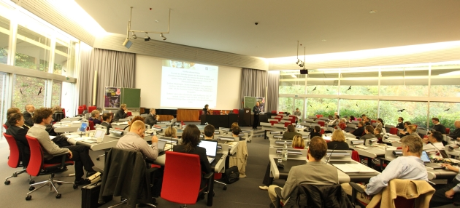
First Workshop AG -FIS
DINI Workshop on standards and exchange formats for research information
January 21st-22nd, 2013 at the University of Bielefeld
CERIF, LOD, case studies of data exchange projects
Notes:
„Öffentliches Arbeitstreffen“, Akteure kennenlernen
Experten identifizieren

Slide 14
DINI AG -FIS
Contact:
Regine Tobias, KIT Library, Karlsruhe, regine.tobias@kit.edu
Barbara Ebert, Leuphana University Luneburg,
barbara.ebert@uni.leuphana.de
Web: http://www.dini.de/ag/fis/
Public mailing list (German): fis@dini.de
14
Notes:
14

