Slide 1
The BRUCE Project (Brunel Research Under a CERIF Environment)
Rosa Scoble & Lorna Mitchell
Brunel University

Slide 2
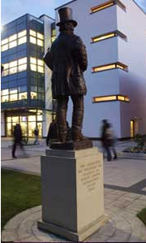
Introduction to Brunel
BRUCE in context
Introduction to the BRUCE Project
Overview
CERIF
Project Outputs
Any Questions

Slide 3
Brunel University
World class university based in Uxbridge, West London
Small research-intensive institution with a broad disciplinary base, building on a very strong historical base in engineering
15,000 students including more than 950 PhD students

Slide 4
BRAD and BURA
BRAD
Symplectic Elements
Comprehensive record of publications
Research profiles on Brunel website
BURA (http://bura.brunel.ac.uk/)
Launched in 2006; 4,372 full-text items
Linked to BRAD via Repository Tools
RESEARCH
BURA
BRAD

Slide 5
The UK Context
Autonomous universities contracted by the funding council (HEFCE)
Data for the sector collected by the Higher Education Statistic Agency (HESA) in a standard format (Students, Staff, Finance, etc.)

Slide 6
The UK Context
Dual support systems for funding research
Research Councils fund competitive projects
Block grant (HEFCE) based on submission of research every 6 yrs
Research Excellence Framework (REF)
assessed by peer review
outcomes presented as profiles

Slide 7
The BRUCE Project
Aims to develop a prototype tool, based on CERIF, to facilitate the analysis and reporting of research information from existing data sources

Slide 8
The BRUCE Project
6 month project, funded by JISC
Project partners:
St George’s University of London
Cottage Labs
Symplectic Ltd
Steering group includes HESA
Advisory group of UK HEIs

Slide 10
Project Outputs
Prototype tool
Based on Apache Solr and Project Blacklight
Open Source Software
BRUCE and CERIF
Mapping CERIF to the HESA data
Gap analysis
Sample Reports

Slide 11
BRUCE Reports
Bring together research information from different source:
Contract information
Academic areas
PhD students supervised
Publications
Funding, etc

Slide 12
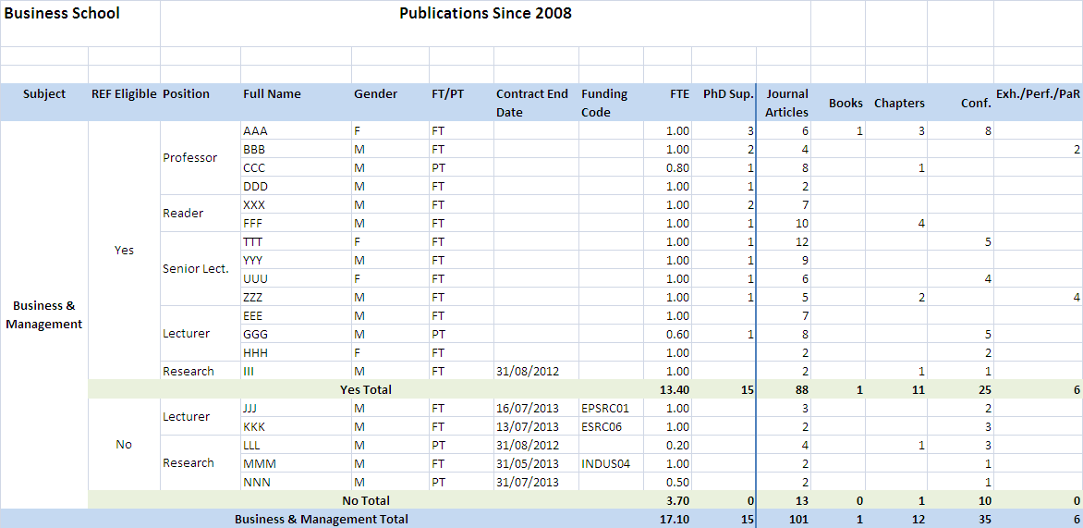

Slide 13
Progress to Date:
Created some data to play with
CerifEYE
Thin python front end to browse the MySQL database and check the indexing in Solr
Generated a first dataset based on the sample report
https://bitbucket.org/richardjones/bruce

Slide 14
Contacts:
BRUCE Project Blog
http://bruceatbrunel.wordpress.com
Email:
Lorna.mitchell@brunel.ac.uk
Rosa.scoble@brunel.ac.uk

