Slide 1
Decision Makers and R&D&I Horizon 2020 WP2014-15 Research Infrastructures (focus on e-Infrastructures)
EuroCRIS 2012
Lisbon, 9 September 2013
Carlos Morais Pires
European Commission
e-Infrastructures, DG CNECT.C1
Author’s views do not commit the European Commission

Slide 2
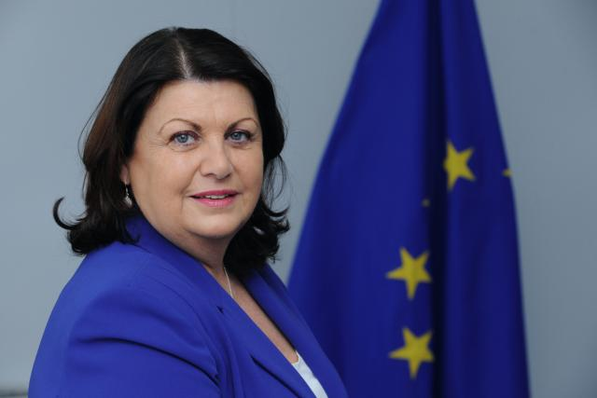
research infrastructures: in the european programmes context
creating industrial
leadership and
competitiveness
tackling
societal
challenges
Neelie Kroes
Digital Agenda
Máire Geoghegan-Quinn
Research, Innovation & Science
Innovation Union
excellence in
science
base

Slide 3
data as infrastructure
The High Level Expert Group on Scientific Data presented Riding the Wave in October 2010
Vision: "data e-infrastructure that supports seamless access, use, re-use, and trust of data. In a sense, the physical and technical infrastructure becomes invisible and the data themselves become the infrastructure a valuable asset on which science, technology, the economy and society can advance".

Slide 4
Policy context
A Reinforced European Research Area Partnership for Excellence and Growth, COM(2012) 392 – July 2012
Towards better access to scientific information: boosting the benefits of public investments in research, COM(2012) 401 final - July2012
Commission, Recommendation on access and preservation of scientific information, C(2012) 4890 final – July 2012

Slide 5
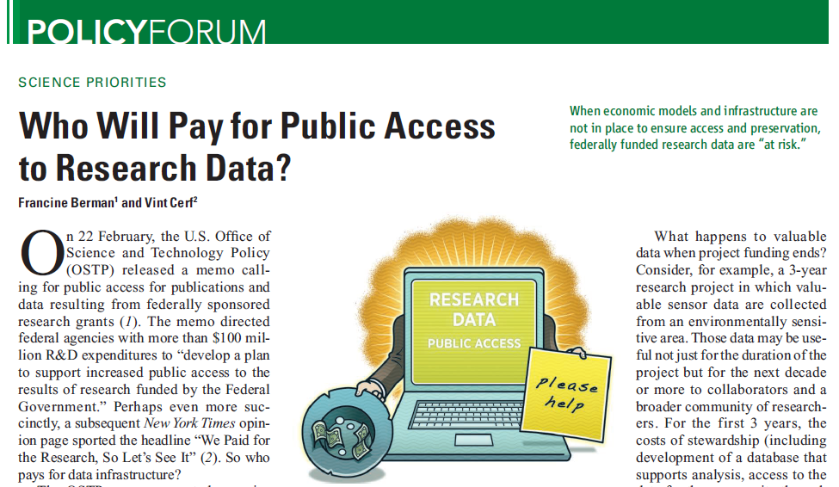
“homeless” data quickly become no data at all
Fran Berman and Vint Cerf in Science, August 2013

Slide 6
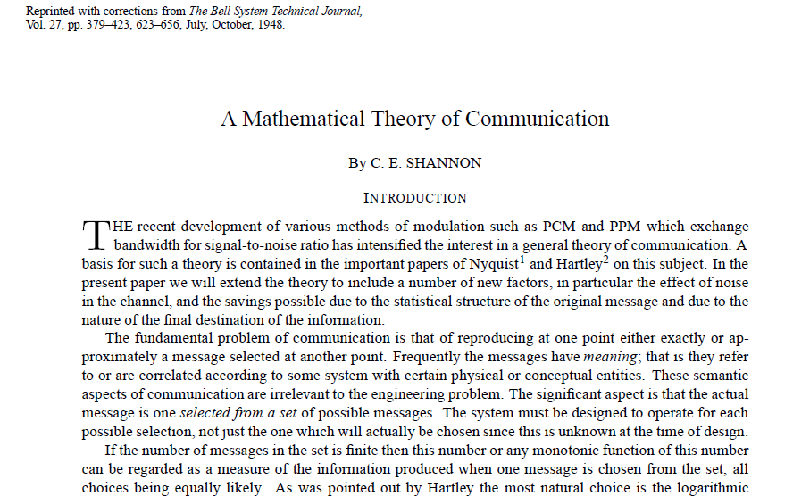
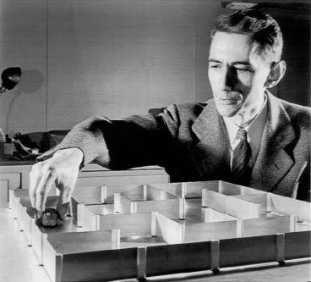
it’s all about communicating information…

Slide 7
Science in the 21st century is still science
Science in the 21st Century is still about pushing further the frontiers of knowledge and about understanding how Nature, Man and Society work through rational and objective methods
It is still about sharing and discussing results with peers to verify and ensure scientific work of the highest quality
It is still about innovating and creating the foundations of socio-economic development by exploiting new knowledge and about spreading it by making it accessible through education and development of new skills

Slide 8
but science…
At the same time, 21st Century Science harbours emerging features that challenge the way researchers work.
The same happens for educators, students and even curious citizens. The volume, diversity and complexity of research data collected and processed every minute confront us with new challenges.
Large, more or less formal, n-way networks of interest groups are formed as we speak and work on relevant scientific issues, re-emphasising the open attitude that originally stood behind the scientific enterprise.

Slide 9
e-infrastructure
make every researcher digital; achieve the digital ERA
physics community
biomedics community
astronomy community
Sharing and federating scientific data
Sharing computers, software and instruments
Linking at the speed of the light
. . . . . . .
scientific facilities, research communities
Notes:
9

Slide 10
Information and Communication Infrastructures
Barriers have to be overcome, or at least lowered, in order to achieve the goal of offering reliable services in a sustainable way
Barriers differ in nature and origin
reconcile funding cycles with the variable time scales of technological evolution
achieve global interoperability when the ICI are composed of distributed parts requiring “local” developments and optimisation
tensions between top-down versus more chaotic developments, with a strong bottom-up drive w/ incremental changes in complex systems
the development of infrastructure is influenced by social, economic, and technological dimensions. It requires interaction and engagement of different stakeholders to take their share of responsibility and contribute to lead the way

Slide 11
Horizon 2020, a new cycle of R&D&I
The European R&D&I Framework for 2014-2020
Launch new ideas, challenges, collaborations…
Research Infrastructures, e-Infrastructures and Excellence in Science
creating industrial
leadership and
competitiveness
tackling
societal
challenges
excellence in
science
base

Slide 12
Areas of action in WP2014-15
(e-infrastructure)
CONNECTIVITY
DATA
CORE SERVICES
SKILLS
VIRTUAL RESEARCH ENVIRONMENTS
INTERNATIONAL COOPERATION AND POLICY DEVELOPMENT
COMPUTING
2014
2015

Slide 13
Research Infrastructure
Work Programme 2014-2015
CALL 1
Developing new
world class infrastructures
Support to the implementation of cross-cutting infrastructure services and solutions for cluster of ESFRI and other rilevant Reserach Infrastructure initiatives in a given thematic area
Design Studies
+
Support to
Preparatory Phase
of ESFRI projects
+
Support to the individual
implementation and operation
of ESFRI projects
+
CALL 2
Integrating and opening
research infrastructures
of pan-European interest
Integrating and opening existing national and regional research infrastructures of
pan-European interest
CALL 3
e-Infrastructures
Managing, preserving and computing
with big research data
+
e-Infrastructures for Open Access
+
Towards global data
e-infrastructures
Research Data Alliance
+
Pan-European
High Performance Computing infrastructure and services
+
Centres of Excellence for Computing applications
+
Network of HPC
Competence Centres
for SMEs
+
Provision of
core services across
e-Infrastructures
+
Research and Education networking – GEANT
+
e-Infrastructures for virtual research environments (VRE)
CALL 4
Innovation potential of
research infrastructures
and human resources
Innovation support measures
+
Innovative procurement
pilot action in the field of
scientific instrumentation
+
Strengthening the human capital of research infrastructures
+
New professions
and skills
for e-Infrastructures
CALL 5
Policy measures and
international cooperation
for research infarstructures
Policy measures for Research Infrastructures
+
International Cooperation
+
Focus on e-Infrastructure policy development and international cooperation
+
Network of National Contact Points

Slide 14
managing, preserving and computing with big research data
Objective:
Development and deployment of integrated, secure, permanent, on-demand service-driven and sustainable e-infrastructures for scientific computing and data.
Scope:
Data e-infrastructures establishment
Data e-infrastructures quality assurance
Data e-infrastructures data management and curation tools
Large virtualisation for on-demand computing capacity
Computing platform to supply PaaS on different e-infrastructures
Supporting the evolution of the EGI (8 million€)
Prototypes for extremely large or highly heterogeneous data sets scaling to zetabytes and trillion of objects
Platform and infrastructure for mining text aggregated from different sources/publishers

Slide 15
e-Infrastructure for open access
Objective:
Robust e-infrastructure supporting Open Access policies in Europe (H2020 etc), providing reliable and permanent access to digital scientific records.
Scope:
Service-driven e-infrastructures for open access to and deposit of scientific information
Proof of concept and new services prototypes (new forms of publishing, new forms of peer review etc.)
Global interoperability of open access data e-infrastructures

Slide 16
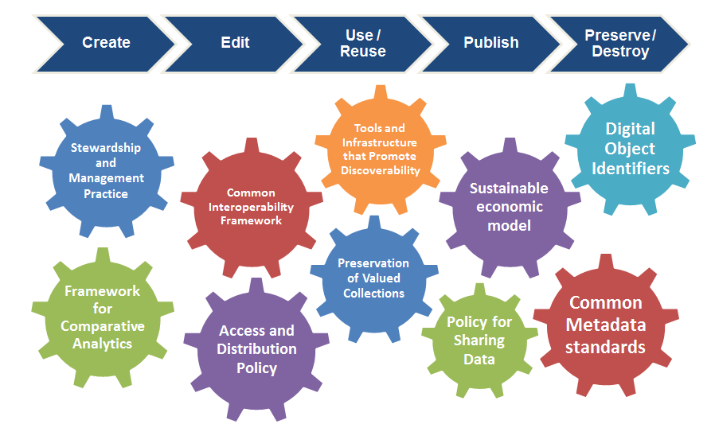
Research Data Alliance: Common Infrastructure, Policy and Practice Drives Data Sharing and Exchange throughout the Data Life Cycle http://rd-alliance.org
From Prof. Fran Berman and Prof. John Wood, Members of the RDA Council

Slide 17
motivation
G8+O6 and Data infrastructures
South Africa (Nov 2011) and Hamburg (April 2012)
Oxford (March 2013)
Technical/Cultural
Creation of data
Curation & Preservation of data
Access to data
Computing infrastructures
International governance
vision that research data will
Unmanaged → Managed
Disconnected → Connected
Invisible → Findable
Single-use → Reusable
Transform research and usher in a
new era of discovery and innovation

Slide 18
reminding the principles: how iGoF expectations
Openness – Membership is open to all interested organizations, meetings are public, processes are transparent, products are openly available to the public;
Balance – organized on the principle of balanced representation for individual organizations and stakeholder communities;
Consensus – achieving consensus and resolves disagreements through appropriate voting mechanisms;
Harmonization – harmonization across standards, policies, technologies, tools, and other data infrastructure elements;
Voluntary – not a government organization or regulatory body and, instead, is a public mission body responsive to its members;
Non-profit –not a commercial organization and will not design, promote, endorse, or sell commercial products, technologies, or services, and that there will be different policies/rules/legal bases in the different countries or regions.

Slide 19
research data alliance
Objective:
Consolidating Europe's contribution to the Research Data Alliance (RDA) and ensuring that RDA serves to foster research data interoperability at global level.
Scope:
Definition, operation and monitoring of the governance structures of the RDA
Support active participation of European stakeholders in RDA.
Engagement of scientific communities in defining the best practices for data exchange and interoperability
Establish coordination mechanisms at European level and with international organisations dealing with standardisation, research data and education issues

Slide 20
pan-European High Performance Computing infrastructure and services
Objective:
Providing access to the best supercomputing facilities and services for both industry and academia, and complementing the activities of the Public-Private Partnership (PPP) in HPC to implement the HPC strategy.
Scope:
Seamless and efficient Tier-0 service to users Europe-wide
Support (training, service prototyping, software development etc.) to Tier-0 services or a functional European HPC ecosystem
Openness to new user communities and new applications
Inclusive and equitable governance and a flexible business model
Strategy for the deployment of a rich HPC ecosystem
Synergy with the CoEs and the ETP4HPC
Training and skills development programmes
International cooperation policy and associated activities

Slide 21
centres of excellence for computing applications
Objective:
Establishing a limited number (8-10) of Centres of Excellence for the application of HPC in scientific and industrial domains, focusing on scientific, industrial or societal challenges.
Scope:
The CoE's are expected to be:
(1) integrated: encompassing not only HPC software but also relevant aspects of hardware, data storage, connectivity, security, etc.;
(2) multidisciplinary: with domain expertise co-located alongside HPC system, software and algorithm expertise;
(3) user-driven, with the application users and owners playing a decisive role in governance;
(4) distributed with a possible central hub, federating capabilities around Europe, exploiting available competences, and ensuring synergies with national/local programmes

Slide 22
network of HPC competence centres for SMEs
Objective:
Set-up pof HPC competence centres have been set up in some Member States to facilitate access of industry and in particular SMEs to HPC services.
Scope:
Networking of existing HPC competence centres providing HPC services to exchange best practices and pool technical, expertise or business resources;
Awareness raising and visibility activities of the benefits of HPC for SMEs;
Identification of the pool of SMEs and available expertise in the different business areas at European level, and mechanisms to match SME needs and the available expertise;
Training (in synergy with the activities carried out by PRACE and other organisations providing specific training for SMEs in HPC)

Slide 23
providing core services across e-Infrastructures
Objective:
Support to harmonise and/or deploy core infrastructure services (e.g. resources).
Scope:
Development and promotion of the uptake of a Digital Identifier e-infrastructure for digital objects (articles, datasets, collections, software, nomenclature, etc), contributors and authors;
Deployment and promotion of a pan-European identity federation for researchers, educators and students, in compliance with existing identity inter-federation efforts.
NB! Core services are considered those that 1) ensure interoperation of and 2) are needed across a broad range of e-infrastructures and research communities.

Slide 24
research and education networking – GÉANT
Objective:
A key step towards the 2020 vision of GÉANT as a communication commons for Europe
Scope:
Moving from connectivity to advanced services notably in the area of mobility and content access
Innovate new business models and technologies in collaboration with industry, academia and user communities
Ensure a long term commitment of Europe to this unique capacity through a Framework Partnership Agreement

Slide 25
virtual research environments (VRE)
Objective:
Capacity building in interdisciplinary research through community-led development and deployment of service-driven digital environments for large-scale multidisciplinary research collaboration.
Scope:
Integrate resources across all layers of the e-infrastructure (networking, computing, data, software, user interfaces) and foster cross-disciplinary data interoperability
Build on requirements from real use cases ie.: integrate heterogeneous data from multiple resources and re-use tools and services from existing infrastructures.
Targeting one or more areas of Science and Technology, including Social Sciences and Humanities.

Slide 26
new professions and skills for e-infrastructures
Objective:
Enabling the development of formal education for emerging professions of e-infrastructure operators, research technologists, data scientists and data librarians.
Scope:
Shaping university curricula for the e-infrastructure competences, and promoting their adoption.
Developing and executing training programmes .
Supporting the establishment of research technologist, data scientist and data librarian as distinct professions from that of a researcher.
Supporting networking and information sharing among already practicing professionals in these fields within research institutes and in higher education.

Slide 27
policy development and international cooperation
Objective:
Coordination of national and/or regional policies and programmes for e-infrastructures and optimal use of different EU funding sources; Cooperation with non-European counterparts for global connectivity and reach, and potential technology transfer; Policy coordination at international level
Scope:
Dissemination of information and results
Stakeholder initiatives, incl. user forum to ensure global interoperability for e-infrastructures
Policy coordination, incl. collection of information through consultations and surveys
Support to monitoring of results and impact assessment, incl. through metrics and indicators
Monitoring and analysis of the take up of digital science and e-infrastructures by the users and the society
Support to technology transfer from the projects to the market
Support to cooperation with developing countries and regions

Slide 28
data e-Infrastructure
E-Infrastructure = Memory x Connectivity x Computing
E= M x C x C
E = M C²

Slide 29
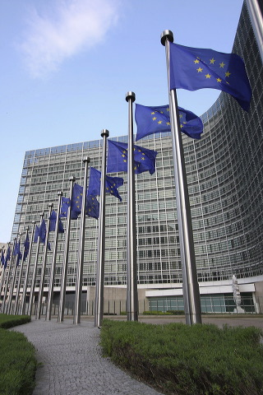
Thank you!
Carlos Morais Pires
carlos.morais-pires[at]ec.europa.eu
@CMPires

