Slide 1
Keeping it simple (…or at least trying to…)
Some experiences in drafting a national RI standard
Magchiel Bijsterbosch, euroCRIS seminar, Brussels, 9 September 2013

Slide 2
About me
Magchiel Bijsterbosch
Project manager
@ SURF since 2007
Software engineering
Enterprise IT architecture
Digital Author Identifier
NL CERIF
Knowledge Exchange
Previous work
Enhanced Publications
NL RIS

Slide 3
Organisation structure

Slide 4
What SURF can do
guarantees collaboration and involvement of managers in
higher education and research
connects users and ICT services and creates new
functional possibilities
favourable conditions for ICT services, software, content
high-performance computing and visualisation for science
efficient management of results of collaboration projects

Slide 5
Evolution of CRIS in The Netherlands
History
1992: METIS (OZIS)
2008-2012: Joint European Tender ‘NL RIS’
now: Individual procurement
Current situation
METIS
Converis
Pure
…?
Notes:
http://www.sunlost.com/phudivwebsm.jpg

Slide 7
- Maurice Vanderfeesten, SURF

Slide 8
Research Information in The Netherlands
Evolved into serving two domains
Institutional Research
Library
Main research information infrastructures
METIS: Research information systems
NARCIS: (Open Access) Repository network
GGC / Digital Author Identifier: Library catalogue
Standard Evaluation Protocol (SEP)
VSNU, NWO, KNAW, Rathenau Institute

Slide 9
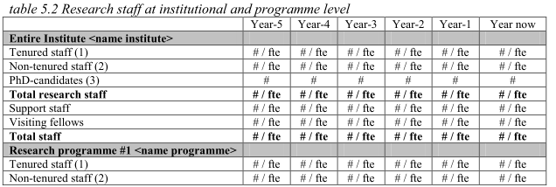
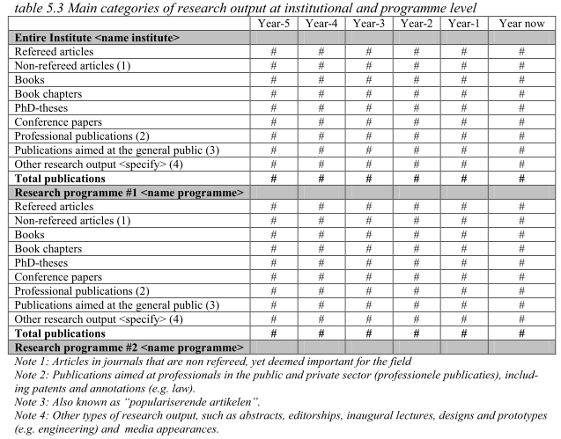
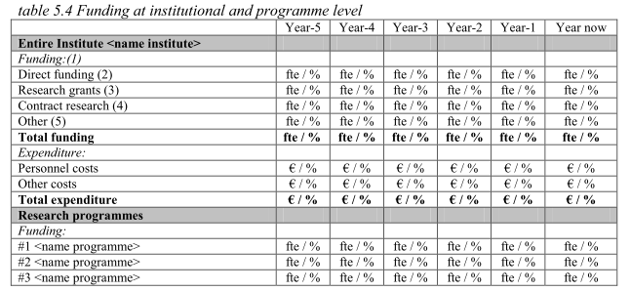
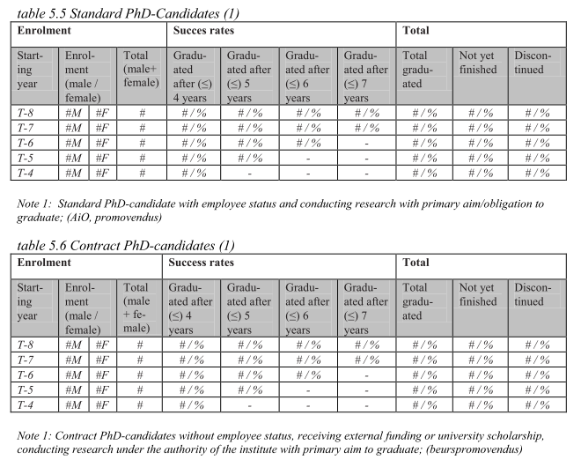

Slide 10
Forcing open doors
Single application != Standardised infrastructure
Business processes are key in tackling interoperability issues
Aggregating demand is NOT summing requirements
Notes:
http://www.onderwatersport.org/Portals/1/Goodpractices/2013-07-05%20-%20Duikteam%20Nemo%20stapt%20af%20van%20one-size-fits-all-lidmaatschap.jpg

Slide 11
Call for a Data model
Fragmentation of the Application Landscape
Maintain interoperability
Money
Research information = expensive
13x Research Information = expensive x 13
Complete picture
Research assessment
Impact of policy
Credit
Data reuse (Accessible, Intelligible, Assessable, Re-usable)
Notes:
http://news.toyark.com/wp-content/uploads/sites/4/2010/03/Star-Trek-TNG-Data-Dragon_1268759249.jpg

Slide 12
Interoperability?
Virginia Modeling Analysis & Simulation Center (VMASC)
-Wang, Tolk & Wang

Slide 13
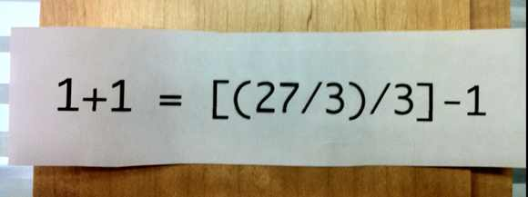
Approach
Working group with different stakeholders and capacities:
University, University of Applied Science, Funder
Library, Research administration, Information architecture
Defined Objective and Scope of a ‘data model’
Exchange of information, not system design
Use the things that are already out there
Only things that we actually want to exchange
Evaluated relevant national policies
Standard Evaluation Protocol, VSNU agreed definitions, KUOZ, WOPI
Evaluated relevant international standards
i.e. VIVO, CERIF, CASRAI, …
Evaluated previous and ongoing work
UK work e.g. CiA, RMAS, C4D
OpenAIRE
Notes:
http://www.accidentalcreative.com/creating/on-my-door-keep-it-simple/
http://www.minimalwall.com/wp-content/uploads/minimalwall-10-52-1-minimal-wallpaper-keep-it-simple-.png

Slide 14
Why CERIF?
International standard for syntax
Semantic layer for semantics
Proper XML serialisation (as of v1.4)
Involvement of vendors
Anticipation on OpenAIRE developments
Keeps aligned with strategic important developments e.g. LOD/VIVO, CASRAI

Slide 15
NL CERIF
Dutch application profile of CERIF
Subset of CERIF entities
Bespoke classifications for Dutch situation based on existing policy
CERIF
Logical data model of entities and relations
Physical data model for applications
Physical data model for exchange

Slide 17
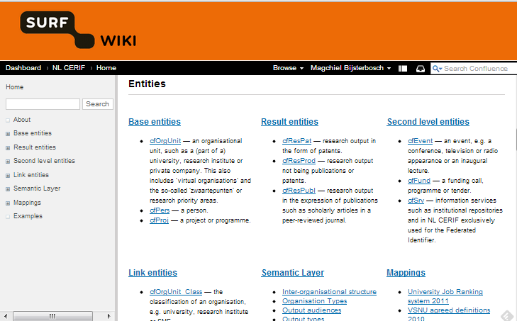
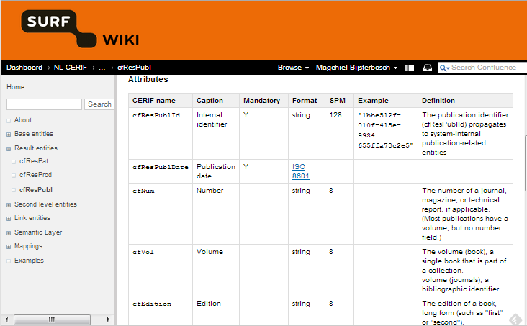
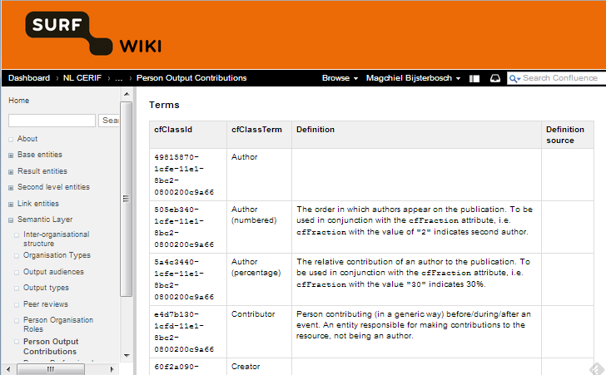
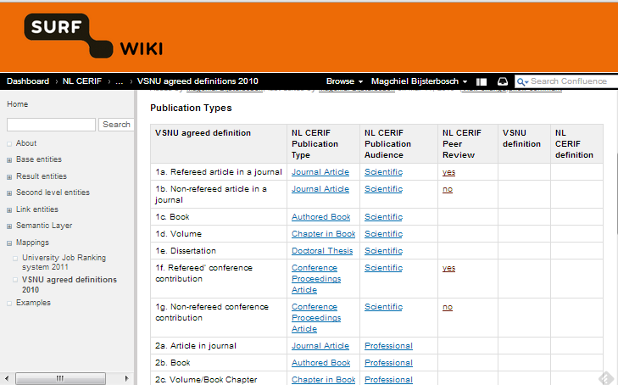
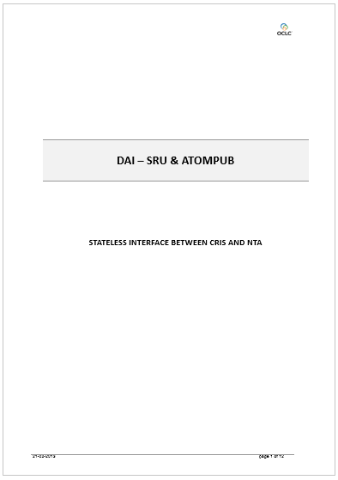
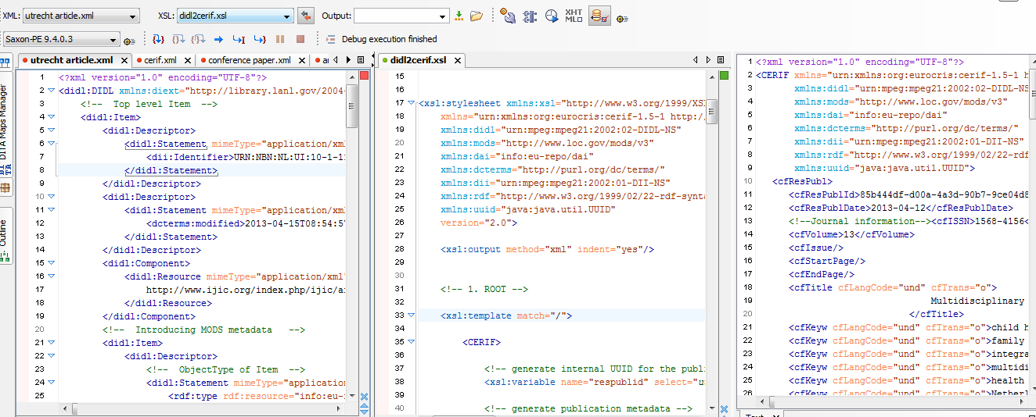
Results
Wiki with coherent documentation
PoC stylesheet for automatic conversion of NARCIS metadata
Draft specifications for new API for DAI (CERIF + SRU + AtomPub)

Slide 18
Some issues
In general
It’s complex. Full stop.
Documentation, examples, best practices help, but is currently limited and fragmented.
Reference document step in right direction
Stuff like CiA helped a lot
Name variants with publication
Digital Author Identifier
Notes:
http://www.redvooz.com/wp-content/uploads/2012/10/Confused-Cat.jpg

Slide 19
Some issues (continued)
Correct name variant in publication
No N:1:N resolution to maintain correct bibliographic information for a given result
Less-than-ideal workarounds:
Multiple cfPers entities with ‘sameAs’ through classification or cfFedId: beats the purpose of having a normalised datamodel
Use of DC entity: deprecated in v1.5
Keep using MODS for bibliographic records: multiple (overlapping) standards
Possible solution: introduction of a new link entity between cfResult… and cfPersName

Slide 20
Issues (continued)
Digital Author Identifier
Requirements
1:N registration of author in central catalog and employee in CRIS at university
Currently administered are institute, temporal information and CRIS ID
-Johan Stapel, KB

Slide 21
904532456
NTA
Institute 12
In: 17-05-’85
Out: 13-04-’90
914892063
Institute 9
In: 13-04-’90
Out: 01-01-’01
123795806
Institute 14
In: 21-12-’01
Out: -
724573901
Institute 4
In: 09-02-’09
Out: -
471928504
CRIS
CRIS
CRIS
CRIS

Slide 22
Some issues (continued)
Solution 1
cfPers_OrgUnit + cfClass
Focus is affiliation
Ugly use of CERIF
Solution 2
cfFedId + cfSrv (+ cfOrgUnit)
Focus is local CRIS Identifier
CRIS service is authority of Id
CRIS service is located at OrgUnit
Conceptually ‘pure’ from an IT perspective
More overhead

Slide 23
Some issues (continued)
Solution 1
Solution 2

Slide 25
Outlook
Polishing the current version
Documentation
Reviews
Pilots
Ironing out the kinks
Standard body (EduStandaard)
Keeping it aligned with developments
CERIF version 1.6 / 2.x
OpenAIRE
New SEP (2016)
Expanding and introducing new features
Project, funding, input
Research Data
Applied science
CASRAI?
Notes:
http://www.bookorchard.com/imgs/media/MediaPhotos/stew-binoculars.jpg

Slide 26
Closing thoughts
We’re only getting started: value creation still to be realised e.g. reduction of duplicated administrative efforts between universities and exchange with funders and VSNU.
True interoperability starts in business processes, but policy and standards help in creating a framework.
CERIF is potentially powerful, but only if understood by the ones that opt to use it: more examples, recipes, case studies.
‘High cohesion, loose coupling’?
Simple things need to be simple.
Notes:
http://cdn.memegenerator.net/instances/400x/37669705.jpg

Slide 27
Magchiel Bijsterbosch
Magchiel.Bijsterbosch@surf.nl
http://wiki.surf.nl/display/nlcerif

