Slide 1
OpenAIREplus – Research Information 2020
Najla Rettberg
University of Göttingen, Germany

Slide 2
Overview
What is OpenAIRE/plus about?
Services on top of Repositories
Interoperability issues
Heading towards Horizon 2020
2

Slide 3


What is OpenAIRE?
2009 – 2012, 27 countries
EC Open Access Pilot, Mandate, SC39
Measure Impact of FP7
OA Publication Infrastructure
Cross-Discipline
FP7 Project Information
Open Access repositories

Slide 4
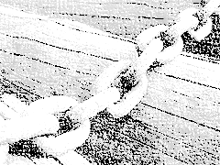
OpenAIREplus - Phase II
Dec, 2011, 2.5 yrs, 33 countries
Building on OpenAIRE
Linking of OA Publications to Datasets
Linking to Funding, outside FP7
Discovery and Reuse
Service for Users

Slide 5

Horizon 2020
Welcome Recommendation & Communication of
17th July
OA to “results of publicly funded research”
“Sharing Data and having the forum to openly use and build on what is shared, are essential to science ”
    Open Infrastructures for Open Science
    Vice-President of the European Commission Neelie Kroes,
Notes:
Very diverse national research environments & policies & collaborations
emerging need to learn more about research data management

Slide 6
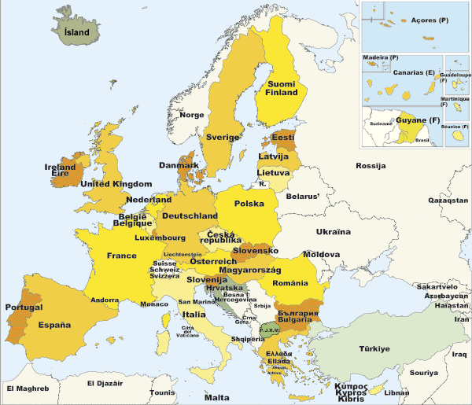



Covering‘European Knowledge’
OA Publication Infrastructure
Open Data Infrastructures
ESFRi, EU wide infrastructures
6

Slide 7
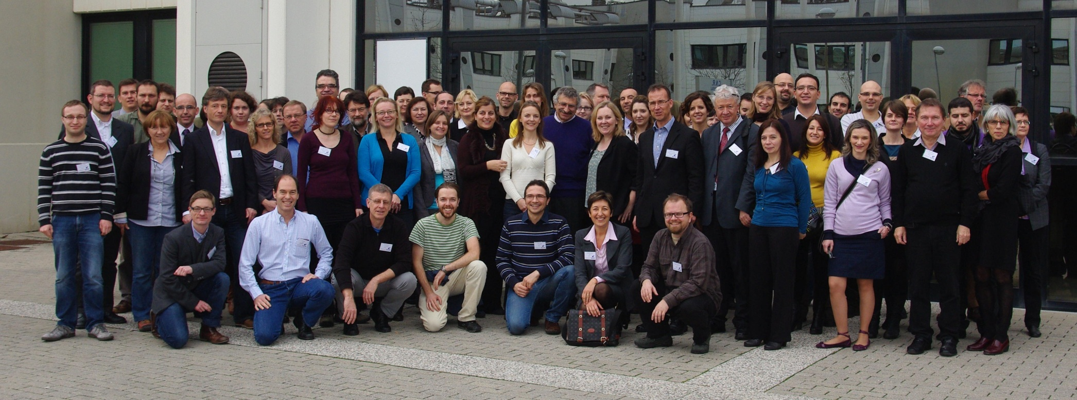
41 Partners…
7
Notes:
7

Slide 8
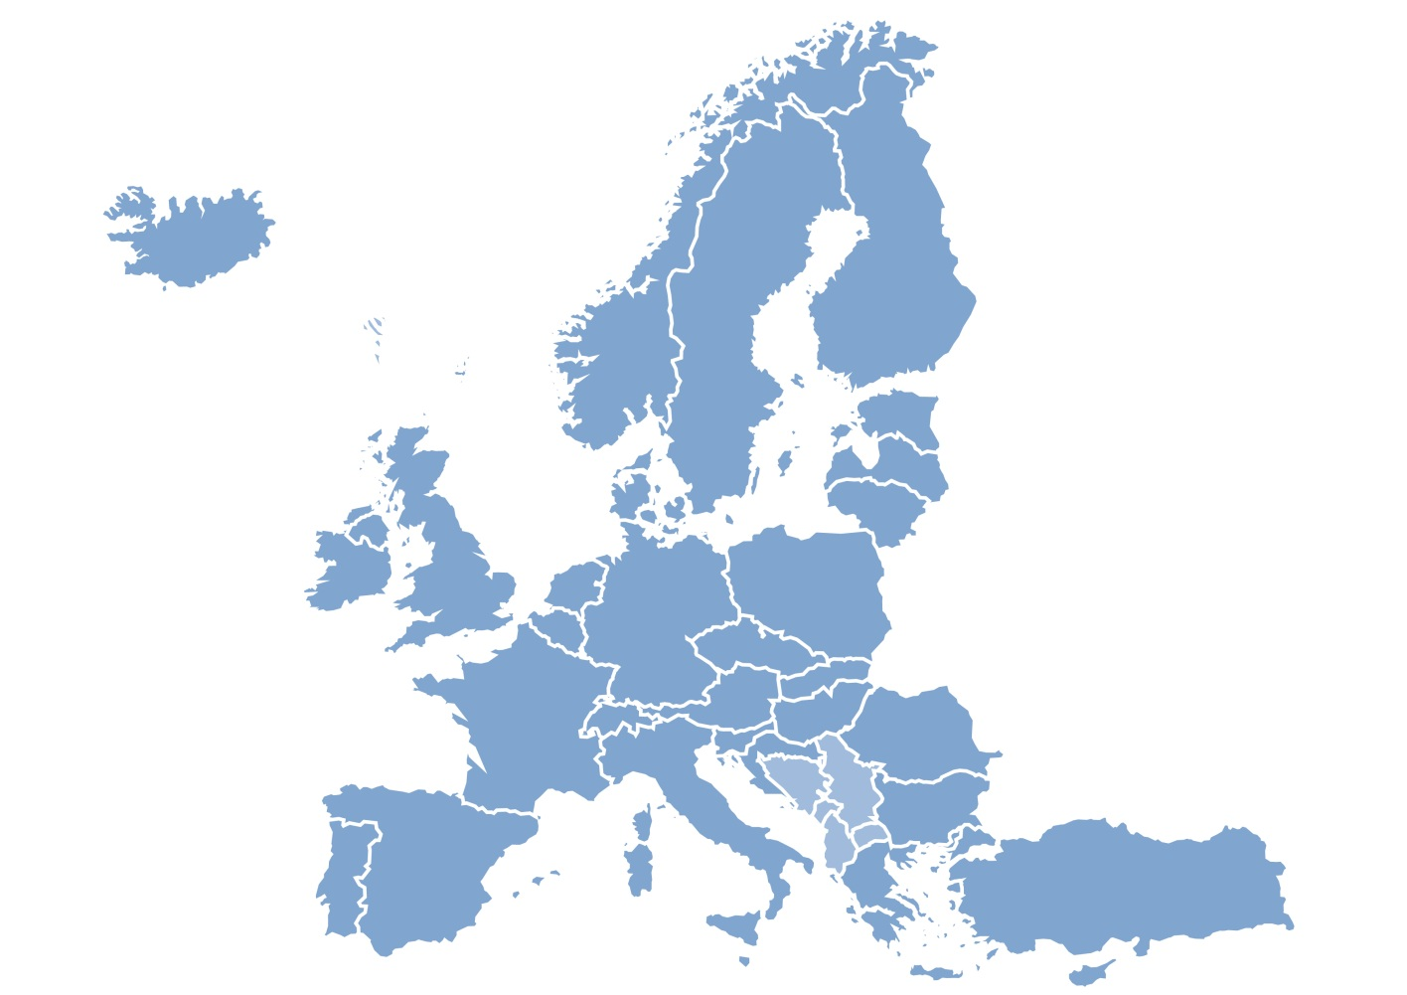
Supporting OA in Europe
Network of EU Open Access Knowledge
Expertise in OA, repositories & services
Champion Open Access
Helpdesk
Workshops, Training
4
2
3
1

Slide 9
Community of Practice
Diverse national research environments
Reach out to:
Users, Researchers, Initiatives
Understanding DATA !!!!!
>> A European network of people sharing experiences & best practice
Notes:
Very diverse national research environments & policies & collaborations
emerging need to learn more about research data management

Slide 10
OA FP7 evaluation – so far
 | FP7 publications | From total of | Projects | OA | Notes
OpenAIRE portal | 3180 | - | 350 | 95% | From OA harvesting
PUMA | 463 | 58,763 | 78 | 40%
ArXiv | 4501 | 313,391 | 863 | 100% | Searched everything published after 2007
UKPMC | 608 | 242,407 | 388 | 100% | Open Access set +350 FP7 publications with no referral to Grant Agreement (ERC)
Other sources | 17,472 | 70,079 | 3496 | 12% | 2,267 OA publications (DOAJ) 937 publications with no DOI 1230 duplicated in ArXiv
Total | 27,180 | 684, 640
35-40%
Total Open Access ~10,000

Slide 11

Services for ….
Researchers
Retrieval and access to «publications», support to new knowledge generation
Research administrators
Research and funding evaluation
Project coordinators
Dissemination & compliance
  EC project officers
  Guide on how to support projects, impact indicators
Data providers
Tools for data source validation and registration
  Support for minimizing effort to comply with guidelines

Slide 12
Researcher - Deposit and claim
Orphan@CERN
  Seamlessly integrated with OpenAIRE
Manual “claiming” through
  DOIs in CrossRef
  OA repositories in DRIVER
Semi-automated crawling to identify FP7 publications from external data sources

Slide 13
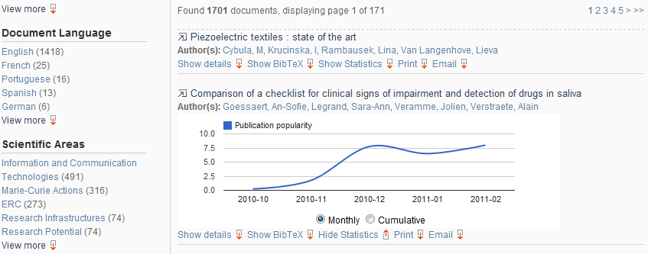
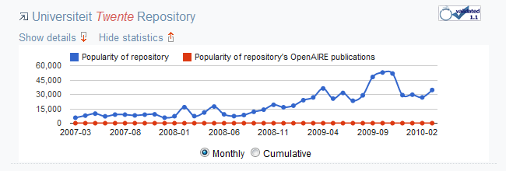
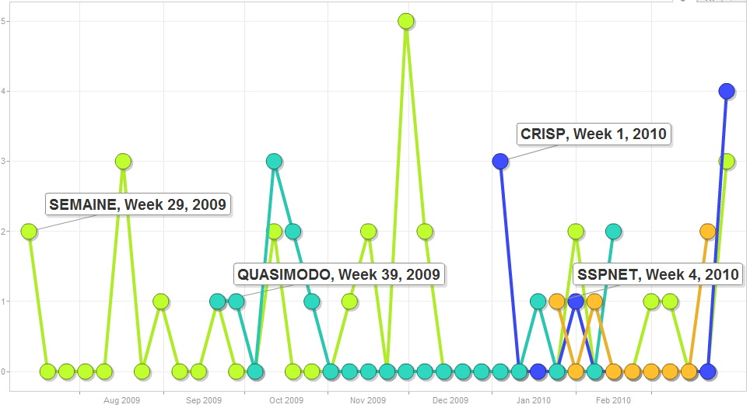
Administrators – Statistics
All
publication level
repository level
project level

Slide 14
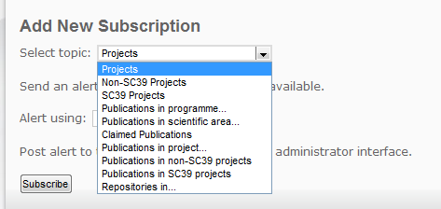

Coordinators - Alerts
All
  Delivery of information to users
Subscribe to topics of interest
Receive notifications through various means

Slide 15
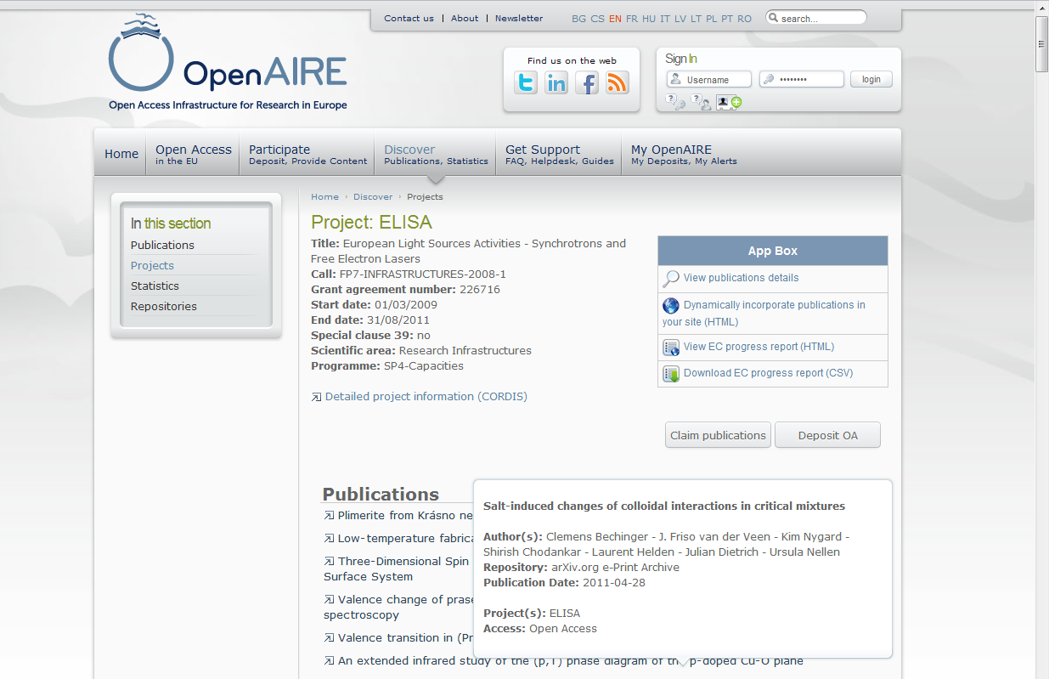
Project Coordinators - Reporting
15

Slide 16
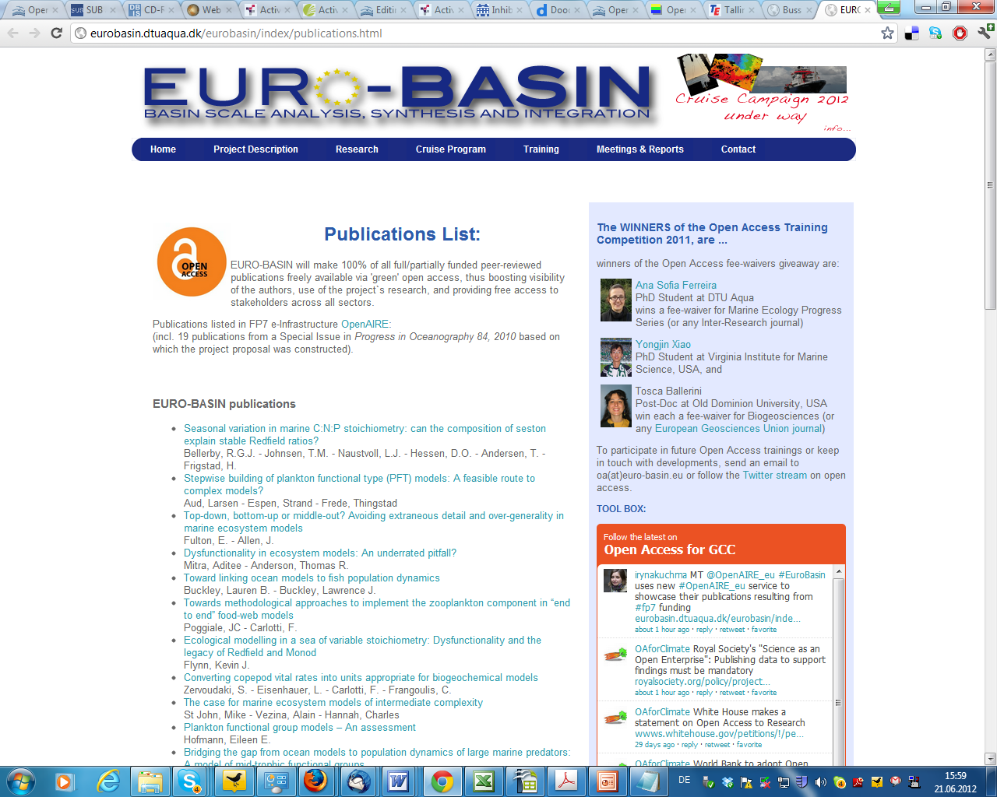
FP7 Projects: Encourage OA
16

Slide 17


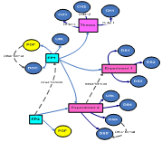





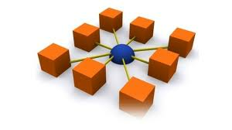


Services/Data Model
Deposit/
Ingest
Publications
&data
Curate & collaborate
Research impact
Citations, usage statistics
+++
Visualize - Manage
Enhanced Publications
Get support
(NOADs)
Search & Browse
Linked Content
Statistics
+++
Licensing Information
Classify
De-duplicate
Cite
Link
Text Mine
APIs
Usage data
5,200,000 OA publications
331 validated repositories
Metadata
on data sets
Guidelines for Data Providers
OpenAIRE Guidelines
Orphan
EC funding
ResearchID (ORCID, ..)
CRIS Systems
OpenDOAR
Publication repositories
Institutional & Thematic
Open Access Journals
National funding
…
Data repositories

Slide 18
OpenAIRE and EuroCRIS
Streamlining OpenAIRE Data Model with CERIF standard
  Captures semantic relationships – research in context
  Publications – datasets –projects – funding
Domain independent commonalities for datasets
Publication-project objects retrieved from CRIS, via OpenAIRE (e.g Norway)
DataCite. Some entities could be re-used by 3rd parties

Slide 19


Guidelines for data repositories
Existing DRIVER and OpenAIRE guidelines
  Publication repositories
Extend to export metadata about research data
Not prescriptive, more exploratory
Value
  Existing standards, community use

Slide 20
Expanding Data Model
Looking at existing data sources and guidelines
  Metadata
  Interfaces for data exchange
  Scope of repository - fields, types of data
  Curation policy - versioning, access policies
Please get in touch as data repository!

Slide 21
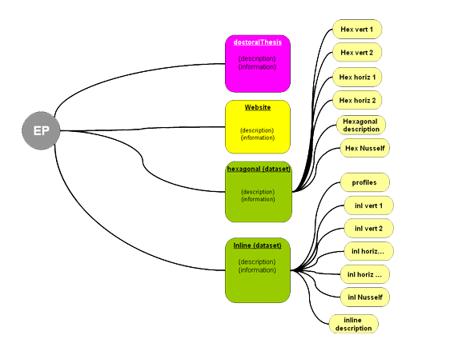
„Enhanced“ Publication
EBI-EMBL, DANS, BADC
Cross-discipline model
Export to other data infrastructures
1st Step: Representation Prototypes
  Publications, datasets, funding
User a richer experience, context

Slide 22
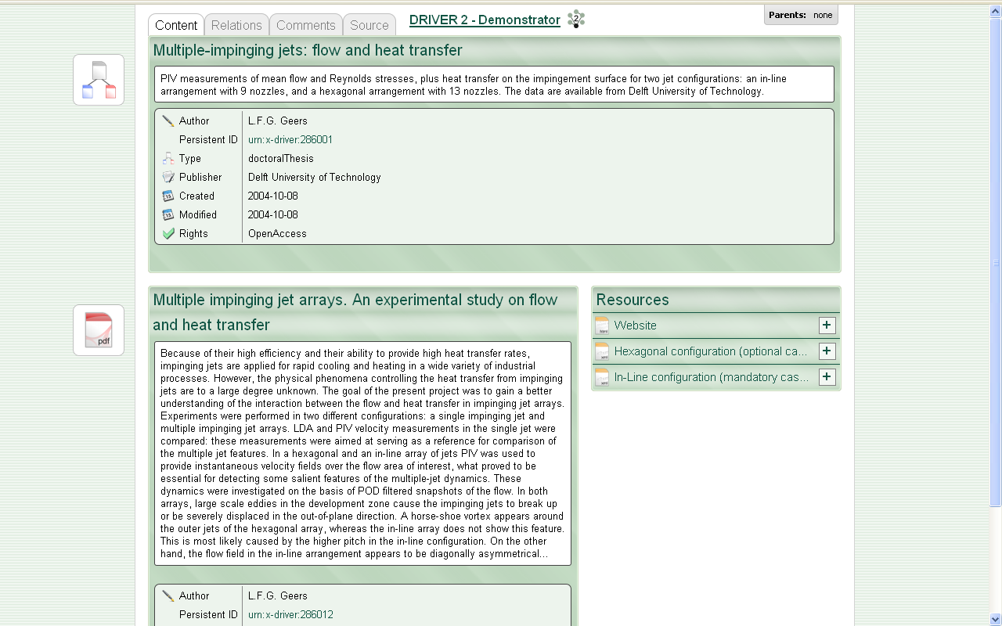
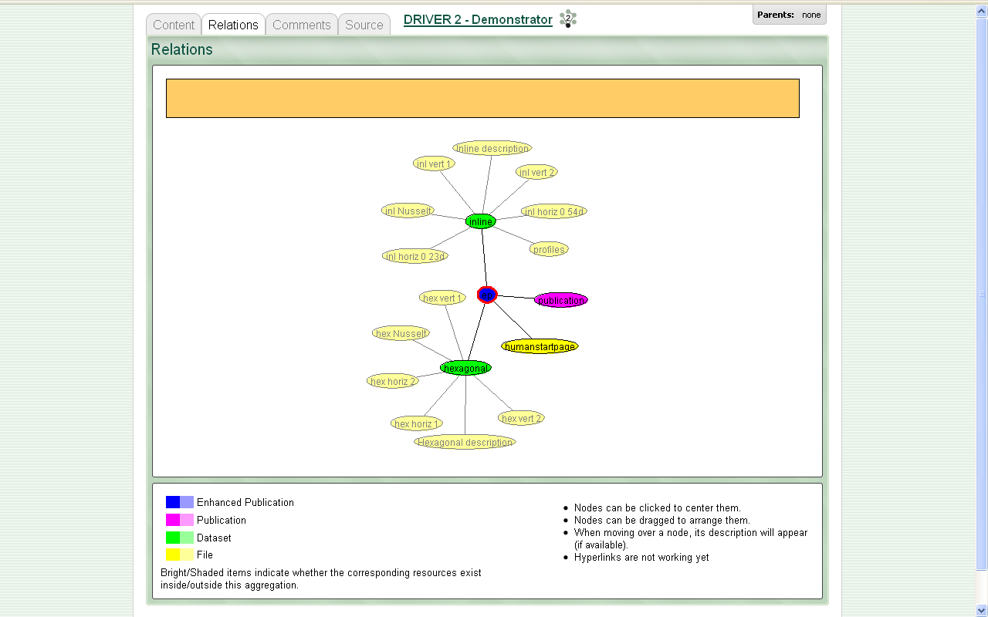
Combining Data and Publications I
<2008/09, DRIVER II Project,
Enhanced Publications, DANS

Slide 23
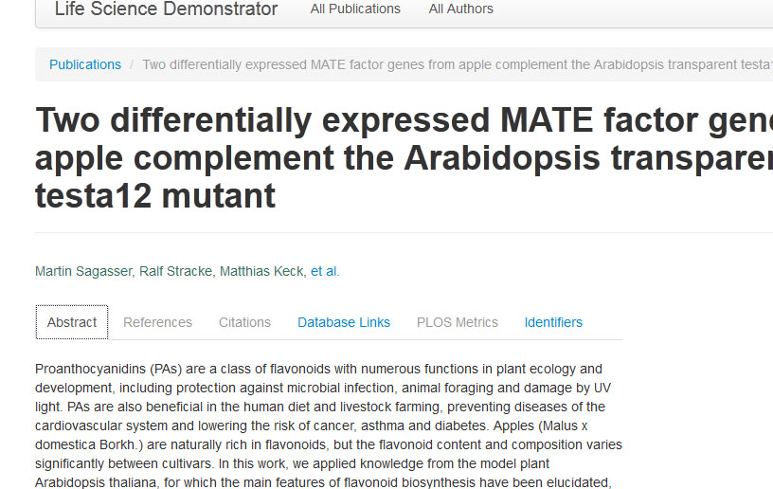
Research in Context

Slide 24
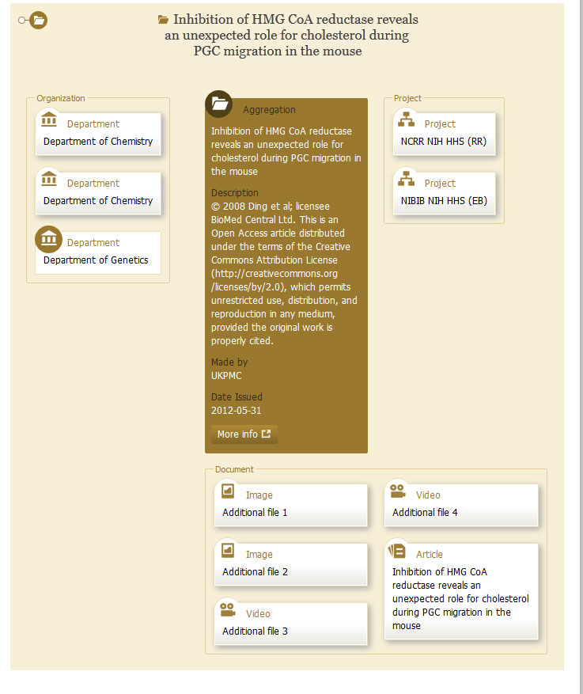
Different Discipline Approach

Slide 25
Prototypes
Bringing data into/export from OpenAIRE
Use CERIF to represent relationships
  Linkage structure of CERIF,
  Benefits of versioning, multimedia, IDs
Issues:
  Authentication
  Boundaries of an EP
  Static vs non-static
Notes:
(a) each component of an enhanced publication represented in CERIF has a unique ID (b) CERIF can link together these components in multiple ways using the temporal and role-based linkage structure of CERIF; (c) CERIF can represent all the current known components of an enhanced publication, (d) CERIF naturally handles multilingual, multimedia information and versioning.

Slide 26
Open Science - Challenges
Policy Harmonisation
Attracting researchers
Organisation:
  Institutional vs. Disciplinary approach
International linkage and embedding
  Stakeholders
Interoperability
  Diverse repository landscape
Notes:
OpenDOAR1– Directory of OA repositories: update of repository information.
− DOAJ 2 – Directory of OA Journals maintained by Lund University3: use to identify OA journals .
− CrossRef4– collective publisher infrastructure for DOI resolve: use to identify publications and link to projects.
− DataCite 5–data citation provider: retrieve dataset metadata to subsequently cross-link to publications.
− PLOS 6– Open Access publisher: collaborate on usage statistics on FP7 publications.
− Mendeley 7– reference manager and academic social network: collect usage statistics and relationships between publications and authors.
− ORCID 8– author identification service: collect author ids and integrate into the portal deposition workflows, as well as in the publication-data linking processes.
− REISearch.eu – European researchers’ social/excellence network: OpenAIRE provides its content (OA publications) to be used by European researchers.
Moreover, OpenAIRE is in the process of extending its services to other funders with established OA policies (national, public or private) so as to cover all European research activities. Current collaborations include:
− Wellcome Trust9- UK life sciences funder: an ongoing effort is in place to produce a prototype with WT funded publications. This will pinpoint the challenges on how all funding information is merged and visualized.
− FundRef 10
− National CRIS systems: exchange funding information and related publications.

Slide 27
An Eye on Research Practice
“Forget PDFs, imagine an ideal publication where you click on tables to get through to raw data, where you can… discuss …and later update …a paper in subsequent versions.”
  PhD Student, UGOE

Slide 28
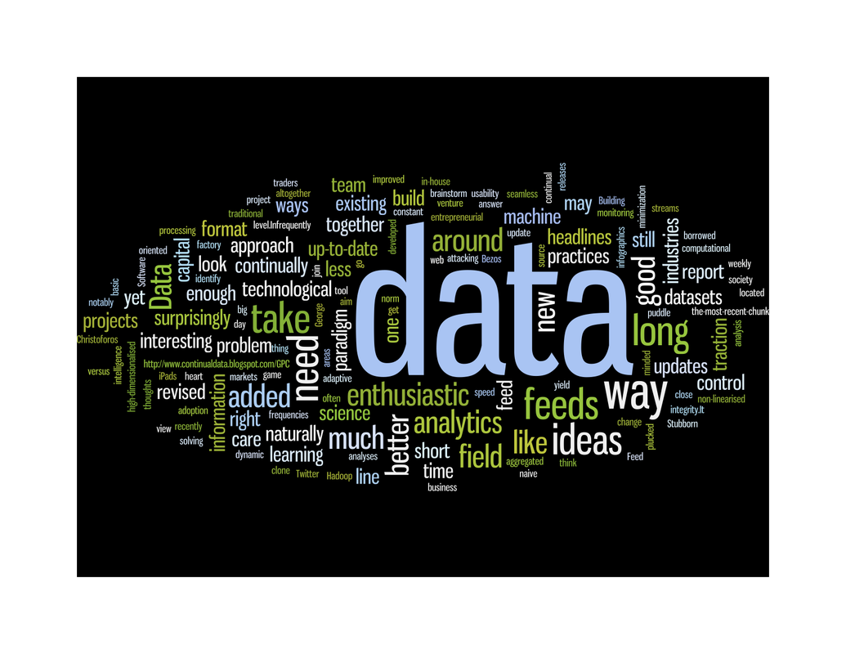
Heading to H2020
OpenAIRE: OA publication infrastructure
Grow repositories
Services ontop of repositories
Include CRIS systems
  use OpenAIRE‘s API for pub – EC funding links
Data is now ‚mainstream‘: Links to data infras

Slide 29
Heading to H2020
Human Infrastructure: local to global
Collaborations with publishers
Impact of funding streams will be key
  Metrics, trends in science
Funders: Investment in harmonisation

Slide 30
Meet us…
Our workshops
Interoperability – Portugal – 6 Feb 2013
Linking Research – Belgium – 28 May 2013
Legal, Sustainability – Lithuania - Late 2013

Slide 31



  najla.rettberg@gwdg.de
  www.openaire.eu
  @openaire_eu
  facebook.com/groups/openaire
  linkedin.com/groups/OpenAIRE-3893548

Slide 32
Credits
Some slides by D. Castelli, N. Manola
Pictures
Wordle Produced from: www.gpcworks.com with kind permission
CC BY-SA 2.0 Wilhei55, source:http://www.flickr.com/photos/wilhei/764583210/in/photostream
Mouse/DNA©: EBI-EMBL www.embl.it. With kind permission for reuse
CC BY-SA 2.0 rdecom source: http://www.flickr.com/photos/rdecom/7336830168/sizes/z/in/photostream/
32

Slide 33
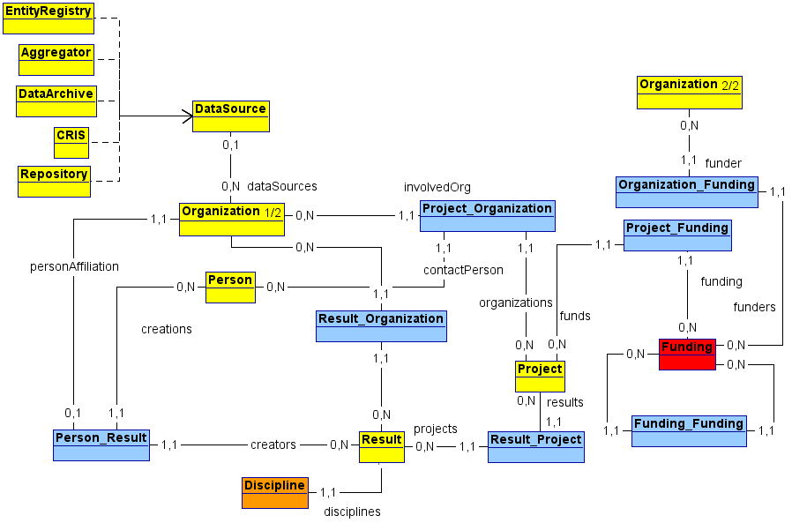
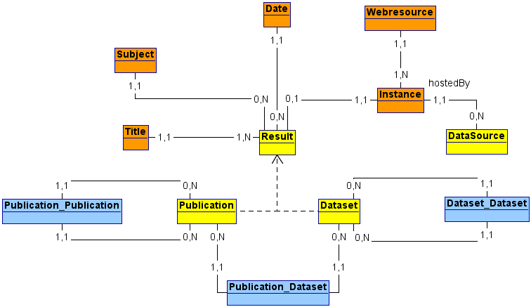

Slide 34
OpenAIRE current data & services
Deposit/
Ingest
Publications
Research impact
Citations, usage statistics
Search & Browse
Linked Content
Statistics
Usage data
Orphan
EC funding
OpenDOAR
Publication repositories
Institutional & Thematic
Open Access Journals
34
Slide: D. Castelli, CNR
Notes:
34

Slide 35
Our challenges
‚Compatible‘ Repositories
  Low-priority, funding ID field, lack of FP7 publications
Weak mandate: SC39
  Reasons: not embedded in workflow
Text-mining, identifying publications
Heterogenous data landscape
35

