Slide 1
Harmonising Research Project Information
EuroCRIS Members Meeting, Amsterdam, 11-12th Nov 2014
Gerry Lawson & Christian Herzog (UberResearch)
Notes:
Note that “Information” is used here rather than “data”. This talk will be about the metadata related to projects - the “inputs” to these projects in terms of money, people, organisations, classifications, project-project links and the publications/outcomes of these projects. It is not about “Research Data” which is generally taken to mean the datasets holding the results collected in the research or the datasets used by the research.

Slide 2
Research projects - why share info?
Why do funders need to share research project information?
Why do research organisations need to share research project information?
Why do governments share research information?
Do we need a Names Authority for funders?
Do we need a Names Authority for projects?
What subject classifications which can be used?
What national/international project-databases exist in Europe?
What does ÜberResearch offer ?
Notes:
These are the questions to be addressed. Gerry will deal with questions 1-7, then Christian will describe how the UberResearch “Funder Dimensions” service is addressing the issues. He will also make an an announcement to make of particular relevance to small funders.

Slide 3
Funder needs
Planning of ‘Directed Mode’ programmes
Monitoring of ‘Responsive Mode’ projects
Thematic comparison of portfolios - spend (%), number people, outcomes, impacts
Plan for international programmes - e.g. ERA-Nets, EUROCORES
Identify proposal reviewers and conflicts of interest
Link projects to publications and outcomes.
Notes:
Needs a thematic comparison of a funders project portfolios with those of other analogues in Europe and elsewhere; this needs international comparability of subject classifications (q.v.).
Responsive mode proposals should only be judged on the quality of the research - not on thematic priorities, BUT the whole portfolio need to be monitored and compared to the funders overall strategy (usually set jointly with the research community).
Projects are usually grouped into Programmes (or Review Panel), but its very difficult to compare funders thematic priorities because they all use different classifications programmes because
EU financial instruments exist to encourage international research projects (Article 185, ERA-Nets, EUROCORES), in addition to international collaboration for EU research funds (recorded in CORDIS).
Funders have panels of reviewers (which they know well), but always need independent external reviewers - who have not worked on projects or publications with the applicants.
Increasingly Funders are funding (at least partially) the Article Processing Charges of publications arising from projects which they fund. There is a need: a) for ROs to report on how they spend these OA funder, b) to do this at the project level, c) to ensure that individual funders are not incurring too high a proportion of this cost. Funders also collect information on outcomes/impacts on an individual project basis.
(possible additional slides in this section - decline in real spend on science (UK), emphasis on value for money, slide to illustrate the “snapshot” project information collected by scores of ERA-Nets)

Slide 4
Research Organisation (RO) needs
ROs (centrally) often don’t have full information on external projects involving their staff
ROs now have sophisticated CRIS systems - and these should be the main source of research outcome information
ROs need to compare their research metrics with other ROs
ROs now have to have Data Management Strategies - datasets are increasingly linked to Project DMPs
Notes:
Central Research Offices in Universities are not always aware of the projects that their staff are participating in (?)
More than 70% of RCUK research funding is given to ROs which run CRIS systems (more than 98% if Institutional Repositories are included)
Universities have performance indicators and REF targets to meet - they are increasingly keen to ensure that Institutions, Departments and Individuals match publication and research income targets. Information on the cash equivalent of time competitively awarded on facilities is also important.
Funders are encouraging Institutions and Projects to have data management strategies and plans. It is best to plan data collection, cataloguing and long-term curation at the PROJECT level.

Slide 5
Government needs
Governments collect research information on research expenditure, personnel and patents etc from universities, public institutions and business
EuroStat, OECD, CORDIS collate this information internationally.
Governments prioritise support to universities based on combination of peer assessment and bibliometrics
Governments bombard universities with demands for information on research funding, staff and students!
Governments have an increasing emphasis on Open Access to publications, projects and research data
Notes:
Describe the UK annual data collection on Research Statistics.
Describe the EuroStat, OECD(GERD) returns - include a graphic). Also the CORDIS Projects and Results Service.
Describe the importance given to research income and “in kind” (e.g. Facilities use, Large Equipment Fund) income in the UK.
Describe the work of the UK HEDIIP initiatives to rationalise information demands
Describe the work of the European Semantic Interoperability Community to develop standards - including the importance of persistent HTTP URIs with standardised metadata schemas. Mention ERC and the Global Research Council. EU Open Science policy, and the increasing importance of shared and discoverable research data.

Slide 7
Names Authority for Funders ?
First attempt was RIN format to “Acknowledge Funders in Journal Articles”
FundRef provides an “unofficial” Names Authority for funder names and associated metadata. It is used by publishers and could be used by Repositories (e.g. in RIOxx and OpenAire).
Funders are not unique entities - they are class of Organisation - and may not need a separate Names Authority if ISNIs are used (currently 447k organisations - 83% from Ringgold).
Interoperability needed with other Names Authorities like ORCID (people), publications (CrossRef), datasets (DataCite) and equipment/facilities (www.equipment.data.ac.uk)
Notes:
The RIN Agreement was published in Feb 2008, and was signed by UK funders and the Publishers Association. It was not international in scope and poorly applied, but did give a format to be used in the Acknowledgement section of papers and stipulated that Grant References should be enclosed in square brackets. Unfortunately it was poorly adopted by funders and publishers. The Thomson Reuters “premium” webservice does make FunderName, GrantRef and AcknowledgementText available, but this is collected manually by TR - possibly supplemented now by metadata from CrossRef.
FundRef maintains a list funding organisation identifiers - and publishers are increasingly expecting these in article submission forms. It is currently possible for authors to ‘invent’ new funder names if they do not find the funder ID they wish on the dropdowns (subsequent checking takes place by Elsevier, using the Ringgold database - although neither the Ringgold ID or its associated ISNI ID are made available yet on the FundRef API. This API provides funder-names, acronyms, country and identifiers). A search tool is provided which shows all publications acknowledging funding from a given funder, with filters for publication type, year, OA status, publication name, category, publisher and source (so far only CrossRef). This is an “unofficial” Names Authority because (unlike CrossRef and DataCite it is not registered with the International DOI Foundation. In the UK, repositories will be asked to become compliant with RIOXXv2.0 (link) by April 2015. This sets OA and Funder acknowledgment metadata standards.
IISNI is the ISO standard (ISO 27729) and Ringgold is the ISNI Registration Agency for organisations. Ringgold IDs are used in ORCID and CCC Rights Link. ISNI is contributed to by 29 institutions and databases, and 40 major national and research libraries. ISNI is the NISO recommended standard for institutional IDs. It is possible for research organisations to fund their own research projects and issue their own ProjectIDs. Thus ISNI has major advantages as a ‘bridging’ institution ID (or URI) linking all IT sustems which use their own OrgID lists. Ringgold is testing the online ISNI online assignment API, to ensure that its database is permanently aligned with ISNI. In mid-Sep 2014 ISNI had 446,237 assigned IDs for organisations. 368,284 of these are Ringgold source and only 430 Ringgold OrgIDs need manual review for possible duplicates. There are a further 2.83 million organisational records with provisional status (mainly derived from VIAF). Membership of ISNI costs only 800 euros per annum, and provides more powerful query facilities than the public search, and access to the provisional data. Business Organisations are only erratically recorded in ISNI/Ringgold. It would be great if one of the specialist business info providers could become a registration agency for ISNI). Organisational heirarchies are in Ringgold, They exist as a field in ISNI but are very poorly populated.
FunderID needs to be interoperable with IDs allocated by Names Authorities for people (ORCID), publications (Cross Ref), datasets (DataCite) etc (e.g the new equipment database (equipment.data.ac.uk). ORCID holds 16 metadata fields associated with a research project, including the ‘grant/contract/award number’.

Slide 8
Names Authority for Projects ?
There is no need for a formal Authority - combination of the Organisation ID and an UUID/ID allocated by the funder is sufficient.
Metadata standards can be set by an international body representing funders - in conjunction with the CRIS community - e.g. RDA, CERIF, CASRAI, RIOXX, OpenAire, GRIST.
Several countries maintain databases of research projects, but there are few APIs or HTTP URIs (qv).
A project Aggregation Service could be developed - perhaps on behalf of an international body?
Aggregation could be funded with a “Freemium” model?
Notes:
Funders don’t want to ask an external Authority to issue IDs!! IDs should be issued by Funders - but including semantics and separators into the ID itself (as in OpenAire) is inadvisable. An HTTP URI landing page should be provided by each funder (or by someone on their behalf).
Several initiatives are relevant. The Jisc-funded RIOXX protocol v2.0 gives guidance to UK repositories on meeting the UK Funding Councils and Research Councils requirements for Open Access reporting, including linking of publications to FunderIDs/ ProjectIDs, and providing Open Access metadata. It is designed to be interoperable with OpenAire through the UK Repository Aggregation Service (CORE).. UK repositories are expected to be fully compliant with RIOXX 2.0 by April 2016. The EU OpenAire project sets standards for institutional and subject repositories in Europe - including 7.1 ContributorType; 7.2 ContributerName; 7.3 NameIdentifier; 7.3.1 NameIdentifierScheme), although there are complications with the recommended name identifier format (involving the use of forward slashes as field separators) which have prevented its uptake in UK repositories. The OpenAire guidelines for CERIF systems are useful. See following slide for examples. There is a useful report on the use of Persistent URIs in Europe.
The Global Research Council is a possibility?
The Free service could provide (for example), LeadFunderName, LeadFunder URI, ProjectName, ProjectPI Name, ProjectPIORCID, ProjectStartDate, ProjectEndDate, AwardValue, AwardCurrency, LeadOrganisation,LeadOrganisationID.

Slide 9
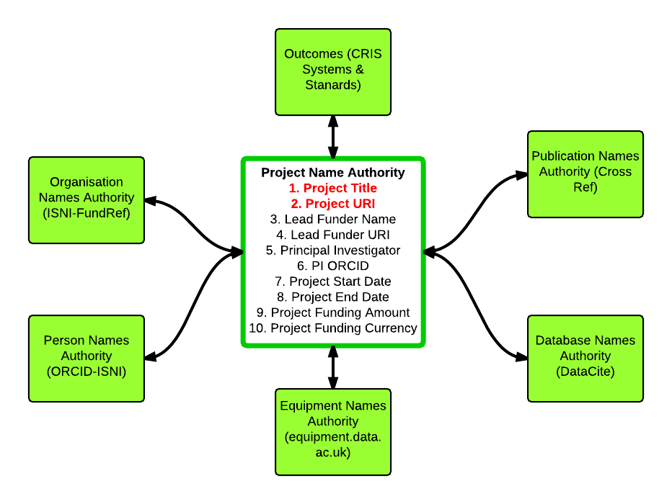
5.1 “Names Authority” for Projects

Slide 10
Research Project Databases in Europe
The UK Gateway to Research Project compiled a DRAFT list of research project databases in the EU28 plus Norway and Switzerland (further input needed from the audience!)
Fifteen have public research project databases - Austria, Belgium, Bulgaria, Czech Republic, Estonia, Germany, Hungary, Luxembourg, Netherlands, Norway, Switzerland, Slovenia, Slovakia, Sweden, UK.
Six have project databases held by the main research funder but these are not yet publicly searchable: Denmark, France, Greece, Poland, Portugal, Spain.
Europe PMC has a search tool linking publications to projects from 22 UK funders plus FWF (Austria), Telethon (Italy) and the ERC.
Notes:
See https://gtrdocs.hackpad.com/Europe-f4oUgkcP3sW for work in progress compiling national information.
See table on following page
Denmark used to have projects in its open access database. Portugal and Spain are close to a public system.
The UKPMC Grant Reporting Tool started operating in 2009 and in 2012 became GRIST (GRant Information SysTem) as part of Europe PMC. It matches publications harvested from CrossRef and elsewhere to lists of grants provided by the 25 funders which subscribe to EuropePMC. GRIST holds 21 metadata fields associated with a research project.

Slide 11
6a. Public Res. Project Databases in Europe
Country | System | Size (K) | Export | Landing Page | Notes
Austria | Projekt Finder | 11.7 | N | N | Modified Frascati FOS
Belguim | FRIS | 27.6 | Y | Y | Own classification
Bulgaria | BulCRIS | 1.6 | N | Y | Ortelius classification
Czech Rep. | IS-VaVal | 41.0 | Y | Y | Own classification
Estonia | ETIS | 12.1 | N | Y | Publication classifications only
Germany | GEPRIS | 96.6 | N | Y | see EUROCris Bonn
Hungary | OTKA | ? | Y | N | Ortelius classification
Luxemburg | FNRL | ? | N | Y | ?
Netherlands | NARCIS | 61.0 | Y | Y | Own classification
Norway | CRIStin | 7.1 | N | Y | Own classification + HRCS
Switzerland | P3 | 57.7 | N | Y | Own classification
Slovenia | SICRIS | 6.0 | Y | Y | Own & CERIF
Slovakia | SK_CRIS | 12.7 | N | Y | Own classification
Sweden | Projektdatabasen | ? | ? | ? | Offline till 21/11/14
United Kingdom | GtR | 49.6 | Y | Y | Own clasification and HRCS

Slide 12
What Subject Classifications to use?
Some classifications (e.g. RCDC, HRCS, RRCS) cover only part of the spectrum of research disciplines.
The Australia/New Zealand Standard Research Classification is comprehensive & classifies expertise, projects, courses and departments.
Some countries with CRIS systems use the 2000 EuroCRIS Subject Classification - based on the Ortelius classification. They may also classify using EUROSTAT “NACE” or “Classification of Products by Activity”.
Some use variants of the Frascati Fields of Science (2007), and one at least (Austria) adds a FOS 3rd level. The European Grid Infrastructure has also added a 3rd level to Frascati FOS and provided an API and change management structure.
CASRAI Canada has a working group on classifications.
UberResearch ran two seminars for CASRAI on Research Classificication.
Notes:
RCDC description here, HRCS description here, RRCS classification description here.
Info on the ANZSRC is here - it is very comprehensive - but lack of a match to Frascati Fields of Science is a disadvantage.
The EuroCRIS classification hasn’t been updated and even the link goes to an archived document. It was previously a 3 part classification, including EuroSTAT Nomenclature Statistique de Activities Economique (NACE) and the EuroStat Classification of Products by Activity.
Can EuroCris delegates please look at the HackPad and update information held there on the subject classifications used for research countries in their countries. (e.g. Statistics Austria has added a third level to the Frascati Fields Of Science (FOS), but only for SOME of the 2nd level terms). The EGI FOS is more comprehensive and balanced - info here here. It is recommended to CASRAI/EuroCRIS. Frascati Manual 7.0 is being produced - and FOS will be expanded in the Arts area. Need better engagement with OECD.
Some information on the CASRAI Working Group is here - but not the draft classification itself. This seems very much a Canadian initiative - its not yet available and unclear how close is it to the Frascati FOS (2007)?
(add a link to the European Grid Infrastructure Site - also clarify the status of the 4th level).

Slide 13
What does UberResearch offer?
Notes:
Chistian - in addition to announcing the price structure for Funders can you address whether a cut down version of metadata (including the Funder ID and Project ID can be made available free (i.e. serving as an ‘Aggregated Names Authority’ for Project IDs).
The UberResearch ‘Dimensions for Funders' system accesses a database of 1.25 million research projects from 7 countries and the European Union. UberResearch uses institutional IDs which are developed together with Digital Science and Nature Publishing Group, and a disambiguation processes for funders and research organisations, which takes ORCID and Fundref IDs into account.

Slide 14
Transmission timeline from idea to impact…
grant
citations
conference
application
publication
idea
1-5 years
2-3 years
3-8 years

Slide 15
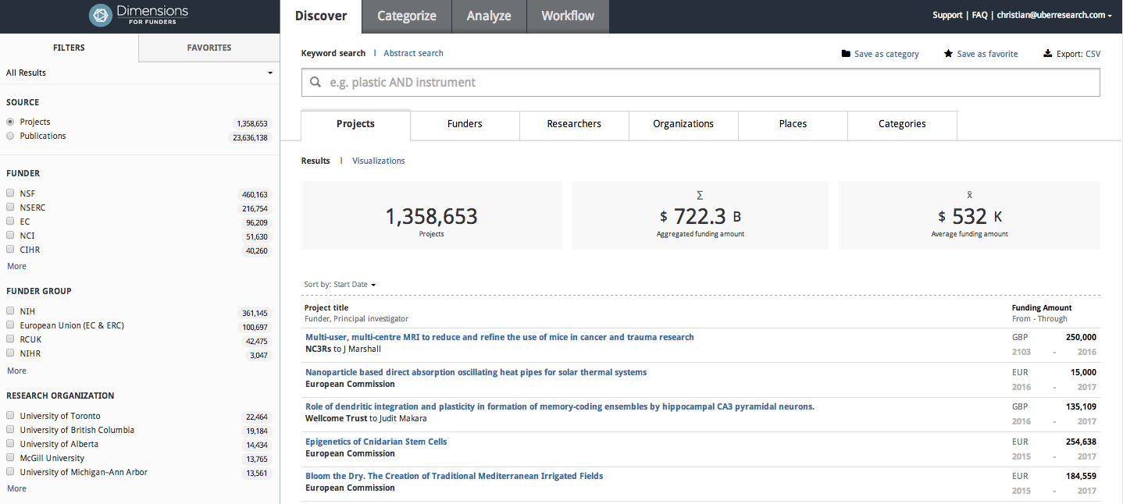
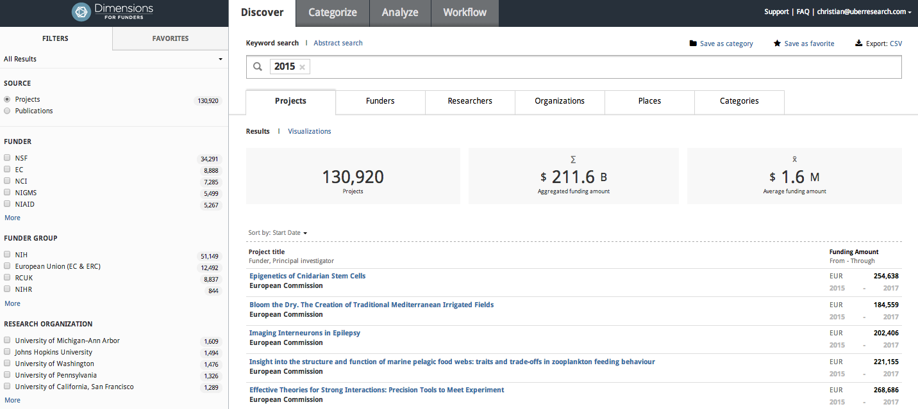
Global Shared Grant Database
Projects and funding amount integrated per Dec. 1, 2014
Filtered for active products in 2015 and beyond:
$211bn which are spent in the future

Slide 16
Dimensions principle in one slide
Shared cloud based solution
Customer / development partner driven
Portfolio Analysis / Comparison
Portfolio Reporting
Content Consolidation
NLP
Person and institution disambiguation
Grants
Grants
ÜberWizard for ORCID
Cost efficient
Internal data
Publications
Publications
Reviewer / Overlap
Disambiguation
Document Matching
Search
Research Classification / ‘Babel Fish’
Custom modules
Coordination and Cooperation

Slide 17
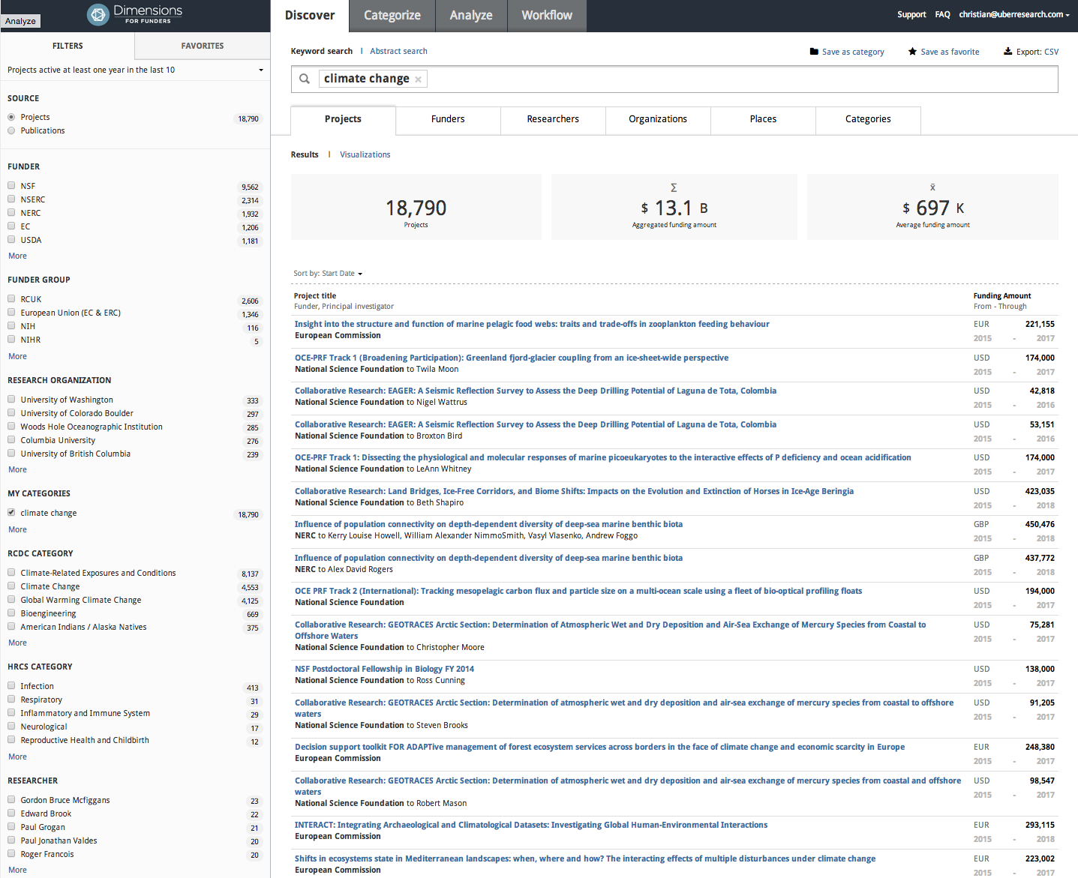

Slide 18
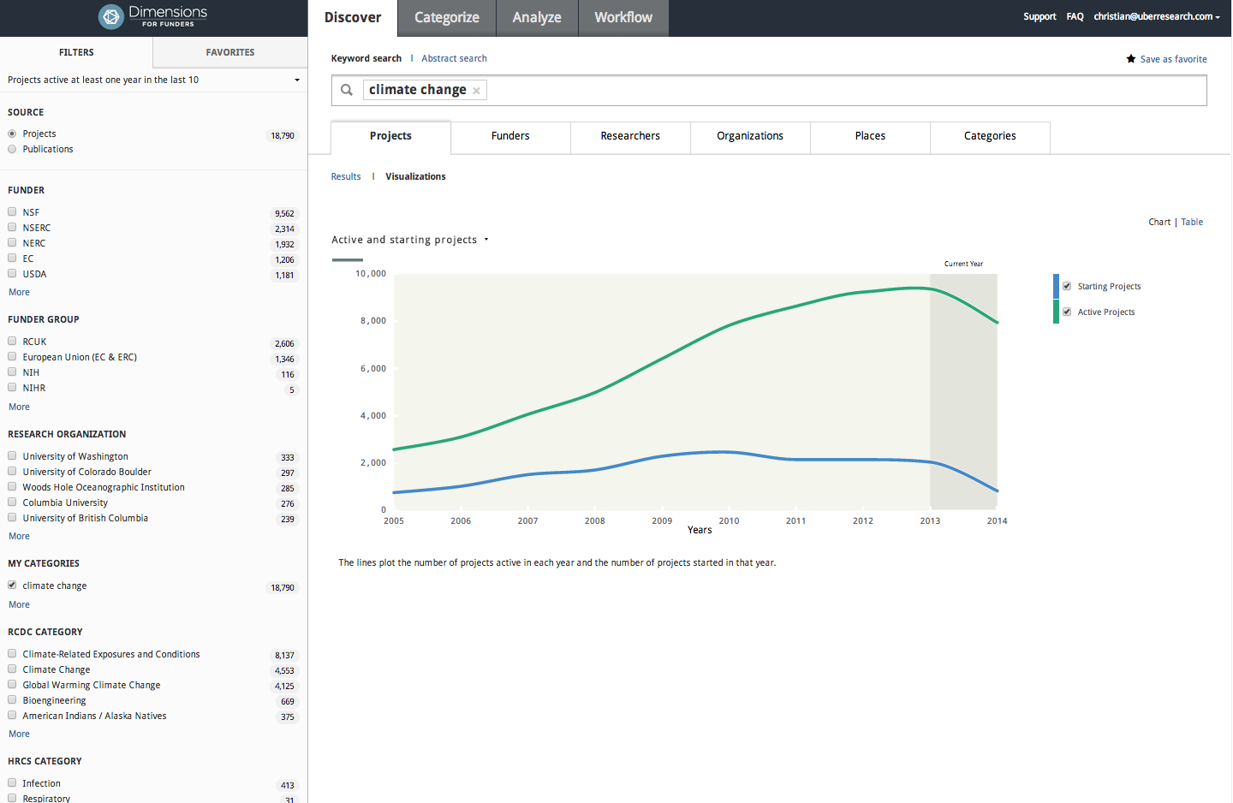

Slide 19
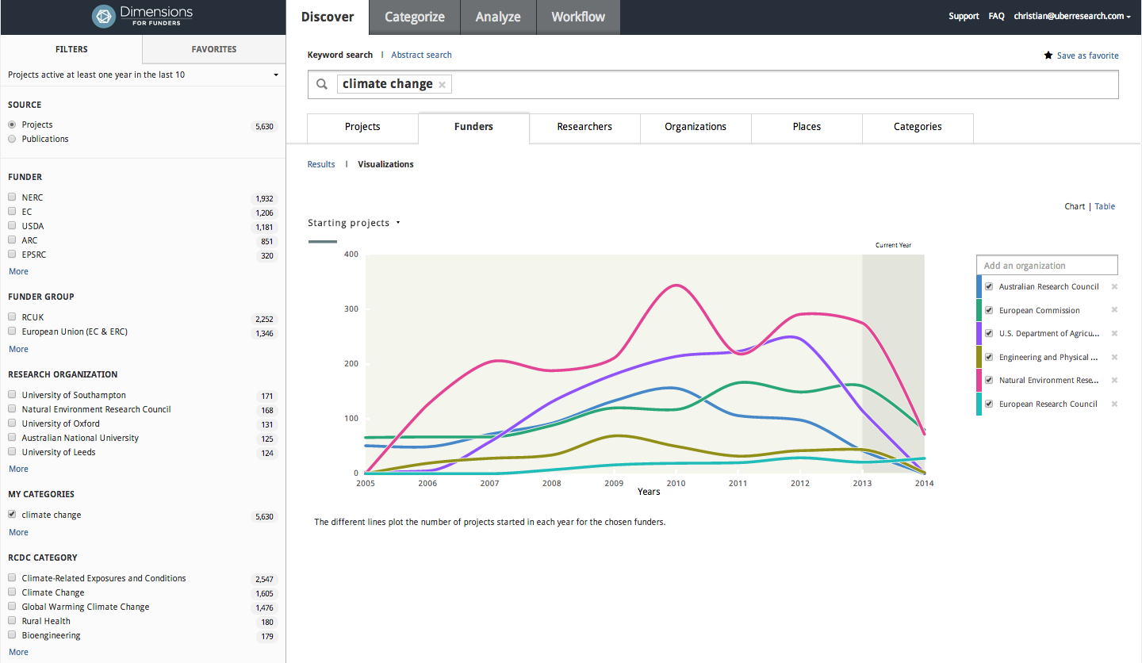

Slide 20
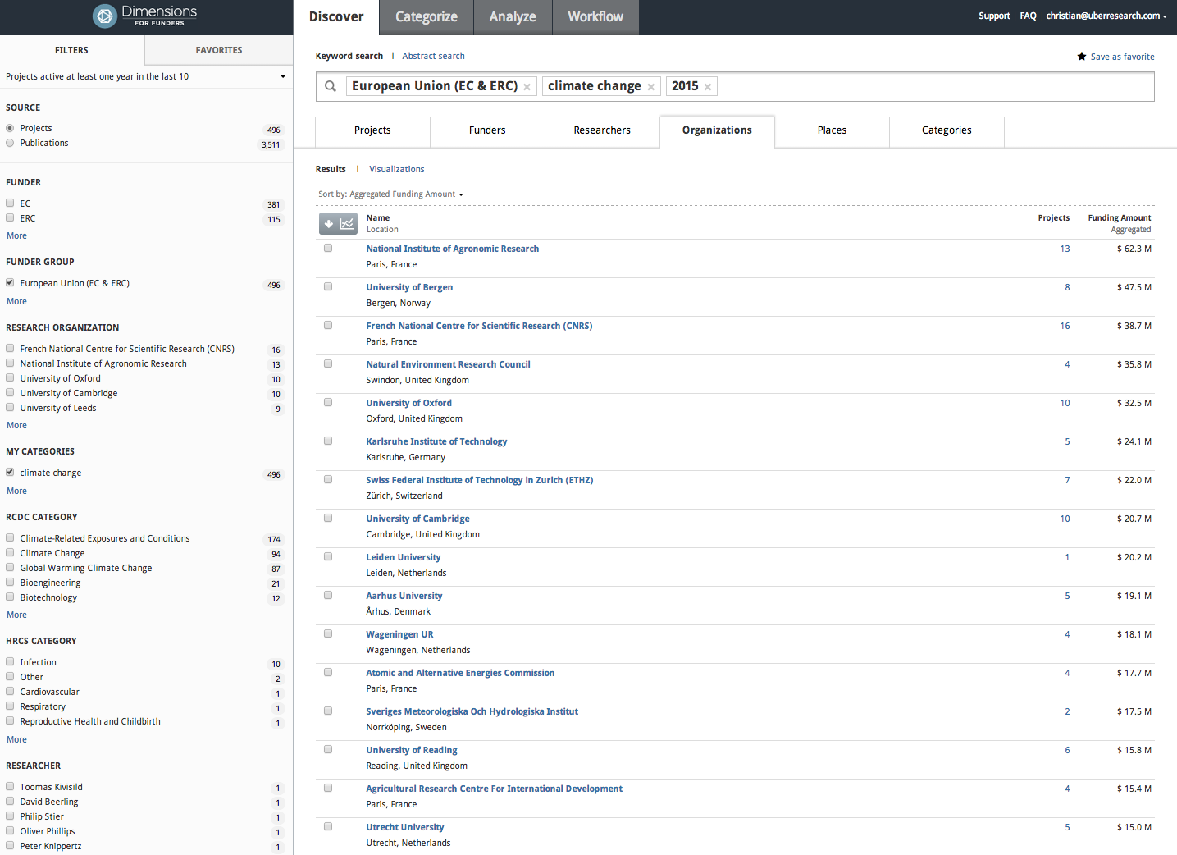
EC/ERC funding in the area of climate change and in the future (2015)
Receiving institutions!

Slide 21
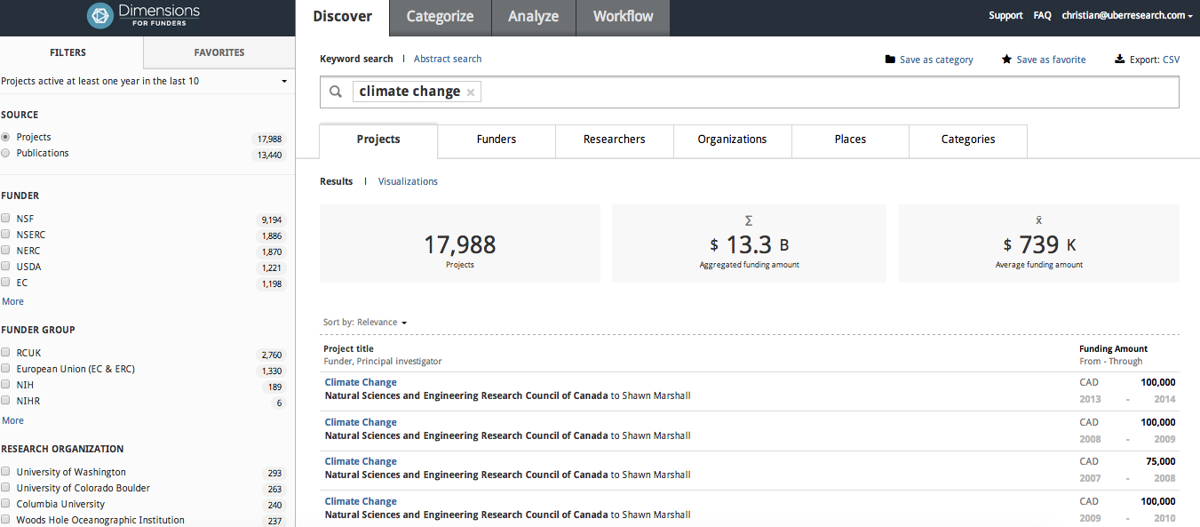
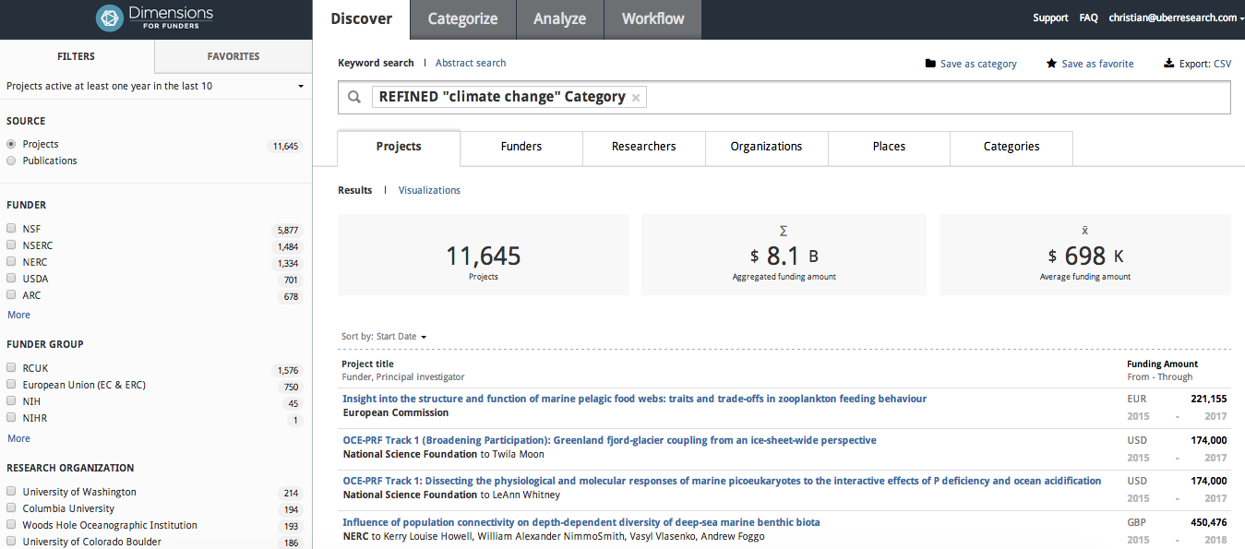
Simple search good enough? What to do about false positives and less relevant results?

Slide 22
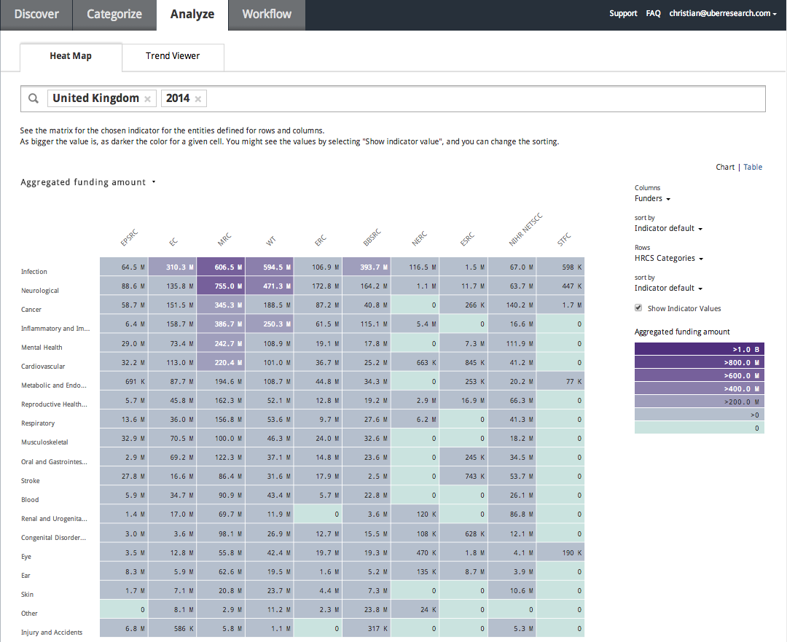
Automatic Research Classification:
Spending of UK based funders in the HRCS Health Categories

Slide 23
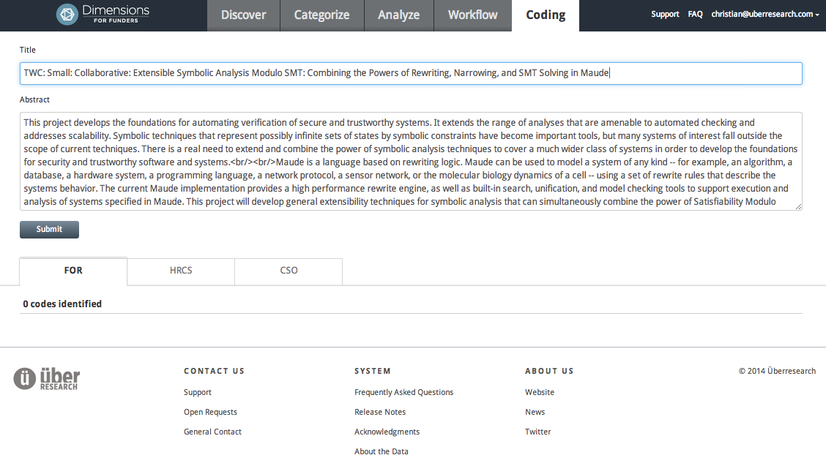
Automatic FOR coding

Slide 24
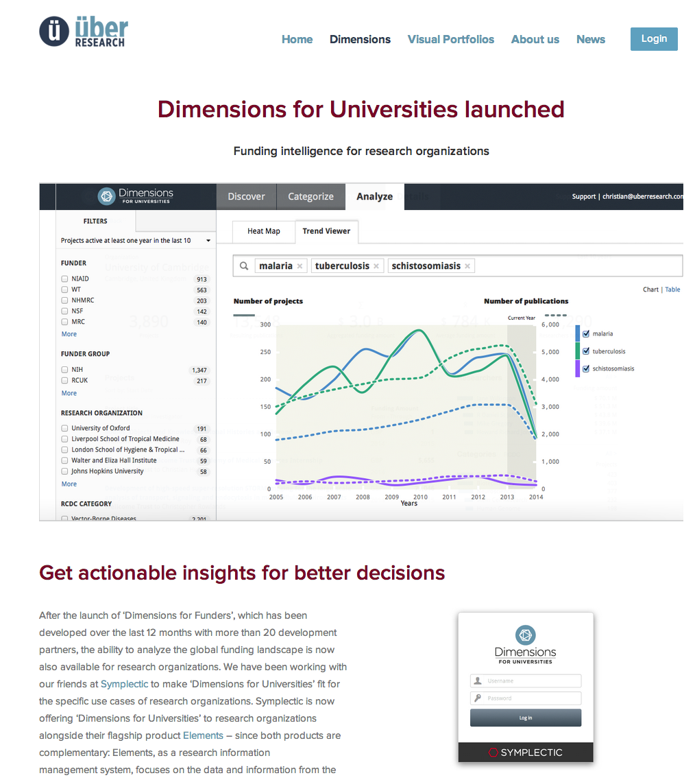
Dimensions for Funders …. and for Research Organizations!
Available for Research organizations
Understand the R&D portfolio of collaborating and competing organizations – as granular as you want
API to feed data into CRIS systems under development.

Slide 25
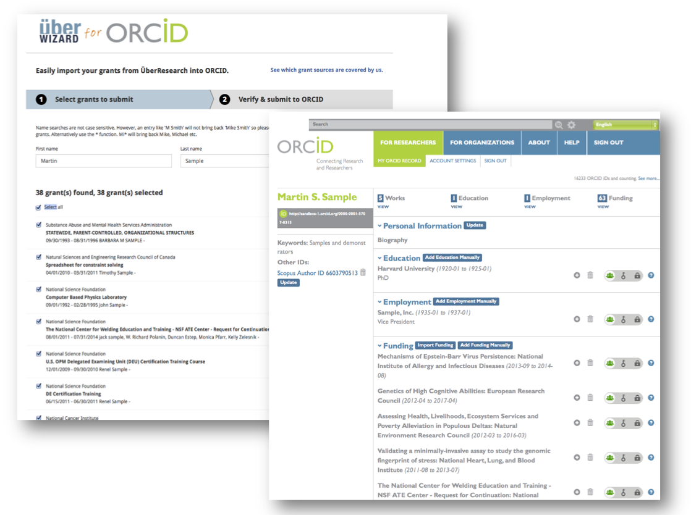
Free and open tool…
Launched together with ORCID in the beginning of February
Free and open tool to allow researchers adding their grants from many funders in one wizard
Funders can benefit from it by adding their grants at no cost
Contribution to drive ORCID adoption and the representation of grants in the ORCID records
FCT / Portugal is leveraging the ÜberWizard systematically

Slide 26
UberShare Initiative Announcement on the November 17, 2014
Upcoming announcement on Nov 17
Dimensions will be available at no cost for funders with $1 million of less funding per year
Free Dimensions

Slide 27
Thank you!
Christian Herzog (christian@uberresearch.com) Tel +49-171-5678917

