Slide 1


Interoperability in Research Information
Linda Naughton
euroCRIS

Slide 2

Overview
Introduction to Jisc
UK landscape and Research Context
Jisc action areas for interoperability – some examples
    Shared Services and infrastructure
    Standards
Interoperability challenges and issues
"Golden Fog, San Francisco" by runner310 http://flic.kr/p/ajwX8m (CC BY 2.0)

Slide 3

Introducing Jisc
Jisc offers digital services for UK education and research. The charity does this to achieve its vision for the UK to be the most digitally advanced education and research nation in the world.
Jisc.ac.uk
Isaxen http://flic.kr/p/dqmfra (CC BY 2.0)
© Isaxen via Flickr
Notes:
23 Oct 2014 - The Higher Education Policy Institute (HEPI) today publishes a new report entitled Jisc: a hidden advantage for higher education
http://jisc.ac.uk/news/new-hepi-report-highlights-the-benefits-of-shared-infrastructure-23-oct-2014

Slide 4




What Jisc delivers…
Digital content
Network &
IT services
Advice
Research & development
We provide institutions, their students and researchers secure, cost-effective access to the UK’s richest collection of digital resources.
We provide the HE sector with Janet, the Jisc network, advanced infrastructure services and collaboration platforms.
We listen to our members to ensure we offer them quality support, guidance and tools - estimated to save the sector £122 million in cost efficiencies each year.
Identifying emerging technologies and developing them around our members’ needs. Testing and learning on their behalf to ensure they are ready to take advantage of new technologies as they arrive.

Slide 5
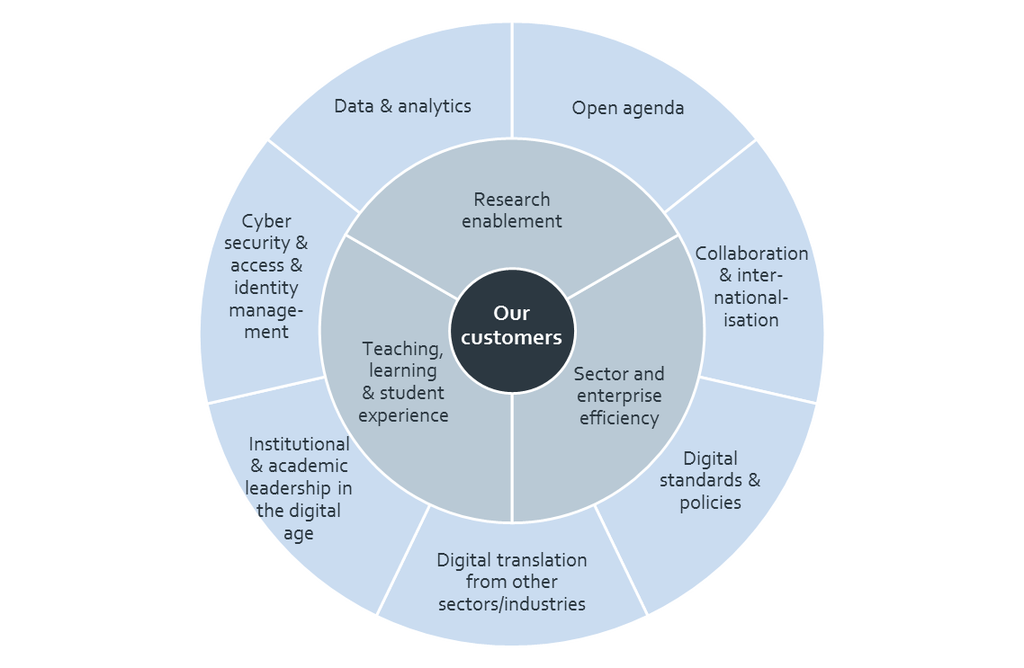
Jisc’s Strategic Framework Impact Areas

Slide 6
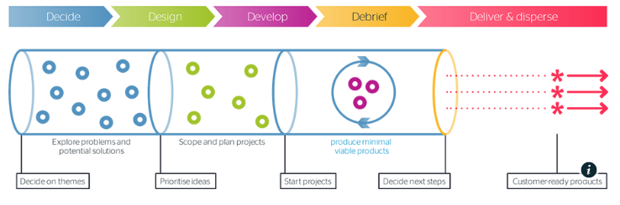
Co-design in research & development
Research at Risk
From prospect to alumnus
Effective learner analytics
Building capabilities for new digital leadership, pedagogy and efficiency
Co-design is our collaborative innovation model. Steered by customer priorities, it is designed to exploit new opportunities and address pressing issues in higher and further education through technology.
Notes:
Co-design take-away: demand driven, address issues and opportunities, through technology

Slide 7

Overview
Introduction to Jisc
UK landscape and Research Context
Jisc action areas for interoperability – some examples
    Shared Services and infrastructure
    Standards
Interoperability challenges and issues
Linh Nguyen http://flic.kr/p/cGP7u5
(CC BY-NC-ND 2.0)

Slide 8

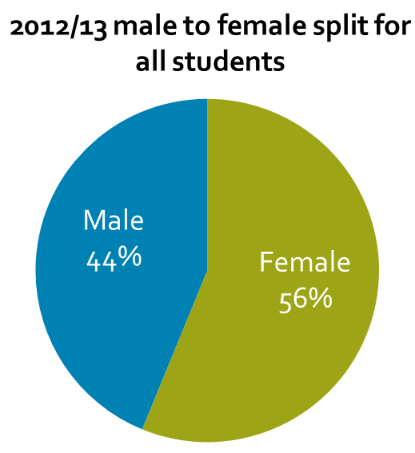
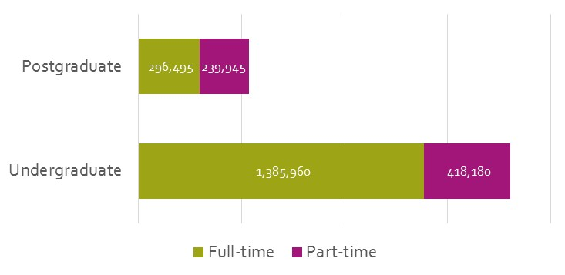
At a glance – HE in the UK
In the UK, there are:
160 higher education institutions (2014)
Finance…
2,340,275
students
£29.1bn
income of HEIs in 2012/13 (5% year-on-year change)
£27.3bn
expenditure of HEIs in 2012/13 (5% year on year change)
185,585 academic staff
196,935 non academic staff
Funding…
£7.0bn
funding body grants in 2012/13
£4.8bn
research grants and contracts in 2012/13
£11.7bn
tuition fees and education contracts in 2012/13
SOURCE: HESA 2012/13 reports All data refers to 2012/13 aside from number of HEIs (2014)

Slide 9
The UK research context: general
Many institutions and research institutes (within and outside universities)
Many research funders (UK Research Councils only 30% of total research income *13 other priority funders mentioned)
Varied infrastructure – Institutional Repositories, CRIS’s, one of these or neither
Changing environment
  Mandates effecting research information and research data
  Increasing importance of external (non-governmental) funding
  Interdisciplinary and international focus

Slide 10
The UK research context: policies and mandates
Research excellence Framework (REF) from the four university funding bodies - research impact (preparation for 2020 - awaiting guidance)
REF open access policy - to be eligible authors accepted manuscripts must be deposited in IR’s (journal material)
Research Councils UK (RCUK)- 7 subject based research councils: Open Access policy the RCUK Policy on Open Access aims to achieve “immediate, unrestricted, online access to peer reviewed and published research papers, free of any access charge” .
EPSRC Research Data Mandate – publicly funded research data should generally be made as widely and freely available as possible in a timely and responsible manner

Slide 11
UK research context: systems and services
  Not a shared national reporting infrastructure
  Funders & agencies
    JeS (Research Proposals submission); Research Fish (research outcomes system used by 95 funders including RCUK); Grants on the Web; GTR; REF; HESA.
  Universities
    60 using an institutional CRIS; repositories used by many, 125 HEIs with an IR – some switching over; some various spreadsheets..
Notes:
168 universities; 7 research councils (Wellcome trust very influential); Dual support funding system – RC at application, FC at output via excellence. Universities contribute £59billion to the UK economy.
Generally can say no shared reporting infrastructure, but there are some key components that have not always been planned in a joined –up way.
Joint eSubmission system – ( Jes) ; Grants on the Web ( all 7 Research Councils ).

Slide 12
Jisc – How are we helping
Support universities core business and help make the research process more productive
  Developing shared services/infrastructure where appropriate
Networking and Advice and Guidance
  Bring together key stakeholders in Research Information Management in order to identify shared challenges and issues and seek solutions that benefit our customers
  Providing a channel for universities requirements with funders, vendors etc.

Slide 13
Jisc – How are we helping
Standards development
  Evaluate, promote and assist with the implementation of the key standards that will ensure greater interoperability of research information and ease of management
  Plan targeted interventions including piloting new services to help improve the current RIM service landscape.
Use and interpretation of research information
  Ensure that information about funded research and its impact can be accessed effectively and is consistently described, shared and interpreted.

Slide 14
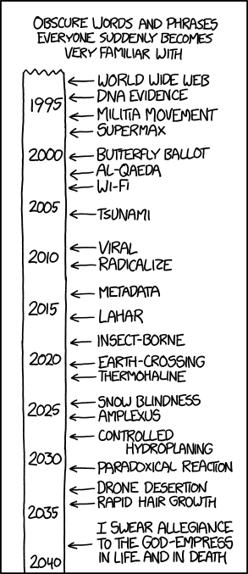
Overview
http://www.explainxkcd.com/wiki/index.php/1413:_Suddenly_Popular
Introduction to Jisc
UK landscape and Research Context
Jisc action areas for interoperability – some examples
    Shared Services and infrastructure
    Standards
Interoperability challenges and issues
http://xkcd.com/1413/

Slide 15
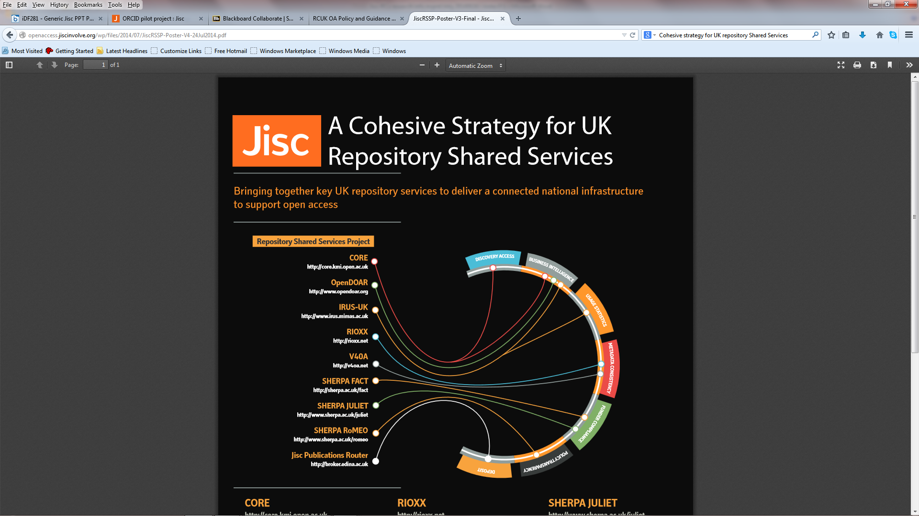
UK research context: systems and services
  Not a shared national reporting infrastructure
  Funders & agencies
    JeS (Research Proposals submission); Research Fish (research outcomes system used by 74 funders including RCUK); Grants on the Web; GTR; REF; HESA.
  Universities
    60 using CRIS/Cerif; repositories used by many, 125 HEIs with an IR – some switch over; some various spreadsheets..
  The glue:
  Shared infrastructure for Repository Shared Services helping with OA and RIM supported by Jisc and others
Notes:
The glue:
Shared infrastructure for Repository Shared Services helping with OA and RIM supported by Jisc and others
For more information http://openaccess.jiscinvolve.org/wp/2014/07/28/a-cohesive-strategy-for-repository-shared-services/
One year project starting in April 2014: Aim is to scope and explore the potential for a managed shared service supporting institutions managing OA and the 2020 REF submission.
Want to develop a prototype on open source code and release in 2015.
Jisc Monitor aggregates data from various sources in the form of a database / knowledge base of an institution’s publication activity
Jisc Monitor connects publisher and institution systems to collate publication data from the point of manuscript submission to acceptance of manuscript and subsequent publication
Jisc Monitor analyses the publication data to determine whether they are compliant with funders’ mandates. If they are not then alerts are generated to illustrate the identified issue.
Jisc Monitor provides data on how much an institution has spent on their OA publications and subscriptions

Slide 16
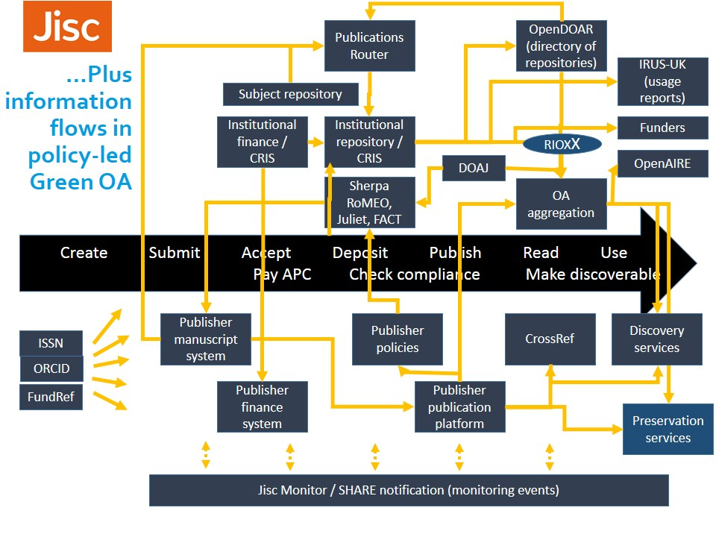

Slide 17

Shared services and infrastructure
  G4HE pilot
  Phase 1 -collaboration and benchmarking tools
  Phase 2 – feasibility of increasing coverage of funders and interoperability with CRISs

Slide 18
RIM – Standards
Supporting adoption and implementation of key standards
  Jisc- Casrai UK pilot
  Orcid
Data models and exchange formats
  CERIF - UKRISS, CiA, C4D

Slide 19
UK CASRAI national network pilot - objectives
To set up and run three working groups on priority topics identified at the UK CASRAI summit in December 2012; to support discussions in other areas (e.g. equipment profiles and research ethics) if required.
Set up a National Review Circle which includes a wider group of people that are interested in the progress of CASRAI UK and who will provide advice and feedback on working group outputs;
Other objectives include exploring how the CASRAI governance arrangements could work in a UK context beyond the pilot and an evaluation of the pilot.

Slide 20
UK CASRAI national network pilot
Jisc and CASRAI are piloting three National Working Groups in the UK
  Data Management Plans
  Organisational Id’s
  Open Access - Research Reporting

Slide 21

CASRAI-UK: Data Management Plans
Developing an initial data profile reflecting the current version of the Digital Curation Centre’s “DMP-Online” tool.
Using this to feed into and inform the UK Research Councils.
Developing use cases to prove viability of profile
Notes:
Concurrently, developing a potential further version of the data profile derived from harmonization and discussions among the UK Research Councils.

Slide 22
CASRAI-UK: Organisational Id’s
Identify main candidate sources of Org ID’s
Subject them to common use cases which are relevant to universities and other parts of the RIM and RDM workflow
The main output will be common statement about how the UK research community should use org ids and the policy requirement in order for harmonised org ids to work.
Develop a sustainable process for maintaining authoritative lists of organisations in the CASRAI dictionary.

Slide 23

CASRAI-UK: Research Reporting
Development of data profile supporting institutional report to UK funders for the new policy on Open Access and research contributions and outputs more generally

Slide 24

What is Orcid?
Jisc aims to streamline ORCID implementation process at universities
develop the best value approach for a potential UK wide adoption of ORCID in HE
Also contribute to ensuring Orcid gets as much traction as possible
This involves working with relevant funders and agencies, vendors, and Jisc’s customers to make that happen
ORCID provides an open registry of persistent unique identifiers for researchers and to automate linkages to research objects such as publications, datasets, other IDs, grants, and patents.
Orcid is also a not for profit organisation based in the US with small team of developers and other staff. A wide range of organisations participate in the management of Orcid including universities, research funders, publishers and publisher organisations like Cross Ref

Slide 25

Researcher Identifiers – ORCID in the UK
January 2013
Joint statement in support of ORCID (ARMA, HEFCE, HESA, RCUK, UCISA, Wellcome Trust, Jisc); joint implementation plan
http://www.jisc.ac.uk/whatwedo/programmes/di_researchmanagement/researchinformation/orcid.aspx
September 2013
Jisc report: use cases and views on the future of ORCID in UK Higher Education
http://www.jisc.ac.uk/publications/generalpublications/2013/future-of-orcid-in-uk-he.aspx
©opensource.com via Flickr

Slide 26
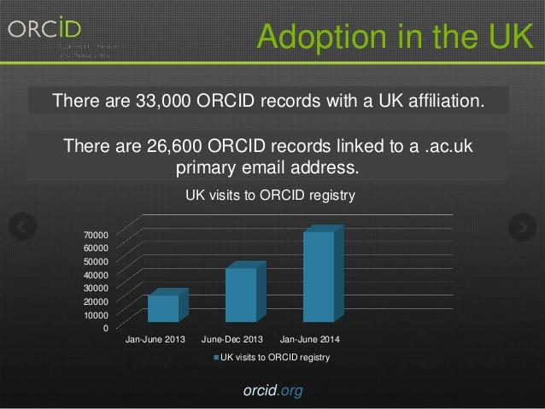
Orcid uptake so far
UK Research Councils
have agreed to capture a valid ORCID Identifier, where one exists, for all researchers supported by Research Council funding
HESA (Higher Education Statistics Agency) has specified and will include ORCID identifiers as an optional field in its Staff and Student Record for the 2014/15 cycle
Wellcome Trust have integrated ORCiD identifiers into our online grant application and reporting systems so they can easily link researchers to their works and speed up grant applications
Notes:
ORCID has over 80 members from the research and scholarly community including major funders, universities and publishers.
Over 900,000 researchers signed up globally
33,ooo ORCID records with a UK affiliation
26,600 ORCID records linked to a ac.uk primary email address

Slide 27



Jisc-ARMA ORCID pilot project
8 HEI based example ORCID implementations and workflows
+ engagement with HEIs and organisations implementing or planning to implement ORCID iDs
+engagement with vendors
ORCID implementation Group
(RCUK, HEFCE, UCISA, ARMA, HESA, RLUK, SCONUL, Wellcome Trust, Jisc)
3 workshops, technical support
case study reports, advice & guidance, business case, recommendations on national ORCID membership
Notes:
Final workshop in January

Slide 28
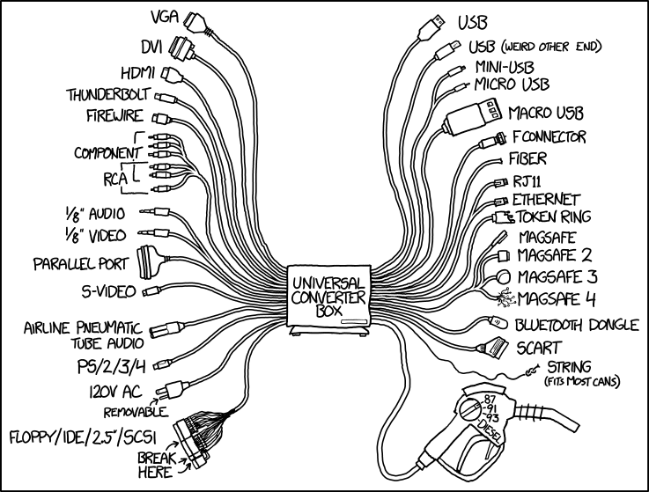
Overview
Introduction to Jisc
UK landscape and Research Context
Jisc action areas for interoperability – some examples
    Shared Services and infrastructure
    Standards
Interoperability challenges and issues
http://imgs.xkcd.com/comics/universal_converter_box.png

Slide 29

Challenges and issues
Governance ambiguity
Focus and Context – local, subject, regional, national, European, international?
Understanding the landscape and the key drivers
Synthesising earlier work in a changing landscape
Standards - implementation and sustainability
Pharoah Hound
http://commons.wikimedia.org/wiki/File:Australian_Shepherd_agility_cropped.jpg
(CC BY-SA 3.0)

Slide 30
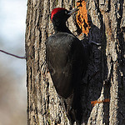
Challenges and issues
When and how to act - new and radical solutions or chipping away?
Complex landscape of systems and services – patchworks vs networks
Inertia: decisions made about systems are difficult to reverse
Building the business case.
Making it easy …or at least easier
By Евгений Арифулин
https://www.flickr.com/photos/95414346@N06/ (CC BY-NC 2.0)

Slide 31
Closing thoughts
http://www.knowledge-exchange.info/Default.aspx?ID=733
Best practice inside and outside the sector
Focus on the value rather than the complexity

Slide 32

Find out more…
Linda Naughton
Senior Co-Design Manager
linda.naughton@jisc.ac.uk
Except where otherwise noted, this work is licensed under CC-BY-NC-ND

