Slide 1
Research Information Management - Impact and Opportunities for Staff Development
James Toon,
Research Information Systems Manager, University of Edinburgh
@jamestoon

Slide 2
Setting the scene…
Developments in research assessment in the UK over last 5 years
Growth in compliance requirement (HESA, RCUK, EPSRC, HEFCE)
Increased commercial pressure
Developing digital footprints
Management, structure, standards, organisation, targets.
Sounds like we need a CRIS!
By LaurMG. (Cropped from "File:Frustrated man at a desk.jpg".) [CC BY-SA 3.0 (http://creativecommons.org/licenses/by-sa/3.0)], via Wikimedia Commons

Slide 3
Edinburgh Setup
Implemented PURE in 2011
University, Colleges, Schools, Centres, Institutes, Research Groups, Research pools
146 Organisational units in PURE
Other stakeholder groups (open access, research data, impact and KE, finance, Governance, web services)
Many completely different approaches
By Kim Traynor (Own work) [CC BY-SA 3.0 (http://creativecommons.org/licenses/by-sa/3.0)], via Wikimedia Commons
Notes:
Large, Research-led Russell Group Institution 32,000 students (11,000 postgrad) Over 6000 academic staff Ranked 4th by research power in UK (REF 2014)

Slide 4
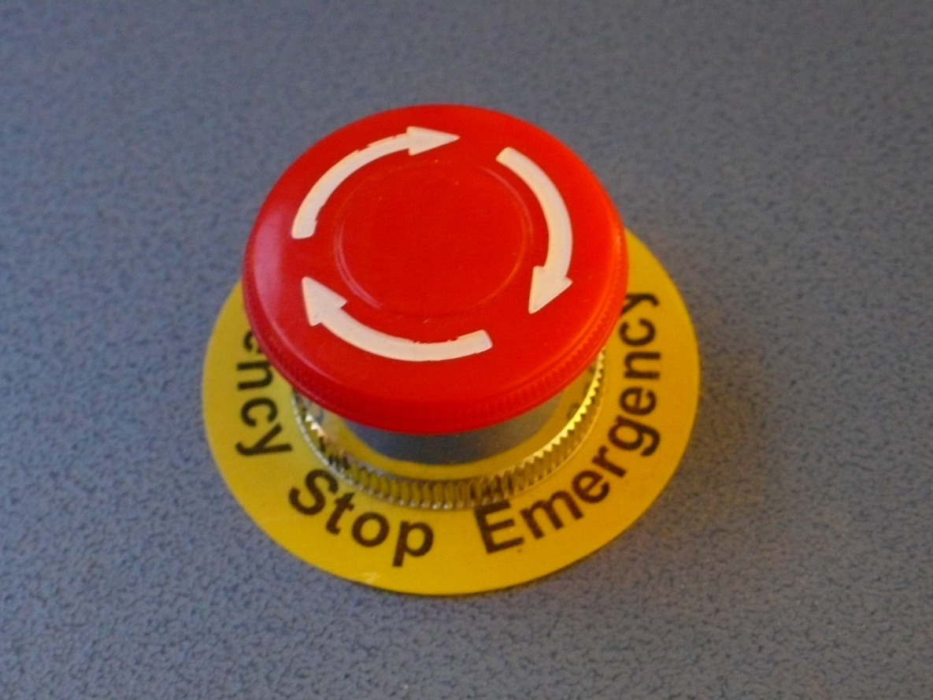
Reality check
CRIS has made a HUGE difference
Has complete senior support.
BUT - No magic bullet
Little direct academic engagement
No one has any time
NOT what we expected?
Regan, Tim. “Emergency Stop Button”. Retrieved 6 May 2015, https://flic.kr/p/5V5DHj [online image]
Notes:
So where are we now? Successful delivery of ref
No magic bullet. Cite ridiculous situation of research fish and rcuk when they have also developed an excellent starter approach like rioxx
Likely to cause enormous friction with staff internally.
Biggest issue is the general abdication of responsibility from research staff to administrators

Slide 5
Concerns observed and heard
Passing the buck – hundreds of proxy users resulting in 101 different ways of doing the same thing
‘I have no idea of what you just said….’
‘who is going to pay for this. We’ve no money and no staff’
‘But this isn’t my job!’
Issues of professional jurisdiction - not talking to each other effectively – leading to confusing messages
Resulting in some degree of staff ‘fending for themselves’

Slide 6
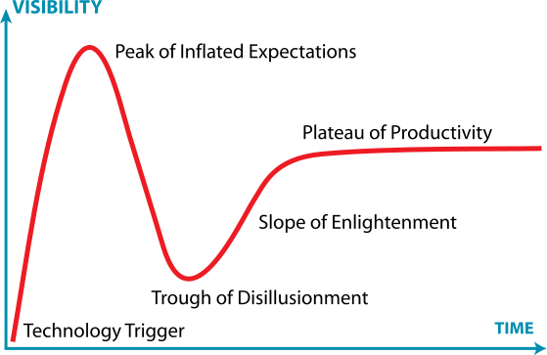
The CRIS ‘hype cycle’

Slide 7
The CRIS ‘hype cycle’

Slide 8
Heading to big school!
Period of hand holding is over.
Some schools positive (restructuring/interest)
Colleges receptive to funding requests and new placements
Some less so (panic, refusals, dumping more and more on admin)
Some adamant that academics will see the light
Much uncertainty
By ajari from Japan [CC BY 2.0 (http://creativecommons.org/licenses/by/2.0)], via Wikimedia Commons

Slide 9
The CRIS ‘hype cycle’ – the way ahead
Installation
Benefits Realisation
2011
2015
Notes:
This path from tech trigger to plateau is a well known effect - the ‘J curve’
Interesting question here is also how do we calculate the likely time to reach to bottom of the trough?

Slide 10
The CRIS ‘hype cycle’ – possible scenario?
CAUTION: This slope is slippery.
Slow march to mediocrity
Installation
2011
2015

Slide 11
The CRIS ‘hype cycle’ – worse case?
CAUTION: This slope is slippery.
Installation
Abandonment?
2011
2015
Notes:
Abandonment – also referred to as the ‘dead cat bounce’ in financial circles….
Not just lack of internal management that might cause this. External influences such as research fish causing enormous pressure and could influence a change in attitude to the cris. Internal advocates and champions really crucial here.

Slide 12
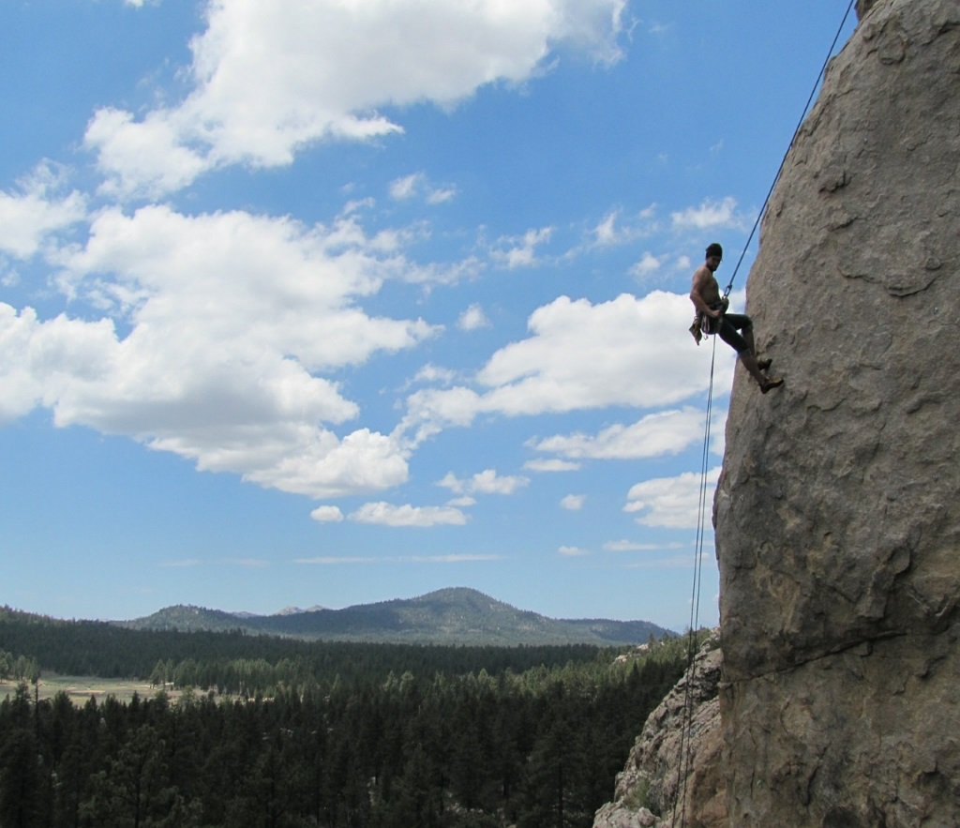
Moving on up the (J)curve!
Now is the time to invest heavily in our people. Do nothing is not considered an option.
Plan to pursue 4 work packages;
Define Research Information Management as a professional opportunity.
What should be our RIM people strategy be for this next stage
Who should be coordinating/responsible for delivery of this work?
Resourcing and sustainability of the programme
Notes:
This is where we need to start comparing notes about how to manage the implementation.
Note that these work packages and not sequential, but all need to happen.
Might want to mention here that we are also planning on a relaunch of pure in advance of the big push to delivery of the next ref.
Important to not see the plateau as the finish line, otherwise that`s just how it will be viewed. It needs to be continuous imporovement.

Slide 13
1. What makes a research information management professional?
Ability to connect systems with core University business
Understand relationships between internal and external systems
Keep up to date with new developments
Act as a leader in chosen field with peers and externally
Add value to the customer base
Encourage continuous development
Generalists vs Specialists vs Advocates vs Leaders
Notes:
As an emerging service, there is a heavy R&D component
Some specialists become leaders in their field, but move away from operational work and are more research focused
Improved reputation for the individual and the University
Some excel in service delivery, and take the operational leadership roles

Slide 14
2. People strategies and development
Vision – view back from the top of the plateau
Network and community building
Goals/Objectives (how will we know we have been successful)
Are there any pre-requisites (i.e. job descriptions redefined?)
Sustainability of the programme (run once, repeat, CPD?)
By Gil Cavalcanti (Own work) [CC BY-SA 3.0 (http://creativecommons.org/licenses/by-sa/3.0) or GFDL (http://www.gnu.org/copyleft/fdl.html)], via Wikimedia Commons
Notes:
Network building important to get an active audience.
Vision critical because it till tell us what it is like on top of the plateau.

Slide 15
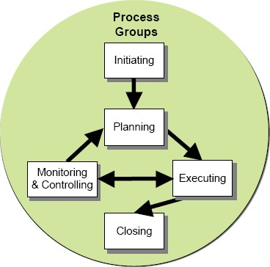
3. Roles/Responsibilities
Who owns research information management in the organisation
Are all the stakeholders included, are they on board?
Role of internal providers (HR teams)
Role of external providers (ARMA)
Who is responsible for the sustainability of the programme
Who is responsible for its delivery
By DEPARTMENT OF VETERANS AFFAIRS Office of Information and Technology (Project Management Guide) [Public domain], via Wikimedia Commons

Slide 16
4. Resourcing
Developing a resourcing plan for the work
Internal vs external opportunities
Working in a coordinated way with Schools and Colleges
Notes:
Really welcome opportunity for funding to make this happen. Suitable calls from jisc etc would be good, but so would other agencies.
One of the reasons for making this presentation is to getmore people thinking about the development issue and many hands make light work etc Are there any known opportunities?

Slide 17
How can help?
Some sort of formal recognition?
Review of institutional approaches and sharing experiences. Work with best practice group (or set up new one?)
Sharing of training materials (or developing something generic for wider reuse)
Develop variation on a theme of ARMA framework (maybe in conjunction with ARMA)
Develop self accreditation framework – People-CMM for research information management?
Notes:
Discussion – how can EuroCRIS help (assuming it doesn’t already do so?) and how can CRIS implementers benefit?
Question intended as a challenge to board.

Slide 18
Thank you for listening… any questions?
And please get in touch if you are happy to share how your institutions are approaching this too!
James.toon@ed.ac.uk

