Slide 1

CERIF 1.6 Tutorial
cfFunding
cfFederated Identifier
cfEquipment
cfExpertise
AndSkills
cfFacility
cfQualification
cfResult
Publication
cfService
cfPrize
cfResultPatent
cfResultProduct
cfElectronicAddress
cfProject
cfPostalAddress
cfCurriculum
Vitae
cfPerson
cfOrganisation
Unit
Jan Dvořák
May 11th, 2015
euroCRIS Strategic Membership Meeting
Paris, Paris
cfGeographic
BoundingBox
cfCitation
cfIndicator
cfMeasurement
cfEvent
cfCountry
cfLanguage
cfCurrency

Slide 2
www.eurocris.org
www.eurocris.org
Jan Dvořák
jan.dvorak@ff.cuni.cz
euroCRIS
CERIF TG Leader since 2013
CERIF TG Deputy Leader since 2011
CRIS 2012 (Prague, June 2012) Org. Committee Chair
Charles University in Prague, Faculty of Arts, Institute of Information Studies & Librarianship
Researcher & Lecturer
InfoScience Praha
Research, Development & Innovation Information System
(the national CRIS for [CZ] – www.isvav.cz)
___
This set of slides is based on the CERIF Tutorial by Brigitte Jörg
CERIF TG Leader 2004-2012

Slide 3
What is Research Information?
www.eurocris.org
www.eurocris.org
Information about:
Researchers
Organisations
  Research performing orgs, Funders, Publishers, Facility Operators
Scientific Disciplines
Funding
  Funding Programmes, Calls
Projects
  Proposed, Ongoing, Completed
Research infrastructures
  Facilities, Equipment, Services
Outputs
  Publications, Patents, Research Data, Research Software, Products
Outcomes
  New product on the market, Improved treatment procedure, Regulation update
Impacts
  Increased market share, Reduced death rate of a disease
And their Relationships

Slide 4

Who needs Research Information?
www.eurocris.org
www.eurocris.org
visibility, finding collaborations,
competitors, CV generation
Researchers
Decision Makers
performance, strategic decisions,
priorities, comparisons
Funding Organisations
Project Managers
distribution of programs
evaluation of results, finding reviewers
overview of ongoing activities
Research Information
Libraries
Research Organisations
acquisition, dissemination
integration and interoperability
strategic management
Publishers
finding reviewers, editors
Educators
Intermediaries / Brokers
integration of relevant
findings into lectures
and training
finding research results of
potential market or innovative value
General Public
Enterprises
Media
finding information
for participation in projects,
partnerships, usage of results
distribution and
communication
information and education,
interest

Slide 5
Kinds of questions we want to support
www.eurocris.org
www.eurocris.org
How many articles has author X published in 2013 as a first author?
How many times have articles by author X been cited by the end of the previous year?
Did author X publish with institutionally external authors?
In how many FP7 projects does/did organisation Z participate?
How many publications have resulted from project Y?
How many people have been employed in the course of FP7 projects from the 1st call in the New Member States?
How many PhD students have participated in national research projects in country C? In which countries have they earned their masters degrees?
How many women have been involved in FP7 projects?
How often have articles in journal A been requested in 2013?
How many articles have been published in field B?

Slide 6
The Ultimate Answer:
Common European Research Information Format
www.eurocris.org
www.eurocris.org
cfFederated Identifier
cfFunding
cfEquipment
cfExpertise
AndSkills
cfFacility
cfResult
Publication
cfService
cfQualification
cfPrize
cfResultPatent
cfResultProduct
cfElectronicAddress
cfProject
cfPostalAddress
cfCurriculum
Vitae
cfPerson
cfOrganisation
Unit
cfGeographic
BoundingBox
cfCitation
cfIndicator
cfMeasurement
cfEvent
cfCountry
cfLanguage
cfCurrency

Slide 7
Common European Research Information Format
www.eurocris.org
    CERIF is an EU Recommendation
    to Member States
    http://cordis.europa.eu/cerif/
    The European Commission (EC)
    has authorised euroCRIS to maintain
    and develop CERIF and its usage http://www.eurocris.org/Index.php?page=CERIFreleases&t=1

Slide 8

Model Levels
www.eurocris.org
www.eurocris.org
Conceptual Level (Specification)
Concepts relevant for the research domain
and their relationships
Logical Level (ER Model)
Entities and their relationships
Physical Level (Database Scripts)
Data Definition commands for the database
Semantic Layer (Declared Semantics)
A formalized controlled vocabulary describing a
general contextual semantics of the research domain
inline with the conceptual, logical and machine description
Funding
Organisation
Person
Organisation
Person
Project
Skills
Project
Service
CV
Publication
Patent
Equipment
Classification
Product
Classification
(
(
)
Semantics
)
Event
Semantics
SQL Script
-----------------------------
CREATE Table cfPers (...);
CREATE Table cfProj (...);
CREATE Table cfOrgUnit (...);

Slide 9
CERIF Base Entities
www.eurocris.org
www.eurocris.org

Slide 10
CERIF Base Entities
www.eurocris.org
www.eurocris.org
Project
ID
URI
Acronym
StartDate
EndDate
Title
Abstract
Keywords
Person
ID
URI
Gender
FirstNames
OtherNames
FamilyNames
NameVariants
ResearchInterest
Keywords
OrganisationUnit
ID
URI
Acronym
Name
HeadCount
CurrencyCode
Turnover
ResearchActivity
Keywords

Slide 11
CERIF Base Entities
www.eurocris.org
www.eurocris.org
cfProject
cfID
cfURI
cfAcronym
cfStartDate
cfEndDate
cfTitle
cfAbstract
cfKeywords
cfFamilyNames
cfOrganisationUnit
cfID
cfURI
cfAcronym
cfHeadCount
cfCurrencyCode
cfTurnover
cfPerson
cfID
cfURI
cfGender
cfBirthdate
cfName
cfFirstNames
cfDescription
cfDescription
cfOtherNames
cfKeywords
cfKeywords

Slide 12
CERIF Result Entities
www.eurocris.org
www.eurocris.org

Slide 13
CERIF Result Entities
www.eurocris.org
www.eurocris.org
ResultPublication
ID
URI
Title
Subtitle
Abstract
Bibl. Note
PublicationDate
TotalPages
StartPage
EndPage
Keywords
ResultPatent
ID
URI
PatentNumber
Title
CountryCode
RegistrationDate
ApprovalDate
Description
Keywords
ResultProduct
ID
URI

Slide 14
CERIF Result Entities
www.eurocris.org
www.eurocris.org
cfResultPublication
cfID
cfURI
cfNumber
cfPublicationDate
cfStartPage
cfEndPage
cfTotalPages
cfEdition
cfSeries
cfIssue
cfVolume
cfISBN
cfISSN
cfTitle
cfBibliographic Note
cfSubtitle
cfVersionInfo
cfAbstract
cfAbbreviation
cfKeywords
cfName
cfName
cfResultPatent
cfID
cfURI
cfPatentNumber
cfCountryCode
cfRegistrationDate
cfApprovalDate
cfDescription
cfAbstract
cfResultProduct
cfID
cfURI
cfKeywords
cfKeywords
cfVersionInfo
cfVersionInfo

Slide 15
CERIF Infrastructure Entities
www.eurocris.org
www.eurocris.org
Facility
Equipment
Service

Slide 16
CERIF Infrastructure Entities
www.eurocris.org
www.eurocris.org
Facility
Equipment
Service
Facility
ID
Acronym
URI
Title
Description
Keywords
Equipment
ID
Acronym
URI
Title
Description
Keywords
Service
ID
Acronym
URI
Title
Description
Keywords

Slide 17
CERIF Infrastructure Entities
www.eurocris.org
www.eurocris.org
Facility
Equipment
Service
cfName
cfFacility
cfID
cfURI
cfAcronym
cfDescription
cfKeywords
cfEquipment
cfID
cfURI
cfAcronym
cfName
cfDescription
cfKeywords
cfName
cfService
cfID
cfURI
cfAcronym
cfDescription
cfKeywords

Slide 18
CERIF 1.6
www.eurocris.org
cfFederated Identifier
cfFunding
cfEquipment
cfExpertise
AndSkills
cfFacility
cfResult
Publication
cfService
cfQualification
cfPrize
cfResultPatent
cfResultProduct
cfElectronicAddress
cfProject
cfPostalAddress
cfCurriculum
Vitae
cfPerson
cfOrganisation
Unit
cfGeographic
BoundingBox
cfCitation
cfIndicator
cfMeasurement
cfEvent
cfCountry
cfLanguage
cfCurrency

Slide 19
Some CERIF Link Entities
www.eurocris.org
www.eurocris.org
ExpertiseAndSkills
Funding
Equipment
Facility
Qualification
Service
Prize
ElectronicAddresse
CV
PostalAddress
Citation
Metrics
Indicator
Measurement
Geographic
Bounding Box
Event
Language
Currency
Country

Slide 20
Some CERIF Link Entities
www.eurocris.org
www.eurocris.org
ExpertiseAndSkills
Funding
Equipment
Facility
Qualification
Service
Prize
ElectronicAddresse
CV
PostalAddress
Citation
Metrics
Indicator
Measurement
Geographic
Bounding Box
Event
Language
Currency
Country
role=author‘s affiliation
role=author
role=deliverable
role=research assistant
role=coordinator
role=principal investigator

Slide 21
Result_Publication Instance Diagram
(slide by Keith Jeffery)
www.eurocris.org
www.eurocris.org
OrgUnit M
part of
member
Person A
OrgUnit O
employee
member
OrgUnit N
project leader
part of
partner
Project P
owns IPR
author
deliverable
Publication X

Slide 22
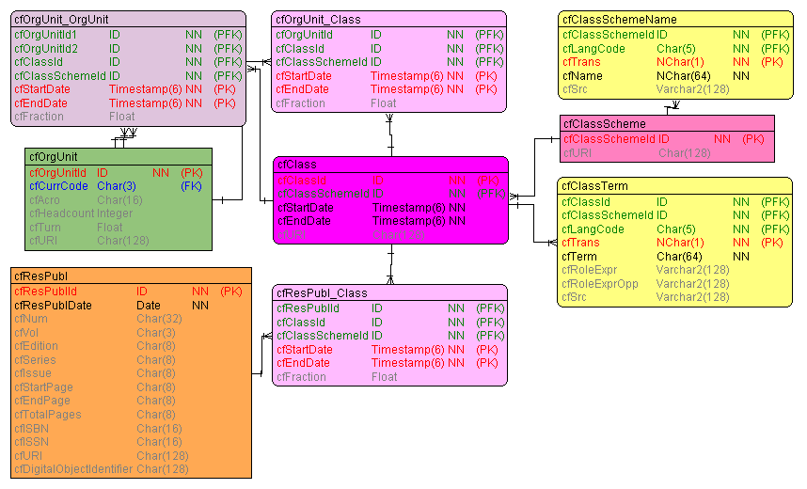
CERIF – Generic Entity Structure
www.eurocris.org
www.eurocris.org
Generic
Identifier
URI
Attributes
Multilingual Entities
Relationships (Links)

Slide 23
CERIF General Pattern
www.eurocris.org
www.eurocris.org
A typical CERIF entity:
Identifier
  internal
Attributes
  the basic ones
Multi-lingual attributes
Classifications
  Type
  Status
  Subject area
Links
  to other entities
  recursive

Slide 24
Generic Linking Entity Structure
www.eurocris.org
www.eurocris.org
cfStartDate cfEndDate
cfFraction
Base object 1
(FK)
Base object 2
(FK)
Fraction
(optional)
Time range
of validity
role : cfClassification
(FK)

Slide 25
Recording Change in CERIF
www.eurocris.org
www.eurocris.org
Example: The Principal Investigator of project P changes effective date D: X is replaced by Y.
Before:
Date range
Role
P
-∞ .. +∞
Principal Investigator
: cfClassification
X
After:
-∞ .. D
Principal Investigator
: cfClassification
X
P
D .. +∞
Principal Investigator
: cfClassification
Y

Slide 26
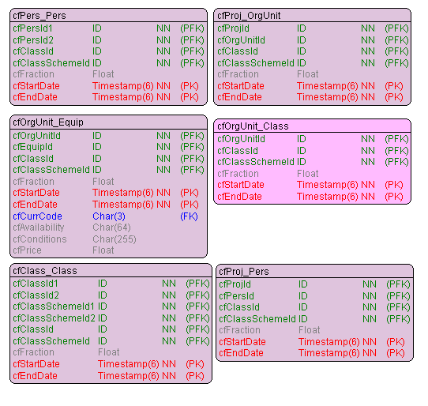
Some CERIF Link Entities
www.eurocris.org
www.eurocris.org
Binary classifications:
Role
Unary classification:
Type
Status
Subject area

Slide 27
CERIF 1.6
www.eurocris.org
cfFederated Identifier
cfFunding
cfEquipment
cfExpertise
AndSkills
cfFacility
cfResult
Publication
cfService
cfQualification
cfPrize
cfResultPatent
cfResultProduct
cfElectronicAddress
cfProject
cfPostalAddress
cfCurriculum
Vitae
cfPerson
cfOrganisation
Unit
cfGeographic
BoundingBox
cfCitation
cfIndicator
cfMeasurement
cfEvent
cfCountry
cfLanguage
cfCurrency

Slide 28
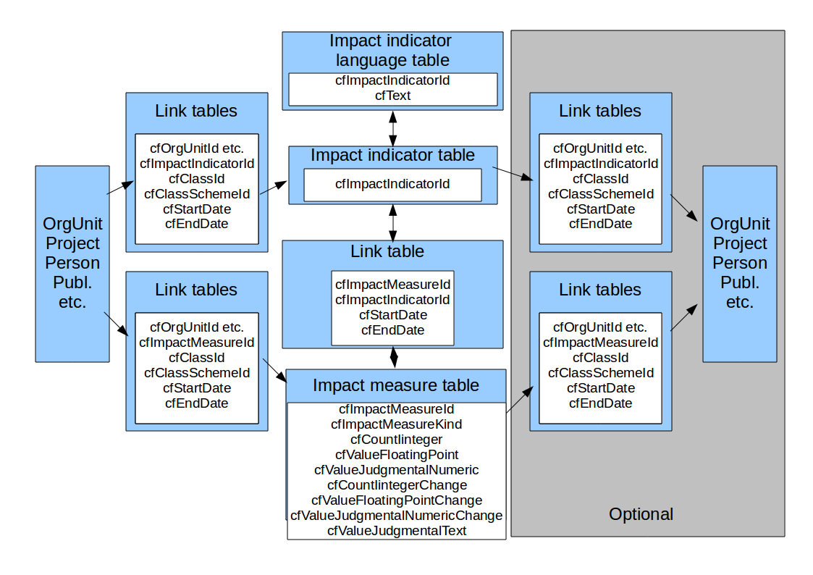
Measuring Impact in CERIF (MICE)
www.eurocris.org
www.eurocris.org
MICE, a JISC-funded Project coordinated by Richard Gartner, Kings College, London, UK

Slide 29
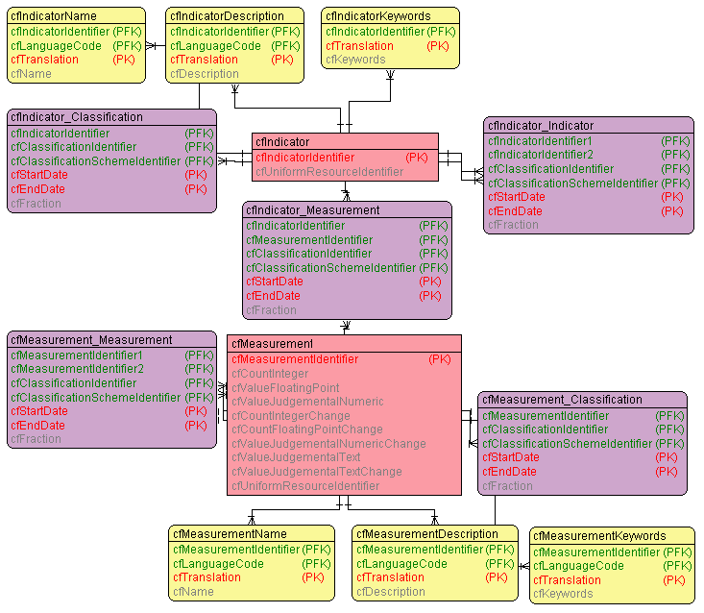
CERIF Measurement & Indicator
www.eurocris.org
www.eurocris.org
Is an Aggregation Entity
cfMeasureIdentifier
cfCountInteger
cfCountIntegerChange
cfValueFloatingPoint
cfCountFloatingPointChange
cfValueJudgementalNumeric
cfValueJudgementalNumericChange
cfValueJudgementalText
cfValueJudgementalTextChange
cfURI

Slide 30
Measurement & Indicator (some examples)
www.eurocris.org
  economic and commercial
    economic
      impact on business
        improving performance of existing businesses
          increased turnover by 1.2M€ in 2012
          time savings of 14.56%
          reduced costs by 42%
        new products/processes
          creating numbers of new products/services
          commercialising / other success measures
Indicator
Measurement
Extract from the MICE List of Indicators

Slide 31
CERIF 1.6
www.eurocris.org
cfFederated Identifier
cfFunding
cfEquipment
cfExpertise
AndSkills
cfFacility
cfResult
Publication
cfService
cfQualification
cfPrize
cfResultPatent
cfResultProduct
cfElectronicAddress
cfProject
cfPostalAddress
cfCurriculum
Vitae
cfPerson
cfOrganisation
Unit
cfGeographic
BoundingBox
cfCitation
cfIndicator
cfMeasurement
cfEvent
cfCountry
cfLanguage
cfCurrency

Slide 32
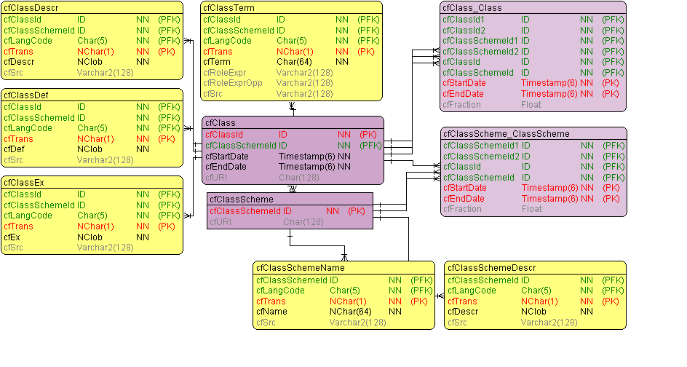
CERIF Semantic Layer
www.eurocris.org
www.eurocris.org
Allows to capture any Schema or Structure
Flat Lists
Thesauri
Classification Systems (e.g. SKOS, ...)
Taxonomies
Ontologies
Open / Extensible in all directions
New Schemas
New Concepts / Terms
New Relationships
Enables to manage
Roles / Types Semantics
Subject Headings
Archiving (Time component)
Allows for Mappings between Schemes

Slide 33
CERIF Semantic Layer (Declared Semantics)
www.eurocris.org
www.eurocris.org
Recursion
is-a
maps-to
is-part-of
Is-broader-term
Scheme-Assignment
Time-based

Slide 34
CERIF 1.6
www.eurocris.org
cfFederated Identifier
cfFunding
cfEquipment
cfExpertise
AndSkills
cfFacility
cfResult
Publication
cfService
cfQualification
cfPrize
cfResultPatent
cfResultProduct
cfElectronicAddress
cfProject
cfPostalAddress
cfCurriculum
Vitae
cfPerson
cfOrganisation
Unit
cfGeographic
BoundingBox
cfCitation
cfIndicator
cfMeasurement
cfEvent
cfCountry
cfLanguage
cfCurrency

Slide 35
CERIF Federated Identifiers
www.eurocris.org
ResultPublication
  ISBN
  ISSN
  DOI
  WoS Accession Number
  Scopus EID
  PubMed Central ID
Person
  Social Security Number
  Staff Id in HR system
  Author identifier
    ORCID
    IdRef
Project/Grant
  Funder’s reference number
  Organisation’s reference number
Organisation
  VAT Identification Number
  Internal Code
  FundId
Classification
  External Code

Slide 36
CERIF Federated Identifiers
www.eurocris.org
Records the “tag” by which an object is known elsewhere
For any Base, Result, Infrastructure, or 2nd Level entity
Federated Identifier Type classification scheme
(optionally) Connected to a Service representing the issuer of the identifier
    Usually an information system

Slide 37
CERIF XML 1.6 Interchange Format
www.eurocris.org
www.eurocris.org
  For point-to-point interchange
  XML namespace
  XML Schema
    Based on the ER model
cfFunding
cfFederated Identifier
cfEquipment
cfExpertise
AndSkills
cfFacility
cfQualification
cfResult
Publication
cfService
cfPrize
cfResultPatent
cfResultProduct
cfElectronicAddress
cfProject
cfPostalAddress
cfCurriculum
Vitae
cfPerson
cfOrganisation
Unit
cfGeographic
BoundingBox
cfCitation
cfIndicator
cfMeasurement
cfEvent
cfCountry
cfLanguage
cfCurrency

Slide 38
CERIF 1.6 XML Interchange Format
www.eurocris.org
www.eurocris.org
<CERIF xmlns=“urn:xmlns:org:eurocris:cerif-1.6-2”>
<cfProj>
<cfProjId>internal-project-identifier</cfProjId>
<cfAcro>ACRO</cfAcro>
<cfURI>http://www.project-url.ac.uk/acro.html</cfURI>
<cfTitle cfLangCode="en" cfTrans="o">The title of the project</cfTitle>
<cfAbstr cfLangCode=”en" cfTrans="o">The goals of the project</cfAbstr>
<cfProj_Class>
<cfClassId>infrastructure-project-uuid</cfClassId>
<cfClassSchemeId>-project-types-scheme-uuid</cfClassSchemeId>
</cfProj_Class>
<cfFedId>
<cfFedId>PROJECT NUMBER</cfFedId>
<cfClassId>project-number-uuid</cfClassId>
<cfClassSchemeId>-federated-identifier-type-uuid</cfClassSchemeId>
</cfFedId>
<cfProj_OrgUnit>
<cfOrgUnitId>orgunit-1-identifier</cfOrgUnitId>
<cfClassId>coordinator-uuid</cfClassId>
<cfClassSchemeId>orgunit-project-roles-scheme-uuid</cfClassSchemeId>
<cfStartDate>from-datetime</cfStartDate>
<cfEndDate>to-datetime</cfEndDate>
</cfProj_OrgUnit>
</cfProj>
</CERIF>

Slide 39
CERIF 1.6 XML Interchange Format
www.eurocris.org
www.eurocris.org
XML Schema-based
Separate namespace
urn:xmlns:org:eurocris:cerif-1.6-2 for CERIF 1.6
Ongoing work:
Improved support for construction of subset (a.k.a. profile) XML Schemas
OpenAIRE Guidelines for CRIS managers finalization
CERIF API specification (-> Arch TG)
euroCRIS CERIF CRIS Reference Implementation

Slide 40
CERIF 1.6 Release
www.eurocris.org
www.eurocris.org
  CERIF Model Introduction and Specification coming
  CERIF XML Data Exchange Format Specification ✓
  CERIF Formal Semantics (Vocabulary) ✓
  CERIF XML Schemas ✓
  CERIF XML Examples ✓
  CERIF Semantics (Excel) ✓

Slide 41
Ongoing Activities: CERIF 1.6.1
www.eurocris.org
www.eurocris.org
Model Cleaning
Research Data
Cross-TG Activities
  Linked Open Data TG
  Institutional Repositories TG
  Architectures TG
  Indicators TG
  Best Practice TG
Cooperation with
  CASRAI
  ORCID
  VIVO
  RDA
cfFunding
cfEquipment
cfFederated Identifier
cfExpertise
AndSkills
cfFacility
cfQualification
cfResult
Publication
cfService
cfPrize
cfResultPatent
cfResultProduct
cfElectronicAddress
cfProject
cfPostalAddress
cfCurriculum
Vitae
cfPerson
cfOrganisation
Unit
cfIndicator
cfMeasurement
cfGeographic
BoundingBox
cfCitation
cfEvent
cfLanguage
cfCurrency
cfCountry

Slide 42
CERIF development
www.eurocris.org
By the CERIF Task Group of euroCRIS
Join euroCRIS
Come to the Task Group meeting

Slide 43
CERIF highlights
www.eurocris.org
Right level of abstraction
Normalized model
  Record information only once
  Reference rather than copy
Versatile Semantic Layer
Time-based relationships
Clean design, regular structure

Slide 44
Metadata Layers
Discovery metadata
DC, MODS, METS, eGMS, DCAT, …
Generate
Contextual metadata
CERIF
Reference
Detailed metadata
Domain-specific standards

Slide 45
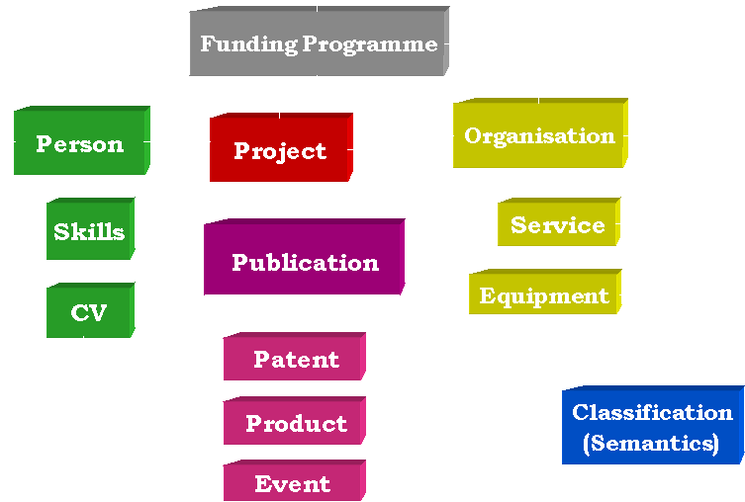
What is a CRIS?
www.eurocris.org
www.eurocris.org
Current
Research Information
System
= CRIS
… that means
of current interest
not necessarily ongoing
… information about
Researchers
Organisations (Research-performing, Funding)
Funding Programmes, Calls
Projects
…
… driven by
Concepts
Model
Implementation (Information System)
CERIF
an integrated approach towards managing research information

Slide 46
CRIS and Repositories at an institution
(slide by Keith Jeffery)
www.eurocris.org
www.eurocris.org
End-User
CERIF
CRIS
Research Context
[projects, persons, organisational units
funding, products, patents, publications
facilities, equipment, events]
CERIF
Various
protocols
OAI-PMH
OA Repository
(hypermedia) Documents
e-Research repository
Datasets and Software

Slide 47

The CERIF Evolution
www.eurocris.org
CERIF 1.6
CERIF 1.5
CERIF 1.4 (XML)
CERIF 1.3
www.eurocris.org
CERIF 1.3
CERIF 2006 / 2008 Model
Infrastructure
Link
Similar Ideas
UN/UNESCO
OECD
CODATA
Base
2ndLevel
Semantics
Language
Base
Link
Measurement
GEO
2ndLevel
Semantics
Language
Funding
Equipment
Facility
F
O
R
M
A
L
S
E
M
A
N
T
I
C
S
EU
Working Group
on Research
Databases
Workshop
ExpertiseAndSkills
Service
CERIF 2000 Model
Qualification
Prize
ElectronicAddresse
CV
PostalAddress
Roles
EXPERTISE
Citation
Metrics
Indicator
Measurement
- Data Model
Infrastructure
- Facility, Equipment, Service
- Measurement & Indicator
- Entities and Link Tables
Geographic Bounding Box
- CERIF 1.3 Vocabulary
- UUIDs
- Terms
- Schemes
- CERIF 1.4 new XML format
- CERIF 1.5 Federated Identifiers
- CERIF 1.6 Dataset-ready
OrgUnit
PERSON
Event
Language
Country
CERIF 91
Currency
PROJECT
PROJECT
RESULTS
EQUIPMENT
Acronym: ERGO
Participant:
Keith Jeffery, Anne Asser
son, many more
Organisations:
Rutherford Appleton, Uni-
versity of Bergen, …
CLASSIFICATION
- Data Model
Model Normalization
- Robust/Consistent Structure
- Extensible Structure
- Semantic Layer
XML Exchange Specification
- Elaboration on Publication
CERIF Core Semantics (2008 1.2)
Data Model
- Multilinguality
- Controlled Vocabulary
- Roles / Types
- User-driven
EC Recommendation to
Member States
- Networking of DBs
Exchange of Records
EC Recommendation to
Member States
+ Linked Data
1987
1991
2000
2006
2008
2012
2013

Slide 48







International Council for Science;
Commission on Data Access
European Association of Research
Managers and Administrators
www.eurocris.org
All European Academies

