Slide 1
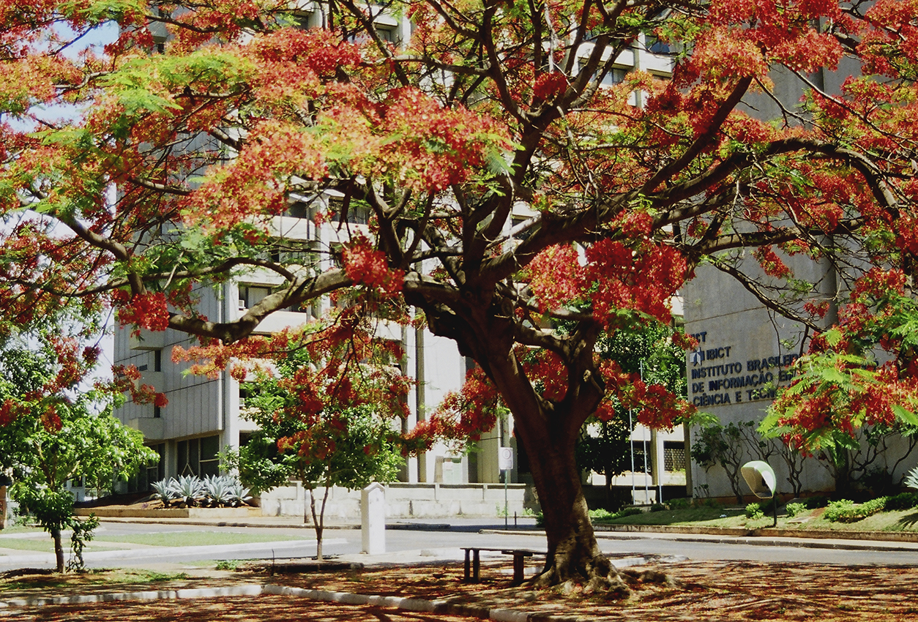


DEVELOPMENTS IN RESEARCH INFORMATION AND CRIS IN BRAZIL
Maria de Nazaré Freitas Pereira
Research Consultant for BRCRIS at the Brazilian Institute for Information in Science and Technology (IBICT)
euroCRIS Strategic Membership Meeting
Barcelona, 9-11 November 2015

Slide 2
Topics
General View of Brazil
Overview of the S & T System
Some Figures on the S & T System
IBICT – The Proponent of BR-CRIS
BR-CRIS
Final Remarks
Maria de Nazaré Pereira, IBICT Research Consultant
Notes:
2

Slide 3
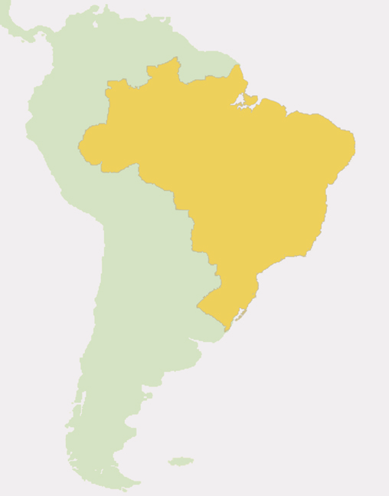
General View of Brazil
Total area
Population
GDP (2013)
Investment in S&T
Scientists and researchers
Scientific papers
8.5 million km²
200 million
~ 2.246 US$ trillion (3% world)
1.24 % GDP
~ 234,000 in 2010
2.43 % of global output in 2013
Sources: http://www.mct.gov.br/index.php/content/view/5860/Brasil_Pesquisadores_em_numero_de_pessoas_por_setor_institucional_e_nivel_de_escolaridade.html
https://en.wikipedia.org/wiki/List_of_countries_by_GDP_%28nominal%29
Maria de Nazaré Pereira, IBICT Research Consultant
Notes:
3

Slide 4
Topics
General View of Brazil
Overview of the S & T System
Some Figures on the S & T System
IBICT – The Proponent of BR-CRIS
BR-CRIS
Final Remarks
Maria de Nazaré Pereira, IBICT Research Consultant
Notes:
4

Slide 5
Brazilian System for Support of S&T&I, and Development of Human Resources
Federal
Government
State
Governments
MCTI
MEC
State of
São Paulo
26 other
States
CNPq
1951
CAPES
1951
FAPESP
1962
FAPs
1965-2011
Fellowships for Post-Graduate Students
FINEP
1967
Funding Individual Research Projects
Funding Institutional Research Projects
Fellowships for Senior and Young Investigators
Sources:
GUIMARAES, Jorge, Funding Science in the Americas: The Case of Brazil. 2009. The slide was updated.
J.A. Guimarães, M.C. Human: (1995) Human Resources in S&T in Brazil Scientometrics 34: 101-119
MCT: Ministério da Ciência e Tecnologia, MEC; Ministério da Educação, CNPq: Conselho Nacional de Desenvolvimento Cientifico e Tecnológico, CAPES: Fundação Coordenação de Aperfeiçoamento de Pessoal de Nível Superior, FINEP: Financiadora de Estudos e Projetos, FAPESP: Fundação de Apoio a Pesquisa do Estado de São Paulo e FAPES: Fundação de Apoio a Pesquisa demais Estados.
Maria de Nazaré Pereira, IBICT Research Consultant
Notes:
5

Slide 6
Brazilian Model for S&T&I Development (1)
Virtuous Cycle of Brazilian Science
Initiation in scientific research
Strong post-graduation program
Formation of research groups
International cooperation
Full access to international literature ( CAPES Portal)
Every component of the cycle is financed
Sources: GUIMARAES, Jorge, Funding Science in the Americas: The Case of Brazil. 2009.
Maria de Nazaré Pereira, IBICT Research Consultant
Notes:
6

Slide 7
Domestic expenditure on research and development (R&D) related to gross domestic product (GDP) of selected countries, 2000-2013
Country | 2000 | 2002 | 2004 | 2006 | 2008 | 2010 | 2012 | 2013
South Africa | - | - | 0,81 | 0,9 | 0,89 | 0,74 | 0,73 | -
Germany | 2,4 | 2,42 | 2,42 | 2,46 | 2,6 | 2,72 | 2,88 | 2,85
Argentina | 0,37 | 0,33 | 0,37 | 0,4 | 0,42 | 0,49 | 0,58 | 0,58
Australia | 1,48 | 1,65 | 1,73 | 2 | 2,25 | 2,2 | - | -
Brazil | 1,04 | 1,01 | 0,96 | 0,99 | 1,13 | 1,16 | 1,15 | 1,24
Canada | 1,87 | 1,99 | 2,01 | 1,96 | 1,87 | 1,84 | 1,71 | 1,62
China | 0,9 | 1,07 | 1,23 | 1,39 | 1,47 | 1,76 | 1,98 | 2,08
Singapore | 1,82 | 2,07 | 2,1 | 2,13 | 2,62 | 2,01 | 2 | -
South Corea | 2,18 | 2,27 | 2,53 | 2,83 | 3,12 | 3,47 | 4,03 | 4,15
Spain | 0,88 | 0,96 | 1,04 | 1,17 | 1,32 | 1,35 | 1,27 | 1,24
USA | 2,62 | 2,55 | 2,49 | 2,55 | 2,77 | 2,74 | 2,7 | 2,73
France | 2,08 | 2,17 | 2,09 | 2,05 | 2,06 | 2,18 | 2,23 | 2,23
India | 0,78 | 0,79 | 0,77 | 0,88 | 0,86 | 0,87 | 0,88 | -
Italy | 1,01 | 1,08 | 1,05 | 1,09 | 1,16 | 1,22 | 1,27 | 1,26
Japan | 3 | 3,12 | 3,13 | 3,41 | 3,47 | 3,25 | 3,34 | 3,47
Mexico | 0,33 | 0,39 | 0,39 | 0,37 | 0,4 | 0,45 | 0,43 | 0,5
Portugal | 0,72 | 0,72 | 0,73 | 0,95 | 1,45 | 1,53 | 1,38 | 1,37
United Kingdom | 1,73 | 1,72 | 1,61 | 1,65 | 1,69 | 1,69 | 1,63 | 1,63
Russia | 1,05 | 1,25 | 1,15 | 1,07 | 1,04 | 1,13 | 1,12 | 1,12
Source: http://www.mct.gov.br/index.php/content/view/336625/Dispendios_nacionais_em_pesquisa_e_desenvolvimento_P_D_em_relacao_ao_produto_interno_bruto_PIB_de_paises_selecionados.html
Maria de Nazaré Pereira, IBICT Research Consultant

Slide 8
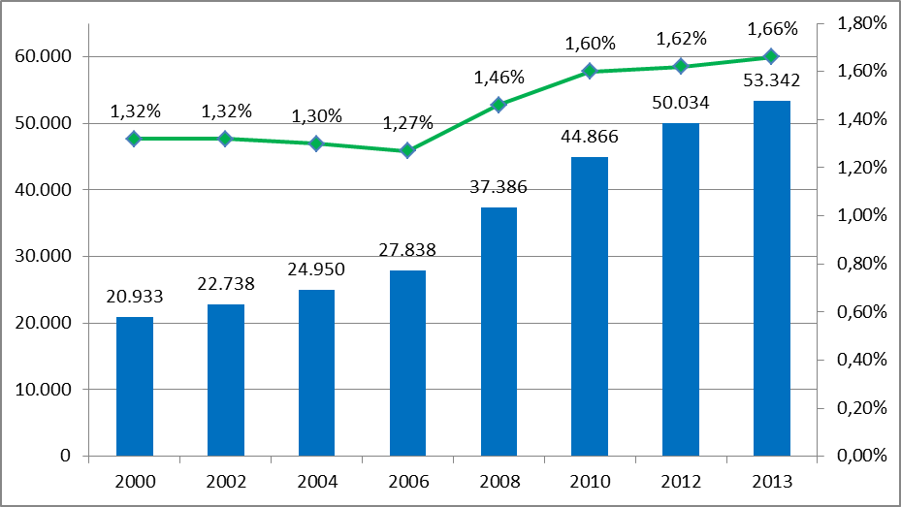
Domestic expenditure on science and technology (S&T) in current values, in relation to gross domestic product (GDP)– Brazil – 2000/2013
(in percentage)
(millions of US$ in current values PPS - Purchasing Power Standards )
Source: http://www.mct.gov.br/index.php/content/view/9058.html
Maria de Nazaré Pereira, IBICT Research Consultant

Slide 9
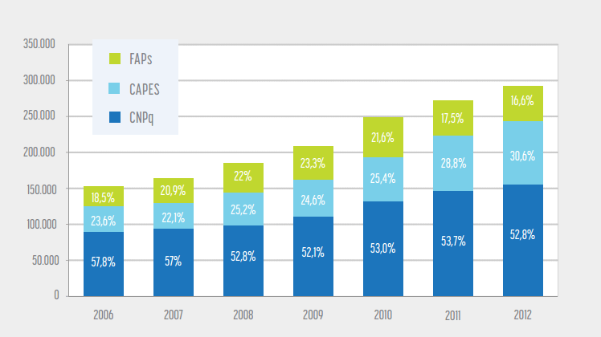
Number of recipients of scholarships granted in Brazil and elsewhere by federal development agencies and state research support foundations – Brazil – 2006-2012
Source: http://www.mct.gov.br/index.php/content/view/361281.html
Maria de Nazaré Pereira, IBICT Research Consultant

Slide 10
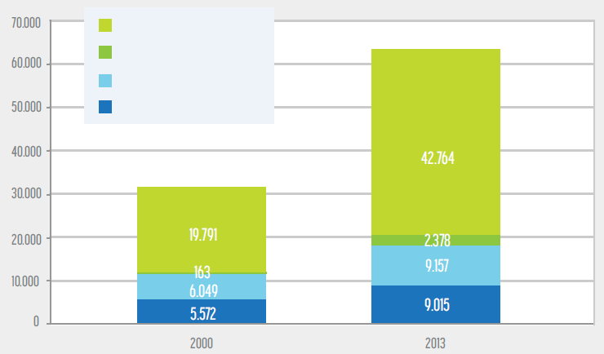
Number of scholarships per year awarded by the National Council of Scientific and Technological Development (CNPq) in Brazil and elsewhere, by program – Brazil – 2000/2013
Initiation of research
Pos-Doctoral
PhD
Master
Sources: http://www.mct.gov.br/index.php/content/view/5824.html;
http://www.mct.gov.br/index.php/content/view/5832.html;
http://www.mct.gov.br/index.php/content/view/341126.html.
Maria de Nazaré Pereira, IBICT Research Consultant

Slide 11
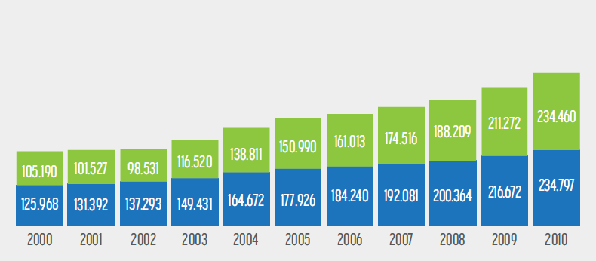
Numbers of researchers and support staff involved in research and development (R&D) – Brazil – 2000-2010
Support staff
Researchers
Source: http://www.mct.gov.br/index.php/content/view/73230.html
Maria de Nazaré Pereira, IBICT Research Consultant

Slide 12
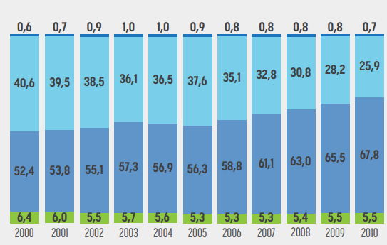
Percentage distribution of researchers in full-time equivalency, by institutional sector – Brazil – 2000-2010
(in percentages)
Private non-profit
Business companies
Higher education
Government
Source: http://www.mct.gov.br/index.php/content/view/362812.html
Maria de Nazaré Pereira, IBICT Research Consultant

Slide 13
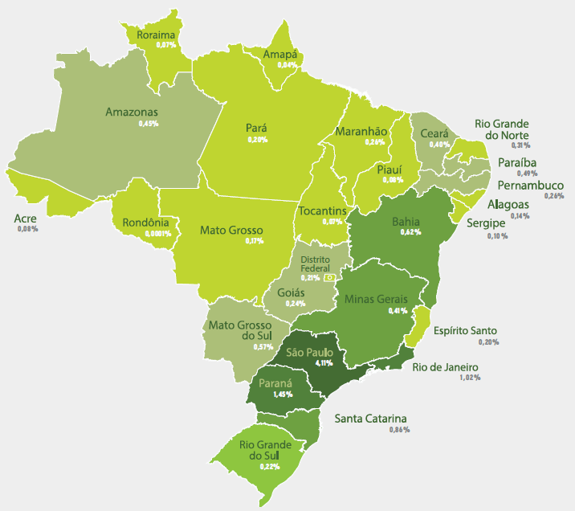

Expenditures by state governments in research and development(R&D) and percentages of these in relation to total state income – Brazil – 2013
up to US$ 31 millions
from US$ 31 to US$ 62 millions
from US$ 62 to US$ 124 millions
from US$ 124 to US$ 311 millions
from US$ 311 milhões to US$ 622 millions
more than US$ 622 millions
US$ PPS - Purchasing Power Standards
Sources: http://www.mct.gov.br/index.php/content/view/317045.html;
http://www.mct.gov.br/index.php/content/view/317046.html.
Maria de Nazaré Pereira, IBICT Research Consultant

Slide 14
Expenditures by state governments in research and development (R&D) and percentages of these in relation to total state income – Brazil – 2013
Regions and Federative Units | Percentages in relation to total state income | Expenditures in millions of US$ PPS¹
Total | 1,42 | 6.838,70
Norte | 0,19 | 77,66
Acre | 0,08 | 2,68
Amapá | 0,04 | 1,31
Amazonas | 0,45 | 44,78
Pará | 0,2 | 23,66
Rondônia | 0,0001 | 0,00
Roraima | 0,07 | 1,74
Tocantins | 0,07 | 3,55
Nordeste | 0,36 | 349,62
Alagoas | 0,14 | 7,41
Bahia | 0,62 | 150,52
Ceará | 0,4 | 53,31
Maranhão | 0,26 | 24,47
Paraíba | 0,49 | 32,88
Pernambuco | 0,26 | 49,57
Piauí | 0,08 | 4,23
Rio Grande do Norte | 0,31 | 21,80
Sergipe | 0,1 | 5,54
Regions and Federative Units | Percentages in relation to total state income | Expenditures in millions of US$ PPS¹
Sudeste | 2,5 | 5.749,37
Espírito Santo | 0,2 | 22,05
Minas Gerais | 0,41 | 199,03
Rio de Janeiro | 1,02 | 487,50
São Paulo | 4,11 | 5.040,73
Sul | 0,77 | 536,38
Paraná | 1,45 | 324,40
Rio Grande do Sul | 0,22 | 65,20
Santa Catarina | 0,86 | 146,78
Centro-Oeste | 0,27 | 125,61
Distrito Federal | 0,21 | 24,41
Goiás | 0,24 | 36,81
Mato Grosso | 0,17 | 19,74
Mato Grosso do Sul | 0,57 | 44,65
(1 - PPP - Purchasing Power Parity)
Sources:
http://www.mct.gov.br/index.php/content/view/317045.html;
http://www.mct.gov.br/index.php/content/view/317046.html.
Maria de Nazaré Pereira, IBICT Research Consultant

Slide 15
Ranking 2013
Nr. | Country | Articles in Web of Science
1 | USA | 419.645
2 | CHINA | 295.582
3 | GERMANY | 114.199
4 | UNITED KINGDOM | 103.582
5 | JAPAN | 93.120
6 | FRANCE | 79.842
7 | CANADA | 70.456
8 | ITALY | 69.604
9 | INDIA | 64.877
10 | SPAIN | 61.431
11 | AUSTRALIA | 58.596
12 | SOUTH COREA | 57.421
13 | BRAZIL | 43.357
14 | HOLLLAND | 40.332
15 | THAILAND | 33.501
Original source: Web of Science, Thomson Reuters (2015). Dataset: 2013, document type: article, review, proceeding paper Data collected in 23 mar 2015
Source: http://www.periodicos.capes.gov.br/images/documents/Apresenta%C3%A7%C3%A3o%20Portal%20de%20Peri%C3%B3dicos_Elenara%20Almeida.pdf
Maria de Nazaré Pereira, IBICT Research Consultant
Notes:
15

Slide 16
The Portal of CAPES
Created in 2000, this is a virtual library which unites and makes available the best of scientific production to teaching and research institutions in Brazil.
The collection is composed of
• More than 37 thousand full-text scientific journals;
• 126 reference databases ; and
• 11 databases dedicated
exclusively to patents.
Also offers electronic books, encyclopedias and reference works, theses and dissertations, technical standards, statistics and audiovisual content.
Source:http://www.periodicos.capes.gov.br/images/documents/Apresenta%C3%A7%C3%A3o%20Portal%20de%20Peree%C3%B3dicos_Elenara%20Almeida.pdf
Maria de Nazaré Pereira, IBICT Research Consultant

Slide 17

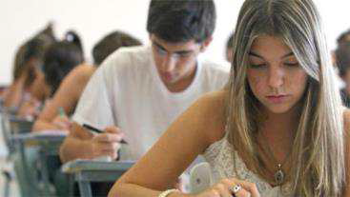
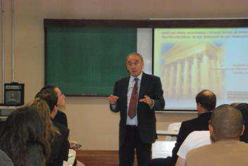
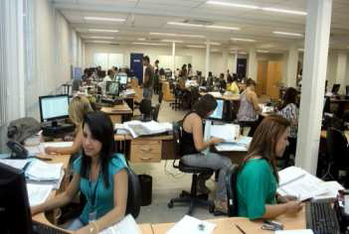

The Portal of CAPES
Target Public ≅ 6 million
Graduate and post-graduate students
Teachers
Staff
Researchers
Source: http://www.periodicos.capes.gov.br/images/documents/Apresenta%C3%A7%C3%A3o%20Portal%20de%20Peri%C3%B3dicos_Elenara%20Almeida.pdf
Maria de Nazaré Pereira, IBICT Research Consultant

Slide 18
Topics
Overview of Brazil
Overview of the S & T System
Some Figures on the S & T System
IBICT – The proponent of BR-CRIS
BR-CRIS
Final Remarks
Maria de Nazaré Pereira, IBICT Research Consultant
Notes:
18

Slide 19
IBICT – The proponent of BR-CRIS
  1954 – Creation of the Brazilian Institution for Bibliography and Documentation (IBBD)
  as part of Unesco initiative to foster the creation of similar institutions in many countries
  IBBD was integrated into the structure of the National Research Council (CNPq)
  In the sixties - IBBD developed a CRIS as part of another Unesco iniative, the World Science Information System (UNISIST)
Maria de Nazaré Pereira, IBICT Research Consultant
Notes:
19

Slide 20
IBICT – The proponent of BR-CRIS
  1976 – IBBD was transformed into IBICT - the Brazilian Institute for Information in Science and Technology and its main function was to act as a coordinator of the information activities in the country
  CRIS was discontinued
Maria de Nazaré Pereira, IBICT Research Consultant
Notes:
20

Slide 21
IBICT – The proponent of BR-CRIS
  Teaching and Research
  1970 – First Master in Information Science in Latin America in partnership with the Federal University of Rio de Janeiro (UFRJ)
  Years later a PhD was created
  1972 – Information Science Journal (Revista Ciência da Informação), the first to be published in Latin America
21
Maria de Nazaré Pereira, IBICT Research Consultant
Notes:
21

Slide 22
IBICT – The proponent of BR-CRIS
  Staff total: 161
  Staff in R,D&I: 118
  Budget: 5, 300.000.00 US$
Maria de Nazaré Pereira, IBICT Research Consultant
Notes:
22

Slide 23

IBICT – The Proponent of BR-CRIS
  Participation in National and International Bibliographic Services
  National Union Catalog for Serial Publications (CCN)
  Bibliographic Commutation Program (Comut)
  Bibliodata Network (cooperative cataloguing in Brazil)
  Brazilian Centre for the International Standard Serial Number (ISSN)
  Support to the Agency for Digital Object Identifier System (DOI)
  Regional Cooperative Online Information System for Scholarly Journals from Latin America, the Caribbean, Spain and Portugal (Latindex)
23
Maria de Nazaré Pereira, IBICT Research Consultant

Slide 24
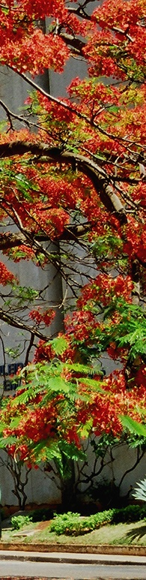

IBICT – The Proponent of BR-CRIS
Library Network of MCTI Research Institutions (RBP)
Portal of the Open Book of Science, Technology and Innovation <livroaberto.ibict.br>
Integrated Catalogue of the MCTI Research Institutes Scientific Production
Thematic Workshops on Information Science open to the public.
24
Maria de Nazaré Pereira, IBICT Research Consultant

Slide 25



IBICT – The proponent of BR-CRIS
Brazilian Program for Free Access to Scientific Information
Brazilian Portal for Free Access to Scientific Information (oasisbr)
More than a 1,000,000 documents
Digital Library for Theses and Dissertations (BDTD)
More than 350,000 documents
Brazilian Open Access Institutional Repositories (RIs)
More than 340,000 documents
Directory About Access Policies to the Brazilian Journals (DIADORIM)
More than 800 editorial policies with access to the journals
Maria de Nazaré Pereira, IBICT Research Consultant

Slide 26
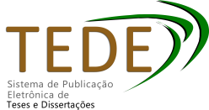


IBICT – The proponent of BR-CRIS
Brazilian Program for Free Access to Scientific Information
Free Software to suport free access actions
System for Thesis and Dissertations Electronic Publishing (TEDE)
Open Journal System (OJS) – Public Knowledge Project
Software for building open digital repositories (DSpace)
Software for building CRIS (DSpace-CRIS)
starting the hands-on phase
Maria de Nazaré Pereira, IBICT Research Consultant

Slide 27
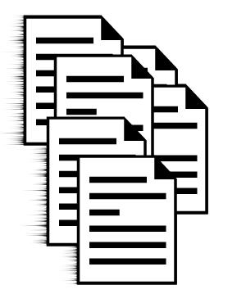
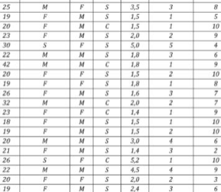
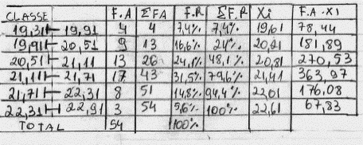
IBICT – The proponent of BR-CRIS
Brazilian Program for Free Access to Scientific Information
Open Data of Brazilian Scientific Research
- Datasets of research funded with public resources for reuse and linking to the scientific production
Maria de Nazaré Pereira, IBICT Research Consultant

Slide 28

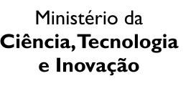








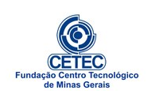

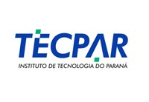






















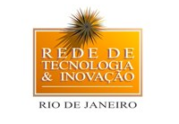

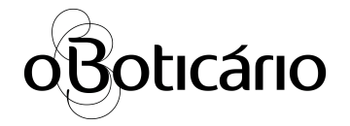



Parcerias Nacionais
NATIONAL PARTNERS
Maria de Nazaré Pereira, IBICT Research Consultant

Slide 29























INTERNATIONAL PARTNERS
Maria de Nazaré Pereira, IBICT Research Consultant

Slide 30
IBICT – The proponent of BR-CRIS
Warning
The following 6 slides have not been translated. They deal with IBICT accomplishments in the field of information for the general public. They will be translated in the version to be deposited in the DSpace EuroCris Database.
30
Maria de Nazaré Pereira, IBICT Research Consultant
Notes:
30

Slide 31
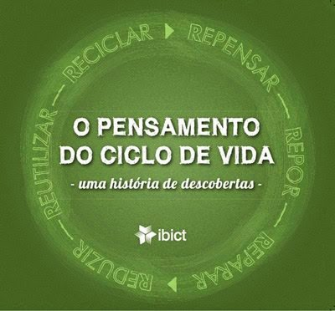
Setor Produtivo
  Serviço Brasileiro de Respostas Técnicas (SBRT)
  127 mil clientes cadastrados (PF: 94%; PJ: 6%)
  30,571 Respostas Técnicas
  464 Dossiês Técnicos
  Avaliação do Ciclo de Vida (ACV)
  Informação para a Indústria
  Pensamento do Ciclo de Vida
  Observatório Nacional dos Arranjos Produtivos Locais (APL)
  Modelo: Portal APLMineral
  Educação Livre
  Educação para jovens
  Parceria CNI, SESI e Unesco
31
Cecilia Leite, out.2015

Slide 32
Inclusão Digital e Informacional
  Mapa da Inclusão Digital no Brasil
  28.800 Pontos de Inclusão Digital georeferenciados
  Visualização por meio de infográficos dinâmicos
  Metodologia de validação dos Pontos e identificação de serviços oferecidos
  Corredor Digital Rural
  26 escolas rurais atendidas (laboratórios de informática)
  Ensino de disciplinas por meio de atividades lúdicas (jogos eletrônicos)
  Busca por informação de interesse local
  Estímulo à autoria, ao empreendedorismo e desenvolvimento socioeconômico das comunidades locais
  Capacitação de professores na manutenção de computadores
32
Cecilia Leite, out.2015
Notes:
32

Slide 33

Popularização da Ciência e
Inclusão Informacional
  Canal Ciência
Portal de divulgação científica que leva à sociedade pesquisas científicas brasileiras, em linguagem de fácil compreensão - validadas pelos pesquisadores-autores.
  Portal
  -Transcrição de textos científicos para linguagem clara
  -Base de apoio didático
  -Conteúdos multimodais (vídeos, jogos eletrônicos educativos)
  -Notícias e Eventos
  -Notáveis da Ciência
  Oficinas pedagógicas presenciais em Escolas e Eventos de C&T
  De 2014 até o momento, foram realizadas
  -53 oficinas presenciais, nas quais se capacitaram
  -1.135 alunos e 136 professores
  -Cerca de 4.000 atendimentos em feiras e eventos de C&T
33
Cecilia Leite, out.2015

Slide 34
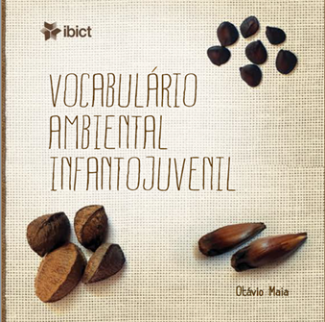
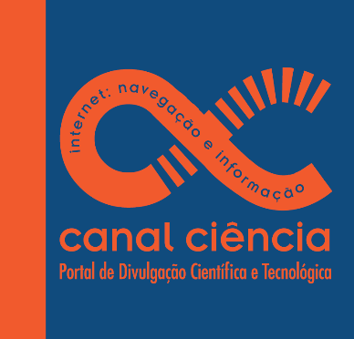
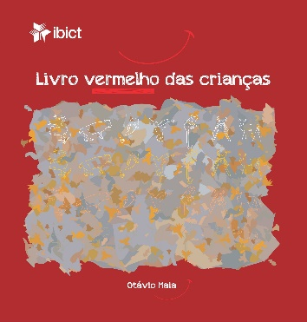
Popularização da Ciência e
Inclusão Informacional
  Canal Ciência
  Publicações
  Vocabulário Ambiental Infantojuvenil
  Cartilha Internet: navegação e informação
  Livro Vermelho das Crianças
Concursos de desenhos infantojuvenis para ilustração de livros
34
Cecilia Leite, out.2015

Slide 35
Programa de Preservação Digital
Rede Cariniana
Rede Cariniana
10 caixas LOCKSS
636 títulos preservados
(941 em processo)
6142 volumes preservados
(4774 em processo)
88 instituições
com títulos preservados
(67 em processo)
IBICT
USP
UNICAMP
UFG
USM
UFPB
UFBA
UFRN
UFRGS
UnB
35
Cecilia Leite, out.2015
Notes:
35

Slide 36
Topics
Overview of Brazil
Overview of the S & T System
Some Figures on the S & T System
IBICT – The proponent of BRCRIS
BR-CRIS
Final Remarks
Maria de Nazaré Pereira, IBICT Research Consultant
Notes:
36

Slide 37
BR-CRIS
First Steps – 16 months ago
2014 July – begining of the studies to develop a Mapa da Competência (Competency Map) for Brazil
The suggestion was made to develop a CERIF- based CRIS
2014 Oct - Attendance at the CONFOA Conference (Coimbra) to report on the IBICT idea to develop a CRIS for Brazil
Finding Joao Moreira
37
Maria de Nazaré Pereira, IBICT Research Consultant
Notes:
37

Slide 38
BR-CRIS
International Cooperation
2015 – Cooperation Agreement was celebrated between the Portuguese Foundation for Science and Technology (FCT) and the Brazilian Ministry of Science, Technology and Innovation (MCTI)
2009 – Memorandum of Understanding in the area of free acess to information between the Portuguese Ministry of Science and Technology and the Brazilian Ministry of Science, Technology and Innovation (MCTI)
Maria de Nazaré Pereira, IBICT Research Consultant
Notes:
38

Slide 39
BR-CRIS
Workshops
Organizers:
IBICT and the Portuguese Foundation for Science and Technology (FCT)
Participation:
PT-CRIS Coordinator – Joao Moreira
March 2015 : Discussion of the framework of a CRIS with the personnel of IBICT, MCTI and the funding agencies for S&T
June 2015 : beginning the hands-on phase of the project
Maria de Nazaré Pereira, IBICT Research Consultant
Notes:
39

Slide 40
BR-CRIS
General Goal
To put into action an integrated national ecosystem for research information which will support ST&I activities developed in Brazil, in accordance with the best international practices and standards
Maria de Nazaré Pereira, IBICT Research Consultant
Notes:
40

Slide 41
BR-CRIS
Targets
To define a set of standards which integrates and internationalizes various research information systems
To standardize and record data on projects, researchers, funding sources, publications, institutions, infrastructure, software, awards, events, patents, technologies, among others, to disseminate reliable and quality information about them
Maria de Nazaré Pereira, IBICT Research Consultant
Notes:
41

Slide 42
BR-CRIS
Targets
3. To integrate the large ST&I information systems in accordance with the standards framework.
4. To coordenate the adaptation and integration of other information in accordance with the standards framework.
5. To offer training in the use of the standards framework.
6. To allow for periodic evaluations of research funding, using business intelligence and data discovery tools.
Maria de Nazaré Pereira, IBICT Research Consultant
Notes:
42

Slide 43
BR-CRIS
Partners
MCTI
CNPq
CAPES
FINEP
RNP
CRUB (Council of Rectors of Brazilian Universities
SBPC (Brazilian Society for the Advancement of Science)
ABC (Brazilian Academy for Sciences)
ABEC (Association of Brazilian Scientific Journal Editors)
CONFAP (National Council for the State Funding Agencies)
CONSECTI (National Council for the State Secretaries for ST&I)
RBP (Library Network of MCTI Research Institutions )
Maria de Nazaré Pereira, IBICT Research Consultant
Notes:
43

Slide 44
BR-CRIS
System Architecture
Plataforma Lattes
Notícias de Pesquisa
Plataforma Aquarius
Base de Dados de Teses e Dissertações (BDTD)
Infraestruturas de Pesquisa
Plataforma Chagas
Ética de Pesquisa
Somos.UFMG
Base de Dados de Projetos da FINEP
Banco de Teses da Capes
Repositórios Institucionais
SCIELO
Bases de Dados Agências Estaduais
Mapa da Competência
Mapa da Competência
Maria de Nazaré Pereira, IBICT Research Consultant
Notes:
Na sequência dos estudos de estado de arte foram identificados vários componentes de um CRIS nacional.
44

Slide 45
BR-CRIS
Dados
Dicionário / Interoperabilidade
Ontologias
Identificador Pesquisadores
BRCRIS
Identificador Organizações
INTERNATIONAL STANDARDS
Maria de Nazaré Pereira, IBICT Research Consultant
Notes:
Na sequência dos estudos de estado de arte foram identificados vários componentes de um CRIS nacional.
45

Slide 46
BR-CRIS
Methodology - Working Packages (*)
Coordination and Management of the BR-CRIS Project: to coordinate and to manage the activities included in the BR-CRIS Project, as well as to establish a mechanism to promote and facilitate collaborative work between the institutions that make up the project consortium;
2. Interoperability: communication languages between systems (eg CERIF-XML) and data dictionary (eg CASRAI);
3. Synchronization: definition and implementation of an information synchronization framework in BR-CRIS ecosystem;
Note: For each work package, an institution (Consortium component) will be indicated as responsible.
(*) Built in Accordance with PTCRIS experience
46
Maria de Nazaré Pereira, IBICT Research Consultant
Notes:
46

Slide 47
BR-CRIS
Methodology - Working Packages (*)
4. Identifiers: definition of identifiers (individuals, organizations, national publications, courses, projects);
5. Indexing Tools: proposition of classification systems for the BR-CRIS and support tools for their adoption;
6. Data Protection: : to define policies and data protection mechanisms for the BR-CRIS;
7. Identity Management: integration of BR-CRIS ecosystem into the RedeCafé authentication and authorization infrastructure;
8. CV: adaptation of the CV system to the standards framework of the BR-CRIS;
(*) Built in Accordance with PTCRIS experience
47
Maria de Nazaré Pereira, IBICT Research Consultant
Notes:
47

Slide 48
BR-CRIS
Methodology - Working Packages (*)
9. Organizations: definition of rules, principles and processes for the registry of the organizations in the country; providing a registration system for them; establishment of a national organization database; implementation of measures at the level of the national CRIS;
10. Projects Data Base: to build a national projects database (funded);
11. Results: to adapt the results management systems to the BR-CRIS framework standards;
12. Research Portal: to provide a service that can present the scientific activity to various stakeholders;
(*) Built in Accordance with PTCRIS experience
48
Maria de Nazaré Pereira, IBICT Research Consultant
Notes:
48

Slide 49
BR-CRIS
Methodology - Working Packages (*)
13. Local CRIS: to provide the institutions with local CRIS built in accordance with the standards framework;
14. BI (business intelligence): to provide a service that allows the extraction of indicators of Brazilian scientific activity, and
15. Data Warehouse: to provide a data warehouse, a "single point of truth" complete, reliable and transparent.
(*) Built in Accordance with PTCRIS experience
49
Maria de Nazaré Pereira, IBICT Research Consultant
Notes:
49

Slide 50
Topics
Overview of Brazil
Overview of the S & T System
Some Figures on the S & T System
IBICT – The proponent of BRCRIS
BR-CRIS
Final Remarks
Maria de Nazaré Pereira, IBICT Research Consultant
Notes:
50

Slide 51
Final Remarks
Benefits for Brazil
  Much can be done with few resources:
    Free software tools; and
    Knowledge ready to be shared..
  Integration of research evaluations from all regions of Brazil.
Maria de Nazaré Pereira, IBICT Research Consultant
Notes:
51

Slide 52
Final Remarks
Internationalization of Science and Technology produced in Brazil
and
Sharing the results of research done in other countries
    international relationships based on equality and reciprocity
Maria de Nazaré Pereira, IBICT Research Consultant
Notes:
52

Slide 53
Final Remarks
Legacy of the Past |  | Current Situation
Research Information Systems owned by MCTI, CNPq, Finep, CAPES, IBICT, FAPs, amongst others; and A strong culture of free software and open access. |  | Cooperation Agreements with Portugal (FCT/PT-CRIS); International Standards Organizations mobilized for collaboration and training; and National funding agencies and institutions mobilized.
Maria de Nazaré Pereira, IBICT Research Consultant
Notes:
53

Slide 54
Final Remarks
Brazil is a country integrated by football.
BR-CRIS represents the opportunity to realize a different kind of integration, one achieved through knowledge of all kinds.
Maria de Nazaré Pereira, IBICT Research Consultant
Notes:
54

Slide 55
Thanks
Maria de Nazaré Pereira, IBICT Research Consultant
marianazare@uol.com.br

