Slide 1
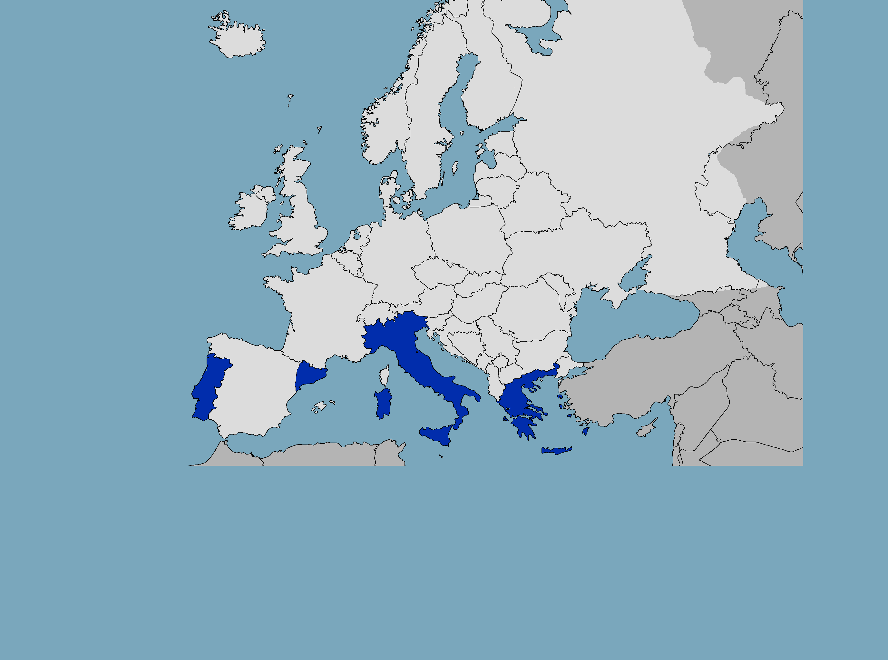
South European Link for Research Information Management
FCT|FCCN (Portugal)
GIVE
PTCRISync: ORCID Synchronization Framework
TAKE
CERIF Model | CERIF Services | CERIF REST API | CERIF OAI | DSpaceCRIS
CINECA (Italy)
GIVE
DSpace-CRIS | ORCID HUB | upgrades | roadmap
TAKE
ORCID Synchronization Framework | CERIF REST API | CERIF OAI
SELRIM
After the 2014 euroCRIS Strategic Membership Meeting in Amsterdam, 4 Organisations decided to seat around a table and start sharing their views on the development of Research Information Systems in their respective Countries. What came out of the very first conversation was that the similarities were more than the differences: not only from a political and cultural point of view, but also and most importantly for the way those organisations see the Research Area, their visions and technological roadmaps. The roots of SELRIM are: CERIF, Open Source, Standards and, last but not least, the idea that Collaboration is the king.
Contact persons
Michele Menielli - CINECA
Andrea Bollini - CINECA
João Moreira - FCT|FCCN
Dimitris Karaiskos - EKT
Vasilis Bonis - EKT
Lluís Anglada - CSUC
Ricard de la Vega - CSUC
Ramon - CSUC
CSUC (Catalonia)
GIVE
CERIF validator | DSpaceCRIS early adaptor
TAKE
DSpace-CRIS | CERIF OAI
EKT (Greece)
GIVE
CERIF Model | CERIF Services | CERIF XML | CERIF REST API | CERIF OAI | upgrades
TAKE
Contribution

Slide 2
South European Link for Research Information Management
FCT|FCCN (Portugal)
GIVE
PTCRISync: ORCID Synchronization Framework
TAKE
CERIF Model | CERIF Services | CERIF REST API | CERIF OAI | DSpaceCRIS
CINECA (Italy)
GIVE
DSpace-CRIS | ORCID HUB | upgrades | roadmap
TAKE
ORCID Synchronization Framework | CERIF REST API | CERIF OAI
Identified common interest topics to work on 2016:
Harvesting and sync info using OAI-PMH (1st quarter)
CASRAI full academic CV express in CERIF xml (2nd quarter)
Improving of data validation processes (3rd quarter)
call for joining us !
SELRIM
CSUC (Catalonia)
GIVE
CERIF validator | DSpaceCRIS early adaptor
TAKE
DSpace-CRIS | CERIF OAI
EKT (Greece)
GIVE
CERIF Model | CERIF Services | CERIF XML | CERIF REST API | CERIF OAI | upgrades
TAKE
Contribution

