Slide 1
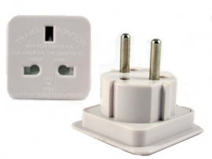
Let’s Talk – Interoperability between University CRIS/IR and
Researchfish : a case study from the UK
Anna Clements, University of St Andrews
Gavin Reddick, Researchfish
CRIS2016 Conference
St Andrews, UK 8-11 June
Henry Legg

Slide 2
What we will cover
Background
Pilot
Next Steps

Slide 3
Funders and Universities require information
Manage research portfolio
Policy compliance
Reputation, promotion & impact
Accountability
Benchmarking
Analyze relationship between funding and outputs
Digital asset management – research outputs
Notes:
Provide a tool that is easy to use & someone in the Library or Research Office who can hand hold
Enter data once and we and you can reuse it
REF2014, REF2020, Web pages, Consortia, CVs
ORCiD
Keeps the institution and funders of our backs
Immediate gratification … put it in the CRIS and it’s out on the portal

Slide 5
Activities
Impact
Publications
Award/ recognition
Indicators
WoS, arXiv, PubMed, Scopus…
Case Studies
Bibtex, Refman
Dissemination// Engagement
Entered
Measures
Manual
Input
Uploaded
Entered
Harvested
University Structure [HR]
Entered
Industry / SME’s
Interface
St Andrews
PURE CRIS
HEI – Strategic
Planning, Benchmarking
Staff Records [HR]
Pulled In
Fed Out
REF, RCUK
SFC, HESA
Student Records [Registry]
Linked
Linked & held
Public, Media Recognition / Impact
Projects, Grants, KT
[Finance]
Collaborations
Research Pools
Full Text
Repository
Open Access
Research data sets
(multiple locations and formats)

Slide 6
Background on Researchfish
MRC e-Val (2008), Researchfish (2011), Disciplinary expansion (2014)
Over 100 organisations in 5 countries
Over £40 billion of funding
Over 100,000 awards
Around 65,000 researchers
More than 1.7 million outputs reported

Slide 7
Pilot
Purpose: to understand the feasibility of information exchange between Researchfish and university repositories
Scope: Publications with 1 to 1 identifiers - DOI/PMID – paired with award reference
Steering Group
Project Team

Slide 8
Participants
Research Organisations: Imperial College London, University of Bristol, University of Cambridge, University of Edinburgh, University of St Andrews
Funding Organisations : AHRC, BBSRC, EPSRC, ESRC, MRC, NERC, STFC, NC3R, Academy of Medical Sciences, Cancer Research UK

Slide 9
Pilot Timescale
Task
Agree scope | Project team | 15th Sep 2015
Prepare data upload | Pilot universities | By 6th Nov 2015
Validate data | Researchfish | Nov – Dec 2015
Upload data into Researchfish | Researchfish | Dec 2015
RCUK submission period | Open to all researchers from all research organisations | Feb – Mar 2016
Analyse submitted data | Researchfish | Apr – May 2016

Slide 10
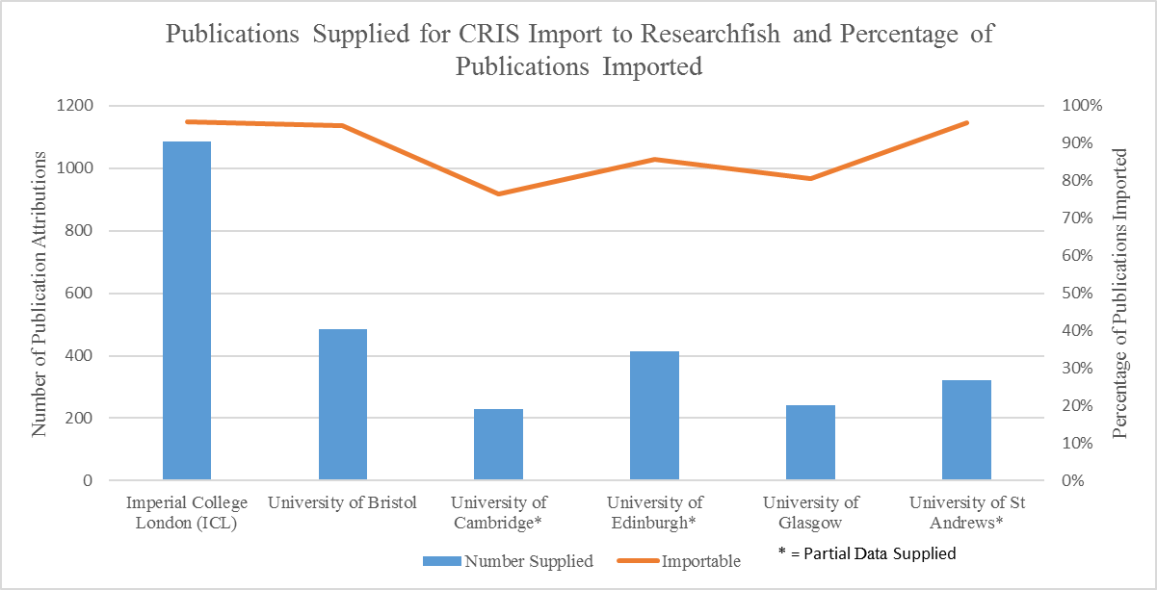

Slide 11
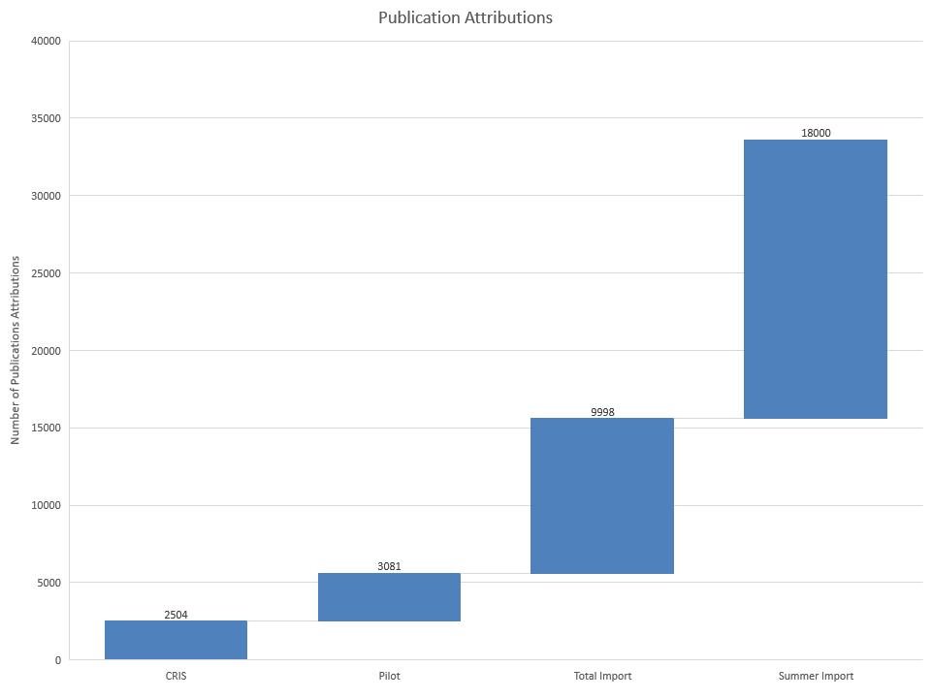

Slide 13
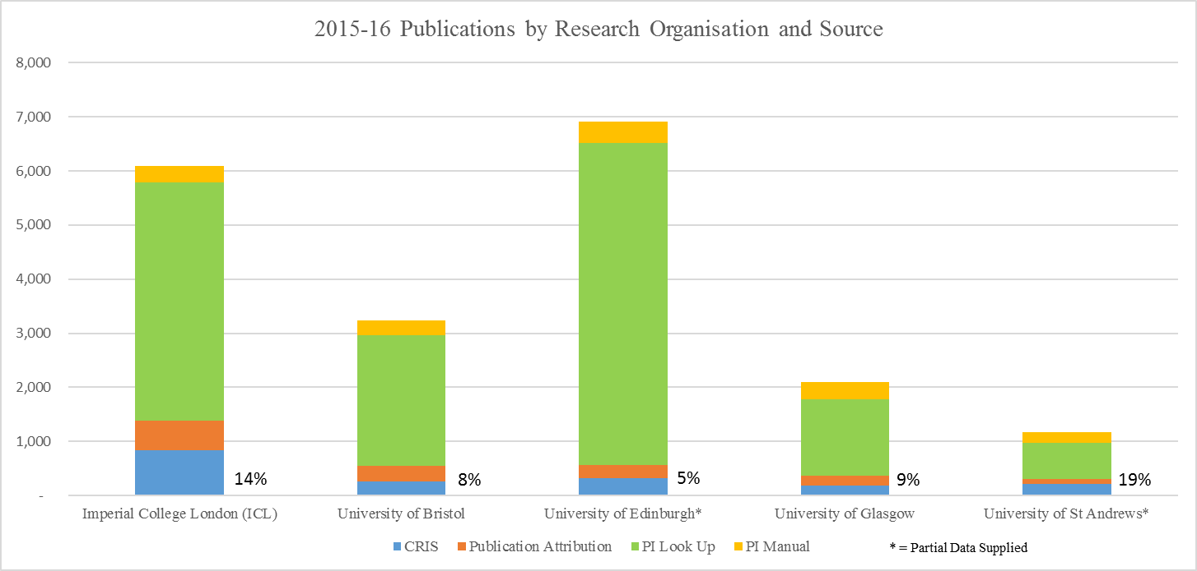

Slide 14
Next Steps - July 2016 +
Researchfish development to further support data exchange
Scaling up of pilot – each institution to expand to the whole university and all funders
Data to be added in advance of 2017

Slide 15
Beyond publications with DOIs
Feedback from Researchers – v. positive and want it to continue/ extend to other outputs
User communities e.g. Impact and Activity Model developments in Pure
CASRAI-UK & Open Standards
DOIs on acceptance / Crossref
RCUK grant application system

Slide 16
Thank you!
Anna Clements, University of St Andrews
@annakclements
Gavin Reddick, Researchfish
Gavin.Reddick@Researchfish.com
CRIS2016 Conference
St Andrews, UK 8-11 June
Henry Legg

