Slide 1
John Green, Chair of Snowball Steering Group formerly Chief Operating Officer, Imperial College London now Life Fellow, Queens’ College Cambridge jtg11@cam.ac.uk Anna Clements, University of St Andrews, UK Board member, euroCRIS Deputy chair , CASRAI-UK Chair, Pure UK Strategy Group Peter Darroch, Elsevier, Project Manager Snowball
Snowball Metrics – providing a robust methodology to inform research strategy – but do they help?

Slide 2
Snowball Metrics address university-driven benchmarking
Universities need standard metrics to benchmark themselves and know their position relative to peers, so they can strategically align resources to their strengths and weaknesses
Snowball Metrics UK Project Partners
Notes:
So The Snowball Metrics project started about 4 years ago following a report led by the Chair of the Snowball Metrics Steering Committee, John Green, when he was Chief Operating Officer at Imperial College London. One of the things the report highlighted was the need for standard metric definitions in order to allow universities to benchmark themselves against their peers in order to allow them to more effectively align strategies to their strengths and weaknesses.
The slide here shows the original 9 partners in the project. The University Partners account for around 50% of UK research output and also research spend and Elsevier as a partner, provided general project management, the capability to help test the feasibility of the metrics and to help communicate and distribute the program using our global networks.

Slide 3
Snowball Metrics approach
Vision: Snowball Metrics enable benchmarking by driving quality and efficiency across higher education’s research and enterprise activities, regardless of system and supplier
Bottom-up initiative: universities define and endorse metrics to generate a strategic dashboard. The community is their guardian
Draw on all data: university, commercial and public
Ensure that the metrics are system- and tool-agnostic
Build on existing definitions and standards where possible and sensible
Notes:
The Snowball Metrics project aims to publish a series of free to use metrics which become the international standard that is endorsed by research-intensive universities so they can build and monitor their strategies. Importantly, it is a ‘bottom-up, or ‘sector led’ initiative in which universities agree a single method to calculate metrics about their own performance so they can effectively compare themselves against each other in an apples to apples way across the whole research workflow from Inputs, throughputs or processes, to outputs and outcomes.
Snowball metrics are not proprietary, they do not depend on a particular data source or supplier and are based on a combination of all the data sources available to universities be they institutional, third party or commercial sources. They should also be system and tool agnostic and build on existing standards where possible and this is where the CASRAI project is obviously relevant.

Slide 4
Globalizing Snowball Metrics
US
University of Michigan
University of Minnesota
Northwestern University
University of Illinois at Urbana-Champaign
Arizona State University
MD Anderson Cancer Center
Kansas State University
Australia / New Zealand
University of Queensland
University of Western Australia
University of Auckland
University of Wollongong
University of Tasmania
Massey University
The University of Canberra
Charles Darwin University
Interest and support from:
Japan RU11 metrics group
Association of Pacific Rim Universities (APRU)
European Commission for H2020
Fundação para a Ciência e a Tecnologia (FCT) in Portugal
Notes:
Started in Uk but desire is to globalise metrics so we have a US group which has been partially successful with a few universities still interested but not taken up as quickly as hope due to many factors. We do however have around 12 US specific versions of metrics where the subject areas have been mapped to the NSF HERD survey subject areas. In ANZ group has been slow and not too successful to this point. Also had interest from other areas listed. Now UK and US universities could benchmark themselves but key to this further success is also our work with standards agencies such as CASRAI and euroCRIS. One issue may be there is no way for univ to see each others metrics and share them.

Slide 5
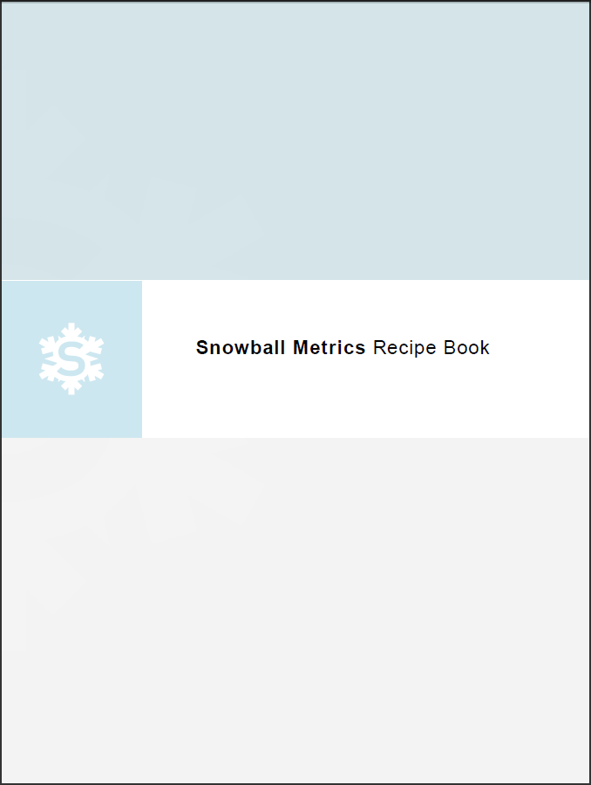
The output of Snowball Metrics
“Recipes” – agreed and tested metric methodologies – are the output of Snowball Metrics
From Statement of Intent:
Agreed and tested methodologies… are and will continue to be shared free-of-charge
None of the project partners will at any stage apply any charges for the methodologies
Any organization can use these methodologies for their own purposes, public service or commercial
www.snowballmetrics.com/metrics
Statement of Intent available at http://www.snowballmetrics.com/wp-content/uploads/Snowball-Metrics-Letter-of-Intent.pdf

Slide 6
The Snowball Metrics Landscape A mutually agreed and tested basket of metric ‘recipes’
 | Research Inputs | Research Process | Research Outputs and Outcomes
Research | Applications Volume Awards Volume Success Rate | Income Volume Market Share | Publications and citations Scholarly Output Citation Count Citations per Output h-index Field-Weighted Citation Impact Outputs in Top Percentiles Publications in Top Journal Percentiles Collaboration Collaboration Collaboration Impact Collaboration Field-Weighted Citation Impact Collaboration Publication Share Academic-Corporate Collaboration Academic-Corporate Collaboration Impact Impact Altmetrics Public Engagement Academic Recognition
Enterprise Activities/Economic Development | Academic-Industry Leverage Business Consultancy Activities | Contract Research Volume | Intellectual Property Volume Intellectual Property Income Sustainable Spin-Offs Spin-Off-Related Finances
Postgraduate Education* | Research Student Funding | Research Student to Academic Staff Ratio | Time to Approval of Doctoral degree Destination of Research Student Leavers
* In feasibility testing, to be published in 3rd recipe book due 2016

Slide 7
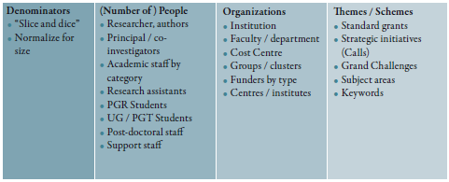
Denominators

Slide 8
Towards global standards for benchmarking
Snowball Metrics denominators should enable global benchmarking as far as possible. We do not know how this will look , but one possibility is:
Common core where benchmarking against global peers can be conducted. Aim is to make this as big as possible
Shared features where benchmarking between Countries 1 and 2 can be supported by shared or analagous data e.g. regional benchmarking
National peculiarity can support benchmarking within Country 1, but not globally i.e. national benchmarking
UK metrics
Japan metrics
Illustrative only, testing underway
Australia / New Zealand metrics

Slide 9
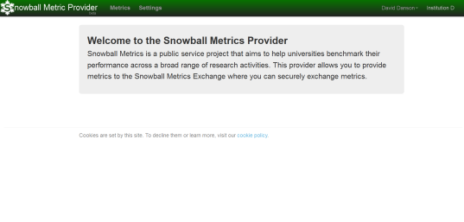
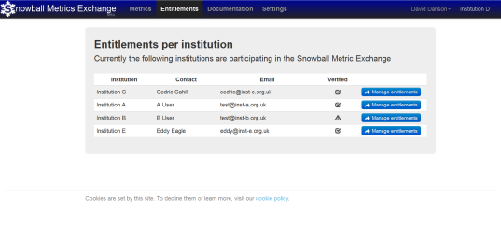
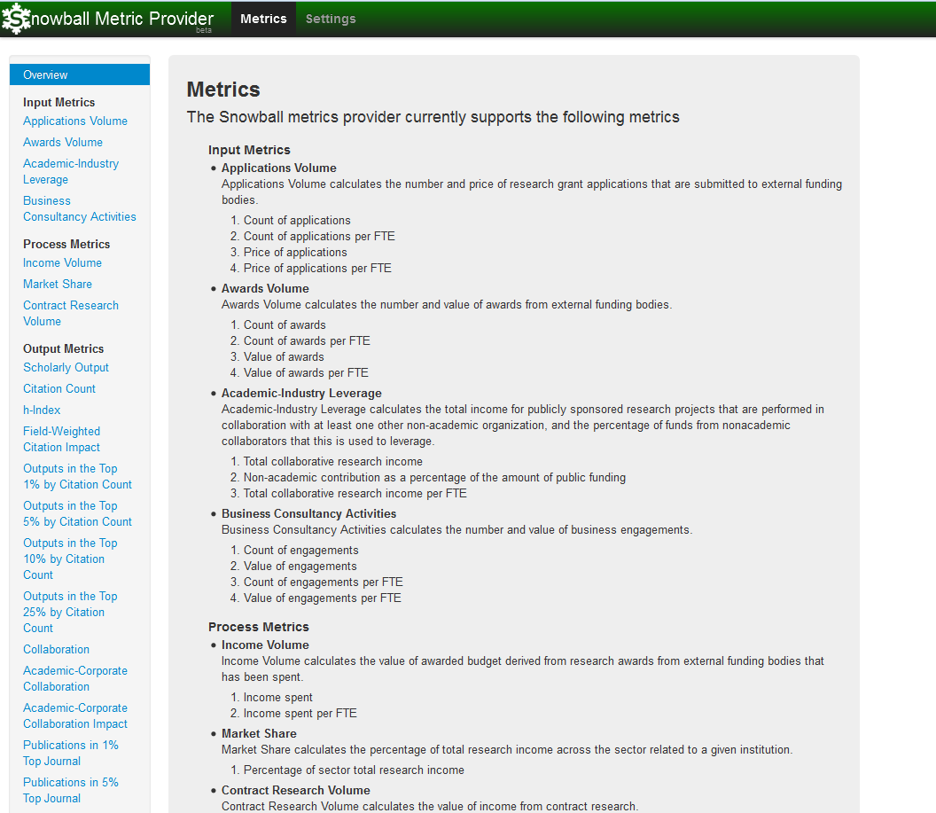
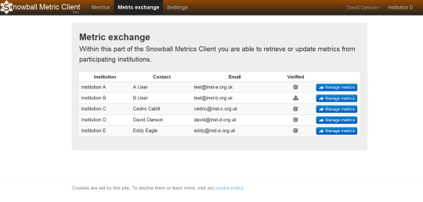
Snowball metrics exchange
Institution A+B add metric values to the SMP
e.g. Scholarly output = 1,376
Institution A+B agree to share encrypted metric values and manage entitlements in the SMX
FJ#)_!A#_+
FJ #)_!A#_+
Institution s A+B retrieve or update metric values in the SMC. e.g. Scholarly output = 1,376

Slide 10
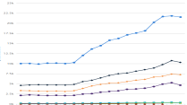
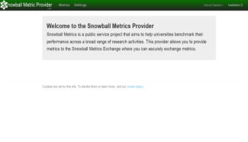
Snowball metrics exchange
Data sources
inputs
Snowball Metrics eXchange
Data sources outputs
database
InCites
InCites
SciVal
SciVal
Symplectic
Symplectic
Pure
Pure
Converis
Converis
spreadsheet
spreadsheet
FJ#)_!A#_+
Scholarly output = 1,376
Scholarly output = 1,376

Slide 11
Snowball Metrics exchange
Any institution who is using Snowball Metrics can become a member of the exchange
Institutional members are responsible for generating Snowball Metrics according to recipes
An institution could be the member of one or more ‘Benchmarking clubs’
Institutions choose what to share
Exchange service encrypts all metrics and only entitled institutions can decrypt
Data underlying metrics will never be exchanged
CRIS system could act as provider and client, communicating directly with exchange APIs

Slide 12
Case study - St Andrews
Review of Institutional KPIs in 2014
Made use of Snowball Metrics, including Outputs in Top Percentiles and Success Rates
Advantages of using Snowball
Tried and tested by Snowball partners
“Benchmark-ready”
Specific questions answered
Notes:
important that metrics have been agreed by expert group from the partner institutions and then tested with real data
Want to be in a position to benchmark either 1:1 via exchange of data or as part of SMX
We were asking the same questions here at St Andrews internally .. Good to have something to refer to … why reinvent the wheel?

Slide 13
Success Rates : Questions
What do we count ?
Record three-states : success / pending / rejection
Uses most up to date price available
pragmatic decision – we all have this in our systems; we don’t all keep requested price, for example
When do we count it ?
Record against year of application : rates could change retrospectively … this was a problem at first for our accountants!
Agree 12 month write-off across all funders
Notes:
12 month write-off for all funders ... need workable rule for benchmarking … agreed a sensible compromise.
Price awarded versus requested … we hold both in our systems but several of the project partners only have data available for price actually awarded – and cannot link back to the originally requested price. As more institutions improve the links between their pre and post award systems this should change and Snowball notes that the recipe will need revisiting.
When do we count the success or failure : our finance team reluctant at first to recipe that meant rates could change retrospectively. However the point here is that Snowball Metrics are indicators to help measure progess towards institutional objectives and benchmark with peers - they are not subject to accounting rules.
Indeed a Success Rate is a percentage and for it to make sense the success or failure has to be recorded against the application. If we have a 12 month write-off period then the most we need to do is look back 12 months to get the final picture – another advantage of an agreed 12 month write off period.

Slide 14
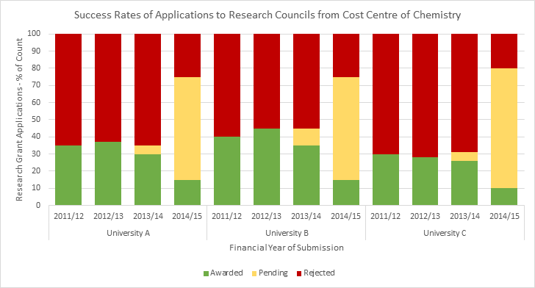
Success Rates : example
Notes:
An example of how the Success Rates indicator can be represented

Slide 15
So do metrics help?
It’s not all metrics, or no metrics – it’s not a black and white decision
Metrics can provide data points on which to build using expert opinion (peer review) to delve deeper & deal with outliers
Metrics aren’t a replacement for human judgment – they complement it
Universities already widely adopt metrics and tools
We value objective normalized universal information that enables meaningful comparisons
After all academia is an evidence-based activity!
Metrics aren’t the antithesis of peer review
(Biblio)-metrics incorporate decisions made by peer review, e.g. whether to publish, what to cite
But metrics aren’t just bibliometrics – there are many measures that can and should be used
First define the question; then pick the metrics to answer them

Slide 16
John Green
Anna Clements
Peter Darroch
jtg11@cam.ac.uk
Snowball Metrics http://www.snowballmetrics.com/

