Slide 1
DMPonline tool
Marta Ribeiro
Digital Curation Centre (DCC), University of Edinburgh
marta.ribeiro@ed.ac.uk

Slide 2
Programme
What is DMPonline?
Main features in DMPonline
Live demo of DMPonline

Slide 3
What is DMPonline?
A web-based tool to help researchers write data management plans
A short history
Launched in April 2010 at the Jisc conference
Released v.2 in March 2011 with extra functionality
Released v.3 in April 2012 with revisions in light of the DMPTool and work from the Jisc MRD programme
Released v.4 in December 2013, incorporating major changes from evaluation
Notes:
DMPonline has evolved greatly over the past few years, initially in terms of adding extra features and functionality requested by users, but subsequently in more fundamental ways in light of how the landscape is changing.
When we started, only a handful of research funders asked for DMPs. The requirements have since increased and these are regularly updated. Universities often ask for DMPs now too, and they want to provide tailored guidance, specific to their local context. Discipline-specific guidance is also emerging.
The tool is evolving to allow us to combine the different funder, institutional and disciplinary contexts to present users with the relevant questions and guidance based on what position they’re in (i.e. if they’re applying for funding but their university also asks for a DMP and offers local guidance, we’ll pull all these things together and present them to the user)

Slide 4
Main features in DMPonline
Templates for different requirements (funder or institution)
Tailored guidance (funder, institutional, discipline-specific etc)
Ability to provide examples and suggested answers
Supports multiple phases (e.g. pre- / during / post-project)
Granular read / write / share permissions
Customised exports to a variety of formats
Shibboleth authentication

Slide 5
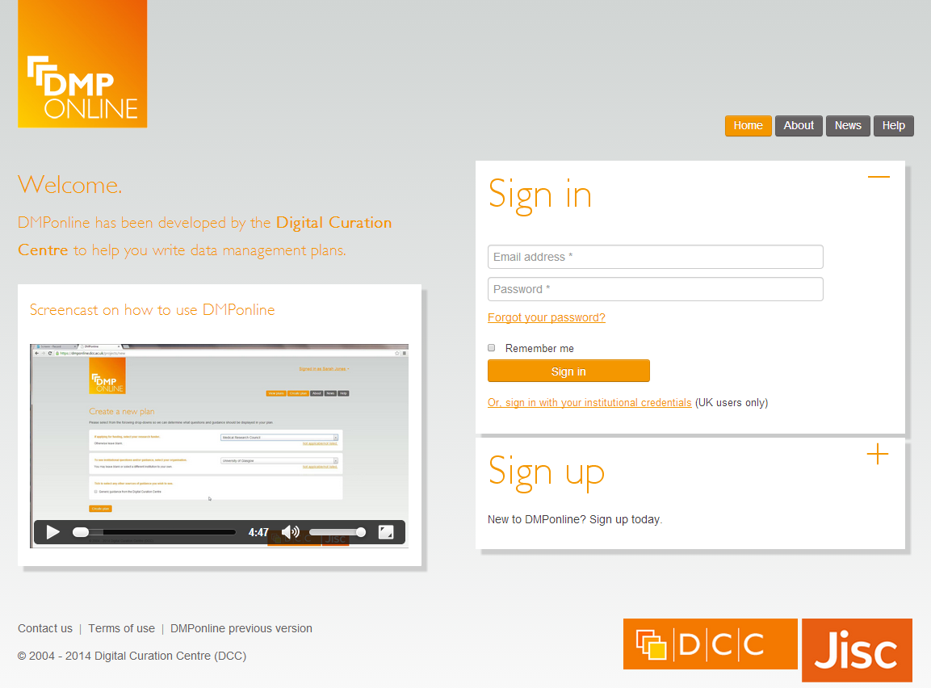
DMPonline v4 features

Slide 6
DMPonline Live Demo

Slide 7
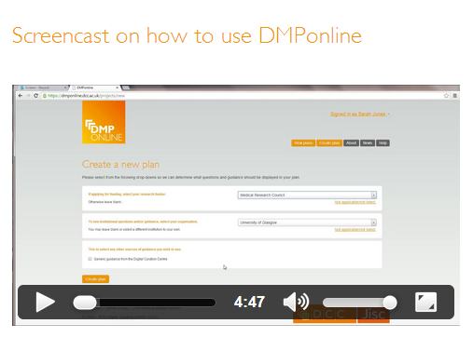
More information
http://www.screenr.com/PJHN
Get the code, amend it, run a local instance, flag issues, request features... https://github.com/DigitalCurationCentre/DMPonline_v4

Slide 8
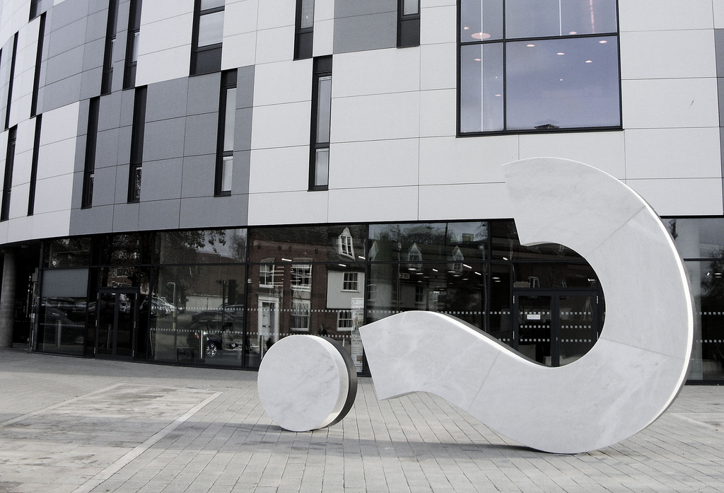
Q&A
Image credit: The original SimonB - www.flickr.com/photos/26565770@N02/6394748009

