Slide 1
Can machines understand what researchers look for?
Conceptualizing the research world
St. Andrews, Scotland

Slide 2
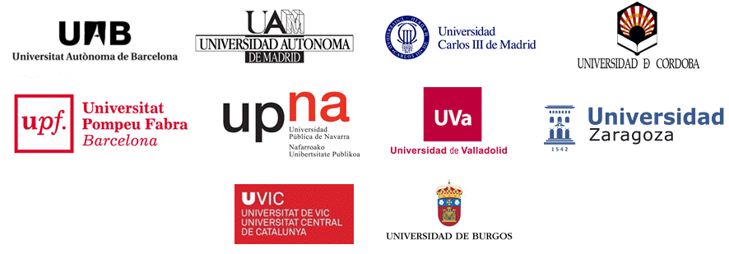
who we are?
SIGMA AIE, is a non-profit higher education consortium created and led by 10 reference Spanish universities, to optimize Academic and Research with information technology. Implementing the best practices of university management that are reflected in SIGMA’s tools and services, given the changing environment of higher education scenario.

Slide 3
Who we are?
SIGMA RESEARCH
Integral 100% cloud solution for the Research & Innovation life cycle to promote collaboration, obtain better impact & visibility, enable decision making and optimize administrative procedures for HE and research institutions
Adaptability
Interoperability with legacy systems and external systems
Ensuring the data quality and data integration
Implementing the best practices at European level
Working to improve the researcher’s interaction with the information…

Slide 4
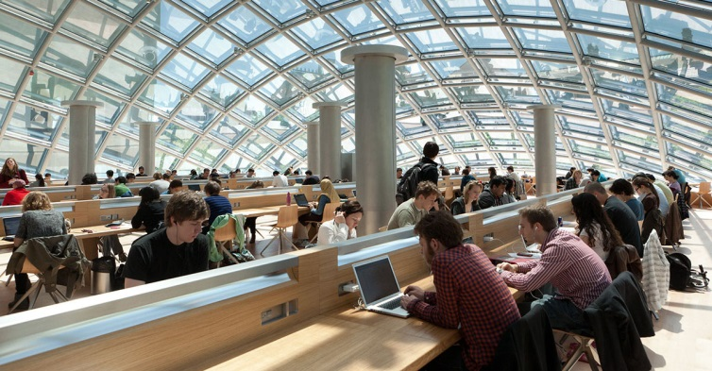
Research: old times vs new times
Vs.

Slide 5
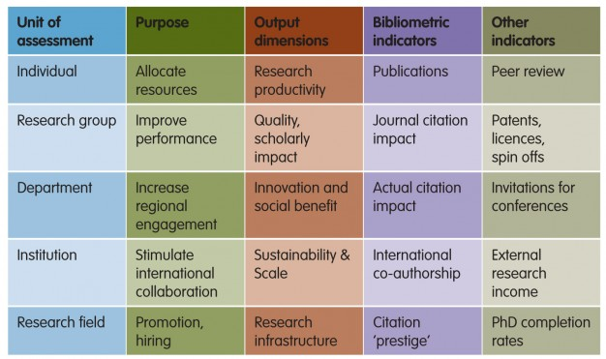
The research scenario
Source: https://goo.gl/l96E73

Slide 6
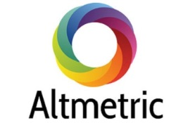
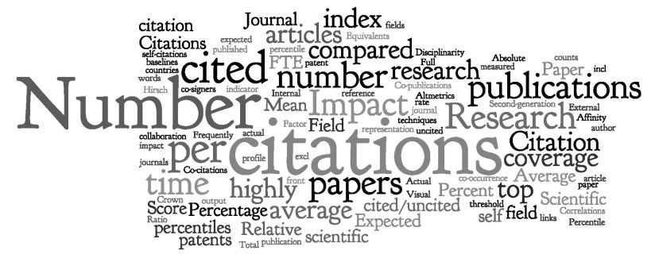
The research scenario in the digital world
http://www.uwe.ac.uk/
Source: http://goo.gl/ZLY8U0
Notes:
A critical aspect of academia is networking with your peers. Connecting with peers who share similar research interests can lead to collaboration, new and exciting projects, and can ultimately enhance a researcher’s scientific impact. However, academic networking is often limited to within-department networking, annual conferences/meetings, or through invited lectures and seminars. With the advent of social media, academic networking has been greatly enhanced.

Slide 7
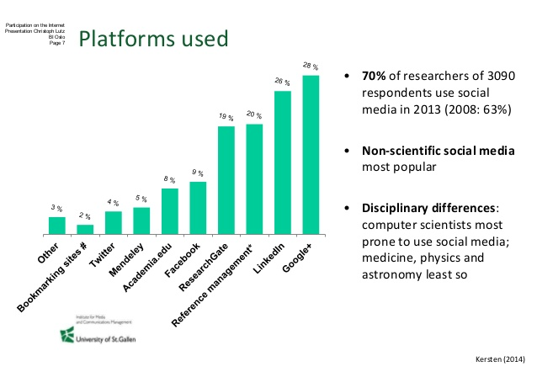
The use of social media in Research
Notes:
A critical aspect of academia is networking with your peers. Connecting with peers who share similar research interests can lead to collaboration, new and exciting projects, and can ultimately enhance a researcher’s scientific impact. However, academic networking is often limited to within-department networking, annual conferences/meetings, or through invited lectures and seminars. With the advent of social media, academic networking has been greatly enhanced.

Slide 8
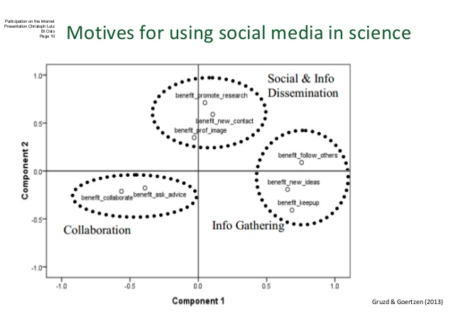
Why researchers use social media?
Notes:
A critical aspect of academia is networking with your peers. Connecting with peers who share similar research interests can lead to collaboration, new and exciting projects, and can ultimately enhance a researcher’s scientific impact. However, academic networking is often limited to within-department networking, annual conferences/meetings, or through invited lectures and seminars. With the advent of social media, academic networking has been greatly enhanced.

Slide 9
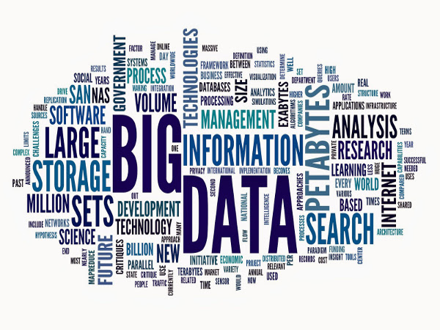
Are we talking about big data? Yes!
Notes:
A critical aspect of academia is networking with your peers. Connecting with peers who share similar research interests can lead to collaboration, new and exciting projects, and can ultimately enhance a researcher’s scientific impact. However, academic networking is often limited to within-department networking, annual conferences/meetings, or through invited lectures and seminars. With the advent of social media, academic networking has been greatly enhanced.

Slide 10
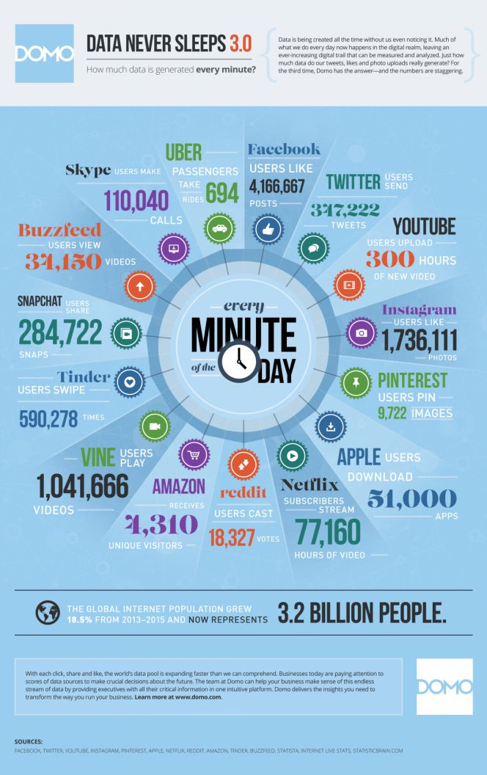
Are we talking about big data? Yes!
Disadvantage!
It’s impossible for the human brain to process and track all this information
Source: http://goo.gl/dUU6xu
Notes:
A critical aspect of academia is networking with your peers. Connecting with peers who share similar research interests can lead to collaboration, new and exciting projects, and can ultimately enhance a researcher’s scientific impact. However, academic networking is often limited to within-department networking, annual conferences/meetings, or through invited lectures and seminars. With the advent of social media, academic networking has been greatly enhanced.

Slide 11
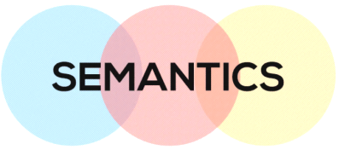
The evolution of data management
Data Curation
Data Sharing
Open Linked Data
How to organize and preserve the data and materials used in the creation of knowledge, once the results have been published
Making data used for scholarly research available to other
investigators
Using the Web to connect related data that wasn't previously linked

Slide 12
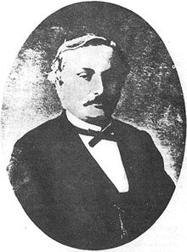
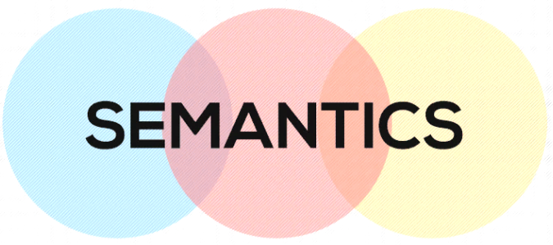
The semantic approach
Semantics try to resolve the problem of understanding
and is based on open world assumption, that states that everything we don’t know is undefined.
In computer science refers to the meaning of languages, providing the rules for interpreting the syntax
Semantic data model or semantic network is a network that represents semantic relations between concepts and is a form of knowledge representation. Is used to describe particular types of data model using directing graphs in which the vertices denotes concepts in the world and the edges relationships between them.
Michel Bréal
French philologist
Father of modern semantics

Slide 13
The semantic approach
Semantics is the next revolution of the information society
Key definitions:
Ontology: formalized vocabularies of terms, often covering a specific domain and shared by a community of users. Are a formal way to describe taxonomies and classification networks, essentially defining the structure of knowledge for various domains: the nouns representing classes of objects and the verbs representing relations between the objects.
OWL: The web ontology language is a family of knowledge representation languages for authoring ontologies. Languages in the OWL family are capable of creating classes, properties, defining instances and its operations
RDF: Resource description framework. Standard model for data interchange in the web. Facilitate data merging from different schemas (directed labeled graph). W3C. RDF 1.1, RDFa.

Slide 14
The semantic approach
So, how can we use semantics?
The Semantic Web enables automated and human navigation to represent and mine digital data, and it supports interoperability and integration of data from a variety of Sources
Semantics is a game changer!

Slide 15
The semantic approach
So, Why we would use semantics?
Because we can answer the basic researchers needs:
Social & information dissemination
Information gathering
Collaboration
Funding
Search
Find
Discover

Slide 16
Technological tools & solutions
Technology must help us in this way to semantics so, how we can define a project of this kind?.
Interface
Visualization
Semantic engine

Slide 17
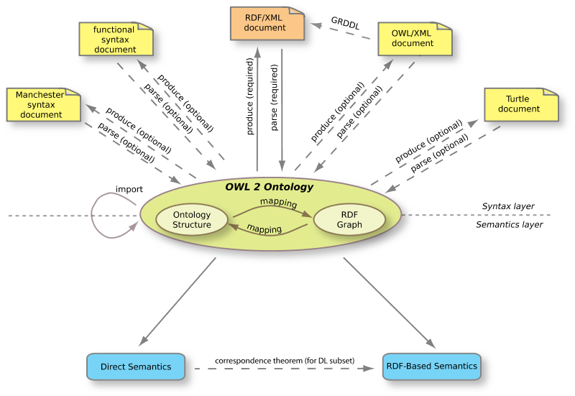
Technological tools & solutions
Searching the best semantic search engine based on concepts such as:
Ontologies. OWL. RDF
W3C recommendations
Neuronal networks
Deep learning
Machine learning

Slide 18
Technological tools & solutions.
2) Defining the best interface (user-computer experience) with a semantic parser (:BaseKB):
Learnability: How easy is it for users
to accomplish basic tasks the first
time they encounter the design?
Efficiency: Once users have learned
the design, how quickly can they
perform tasks?
Memorability: When users return to
the design after a period of not using
it, how easily can they re-establish proficiency?
Satisfaction: How pleasant is it to use the design

Slide 19
Technological tools & solutions.
3) Modeling the way to display the results:
Graphics
Statistics
Unexpected results
Discarding not relevant results
Learning from the searches,
results and findings

Slide 20
Technological tools & solutions. An example
Is an open community, an open information model, and an open source semantic web application, supporting the advancement of scholarship by integrating and sharing information about scholars, their activities and their accomplishments.
By Cornell university

Slide 21
Technological tools & solutions. An example

Slide 22
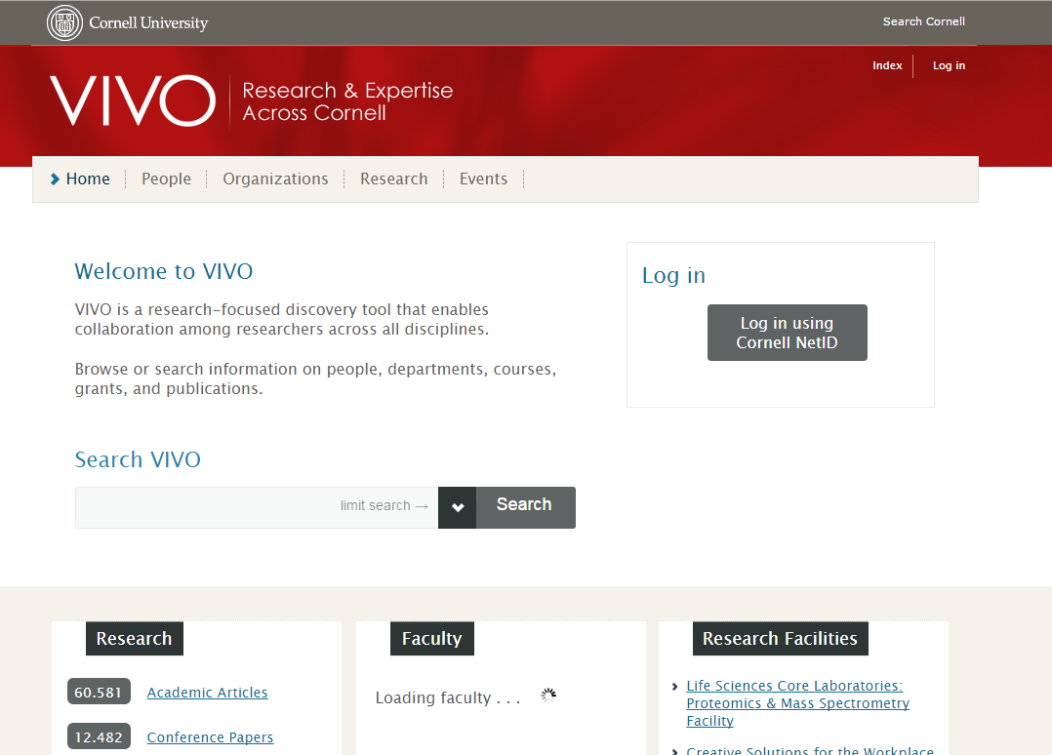
Technological tools & solutions. An example

Slide 23
In summary…
We want to develop a new way of researchers-information interaction. Open to collaborations:
Usable interface (researcher-computer) near to natural language
Computer capable to translate the information introduced by the researcher
Find the most related information
Discard not relevant information
Computer must ‘learn’ from the feedback of the researcher about the answers in order to provide increasingly better answers and proposals
Researchers would:
Find best colleagues
Build research groups
Find best projects
Find more and best funding

Slide 24
In summary…
Finally this kind of tools can be integrated to be a platform previous to access all the research information of the institution
SEMANTIC PLATFORM
Management
Production
Promotion
Analytics
Demand
Institutional Repository
(OA)
SIGMA RESEARCH

Slide 25
Thank you for your attention!
Anna Guillaumet @annaguillaumet
anna.guillaumet@sigmaaie.org

