Slide 1

The transition of FRIS 1.0 towards FRIS 2.0:
Focus on semantic interoperability
Sadia Vancauwenbergh
2017-05-31

Slide 2
FRIS
Flanders Research Information Space:
Virtual space collecting information on publicly-funded research
in Flanders
Goal:
  Simple, transparent, open platform
  Government, researchers, business, citizens
Initiative:
  Flemish Government, Dep. Economy Science and Innovation

Slide 3
FRIS 1.0
  Data providers:
    All 5 Flemish Universities
    Financial stimulus for data delivery in bulk, 2 times/year
    CERIF-XML
  Data & classifications:
    Researchers Science Discipline Codes
    Organisations Science Discipline Codes
    Research projects Financial Codes
  Simple technical validation rules
    Example: Use a valid financial code

Slide 4
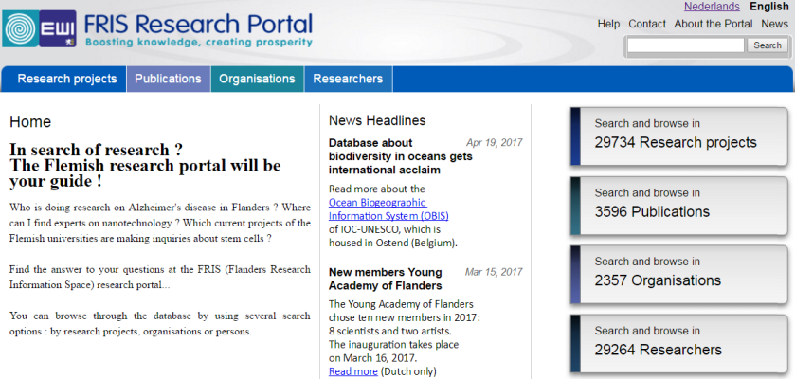
FRIS 1.0

Slide 5
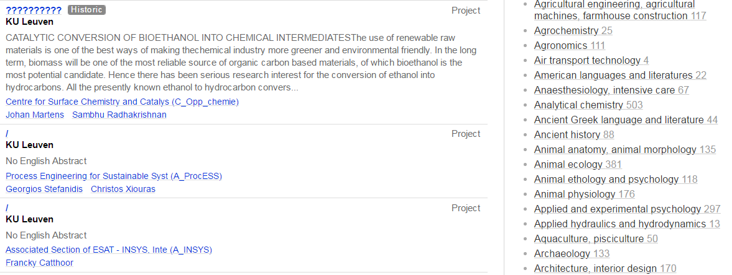
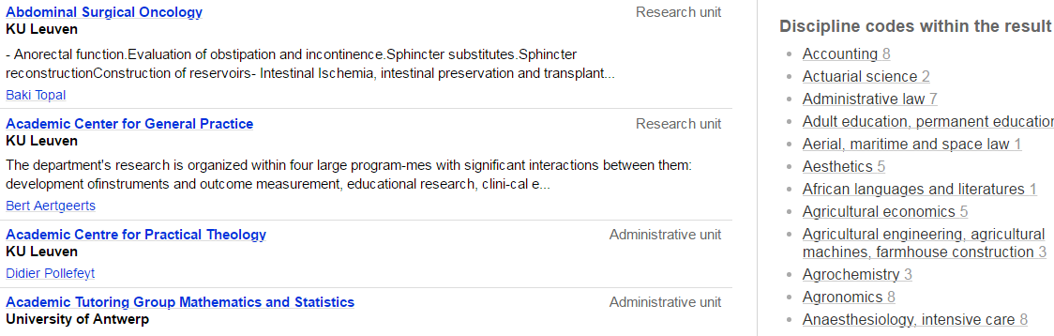
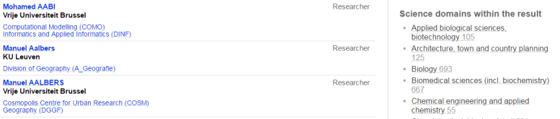
Project IDs
Organisation IDs
ORCID
ResearcherID
ScopusID

Slide 6
FRIS 2.0 Needs & drivers
Correct, actual, complete research information
  Maximum reuse of research information
  By connecting data silo’s using standards & identifiers
  Reducing system costs
CRIS services & applications
  Administrative reduction of research reporting (Peters et al. 2011)
  Increased strategic intelligence
  Efficient & effective policy monitoring
  More information services

Slide 7
FRIS 2.0
  Data providers:
    All 5 Flemish Universities
    Some strategic research centres
    Some research institutes
    Not (yet) university colleges
    Real-time data delivery
    SOA, 1 SOAP data entry webservice built on CERIF-XML
Notes:
: ILVO, INVO, ITM

Slide 8
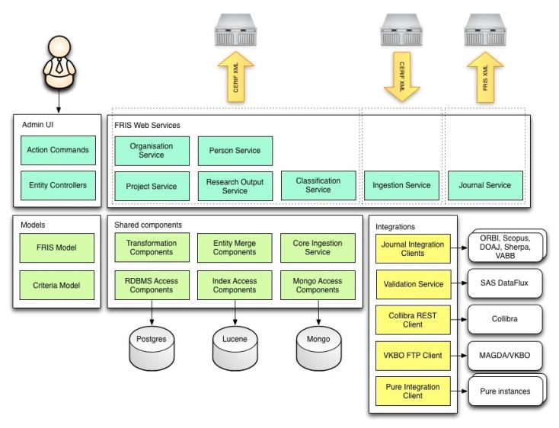
FRIS 2.0
Figure taken from the FRIS portal, Dept. EWI, Flemish government

Slide 9
FRIS 2.0
Data & classification governance:
    Researchers Science Discipline Codes
    Organisations Science Discipline Codes
    Research projects Financial Codes
    Publications
  Data quality and completeness:
    Business & technical validation rules
  Open data:
    6 SOAP webservices
  New research portal with more search functionalities

Slide 10
The transition of FRIS 1.0 towards FRIS 2.0:
Focus on semantics

Slide 11

The importance of semantics
FRIS is not only about the architecture, technology, …
The true value comes from the quality of the information contained

Slide 12
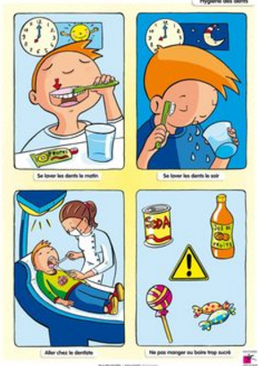
The importance of semantics
It’s not about agreeing that semantics is important, it’s about real commitment by everyone to implement semantics

Slide 13
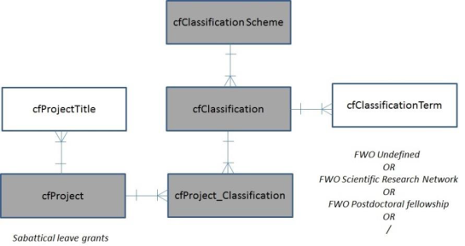
CERIF, almost unlimited flexibility for modelling RI
Semantic mismatches
  Terminology:
  same concepts, differents meanings and vice versa
  → at the inter- and intra-organizational level
FWO Undefined
OR
FWO Scientific Research Network
OR
FWO Postdoctoral fellowship
OR
/
Sabbatical Leave Grant

Slide 14
The transition of FRIS 1.0 towards FRIS 2.0:
Focus on semantics
→ data and classification governance
Sadia Vancauwenbergh
2017-05-31

Slide 15
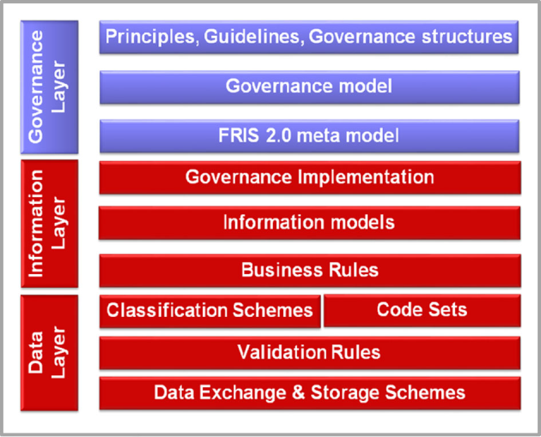
1. Installation of a governance structure: WHO?
Notes:
Introducing model driven formal semantic management at the business level

Slide 16
2. Creation of a business layer: WHAT?
Recording of business concepts & meanings by term. theory
Business
Application
Technology
Notes:
FRIS – Enterprise Information Architecture

Slide 17
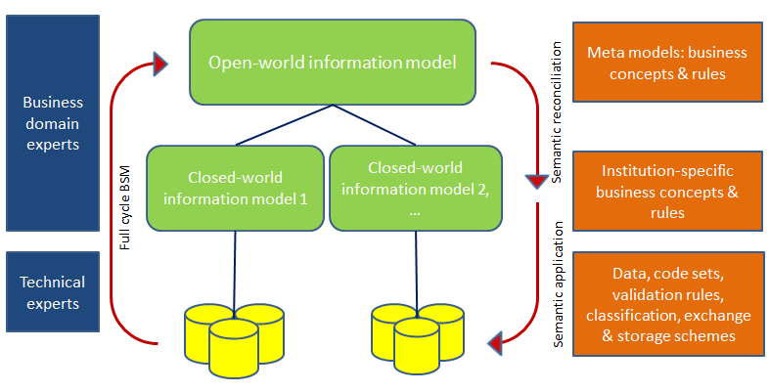
3. Inter-organizational semantic alignment
  Definition of required business concepts on the meta-level
  Collaborative, machine-readable manner
  Full-cycle business semantics management

Slide 18
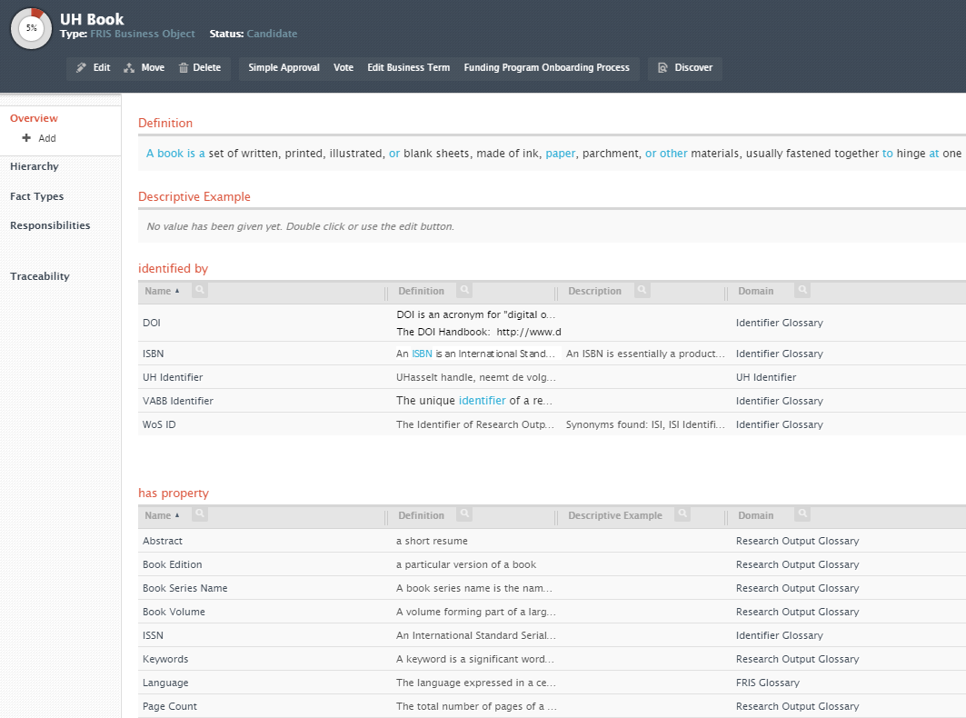
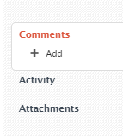
Data governance
Notes:
Syntactic and semantic alignment is realized at the systems interfaces.

Slide 19
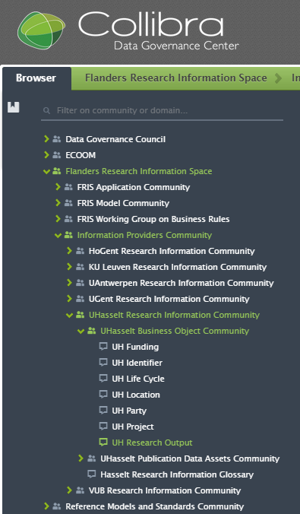
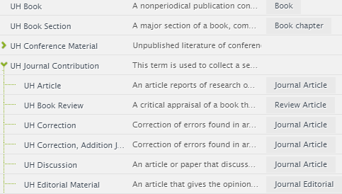
UH Model
FRIS MetaModel
Notes:
Providers are responsible for their semantic management and the mapping to the agreed FRIS semantics.

Slide 20
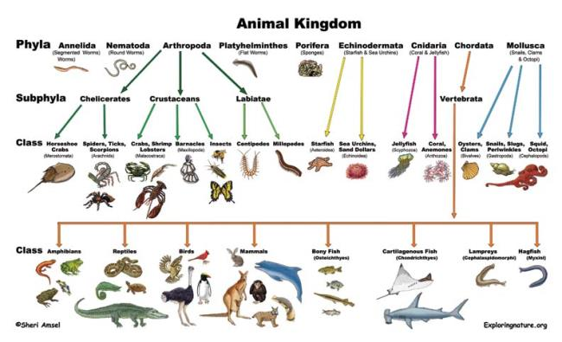
What about research classifications?

Slide 21
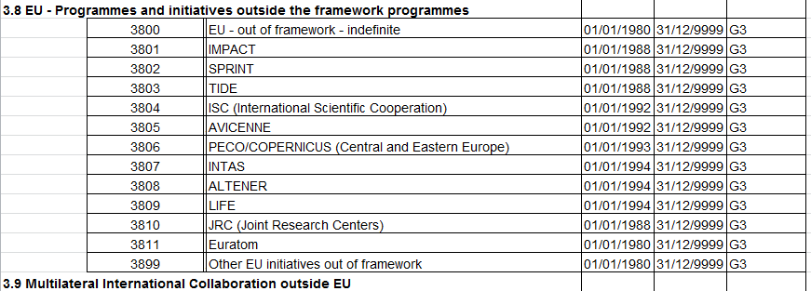
Example financial code list
  Used for labelling research projects
      Confusing terminology, no semantics foreseen
      Decentral maintenance of code lists

Slide 22
Classification governance
  Roles & responsibilities
  Central maintenance of code lists in DGC, incl. allowed value
  Semantics and examples
  Workflows for creating/editing existing codes
  Full view on remarks & comments
  Concordance tables
  Publications, research projects, research disciplines, technology domains,…

Slide 23
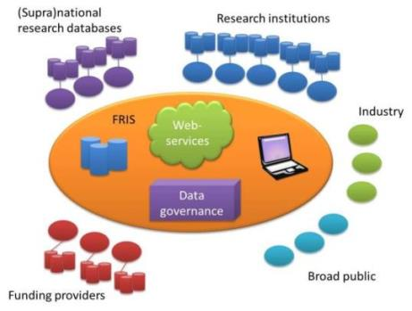
Integration with CRIS system
Data and classification governance is
key to true semantic interoperability of CRIS systems in inter-organizational contexts

Slide 24
Towards (open) research data management: status of the Flemish universities

Slide 25

(Open) Research Data management
Sense of urgency:
Research data are valuable
  verification of research results
  verification of ownership
  data collection and reuse
Drivers:
EU Commission Open data pilot; 2017
Fund for Scientific Research Flanders end 2017

Slide 26
Survey in Flemish universities
Raising awareness:
Head of department
Per department:
  Professor
  Postdoctoral fellow
  PhD student
  Publications:
  - Thema (proofs)
  - White paper (in preparation)

Slide 27
Drafting a research data policy
Hasselt University: Central + 4 disciplinary RD policies
  Responsibility of researcher, central support
  Data management plans (criteria for internal research funds)
  Legal & ethical issues
    RRI, GDPR, Property Law, Privacy Law, Ethics, Information safety, Acceptable Use Policy, Regulations from third parties (funders)
    Anonymised, pseudonymised, encrypted data, metadata
  Infrastructure:
    Which data? Digital data, materials and objects
    Preservation, archival and removal
    Interoperable: semantically, technically, linkage to RI objects/publishers

Slide 28
Drafting a research data policy
Hasselt University: Central + 4 disciplinary RD policies
  Skills and expertise
    Doctoral and senior training, training of reviewers
  IPR issues
  Reuse and public disclosure
  Exit policy for data of researchers leaving the university
  Monitoring and compliance
  Inclusion of RDM in the research(er’s) life cycle
    Redraw research process
    New expert team: legal and ethical expertise, information safety and data protection officers, valorisation experts, data repository managers, HR officers

Slide 29
(Open) Research Data management
VLIR Working Group RDM
  Members:
    Legal officers, research coordination officers + …
  Cooperation on:
    Drafting DMP questions for funders
      Application, start & end
      Financial incentives? By and to whom?
    Looking for an appropriate infrastructure
Flemish consortium
  DMPonline.be
  BELNET server, coordinated by Ghent University
  4 Flemish universities
  From 1/1/2018: research institutes

Slide 30
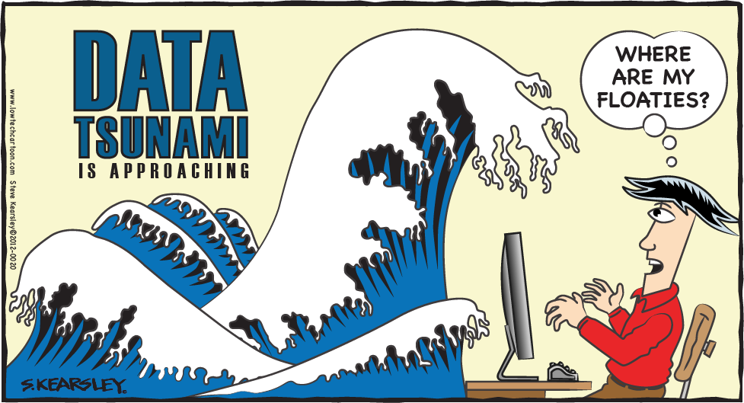

Slide 31


Slide 32


Slide 33
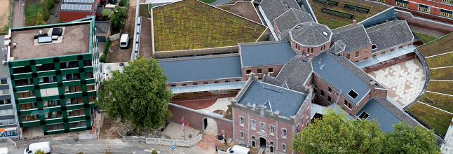
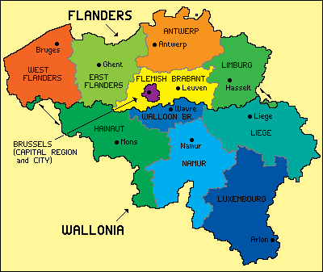
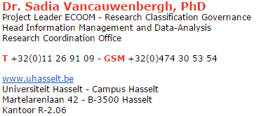
Acknowledgements
Flanders Government, Department Economy, Science and Innovation (EWI)
ECOOM-UHasselt project team

Slide 34


