Slide 1
Digital Repository of Ireland
____________________
Dr. Aileen O’Carroll
Policy Manager
Digital Repository of Ireland

Slide 3
DRI is also…
Research Centre for Best Practices
Digital Preservation
Digital Archiving & Metadata
Data Curation & Digital Exhibitions
Education & Training
Advocacy & Policy influence
Gateway to international network

Slide 4
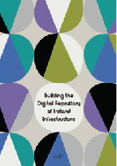
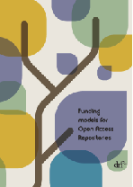
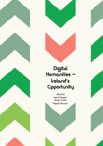
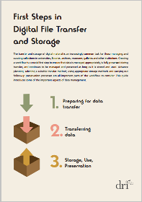
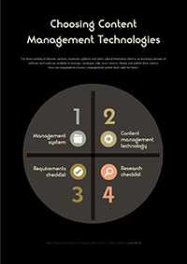
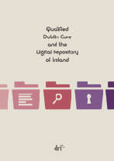
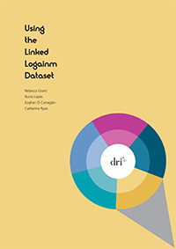
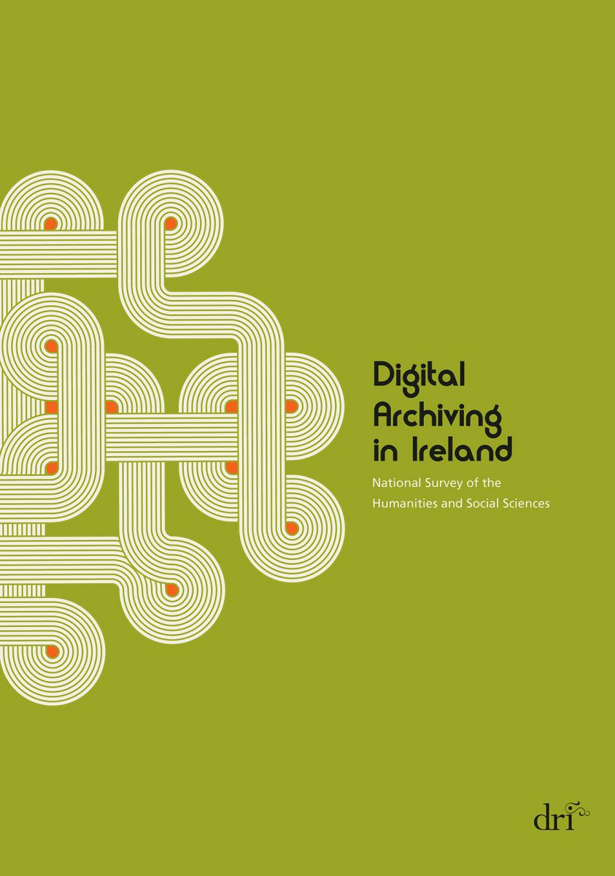
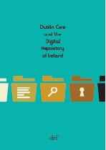
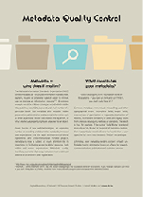
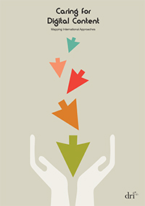
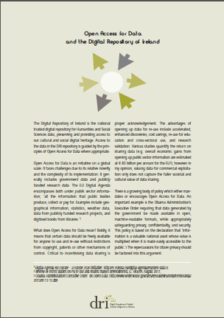
Publications

Slide 5
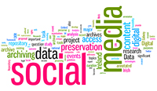
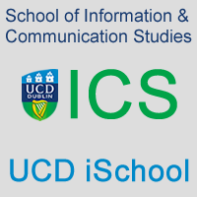
Partners & Projects

Slide 6
Networks & International Initiatives

Slide 7
Curation Projects
Research Data:
Preservation, Access, Dissemination
New Collections:
Storytelling & Engagement

Slide 8
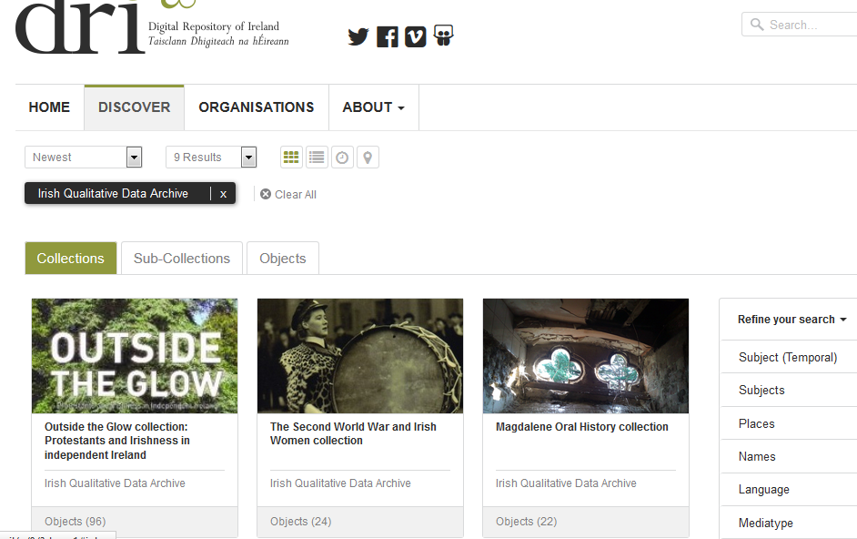
‘Research Data’ Example: IQDA Oral Histories

Slide 9
Research Data Example: IQDA Qualitative Data
Second World War and Irish Women
Magdalene Oral History Collection
Outside the Glow: Protestants and Irishness in Independent Ireland
Life History and Social Change

Slide 10
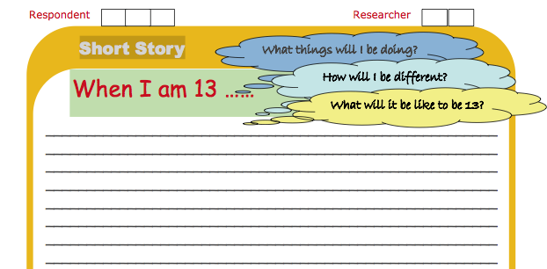
‘Existing Data’ Example: IQDA Qualitative Data
Growing up in Ireland

Slide 11
‘New Collections’ Example: Inspiring Ireland
Inspiring Ireland 1916: Weaving Public and Private Narratives
Inspiring Ireland 1916: Frongoch 1916

Slide 12
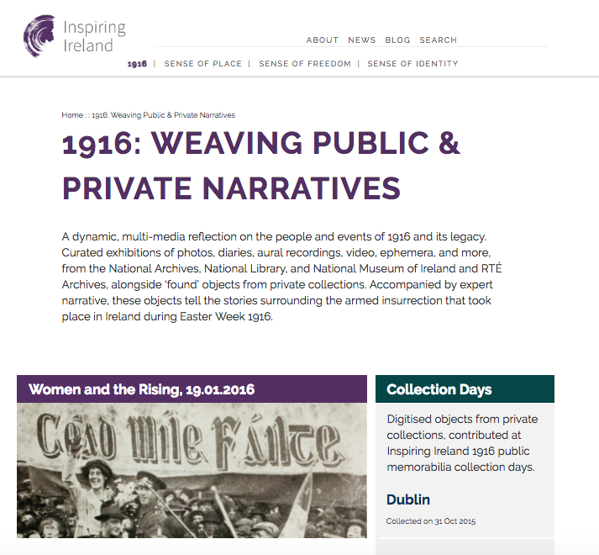

Slide 13
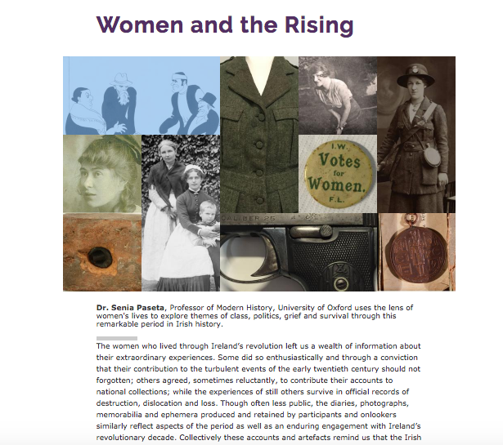

Slide 14
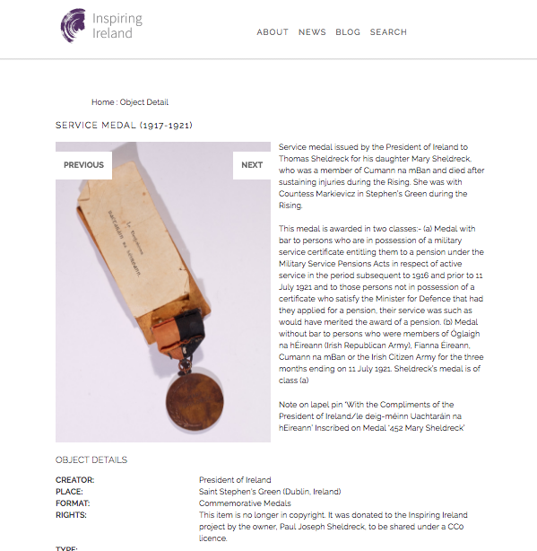

Slide 16
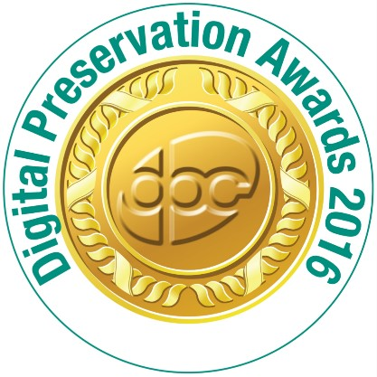
Digital Preservation
Digital Preservation Awards 2016
Finalist: Safeguarding the Digital Legacy
International Panel of Judges:
“DRI is not only an exemplar in digital preservation, but is leading the way internationally.”
Best practices in archiving & repository architecture
Advocacy and policy work in Open Science
Publications, Guidelines, Interoperability
Education, Training, Community building

Slide 17
DRI Presentation

Slide 18
Research Data – future trends
Networks: Research Data Alliance
Services: Research Data Management

