Slide 1


OMEGA-PSIR: Institutional CRIS at Polish Universities
Bratislava, November 2017
Henryk Rybiński, Łukasz Skonieczny, Jakub Koperwas, Wacław Struk

Slide 2


Who we are?
We are the team from Institute of Computer Science Warsaw University of Technology
We are developing open CRIS software that is
  free,
  open
  already eveluated in 16 polish universities
  and was awarded in EUNIS’15

Slide 3
Agenda
History and vision
  Legislation context in Poland
  CRIS systems adoption in Poland
  Our vision on nation-wide CRIS
Omega-Psir
  Key assumptions
  System overview
Insights from Omega-Psir deployments (If there is any time left…)
  Keys to success
  Key blockers
  Key adaptation requests
  etc

Slide 4
History and vision

Slide 5

Legislation Context in Poland
Central System run by Goverment
Collects data about scientific outcome (publications etc)
…

Slide 6

Legislation Context in Poland
…
Collects only the data it is interested in
Harvests data in it’s own format
Doesnt care about universities needs
It main purpose is to evaluate Universities and decide on
The evaluation criterias are the subject of constant chage (even backwards)
Also format and API chages from time to time

Slide 7
Problem and a solution
Problem
Complicated error-prone reporting with direct impact on funding
Solution
OMEGA-PSIR CRIS
More publications in Open Access
Better visibility of researchers and University
Valuable insights for University Managers
Databases consolidation
Many more…
Side effects*

Slide 8



On our way to Omega-PSIR
Technologies..
Activities
Patents
Projects
Diplomas
Publications
Users
Version 0.1
Version 1.20

Slide 9

WUT Knowledge Base
– facts
6 year of system exploitation
148 units of WUT
195 administration users
We evaluate employees
We report to Polish Ministry
We „generate” documents for habilitation and many other..

Slide 10





Omega – Psir Users
16 subscriptions
Users member group
Annual member meeting

Slide 11
Milestones
Warsaw University of Technology Knowledge Base (CRIS)
Omega-PSIR as universal widely-adopted CRIS system
Network of Omega-Psir installation forming Nation-wide CRIS

Slide 12
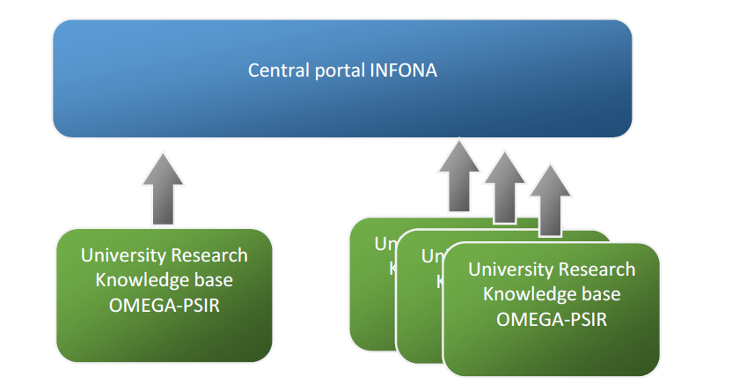
Central Nation – wide CRIS
Integration platform

Slide 13
Bottom-up approach: key to success
Report for the Ministry
Organization-level Legislation
Organization-level adoption
Organization culture
IR
(full texts)
Recent publications
Older publications
employee assessment
Habilitation application
CRIS

Slide 14
Architecture and Services
Nation – level CRIS
Aggregated presentation
Federated search
Metrics
Data Warehouse
Integration platform
Authors Database
Journals database
Data Curation
Cross- university sharing
Federated Identity
InstitutionalCRIS
InstitutionalCRIS
InstitutionalCRIS
Not thrivial tasks

Slide 15
Omega-PSIR
Key assumption

Slide 16
Functionalities of IR, CRIS i RPS
(at least in theory)
IR
Long-term preservation
CRIS
Run by adminstration
Covers all the research activities
Providing access to full text
Dublin Core
Limited to OA
Rather bibliogr. description
RPS
Run by scientists
Reporting
Research assessment
Covers all the research activities
Building profiles
Vizualizes the activities and cooperation
Social networks functions
No evaluation
Self-archiving
Run by libraries
Metadata (CERIF)
(e.g. IF vs costs)

Slide 17
Ω-Ψ^{R =} CRIS+IR +RPS
RPS
IR
CRIS

Slide 18
OMEGA-PSIR - synergy
Open Access
IR
(full texts)

Slide 19
OMEGA-PSIR - synergy
Open Access
Reporting
Current publications
IR
(full texts)
CRIS

Slide 20
OMEGA-PSIR - synergy
Open Access
Reporting
Current publications
IR
(full texts)
Archival publications
Research evaluation (promotion)
CRIS

Slide 21
OMEGA-PSIR - synergy
Open Access
Reporting
Current publications
IR
(full texts)
Archival publications
RPS
Research evaluation (promotion)
CRIS
Visualization of profiles
Cooperation
expert search

Slide 22
Groups of features
Data Collection and Archiving
Employees and units
Presentation and Sharing
External systems exchange(national repository etc.)
Analytics and Reporting
Employee evaluation
Reports for University Authorities
People/unit achievement exposition
Publications, diplomas, projects, report etc.
Including full-text
Reports for National Authorities
Social networks

Slide 23
Publication 1
TV interview
Researcher 1
Is an author
Publication 2
Is performer in
Is an author
$
Research project
is a result of
PhD Desideration
is a result of
Is a leader
Is a supervisor
Publication 3
Is an author
Researcher 2
Metrics

Slide 24
Complete research lifecycle
Ideas, Research proposals
Research grants application
Projects
Publications, Patents
Implementations and practical results

Slide 25


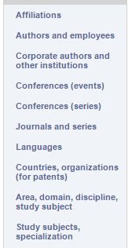
Selected types & functionalities
Full texts
Metadata
Searching
Sharing
Reporting
Evaluation
+Infrastructure

Slide 26
University Knowledgebase -QA
Who is a specialist in Data Mining
  What researchers, what teams, do they collaborate?
What is my total citations number
What project has the best funding to number of publications ratio.
What are the key research areas in our institute
What institute performed best last year in terms of number of quality publications
How the total university score acording to the Ministry would change if LNCS series score were vauled 5 points more

Slide 27
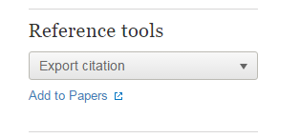


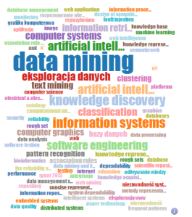



Information-rich but Easy to Use
Complete, consistent Metadata
Classification of research output
automatic
Web of Science
Metrics
zdelegowanie
weryfikacja
Full Texts
Financial Data

Slide 28








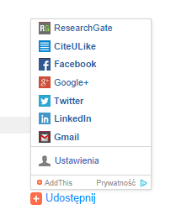




Interoperability, standards
National „CRIS”
Web of Science
University systems (e.g. SAP)

Slide 29

Standard - bridge
Omega Native Ontology
OAI-PMH
CERIF
National Exchange formats
….

Slide 30
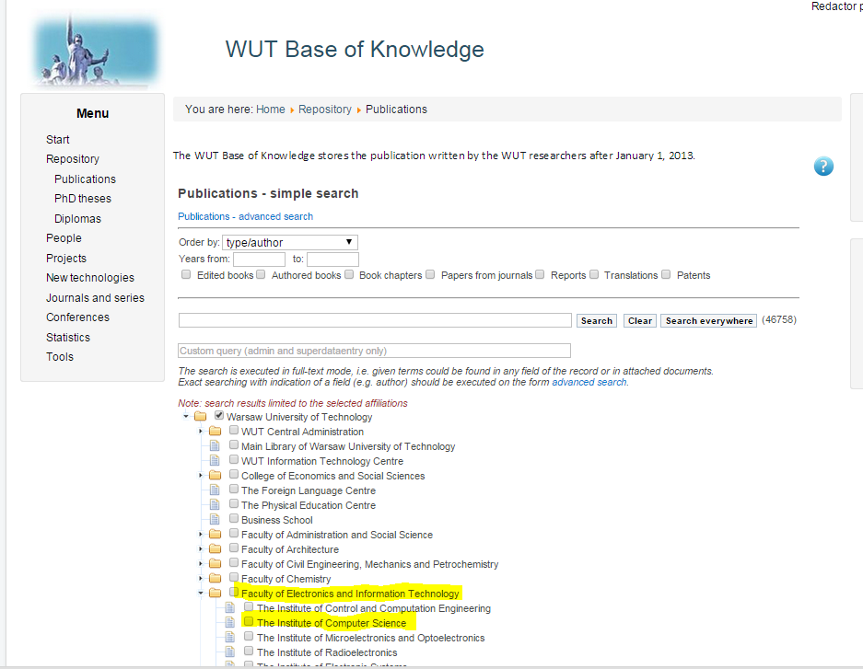
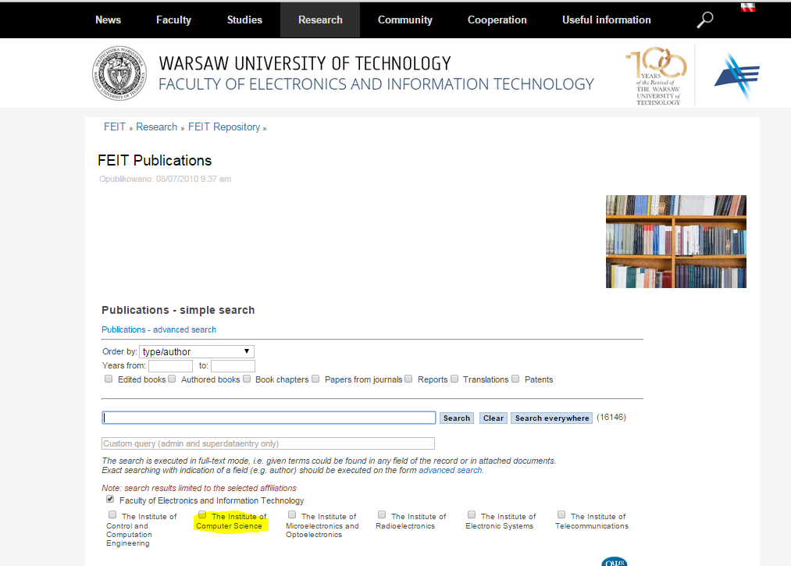
Flexibility
Look & Feel
Security Rules, Evaluation Rules …
Reports
…

Slide 31
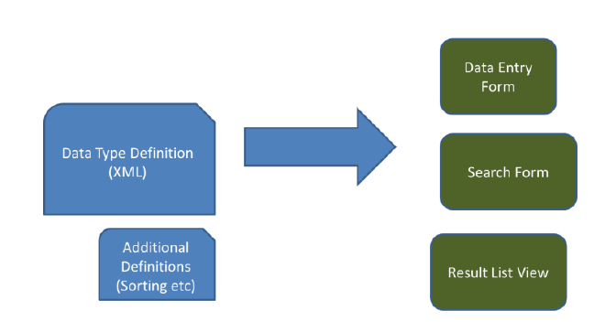
Extending
(Almost) schemaless approach
  Entities are defined by means of XSD
  Based on XSD the data entry/search screens can be
  generated
Defineable validation rules for the data entry worksheets
Defineable output screens, including sorting rules

Slide 32
Omega-PSIR
Some screens

Slide 33
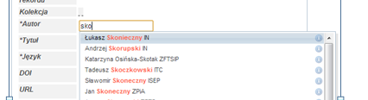
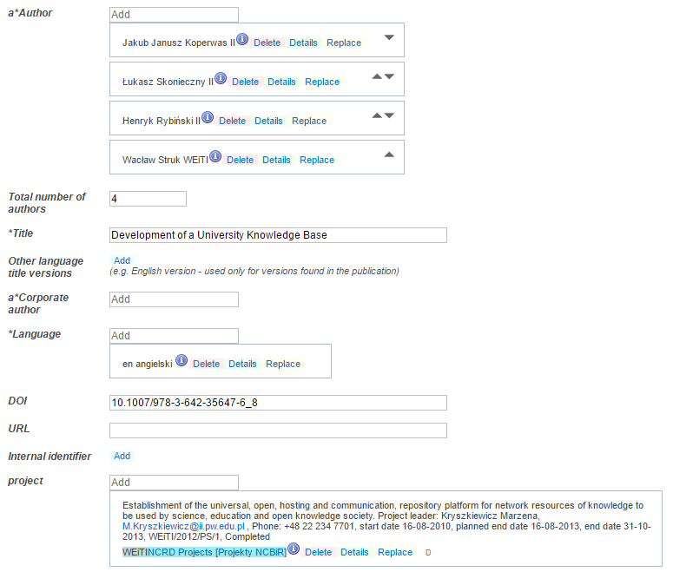
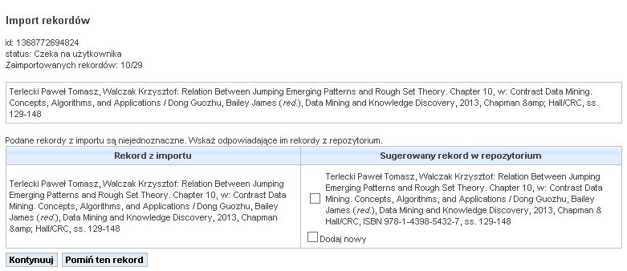
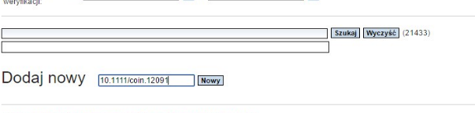
Data Entry

Slide 34
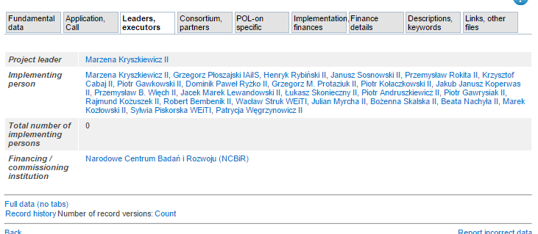
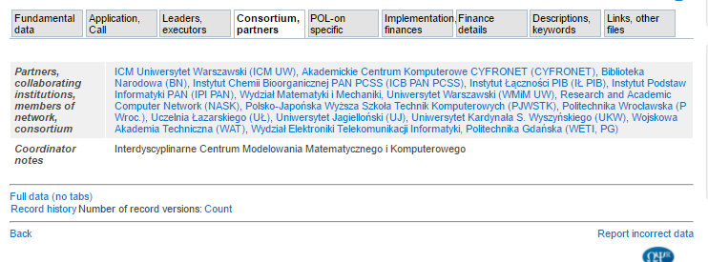
Project
People
Partners

Slide 35
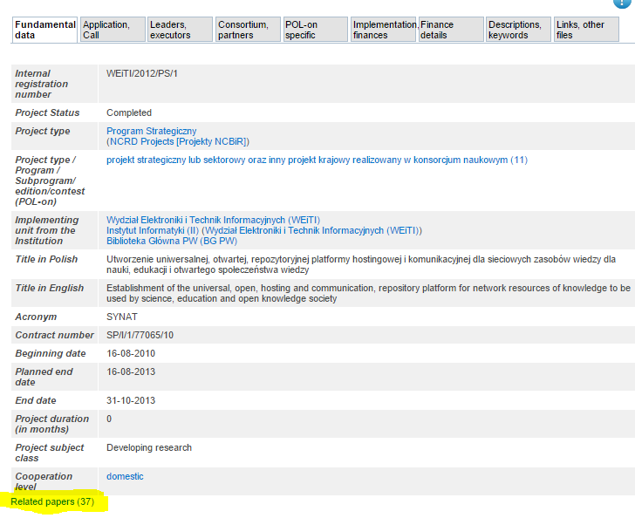
Project
Files
Publications

Slide 36
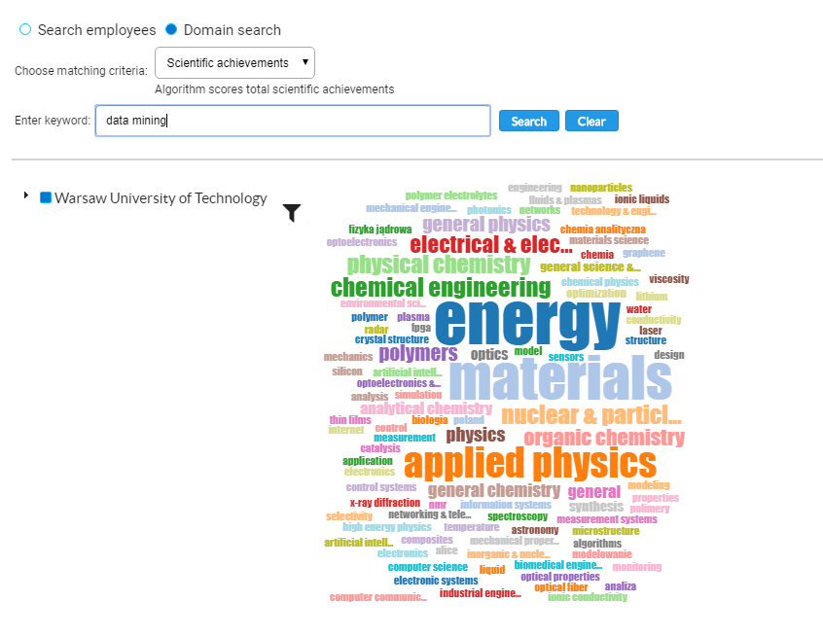
Expert search step 1
More than metadata and full text search!

Slide 37
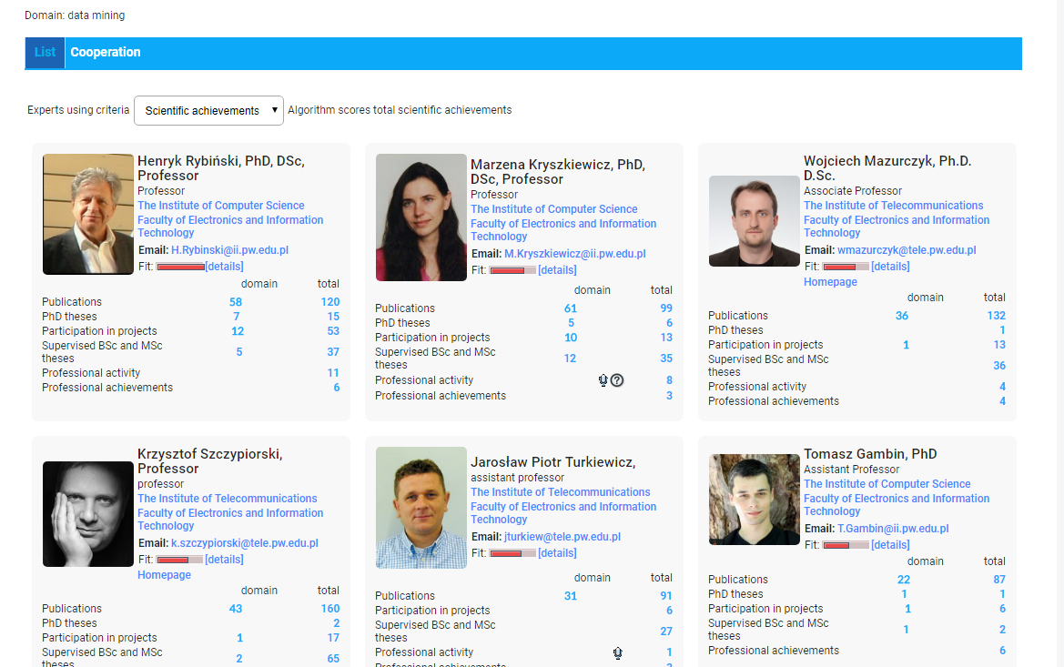
Expert search step 2

Slide 38
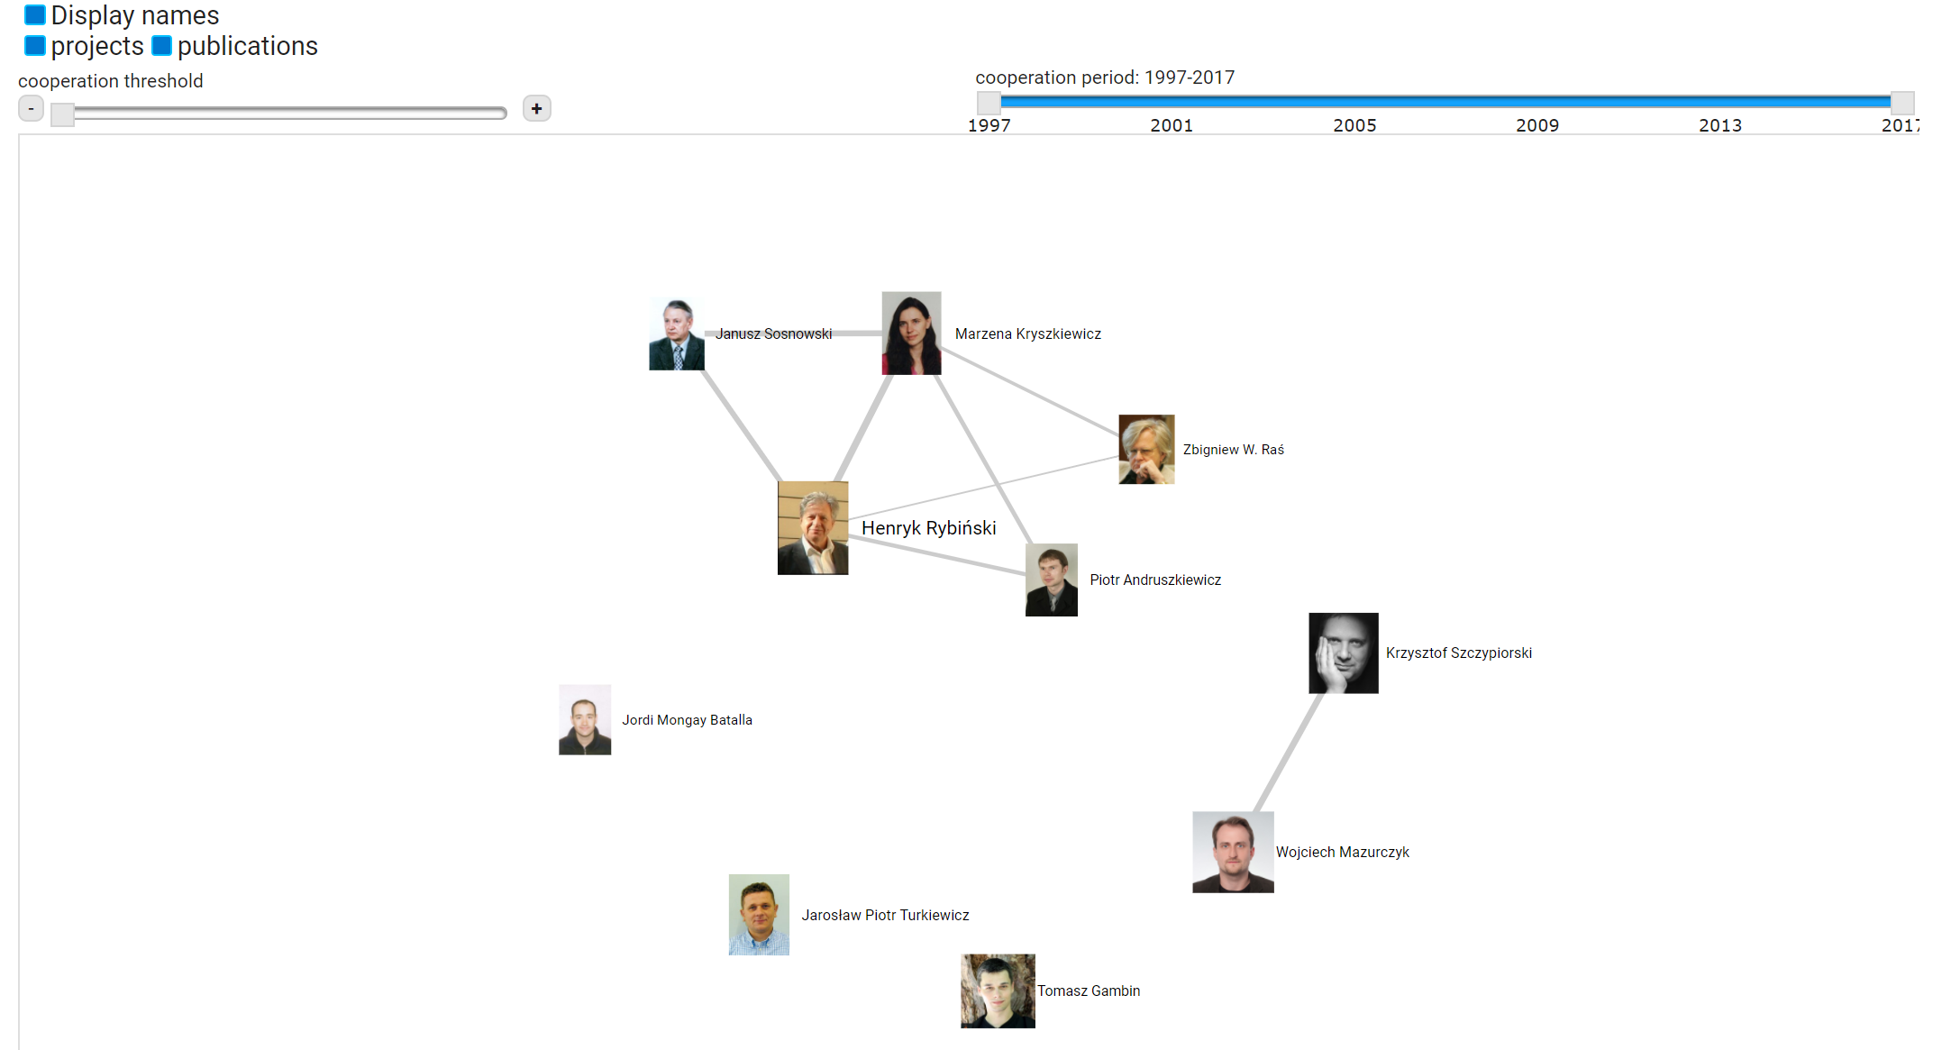
Expert search step 3

Slide 39
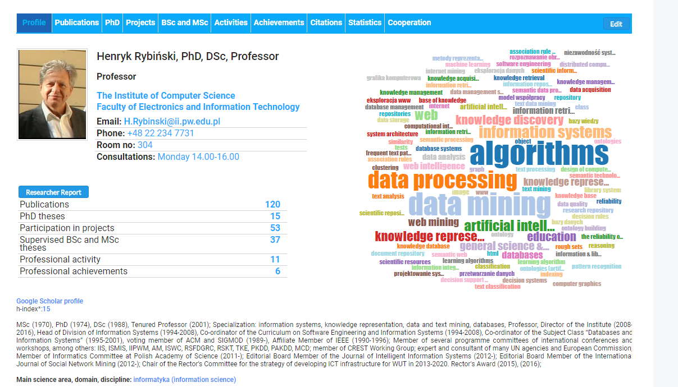
Researcher

Slide 40
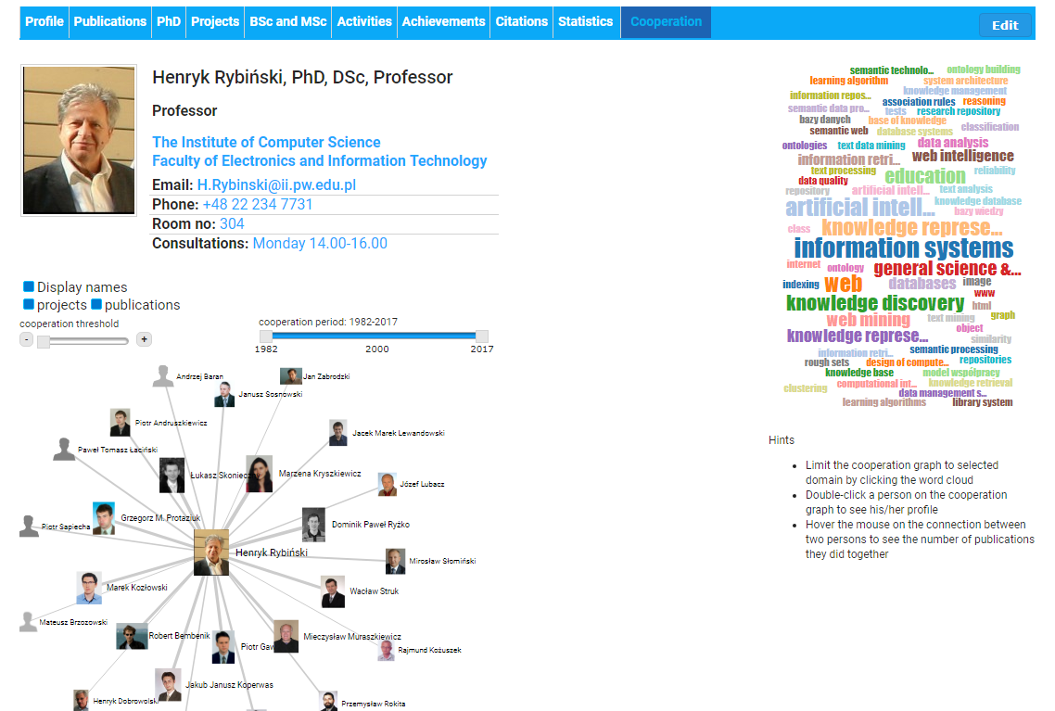

Slide 41
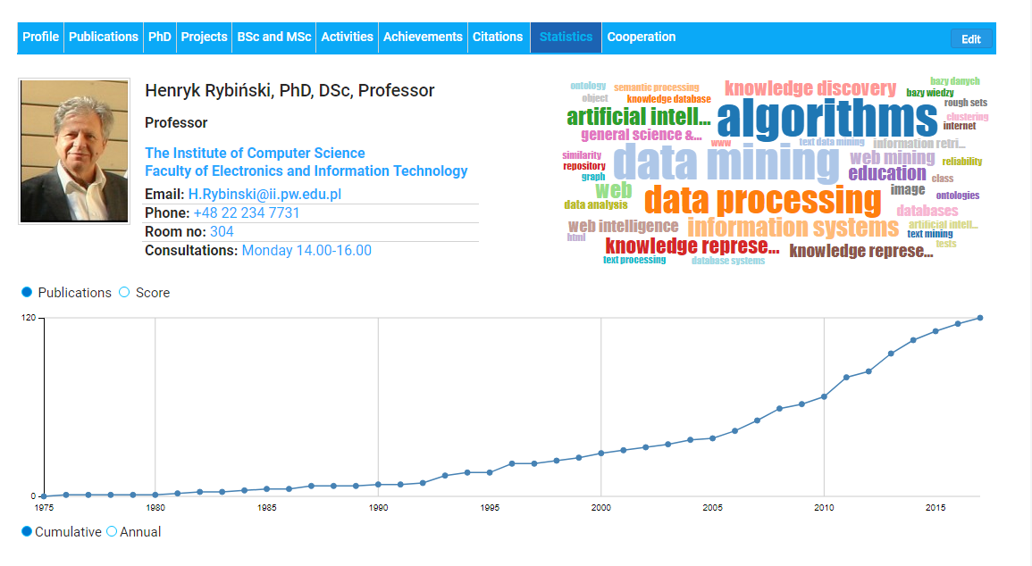

Slide 42
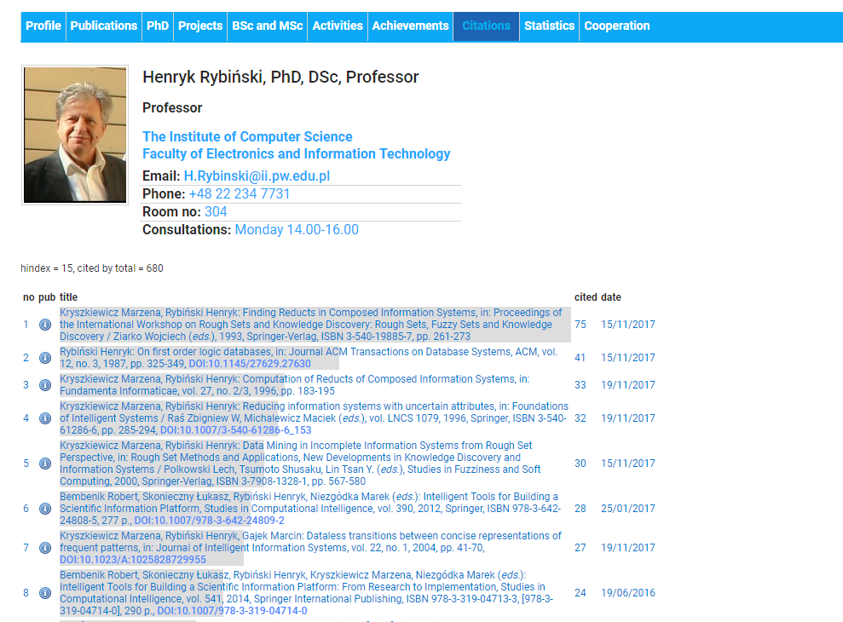

Slide 43
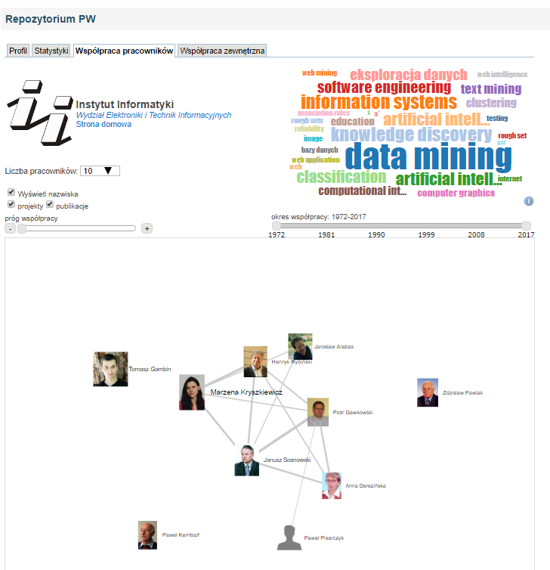
Cooperation within a unit (teams)

Slide 44
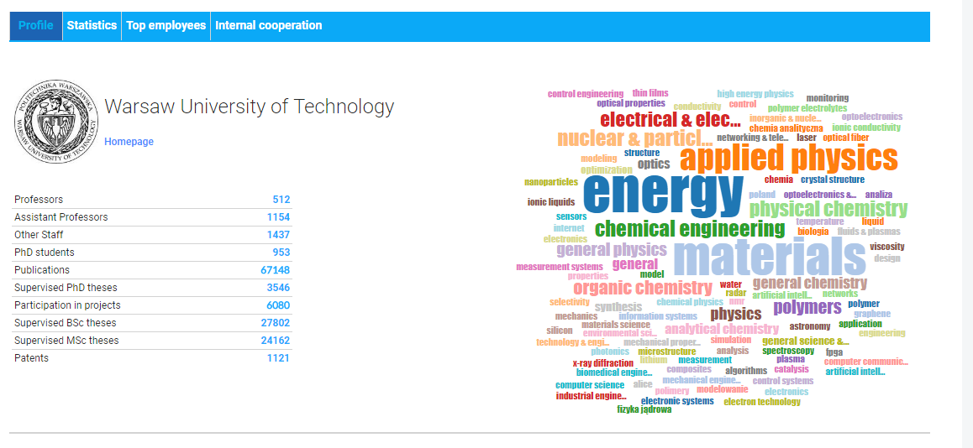

Slide 45
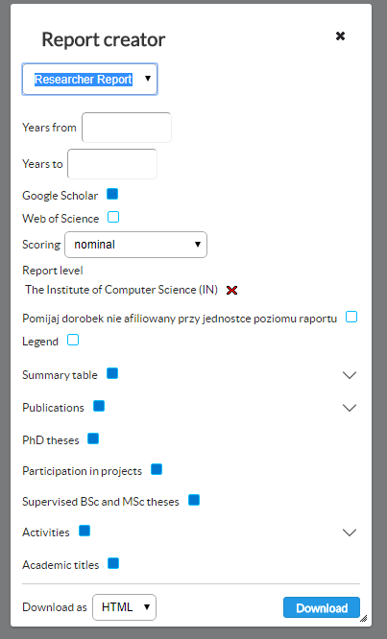
Reports

Slide 46
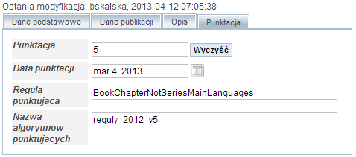
Automatic scoring of the publication
Based on the bibliographic description
According to the defineable rules
Rules simulation

Slide 47
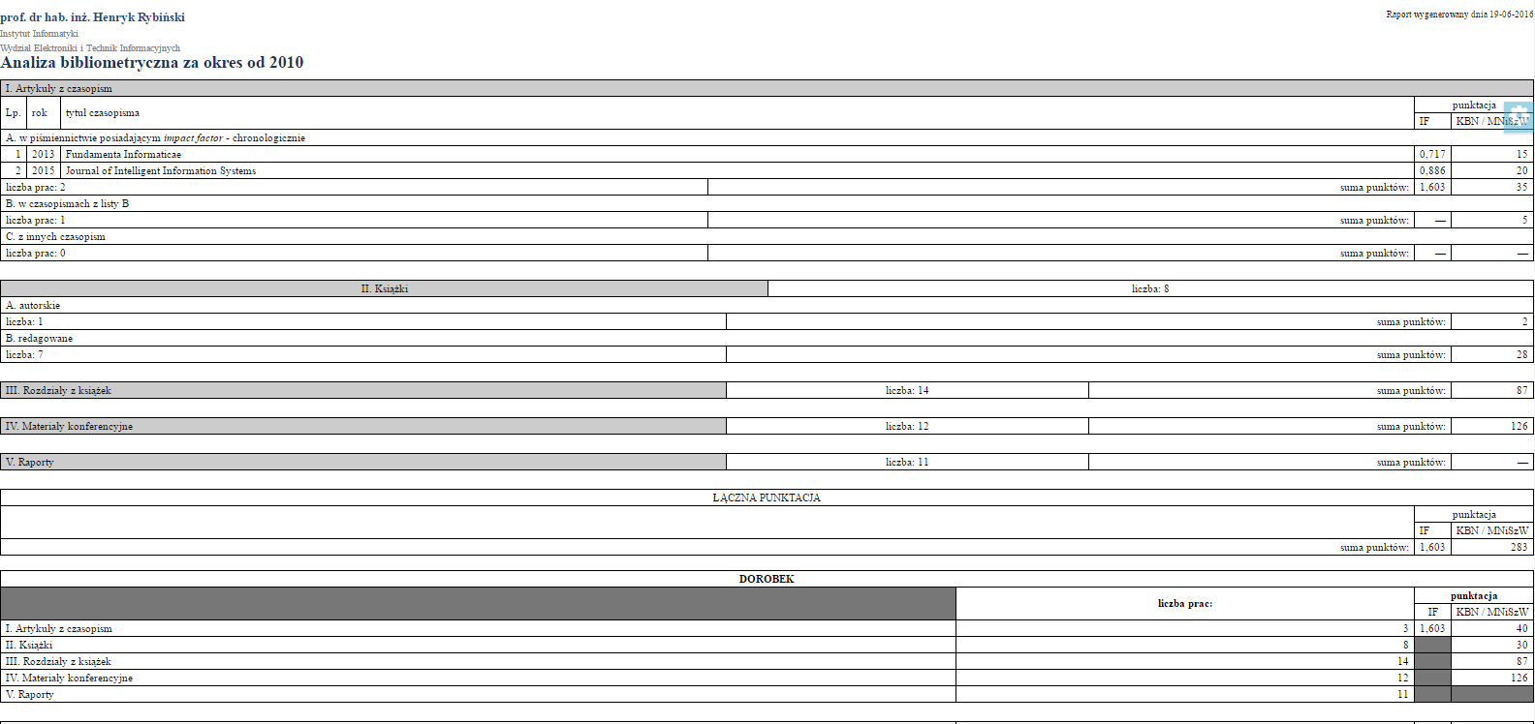
Bibliometry

Slide 48
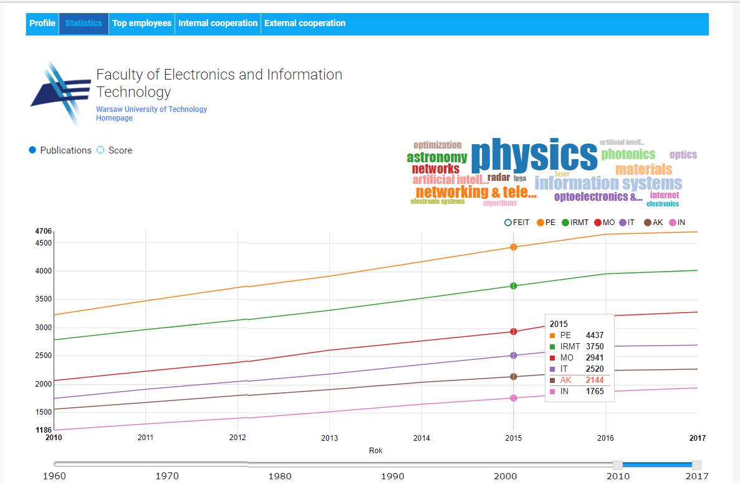
Statistics of a unit

Slide 49
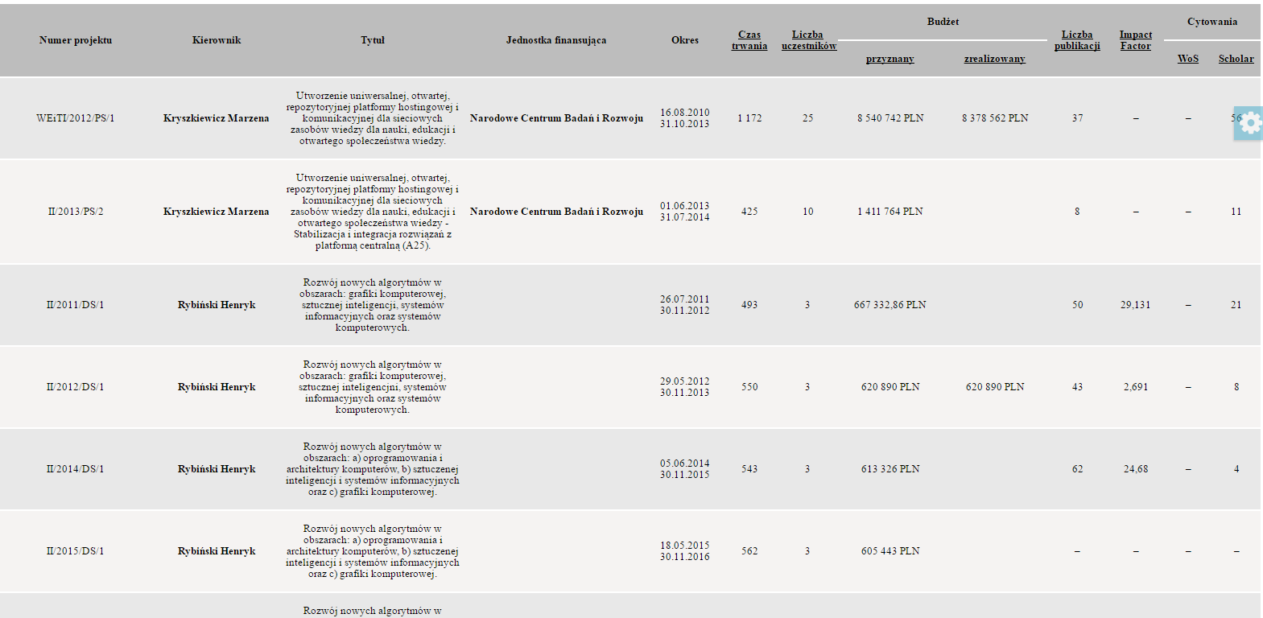
Reports on projects

Slide 50
Insights
If we still have time

Slide 51
Key points of succesful deployment
Organization-level legal regulations
Employee/ Researchers involvment
Building open science culture on the University
Direct benefits to users

Slide 52
Internal regulations
Registering all research output including full-texts is obligatory
All evaluation or applications must be generated from the system (ie. Habilitation application, interim evaluation etc)
Export to the Ministry is done basing on the data stored in the system

Slide 53
Key deployment challenges
Heterogenous data sources
Integration with Internal systems
Multiple systems running at once
Adaptation to Organizational structure
Legal adaptations and chasing the changes

Slide 54
Key adaptaion requests
New Data Types
Custom Look for Faculties
Custom Evaluation of Employees
Reports

Slide 55
Key blockers
Organizational (im)maturity
IT Operations departaments not always prepared to host complex solution and the same time no will for cloud solution

Slide 56

Researchers
Librarians
Key beneficieries
Management
Administration
The University as whole institution

Slide 57
The End
www.omegapsir.io
www.repo.bg.pw.edu.pl

Slide 58
References
Koperwas, J.J., Skonieczny, Ł., Kozłowski, M., Andruszkiewicz, P., Rybiński, H., and Struk, W. 2014. AI Platform for Building University Research Knowledge Base. Foundations of Intelligent Systems. Proceedings, Springer, 405–414.
Koperwas, J.J., Skonieczny, Ł., Kozłowski, M., Andruszkiewicz, P., Rybiński, H., and Struk, W. 2016. Intelligent information processing for building university knowledge base. Journ.Intell. Inf. Syst.
Koperwas, J.J., Skonieczny, Ł., Rybiński, H., and Struk, W. 2013. Development of a University Knowledge Base. In: R. Bembenik, Ł. Skonieczny, H. Rybiński, M. Kryszkiewicz and M. Niezgódka, eds., Intelligent Tools for Building a Scientific Information Platform: Advanced Architectures and Solutions. Springer-Verlag Berlin Heidelberg, 97–110.

Slide 59
References
Rybiński, H., Koperwas, J.J., and Skonieczny, Ł. 2015. Omega-PSIR – A Solution For Implementing University Research Knowledge Base. .
Rybiński, H., Koperwas, J.J., Skonieczny, Ł., Kozłowski, M., and Struk, W. 2013. OMEGA-PSIR: From the Repository to the Research Knowledge Base of Warsaw University of Technology. Foundations of Management 5, 1, 53–68.
Rybiński, H., Skonieczny, Ł., Koperwas, J.J., Struk, W., Stępniak, J., and Kubrak, W. 2017. Integrating IR with CRIS – a novel researcher-centric approach. Program-Electronic Library and Information Systems 51, 3, 298–321.

