Slide 1
SweCRIS

Slide 2
SweCRIS - overview
A national database containing funded research projects in Sweden
Initiated by Swedish Universities and used by individuals as well as media, private companies and grants offices
Operated and developed by the Swedish Research Council
Funders SweCRIS Universities

Slide 3
SweCRIS - overview
Funders SweCRIS Universities

Slide 4
SweCRIS - overview
Number of funders are fairly large
Funders SweCRIS Universities

Slide 5
SweCRIS - overview
Number of funders are fairly large
Size of funding organisations vary greatly
Funders SweCRIS Universities

Slide 6
SweCRIS - overview
Number of funders are fairly large
Size of funding organisations vary greatly
Almost all funders have individual databases
Funders SweCRIS Universities

Slide 7
SweCRIS - overview
Number of funders are fairly large
Size of funding organisations vary greatly
Almost all funders have individual databases
Many databases are in practice black boxes
All databases contain different information
Funders SweCRIS Universities

Slide 8
SweCRIS - information
Technical solution
API
CSV export
?
Language
English only
English and Swedish
Swedish only
Project information
Title
Title and abstract
Title, abstract, objectives
Organisation ID
VAT
Organisation name
Domain name
Personal ID
ORCID
E-mail addresses
Not available

Slide 9
SweCRIS - information
A common spreadsheet was constructed for data collection
Information exported from funders 1-2 times per year
Exports from funders were often handled by consultants
Imports into SweCRIS were administered by a commercial actor
Funders SweCRIS

Slide 10
SweCRIS - information
One template for data collection was sent out
Several data files collected from funding organizations
Many ”improvements” were made when filling in the template
Additional information was added
Difficulties related to categorization and standardization of projects
Outgoing Incoming

Slide 11
SweCRIS - information
Research information was sent to a commerical partner
We where provided with a web interface
We had very limited insights into the actual database
Data quality was largely unknown to us
Exports as well as imports were limited
Swedish Research Council Commercial partner

Slide 12
SweCRIS – the end product
This was our goal
Funders SweCRIS Universities

Slide 13
SweCRIS – the end product
This was our end product
Funders SweCRIS Universities

Slide 14
SweCRIS – feedback
Funders:
Complicated to deliver data, takes a lot of manual work
Swedish Research Council
Lack of control of data quality
Universities
Can’t really use the service due to inaccurate and outdated information
Funders SweCRIS Universities

Slide 15
SweCRIS – wish list
Increase the quality control in SweCRIS
Don’t only supply the universities with a web interface but give them good and accessible information
Try to remove the funders’ black boxes
Funders SweCRIS Universities
API
API

Slide 16
SweCRIS – structure
CERIF is a good and flexible standard with some flaws
CERIF is relatively complex and difficult to introduce to, especially, non technical persons
CERIF is not a real demand from the end users
Funders SweCRIS Universities
API
API
Structured
information
Unstandardized
CERIF

Slide 17
SweCRIS - structure
People
has researcher
has principal investigator
Organizations
is affiliated to
has co-investigator
Projects
has coordinator
Classification
Classification
has funder
has funding
provides funding
has funding
Funding

Slide 18
SweCRIS idag
Vetenskapsrådet
Energimyndigheten
Vinnova
SweCRIS
Formas
API
Forte
Rymdstyrelsen
85%
15%
Riksbankens Jubileumsfond
Östersjöstiftelsen
Hjärt-lungfonden
IFAU

Slide 19
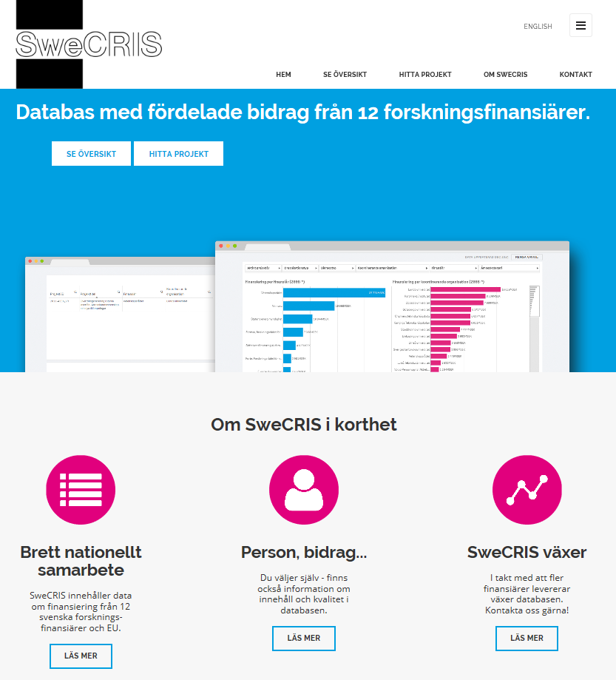
SweCRIS www.swecris.se
50 000 projects
4 500 organisations
20 000 researchers
10 000 M€ funding
Data from 2008

