Slide 1

Integrating a national network of institutional repositories into the national/international research management ecosystem
João Mendes Moreira
0000-0002-9081-2728

Slide 2
Outline
Background
Goals and motivation
Methodology
Results
Conclusions

Slide 3
Mission
Ensure the creation and sustained development of national integrated information ecosystem (PTCRIS) to support research management
Notes:
Apoiar os utilizadores na gestão, reporting e tomada de decisão relativos ao processo de investigação nas atividades de desenvolvimento de programas, atribuição de financiamento, avaliação de projetos, execução de projetos, geração de resultados, avaliação de resultados ou a transferência de tecnologia

Slide 4
Goals
Regulatory framework
Adapt external systems
Adapt FCT systems
Communication dissemination and training
Notes:
Definir o quadro normativo a adotar pelos vários sistemas
Coordenar a adaptação e integração dos sistemas da FCT de acordo com o quadro normativo
Coordenar a integração dos sistemas externos à FCT (nacionais e internacionais) de acordo com o quadro normativo
Apoiar e divulgar na comunidade a utilização dos sistemas do PTCRIS.

Slide 5
Regulatory framework
System A
System B
Identifiers
Identifiers
data
data
semantics
API
API
semanthics
Standards others
Standards others

Slide 6
The ecosystem
CRIS – Current Research Information Systems
Academic expertise
Research news
Funding database
Outcomes / outputs
Organizations database
Scientific equipment
Grant management
Research ethics
Research portal
Indicators
Notes:
After the studies and surveys we were able to identify several components of a national CRIS

Slide 7



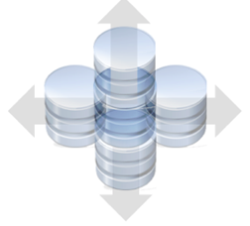
Stage 0
-Funding-
Seed funding
Fase 0
CV
IRs (RCAAP)
Grant Mng
RF
National IS
PTCRISync
Local IS
CRIS 1
CRIS 2
Services
PTCRISync
(SaaS)
CV
Recon
service
DaaS v1

Slide 8





Stage 1
-Funding-
Fase 1
RF
National CRIS
Dgrees ID
Data protection
Local CRIS
Services
Research Portal
BI
DaaS v2

Slide 9
The RCAAP

Slide 10
Objectives of the RCAAP
Increase the visibility, accessibility and dissemination of results of academic activity and scientific research Portuguese
Facilitate management and access to information on scientific production national
Portugal integrate a number of international initiatives

Slide 11


Management
FCT | FCCN
General coordination and infrastructures
Minho's university
Scientific and Technical Coordination

Slide 12
Electronic services
Hoteed IRs
(SARI)
Data
(SARDC)
Journals
(SARC)
RCAAP Portal
Directory
Shared Repositories
Stats
(SCEUR)

Slide 13
Figures
47 Institutional Repositories (28 hosted)
1 shared repository shared by 50 institutions
44 journals (14 housed)
1 million documents (330K PT)

Slide 14
Recognition / Consolidation RCAAP
Legal support for the deposit of doctoral dissertations and master's theses (DL 115/2013 and Ordinance No. 285/2015).
Support compliance and monitoring of open access policy of the FCT.

Slide 15
Motivation
Integrate RCAAP services, namely institutional repositories, into PTCRIS ecosystem by adopting it’s regulatory framework
Provide added value services to institution by extending functionalities on IRs (DSpaceCRIS=IR+CRIS)
open source solution, non-disruptive and sustainable approach

Slide 16



Motivation: Goal 2: Comply with PTCRIS regulatory framework
PTCRIS
Research news
Funding database
Outcomes / outputs
(RCAAP)
Org. database
Scientific equipment
Grant mng
Research ethics
Research portal
Statistics
Academic expertise
RI
(Dspace)
Revistas
(OJS)
Dados científicos
(CKAN)
PTCRISync
Notes:
Isto porque passará a usar os identificadores e o modelo de interoperabilidade comum ao ecosistema

Slide 17

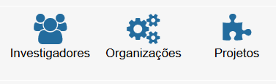
Motivation: Goal 1: added value services
DSPACE CRIS

Slide 18
Motivation: Goal 3: open source solution, non-disruptive and sustainable approach
DSpaceCRIS = Open Source
Non-disruptive = pilot with 3 institutions
Sustainable = CINECA + REX (configuration management and software deployment)

Slide 19
Methodology
Prep
DSpaceCRIS master instance
Client form
Kick-off
Goals and expectations
Team
Entities stage 1
Entities stage 2
Report
Tools
Publications
Persons
Organizations
Projects
Events
Journals
Others
Project scope

Slide 20
Participants (Pilot)
Institution (Univ. Aberta, Univ. Alg, Egas Moniz)
  Project team
  Researchers
RCAAP (FCT|FCCN & UMinho)
  Electronic services team
  Project team

Slide 21
Tasks
Institution | RCAAP Team
1 – Fill the form | 1 – Installation, basic configuration
2 – Entities (record selection) - authors– ORCID; - projects – OpenAIRE; - T&D – RENATES - Organizations- ISNI; … | 2 –Design / layout
3 – Tests & system exploring | 3 – Basic configurations
4 – Information validation | 4 – Information import
FORMAÇÃO ONLINE
5 – Information consolidation | 5 - Support
6 – Tests with final users | 6 - Corrections
7 – Metrics and statistics analysis | 7 – Security and load tests
Implementation report | Implementation report

Slide 22
Results (provisional)
IR and PTCRIS regulatory framework (in progress)
  ORCID (done)
  PTCRISync (done but work need to be done)
  OrgIds (not started)
  CERIF-XML (soon to be deliverer: Data provider, data harvester)
Provide added value services to institution by extending functionalities on IRs (DSpaceCRIS=IR+CRIS)
open source solution, non-disruptive and sustainable approach

Slide 23
Challenges
Connecting entities with authority control (ORCID; Projects; ISNI; ...) (in progress)
Export/import information in CERIF-XML (to be addressed by CINECA ☺)
Cultural change (CRIS-IR in research institution and researchers habits)

Slide 24
Conclusions
Work in progress
Results achieved so far are positive
Data quantity and quality will increase (DC vs CERIF)
If successful this initiative can change the Portuguese landscape of CRIS (from very low to very high implementation)

Slide 25
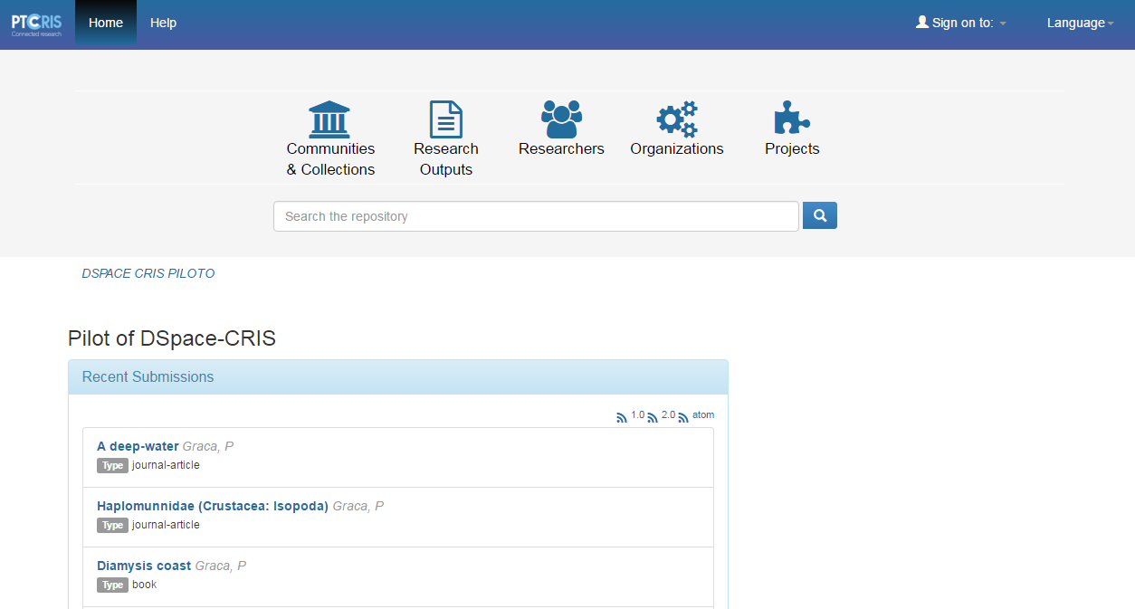

Slide 26
Cooperation is power!

