Slide 1
ACUMEN a multi-dimensional researcher portfolio
EVALUATION STANDARDS and their dilemmas
euroCRIS Strategic Membership Meeting 11-12 November 2014, Amsterdam
Paul Wouters

Slide 2
Profile CWTS

Slide 3
Research leaders face key questions
How should we monitor our research?
How can we profile ourselves to attract the right students and staff?
How should we divide funds?
What is our scientific and societal impact?
What is actually our area of expertise?
How is our research trans-disciplinary connected?
Notes:
Questions and problems that motivate research leaders to enlist the help of CWTS

Slide 4
Evaluation Gap
discrepancy between evaluation criteria and the social and economic functions of science
evaluation methods (esp. qualitative) have not adapted to increased scale of research
available quantitative measures are often not applicable at the individual level
lack of recognition for new types of work that researchers need to perform
Notes:
The cause of the public debate and anxiety about the management and governance of science

Slide 5

Notes:
CWTS rsponse to both: an innovative research programme

Slide 6
CWTS Publication classification system
Proper and robust classification because of true citation relations of all WoS publications 2000-2013
No issues with multidisciplinary journals
No human involvement
More refined granularity than other bibliometric classification systems:
    24 disciplines/main fields
    828 fields
    ~32,500 topics
Notes:
Important technical achievement: a new standard for defining scientific fields and areas

Slide 7
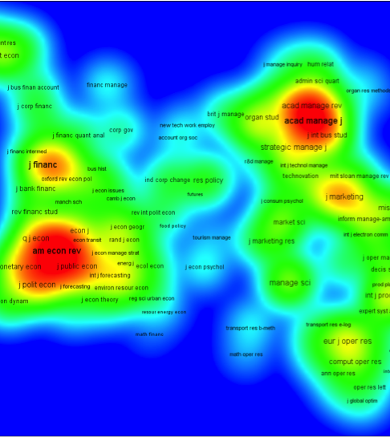
CWTS Advanced Analytics
Tailor-made analysis based on network analysis, text mining and visualisation techniques
Research strengths analysis
Find blind spots/hot spots
Identification of partners/potential new staff
Enhanced collaborative network analysis
Notes:
Advanced analytics in development at CWTS

Slide 8
Research performance measurement/ metrics
Johann Mouton
RDF Workshop
© 5 November 2014
Notes:
CWTS develops international network of scientometric and STS expertise and research centres. South Africa the most recent example.

Slide 9
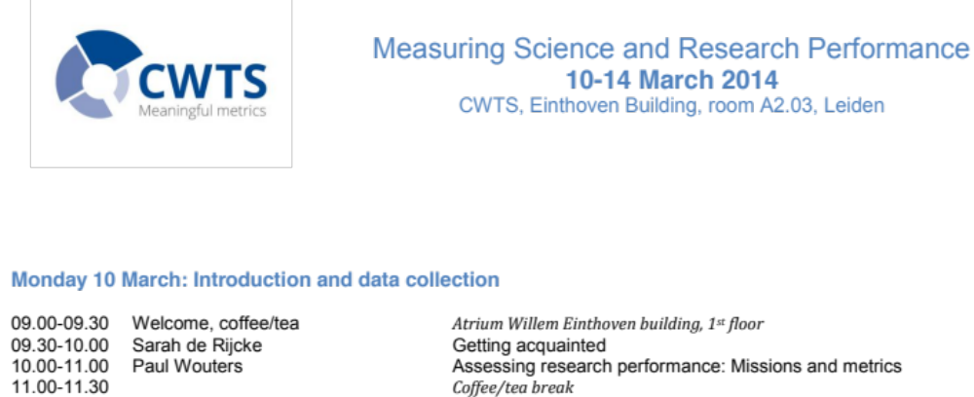
Training & Education
CWTS Courses 'Measuring Science and Research Performance'
Notes:
Many librarians and information specialists have found their way into scientometrics via our courses

Slide 10
Researcher profiles

Slide 11

portfolio
aim is to give researchers a voice in evaluation
evidence based arguments
shift to dialog orientation
selection of indicators
narrative component
Good Evaluation Practices
envisioned as web service
expertise
output
narrative
influence

Slide 12
ACUMEN Portfolio
Career Narrative
Links expertise, output, and influence together in an evidence-based argument; included content is negotiated with evaluator and tailored to the particular evaluation
Evaluation Guidelines
aimed at both researchers and evaluators
development of evidence based arguments (what counts as evidence?)
expanded list of research output
establishing provenance
taxonomy of indicators: bibliometric, webometric, altmetric
guidance on use of indicators
contextual considerations, such as: stage of career, discipline, and country of residence
Expertise
- scientific/scholarly
- technological
- communication
- organizational
- knowledge transfer
- educational
Output
- publications
- public media
- teaching
- web/social media
- data sets
- software/tools
- infrastructure
- grant proposals
Influence
- on science
- on society
- on economy
- on teaching

Slide 13
Portfolio & Guidelines
Instrument for empowering researchers in the processes of evaluation
Taking in to consideration all academic disciplines
Suitable for other uses (e.g. career planning)
Able to integrate into different evaluation systems

Slide 14
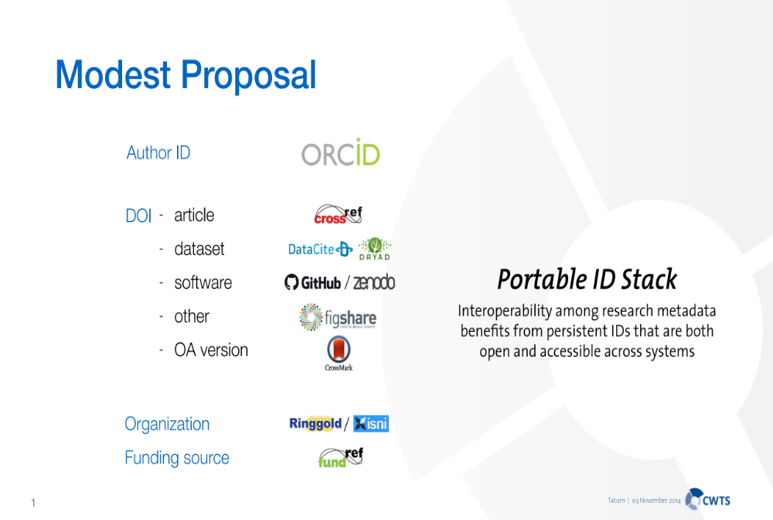
Notes:
ACUMEN and comparable initiatives require an infrastructure of identities

Slide 15
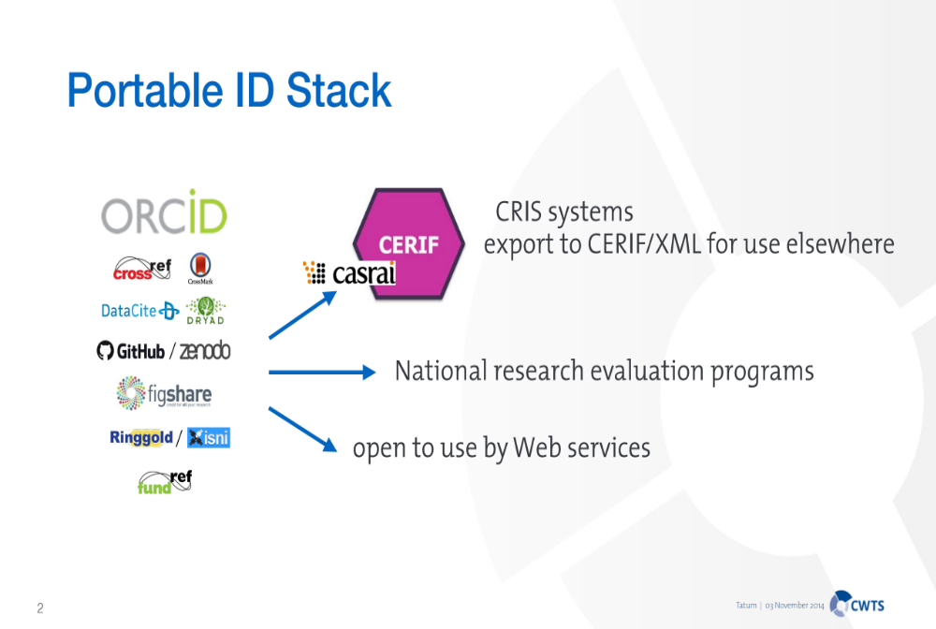

Slide 16
Profiles of individual researchers
Notes:
An example of a profile on demand. The interface is the same as the interface of the CWTS research monitor

Slide 17
Profiles of individual researchers II
Notes:
Four dimensions of the individual profile are central: raw impact, normalized impact, collaboration, and the data on the individual publications

Slide 18
What role for standards in evaluation?

Slide 19
Evaluation Machines
Primary function: make stuff auditable
Mechanization of control – degradation of work and trust? (performance paradox)
Risks for evaluand and defensive responses
What are their costs, direct and indirect?
Microquality versus macroquality – lock-in
Goal displacement & strategic behaviour

Slide 20
Constitutive effects
Limitations of conventional critiques (eg ‘perverse or unintended effects’)
Effects:
    Interpretative frames
    Content & priorities
    Social identities & relations (labelling)
    Spread over time and levels
Not a deterministic process
Democratic role of evaluations

Slide 21
Effects of indicators
Intended effect: behavioural change
Unintended effects:
  Goal displacement
  Structural changes
The big unknown: effects on knowledge?
Institutional rearrangements
Does quality go up or down?

Slide 22
STANDARDS: What are we talking about?
Standardization of technical infrastructure and information systems?
Standardization of performance indicators:
  their construction and transparency?
  their comparability?
  their use?
Standardization of evaluation practices?

Slide 23
And the answers are:
Standardization of technical infrastructure and information systems? – YES – CERIF/CASRAI/persistent IDs
Standardization of performance indicators:
  their construction and transparency? – YES IN MINIMAL MODE (not maximal mode)
  their comparability? – PARTIAL YES (partially impossible)
  their use? – NO (except GEP see below)
Standardization of evaluation practices? – NO: context and goals must come first
However: principles of GOOD EVALUATION PRACTICES? – YES
Reflexive attitude critically important:
  the social dynamics of standardization;
  who sets the standards for what purposes?

Slide 24
The Leiden Manifesto in the making
Quantitative evaluation should support, not replace qualitative, expert assessment.
Metric systems should measure performance in accordance with the research mission.
Metric systems should also encourage excellence in the domestic literature.
Data collection and analytical processes should be open, transparent and simple.
Data and analysis should be open to verification by those evaluated.
Data should be interpreted taking into account the variation in publication and citation rates by field and over time.
Data should be interpreted taking into account the difficulty of credit assignment in the case of multi-authored publications.
The assessment of individual researchers must be based on qualitative judgment.
Avoid false precision.
Constitutive effects of the assessment and the indicators should be taken into account.

Slide 25
Key challenges
Will the information infrastructure contain high quality data and indicators?
Will it enable and support context- and mission-sensitive research assessments?
Will it enable application of research information for primary research purposes (eg in VREs)?
Will the public sector remain master in its own house or will they hand over control to the private sector?
Will it be possible to truly open up the research agenda to all stakeholders – open science in a democratic society?

Slide 26
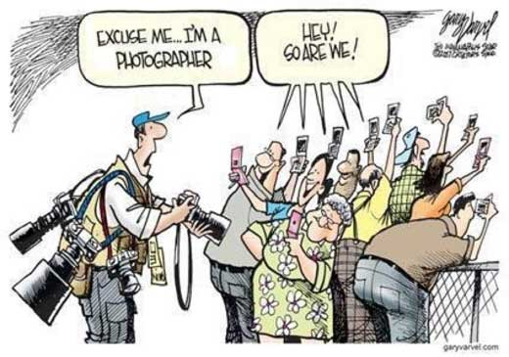
Thank you for your attention

