Slide 1

Harmonizing classifications schemes for organisations and subjects between a local and a national CRIS euroCRIS Membership Meeting
Mai 13-14, 2013, Bonn, Germany

Slide 2
Currently there are no national-wide standards for research reporting in Germany
Universities and HEI more and more request for research information
  Internal planning and controlling purposes (e.g., profiling, evaluations)
  Requests from external organisations (e.g., ministries, German Council of Science and Humanities (Wissenschaftsrat), Federal Statistical Office (DESTATIS))
No central obligation for HEI to collect and report information about research activities
  Requesting organisations have different data and classification schemes
  Results in redundancies, error-prone, high efforts and costs
Initiative of the German Council of Science and Humanities to establish a core data set for research activities
  Standard for all data requesting organisations
  Discipline-oriented data collection

Slide 3
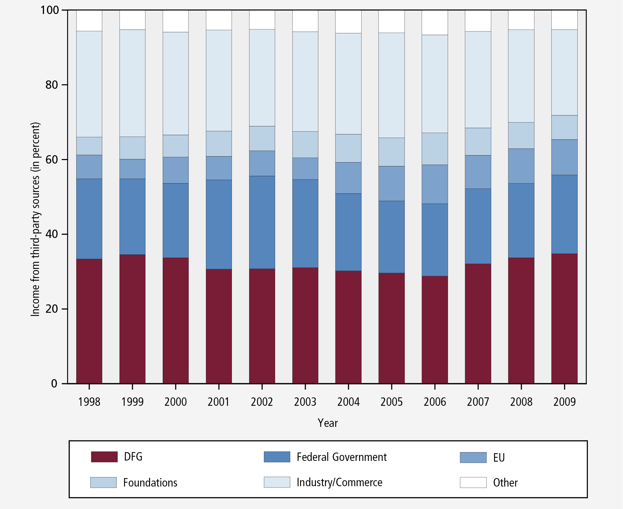
German Research Foundation (DFG) is not only one of the main funding agencies in Germany
Source: DFG (http://www.dfg.de/download/pdf/dfg_im_profil/
evaluation_statistik/foerderatlas/en/figures/dfg-fundingatlas2012_figure-7_2-7.png)

Slide 4
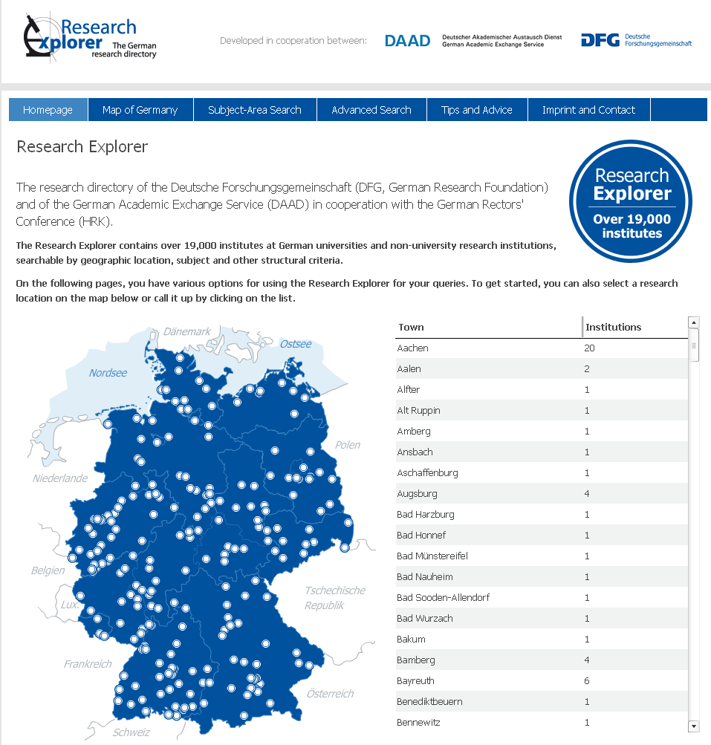
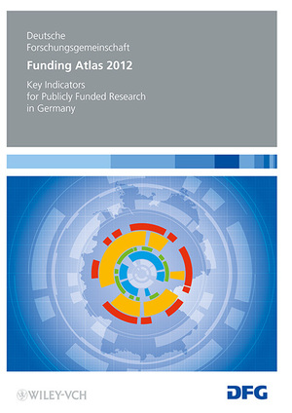
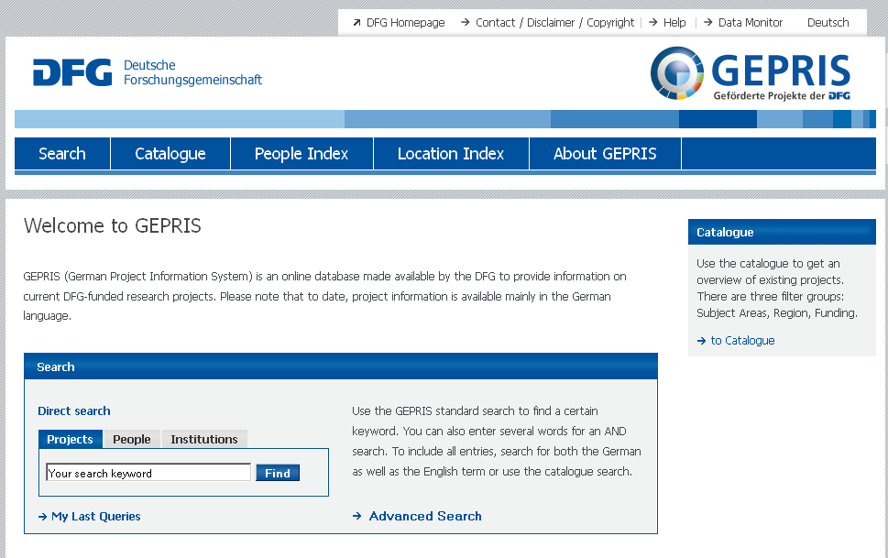
DFG is also a main provider of research information at national level

Slide 5
Research information management at the University of Münster

Slide 6
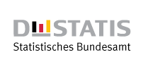
How to collect research information at national and local level, that they can be interrelated and used on both levels?
Harmonise organisational, personal and project information and their classification
Define a consistent reference object to relate these information and allow for a discipline-oriented research reporting at national and local level
Federal Statistical Office (DESTATIS)

Slide 7
Definition of a consistent reference object for discipline-oriented research reporting
Which kind of research information should be classified
and serve as reference base for statistics
and key performance indicators?
Currently: projects where directly classified and
used for statistical purposes
Problem: representing the different disciplines working together in interdisciplinary projects (e.g., project is related to the field “chemistry” but persons/organisations from the fields of “physics” and “chemistry” are involved)
Suggestion: classification and use of organisations as reference base and relating project and personal information for discipline-oriented statistics
  How many medical research is done in the field of medicine?
  In which fields is the faculty of physics involved with its projects?
  What is the personal related amount of grants in the field of chemistry?

Slide 8
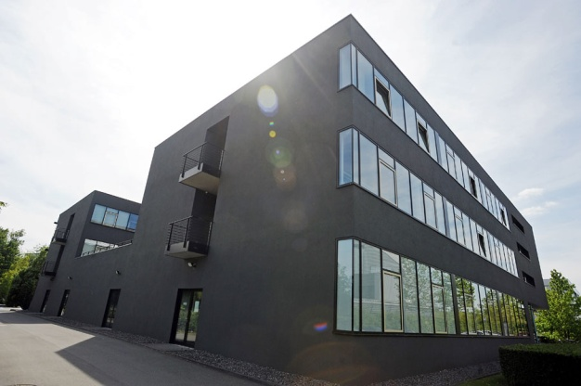
Suggestion of a working programm – organisations
Comparison and harmonisation of the organisational information at the DFG with the information of the University of Münster concerning
  Organisational structure
  Naming and address
  Classification
Establishing a process for the continuous maintenance of the organisation information at the DFG by the universities
Prototypical implementation of the maintenance process
and technical possibilities for the exchange of
organisational information

Slide 9

Suggestion of a working programm – personal information
Analysis of potential sources for personal information
  University of Münster holds personal information in HR-system and the CRIS
  DESTATIS collects classified information about persons employed at universities
Development of a concept to relate these personal information to
  organisations,
  granted projects, and
  disciplines/field
to allow for a personal related research reporting
Prototypical application of the concept for
selected report formats

Slide 10

Suggestion of a working programm – linking the CRIS´ of the DFG and the University of Münster
Evaluation of different ways of integration concerning costs and benefits
  Simple links between the research portals of the DFG and University of Münster
  Usage of the linked data concept to mutually integrate data in the research portals
  Exchange of data between both CRIS´
Focus on information about organisations and projects (and related research information like publications, awards, PhD thesis etc.)
Perspectively: coupling the CRIS´ to allow for
data exchange along the project life cycle
(application, review, granting, evaluation)

