Slide 1
euroCRIS
Membership Meeting Paris, May 2015
Conclusions
Ed Simons,

Slide 2
External Relations: the first 5 months of 2015
Conclusions.
Value of the MM’s as a source of information and expertise exchange has once again been clearly demonstrated.
Examples of the use of CRIS / CERIF(XML) on a national level are now becoming available and can function as “best practice” cases for countries just starting off on the “CRIS Road” (e.g. EKT CERIF-based CRIS network).
The launch of the “CERIF OpenAIRE Guidelines for CRIS Managers” may speed up significantly the implementation of CERIF as the interoperability standard.
Common problems can be indentified in (institutions / countries) implementing CRIS.
  Researchers not (willing to) using the CRIS
  CRIS not well known/high priority to/in the insititution’s (IT) management
  Silo-ed behaviour / developments
  .....

Slide 3
External Relations: the first 5 months of 2015
“Magic word”: INTEGRATION
  An overal view on the Policy level, integrating all aspects of RI.
  Functional: overall and integrated definition of goals/aims (profiling, reporting, dissemination, assessment, ...)
  Organisational: integration of units involved with the execution/application of the RI Policy.
  Systems: integration of information systems involved: CRIS, Publication Repositories, Data Repositories, .....
  Standardisation: adapting and integrating standards for all aspects: definitions, identifiers, datamodel and exchange format.

Slide 4
External Relations: the first 5 months of 2015
What does this mean in practice? Let’s put it in the form of questions:
  Does your institution/country has an integrated Research Information Policy Plan?
  Is there an integrated “Research Information Services” organisational unit managing the RI applications/developments .
  Is there an integrated Research Information (systems) Infrastructure optimally combining the various systems involved?
  Have you adapted international standards for definitions/vocabularies, identifiers and exchange formats?
  Is there a “one stop” solution (read: one interface) for the researcher to manage all it’s RI aspects (registration of publications, full text, archiving of datasets, CV-exposure on the web, ...)?
  Is the on line research environment of a researcher (VRE) integrated with the online Research Information Environment?
  If the answer is no to one of these questions: ... you may be in trouble ... ☺☹

Slide 5
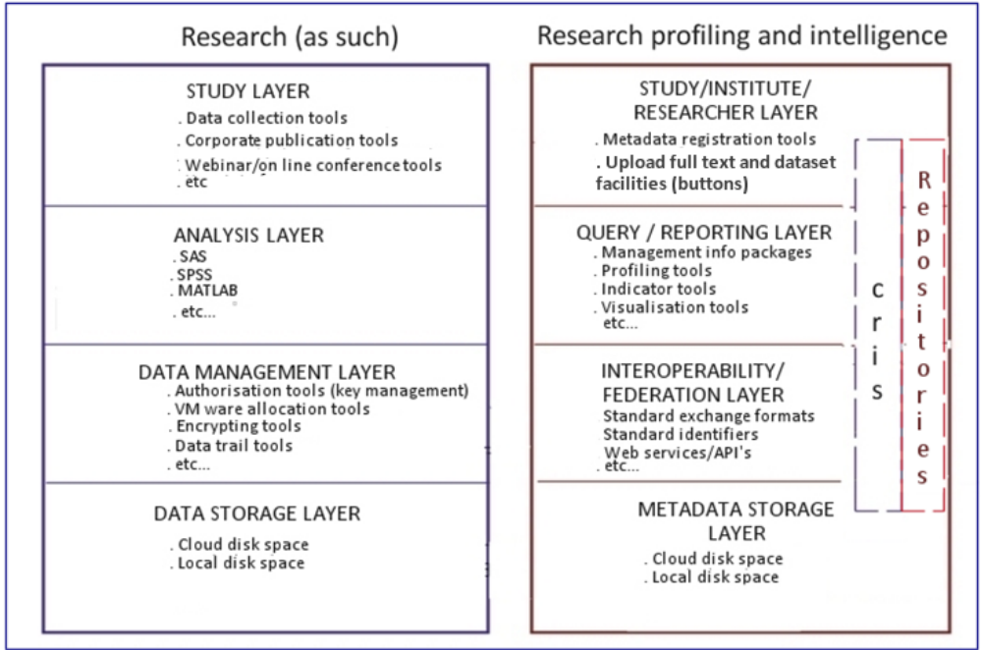
External Relations: the first 5 months of 2015
Full, integrated Digital Research Environment, steered by one interface for the researcher

Slide 6
External Relations: the first 5 months of 2015
Thank you and see you in Barcelona in November!

