Slide 1




Say, “S” (as) = semantics – and mean it!
Path to semantically interoperable digital research services
Suvi Remes, Miika Alonen, Patrik Maltusch, Mikael af Hällström, Stina Westman
13th International Conference on Current Research Information
Systems, CRIS2016, Scotland, UK, 9.6.2016

Slide 2
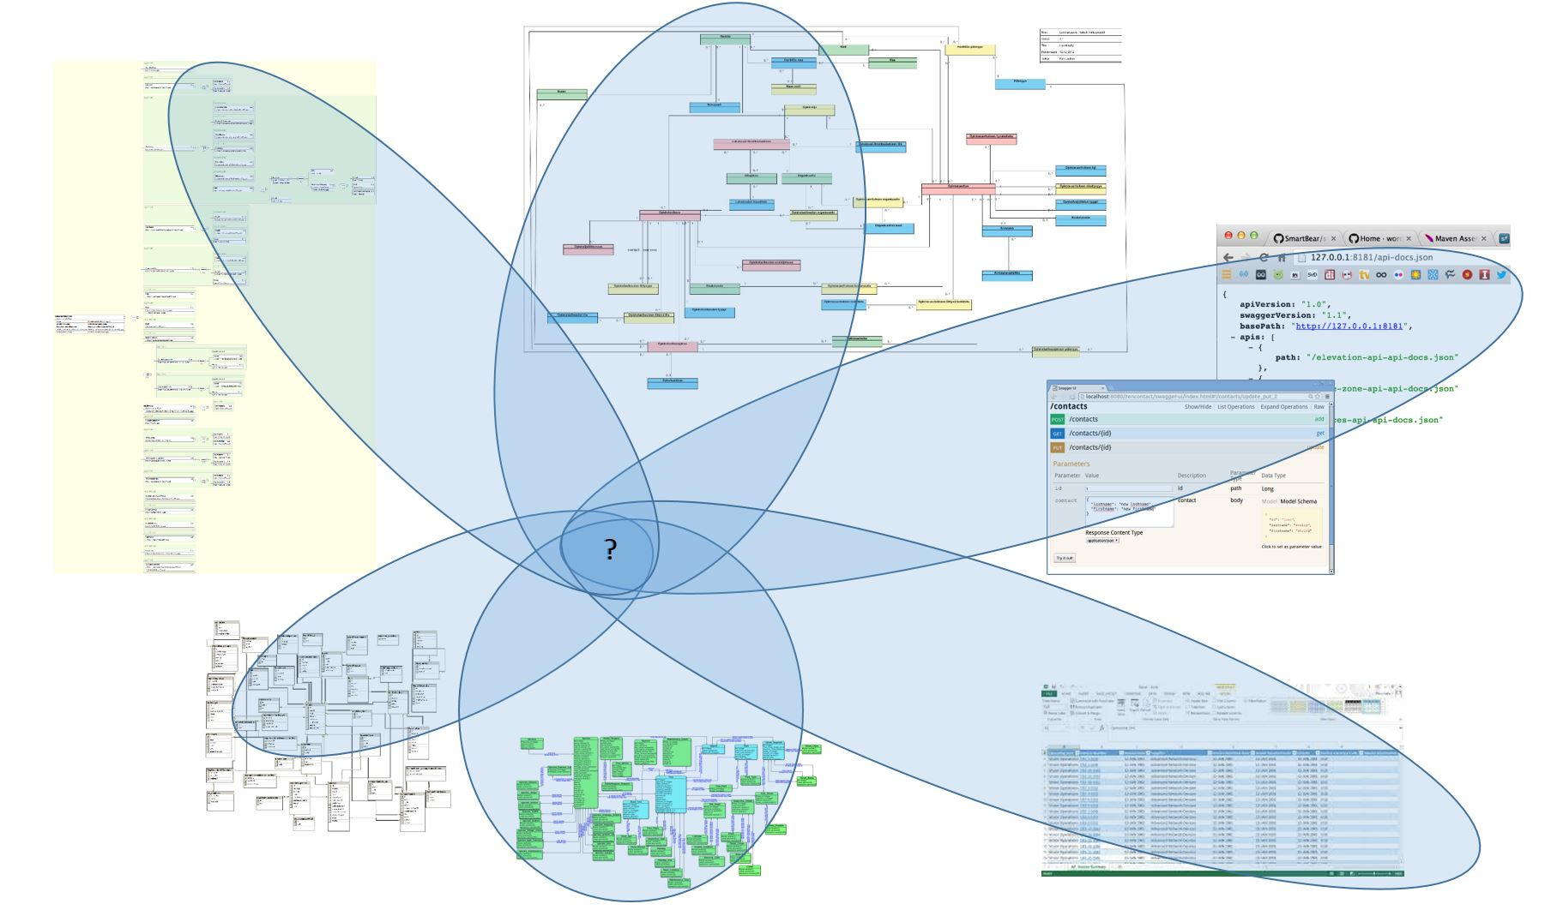
”Once upon a time…”
It is not that we would not have data spesifications – it is that we have so many, maintained on various tools, in various formats, built for various purposes…
The work presented is about
approach to achieve semantic interoperability
  shared terminology - less confusion
  same concepts & terms for many communications needs
  modular and reusable metadata definitions
  improved readability and understandability of data models
  interoperability with international standards – promoting standard reuse
description of a new tool for metadata publishing
  avoid redefinition of data models – lowering costs
achieving semantic interoperability on the national level
Notes:
Challanges – ”the usual story”
- organisation specific documentation
- no change management over organisation borders
- missing formal and actual semantic mappings
All kind of costs – integration costs, human labour costs needed in (re)defining data models and terminologies
- on the national level – work covers not only research but also study and public administration, which are all interconnected

Slide 3
Development of Information Architecture on a National Level in Finland
International exchange
(ERASMUS+ / EMREX)
2015-20??
New services and more application interfaces
É
Å
KAPA
National service bus for organisational and personal data
Rest APIs
University a-x
University z
SOAP APIs
OILI
Rest APIs
ESB
KSHJ
XDW
Opintopolku
Research data
VIRTA
Publications
Etsin
National research data catalog
Juuli
National catalog for publications
?
New services
Catalog y
research data catalog
Catalog a-x
research data catalog
Incorporated University Coalitions
= Universities building new informations systems together
Notes:
e.g. research data catalogs focused on specific research fields and/or based on state agency assignment

Slide 4
Elements of the semantically interoperable information management infrastructure
Terminology
Core vocabularies
Application Profiles
  Concepts
  Definitions
  Classifications
  Classes
  Attributes
  Associations
  Context
  Constraints
  Extensions
Terminological theory
mutual understanding of conceps
consistant use of terms
logical data structures
Semantic Interoperability Model
systematic method to apply descriptions
Well defined management responsibilities enable efficient use of different resources
– commitment needed for this long-term work
Notes:
Terminological theory, terminological concept modelling
originally used on cross-human communication
not only in human-readable, but also in machine-readable format
Semantic Interoperability Model >> named to show its intermediary role, naming needed in communication purposes for non-IT-persons

Slide 5
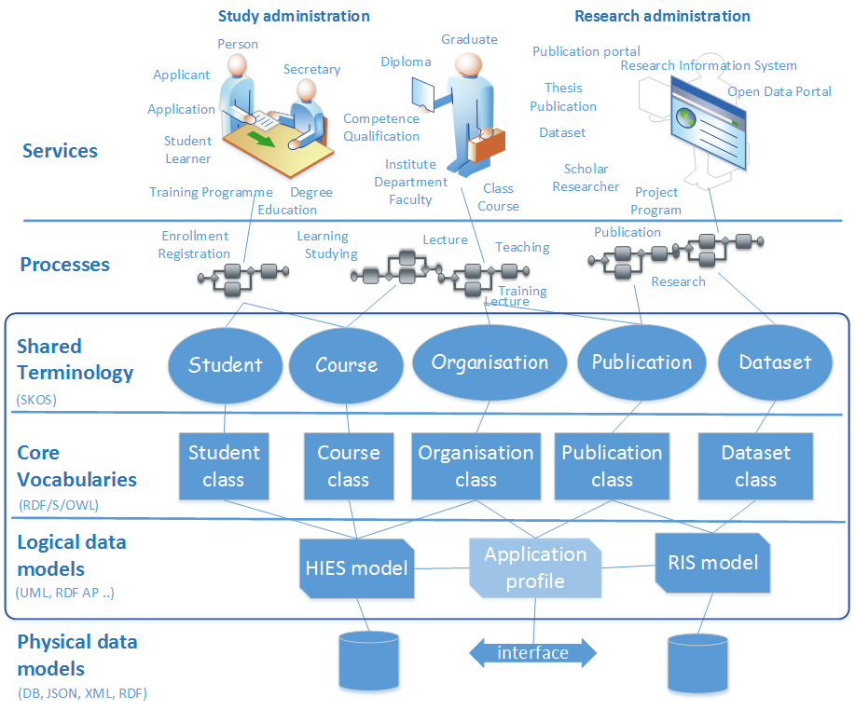
Need for common framework
Shared concepts with the business and IT:
    Well defined concepts
    Unique identifiers
    Machine readable format
Service innovation and data modeling based on business needs:
    Reuse terms and definitions
    Create reusable components
    Focus on the interfaces and integration
  Framework for semantic interoperability:
    How to publish core vocabularies
    and application profiles?
    How to reuse standards?
    How to reuse core vocabularies in the implementations?
    How to document the metadata reuse?
    How to document application interfaces?

Slide 6
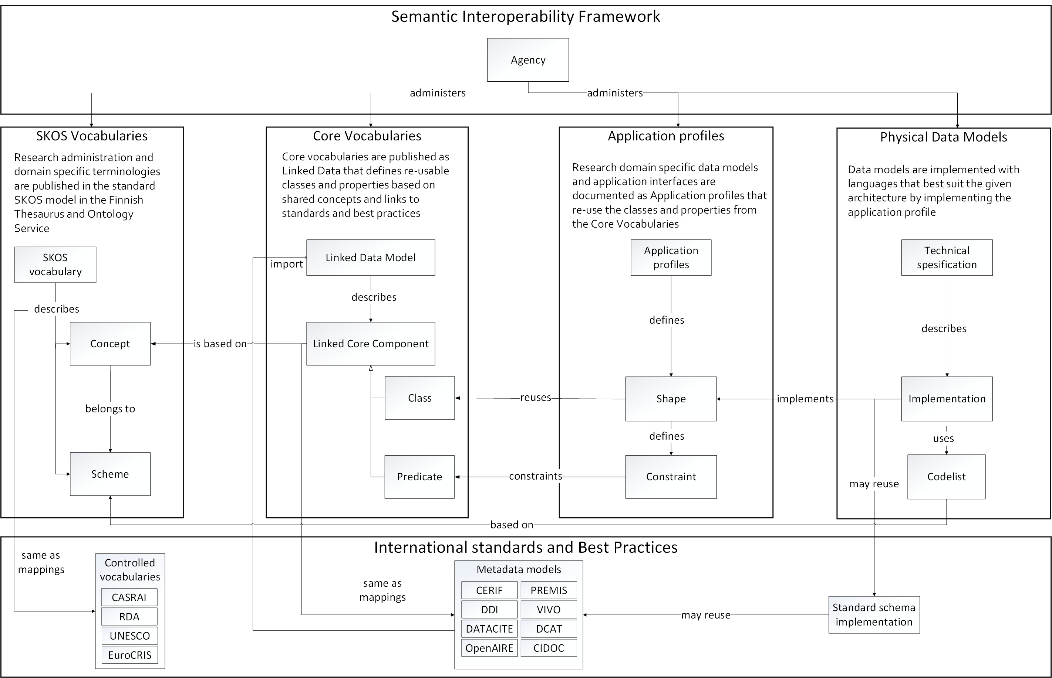
Notes:
- Open Science Cloud – FAIR?

Slide 7
Domain specific vocabularies are administered by different agencies,
and published in the standard SKOS model
(in the Finnish Thesaurus and Ontology Service).

Slide 8
Core vocabularies are published as Linked Data that defines re-usable classes and properties based on shared concepts and links to standards and best practices.

Slide 9
Domain specific data models and interfaces are documented as Application profiles that re-use the classes and properties from the Core Vocabularies.

Slide 10
Data models are implemented with languages that best suit the given architecture by implementing the Application Profile.

Slide 11
New tool(s) to support collaborate data modelling and reuse of resources
Terminology
Core vocabularies
Application Profiles
  Concepts
  Definitions
  Classifications
  Classes
  Attributes
  Associations
  Context
  Constraints
  Extensions
Notes:
In Finland we are currently building the core resource needed to ensure semantic interoperability. This work is essential also for international cooperation as stated in the morning’s key note speak.
It is however more efficient to use the resourses if there proper tools for that. So we have created one.
Barckets there in the title are to indicate that the tool developed is a modular IT-solution, open software it is also, which is linked to the mentioned ontology service and supports therefore terminology process. It is also linked to code service. Together these parts will form a centralised national metadata service.

Slide 12
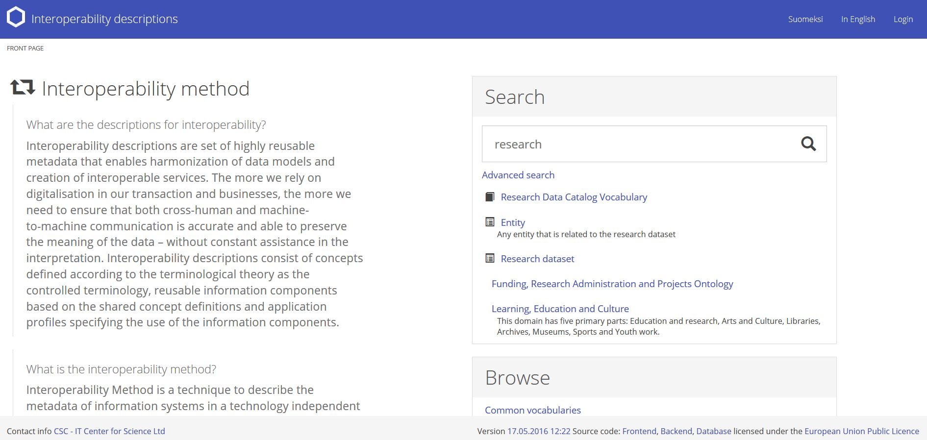
Interoperability workbench
Collaborative online tool for creating and documenting Core Vocabularies and Application Profiles:
iow.csc.fi
Notes:
Anyone can access the service at the address mentioned on the slide, data description can be browsed freely
Some core functions require user account, like creating models or modifying them

Slide 13
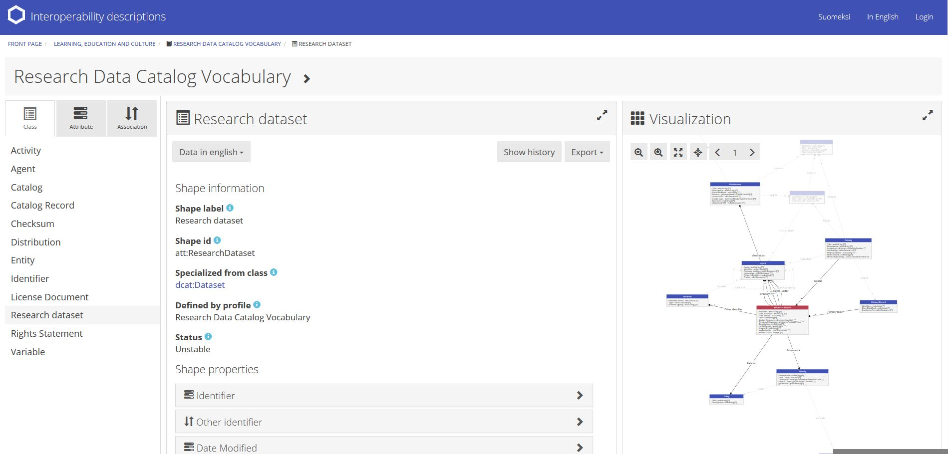
Interoperability workbench
Tool for defining resolvable and machine readable data models
Document the use of data models, standards and best practices
Notes:
Most users are after the application profiles for their own use cases
Open science and research initiative’s metadata working group is currently defining a general metadatamodel for research data, here in the screen shot is showed part of the draft model >> if case you wish to have a closer look, please navigate to the address iow.csc.fi and select the model ”Reserach Data Catalog Vocubulary”.
This model is quite interesting as it based on the European Comissions’s DCAT-AP and is further adapted to suit the field of research and science – it is thus led directly from an international metadatamodel and play a good example of linked data

Slide 14
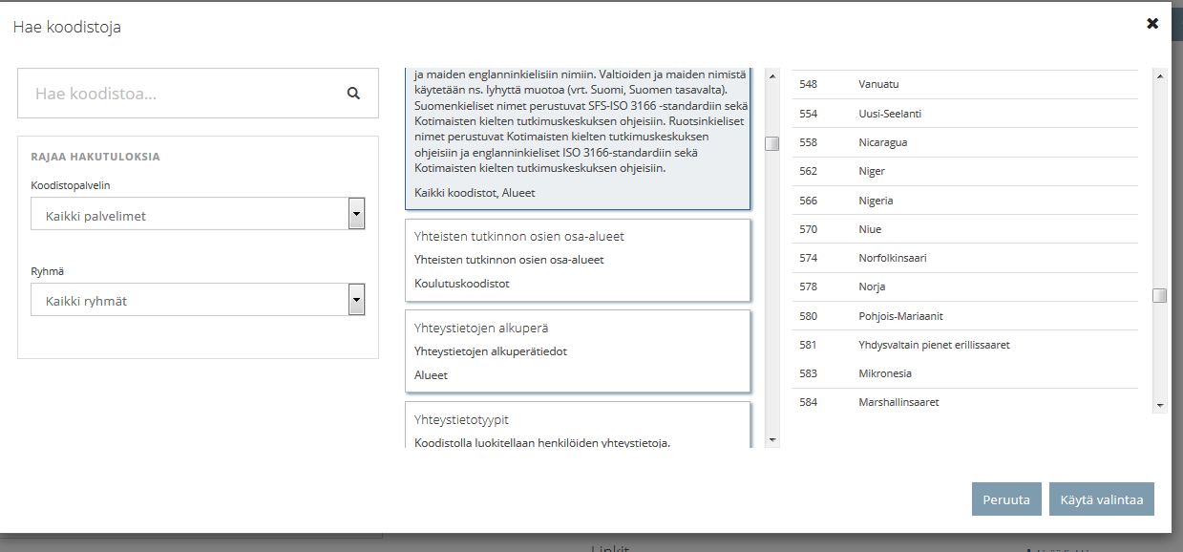
Interoperability workbench
Functionalities – e.g.
Integration to controlled vocabularies
  link controlled vocabularies to created model
  create classes and properties based on existing concepts – ”terminological concepts”
Map new classes and class usage to relevant standards
Integration to classification schemes
  link to existing reference data from code service
  restrict allowed values by using existing reference data
  Import existing models from local models and external namespaces
  Include and search metadata from imported standards
  Create new domain models as highly reusable metadata
  Version history and track changes

Slide 15
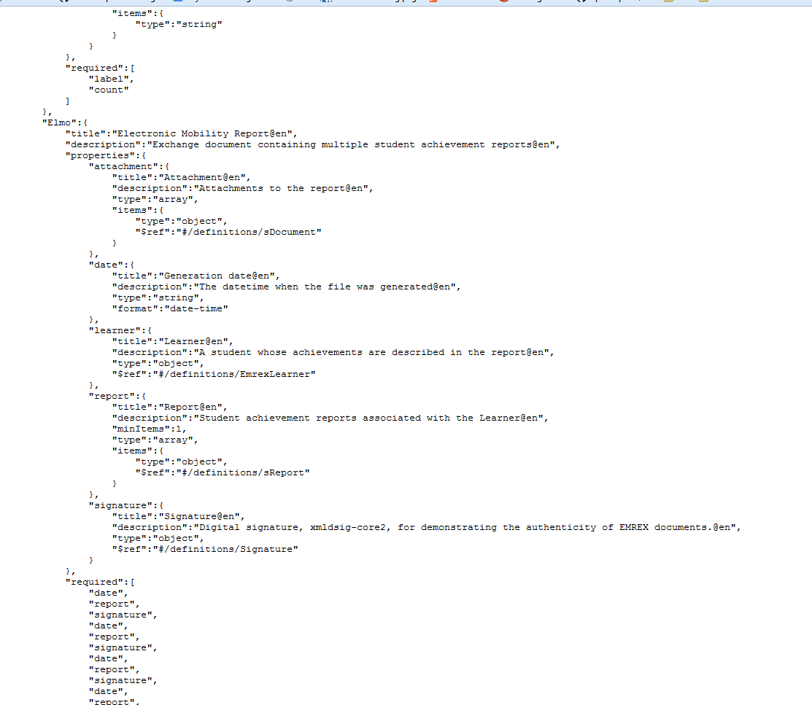
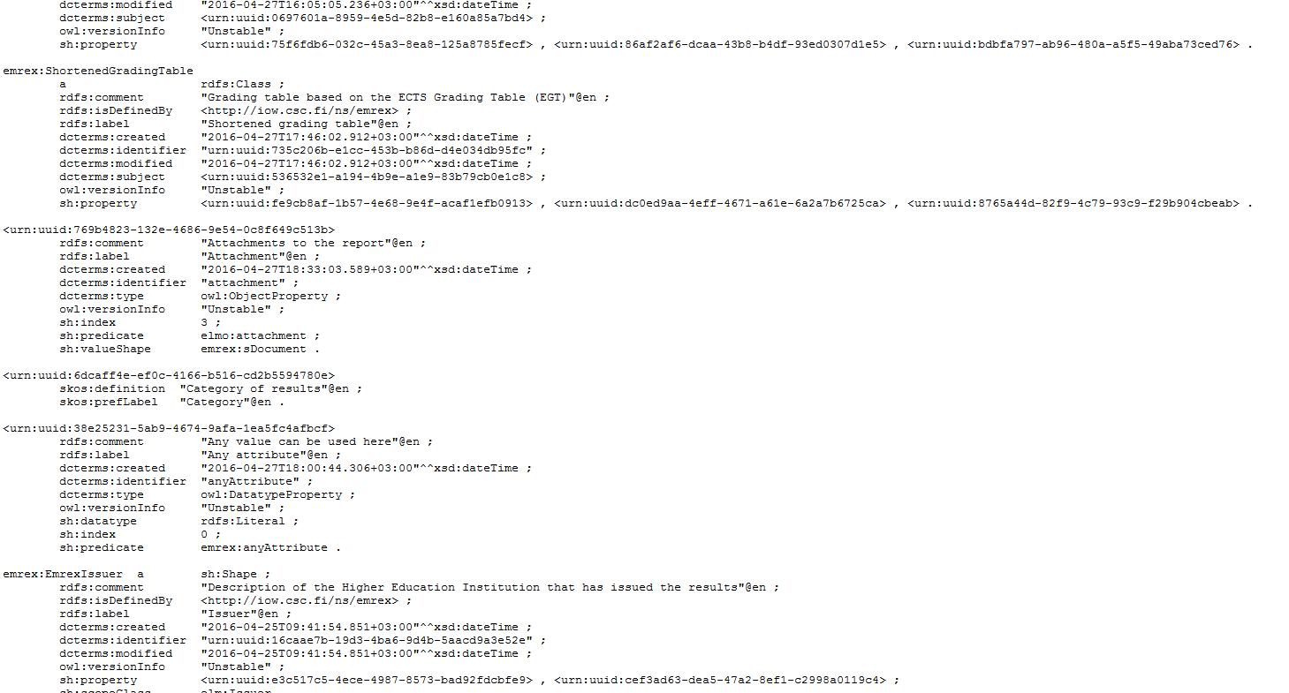
Interoperability workbench
Export schemas in multiple formats
Enforces Naming practices
RDF
XML Schema
tbd …
JSON Schema
15

Slide 16
The closer the used terminology in IT systems supporting researchers
is to common research parlance,
the greater is the possibility that the services
are both semantically interoperable
and, even more important,
understandable to their users.
Notes:
How this all benefits the researchers then? We are able to build better services for them, we argue.

Slide 17
Citizens…
Students…
The closer the used terminology in IT systems supporting (researchers)
is to common (research) parlance,
the greater is the possibility that the services
are both semantically interoperable
and, even more important,
understandable to their users.
Notes:
Study administration and research administration are in many ways interconnected in this matter.
And not only that, in Finland we are building a National Service Architechture, boosted by the Ministry of Finance. The new digital services the National Service Architehture brings, aimed at just ordinary citizens need semantics, mutual understanding of data and information their handle, to perform properly. Sematic Interoperability framework and IOW-tool are planned to be part of digitalisation of public services.

Slide 18
Questions – Feedback?
Thank you!
Suvi Remes¹, Miika Alonen¹, Patrik Maltusch², Mikael af Hällström³, Stina Westman¹
¹ firstname.lastname@csc.fi, ² firstname.lastname@aalto.fi, ³ firstname.lastname@vero.fi
13th International Conference on Current Research Information
Systems, CRIS2016, Scotland, UK, 9.6.2016

