Slide 1
Towards reliable data – counting the Finnish Open Access publications
CRIS 2016, St Andrews, June 10, 2016
Jyrki Ilva <jyrki.ilva@helsinki.fi>

Slide 2
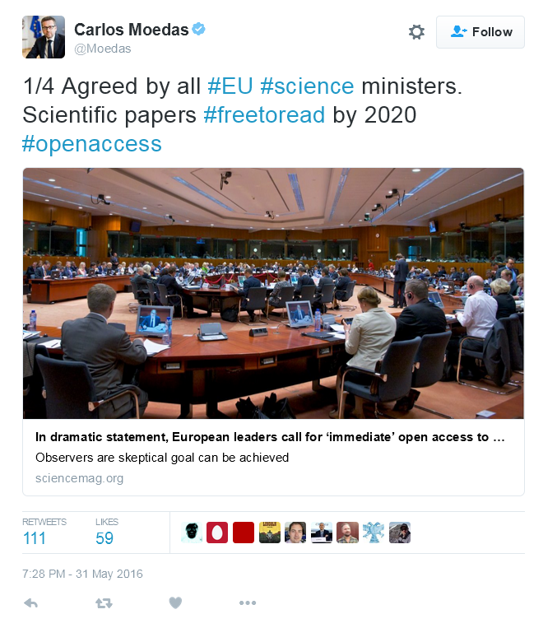

Open Access as a political goal
Open access is moving forward on a European level
In Finland the Ministry of Education and Culture has funded Open Science and Research, a big national project
  Open Access, Open Research Data and Open Research Methods

Slide 3
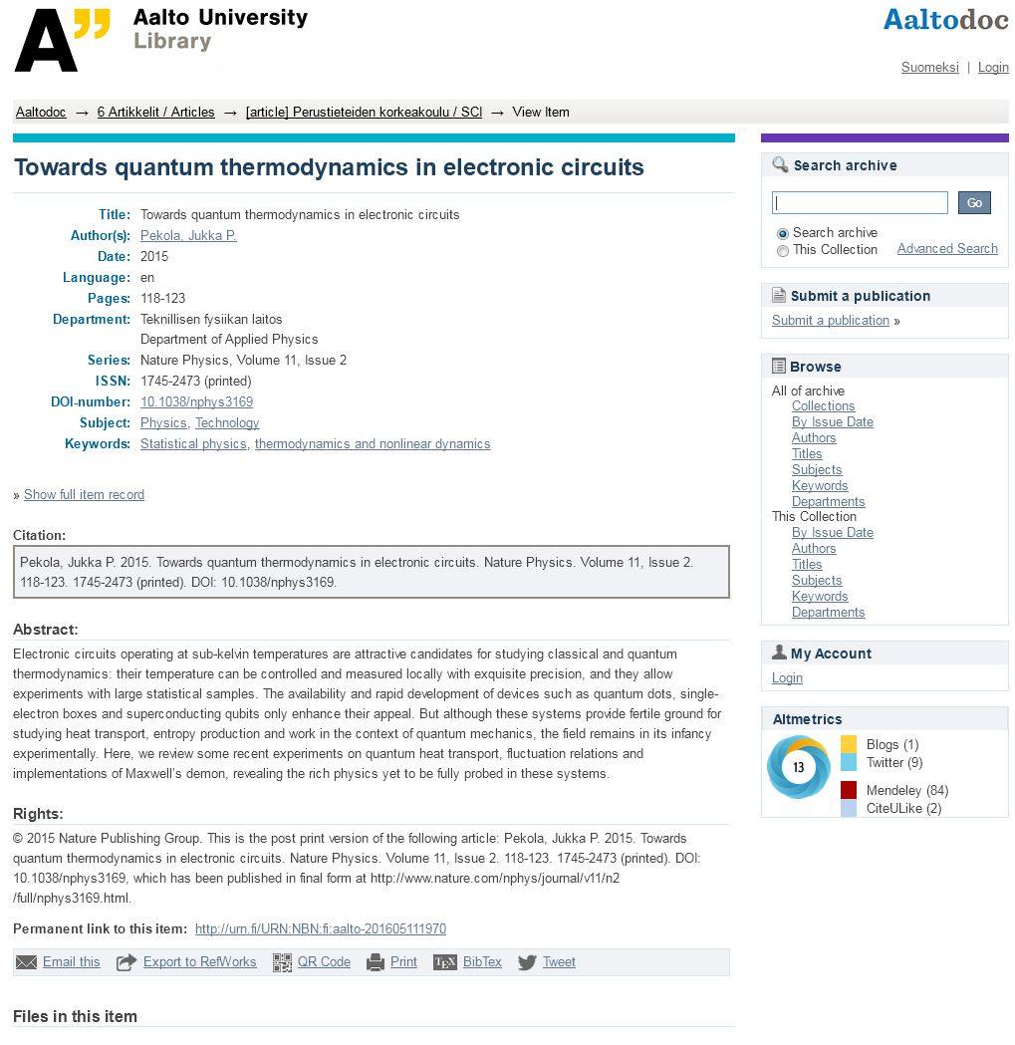
Supporting Open Access in Finland
Quite a lot has been done already
  Finland has a fairly well-developed network of institutional repositories
  Many of the universities have self-archiving mandates
  The Academy of Finland launched an Open Access mandate in 2015

Slide 4
Open Access and state funding?
Would it be possible to use the Open Access availability of research output as a factor in the funding model for the universities?
  Currently 13 % of all state funding for the Finnish universities is distributed based on the number and quality of the publications
  The committee responsible for the university funding model has been discussing this, but no final decision has been made
  Possibly starting from 2019, as the funding is based on the publication data from the previous three years

Slide 5
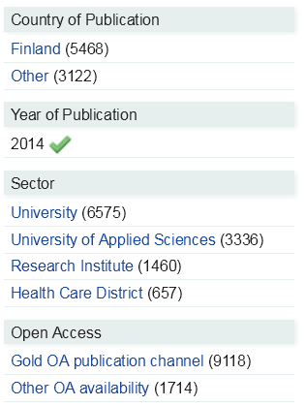
The current amount of OA in Finland?
According to the publication data collected by the Ministry of Education and Culture, the Finnish research organizations produced more than 40.000 publications in 2014
  About 24.000 of all reported publications were peer-reviewed
How many Open Access publications?
  The 2014 data would indicate that about 26% of all reported publications were OA
  18% of all peer-reviewed publications were OA
  19% of the peer-reviewed journal articles were OA

Slide 6
But can we actually trust these numbers?
Unfortunately, a closer look reveals that there are many problems with the data, some of them quite serious
  The definitions that have been used were not clear enough
  As long as the OA status of a publication doesn’t have any financial effect for the organizations, the motivation for collecting and verifying the information remains low
At the moment the OA data is not reliable enough be used as a basis for distributing funding to the universities
The Ministry of Education and Culture has already taken steps to rectify the situation, starting from 2016

Slide 7
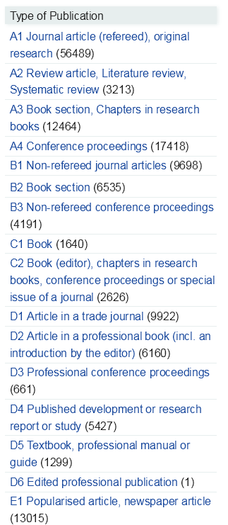
Collecting the publication data (1)
The Ministry of Education and Culture has been collecting publication data from the universities since 2011
  The universities of applied sciences joined the data collection in 2012
  Data collection from the state research institutes and central hospital districts started in 2015
CSC - IT Center for Science is responsible for the data collection
  Close collaboration with the research organizations, the Ministry and the Federation of Learned Societies

Slide 8
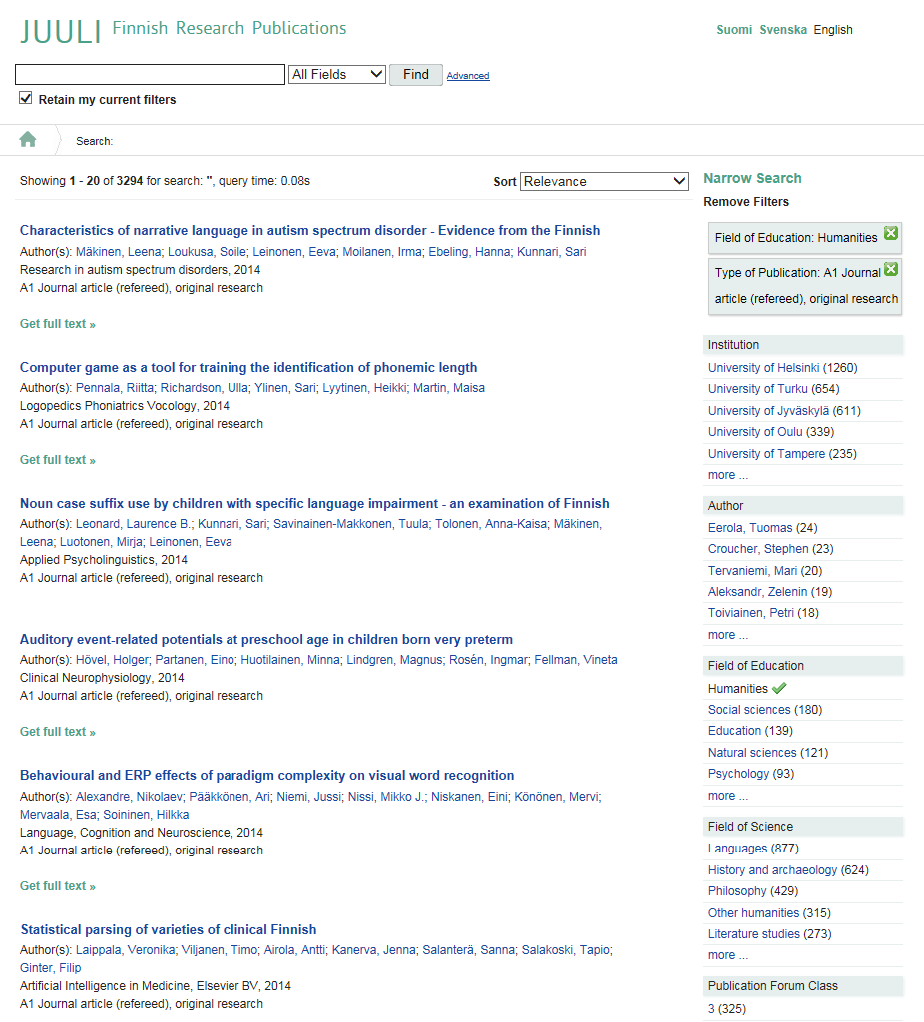
Collecting the publication data (2)
The combined data is available for viewing at Juuli (www.juuli.fi), a national research publications portal developed by the National Library of Finland
The processes of data collection are currently under development
Starting from 2016, the new Virta publication information system will harvest data from local CRISes and provide the de-duplicated data via APIs

Slide 9
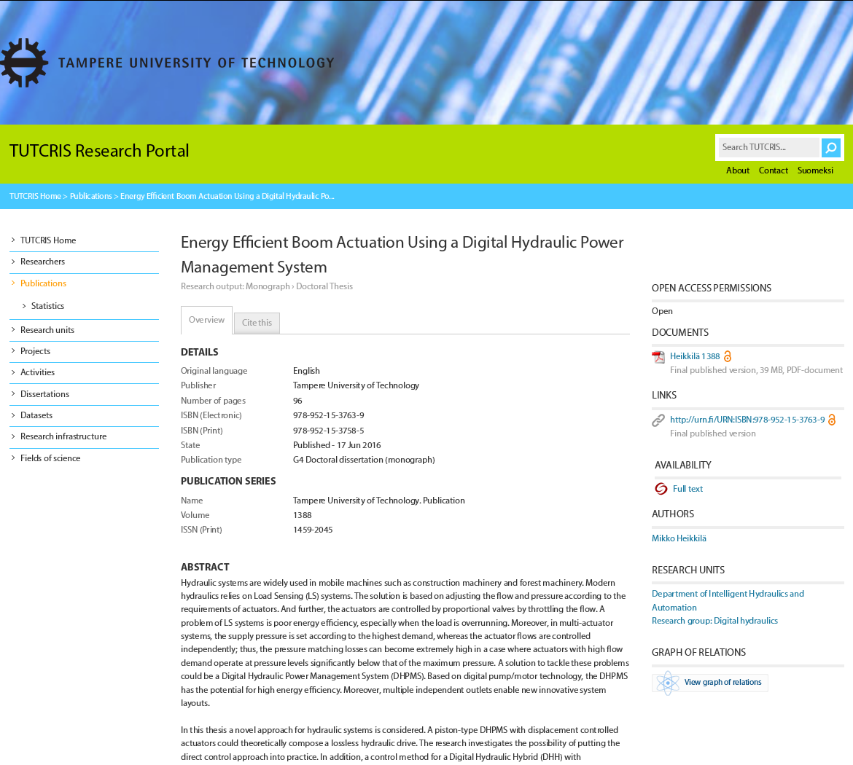
National data collection and the local CRIS
At the university level the growing importance of national data collection has led to a widespread adoption of modern CRIS platforms
  Most of the recently implemented systems have been based on Pure or Converis
However, many of the smaller institutions are working with less sophisticated legacy systems

Slide 10

How to verify the OA status of a publication?
One method is to check the status of each publication individually
  May require quite a bit of resources
The other method is to utilize outside data sources in an automated identification process
  For example, it is possible to identify most of Gold OA journal articles by checking if the journal is listed in Directory of Open Access Journals (DOAJ)
In many cases a combination of these both approaches is likely to produce the best results

Slide 11
Data sources for the Open Access status?
DOAJ covers most of the OA journals actually used by researchers
  However, currently there is no reliable method for articles published in Hybrid OA journals or articles that have appeared as book chapters or in conference proceedings
It is relatively easy to check if the publication is available in the local institutional repository
  If the publication is deposited into a non-local repository, there might not be an easy way to get notification of this
International initiatives like OpenAire, SHARE or CHORUS may prove to be useful
  There is still a lot of work ahead before they are comprehensive or reliable enough

Slide 12
OA status in the national data collection
The fields used for indicating the OA status of the publication were updated starting from 2016
  The aim was to keep the number of required fields small - the collection of new information costs money on the local level
It was decided that there would be two separate fields for indicating the OA status of a publication
  One field indicates whether the publication is OA via a Gold or a Hybrid OA channel
  The second field is used for indicating whether it has been deposited into a repository
There is quite a bit of overlap between Gold and Green OA
  Many of the articles published in OA journals are also uploaded into a repository

Slide 13
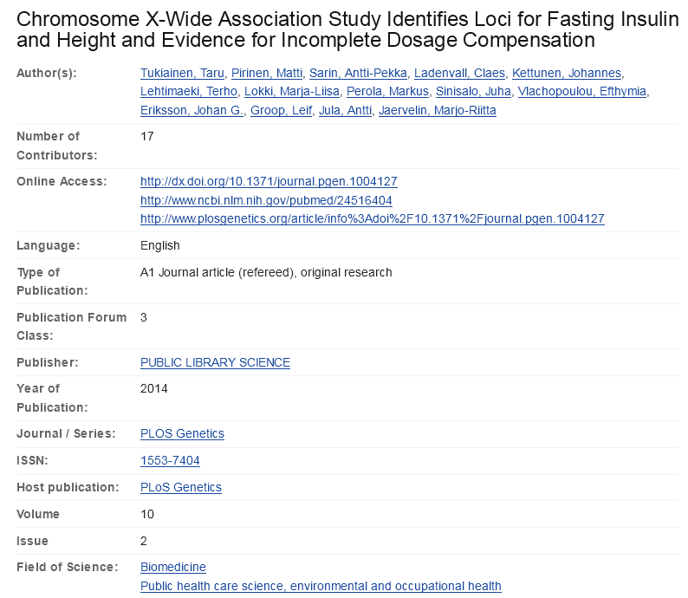
URLs for the open access versions
There should be a URL for each OA version of the publication so that the OA status can be verified
  In the past there was only one field for this: the organizations usually chose to report a DOI leading to publisher’s web site
  There were also cases in which there was no URL provided for publications that were claimed to be OA

Slide 14

What qualifies as Open Access?
It would be very nice to have a short and easy-to-understand definition for Open Access
However, Open Access is actually a relatively complicated issue, with many different flavors
Gold OA?
Green OA?
Hybrid OA?
Gratis OA?
Libre OA?
Embargoes?
Versions?

Slide 15
OA definition for the data collection?
The goal was to come up with a fairly strict definition of OA, which would still be permissive enough to be acceptable for all fields of research

Slide 16
OA definition for the data collection 1/4
“The publication can be read online in full and without restriction, printed out and copied at least for research use”
The publication should be at least free to read (“gratis OA”)
Some of the Open Access advocates stress that all Open Access publications should be published under a CC BY license (“libre OA”) so that their content can be re-used e.g. in text-mining
However, there is no universal agreement on this

Slide 17
OA definition for the data collection 2/4
“The publication is available either a) directly from the publisher's service or b) no later than after the end of an embargo period set by the publisher, through archiving in a repository dedicated to a specific organization or field of science”
Gold/Hybrid and Green Open Access are all accepted
Institutional and subject-based repositories are both OK
Embargoes are allowed for Green OA but not for Gold or Hybrid OA

Slide 18
OA definition for the data collection 3/4
“The publication is freely available from a service provided by either a publisher or research organization that 1) enables the harvesting of the metadata of publications and the indexing of them to other search services, and which 2) supports citations and links to publications preferably using URLs based on persistent identifiers (DOI, URN, Handle)”
Papers posted to a personal or project web site don’t qualify
Although commercial networking services like Research Gate and Academia.edu are very popular among researchers, uploading a paper into them does not qualify as proper Open Access
Persistent identifiers should be used whenever possible

Slide 19
OA definition for the data collection 4/4
“The freely available version of the publication is, depending on the publication contract or publisher's policy, either the author's last self-archived (peer-reviewed) version or the final version published via the publisher's service”
The OA version must be peer-reviewed to qualify
OA pre-prints don’t qualify – which means that in the case of e.g. ArXiV, the researchers must deposit a post-print version as soon as it becomes available to them

Slide 20
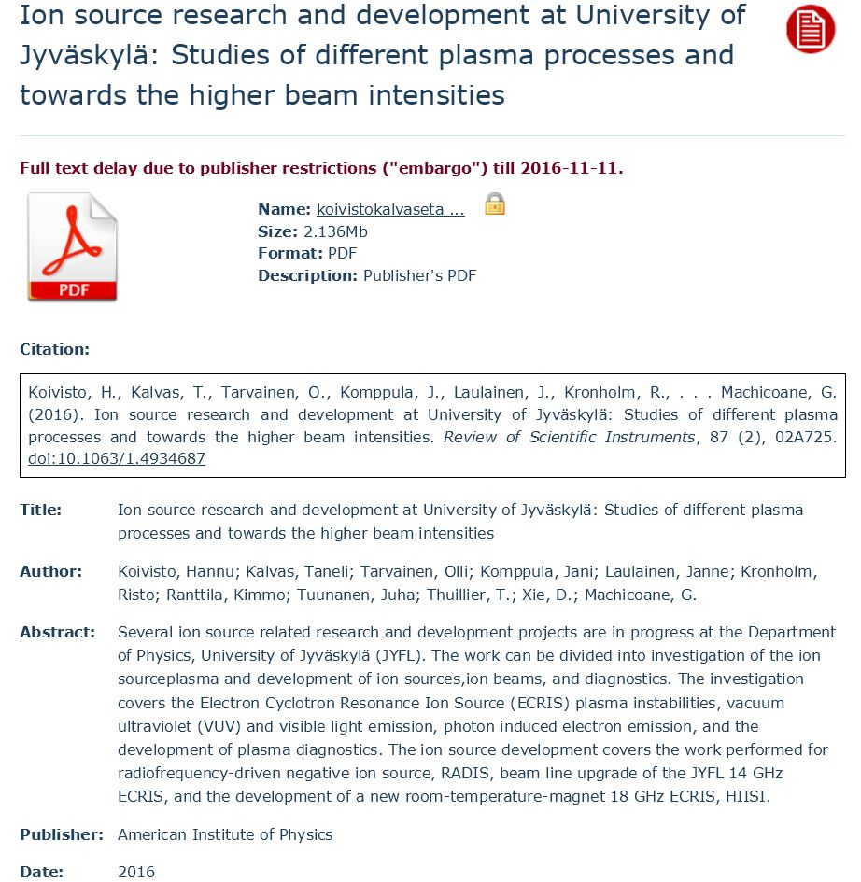
Further policy issues
There are number issues which may require further discussion
Should there be a maximum embargo – or no embargo at all - allowed for Green OA?
Should all publications be deposited into a repository?
Should there be a more strict policy on licensing (gratis OA vs. libre OA)

Slide 21
Towards a seamless flow of information
In an ideal world the OA status information should be transferred automatically from the publishers’ services and repositories to other services
  Linked open data, integration via APIs
  Would benefit both the local, national and international OA monitoring efforts
We can work on this on a national level, but there is a strong need for international co-operation as well

Slide 22
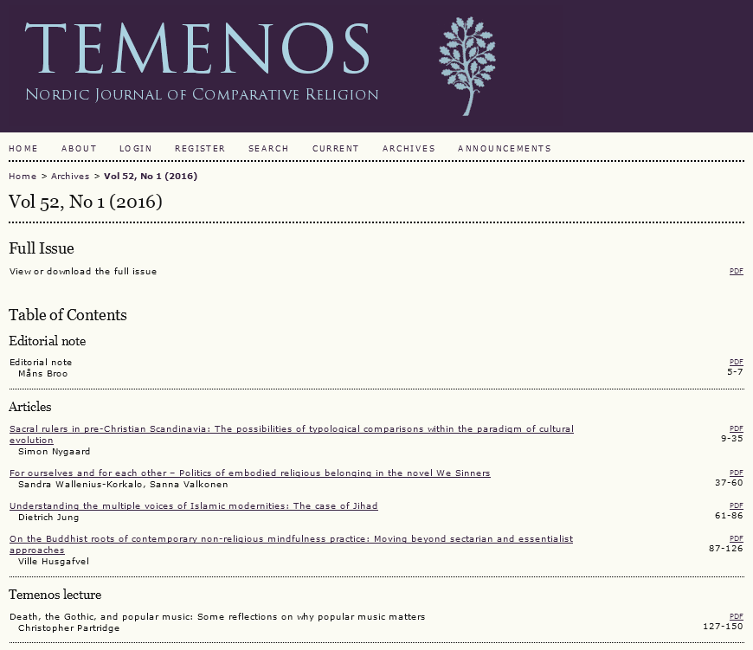
Working with the domestic publishers
A project funded by the Ministry of Education and Culture is providing upgrades to an Open Journal Systems based centralized infrastructure
Adoption of DOIs, ORCIDs, providing metadata for national and international aggregators

Slide 23
Keeping track of the OA costs
A national survey on the management of Article Processing Charges (APCs) at Finnish universities conducted in 2015
  Result: we can make educated guesses on how much we pay, but we don’t really know
  There are countries like the UK which are much further in this
The monitoring of APCs has been out of scope for CRISes
  Would it make more sense to integrate all of this information into one system or build separate systems which share information between each other?
  Will this information be a part of the national data collection at some point?

Slide 24
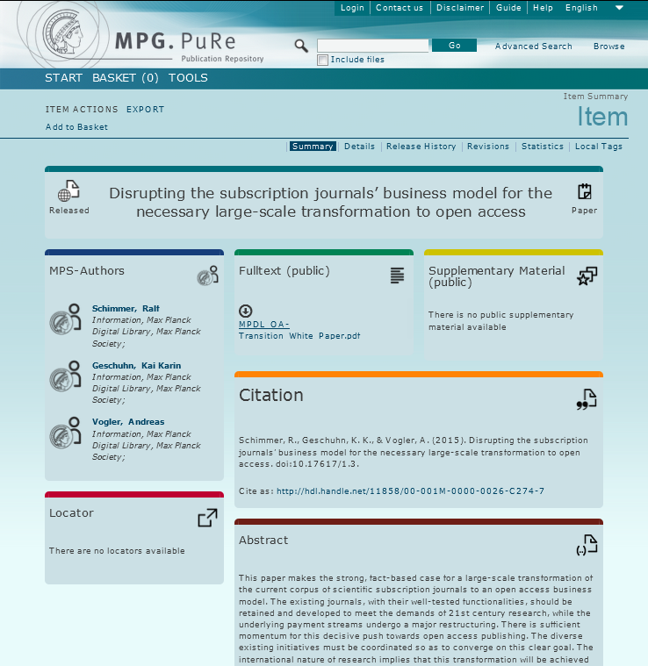
Offsetting deals and the cost of OA
OA monitoring information also essential for the negotiation of large-scale offsetting deals with publishers
  Licensing costs paid from the library budgets: not part of the research management processes served by CRIS
  However, if we move away from the subscription model, there will be a growing need to look at the total costs related to the publication of research outputs

Slide 25
Thank you!

