Slide 1

EUROCRIS
Some figures on Research in France.
11 May 2015
Isabelle Pouliquen,
Professor at Aix Marseille University,
in charge of Information System at the Higher Education and Research Ministry
Géraldine Seroussi,
Deputy Head of the Statistical Studies Department at the Higher Education and Research Ministry
Notes:
Hello, to introduce this French session which begin your annual seminar we are pleased to present you a quick overview of the research landscape in France and corresponding information system. I enjoy to share this time in front of you with Géraldine, an expert of research statistical datas.
I am I Pouliquen, and i am more involved in the information system part and especially in the interoperability of our informations system.
I want begin to thanks the organization of this seminar to let us share with you our context about it and apologize me for my poor english.

Slide 2
OVERVIEW OF FRENCH RESEARCH
1
Notes:
Let’s have a rapid overview about the french research organization.

Slide 3
French National Research and Innovation System
An organisation around 4 main functions
Strategy : national research and innovation policies decision processes, general objectives and public research overall budget.
Programming: Formulation of thematic priorities per sector and resources allocations.
The actual research : implementation of research activities in research bodies, institutions of higher education, ...
Assessment : The « High Council for Evaluation of Research and high Education » HCERES performs assessments of research bodies or ensure assessments quality conducted by other authorities (validates the adopted procedures)
Notes:
The French National Research and Innovation System is organized around four major functions:
Strategy defines national research and innovation policies decision processes, general objectives and public research overall budget,
Programming formulates thematic priorities by sector and allocates resources,
The actual research takes place, as we shall see, in organizations which is the core business, as well as in higher education and research institutions such as universities,
Evaluation and monitoring aimed at evaluating the effectiveness of public policies and the functioning of organizations. The assessment is usually performed by The « High Council for Evaluation of Research and high Education » HCERES.

Slide 4
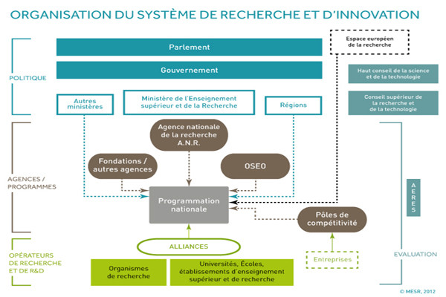
Organisation of the research and innovation system
European Research Area
Parliament
POLITICAL
Government
Other Ministries
Ministry of National Education, Higher Education and Research
Regions
National Research Agency (A.N.R.)
Foundations / other agencies
BPI France
AGENCIES /
PROGRAMMES
HCERES
NATIONAL PROGRAMMING
Poles of competitiveness
Research operators
and R & D
Enterprises
Research institutions
Universities, Schools, Institutions of higher education and research
Notes:
We can represent the functioning as shown in this diagram, on which we find the various functions mentioned but also the stakeholders whose they are in charge.
Thus, we can find the political authorities at the top in blue, especially MENESR, instances that produces for eg the National Strategy for Research and Innovation.
in Brown, there are agencies such as the National Research Agency, which funds research projects .
A the right, we'll find the evaluation function carried by the HCERES but also statistics monitoring, which leads to the types of analysis represented on the following slides.
The subdirection of SIES generates as well public data from surveys but also from information systems and analyzes them such as the following.

Slide 5
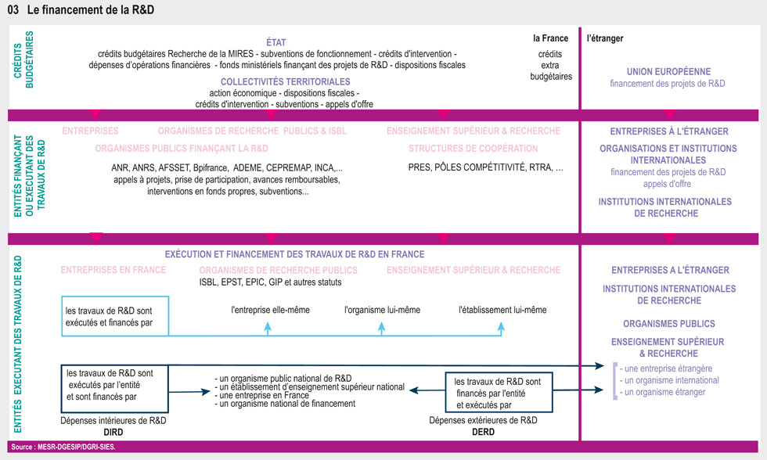
R & D funding
Notes:
We can see here the distribution of research funding origins as stakeholders

Slide 6
Publicy research stakeholders
Notes:
but also the distribution of stakeholders according to DIRDA.

Slide 7
Organisation of the research and innovation system
European Research Area
Parliament
POLITICAL
Government
High Council for Science and Technology
Other Ministries
Ministry of Higher Education and Research
Higher Council for Science and Technology
Regions
National Research Agency (A.N.R.)
Foundations / other agencies
OSEO
AGENCIES /
PROGRAMMES
HCERES
NATIONAL PROGRAMMING
Poles of competitiveness
Research operators
and R & D
Enterprises
Research institutions
Universities, Schools, Institutions of higher education and research
Notes:
Our first diagram finally shows us, in green, research operators, among which alliances that coordinate stakeholders in field and make them close,
then research organizations and higher education and research institutions where research is performed in fact.

Slide 8
Policies linkage - Achievement
The French research policy is conducted by the M.E.N.E.S.R.
Research activities are carried out either in higher education institutions or public research organizations (public research), or private companies (private research).
More than 540 000 peoples working in this sector with at least half are researchers.
A powerful information system is necessary.
Notes:
Led by MENESR, research policy is implemented daily by a large number of very varied institutions, constituting a rich and complex system.
The proper functioning of this system requires of course amounts of information exchange top down as bottom up, for dissemination and implementation of the policy, for its monitoring and evaluation, in terms of resources (financial, humans, ..), of results, but also for the administration and management of the system.
Such exchanges are based on multiple channels of communication and information, ranging from the most open to the most structured, and making up the research information system

Slide 9
RESEARCH STAKEHOLDERS
2
Notes:
Before addressing the French research information system, to allow to understand the complexity, let's look more finely the organization of research from the perspective of its actors.

Slide 10
Where is research achieved ?
Higher education institutions : Scientific, Cultural and Professional Public Establishments, such as universities, PRES, COMUE
Research Bodies (CNRS, …)
«Grandes écoles» and higher education institutions
University Health Centers (C.H.U.),
Associations and Foundations (mainly government founded),
Some public administrative institutions and ministries,
Public interest groups GIP
Notes:
So we are in the green part of our initial diagram.
The staff allocated to public research is in universities, in research bodies but also in PRES, now in COMUE, high schools, CHU, GIP…..
Each of the institutions or organizations mentioned above actually implements its research activities through "research structures or researc units" at several levels, starting with internal teams to more extensive grouping.

Slide 11
Research organisms
including Scientific and Technical Public Establishments (EPST), whose staff are state officers.
such as the CNRS (French National Centre for Scientific Research), IFSTTAR, INED, INRA (National Institute for Agronomic Research), INRIA, INSERM (for health), IRD, IRSTEA.
Industrial and Commercial Public Establishments (EPIC), whose staff are private employees.
ADEME, ANDRA, BRGM, CEA (Atomic Energy Commission), CIRAD, CNES, Ets Public BPI-GROUPE, Ets public du palais de la Découverte et de la CSI, Ets public de Paris-Saclay, IFREMER, IRSN
Notes:
Research bodies themselves are subdivided into Scientific and Technical Public Establishments (EPST), whose staff are state officers, and Industrial and Commercial Public Establishments (EPIC), whose staff are private employees.
This coexistence between state officers and private employees complicates the functioning of organizations and the monitoring of resources and activities

Slide 12
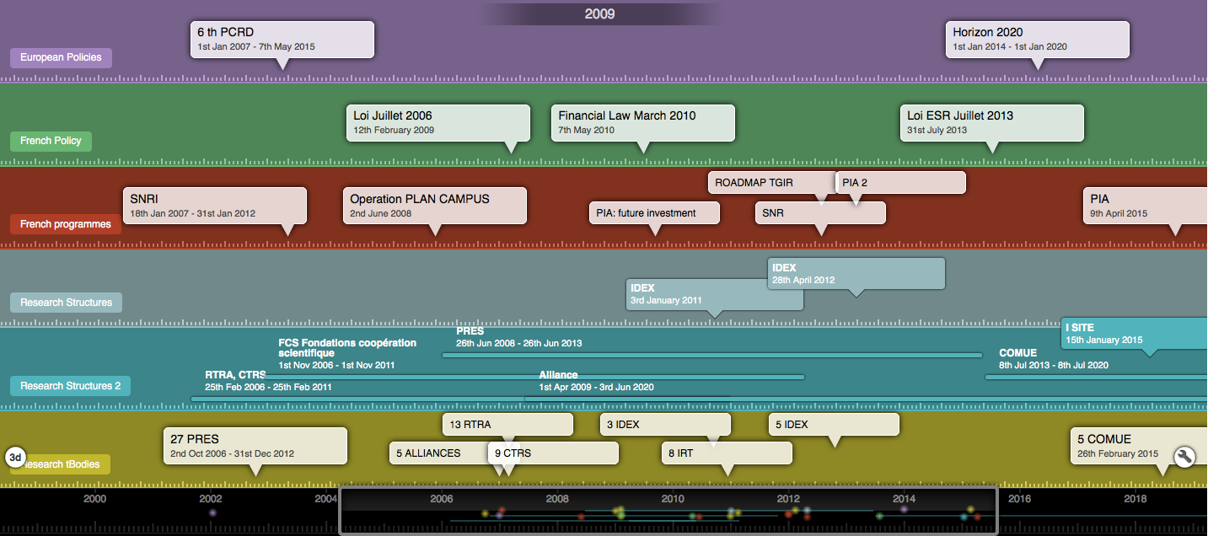
Public Policies and research structures: Timeline
Notes:
As shown in this timeline, public policy over time create new structures.
Thus, under the aegis of European policies, of French policies and strategies, such as SNRI then SNR, programs are set up: Future Investment Programs, IDEX, LABEX ....
These programs are created to develop actions to implement synergies and increase the visibility and efficiency French research.
They lead to the creation of structures which succeed or pile.

Slide 13
Partnerships and Tools
Programs promoting visibility, competitiveness and emergence of new projects such as “future investment program”
PRES between 2006 and 2013,
Poles of Competitiveness (2005, 2009-2012, 2013 -2018)
Alliances in 2009- 2010,
RTRA, CTRS in 2009
IRT,IHU, SATT in 2010
IDEX, Labex in 2011, 2012, 2015,
COMUE and I-SITES today
Notes:
On this slide, we can see the types of structures that were created over time with their dates of establishment:
From PRES between two tausend and six and twenty forteen
alliances in 2009 2010,
IDEX and Labex in 2011, 2012, 2015,
IRT,IHU, SATT 2010
until COMUE and I-SITES today ...

Slide 14
National directory of research structures
RNSR and Concerned Institutions
Institutions Type | Code | Bodies Nb
Universités, INSA et INP | UNIV | 84
Grandes écoles | ECOLE | 61
Autres écoles | AUT_EC | 20
ENS et grands établissements | ENS | 16
Organismes de type EPIC | EPIC | 11
Organismes médicaux | MEDIC | 11
Entreprises privées | PRIVE | 9
Organismes de type EPST | EPST | 8
EPA, GIP, organismes avec autre statut | EPA | 7
Ministères | MIN | 7
IEP | IEP | 6
Fondations | FONDATION | 4
Autres établissements | AUTRE | 3
Ecoles françaises à l'étranger | EC_ETR | 2
Observatoires | OBSERV | 2
ESPE ou IUFM | ESPE-IUFM | 2
PRES ou COMUE | PRES-COMUE | 1
UFR ou composantes d'universités | UFR | 1
INHA | INHA | 1
about 4000 research structures out of 256 institutions (with at least one active research structure).
Notes:
Research organizations and corresponding agencies are listed in the RNSR, national directory of research structures, thus constituting the backbone of Research Information System .
These research structures are about for tausend out of two hundred fifty six institutions (with at least one active research structure).

Slide 15
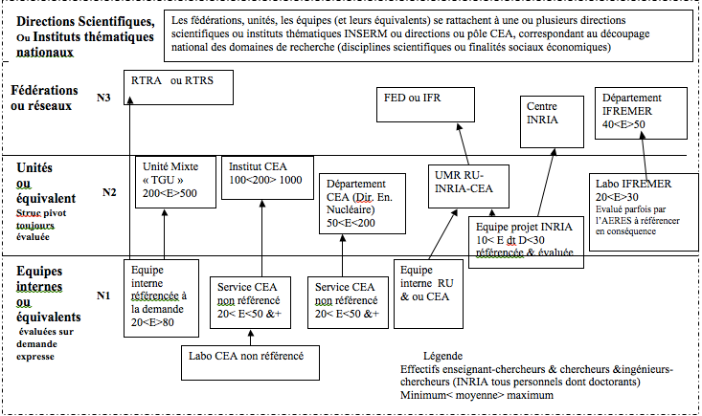
Structure Levels
Notes:
Each of the research institutions or organizations in fact puts out its research activities through "research structures or units" at several levels, starting with internal teams to more extensive combinations.
This table, currently under review, shows the distribution of research structures in the three levels from the internal team, Level 1, comprising 20 to 80 people, to the RTRA, federations, departments ... involving several teams or laboratories in research themes.

Slide 16
RNSR and Operational Structures
The RNSR lists today 3838 structures including 3271 structures from level 2.
Notes:
The pivot level of French research is the level 2 “research units”.
They constitute the bulk of the research structures itself.
The RNSR lists today three thousand eight hundred thirty eight structures including three thousand two hundred and seventy one structures from level 2.

Slide 17
Composite Structures between research bodies
Level 2: very large units (TGU), departments, institutes ...., joints research units (UMR, which are the most numerous) depending on the agencie(s) involved
 | ADEME
ADEME | 1 | ANDRA
ANDRA |  | 1 | BRGM
BRGM |  | 1 | 8 | CEA
CEA |  |  | 1 | 157 | CIRAD
CIRAD |  |  |  | 1 | 48 | CNES
CNES |  |  |  | 3 | 1 | 15 | CNRS
CNRS |  | 1 | 7 | 100 | 16 | 14 | 1709 | CSTB
CSTB |  |  | 1 |  |  |  | 1 | 1 | IFREMER
IFREMER |  |  |  | 1 | 1 |  | 16 |  | 105 | IFSTTAR
IFSTTAR |  | 1 | 2 |  |  |  | 10 | 1 |  | 45 | INED
INED |  |  |  |  |  |  | 2 |  |  |  | 14 | INERIS
INERIS |  | 1 | 1 | 1 |  |  | 2 |  |  | 1 |  | 4 | INRA
INRA |  |  | 3 | 14 | 27 | 2 | 125 |  | 3 | 1 |  | 2 | 387 | INRETS
INRETS |  |  |  |  |  |  | 1 |  |  |  |  |  |  | 3 | INRIA
INRIA |  |  | 1 | 10 |  |  | 48 |  |  | 2 |  |  | 6 |  | 226 | INSERM
INSERM |  |  |  | 28 |  |  | 270 |  | 1 | 2 | 3 |  | 43 |  | 10 | 574 | IRD
IRD |  |  | 2 | 7 | 16 | 8 | 68 |  | 9 | 2 | 1 | 1 | 24 |  | 1 | 6 | 89 | IRSTEA
IRSTEA |  | 1 | 4 | 2 | 3 |  | 12 |  |  | 2 |  | 3 | 8 |  |  |  | 5 | 40 | ONERA
ONERA |  |  |  | 3 |  | 2 | 9 |  |  | 1 |  |  | 1 |  | 1 |  | 1 | 1 | 9
Number of units between 2 organisms
Notes:
Research structures can be entities under the supervision of one research organism, but the most of them depend on several organisms together.
The following diagram shows that the number of structures that include at least two research bodies is important (in red agencies with more than 10 structures in common).
This character of multiple supervision is underrepresented here, because universities do not appear, while most of the units are also under university partnership.

Slide 18
How research structure work
Various projects
Groups, partnerships
ANR
Contracts
FUNDING
RESEARCH STRUCTURE
Univ4
Org 4
Contractualization
Univ3
Org 3
Univ2
MENESR
Org 2
Univ1
Org 1
Other Ministries
Notes:
A research structure (center of this figure) is in a typical configuration related to one or more universities, one or more research organizations, can work in a federation, with a covenant and meet one or more line ministries. It can be financed, beyond its contractual funding, by projects, contracts ...
These groupings research units operate under particularly flexible legal framework, under simple contract with one or more partners without actually leading.
In each unit, informations systems and management systems of various partners coexist.

Slide 19

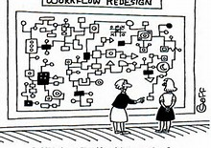






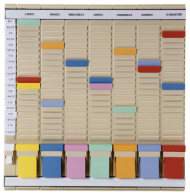

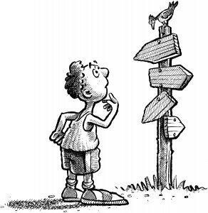
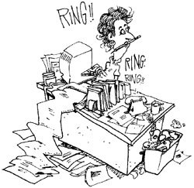
A complex organization
Notes:
The director of a research structure will have to take into account the guidelines, strategies and policies, declined since the SNRI, but nevertheless specific for each of its partner.
It will also take into account the procedures, instructions and various calendars of these organizations, whose rate of operation, schedules and contract management are not consistently aligned.
Of course, this multiplicity of cultures and modes of operation will allow the laboratory director to access various financing, complementary, from different sources, but also to manage a synergy because of different cultural operations, making it the whole point.

Slide 20
Data Exchanges
Various projects
Groups, partnerships
ANR
Contracts
FUNDING
RESEARCH STRUCTURE
SI 2
SI 3
SI 4
Data exchange
Univ4
SI 1
Org 4
Univ3
Org 3
Univ2
Org 2
Univ1
SI 5
Investigations
Org 1
MENESR
Notes:
But all this requires an organization based in particular on information exchange.
Thus the research structure will exchange informations with multiple partners and together form the research information system.

Slide 21
Information Systems
3
Notes:
The information that can be collected and aggregated at the national level will come from a part of the investigations conducted by MENESR on research and development themes.

Slide 22
R&D surveys
Two types of surveys:
  Statistical surveys
  Administrative surveys
The statistical surveys follow the 51 Law:
  One compulsory statistical survey sent to 11 000 enterprises
  A non-compulsory statistical survey sent to private non-profit organisations and fondations (like Pasteur, Curie, Fondation of France,…)
Notes:
This produces two types of surveys:
statistical surveys and administrative surveys
The statistical surveys follow the 51 Law:
One compulsory statistical survey sent to 11 000 enterprises
A non-compulsory statistical survey sent to private non-profit organisations and fondations (like Pasteur, Curie, Fondation of France,…)

Slide 23
Administratives surveys sent to public organisations
Survey sent to High Education entities under the supervision of the ministry of National Education, High Education and Research (MNEHER), in particular, the Universities
Survey sent to High Education entities under the supervision of other ministries than ours (for example, the Polytechnique School, the Agriculture schools or other Engineering schools)
Surveys sent to teaching hospitals and Centers of fight against cancer
Surveys sent to public research organisations and ministerial services or departments
Notes:
The administratives surveys sent to public organisations are :
Survey sent to High Education entities under the supervision of the ministry of National Education, High Education and Research (MNEHER), in particular, the Universities
Survey sent to High Education entities under the supervision of other ministries than ours (for example, the Polytechnique School, the Agriculture schools or other Engineering schools)
Surveys sent to teaching hospitals and Centers of fight against cancer
Surveys sent to public research organisations and ministerial services or departments

Slide 24
SI Organismes
Attached files and Forms
Assessments, projects
UR, ED
SI HCERES
Attached files and Forms
Assessments, projects
UR
PELICAN
Assessment
Nb publishing researchers
UR
SI Etab. ESR
Attached files and Forms
Assessments, projects
UR, SF, ED
Attached files and Forms
Projects
UR, ED
Data
Active UR
ED
SYMPA
SIREDO Contrats
SIREDO ED
RNSR
Data
Labellised UR
Enquête ED
Infocentres
PAPESR
PES
CPER
Data accredited
ED
expertise internationale
Annuaire ED, UR
SI ANR
SDT
Base SIREDO
Notes:
Besides these statistical surveys, are the applications of the research information system.
This information system, simplified here, clearly shows the complexity.
You can see the nationals plateforms in blue
The universities information systems in purple
The researc bodies information systems in green
A substantial number of data is exchanged in unstructured form (assesments, research projects),
This data are the subject of several exchanges between different actors,
creating multiple entries, situations of risk of errors and difficulties to aggregate and consolidate information.

Slide 25
Operators IS
AMUE
COCKTAIL
INTERNAL DEVELOPMENTS
OTHER EDITORS
Notes:
Different operators are working to equip these exchanges, and the applications have been made over time, at different speeds, following needs of the different organizations and institutions, their means and strategies.
The development of applications is realized in most cases either by AMUE or by cocktail association, or by internal development.
It uses some private publishers but relatively anecdotally.
Developments not dating the same periods, being based only on rare references and classifications, and make it difficult to implement automated data exchange or aggregate the data collected.

Slide 26
Findings and needs
Multiples entries, in various forms
Multilateral exchanges
Consolidation work and fragmented quality implementation
No fully and reliably Consolidating Unity
To take into account the context of developments: IS to evolve
Visibility increasing need, traceability
A need to strengthen the information, disseminate, compare, assess ...
Notes:
Today, and given the many changes in the context of research in France, information systems must evolve to meet a growing need for visibility, traceability, reporting ... in order to consolidate information, disseminate and exploit it for comparison purposes, steering research

Slide 27
JOINT PROJECTS
4
Notes:
With these findings, under the leadership of MENESR, a national organization of IS was born in 2014.

Slide 28
National Organization of IS
National Digital Coordinating Committee
4 STEERING COMITTTEES
Education
IS
Infrastructure and Services
BSN, research libraries
Consult and adopt joint decisions
Sharing experiences, perform mutualization
Novembre 2013 IS Research. Reflection around a shared IS Research, submitted by AMUE
Notes:
It includes a director of digital ESR Committee, which is based on four steering committees in the areas of training, SI, infrastructure and services, and research libraries to make decisions notably to govern this type of difficulty, promote consultations, sharing of experiences and pooling.
The ESR IS steering committee has recently launched a number of joint projects, including that of a shared repository presented to information system steering comitee in November 2013 by AMUE.

Slide 29
Issues for partners and benefits of a shared repository
Managing complexity of the Combined Research Unit (UMR) and act on the simplification and improvement of the administrative management of research
For laboratories
- A complete and reliable IS
- Consolidated data available
- Improved quality of information
- A decrease of project costs
- The facilitation of existing and future common projects
- The sharing of data
A consolidated and shared common view of Data from combined units
Avoid multiplication of costs and local solutions by offering the provision of shared reference data
Allow the sharing of consistent and comprehensive information responding to the need for single entry of information in IS
Facilitate interoperability between institutions avoiding often complex multilateral exchanges data to implement
Organize the sharing of data by bringing together in a shared repository
For institutions
carrying projects
For collaborative
projects
© Amue 2013
COPIL SI ESR 04/11/2013
Notes:
This presentation Included the findings made above , about it will be discussed later

Slide 30

Target Vision on shared research information system
LABORATOIRES
CNRS
(Direction)
UNIVERSITES
(Direction)
INSERM
(Direction)
SI UNIVERSITE
IRD
(Direction)
MESR ?
… ?
SI UNIVERSITE
SI IRD
SI UNIVERSITE
SI UNIVERSITE
Build a unique and shared IS for research, containing available information for various stakeholders: labs, institutions, organizations and ministry
PILOTAGE
PILOTAGE
GRH
GFC
PAT
SI RECHERCHE PARTAGE
PILOTAGE - DECISIONNEL
GRH
GFC
PAT
FVE
RECH
SI partagé
RECH
SI partagé
CAPLAB
GESLAB
DIALOG
REFERENTIELS SI UNIVERSITE
REFERENTIEL SI IRD
autres
autres
SI CNRS
REFERENTIEL
PARTAGE
Personnes
Structures de recherche
SI INSERM
PILOTAGE
PILOTAGE
GRH
GFC
PAT
GRH
GFC
PAT
RECH
SI partagé
RECH
SI partagé
SI MESR
REFERENTIEL SI CNRS
RNSR
REFERENTIEL SI INSERM
© Amue 2013
COPIL SI ESR 04/11/2013
Notes:
It also proposed a target vision for a shared research information system

Slide 31
Information System Mutualization
CAPLAB, shared tool by research units and their support institutions (universities and organizations), would allow activities description, carried out within units and provide data for best monitoring and managing research activities.
GESLAB financial management tool of research unit
DIALOG (shared budget process)
CONDITOR The goal of Conditor project is to list all of the scientific production (articles, books, conferences, theses, reports ...) of Higher Education and Research community.
Notes:
In continuation of this presentation, actions have been initiated and are ongoing with the implementation of several applications such as caplab, geslab or dialog, applications which we will talk to you later today.
Other initiatives are under way, for example on the subject of the census of scientific production.

Slide 32
RNSR: National Catalogue of Research Structures
The RNSR is a program administered by MENESR that references all government operational research structures at national level.
it contains :
  Research unit (Composite structures, organisms own structures, host teams) and equivalent structures EPIC,
  Federative structures (RTRA, CTRS, IFR, Research federations, …).
Since sept 2013:
  Direct power supply by agencies and institutions.
  Publicy available Application
Notes:
Meanwhile, under the guidance of MENESR, substantive work is done for the improvement and evolution of RNSR that reference all public operational research structures .
Today, the RNSR is directly provided by organizations and institutions, to mandatory annual fixed date by campaign.
This application is also public available

Slide 33
RNSR figures
3838 active structures in 2015
  3271 of level 2
With around 9000 cumulative tutorships (in the broadest senseat).
Whose (level 2):
  1668 for CNRS (mostly joint with one or several universities)
  446 for INSERM
  273 for INRA
Notes:
This directory now lists thirty eight thirty eight active structures for eighty nine eighty two cumulative supervisions.
Mostly of the structures depends from one or several universities

Slide 34
    RNSR structuring element of Research IS
Provide each structure of a "civil status":-recognized by all stakeholders (MENESR, HCERES, ANR, universities, agencies ...) and clearly identified as well as its tutorships
Linking the SI between agencies, universities through national login that allows to bring closer multiple identifications
Linking the IS agencies, universities, the MENESR with the agencies (HCERES, ANR)
Arrange thus unifying items required to reconcile data from different research institutions at national, regional and local level
Notes:
The RNSR delivers to each structure a single national ID that is intended to be reused by all the Research IS bricks.
It will allow to articulate the differents informations systems and to have unifying elements to reconcile data from different institutions at local, regional and national areas.
There is a strong structuring element of the Research IS

Slide 35
Consistency frameworks
Their aim
Interoperability of IS
Expected result :
through the harmonization of concepts and classifications, as well as data exchange tools, interoperability in each management area:
inside establishment or organization, between organizations and business, and between the Ministry and the institutions and agencies.
Notes:
Finally, to overcome the difficulties related to standards and nomenclatures to approach the expected interoperability of IS, we are working on coherence frameworks
This work is carried out by research actors, under control of MENESR

Slide 36
Method
Common definition of processes implemented
Identification of ”objects" used
Identification of data flows (current or useful, based on the needs of the actors)
Structure and classification of data exchanged
Collaborative work involving all actors
Notes:
It comes in a consensus process to harmonize concepts and classifications,
define a common way the process used to identify the "objects" used and the data flow (current and depending helpful the needs of actors) and to define the structure and classifications of data exchanged

Slide 37


Present status
Work converged with those of EUROCRIS
Consistency frameworks
Establishment - update - Content
Consistency framework technical choices component
Consistency framework HR component
Consistency framework schooling component
Consistency framework Research component
V1 Novembre 2008
V1 2008. Travaux 2009
V1 février 2006. V2 June 2012. Updates on going
On going
Notes:
Coherence frameworks are thus made by business areas, a meta framework complementing all for exchanges between areas.
We have worked on the technical coherence framework (2008),
the human resources component (updating),
and are currently working on an update of the coherent framework Education Student Life
and writing research coherence framework .
These studies are consistent with those that concern euroCRIS, and it is with great interest that we will follow your debates and conferences

Slide 38
THANK YOU FOR YOUR ATTENTION
Notes:
I apologize for the quality of my English and hope you could nonetheless follow my presentation

