Slide 1


An Overview of the Research Information Metadata Ecosystem
http://www.engage-project.eu/engage/wp/
Prof Keith G Jeffery
keith.jeffery@keithgjefferyconsultants.co.uk
©Keith G Jeffery
An Overview of the Research Information Metadata Ecosystem
euroCRIS Strategic Seminar 2013
1

Slide 2
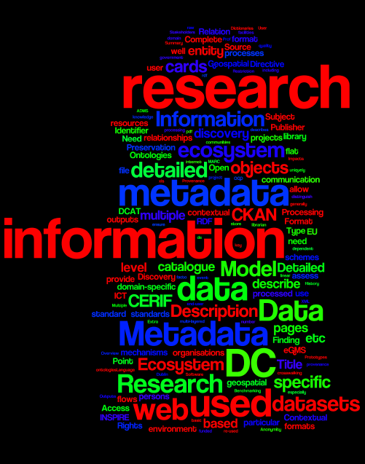
Structure
An Overview of the Research Information Metadata Ecosystem
Acknowledgements to
©Keith G Jeffery
An Overview of the Research Information Metadata Ecosystem
euroCRIS Strategic Seminar 2013
2

Slide 3

Research Information
Who are the Stakeholders
What is it used for
What is it
What is available / useable
Acknowledgements to UKOLN and
©Keith G Jeffery
An Overview of the Research Information Metadata Ecosystem
euroCRIS Strategic Seminar 2013
3

Slide 4
Stakeholders and Usages
Researchers
Research Managers
  Research institutions
  Funders
Innovators
Media
Public
CV, bibliography, web pages, cooperation
Management decisions
Reporting
Benchmarking
Evaluating
Finding reviewers
Ideas to exploit
Communicating ‘stories’
Being informed, ‘citizen science’
©Keith G Jeffery
An Overview of the Research Information Metadata Ecosystem
euroCRIS Strategic Seminar 2013
4

Slide 5
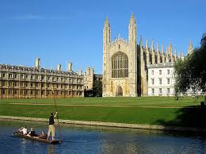
What is it?
Organisations
Persons
Projects
Funding
Facilities
Equipment
Events
©Keith G Jeffery
An Overview of the Research Information Metadata Ecosystem
euroCRIS Strategic Seminar 2013
5

Slide 6
What is it?
Organisations
Persons
Projects
Funding
Facilities
Equipment
Events
Outputs
  Publications
  Products
    Datasets
    Software
    Artifacts
  Patents
Outcomes
Impacts
©Keith G Jeffery
An Overview of the Research Information Metadata Ecosystem
euroCRIS Strategic Seminar 2013
6

Slide 7
What is it?
Organisations
Persons
Projects
Funding
Facilities
Equipment
Events
Outputs
  Publications
  Products
    Datasets
    Software
    Artifacts
  Patents
Outcomes
Impacts
And role-based, temporal, spatial relationships between them
©Keith G Jeffery
An Overview of the Research Information Metadata Ecosystem
euroCRIS Strategic Seminar 2013
7

Slide 8
What is available / useable
Trust
Security
Privacy
  Anonymity
Commercial Protection
Do you trust information from the university, person, publisher?
Is (some of) the information unavailable
Under what conditions can it be used
Is it lawful to access, process, communicate the information
  Can the information be processed to ensure anonymity
Licences, contracts
©Keith G Jeffery
An Overview of the Research Information Metadata Ecosystem
euroCRIS Strategic Seminar 2013
8

Slide 9
Structure
An Overview of the Research Information Metadata Ecosystem
Acknowledgements to
©Keith G Jeffery
An Overview of the Research Information Metadata Ecosystem
euroCRIS Strategic Seminar 2013
9

Slide 10
Metadata
Description of some objects in the real world
  Not only web pages
  Not only scholarly publications
  Not only data
©Keith G Jeffery
An Overview of the Research Information Metadata Ecosystem
euroCRIS Strategic Seminar 2013
10

Slide 11
Metadata
Description of some objects in the real world
  Not only web pages
  Not only scholarly publications
  Not only data
  Also persons, organisations, projects, funding, facilities, equipment, events
©Keith G Jeffery
An Overview of the Research Information Metadata Ecosystem
euroCRIS Strategic Seminar 2013
11

Slide 12
Metadata
Description of some objects in the real world
  Not only web pages
  Not only scholarly publications
  Not only data
  Also persons, organisations, projects, funding, facilities, equipment, events
  In the e-Research context in roles:
    Users (persons)
    Processes (products or services)
    Data (products)
    ICT platforms (facilities or services)
©Keith G Jeffery
An Overview of the Research Information Metadata Ecosystem
euroCRIS Strategic Seminar 2013
12

Slide 13
Metadata
Data about data (DCMI defintion)
  Unhelpful!
Analogy of user of library
Somehow describes internet resources for the end-user
Library User Internet User
Catalog card
Meta
data
Book on shelf
Internet
Resource
©Keith G Jeffery
An Overview of the Research Information Metadata Ecosystem
euroCRIS Strategic Seminar 2013
13

Slide 14
Metadata
Consider a library
  Catalogue cards
  Books on shelves
To researcher or reader the catalogue cards are metadata
  Describe the book and point to where it is on the shelf
  Descriptive and navigational metadata
To librarian catalogue cards are data
  use catalogue cards to count number of books on ‘information technology’
So do not distinguish data and metadata except by how used
User Librarian
Catalog card
report
Book on shelf
©Keith G Jeffery
An Overview of the Research Information Metadata Ecosystem
euroCRIS Strategic Seminar 2013
14

Slide 15
Classification of Metadata
No really satisfactory classification : dimensions required:
Finding and Using
  Navigation
  Description
  Restriction
Processing
  Schema (validation)
  Detailed domain-specific metadata
    Precision, accuracy, calibration etc
Supporting
  Vocabularies
  Thesauri
  Ontologies
Maintaining
  Preservation
  Provenance
©Keith G Jeffery
An Overview of the Research Information Metadata Ecosystem
euroCRIS Strategic Seminar 2013
15

Slide 16
Broader Picture: e-Science
Complete cohort of researchers, research managers, innovators, media
User Model
interaction with data, processing, persons
Processing Model
providing what the user requires
Data Model
representing research
Resource Model
representing ICT
Complete ICT environment for research
©Keith G Jeffery
An Overview of the Research Information Metadata Ecosystem
euroCRIS Strategic Seminar 2013
16

Slide 17
Broader Picture: e-Science
Complete cohort of researchers, research managers, innovators, media
User Model
interaction with data, processing, persons
Virtualisation
providing what the user requires
Processing Model
Data Model
representing research
Resource Model
representing ICT
Complete ICT environment for research
©Keith G Jeffery
An Overview of the Research Information Metadata Ecosystem
euroCRIS Strategic Seminar 2013
17

Slide 18
Broader Picture: e-Science
Complete cohort of researchers, research managers, innovators, media
User Model
interaction with data, processing, persons
Processing Model
providing what the user requires
This is all metadata
Data Model
representing research
Resource Model
representing ICT
Complete ICT environment for research
©Keith G Jeffery
An Overview of the Research Information Metadata Ecosystem
euroCRIS Strategic Seminar 2013
18

Slide 19
Metadata Standards
There are hundreds of specific formats used as a ‘standard’ within a specific communities but some used widely are:
DC (Dublin Core): used to describe web pages ➔ web resources
CKAN (Comprehensive Knowledge Archive Network): used in government open data sites – based on DC
eGMS; e-Government Metadata Standard – based on DC
DCAT (Data Catalog): used for datasets on the web – based on DC
INSPIRE : used for datasets with geospatial coordinates
  EU Directive and standard; some overlap with DC but extended
ADMS (Asset Description): W3C/EC; specialises DCAT
CERIF (Common European research Information Format): used for all research information
(blue = ‘flat’, green = RDF, purple = semantic-rich)
©Keith G Jeffery
An Overview of the Research Information Metadata Ecosystem
euroCRIS Strategic Seminar 2013
19

Slide 20
Metadata Standards: DC
Contributor
Coverage
Creator
Date
Description
Format
Identifier
Language
Publisher
Relation
Rights
Source
Subject
Title
Type
Text
HTML
XML
RDF
Namespaces
  qDC
Ontologies
  RDF
©Keith G Jeffery
An Overview of the Research Information Metadata Ecosystem
euroCRIS Strategic Seminar 2013
20

Slide 21
Metadata Standards: e-GMS
Accessibility
Addressee
Aggregation
Audience
Contributor
Coverage
Creator
Date
Description
Digital signature
Disposal
Format
Identifier
Language
Location
Mandate
Preservation
Publisher
Relation
Rights
Source
Status
Subject
Title
Type
Blue signifies same as DC
©Keith G Jeffery
An Overview of the Research Information Metadata Ecosystem
euroCRIS Strategic Seminar 2013
21

Slide 22
Metadata Standards: CKAN
Title
Unique Identifier
Groups
Description
Revision History
Licence
Tags
Multiple Formats
API key
Extra Fields
RDF
ontologies
Blue signifies same as DC
©Keith G Jeffery
An Overview of the Research Information Metadata Ecosystem
euroCRIS Strategic Seminar 2013
22

Slide 23
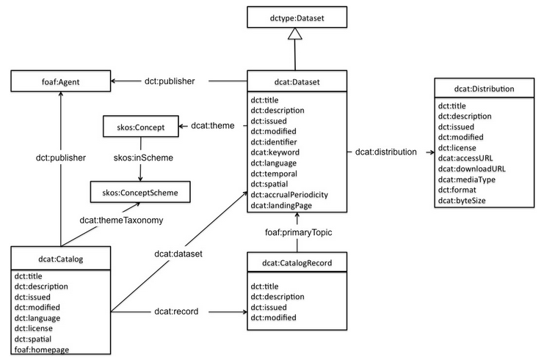
Metadata Standards: DCAT
RDF
Ontology (SKOS)
Same as DC are:
Title, description, identifier, keyword, language
Note: ‘publisher’ not ‘creator’
©Keith G Jeffery
An Overview of the Research Information Metadata Ecosystem
euroCRIS Strategic Seminar 2013
23

Slide 24
Metadata Standards: INSPIRE
EU Directive (2008, 2009)
For Geospatial datasets
  Initiated by ESA
Essentially DC plus geospatial information
Geospatial information very detailed – coordinate system, precision etc
©Keith G Jeffery
An Overview of the Research Information Metadata Ecosystem
euroCRIS Strategic Seminar 2013
24

Slide 25
Metadata Standards: INSPIRE
EU Directive (2008, 2009)
For Geospatial datasets
  Initiated by ESA
Essentially DC plus geospatial information
Geospatial information very detailed – coordinate system, precision etc
HOT NEWS
Although already CERIF-INSPIRE mapping
agreed with EC JRC ISPRA to produce
a definitive CERIF-INSPIRE-DC-DCAT mapping
©Keith G Jeffery
An Overview of the Research Information Metadata Ecosystem
euroCRIS Strategic Seminar 2013
25

Slide 26
Problems with ‘flat’ Metadata
they violate basic principles of information integrity
  elements do not depend referentially and functionally on the uniquely identified (primary key, unique ID) metadata record.
they store event flags or dates in the metadata
  e.g. ‘published’ or ‘date of publication’.
they do not handle well multilinguality and multiple linguistic versions of the same text field;
they do not manage well versioning and provenance
  this requires time-stamped relationships between one research information entity and another
they do not allow multiple classification schemes for the same entity or – more generally – multiple terminology schemes for the same attribute of an entity;
they do not provide mechanisms for crosswalking between different vocabularies;
they do not provide extension mechanisms that preserve interoperability;
©Keith G Jeffery
An Overview of the Research Information Metadata Ecosystem
euroCRIS Strategic Seminar 2013
26

Slide 27
Problems with ‘flat’ Metadata
they violate basic principles of information integrity
  elements do not depend referentially and functionally on the uniquely identified (primary key, unique ID) metadata record.
they store event flags or dates in the metadata
  e.g. ‘published’ or ‘date of publication’.
they do not handle well multilinguality and multiple linguistic versions of the same text field;
they do not manage well versioning and provenance
  this requires time-stamped relationships between one research information entity and another
they do not allow multiple classification schemes for the same entity or – more generally – multiple terminology schemes for the same attribute of an entity;
they do not provide mechanisms for crosswalking between different vocabularies;
they do not provide extension mechanisms that preserve interoperability;
It was understanding these problems 1990-1997 that caused the change from CERIF91 to CERIF2000
©Keith G Jeffery
An Overview of the Research Information Metadata Ecosystem
euroCRIS Strategic Seminar 2013
27

Slide 28
Problems with RDF Metadata
Distinguish those evolved to RDF from ‘flat’
  They carry the disadvantages of ‘flat’;
From those ‘native RDF’
  Have concept of structures e.g. CKAN;
  Or relationships e.g. DCAT, ADMS;
But
  Limited in coverage (only ‘assets’);
  Many RDF assertions to express a role-based, temporal relationship;
  Lack of referential and functional integrity;

Slide 29
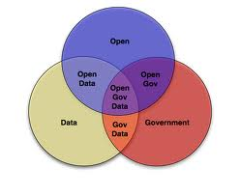
Open Data
Distinguish between
Open Government Data Open Access to datasets from publicly funded research
Metadata
  DC, CKAN, eGMS discovery, contextual, detailed (schema)
Environment
  LOD, semantic web web portal to relational / file systems
Data kind
  Summary or processed multi-layered including raw
Data format
  pdf, csv,xls, rdf particular file or database format
Access
  Browsing via links, SPARQ particular program, SQL
©Keith G Jeffery
An Overview of the Research Information Metadata Ecosystem
euroCRIS Strategic Seminar 2013
29

Slide 30

ENGAGE
Key aspects:
  Portal for OGD
  Linked through to research datasets
  With social networking
  With rich metadata CKAN ➔ CERIF
http://www.engage-project.eu/engage/wp/
©Keith G Jeffery
An Overview of the Research Information Metadata Ecosystem
euroCRIS Strategic Seminar 2013
30

Slide 31
Structure
An Overview of the Research Information Metadata Ecosystem
Acknowledgements to
©Keith G Jeffery
An Overview of the Research Information Metadata Ecosystem
euroCRIS Strategic Seminar 2013
31

Slide 32
Metadata Ecosystem
Many de facto standards
Discovery: DC, CKAN, INSPIRE, DCAT, ADMS
  Only describe digital objects; do not describe projects, persons, organisations etc
Detailed: specific formats by domain, project or even dataset
  Very detailed and dependent on research environment
To link them need Contextual: CERIF
©Keith G Jeffery
An Overview of the Research Information Metadata Ecosystem
euroCRIS Strategic Seminar 2013
32

Slide 33
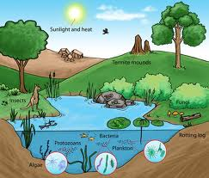
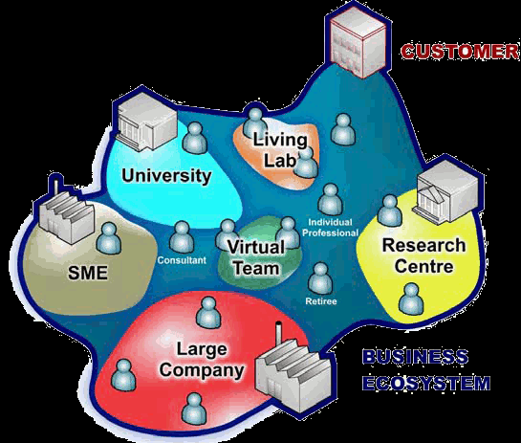
Ecosystem
Originally ECOlogy SYSTEM
Then re-used for many purposes:
  Enterprise ecosystem
  knowledge ecosystem
  Business ecosystem
  Social ecosystem
Key Point: ecosystem consists of
entities
connected by
flows
©Keith G Jeffery
An Overview of the Research Information Metadata Ecosystem
euroCRIS Strategic Seminar 2013
33

Slide 34

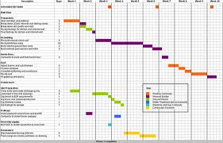

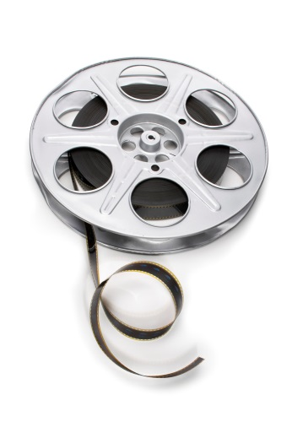
Metadata Ecosystem
Funding
Research manager
Project
Organisation (business)
Researcher
Metadata provides the ‘substance’ of the flows
Organisation (academic)
Facility/Equipment
Publication
Product (video)
Product (dataset)
©Keith G Jeffery
An Overview of the Research Information Metadata Ecosystem
euroCRIS Strategic Seminar 2013
34

Slide 35
Metadata Ecosystem
Research manager
Researcher
funds, research outputs, evaluation, communication
©Keith G Jeffery
An Overview of the Research Information Metadata Ecosystem
euroCRIS Strategic Seminar 2013
35

Slide 36
Metadata Ecosystem
Research manager
Researcher
funds, research outputs, evaluation, communication
DC
DCAT
©Keith G Jeffery
An Overview of the Research Information Metadata Ecosystem
euroCRIS Strategic Seminar 2013
36

Slide 37
Metadata One Research Activity
Other researchers, research managers, innovators, media
Web pages
Research manager
Researcher
©Keith G Jeffery
An Overview of the Research Information Metadata Ecosystem
euroCRIS Strategic Seminar 2013
37

Slide 38
Metadata One Research Activity
Other researchers, research managers, innovators, media
Web pages
Research manager
Authorised proposal
proposal
Researcher
©Keith G Jeffery
An Overview of the Research Information Metadata Ecosystem
euroCRIS Strategic Seminar 2013
38

Slide 39
Metadata One Research Activity
Other researchers, research managers, innovators, media
Web pages
review
Research manager
Authorised proposal
proposal
Researcher
©Keith G Jeffery
An Overview of the Research Information Metadata Ecosystem
euroCRIS Strategic Seminar 2013
39

Slide 40
Metadata One Research Activity
Other researchers, research managers, innovators, media
Web pages
review
Research manager
Authorised proposal
proposal
funding
approval
Researcher
©Keith G Jeffery
An Overview of the Research Information Metadata Ecosystem
euroCRIS Strategic Seminar 2013
40

Slide 41
Metadata One Research Activity
Other researchers, research managers, innovators, media
Web pages
review
Research manager
Authorised proposal
proposal
funding
approval
Researcher
publication
data
©Keith G Jeffery
An Overview of the Research Information Metadata Ecosystem
euroCRIS Strategic Seminar 2013
41

Slide 42
Metadata One Research Activity
Other researchers, research managers, innovators, media
Web pages
review
Research manager
Authorised proposal
proposal
funding
approval
Researcher
evaluation
evaluation
publication
data
©Keith G Jeffery
An Overview of the Research Information Metadata Ecosystem
euroCRIS Strategic Seminar 2013
42

Slide 43
Metadata One Research Activity
Other researchers, research managers, innovators, media
Web pages
Research manager
Researcher
©Keith G Jeffery
An Overview of the Research Information Metadata Ecosystem
euroCRIS Strategic Seminar 2013
43

Slide 44
Metadata One Research Activity
Other researchers, research managers, innovators, media
Web pages
Research manager
Researcher
©Keith G Jeffery
An Overview of the Research Information Metadata Ecosystem
euroCRIS Strategic Seminar 2013
44

Slide 45
Metadata One Research Activity
Other researchers, research managers, innovators, media
Discovery research information
Research manager
Contextual research information
Researcher
Detailed, specific research information
©Keith G Jeffery
An Overview of the Research Information Metadata Ecosystem
euroCRIS Strategic Seminar 2013
45

Slide 46
3-Layer Model
Need to interoperate at discovery level with other commonly-used metadata standards (DC, DCAT, CKAN..)
Need to navigate expert (research) user to detailed domain-specific metadata on research entities (especially outputs: datasets, software) to allow further (re-)processing
Between these two need to understand the CONTEXT of the described objects (not only data)
  To assess relevance (for research, evaluation, innovation)
  To assess quality (evaluation of outputs, outcomes, impact)
  To initiate communication (researchers, research managers, innovators, media, public)
So use CERIF as the middle contextual layer
Generate discovery level (above) to ensure congruence
Point to detailed level (below)
©Keith G Jeffery
An Overview of the Research Information Metadata Ecosystem
euroCRIS Strategic Seminar 2013
46

Slide 47
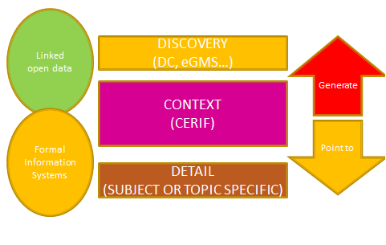
3-Layer Model
©Keith G Jeffery
An Overview of the Research Information Metadata Ecosystem
euroCRIS Strategic Seminar 2013
47

Slide 48
3-Layer Model
CERIF acts as the interoperation converter hub for various metadata formats
©Keith G Jeffery
An Overview of the Research Information Metadata Ecosystem
euroCRIS Strategic Seminar 2013
48

Slide 49
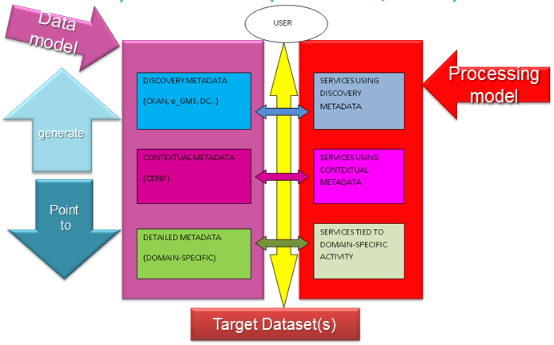
  3-Layer Model
©Keith G Jeffery
An Overview of the Research Information Metadata Ecosystem
euroCRIS Strategic Seminar 2013
49

Slide 50
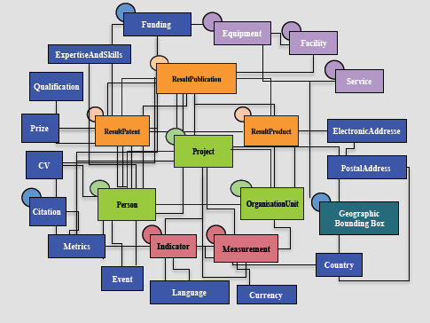
Contextual Metadata: CERIF
©Keith G Jeffery
An Overview of the Research Information Metadata Ecosystem
euroCRIS Strategic Seminar 2013
50

Slide 51
keith.jeffery@keithgjefferyconsultants.co.uk
Acknowledgements to
©Keith G Jeffery
An Overview of the Research Information Metadata Ecosystem
euroCRIS Strategic Seminar 2013
51

