Slide 1
The Italian model of distributed research information management systems: a case study
Paola Galimberti & Susanna Mornati
CRIS 2016, St-Andrews June 8-11

Slide 2
CRIS adoption in Italy
2006: two systems feeding the national database: UGOV Research and SURplus (55 installations)
  Critical issues: closed data (UGOV)
  Poor metadata and duplicated records
  No validation processes (poor quality of data)
2015: all installations migrated to IRIS, the new CRIS based on Dspace-CRIS, plus 11 new (total 66)
  Advantages: open repositories
  Richer metadata and shared records
  Validation processes and better quality
Galimberti & Mornati, CRIS 2016

Slide 3
Benefits of country-wide adoption of Dspace-CRIS
Dspace-CRIS is open source (independency from providers)
CERIF compliancy (CERIF-XML import and export)
Increased visibility of national research production (national harvester PLEIADI)
Consistent data uploaded to the national database
3,5 million publications available in the Internet (10% with open-access full-text)
More transparency for national research evaluation procedures
Galimberti & Mornati, CRIS 2016

Slide 4
The «persistent-identifier» approach
April 2015: the Italian National Evaluation Agency for University and Research announced ORCID mandatory
June 2015: national agreement signed with ORCID
September 2015: central Italian register (ORCID hub) launched
November 2015: over 60,000 Italian researchers have an ORCID (> 90%)
DSpace-CRIS is populated with ORCIDs but also with DOIs, Scopus IDs, WoS IDs, PubMed IDs, interoperable with Datacite, born to be interoperable with any external data source or target.
Galimberti & Mornati, CRIS 2016

Slide 5
Lessons Learned
The adoption of the same CRIS is a first step towards stronger harmonization
The built-in open repository supports Open Access to publications and datasets
Support for PIDs enhances data quality through disambiguation and contributes to a new architecture of research information infrastructure
The huge amount of available data makes it possibile to conduct significant research and analysis
Galimberti & Mornati, CRIS 2016

Slide 6
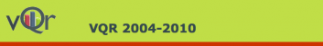

National Research Evaluation Exercises
% of public funding on the basis of research performance:
2009 7%
2013 13,5%
2015 18 %
Galimberti & Mornati, CRIS 2016

Slide 7
Research Questions
Were the editorial choices of Italian researchers influenced by the criteria of the funding system?
Can we register an improvement in the quality of the Italian research as a consequence of the national assessment?
Galimberti & Mornati, CRIS 2016

Slide 8
Methodology
Disciplinary areas (Italian Ministry classification):
  05 Biology
  10 Philology, Literature and Arts
  11 Philosophy, Psychology and Pedagogy
  12 Law
  13 Political and Social Sciences
Publications of Italian researchers from 2009 to 2014
Criteria: Impact Factor™ and IF location in percentiles for Biology, type of publication and language for HSS
Source: CRIS of 66 Italian Universities
Galimberti & Mornati, CRIS 2016

Slide 9
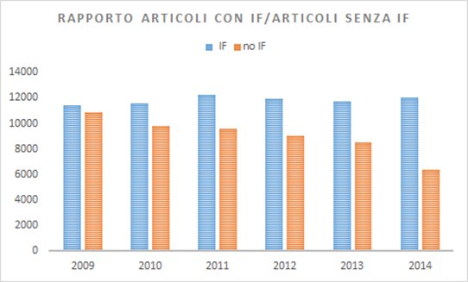
Biology - IF
IF trends 2009-2014
71,008 items with IF and 54,281 items without IF
# articles with IF stable, # articles without IF decrease
Galimberti & Mornati, CRIS 2016

Slide 10
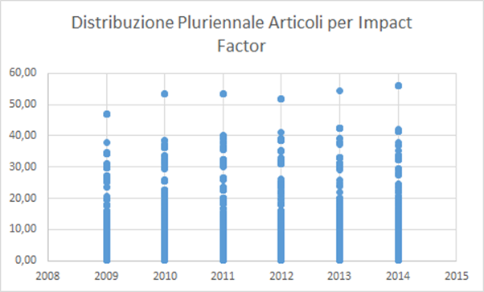
Biology – IF location in percentiles
Analysis of the distribution of IF value ranges shows that most articles are in the lower range and it does not change much over time
Galimberti & Mornati, CRIS 2016

Slide 11
Results for Biology
Moderate effects of the introduction of a Performance-Based Funding System where distribution of IF was one of the indicators
Further investigation is necessary in other scientific areas (less influenced by DORA, the San Francisco Declaration on Research Assessment)
Galimberti & Mornati, CRIS 2016

Slide 12
Disciplinary areas 10,11,12,14
Were opportunistic behaviours encouraged?
Is the number of articles increased compared to the number of monographs?
Area 10 48.572 records examined
Area 11 54.150 records examined
Area 12 52.799 records examined
Area 14 17.787 records examined
Galimberti & Mornati, CRIS 2016

Slide 13
Results for type of contribution in HSS
Clear decrease of the number of monographs
Slight decrease in the number of book chapters except in area 12 (Law)
Researchers tend to choose less time-consuming (better rewarding) formats (articles)
Galimberti & Mornati, CRIS 2016

Slide 14
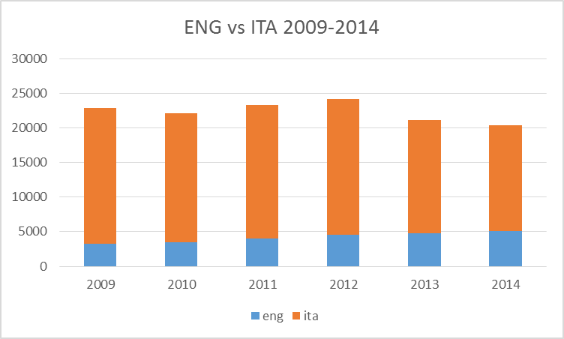
Internationalisation (use of English)
Decrease in contributions written in Italian
Increase in contributions written in English
Even when the «lingua franca» is another language (Italian or other)
Galimberti & Mornati, CRIS 2016

Slide 15
Critical issues
For the first time in Italy a vast amount of data was available to analyse scholarly output not only in STM disciplines but also in HSS.
Deduplication is provided at institutional level but not at national level, but we believe that on such a large scale the presence of duplicates has small influence on findings.
Galimberti & Mornati, CRIS 2016

Slide 16
Conclusions
Galimberti & Mornati, CRIS 2016
In Biology the number of publications in IF journal has not significantly changed over the last few year, while the number of thios published in journal without IF has decreased. Further investigations shoul be conducted in disciplines less influenced by the DORA.
In HSS we observed a tendency to publish more journal articles and less monographs (more time-consuming and less rewarding in national evaluation criteria), and to publish more contributions in English (where internationalisation criteria were often confused with the mere use of the English language).
Further research form CRIS data, in other disciplines and in other countries, should be encouraged.

Slide 17
Thank you very much for attention
Corresponding author:
paola.galimberti@unimi.it
Galimberti & Mornati, CRIS 2016

