Slide 1
ORCID in Pure
ORCID and other IDs in Pure needed for IT-based collaboration
10 November 2015 - Bo Alroe, Director SE, RM, ERI, Elsevier
Notes:
Welcome
CLICK

Slide 2
My background
CRIS projects since 2004 (our CRIS product is called Pure)
  200+ Pure projects
  26 countries
Some of the Pure projects
  Vienna, St. Andrews, VUB Brussels, KCL London, Edinburgh, Monash Melbourne, Lund, Hamburg, Helsinki, Copenhagen, etc.
The countries
  South Africa, Australia, Singapore, China, Japan, Korea, Malaysia, England, Scotland, N. Ireland, Wales, Portugal, Fiji Islands, Taiwan, Sweden, Denmark, Finland, Belgium, Netherlands, Germany, Austria, Hungary, Russia, USA, Canada, Saudi Arabia
Notes:
Let me recap where we are with ORCID support in Pure:
CLICK
Today, researchers can add their existing ORCID to their profile in Pure, and if they don’t have one, they can have it created automatically from within Pure and added to the profile. The can also have their ORCID exhibited on PurePortal and over Pure’s web service API.
CLICK
To that, administrators in Pure can set the details of their institutions ORCID membership – e.g. institution ID, the secret code, all necessary URIs, and more. Administrators can also set if researchers are allowed to edit or create ORCIDs on their own profiles.
CLICK
Finally, let me just mention that we make use of both ORCID’s APIs, the open one and the membership one.
CLICK

Slide 3

My background
Also, I am from Denmark, where we have one important experience of relevance to the Brazilian speaker before me:
Notes:
Let me recap where we are with ORCID support in Pure:
CLICK
Today, researchers can add their existing ORCID to their profile in Pure, and if they don’t have one, they can have it created automatically from within Pure and added to the profile. The can also have their ORCID exhibited on PurePortal and over Pure’s web service API.
CLICK
To that, administrators in Pure can set the details of their institutions ORCID membership – e.g. institution ID, the secret code, all necessary URIs, and more. Administrators can also set if researchers are allowed to edit or create ORCIDs on their own profiles.
CLICK
Finally, let me just mention that we make use of both ORCID’s APIs, the open one and the membership one.
CLICK

Slide 4
First, what CRIS is Pure?
Notes:
… and let’s take a look at what Pure really is:
CLICK

Slide 5
Consolidate your research info on
one platform.
E.g. researchers, departments, grants, publications, datasets, ethical reviews, press ...
Use it to provide overview. And to showcase, evaluate and comply.
E.g. for more collaboration, better internal evaluation, or faster compliance with funder requirements
Notes:
In a nutshell,
Pure is a single platform for all info about your research.
CLICK
You can include many type of information and data in Pure.
CLICK
Having all that data on a single platform is very powerful. You can maintain an overview for many stakeholders. That alone is valuable. But you can also use it to ...
CLICK
... Increase collaboration, advance internal evaluation, and comply faster with requirements from funders and other external stakeholders.
CLICK

Slide 6
Info in Pure
Persons - researchers, postgraduate students, external persons
Organizations - faculties, departments, research groups, external units
Funding opportunities - funder, programme, eligibility, etc.
Grant applications - stage, funder, programme, amount applied, documents attached
Ethical approvals - with all relevant documents attached
Grants - Funder, programme, amount, dates, contract docs, applicants, budget
Projects - budget, expenditure, participants, collaborators, students, outputs
Publications - Peer-reviewed journal articles, books, chapters, theses, etc.
Datasets - stored in Pure or in separate data store
Activities - Conferences, boards, learned societies, peer reviewing, prizes
Impact - narrative recordings of the impact of research – can be peer-reviewed
Bibliometrics - citations, impact factors, Altmetrics
Press clippings - national and international papers, electronic media
Publishers and journals - Names, IDs, ratings
Equipment - type, placement, ownership details
Notes:
These are the types of data that can be in Pure:
CLICK
[walk-through off the main screen]
IF YOU GET QUESTIONS:
Impact is a relatively new type used to assess the quality of research not by citations but
by the impact it has on things like public health, the economy, social welfare, the community,
Or private sector businesses, for example. The use of this type is like all other types optional.
Press clippings can come into Pure automatically from outside sources or they can be typed in.
Most universities that use this type subscribe to a freed from the outside, for example
Elsevier’s British NewsFlo” product.

Slide 7
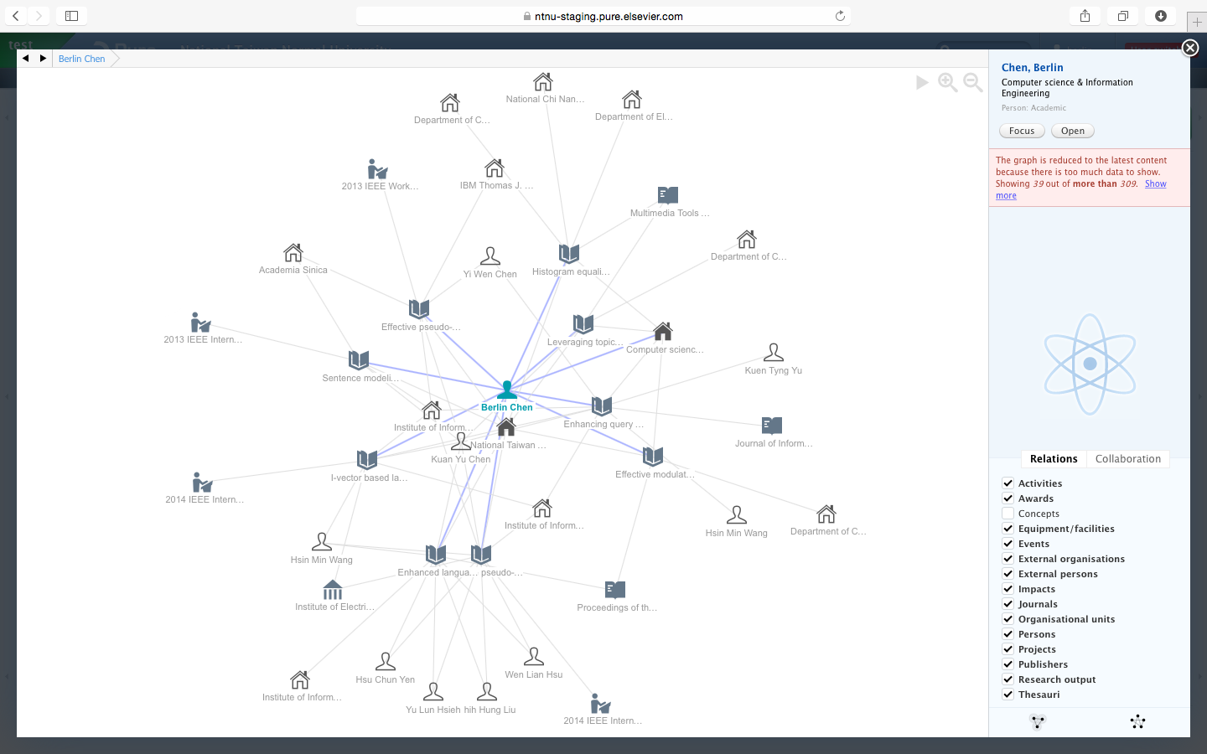
Data in Pure is related
A quick example:
Publications and datasets are related to grants. This allows a report to show which publications were funded by which funders
That allows highly advanced reporting across the different types of data. This powerful reporting is available instantly to users without technical knowledge.
Notes:
The different types of data are all related to each other.
CLICK
Publications and datasets are for example related to projects, projects to grants, and grants to funders.
That allows a report to inform funders which publications or datasets came from their awards last year.
CLICK
Such relations allow highly advanced reporting, that is not available in other systems on campus.
It is available instantly to users without technical skills.
CLICK
This graph is an example of how things are related in Pure – the graph is actually a screenshot from the system itself –
you see a researcher and how he is related to external collaborators through projects and co-authorships
CLICK

Slide 8
In other words
Data in a CRIS is uniquely identified, and inter-related.
This is key for IT-facilitated RM collaboration; e.g. exchange of data between systems.
On the CERIF-model’s person-object in Pure, the Scopus ID, the Researcher ID, and the ORCID are included as standard, others can be added by system admins as needed. Let’s take a look at two of them.
Notes:
A different way of looking at this –
CLICK
We can deliver fresh publications four times a year
CLICK
You can populate Pure regularly with data from most of your key systems
CLICK
Pure can be your master system – the system where you produce and maintain the data
CLICK
This is an example of a typical setup:
Persons and organizations will come from the local HR system
CLICK
Publications will come form Elsevier four times a year
CLICK
Datasets are added by researchers
CLICK
Grant applications and awards comes form the respective local systems
CLICK
Projects created automatically based on grants, then enriched by PIs
CLICK
Research area keywords are added automatically by Elsevier’s Fingerprint engine
CLICK
Activities (e.g. conference participation) is typed in by researchers as needed
CLICK

Slide 9
ORCID in Pure
Notes:
SHORT: True global unique identification of researchers can make it easier and cheaper to own a CRIS system such as Pure because it make inter-ration of research information faster. We also want to support the mission of the ORCID project.
LONG: ORCID is a project to introduce unique identification of researchers globally with an option to also have a centrally hosted online profile. The potential of unique global identification is huge, and that is also the case when applying it in a CRIS system such as Pure. Few systems within research management are as broad as the CRIS system – Pure contains persons, organizations, grants, collaborations, equipment, datasets, publications, activities, and much more, and everything else inter-related. Such inter-relation is highly valued by system owners because they can have views across all this content, but inter-relating data requires unique identification. A true, reliable, global identifier on persons will be a big step forward for what can be achieved with a CRIS system – and how fast and how cheaply it can be achieved – and that is why we have been keen to support the ORCID project, now for several years: To allow our users to harvest such benefits. Generally, we also want to support the mission of the ORCID project.
SEGUE: Let’s take a look at where we with ORCID support in Pure are and where we are going.
CLICK

Slide 10
ORCID support in Pure – where we are
Researchers
  Can add existing ORCID on profile in Pure
  If membership: Can create new ORCID in Pure
  Can exhibit on PurePortal
Administrators
  Can set institutional membership in Pure
    ORCID institution ID and secret, URIs, and other membership details
  Can set researchers can edit ORCIDs
  Can set if researchers can create new ORCIDs
Technical
  We support both ORCIDs open API and the membership API
Notes:
Let me recap where we are with ORCID support in Pure:
CLICK
Today, researchers can add their existing ORCID to their profile in Pure, and if they don’t have one, they can have it created automatically from within Pure and added to the profile. The can also have their ORCID exhibited on PurePortal and over Pure’s web service API.
CLICK
To that, administrators in Pure can set the details of their institutions ORCID membership – e.g. institution ID, the secret code, all necessary URIs, and more. Administrators can also set if researchers are allowed to edit or create ORCIDs on their own profiles.
CLICK
Finally, let me just mention that we make use of both ORCID’s APIs, the open one and the membership one.
CLICK

Slide 11
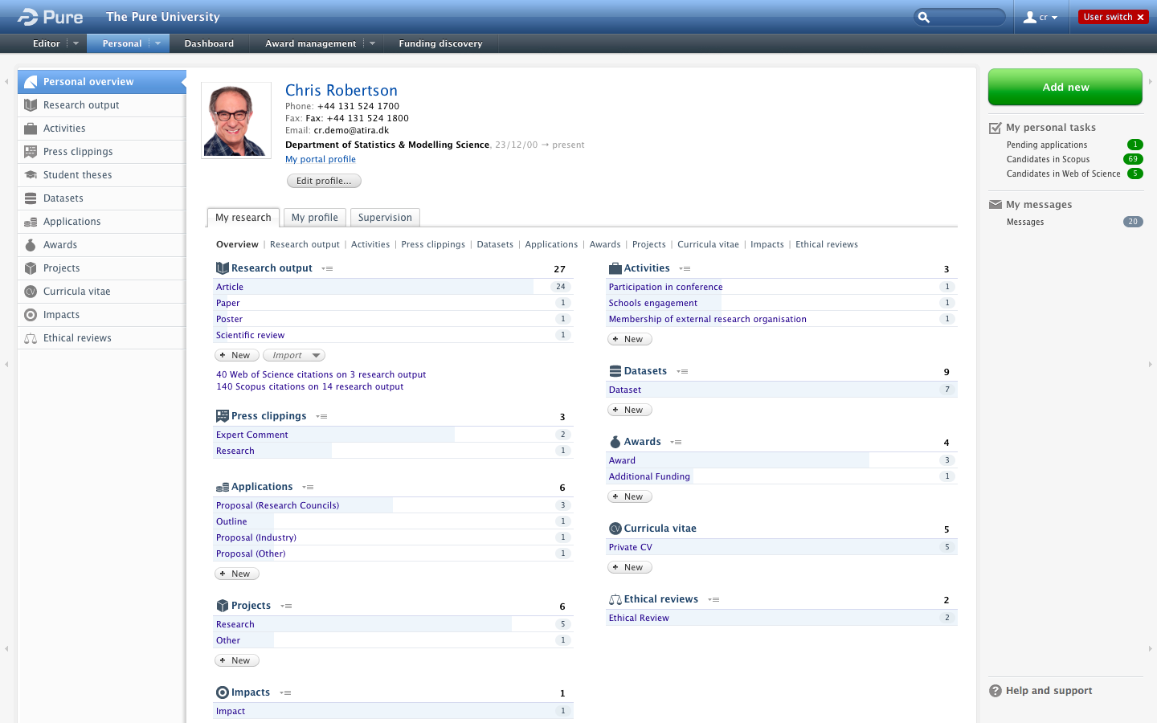
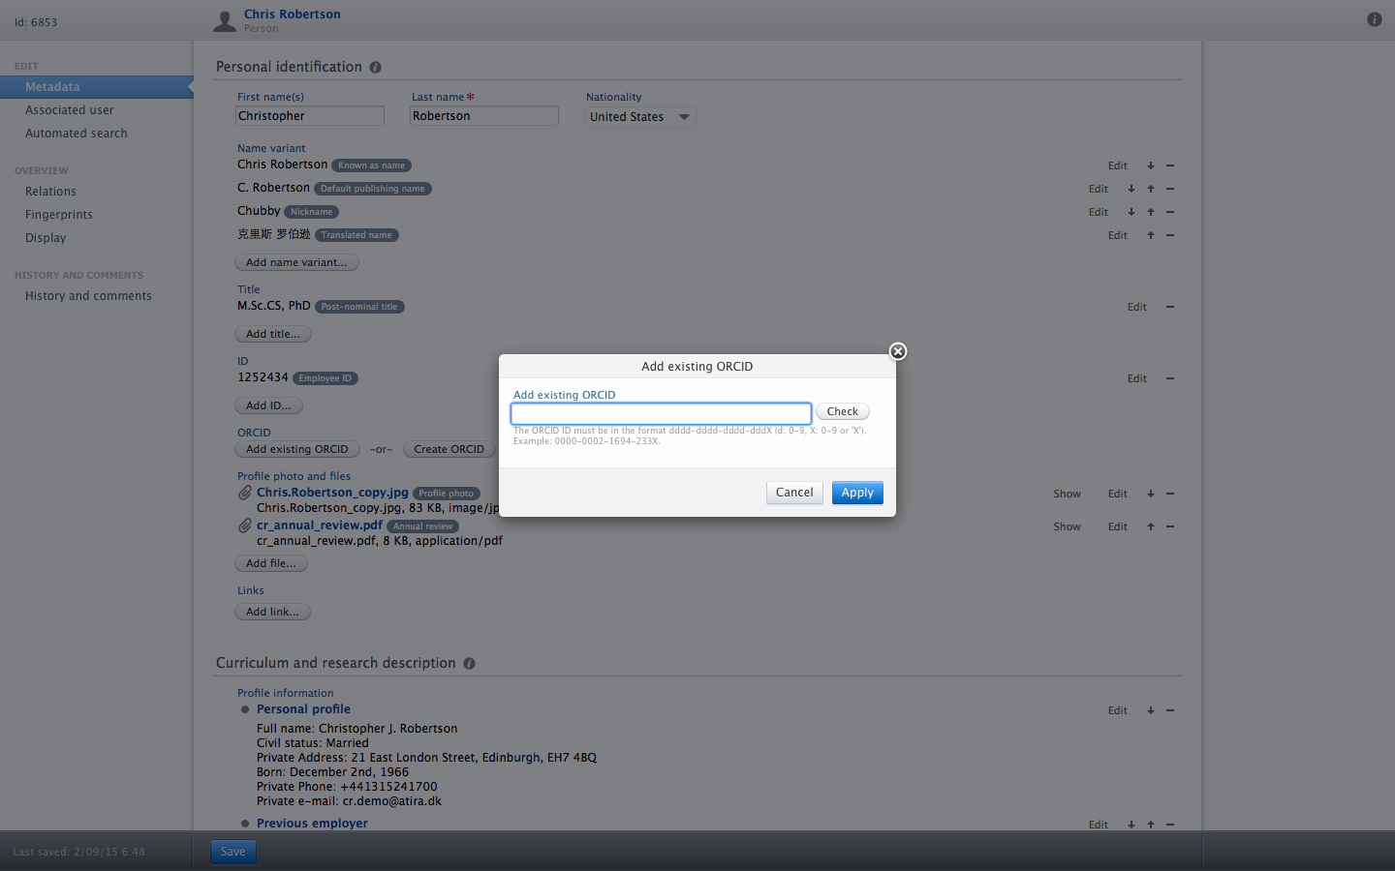
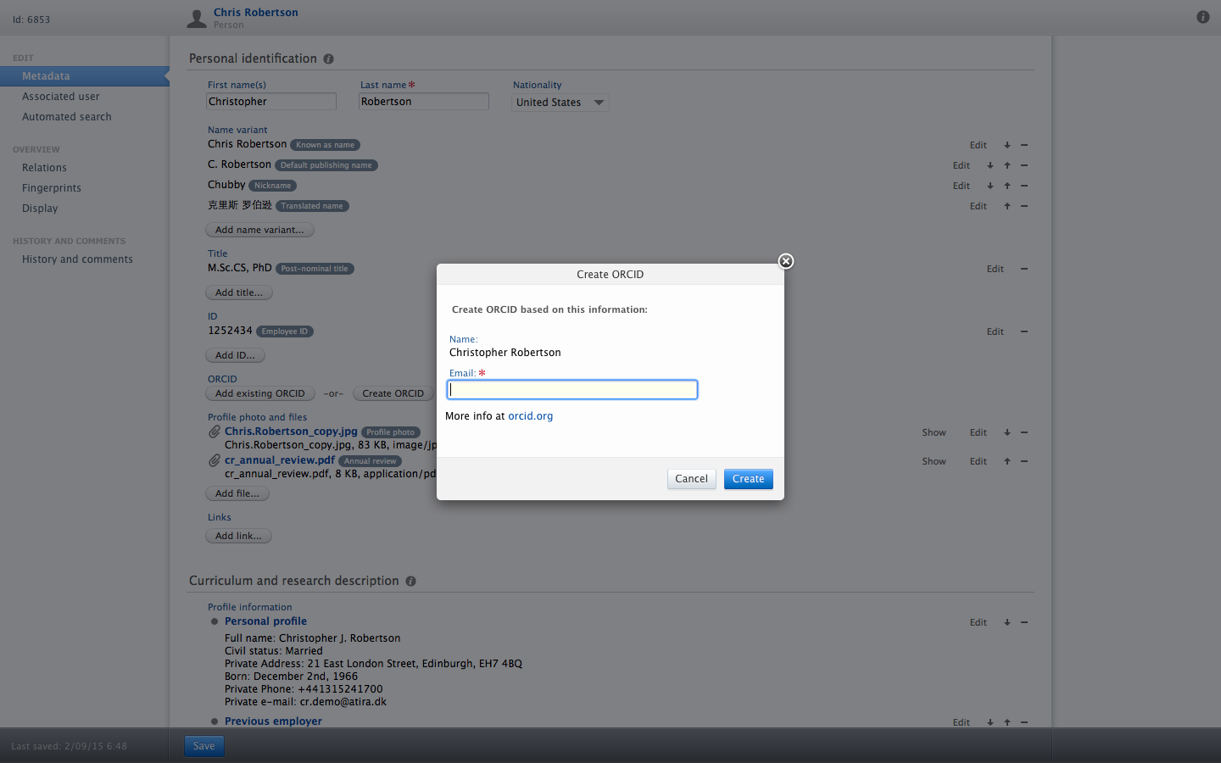
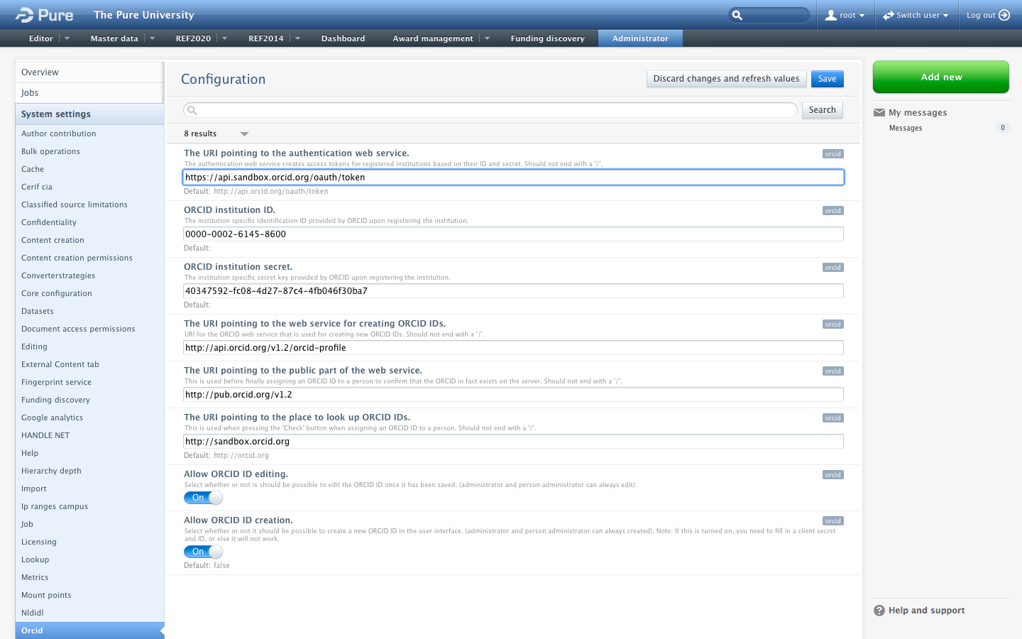
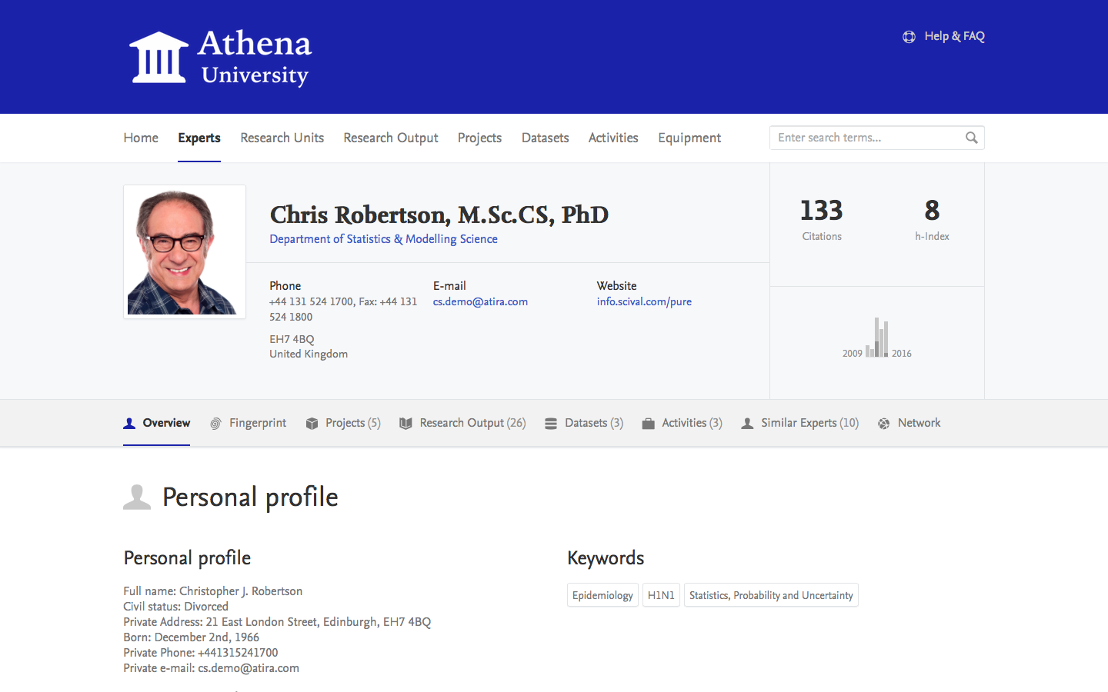
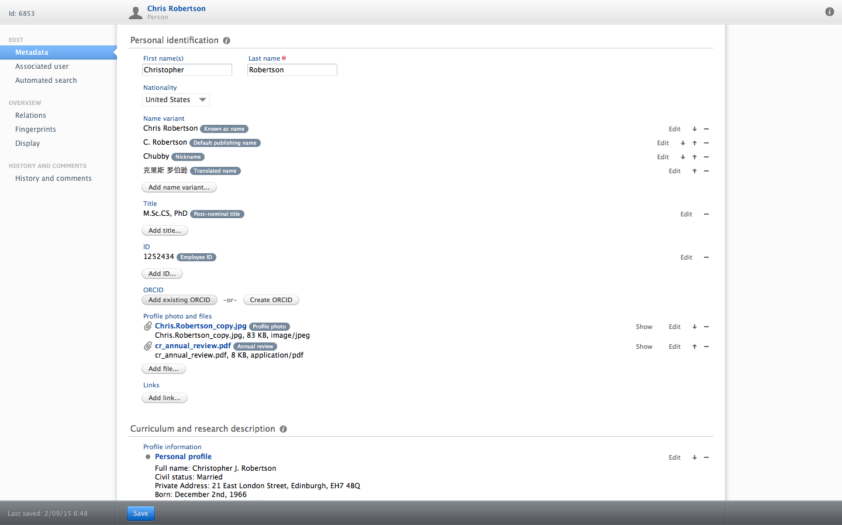
ORCID support in Pure – where we are
Open profile ...
Add existing ORCID
Show ORCID on open web
Set institutional membership
Create new ORCID
Allow add and create
Notes:
Let me show you what it all looks like.
CLICK
When the researcher is logged into Pure, it looks like this.
CLICK
The research can open the profile using this button.
CLICK
On the profile, the researcher can add an existing orchid.
CLICK
It looks like this.
CLICK
Or the researcher can create a new ORCID.
CLICK
And it looks like this.
CLICK
The researcher can also have his profile on PurePortal, a free institutional research-portal that comes with Pure.
CLICK
It looks like this.
CLICK
And here, the researcher can choose to have his orchid shown publicly.
CLICK
Administrators in Pure have these options.
CLICK
They can allow editing and creation of ORCIDS
CLICK
And set institutional membership details like this.
CLICK

Slide 12
ORCID support in Pure – where we are
What happens when a researcher creates new ORCID in Pure
  Pure checks for existing ORCID on open API
  If check positive:
  No action
  If check negative:
  Pure request new ORCID from membership API
  Membership API issues new ORCID in status pending
  Pure retrieves new ORCID
  User confirms new ORCID via mail
  New ORCID changes status to validated
  Pure holds validated new ORCID ready to use
Notes:
Okay, we’re moving on.
CLICK
Let me just run you though what happens, when a researcher creates a new ORCID in Pure.
CLICK
Pure first check if an ORCID already exists for that person.
CLICK
If the check is positive, Pure aborts the operation.
CLICK
If the check is negative, Pure requests a new ORCID from the membership API
CLICK
That API then issues the new ORCID in a status where it awaits validation
CLICK
Pure retrieves the new ORCID
CLICK
At the same time, the user validates via mail
CLICK
The new ORCID now changes status to validated
CLICK
Pure now holds a new validated ORCID
CLICK

Slide 13
ORCID support in Pure – where we are
going
Automatic population of ORCID profile
  DEFINITION: The researcher’s public profile on orcid.org is automatically filled with data by Pure
  Automatic initial population
  Automatic maintenance
  Use ORCID when matching content from sources when available
    E.g. grants from NIH Reporter
Notes:
Right – those are all things that Pure does now.
CLICK
Let’s look at the next release due in February 2016
CLICK
By February, Pure will be able to fill the ORCID profile
CLICK
What that means is, that Pure can populate the profile automatically with the content it requires.
CLICK
Pure will be able to populate the ORCID profile initially
CLICK
Pure will be able to maintain the profile over time
CLICK
The relevant content in Pure will automatically be shown on ORCID.ORG if it already visible in Pure. Confidential information in Pure will not be shown.
CLICK
To that, we will gradually begin to use ORCID IDs when importing and matching content where possible
CLICK

Slide 14
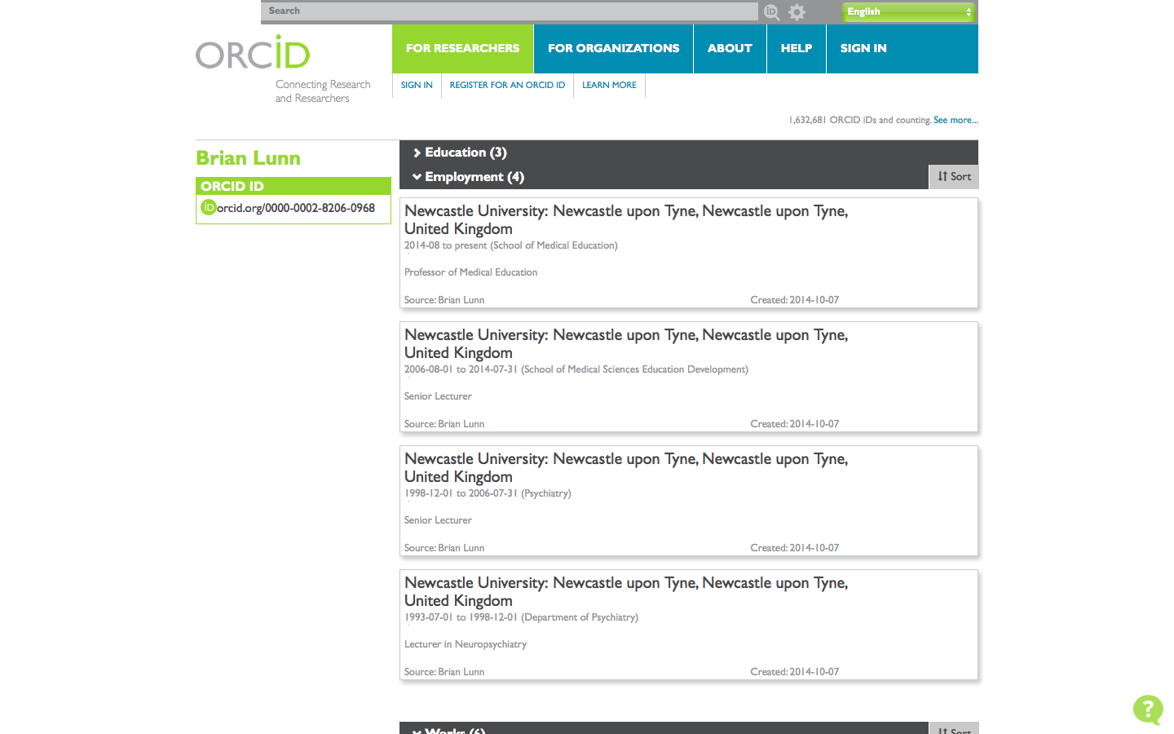
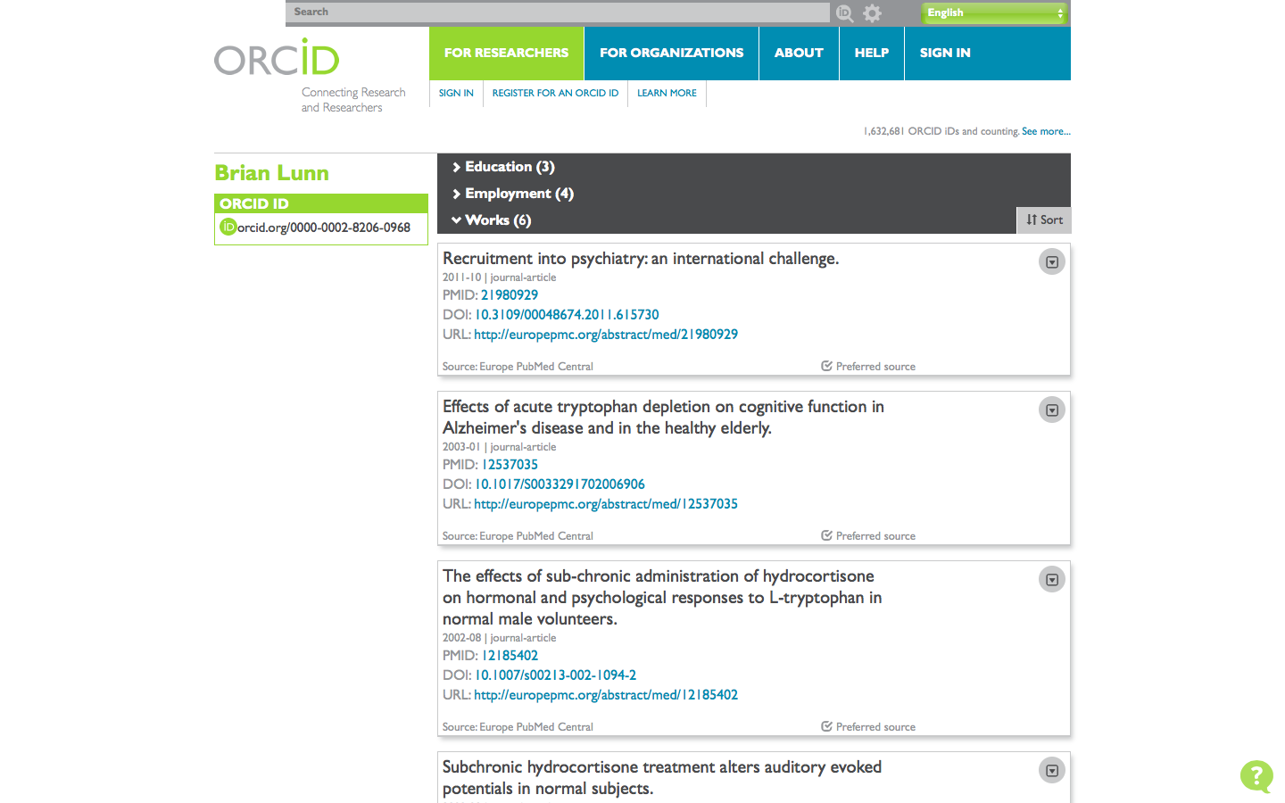
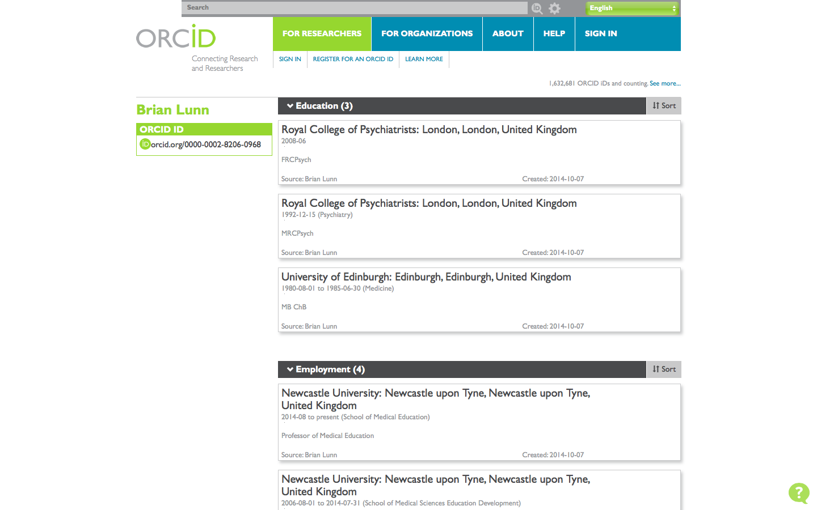
ORCID support in Pure – where we are
going
Education
What content is on the ORCID profile?
  EDUCATION – Already information in Pure
  EMPLOYMENT – Already information in Pure
  WORK – Already information in Pure
Employment
work
Notes:
CLICK
The content required by the ORCID profile is the following:
CLICK
Education
CLICK
Employment
CLICK
And work
CLICK
And Pure is 100% able to deliver that data.
That is true for education,
CLICK
For Employment,
CLICK
And for the “work”, which here means outputs.
CLICK

Slide 15
ORCID support in Pure – questions
When will automatic population of ORCID profiles be in Pure?
  With the release of Pure version 5.5 in February 2016
Will Elsevier continue to support ORCID in Pure?
  Yes, ours is a firm commitment. We also support Researcher ID (TR), Scopus ID (Elsevier), and other source IDs
Are there any charges?
  No, existing ORCID support and and release 5.5 is free of charge
What happens when the two ORCID APIs changes?
  Then we update Pure accordingly. That is also at no extra charges.
Will Elsevier support ORCID in all its products?
  We consolidate our product strategies concurrently, but we are not able to say today how emerging standards such as ORCID will impact them
Is the ORCID ID in Pure a reportable piece of data?
  Yes, managers can report on ORCIDs, e.g. include ORCIDs in staff lists
Notes:
I took the liberty to add this slide with the most commonly asked questions about Pure and ORCID:
CLICK
Automatic population will be available with our release of Pure version 5.5 in February 2016
CLICK
We will continue to support ORCID in Pure
CLICK
Pure’s support of ORCID is standard in Pure and comes at no additional charge
CLICK
We will update Pure according to changes of the ORCID service, for example changes to the APIs
CLICK
We are not able to speak today about Elsevier utilization of source IDs in the future and across the entire product portfolio
CLICK
The ORCID ID is a fully reportable piece on data in Pure
CLICK

Slide 16
Example use-case
Notes:
Okay,
as mentioned earlier, Pure basically supports showcasing, evaluation and compliance within research management.
CLICK

Slide 17
Showcasing
  Disclose data from multiple sources online
  Increase discoverability
  Qualify profiles
  Increase collaboration
  Support Open Access mandates
Notes:
Here are four use-cases in those areas:
CLICK

Slide 18
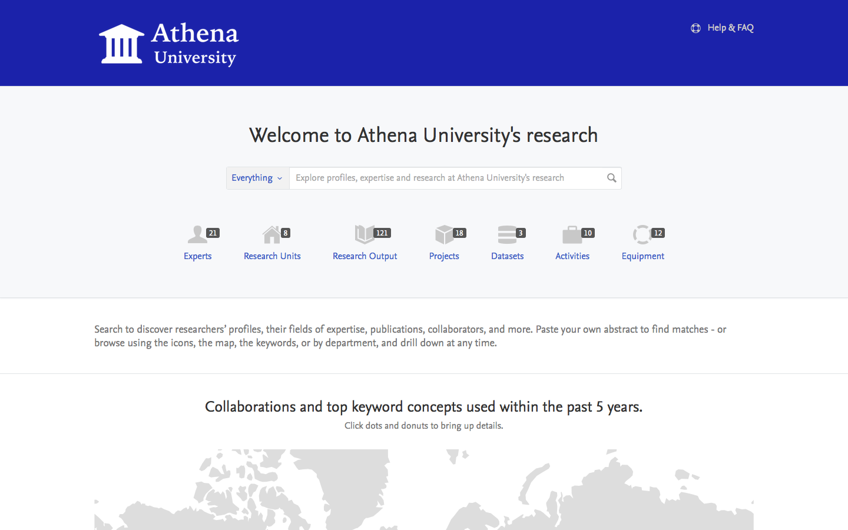
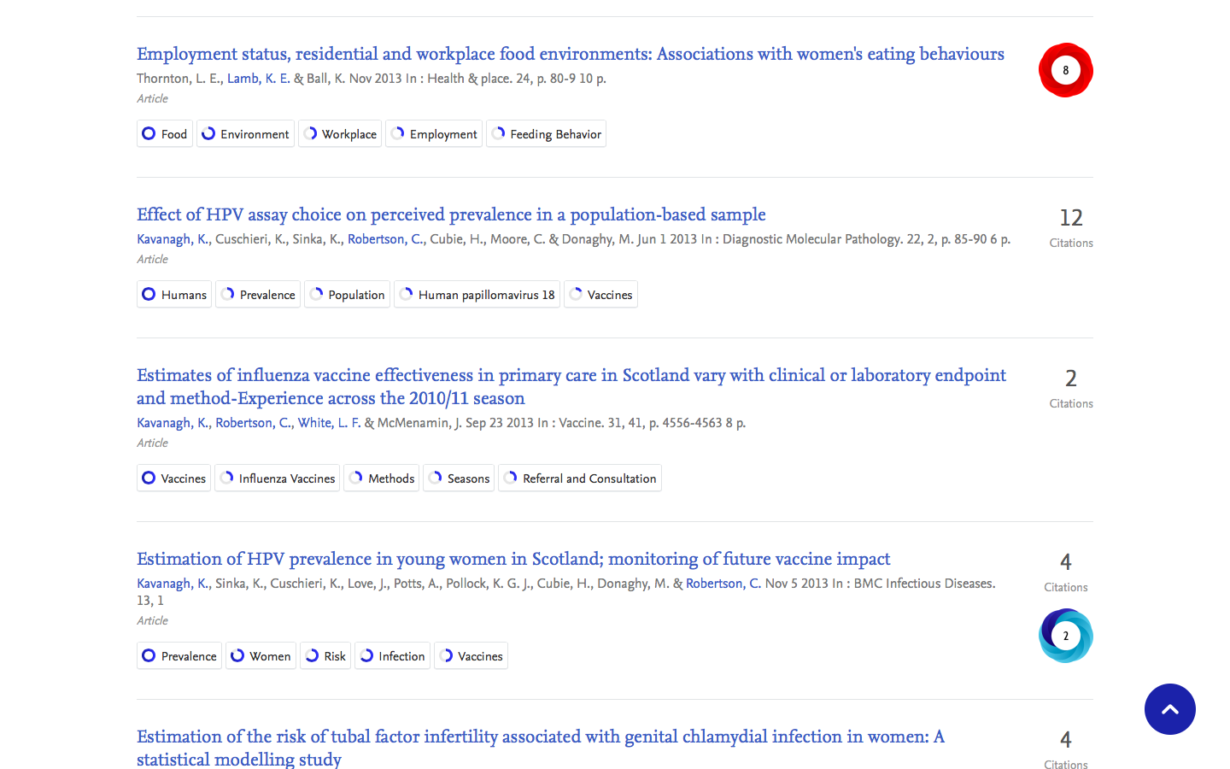

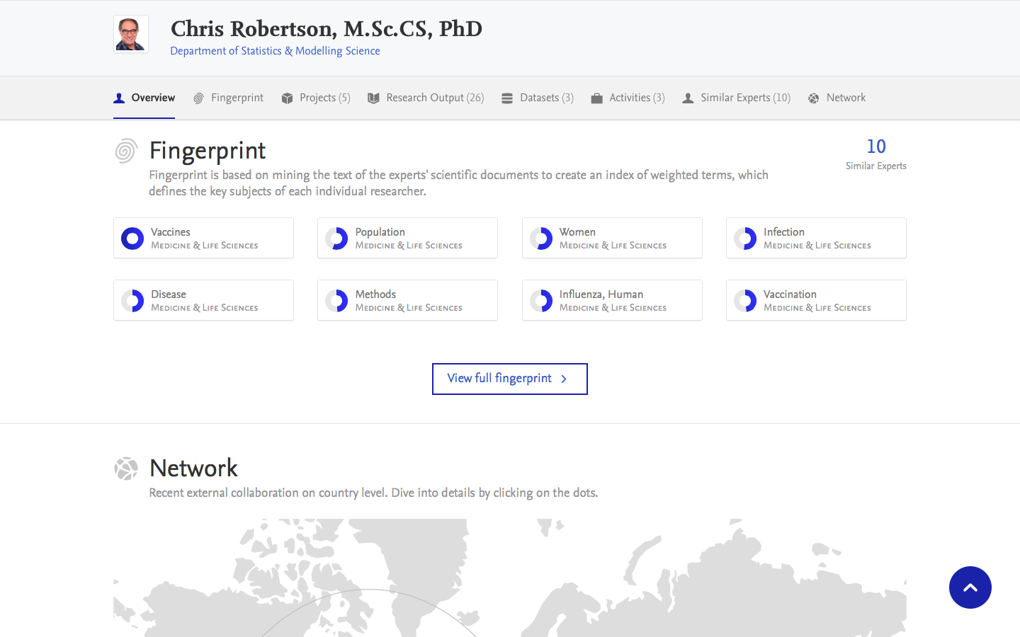
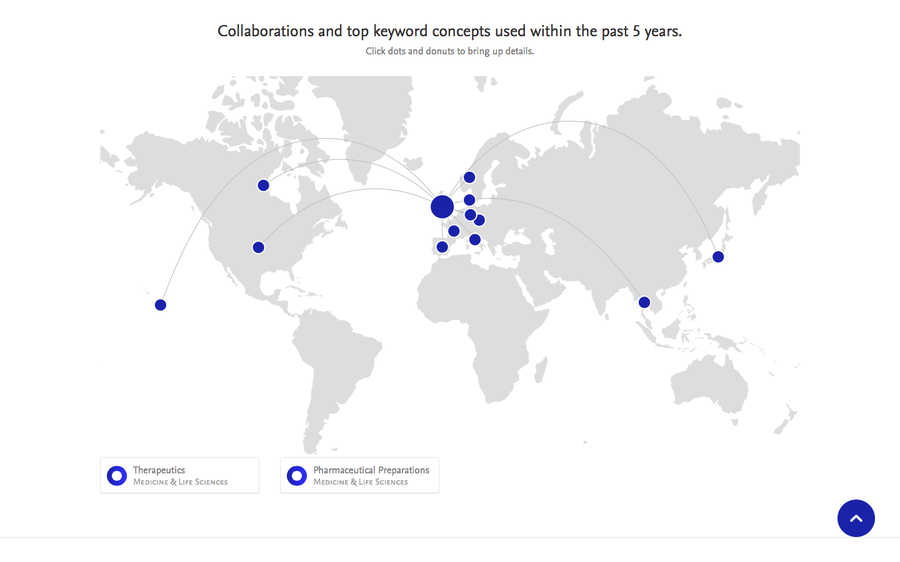
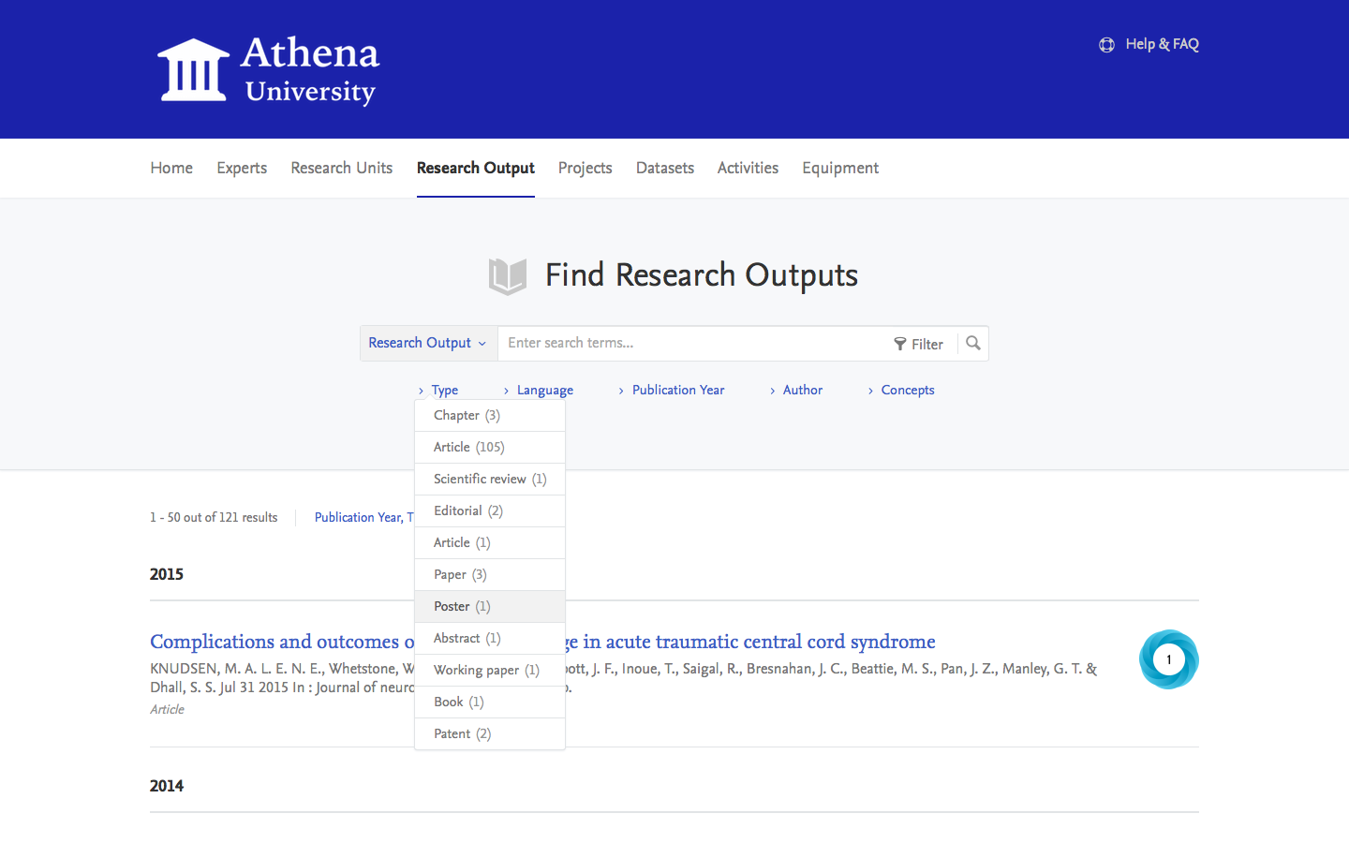
1. Showcasing – “We need to improve on the web”
Publications - Already there, but slow process and varying data quality
Researcher profiles - Some are there but not all – lacks details
Discoverability - When people search, they get too many results
Collaboration - We need to be more visible for potential collaborators
Open access - We need to disclose publications faster and with better QA
PurePortal is an integrated part of Pure
Publications - shown automatically based on rules. Workflows for quality assurance
Researcher profiles - can contain all info with relations + updated automatically
Discoverability - FingerPrint™ keywords automatically on researchers
Collaboration - Collaboration charts
Open access - PurePortal is a repository. Use it to show articles, track downloads, etc.
Showcasing
Notes:
First, showcasing
In this use-case, a university needs to improve its research web presence
CLICK
Their publications are already online but the process is slow and data quality varies
CLICK
Their researcher profiles online are incomplete and lacks detail
CLICK
When people search the web, they do not get too many hits
CLICK
They worry that potential collaborators don’t see them
CLICK
They need to disclose publications faster and in better quality
CLICK
PurePortal can help with all that because it is an integrated part of Pure
CLICK
Publications are shown automatically based on rules
Researcher profiles are rich and updated automatically
FingerPrint™ keywords are automatically on researchers, placing them much higher on Google et al
Interactive charts show collaboration networks
PurePortal is a repository for OA and also shows or points to fulltext articles, tracks downloads, and more
CLICK
This is PurePortal’s frontpage.
You see researchers, departments, outputs, grants, datasets, and much more.
CLICK
This is a list of publications in Pure.
You see citations, altmetrics, keywords, and much more.
CLICK
This is a person profile in Pure.
You see all details about the person. Charts and lists are interactive.
CLICK
This is a researcher’s keyword “fingerprint” in Pure – look how well he is profiled for organic web searches.
CLICK
This is a collaboration map for a department.
They are interactive and also available for persons.
CLICK
And finally, the search option in Pure.
Note that guest looking for collaborators can just paste one of their own publication abstracts to find people in the same scientific area.
CLICK

Slide 19
Conclusion
Vision for the future (no
  Move from algorithmic import matching to ID-based matching
  Move from 70-80% correct matches to +90%
  Higher quality data at lower cost
  Richer and more correct co-authorships
  More precise collaboration analyses and mapping
  Controlled move from one institution to another
Notes:
Okay, we’re moving on.
CLICK
Let me just run you though what happens, when a researcher creates a new ORCID in Pure.
CLICK
Pure first check if an ORCID already exists for that person.
CLICK
If the check is positive, Pure aborts the operation.
CLICK
If the check is negative, Pure requests a new ORCID from the membership API
CLICK
That API then issues the new ORCID in a status where it awaits validation
CLICK
Pure retrieves the new ORCID
CLICK
At the same time, the user validates via mail
CLICK
The new ORCID now changes status to validated
CLICK
Pure now holds a new validated ORCID
CLICK

Slide 20
Thank you
Notes:
Thank you

