Slide 1




Research Data in Current Research Information Systems
Joachim Schöpfel, GERiiCO laboratory, University of Lille 3 (France)
Hélène Prost, CNRS, Nancy (France)
Violaine Rebouillat, Dicen-IDF laboratory, Paris (France)

Slide 2

Objectives
« Big data is fuel for economy and science »…
How do the CRIS capitalize on this fuel?
  What does “research data” mean? In other words, what exactly is (or should be) the object of evaluation?
  How are research data identified? Or how should research data be identified?
  What is the link between evaluation and long-term preservation?
Recommendations for further development of CRIS
“Value agnostic approach” - it does not ask whether evaluating research data is good or bad.
  It rather assesses the way in which the evaluation is performed, the conditions under which it is performed, and the way in which it could be improved.

Slide 3
Methodology
Literature review: we identified about 30 recent papers on the link between research data and current research information systems, with Google Scholar, the Scopus database and the euroCRIS digital repository .
Survey on data repositories: we analyzed the social sciences and humanities data repositories in the re3data directory , regarding their compliance with the requirements of research evaluation.
Studies on data management: we re-analyzed our own former and ongoing surveys on research data management (Schöpfel & Prost 2016, Rebouillat 2015), in particular regarding the typology of data resources and results, in order to gain complementary empirical evidence for the discussion on the object of evaluation.

Slide 4
Research data in CRIS studies
All papers and meetings in current research information systems talk about data.
However, only a small number focus on research data.
Especially since 2010, probably due to their growing importance in the context of cyberinfrastructure and open science.
Some papers confuse data on research with research data.
Research data have been defined in many different ways but there is little consensus.

Slide 5
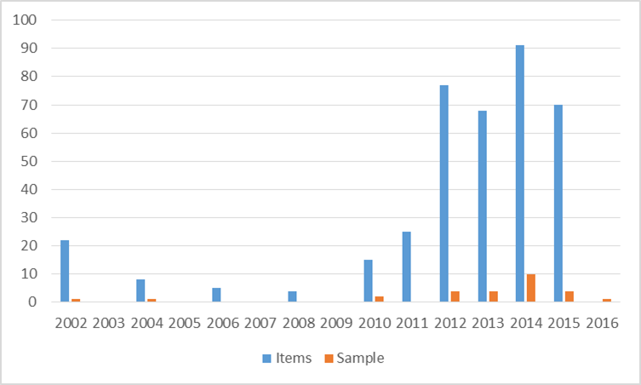
CRIS digital repository: items (n=385) and sample (n=27)

Slide 6
CRIS and data
The usual format of research evaluation systems like CERIF distinguishes between persons, units and projects; with regard to the research output, they usually take into account publications, patents and other products. Research data are part of the latter.
CRIS are usually considered as an option to improve library services for research data management, especially by linking and storage.

Slide 7
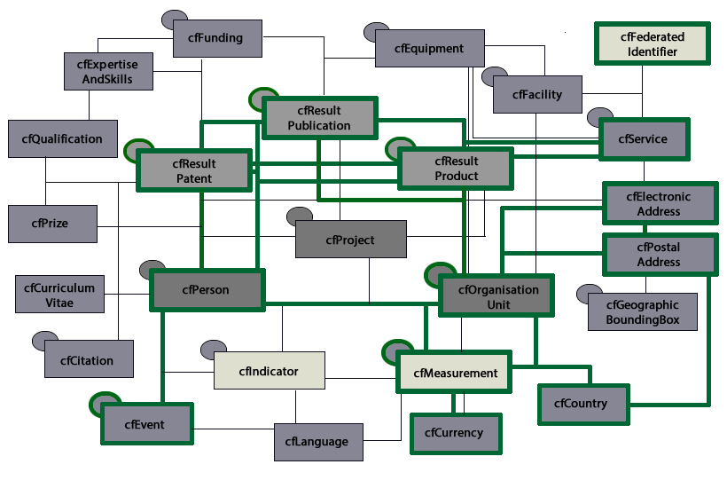

Slide 8
Funding agencies’ requirements
Each funding agency labels its own and specific data-related requirements. Nevertheless, some essential criteria are common to most of them:
• An explicit data policy (awareness) governing the research life cycle,
• A research data management plan,
• A statement about open access to the data,
• Long-term surely preservation (storage) for at least ten years,
• A structured metadata description.

Slide 9
Funding agencies’ requirements (cont’d)
Increasing interest by funding bodies generally means strong recommendations or a code of conduct for the data management.
  It sometimes involves a clear and explicit request or mandate.
Often, funding bodies expect the creation of a public data catalogue (metadata) and a data archive (preservation).
  Also, they expect institutions to provide the necessary human and technical infrastructure.
  Sometimes they offer additional funding for data curation.
However, it is not always obvious how (and if) they will assure the follow-up, beyond the initial statement of intention.

Slide 10
Metadata: standards
In general, sufficient metadata and stable identifiers are considered as necessary to improve the usefulness of repository workflows.
A generic, domain agnostic metadata schema, reducing lack of consistency and providing interoperability through a limited number of properties.
Metadata should at least contain information on funding, access rights and licensing, related publications and datasets, and embargoes.
The Dublin Core appears compliant with research data.
  At least eleven out of the fifteen DC core elements can be qualified in a way that the DC supports functions required in a laboratory setting – discovery, usage, authentication, administration.

Slide 11
Metadata: specificity and granularity
Enhanced metadata for datasets are typically specific to research fields, disciplines or institutions inferring a community perspective to data from different sources and disciplinary contexts
  Detailed information about datasets describe for instance particular subjects, data types, methods or scientific names (species).
Metadata should be as standard as possible, but also as flexible as is needed, to accommodate the variant practices among communities, without compromising interoperability of data across communities.
Granularity is a particular problem: some metadata catalogues provide a rather low level of detail and specificity in describing the various aspects of data and datasets.
  Identifiers like the DOI do not by themselves address granularity.

Slide 12
Data repositories and evaluation
All data repositories are not qualified for research evaluation. Only few repositories satisfy all conditions, i.e. are compliant with the main CRIS requirements. The re3data.org directory reveals a landscape of a large number of very different data repositories, domain or institution specific rather than generic. Variety and diversity prevail.
  Identifiers: DOI (31%), handle (20%), other identifiers (URN, ARK, Purl) are hardly used. ORCID (2%).
  Metadata: standards (38%). The part of domain agnostic, generic standards can be estimated at 16% (Dublin Core, W3C, DataCite, OAI-ORE) while the part of domain specific metadata schemas is 22% (social sciences, surveys, geography, ecology…).
  Quality: some kind of quality management (69%). Certificate or label (33%), such as the Dutch Data Seal of Approval DSA, a domain agnostic label (14%), the German Council for Social and Economic Data RatSWD label (6%) or the European Common Language Resources and Technology Infrastructure CLARIN certificate B (4%).
  Open access: 80% provide complete open access to the deposited data. 65% can (also) provide restricted access (for registered users, institutional members, on demand, required fees), 10% can manage embargoes and 15% can support closed access.
  Licensing: 38% disseminate their data with full copyright but this does not mean that they do not allow some kind of licensing, on request. 33% support the Creative Commons CC licenses.

Slide 13
Research data management
Output/input: The distinction between primary and secondary data is essential for research data management and data sharing. However it is unclear what should be measured for research evaluation.
  Normally, only output should be assessed - in other words, secondary data. On the other hand, collecting and curating primary data as input for research is time and resource consuming and co-determines the quality of the scientific result. Should input be valued?
Generic/specific data: According to our survey results, the data distribution (“data profile”) seems to characterize a discipline better than a specific type of data.
  This is a strong argument for a domain agnostic approach to metadata and evaluation.
Functional/dysfunctional: What researchers do with “their own data” is more or less functional and compliant with their immediate needs.
  This functional practice becomes dysfunctional regarding CRIS requirements and evaluation, which imply collective, standard and community procedures.
Funders are the key (but not exclusively): Funders’ requirements are a strong incentive for research data management and sharing. H2020 guidelines on project proposals are a very (if not the most) important motor for preparing a data management plan.

Slide 14
Discussion: object of evaluation
The development of CRIS did (does) not produce any special data typology.
Current research information systems generally do not evaluate research data in the strict sense but data management, along with a more or less generic and standard description.
The exact nature of data seems more or less irrelevant for research evaluation, because the real object of evaluation is data curation NOT data.

Slide 15
Discussion: identifiers
Persistent identifiers are a crucial condition for the identification of datasets and their linking to publications.
  DOI is usually the preferred solution.
Granularity: a high-level DOI makes the access to data more difficult. A low-level DOI makes the citation difficult. The optimum level and nature of granularity, however, would vary with the kind of data.
  It is possible but not necessary to attribute different DOIs to the same dataset, on different levels.
This manifest problem of the so-called granularity principle makes it difficult to use identifiers for the evaluation of research data.
  DOIs are useful for discovery, citation etc. but not for evaluation of data.
In fact, CRIS evaluate the assignment of DOIs or other persistent identifiers as a criterion of high-quality research management NOT the datasets identified through DOI themselves.

Slide 16
Discussion: preservation
Studies on data curation and CRIS consider long-term conservation necessary and critical for research evaluation.
  The critical issue can be described as the choice of the repository(ies) for the deposit of the research.
  The objects of assessment vary from policy statement (declaration, guarantee) and institutional investment (human resources, budget) to certification, quality label and institutional partnership with another expert and specialised organisation (service) in charge of data preservation (data centre…).
The re3data.org directory reveals that only one part of the data repositories meets the needs of research evaluation formats and systems.

Slide 17
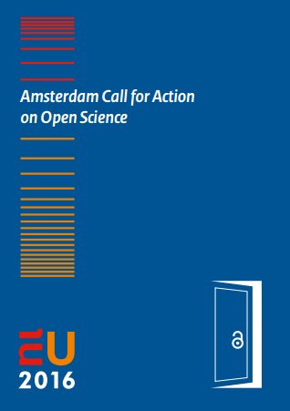
Discussion: sharing and open access
Usually, open data policy is part of research evaluation, yet dependent on several conditions such as third-party rights, confidentiality, etc.
The European Amsterdam Call for Action on Open Science imposes on the Member States the fact that open data should set the default standard for publicly funded research.
  Other access regimes are allowed, from open and free downloads to application and registration-based access.
CRIS usually appear assessing rather the (formal) possibility and/or policy of open research data rather than the real openness.

Slide 18
Conclusion: recommendations
Evaluation should not concentrate on data but on data management.
The deposit of data in labelled data repositories should be preferred (expected).
Standard, generic and rich metadata should be required.
Standard persistent identifiers for data and contributors (authors), namely DOI and ORCID, should be required.
Open data policy should be the default, at least for public funded research.
Evaluation should include explicit measures for reporting and follow-up (no simple declaration of intention).

Slide 19
References
Schöpfel, J., Prost, H., Rebouillat, V., 2016. Research Data in Current Research Information Systems. In: CRIS 2016, St Andrews, 8-11 June 2016.
http://www.citeulike.org/user/Schopfel/tag/cris2016
Corresponding author: joachim.schopfel@univ-lille3.fr

