Slide 1
euroCRIS 2015
Scientific output at the UPF: management and dissemination
Elena Blanco
Marina Losada

Slide 2
Scientific output at the UPF
CRIS
Repository
Lines of work

Slide 3
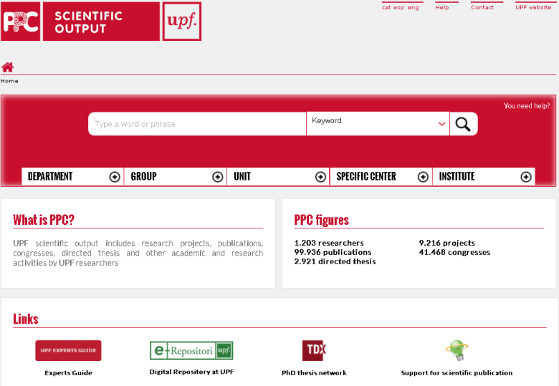
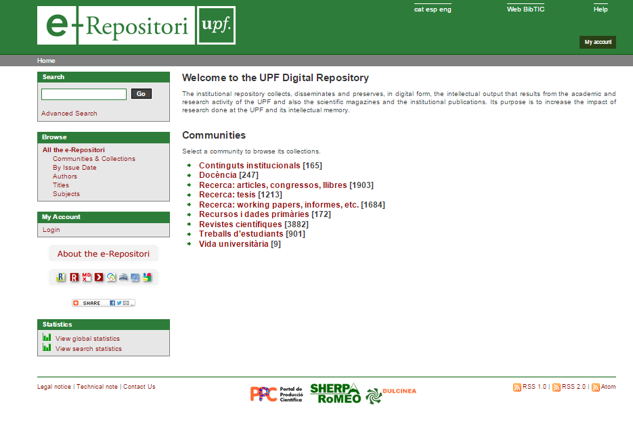
CRIS
SCIENTIFIC OUTPUT
PORTAL
References of the scientific output of the UPF researchers
REPOSITORY
e-Repositori
Open access digital documents produced at the UPF

Slide 4
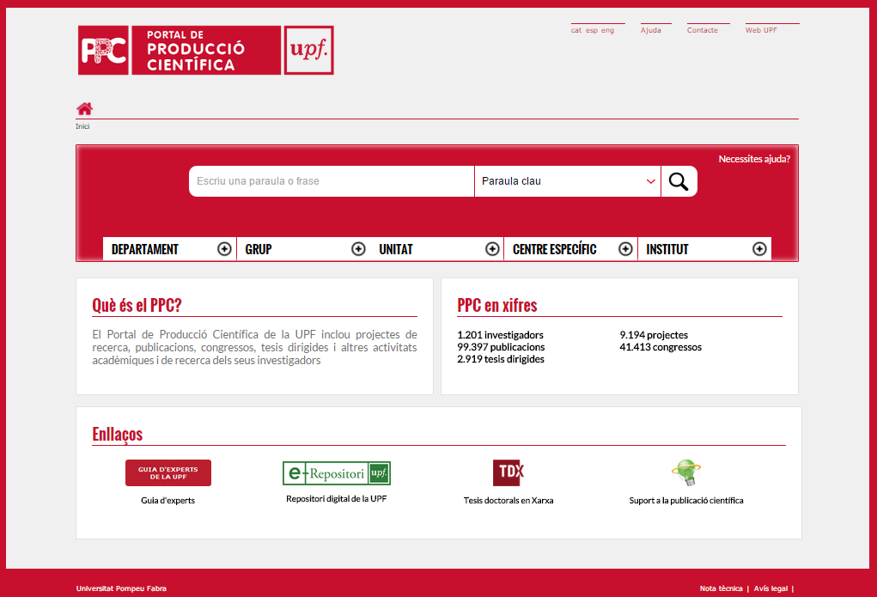
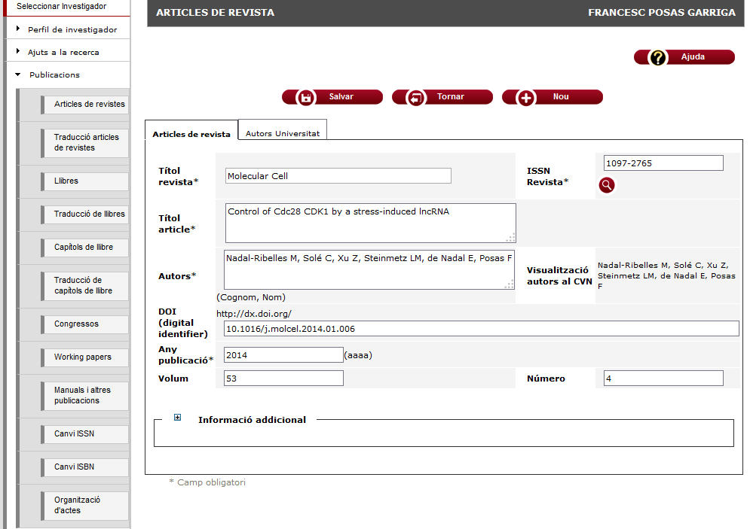
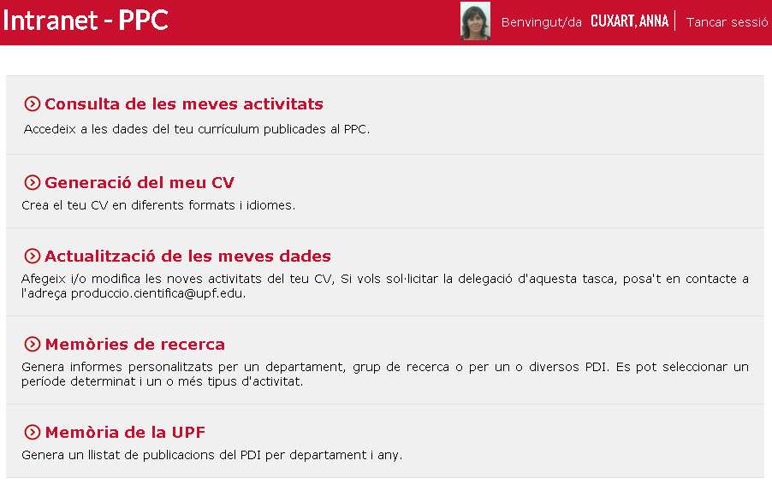



CRIS
Back-end
Front-end
GPC
PPC
Publication
Search
Generación CV
Research projects data
Human reosurces data
CERIF compliant

Slide 5


Slide 6
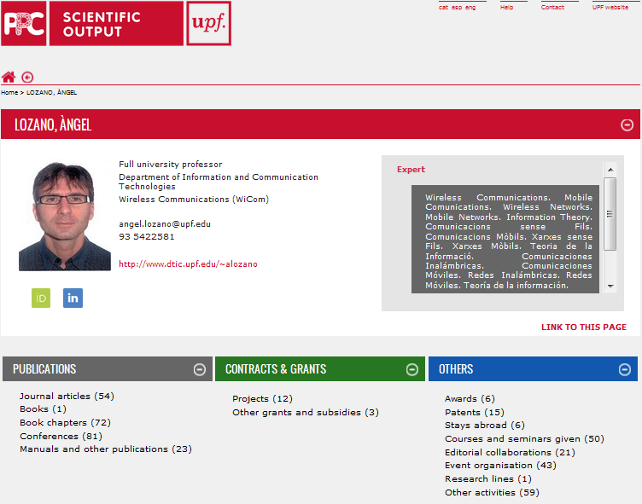

Slide 7
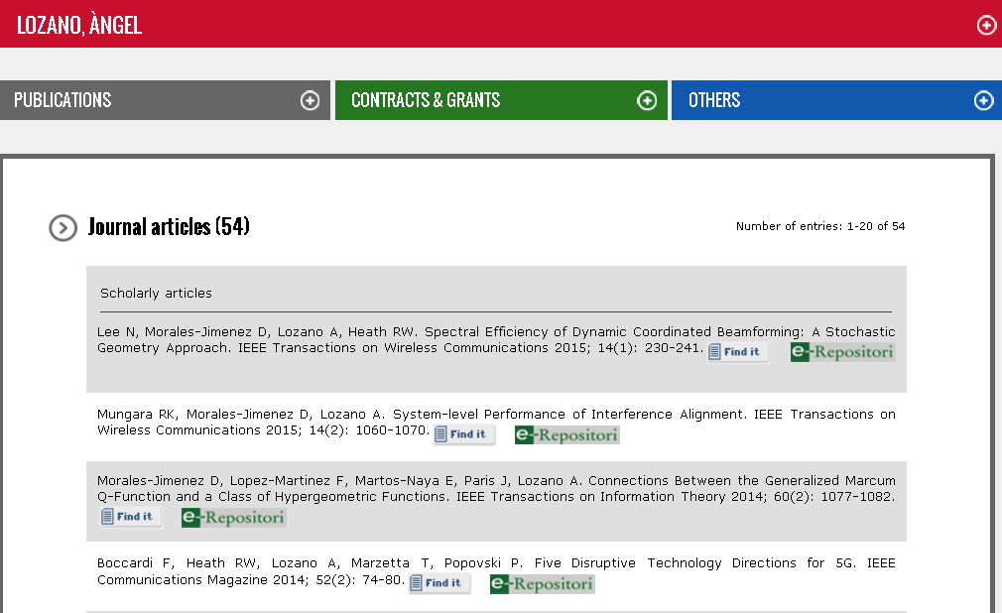

Slide 8
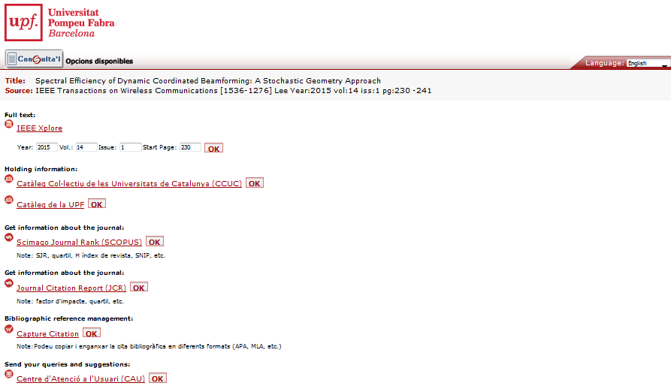

Slide 9
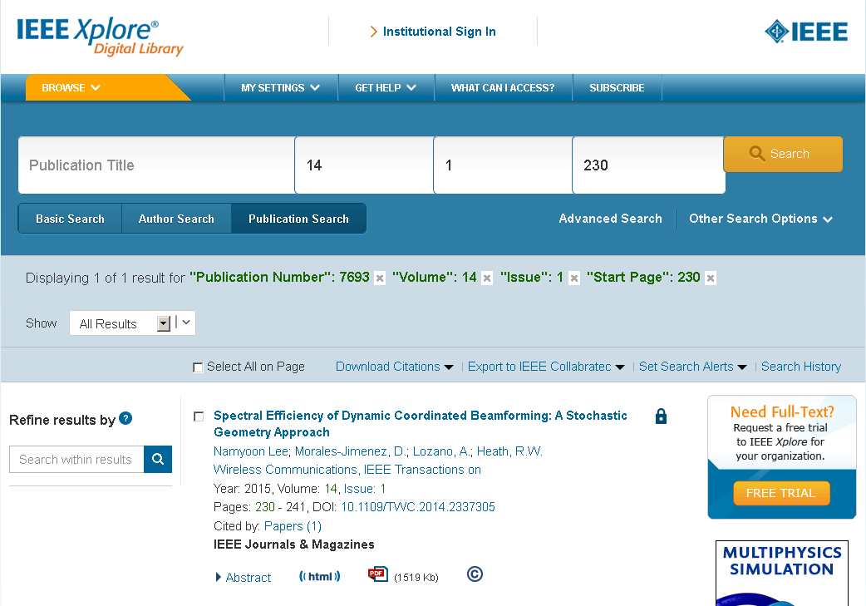

Slide 11
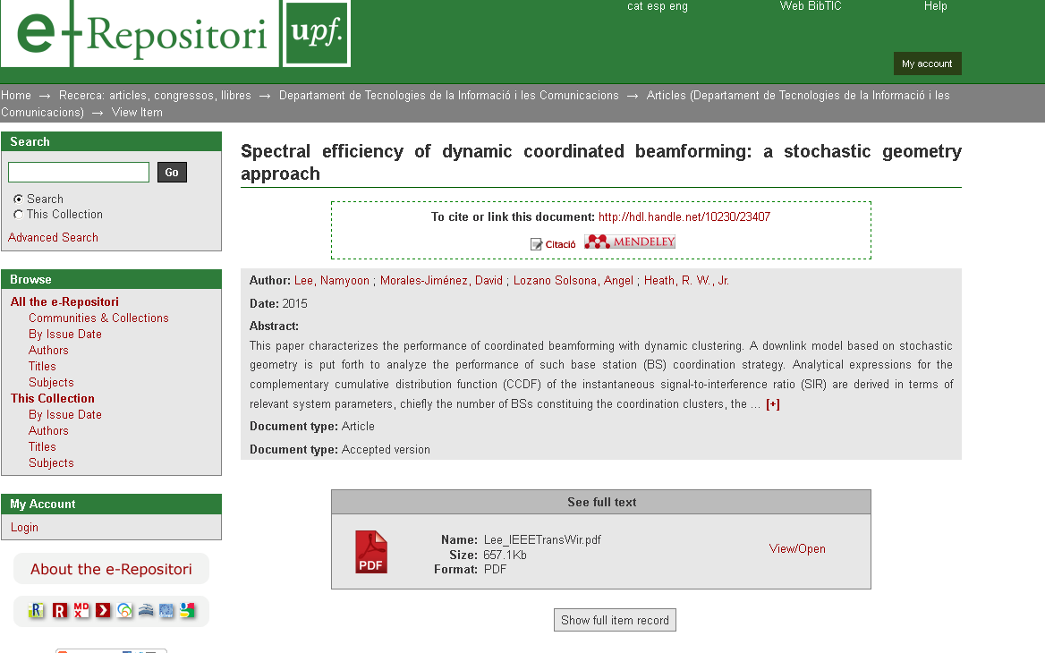

Slide 12
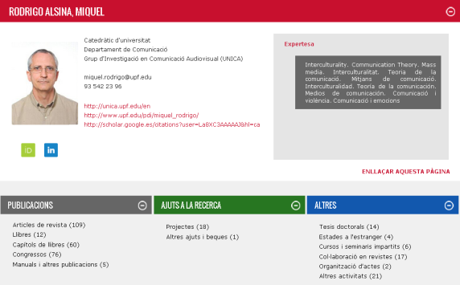
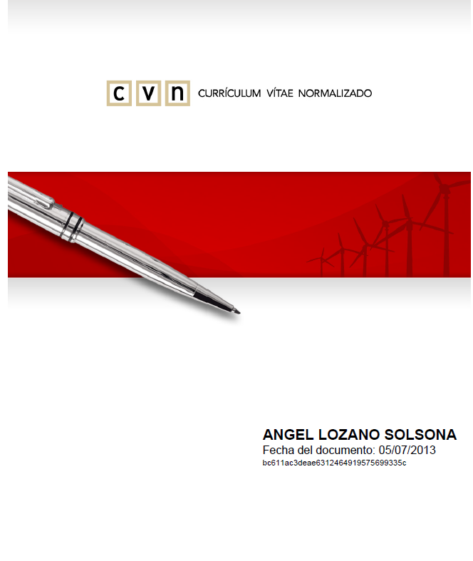
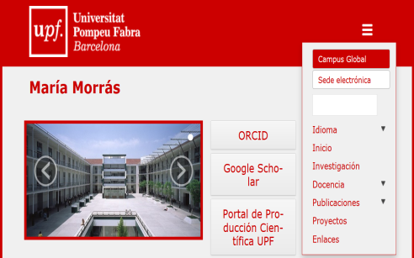
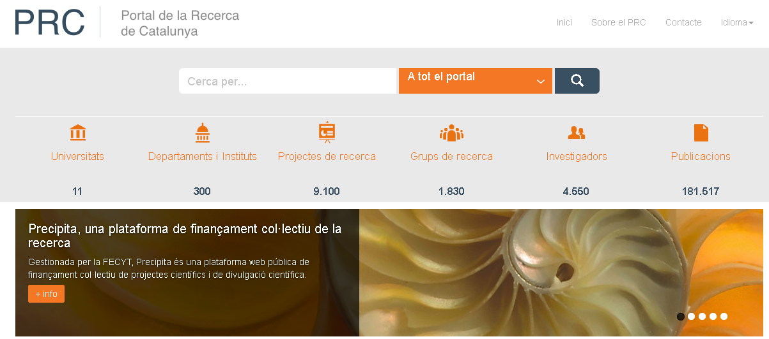
Scientific output at the UPF
Experts guide
CV
PRC
Liferay
Researchers’
web pages
Information
for the media
CVA
CVN
CV AQU
Customized CV
Portal de la
Recerca de
Catalunya

Slide 13
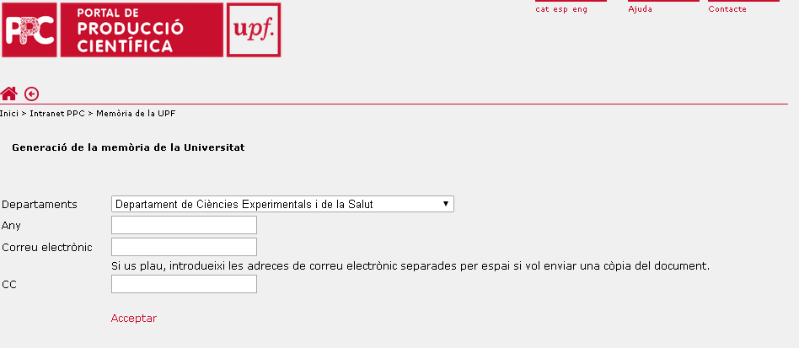
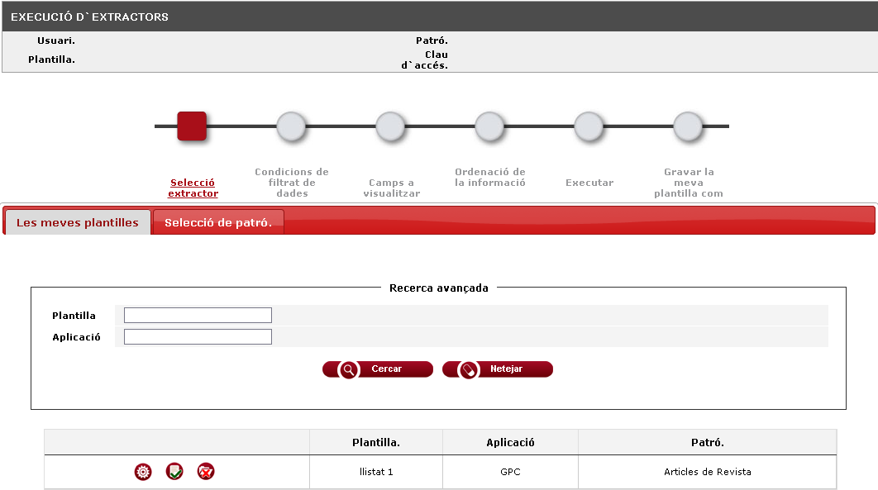
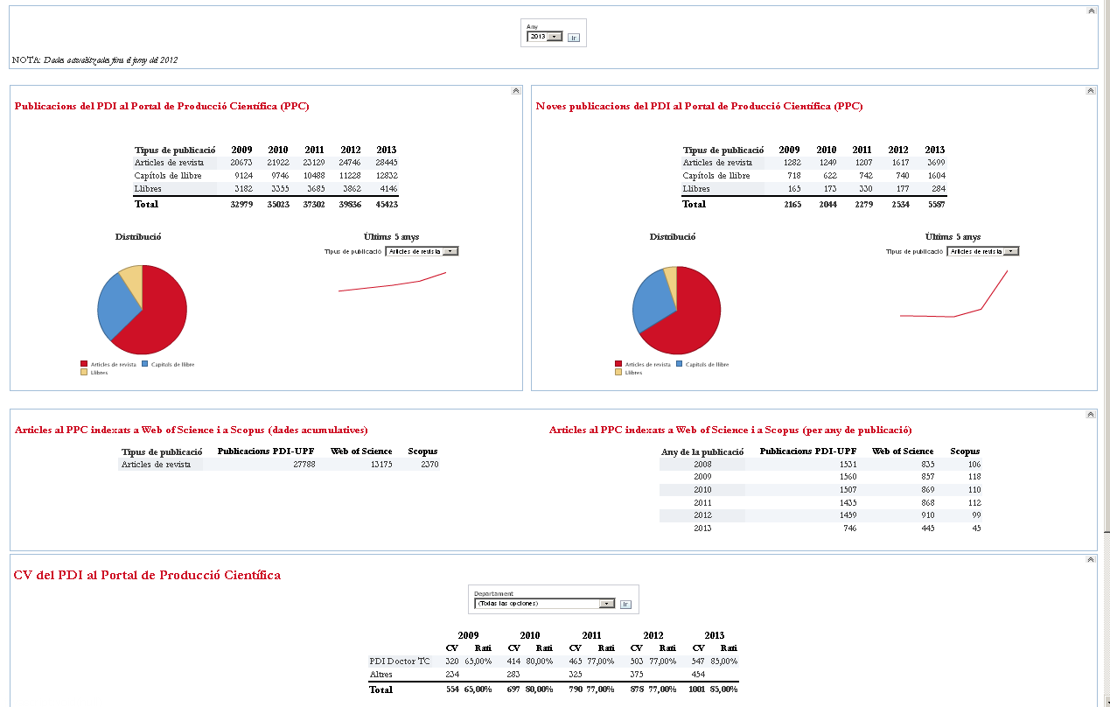
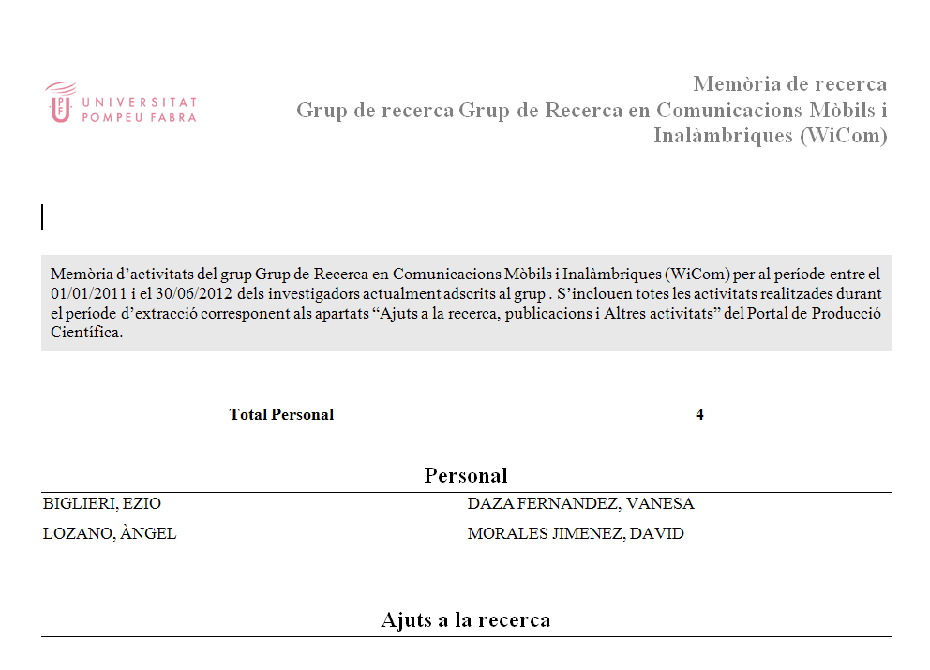
Scientific output at the UPF
by
Department
Group
Unit
Annual report
UPF reports
Explodat
Datawarehouse
Researchers’
publicationss
Excel files
Control panel

Slide 14
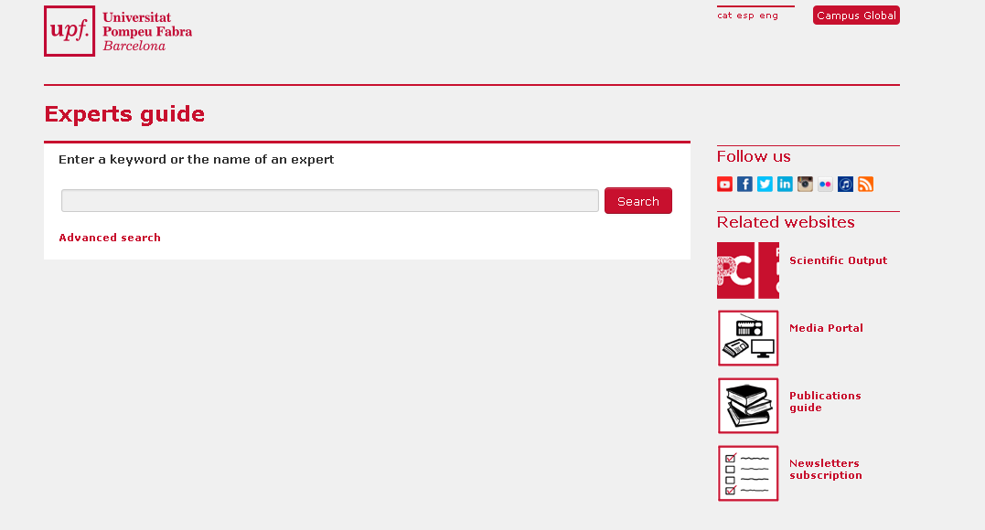

Slide 15
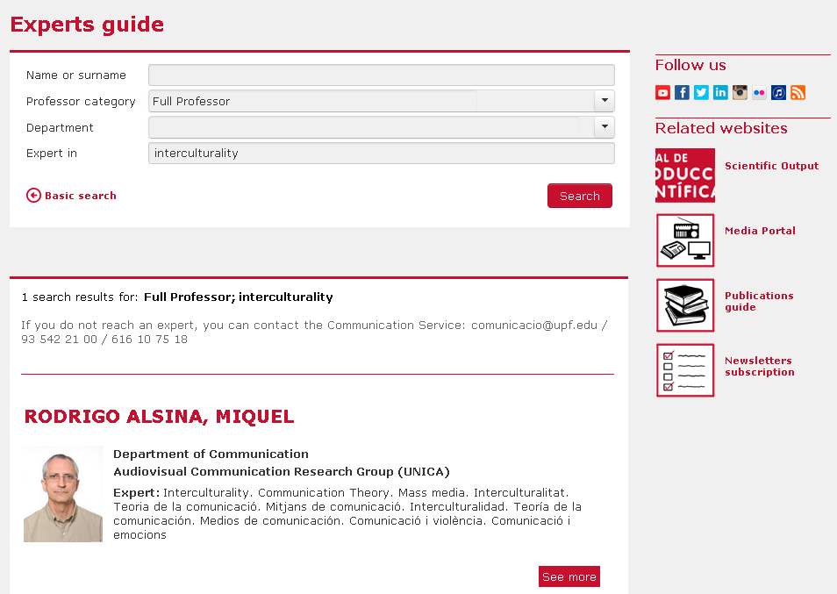

Slide 16


Slide 17
Scientific output at the UPF
CRIS
Repository
Lines of work

Slide 19
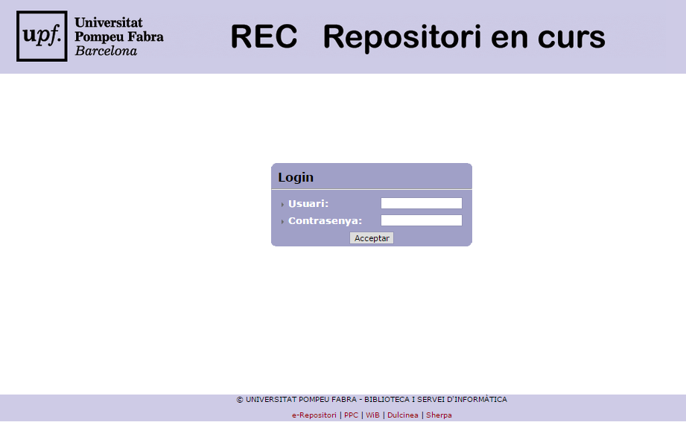

Slide 20
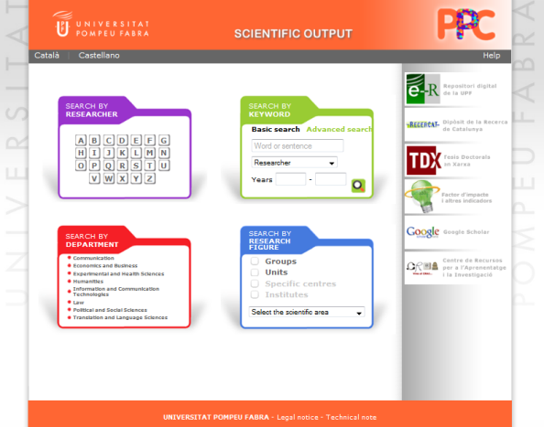
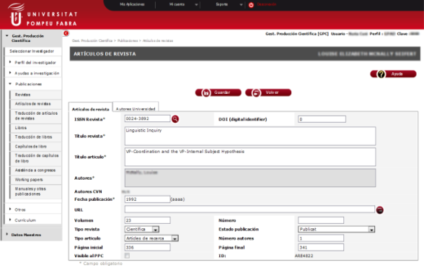


Repository
Back-end
Front-end
REC
e-Repositori
Publication
Search
Input
Validation

Slide 21
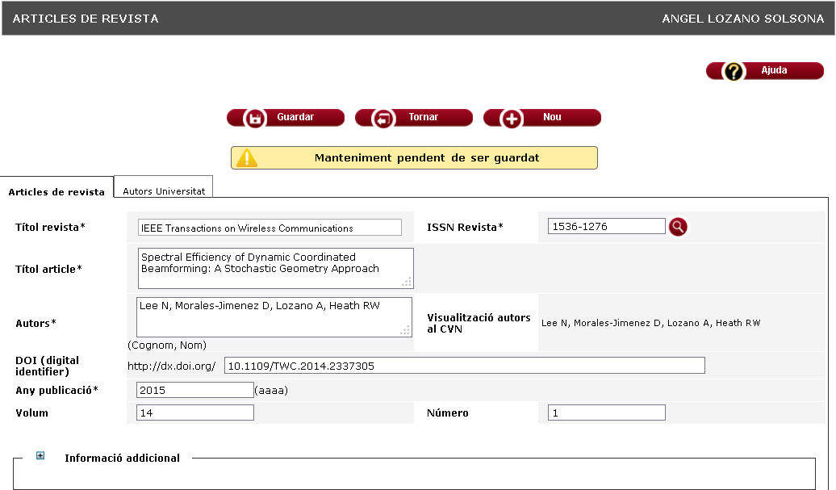

Slide 22
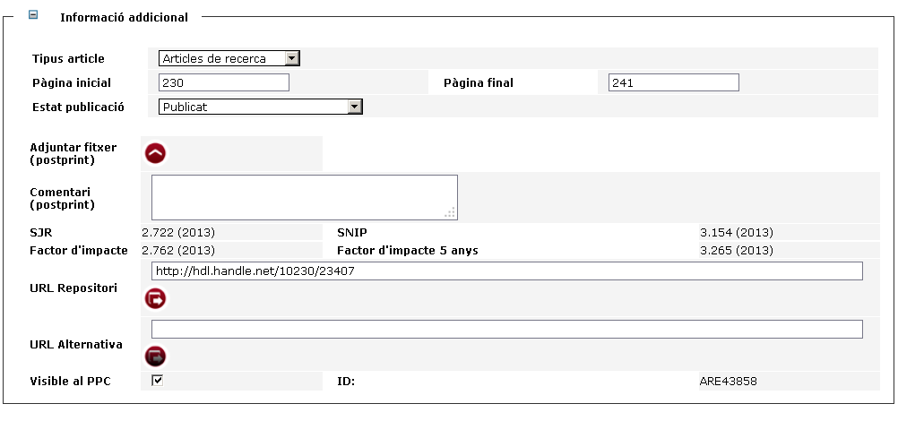

Slide 23
Scientific output at the UPF

Slide 24
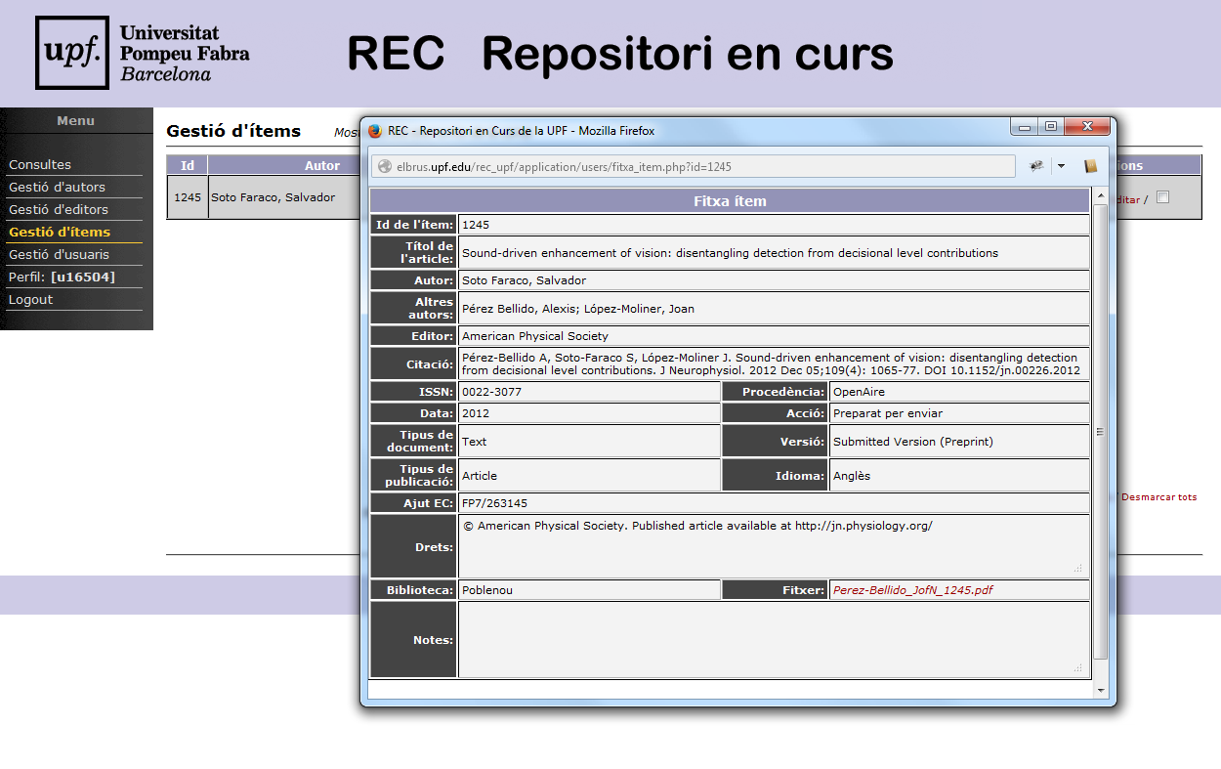
Scientific output at the UPF

Slide 25
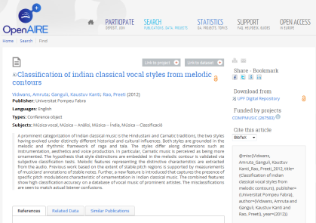
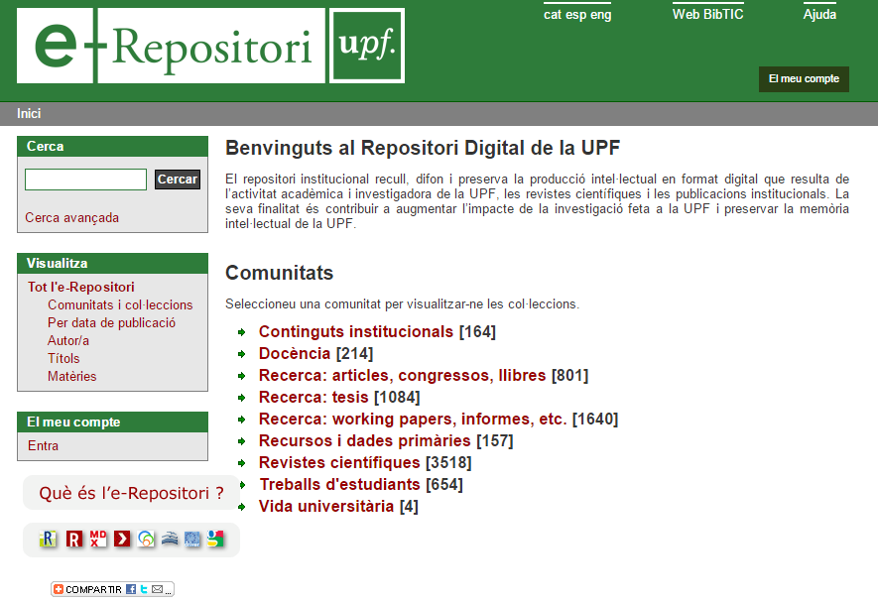
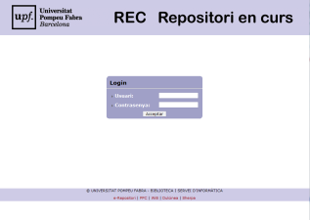
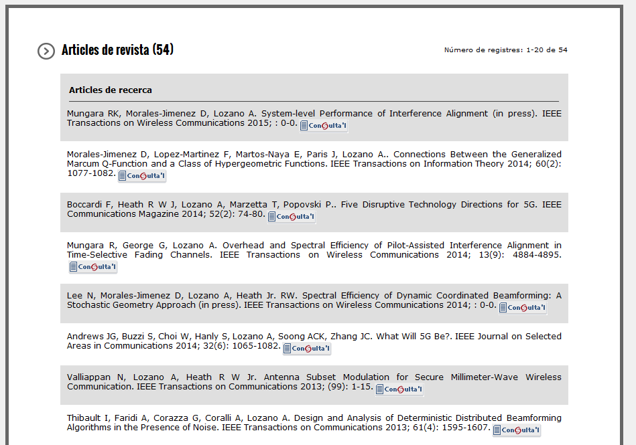
Discovery
Repository
Management
Publications

Slide 26
Scientific output at the UPF
CRIS
Repository
Lines of work

Slide 27
Scientific output at the UPF
Lines of work:
To improve bibliometric indicators in the CRIS
Continuous improvement of loads from WoS and Scopus
To increase the search capabilities in our CRIS and Experts guide
To link the CRIS and the repository via webservice

Slide 28


