Slide 1
11th euroCRIS Strategic Seminar
ScienceAtlas.ijs.si
euroCRIS 2013
Brusel, September 10th 2013
Gaber Cerle, JSI

Slide 2

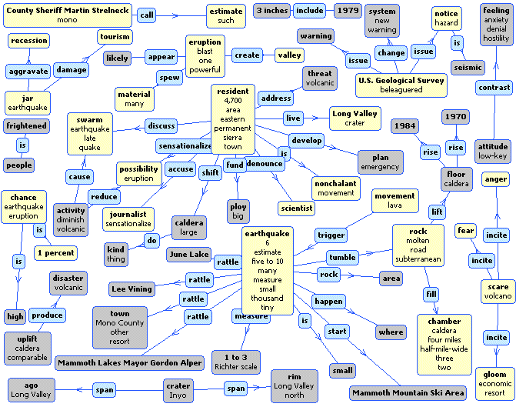
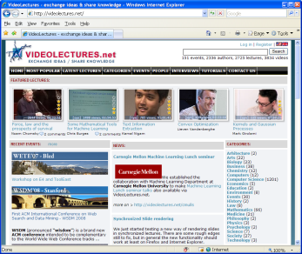
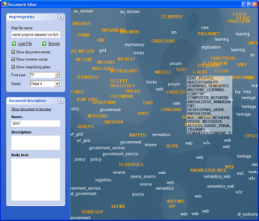
Jozef Stefan Institute Artificial Intelligence Laboratory
Jozef Stefan Institute (JSI) is the leading Slovene research institution for natural sciences (900+ people) in the areas of computer science, physics, chemistry
Artificial Intelligence Laboratory has approx. 40 people working in various areas of artificial intelligence (machine learning, data mining, semantic technologies, computational linguistics, decision support)
Spinouts: Quintlligence, Cyc-Europe, LiveNetLife, BlueEye, Envigence
Academic Partners: Carnegie Mellon, Cornel, Stanford, MIT, Uni. Maryland, KIT, UCL, W3C
Business Clients: Accenture Labs, Bloomberg, British Telecom, Google Labs, Microsoft Research, New York Times, Siemens, Wikipedia
Selection of Portals and Products:
  Text-Garden (http://www.textmining.net)
  Enrycher (http://enrycher.ijs.si/)
  VideoLectures.NET (http://videolectures.net/)
  IST-World (http://www.ist-world.org/)
  Project Intelligence (http://pi.ijs.si/)
  Search-Point (http://searchpoint.ijs.si/)
  OntoGen (http://ontogen.ijs.si/)
  Document-Atlas (http://docatlas.ijs.si/)
  AnswerArt (http://answerart.net/)
  Sience-Atlas (http://scienceatlas.ijs.si/)
Semantic-Graphs
VideoLectures.NET
Document-Atlas

Slide 3
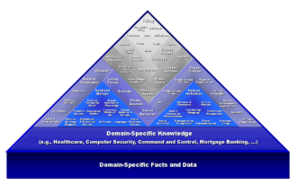
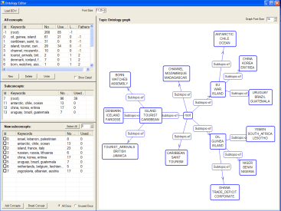
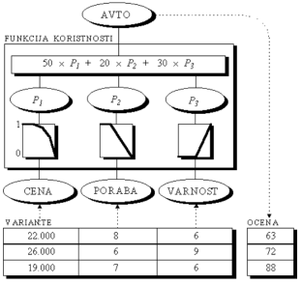
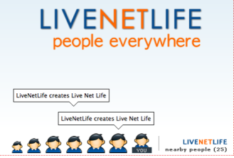
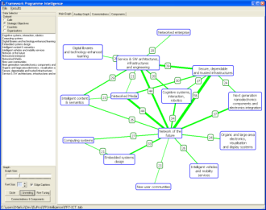
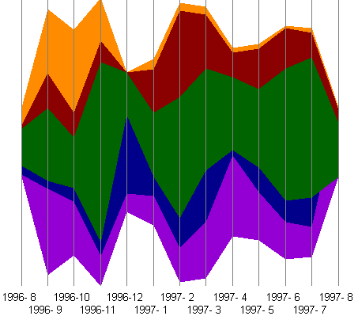
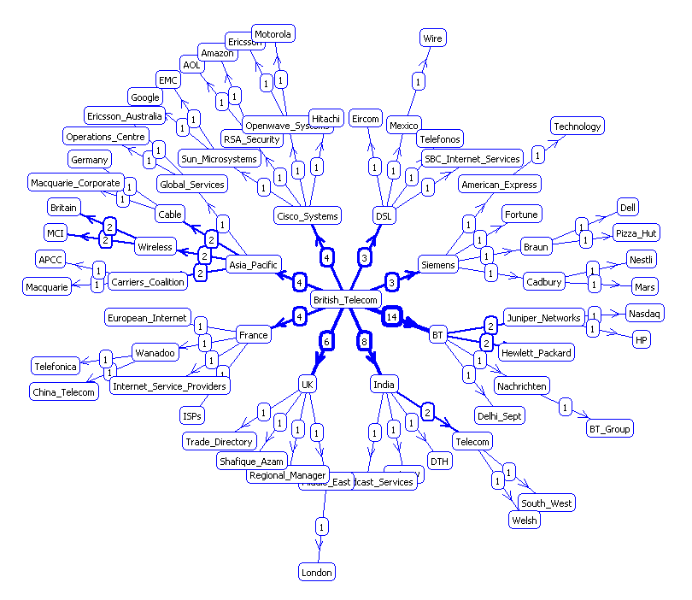
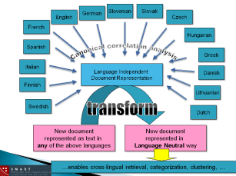
Technologies and Research
Deep Semantics & Reasoning (Cyc)
Light-Weight Semantic Technologies
(OntoGen, OntoBridge)
Decision Support (DEX)
Social Computing/Web2.0 (LiveNetLife)
Computational Linguistics
(Enrycher, AnswerArt)
Complex Data Visualization
(DocAtlas, NewsExplorer, SearchPoint)
Graph/Social Network Analysis
(GraphGarden/SNAP, IST-World, FPIntelligence)
Data/Web/Text/Stream-Mining
(TextGarden Suite of tools)
Statistical Machine Learning

Slide 4
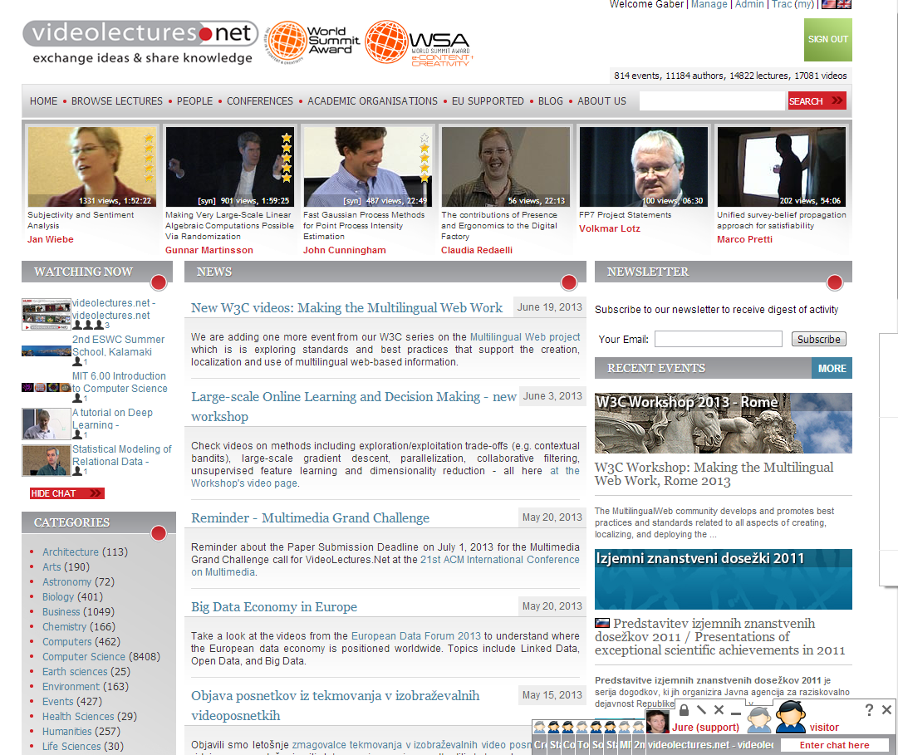

Slide 5

MediaMixer project (FP7)
VideoLectures.NET use case
http://community.mediamixer.eu/

Slide 6
ScienceAtlas
THE web portal exploring the scientific community in Slovenia
AILAB (JSI) + ARRS (SRA)
ScienceAtlas.IJS.si

Slide 7
Data Used
CERIF compliant ☺
siCRIS:
  942 research organizations,
  1491 research groups,
  14200 researchers,
  5713 research projects and
  451 research programs
COBISS - Co-operative Online Bibliographic System
VideoLectures.NET
FP7 (2007-2012)
Digital Library of Slovenia –consists of texts (journals, books, ARRS reports, academic achievements) and other types of media (photos, multimedia)

Slide 8
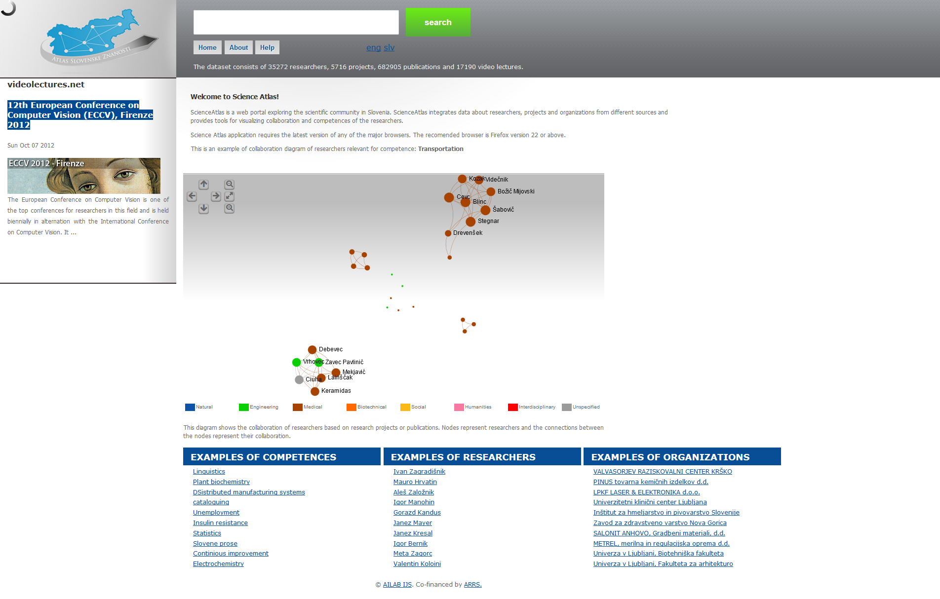

Slide 9
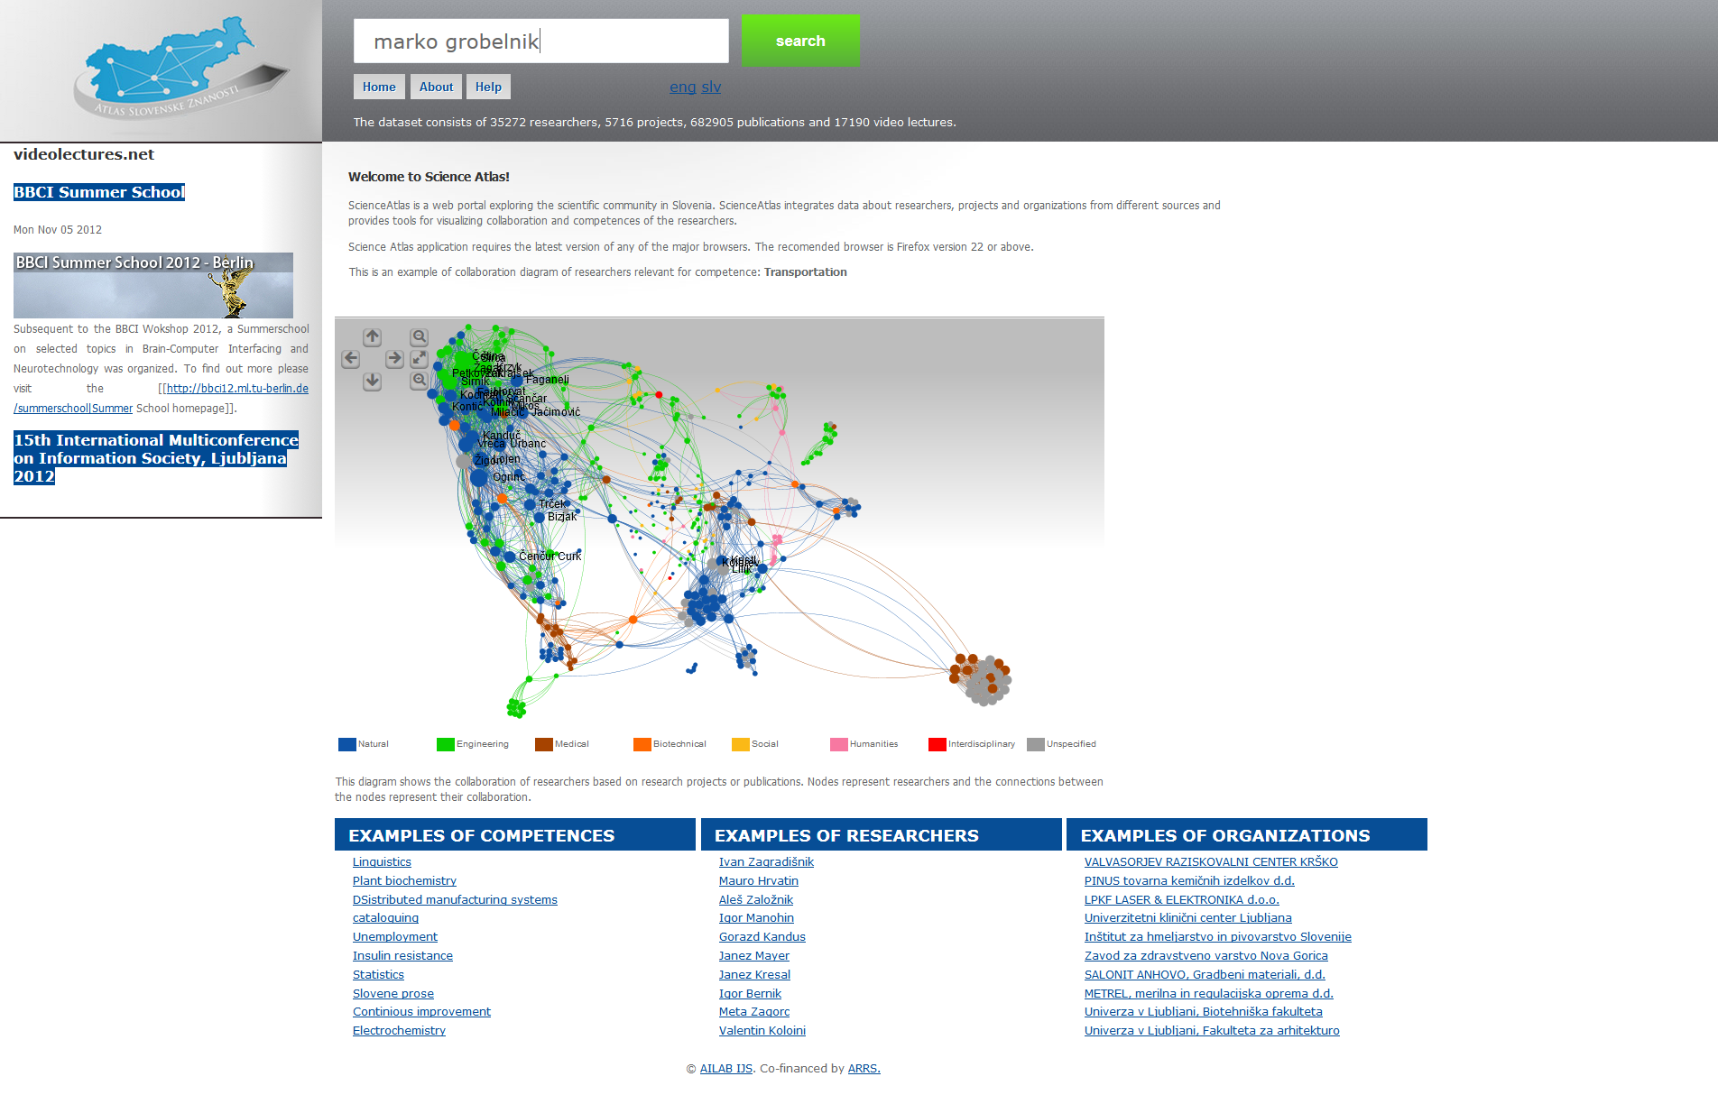

Slide 10
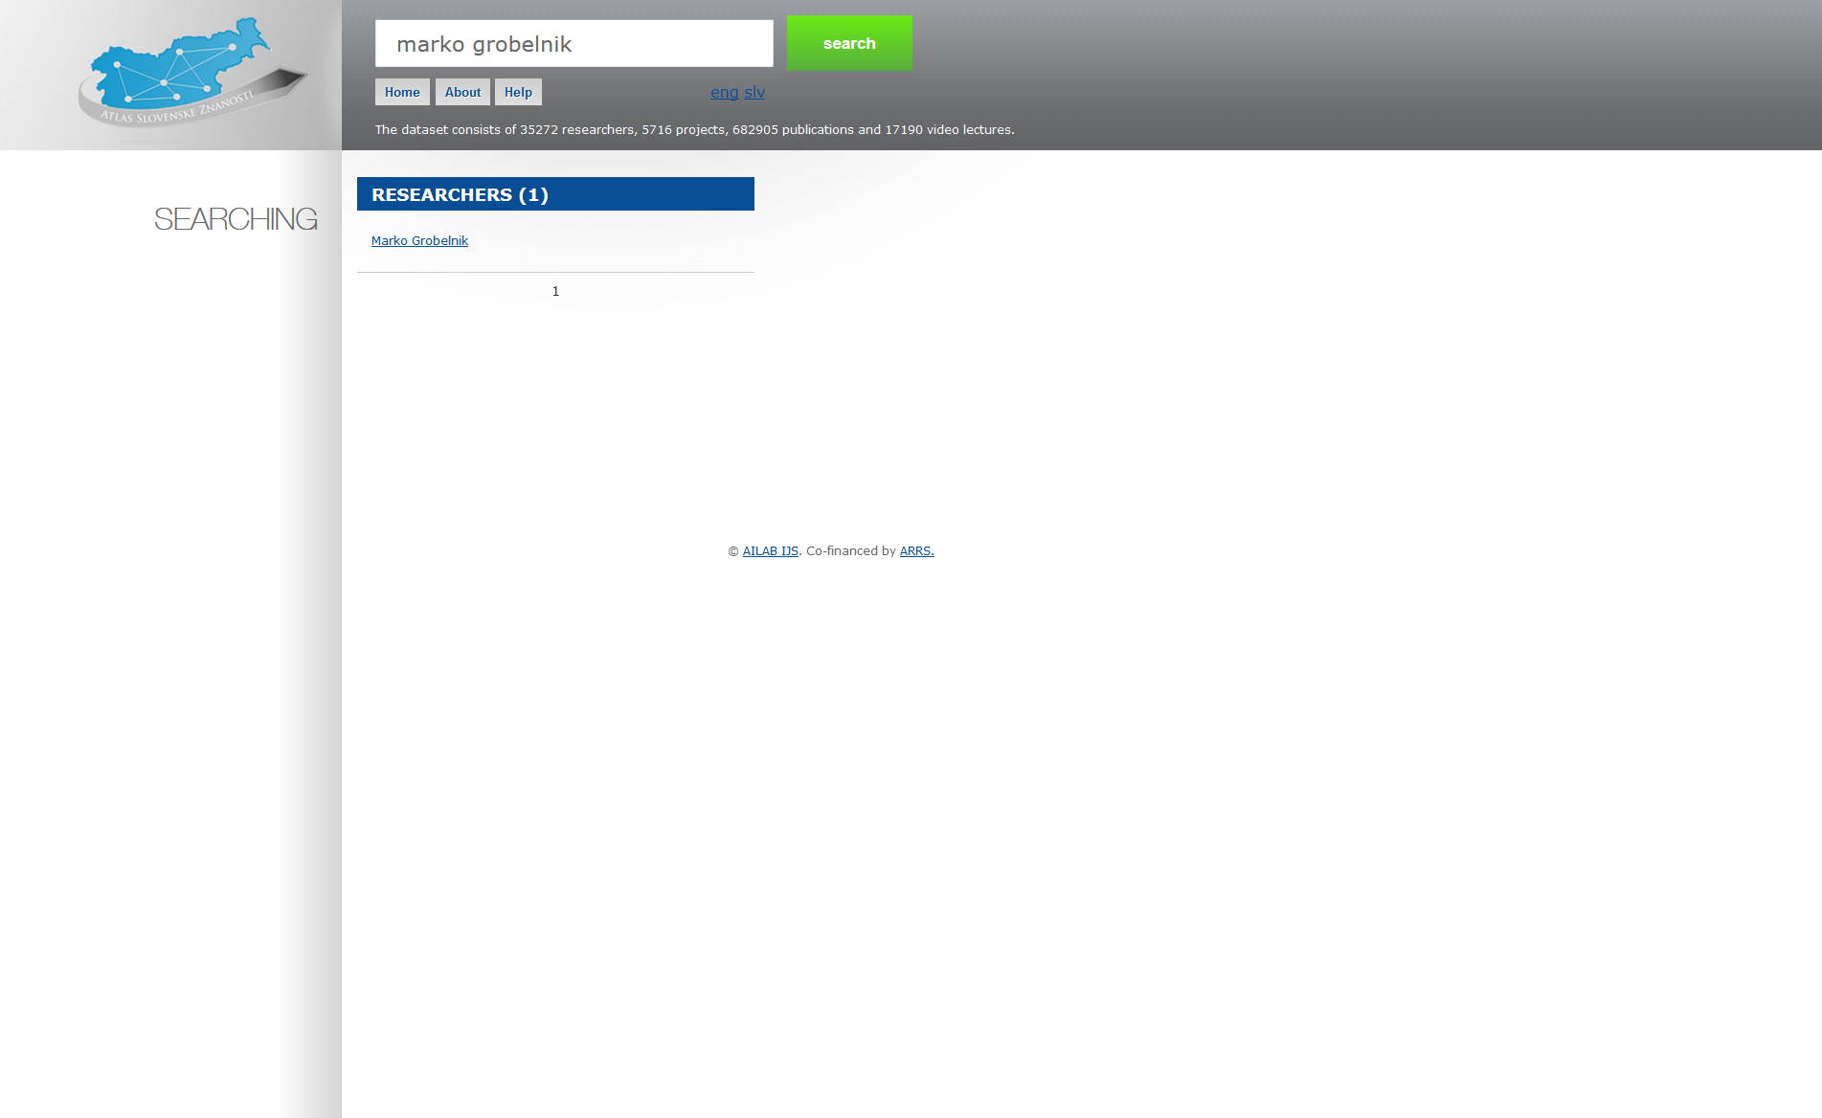

Slide 11
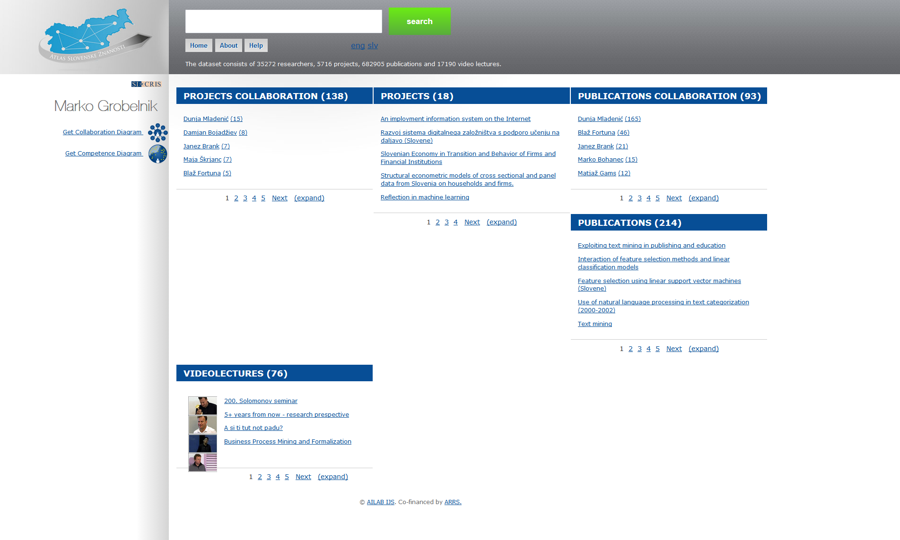

Slide 12
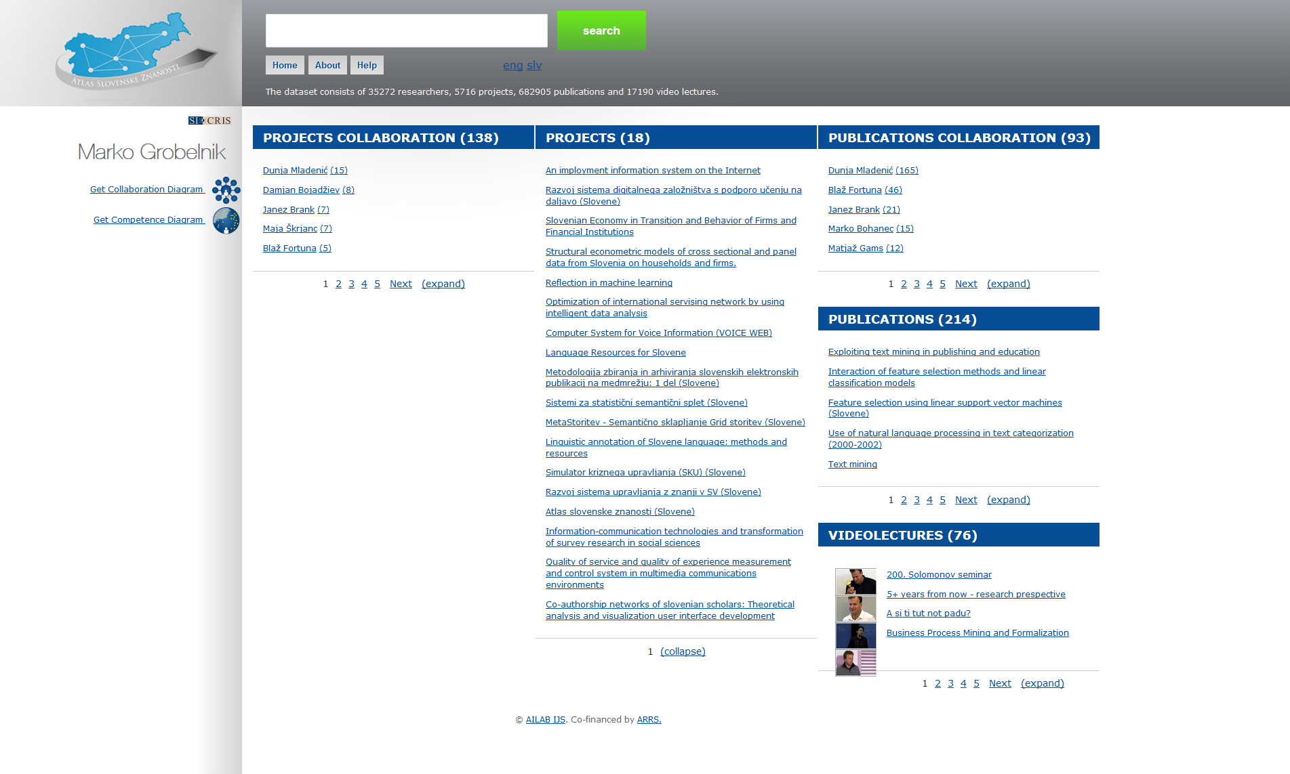

Slide 13
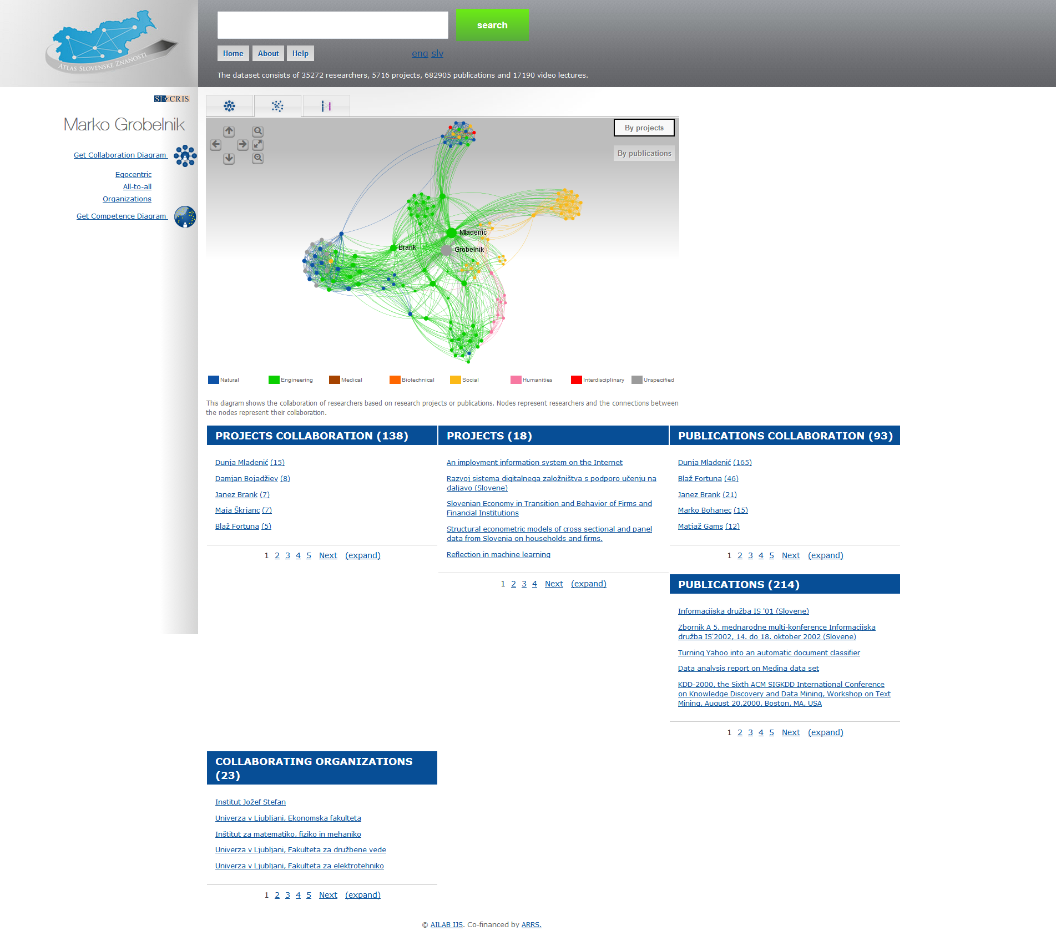

Slide 14
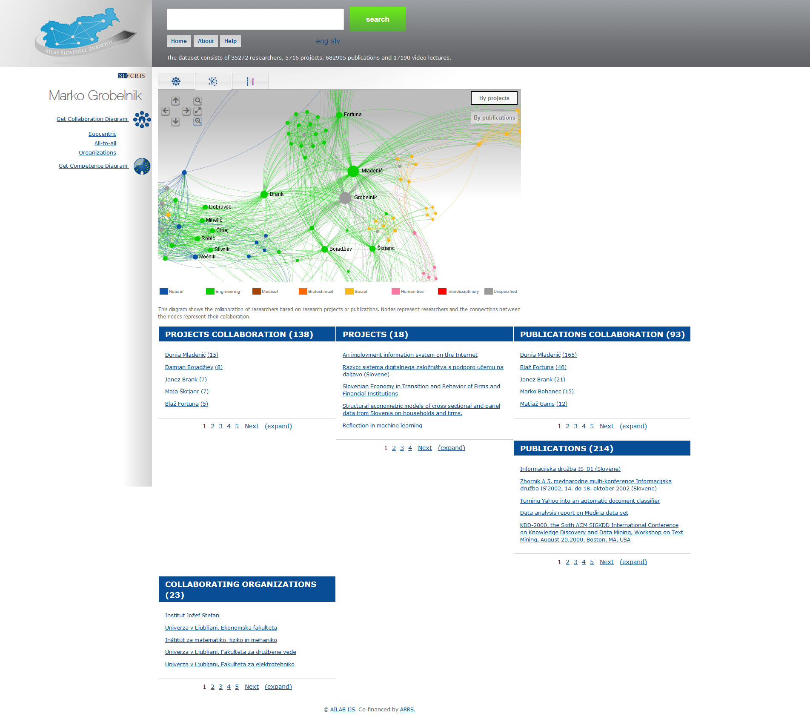

Slide 15
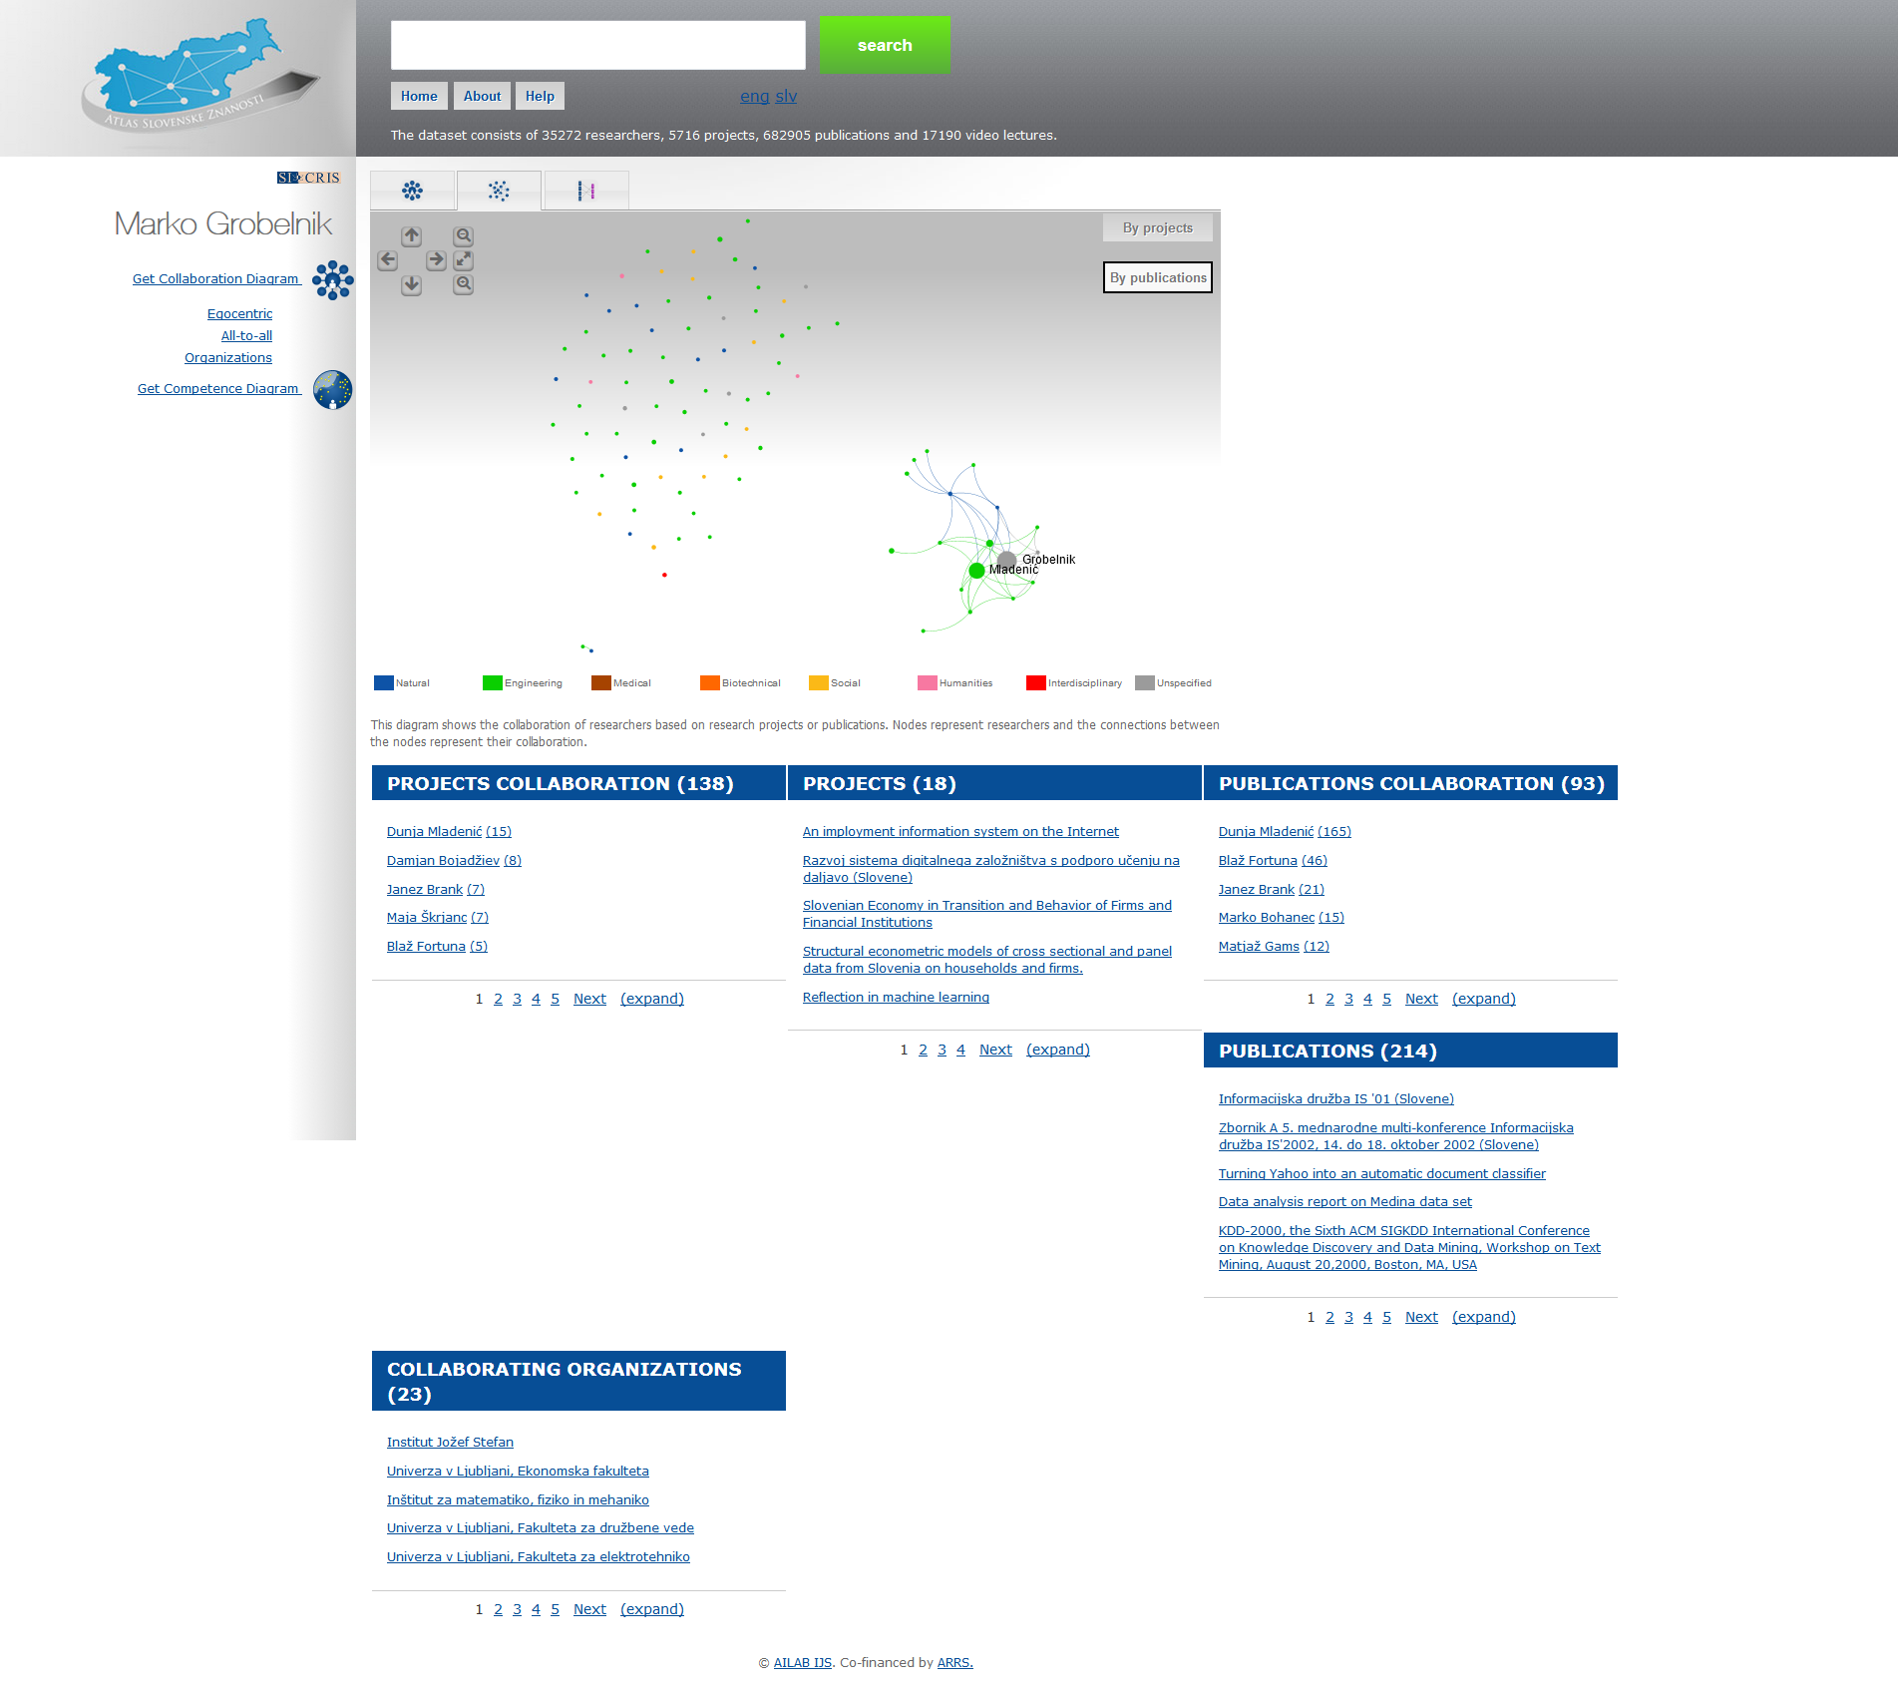

Slide 16
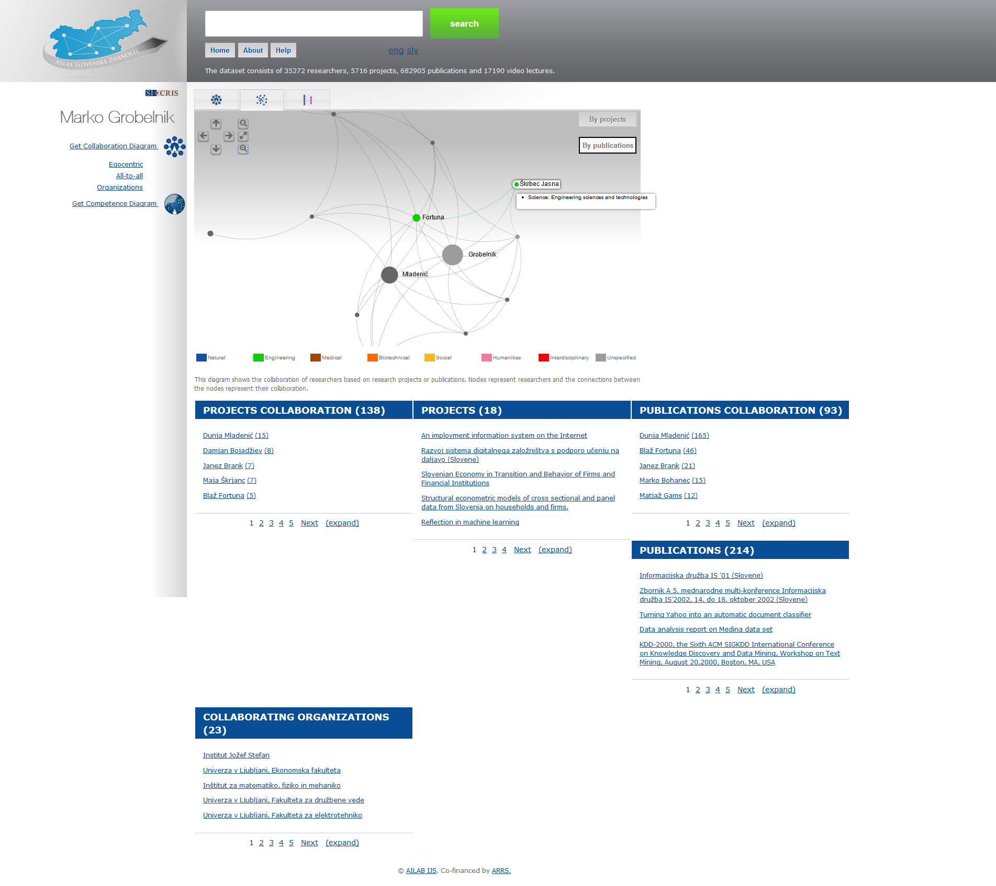

Slide 17


Slide 18
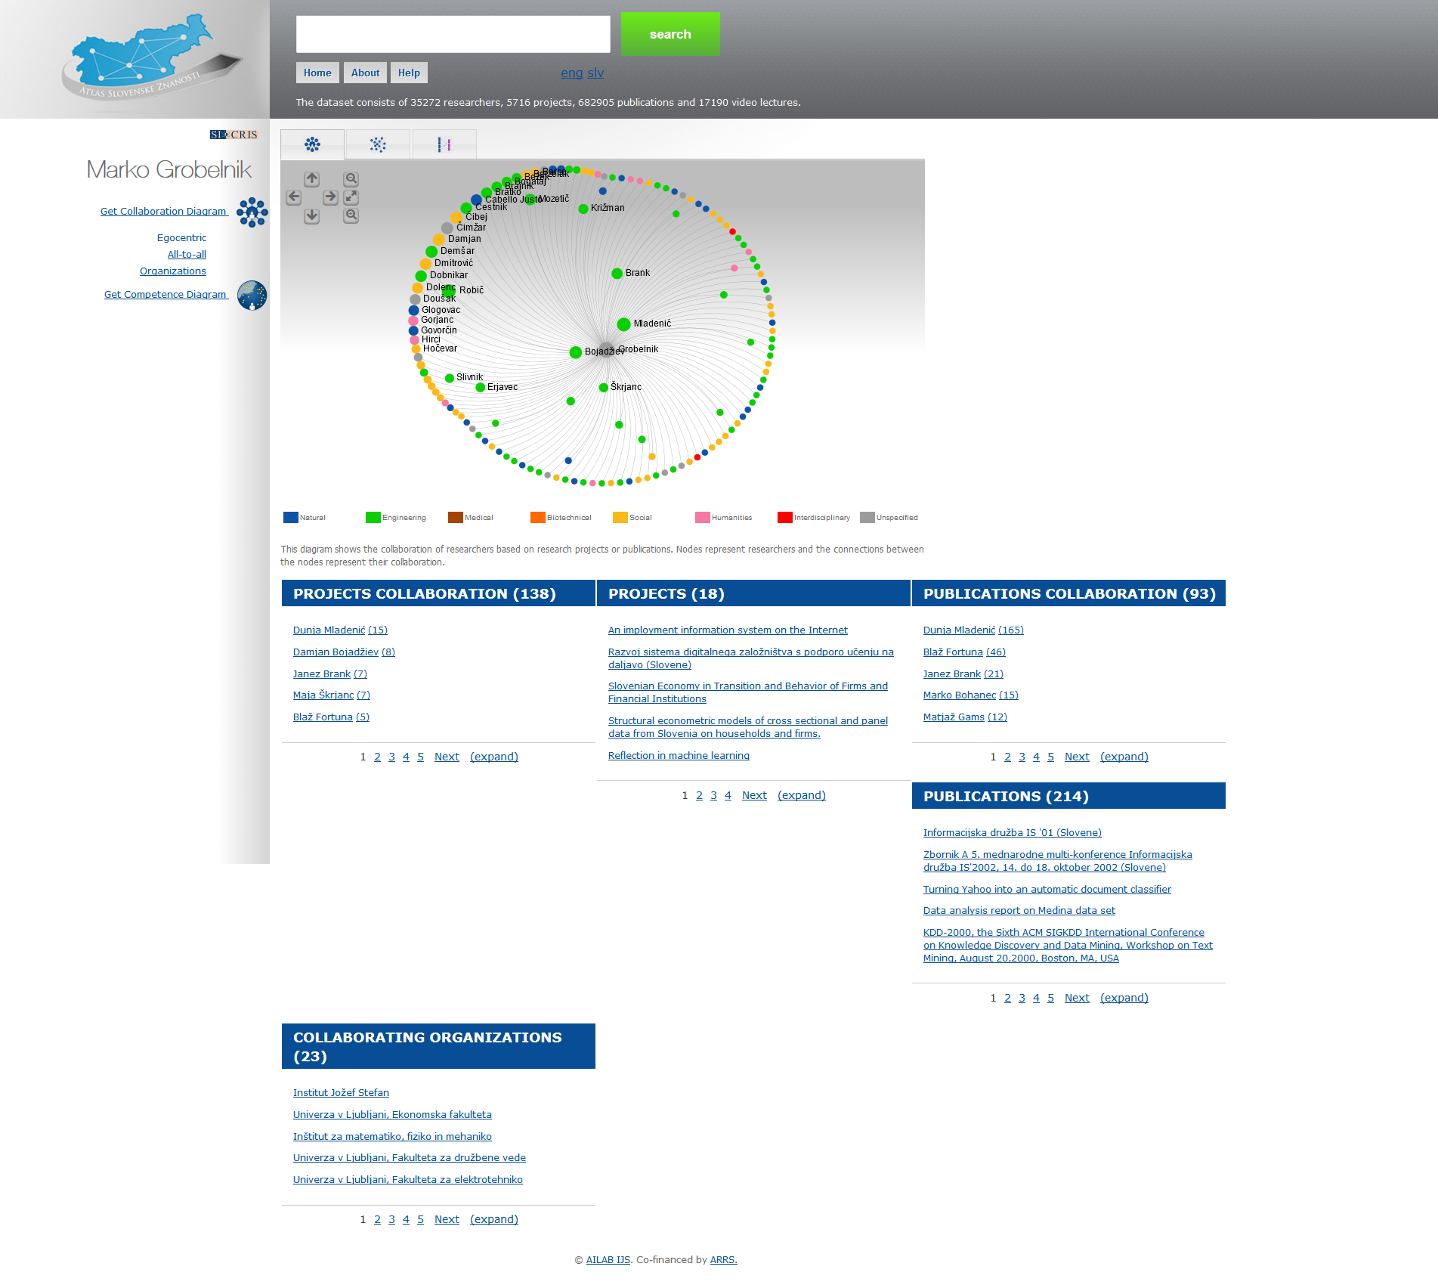

Slide 19
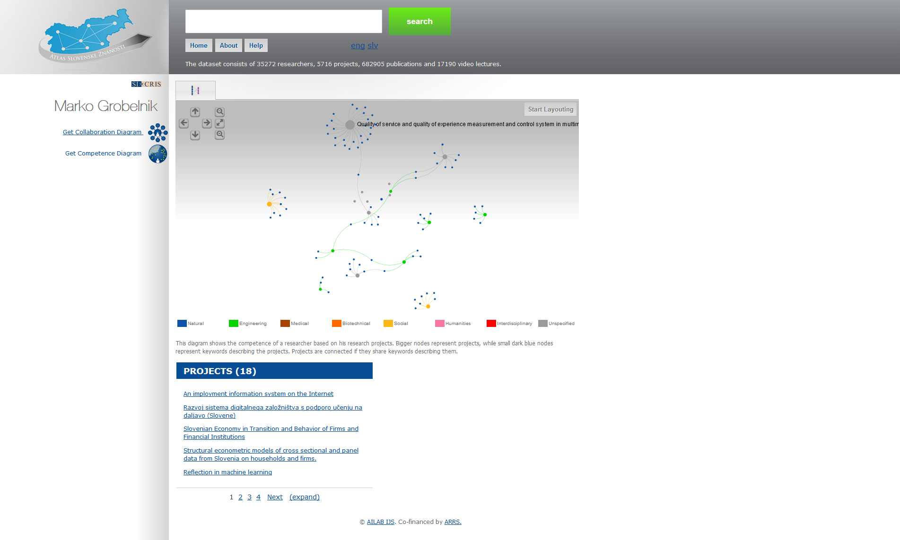

Slide 20
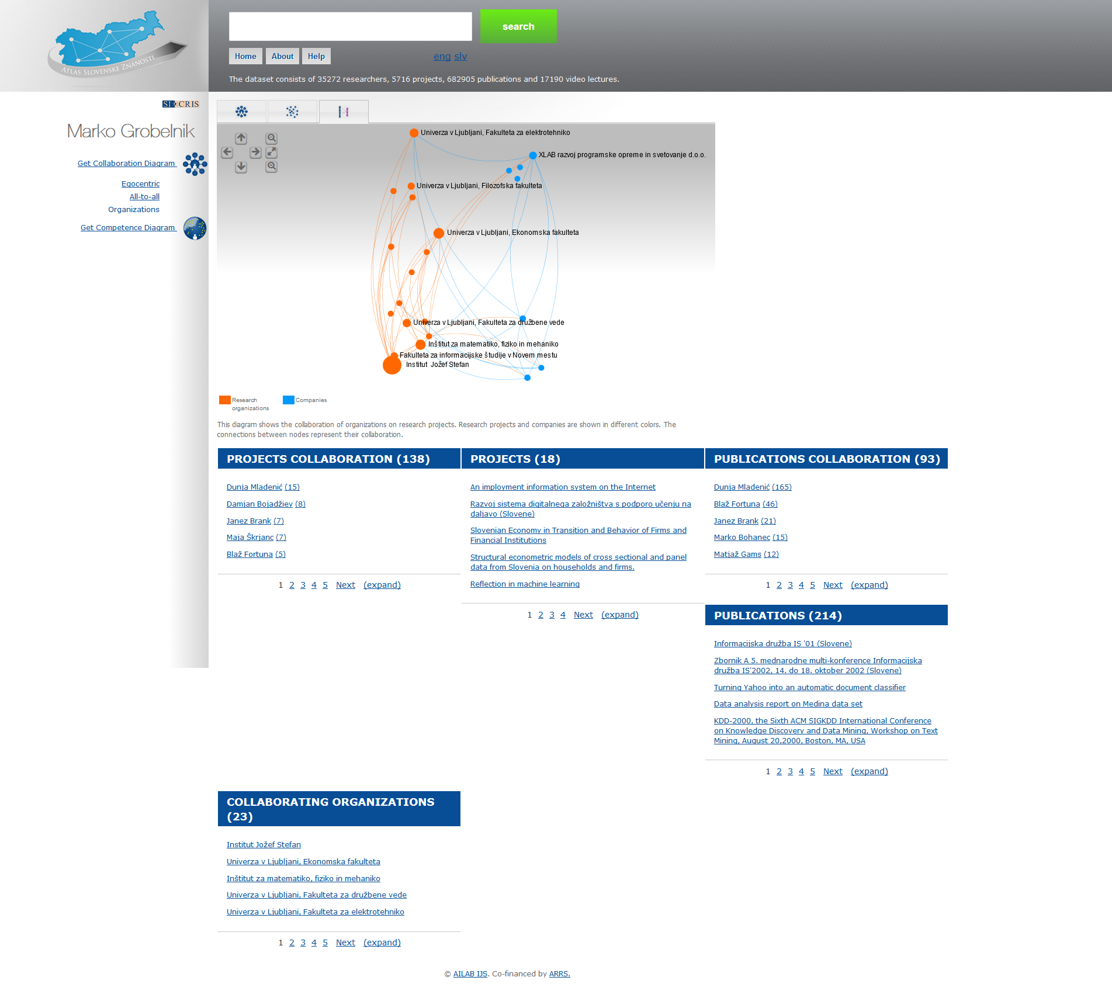

Slide 21
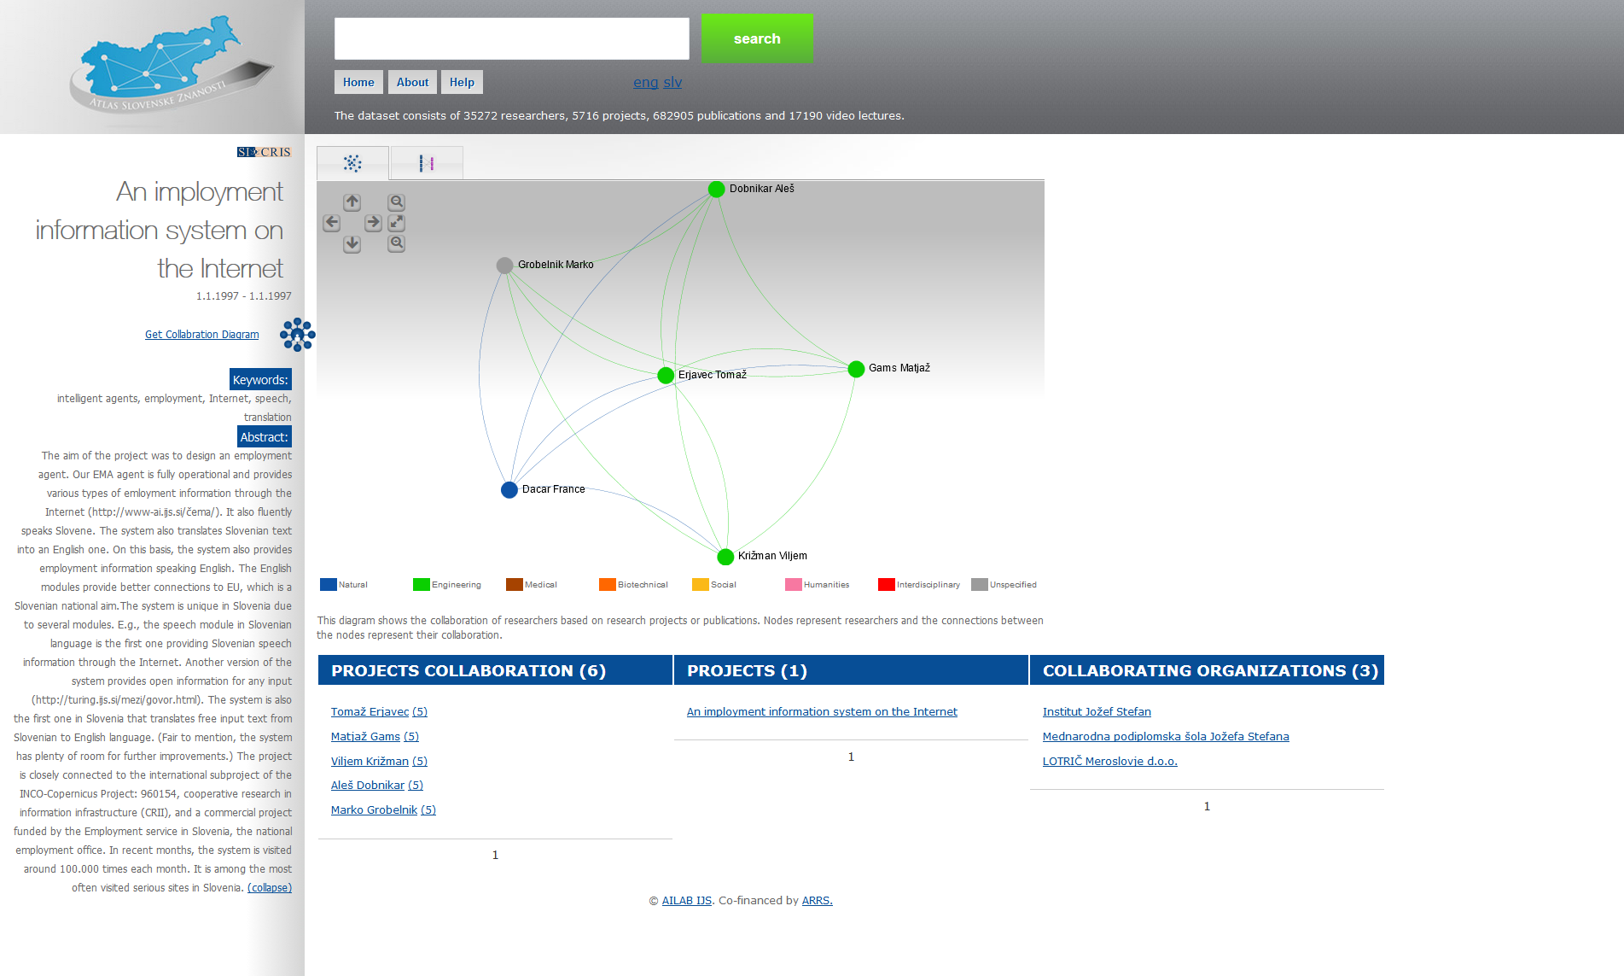

Slide 22
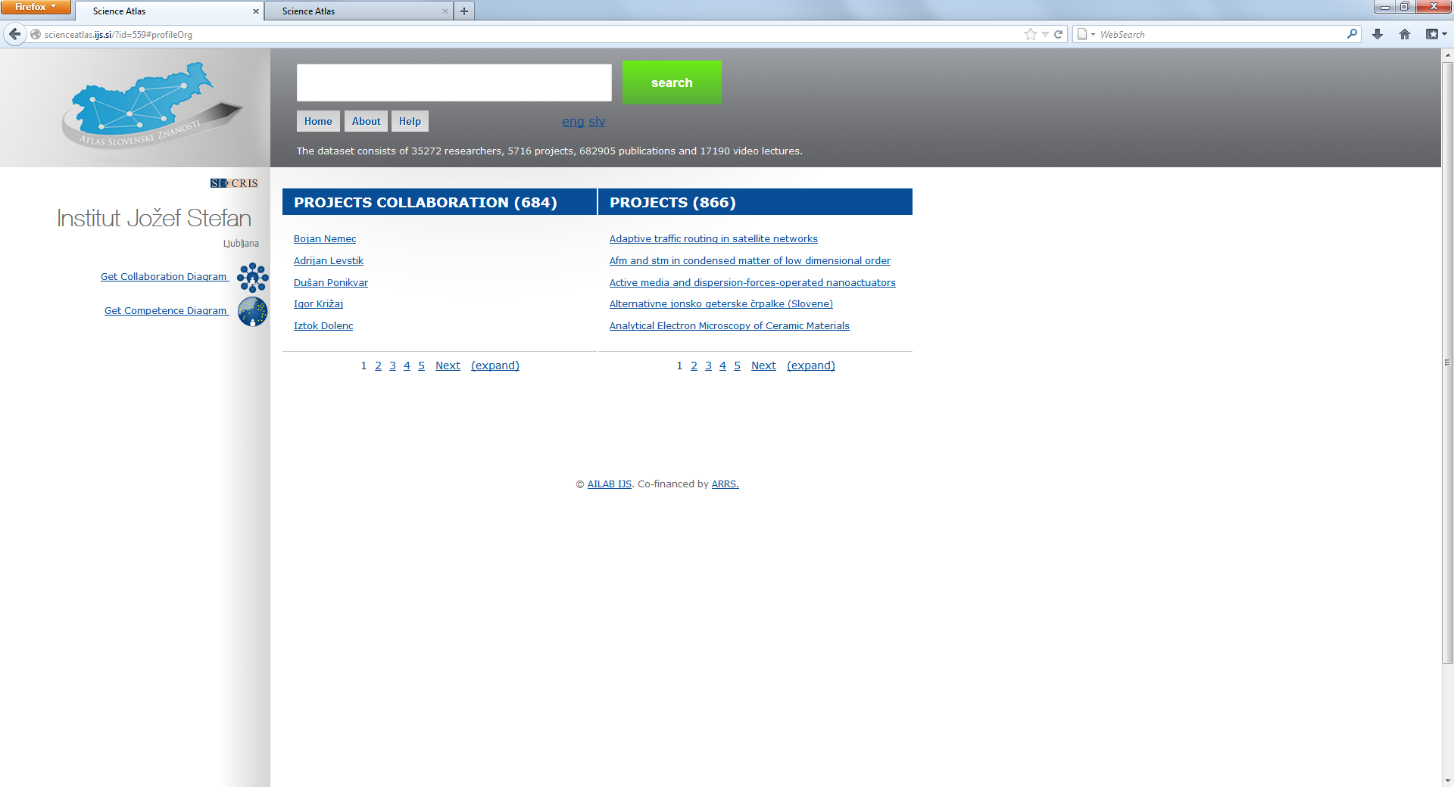

Slide 23
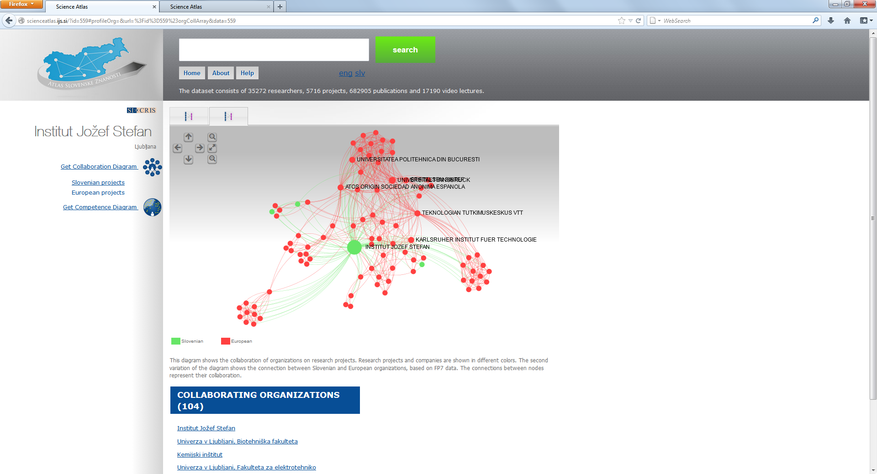

Slide 24
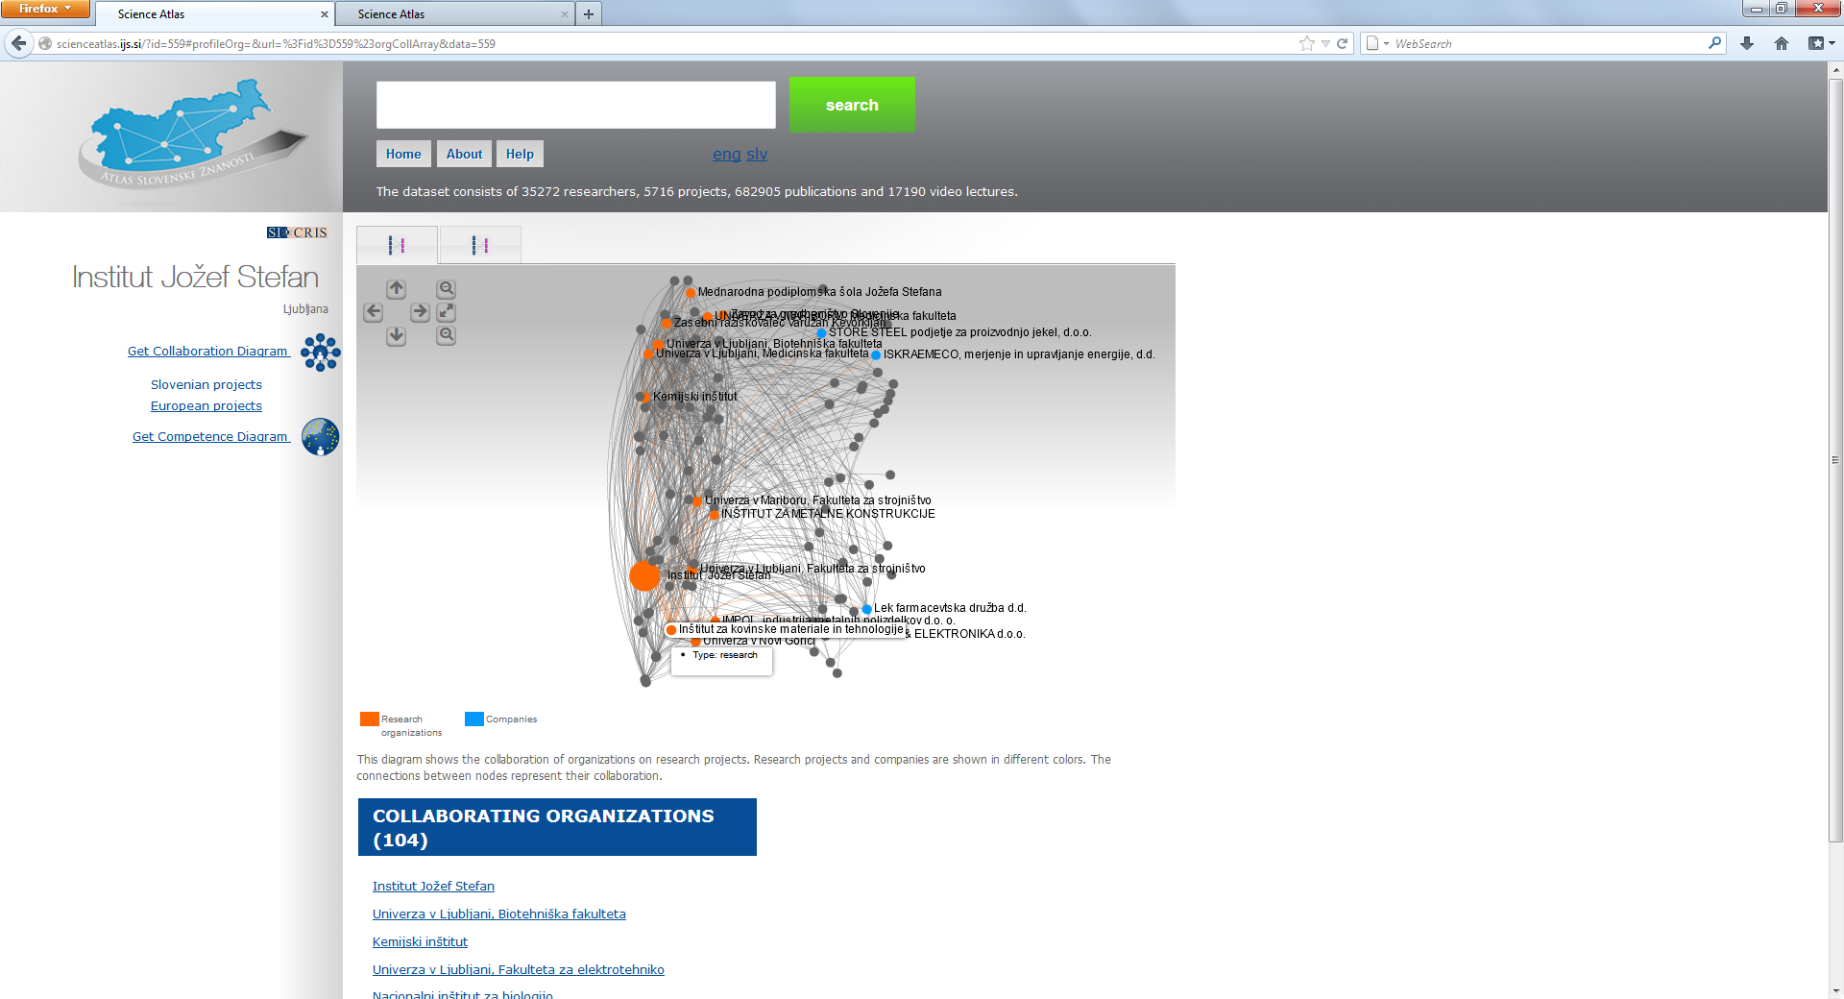

Slide 25
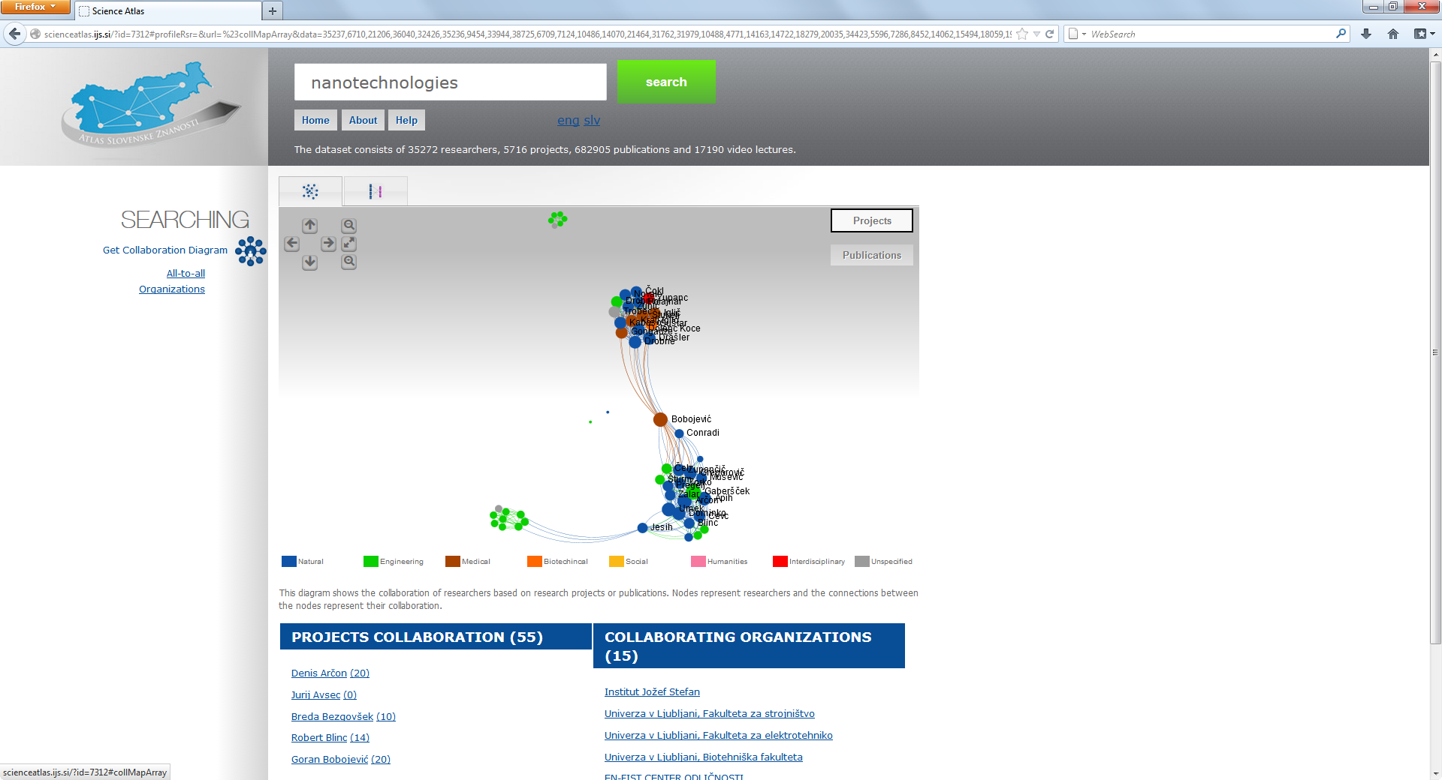

Slide 26
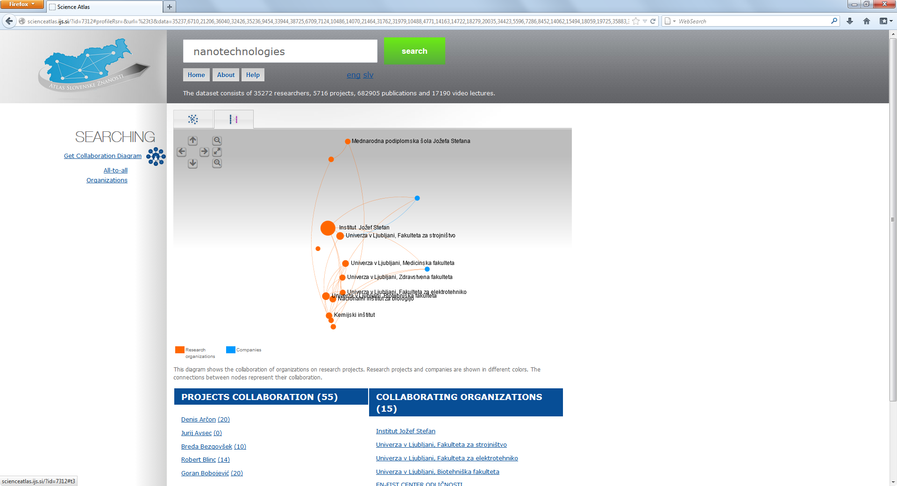

Slide 27
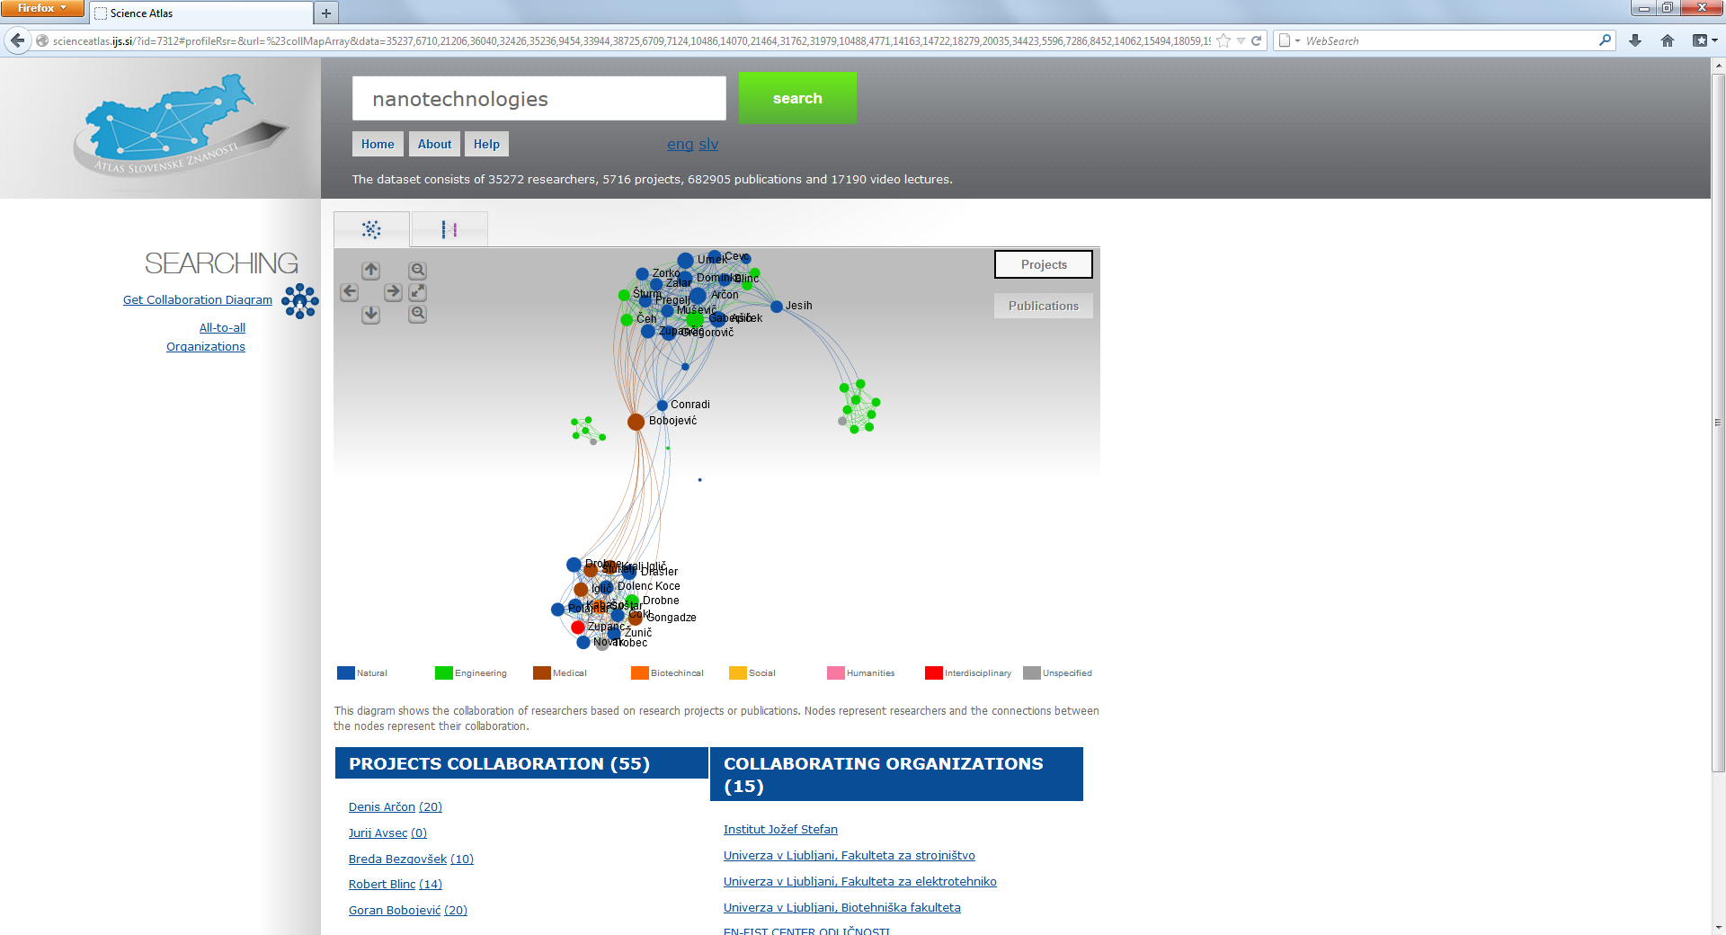

Slide 28
Future Goals
IST World Data incorporation (Information Society Technology)
ScienceAtlas is an analytics package – reuse in other CRIS-is? Transfer to commercial use?
Research areas forecasting

Slide 29
DocumentAtlas
A utility for visualizing large corpora of text documents.
First it identifies relevant semantics based on the documents from the input corpus.
Then the whole corpus is projected onto discovered semantics and positioned on a 2D plane using multidimensional scaling.

Slide 30
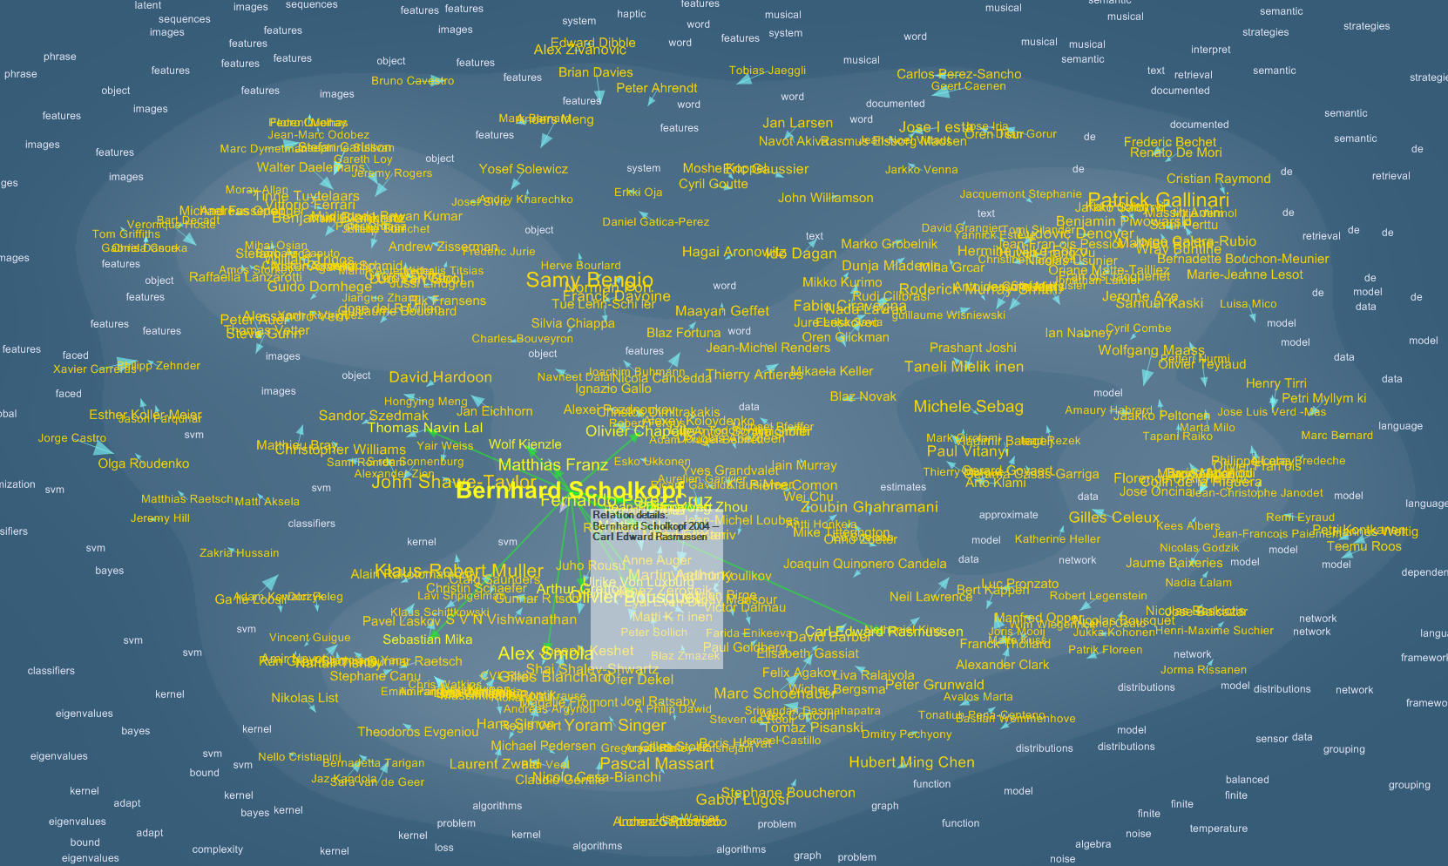

Slide 31
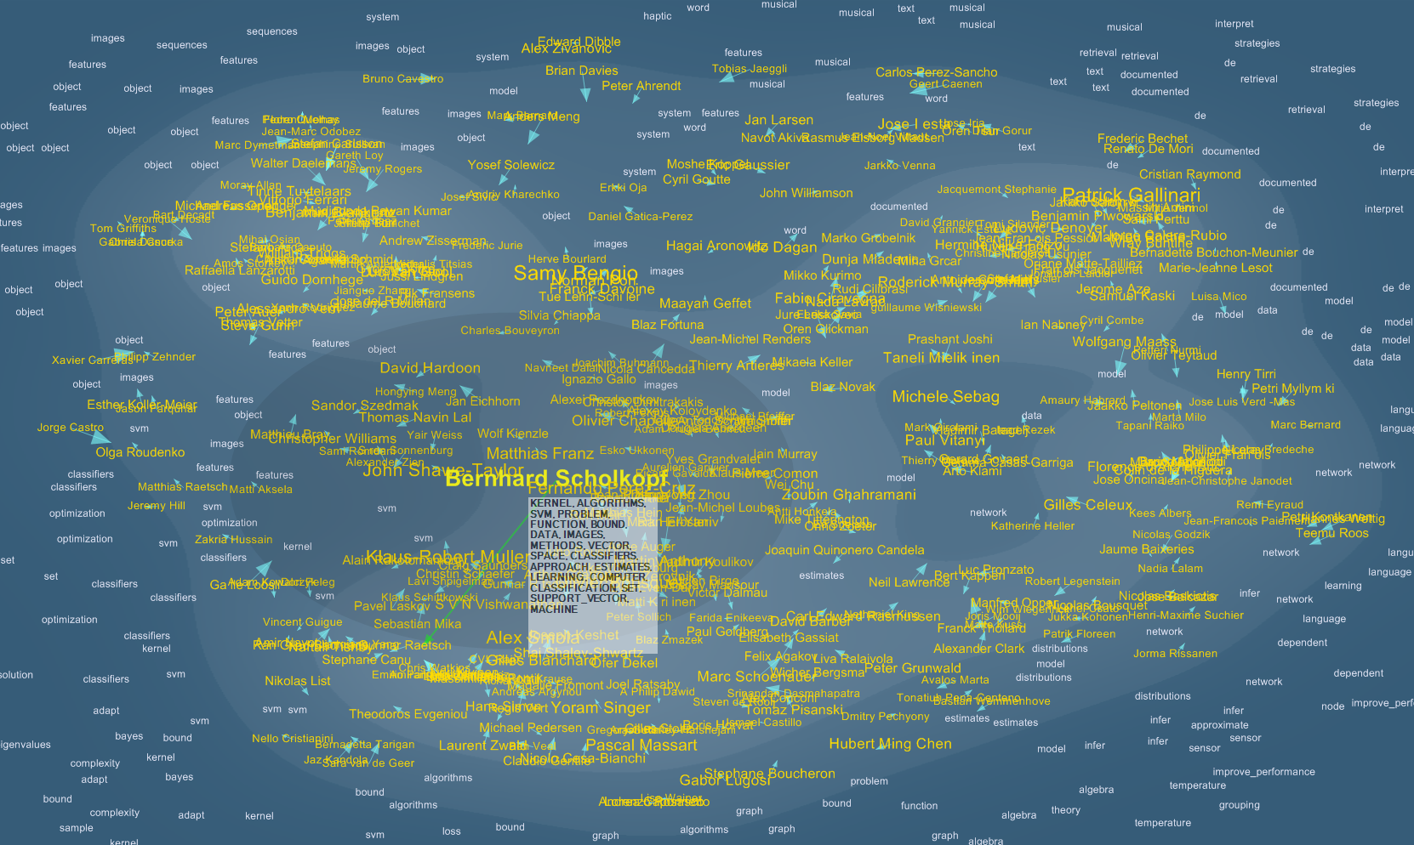

Slide 32
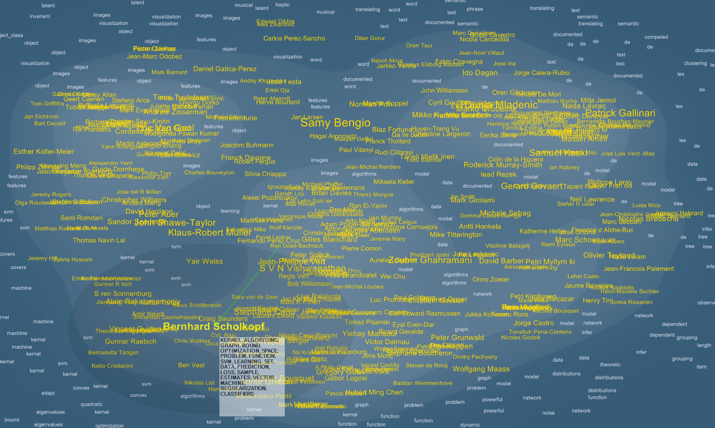

Slide 33
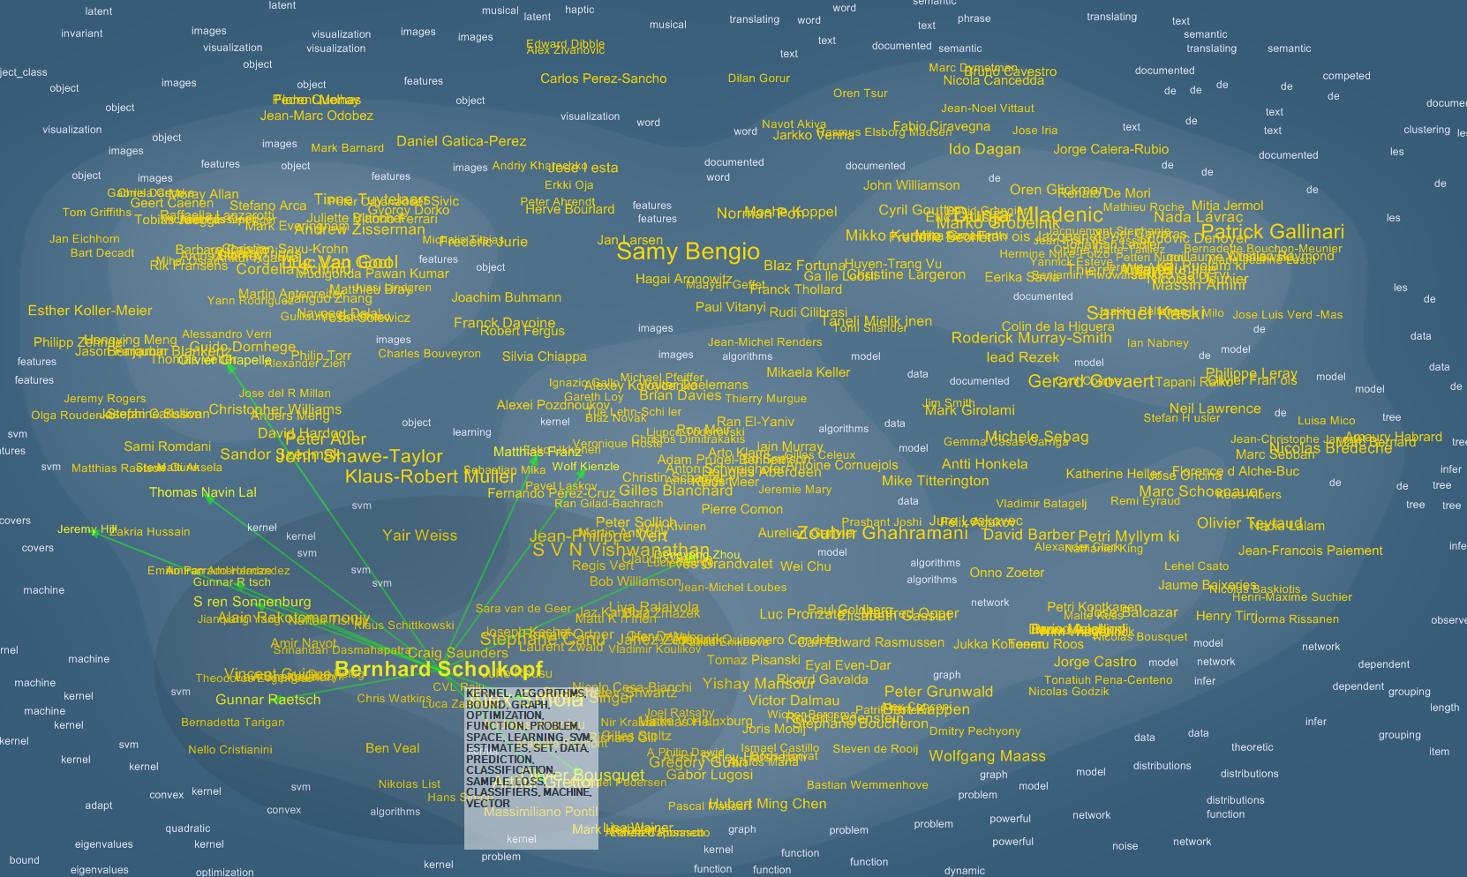

Slide 34
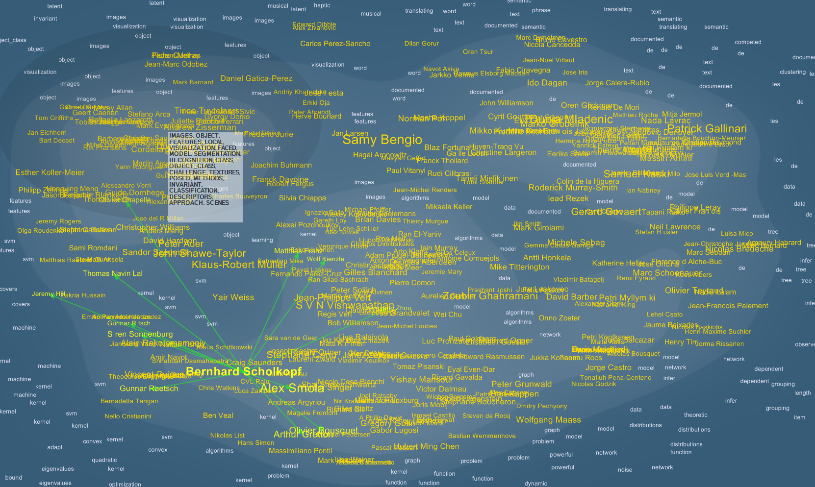

Slide 35
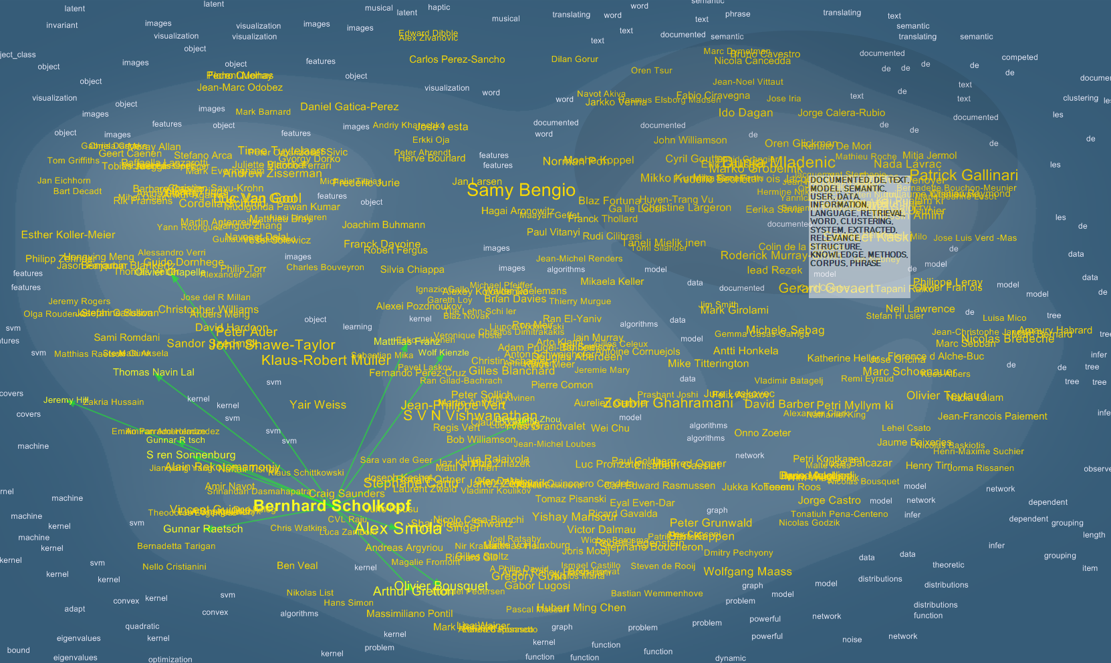

Slide 36
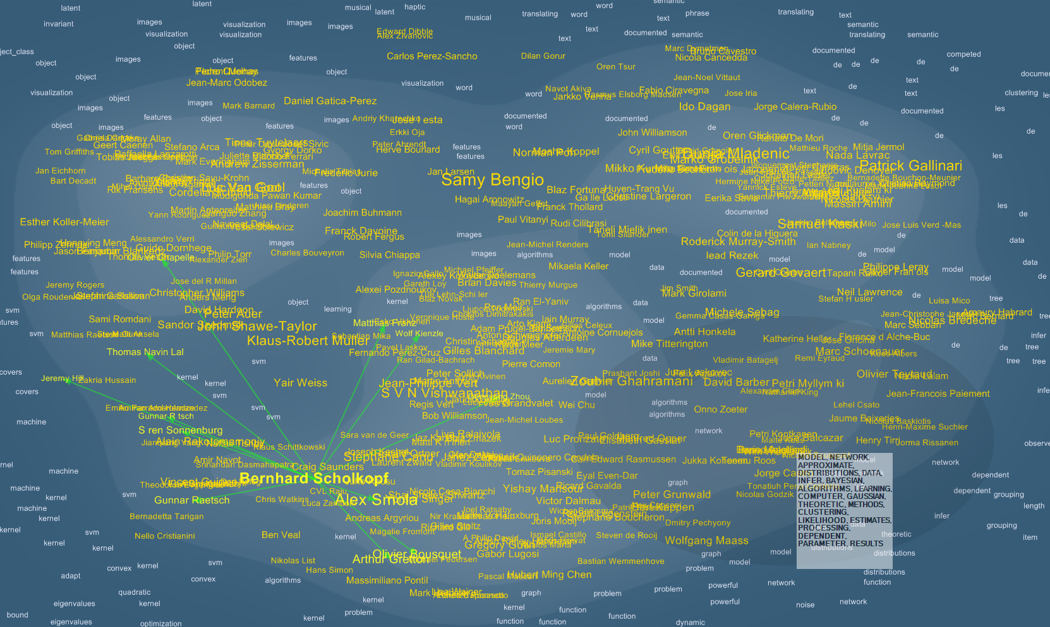

Slide 37
Thank You
Gaber Cerle
gaber.cerle@ijs.si
+386 40 709 892

