Slide 1
Open repository of semantic linkages at Socionet CRIS
Sergey Parinov,
CEMI RAS, Moscow, Russia
euroCRIS

Slide 2
Challenges
To provide funders with better data for research evaluation we have to:
  increase a quality of basic research assessment data
  measure a qualitative characteristics of research usage and impact
  visualize forms and characteristics of research usage and impact
  provide tools and services to allow scientists to use research outputs in this new style

Slide 3
Research usage = making relationships
A fact: Using research outputs scientists create different relationships between objects of research data and information space (DIS)
Some of these relationships are visible (e.g. citations), the most of them are not observable and exist in mental form only
If we can visualize relationships, we get:
  a new dimension for public scientific creativity
  a new approach to measure research impact
  new basic research assessment data
  better research evaluation procedures, etc.

Slide 4
Specification of relationships
Within virtual research environment the relationships exist as semantic linkages
Scientists can create linkages with assigned semantic value between any DIS objects
Semantic linkages belong to DIS as information objects of ‘linkage’ data type and semantic vocabularies as ‘metrics’ data type
A set of linkages organized within DIS as discipline-thematic collections
Collections of linkages establish a multilayer network structure over DIS objects
The multilayer structure is defined by existed in research practice scientific relationships types

Slide 5
Scientific creativity within virtual research environment
Research outputs (RO) creation = new objects + new relationships between objects
  New research objects are materials deposited at DIS, including non-traditional (artifacts, citations)
  New research relationships are semantic linkages of different types between objects of DIS
Semantic linkages are created by researchers to visualize their opinion on impact and to make observable many types of scientific relationships

Slide 6
Research objects types at Socionet DIS
RO: paper, article, book, chapter, thesis, artifact, citation
Research players: person, institution
Research relationships: linkage
Semantic vocabularies: metrics
Non-traditional objects: artifact, citation, linkage, metrics

Slide 7
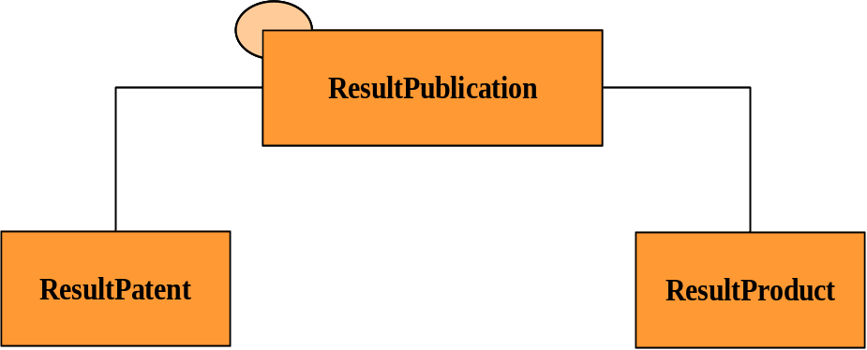
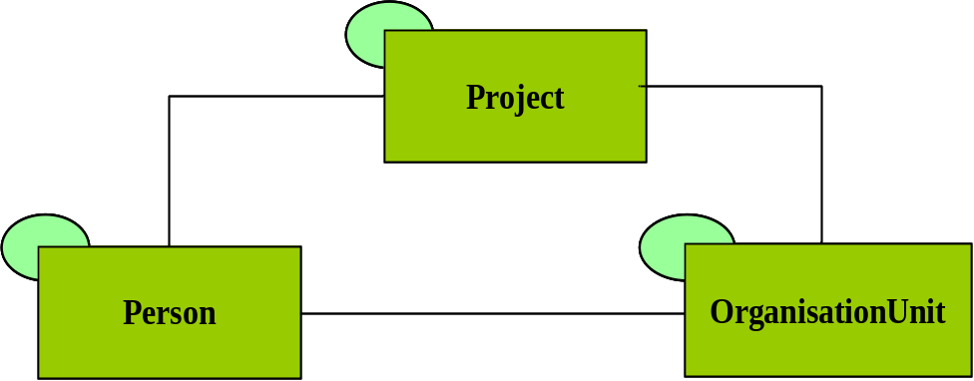
CERIF Base, Result and 2nd Level Entities
Equipment
Facility
Funding
ExpertiseAndSkills
Service
Qualification
ElectronicAddresse
Prize
PostalAddress
CV
Country
Citation
Currency
Metrics
Event
Language
Source: Brigitte Jorg. CERIF 2008 – 1.2 Release, www.eurocris.org
Notes:
7
7

Slide 8
Non-traditional RO
Fragmentation of traditional research paper/article is a way
  to make visual more relationships of different types
  to improve scientific circulation of RO
  to create better conditions for measuring of RO usage
  to allow researchers working in incremental style

Slide 9
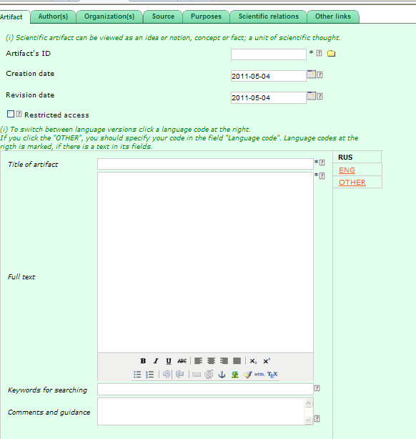
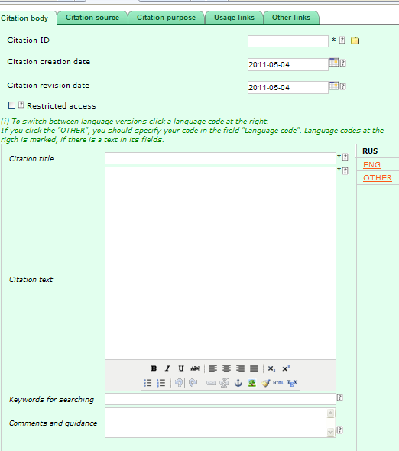
Artifact and citation objects

Slide 10
Matrix of relationship types
 | Pers | OrgUnit | ResPub | Project | Linkage
Pers | Subordination | Organizational role | Professional opinion | Project role | Professional opinion
OrgUnit | Position | Subordination
ResPub |  |  | Sci. inference Sci. usage Hierar., assoc. Components
Project
Linkage

Slide 11
Initial relationship types
Scientific inference: if output is wrong, related outputs should be revised (ResPub-ResPub)
Scientific usage/impact, but not inference (ResPub-ResPub)
Hierarchical and associative relationships (ResPub-ResPub)
Relationships between components of scientific composition (ResPub-ResPub)
Professional opinions (Pers-ResPub)
Personal-organizational relationships (Pers-OrgUnit-ResPub)

Slide 12
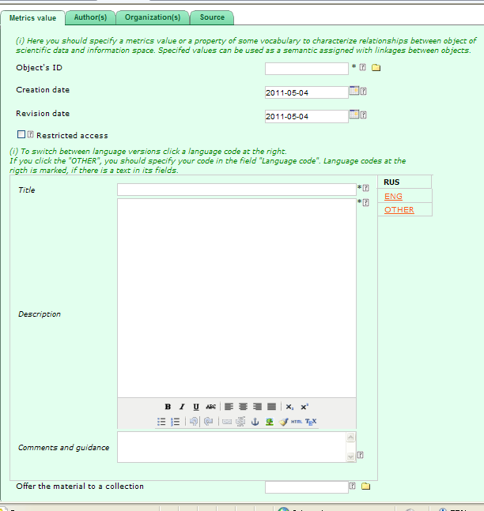
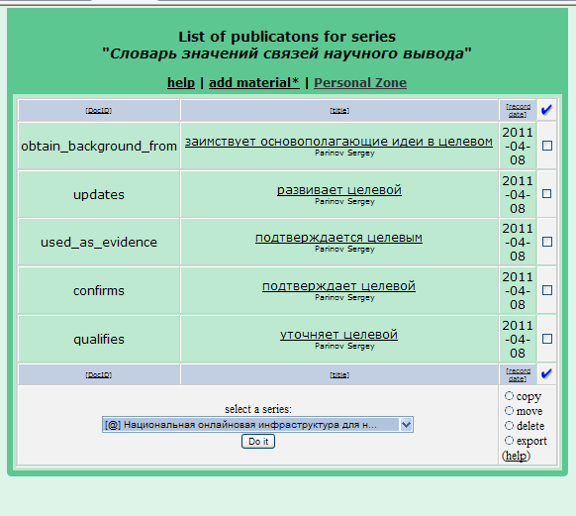
Metrics objects

Slide 13
ResPub-ResPub relationships
Inference (CiTO)
  obtain background from, updates, used as evidence, confirms, qualifies
Impact/usage (CiTO)
  contains assertion from, uses data from, uses method from, corrects, refutes
Hierarchical and associative (SKOS, SWAN)
  broader, narrower, related, alternative to
Components of scientific composition (DoCo)
  duplicate, revised, so on

Slide 14
Pers-{ResPub,OrgUnit,Pers} relationships
5. Professional opinions (SWAN)
  responds negatively to, responds positively to, responds neutrally to
6.1. Person-organization (CERIF)
  employee, head, member, director, so on
6.2. Person-person (CERIF)
  manager, supervisor, mentor
6.3. Person-ResPub (CERIF)
  author, editor, reviewer, translator

Slide 15
OrgUnit-ResPub relationships
6.4. Organization – ResPub (CERIF)
  intellectual property rights claim
  publisher
  organizational author

Slide 16
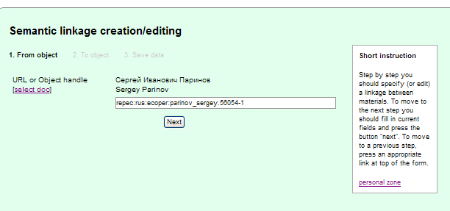
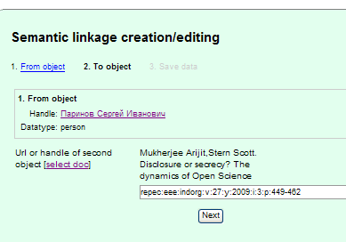
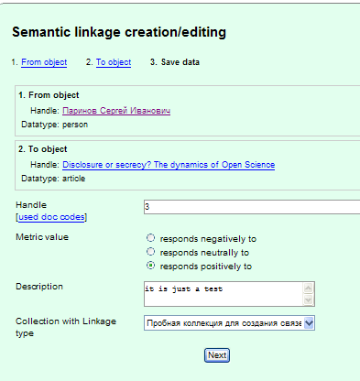
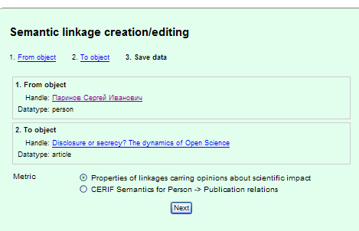
Linkage objects
1
2
4
3

Slide 17
Socionet CRIS technology of semantic linkages repository
Tools for scientific creativity
  depositing of all RO types as objects of DIS
  creating, managing of relationships (as semantic linkages) between DIS objects
An infrastructure to manage relationships
  managing metrics, vocabularies and linkage properties
  an open repository of of semantic linkages, including personalized tools to create and to change linkages
Monitoring and visualization of linkages within DIS, collect statistics about its changes
Notification and confirmation services
Scientometrics services (basic research assessment data)

Slide 18
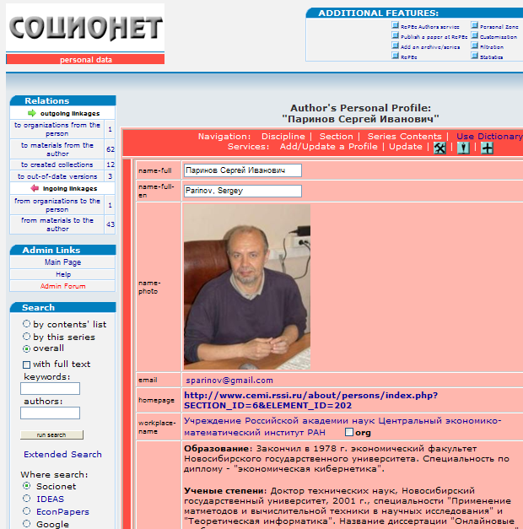
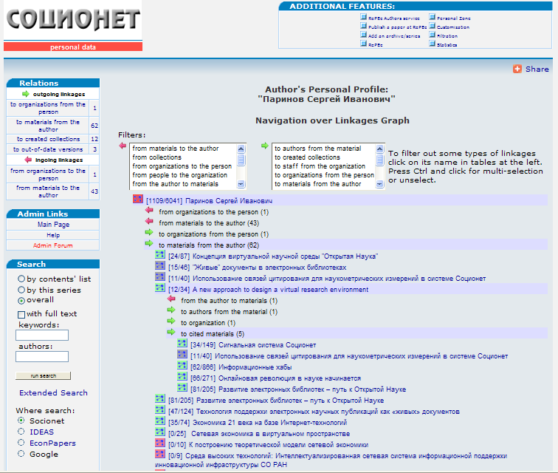
Linkages between Socionet objects

Slide 19
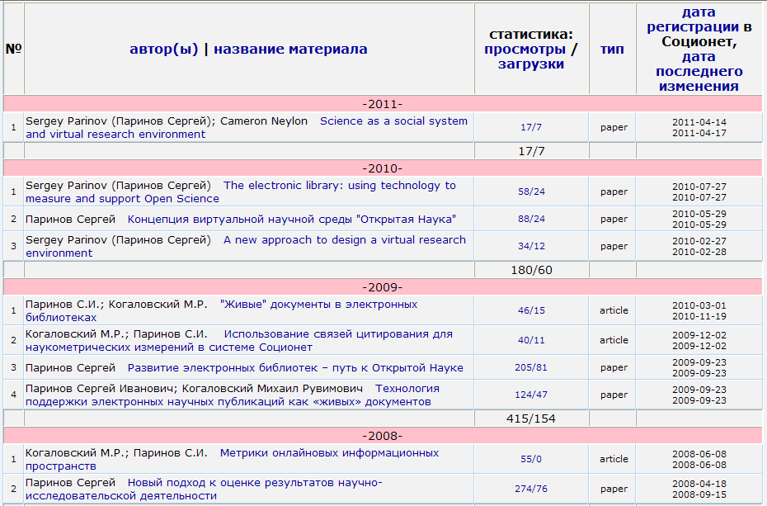
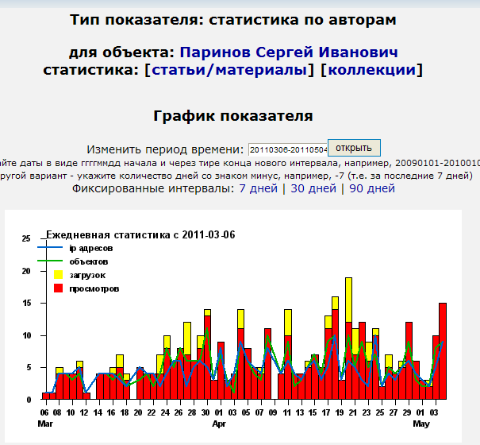
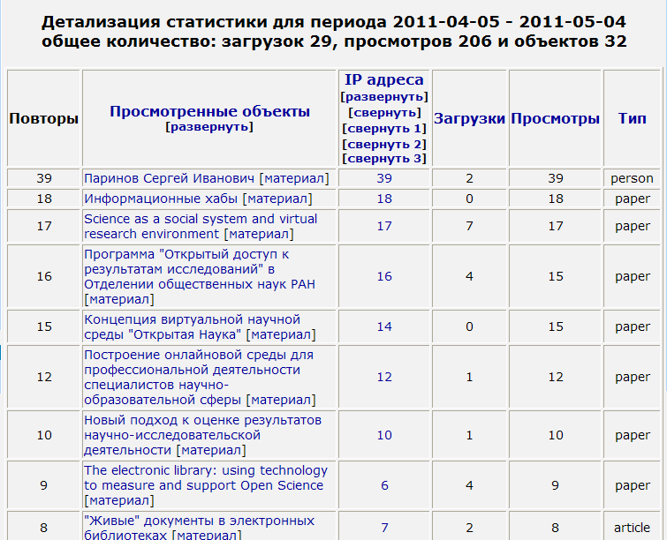
Socionet scientometrics

Slide 20
Development program
Open global repository of semantic linkages
  using euroCRIS help to initiate a EU level project to build the repository
  collaboration with CERIF TG to add into the data model multilayer networks of semantic linkages between objects of different types

Slide 21
Development program
2. Open library of utilities to use data of repository of semantic linkages and to add new services to it
3. Initial visualization of linkages within a scientific DIS
4. Initial public services: monitoring of linkages, notifications, scientometrics, basic research assessment data
5. RO life cycle concept/model development

Slide 22
Challenges for researchers
A paper gets a network form, researchers can work in incremental style
Public statistical portrait of a RO, a researcher, an organization
  views/downloads data
  ingoing/outgoing linkages
  a distribution of qualitative characteristics assigned with linkages
Researchers become public figures

Slide 23
Challenges: new research practice
An author registers RO as a ready for testing scientific object-for-reuse (OfR) by
  specifying which research materials were used as roots/basements for his/her output (citation links)
  specifying materials/scientist where/by whom the output could be used/reviewed (links to possible users)
A researcher make semantic linkages between RO
Authors of linked materials receive a notification about created links, and
  they can protest on how the materials were used
  they can use suggested OfR and link it with their materials, or can review it, or can ignore it

Slide 24
Challenges: new scientific communication
On a producer side
  specify used OfR with quality characteristics
  request on using-reviewing own OfR by linking it with other OfR or scientists
On a consumer side
  protest against usage characteristics and/or provide comments on it, or do nothing
  ban requests from some authors, or specify personal reviewing rate, or rewrite own OfR by using/citing suggested OfR

Slide 25
Challenges: open science business model
Open Science paradigm is based on:
  open access to research outputs/results, and we propose a way to overcome a veto of commercial publishers
  open access to research outputs/results usage data, and we provide a way how to make visual such data and collect it in a computer-readable form
  open access to basic research assessment data, and we provide a mechanism of natural research assessment
Three types of openness create Open Science as a new research practice and new scientific communications

Slide 26
Scientometrics challenges
Scientometric services collect data:
  usual quantitative characteristics of researchers/organizations and results of their activity;
  quantitative data about all existed relationships between information objects, e.g. number of persons linked with organization, number of publications linked with a person, number of citation/usage linked with a publication, and so on;
  qualitative data about all existed relationships between information objects, as a graph with semantic values assigned to each edge of the graph, e.g. a set of relations with the semantic value "member of staff" between an organization and persons; a set of relations with the semantic value "basement" between a publication and citations; and so on;
  data about views/downloads aggregated for each information objects according linkages, e.g. numbers of views/downloads for all publications related with a person or a sum of these numbers for all persons related with an organization and so on

Slide 27
Funders opportunities
Funders can use existed basic research assessment data, including qualitative impact characteristics
or
They can provide their own types of relationships between RO, including vocabularies of linkage properties, and mandate researchers to use it

Slide 28
Expected basic research assessment data
Accumulated data about a researcher-producer activity
  total number of produced RO for certain period of time
  numbers of produced RO that were used for certain period of time, including its quality characteristics distribution
  numbers of produced RO that were reviewed for certain period of time, including its quality characteristics distribution
Accumulated data about a researcher-consumer activity
  numbers of requests to use/review RO from other researchers
  numbers of used RO by the person, including its quality characteristics distribution
  number of made reviews by the person, including its quality characteristics distribution
  number of banned authors, queue length of requests compare with personal rate, number of rejections

Slide 29
Expected qualitative impact characteristics
Researcher/Metrics | Scientific inference metrics (obtain background from, updates, used as evidence, confirms, qualifies) | Research usage metrics (contains assertion from, uses data from, uses method from, corrects, refutes) | Hierarchical and associative metrics (broader, narrower, related, alternative to) | Professional opinion metrics (responds negatively to, responds positively to, responds neutrally to)
Researcher’s portrait by outgoing linkages | Which RO a researcher used as a basement for own RO | What RO a researcher used to produce own RO | How a researcher impacts on science corpus | What RO a researcher evaluated and how
Researcher’s portrait by ingoing linkages | Who/where/ how used researcher’s RO as a basement | Who/where/ how used researcher’s RO to produce RO | How researcher’s RO are assigned with science corpus | What/whom researcher’s RO are evaluated and how

