Slide 1

VIVO: Vision for Research Information, 2020
Brussels, September 10, 2012
Michael Conlon, PhD
Clinical and Translational Science Institute
University of Florida

Slide 2
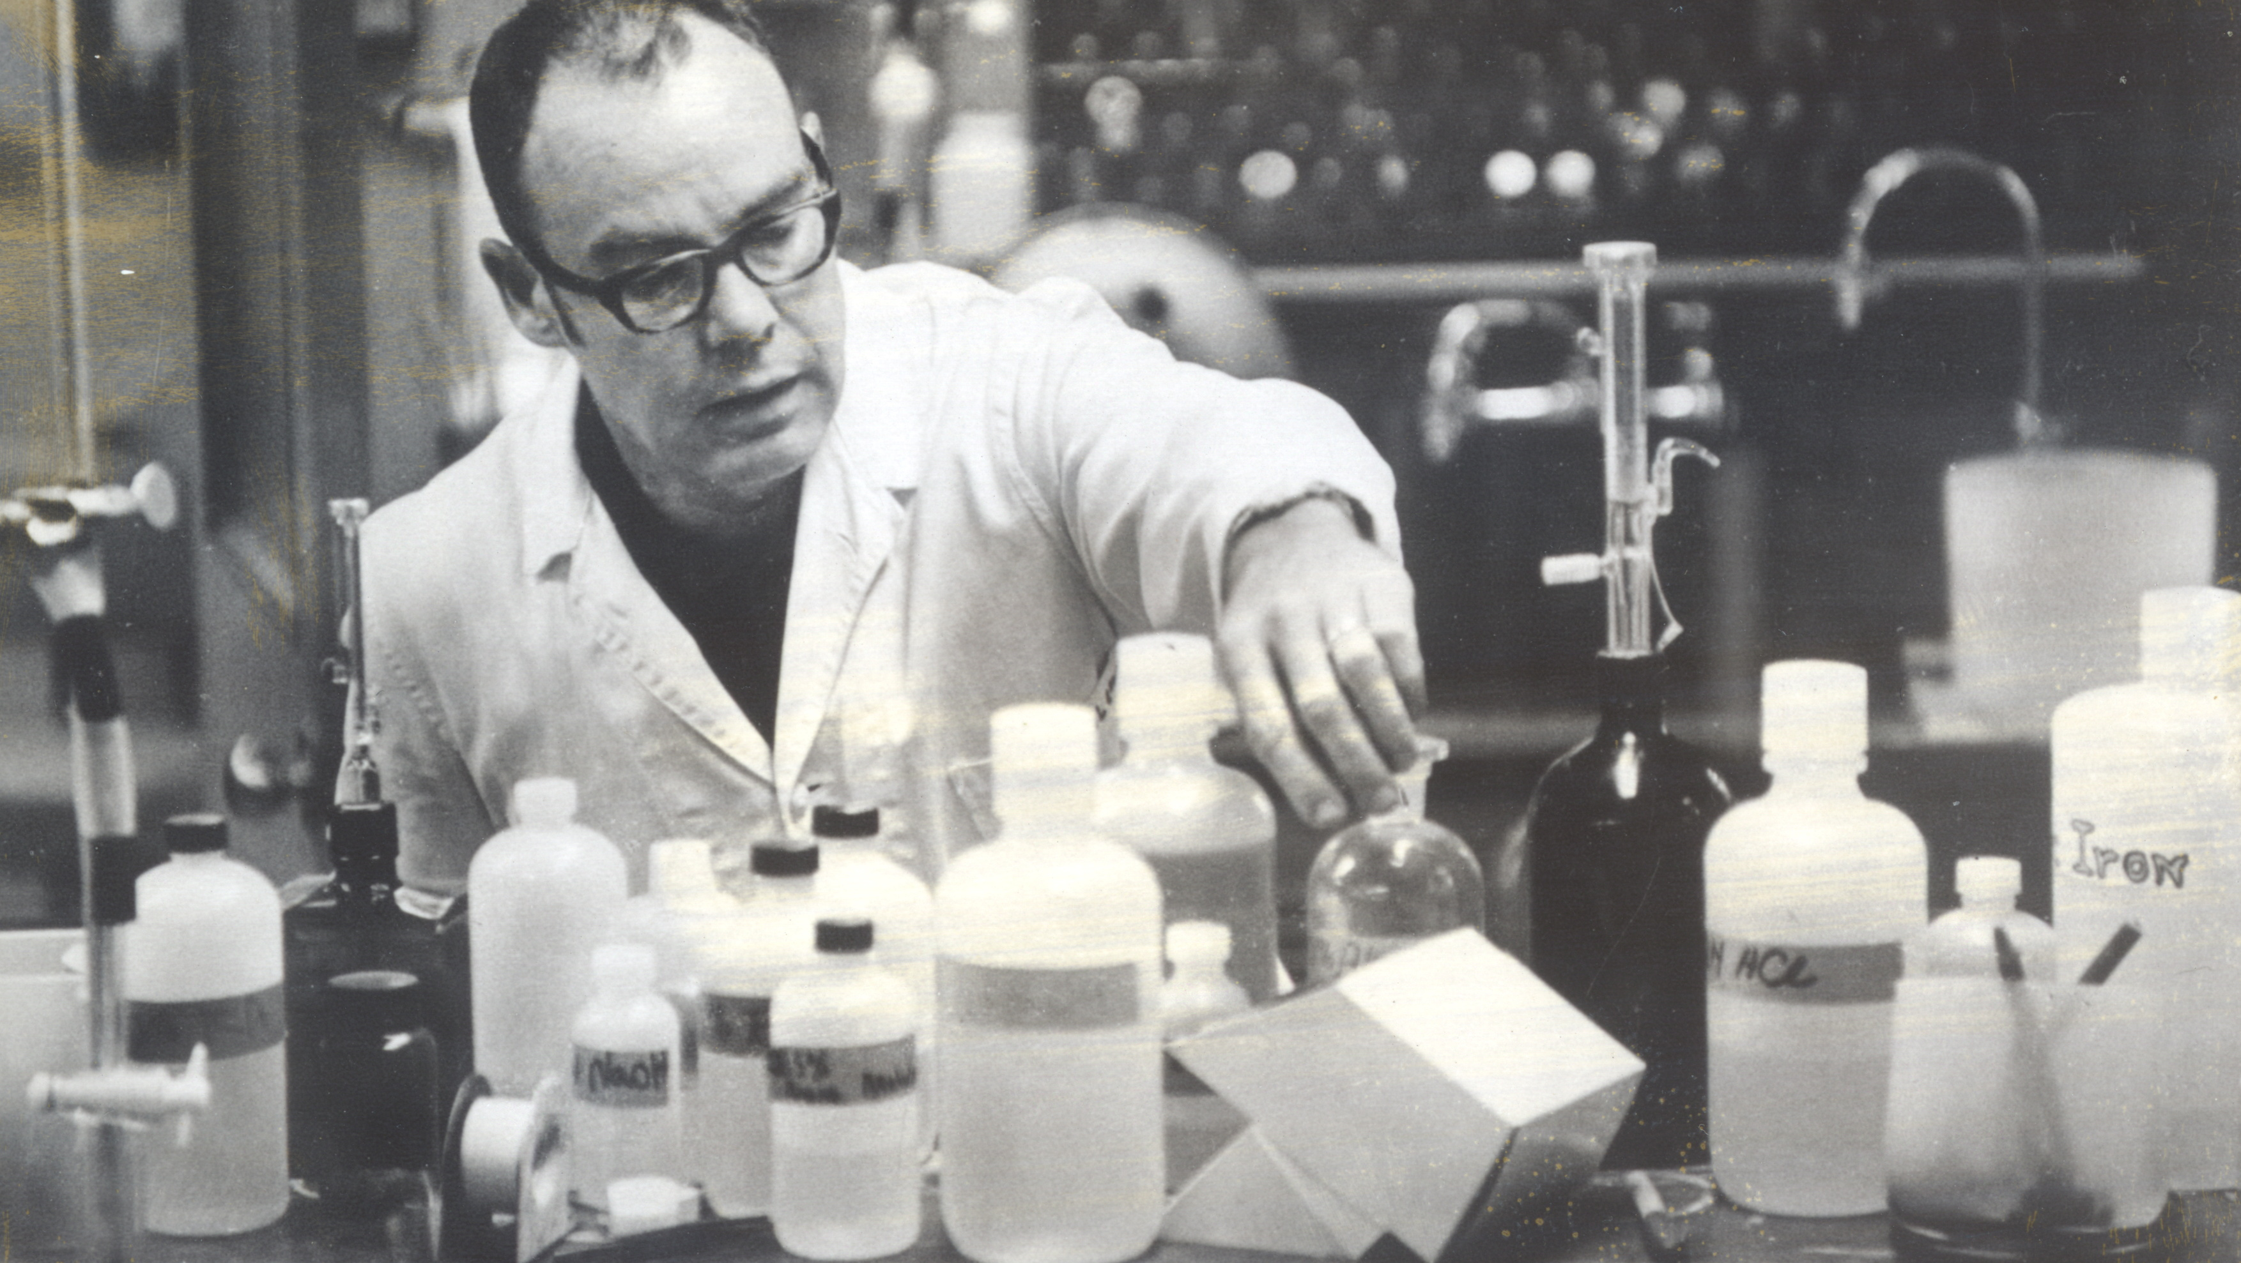
Learned a field, learned the scientific method, did science
Notes:
Learned a field, learned the scientific methods, did science, wrote papers

Slide 3
Research Process 1972
Hypothesis
Experiment
Publication

Slide 4
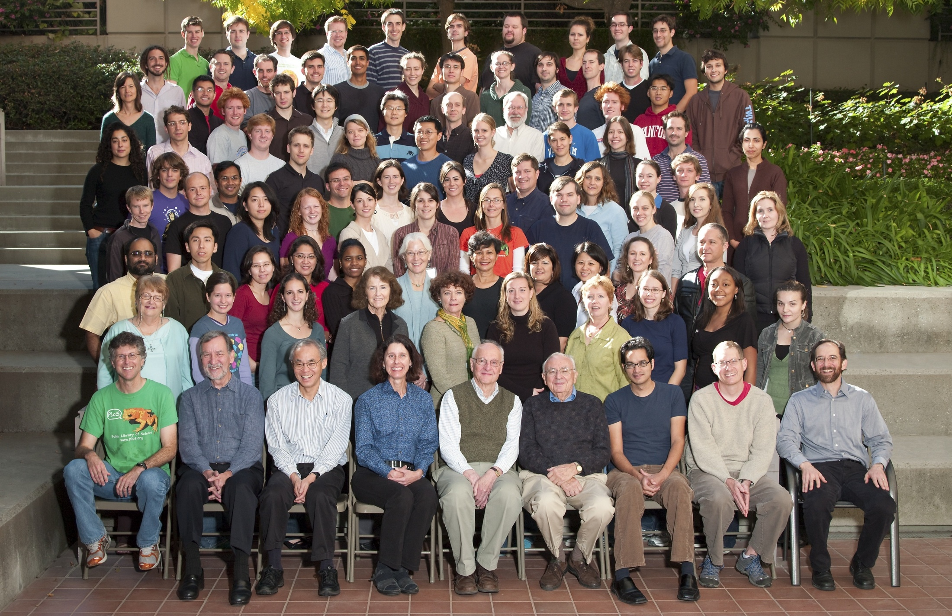
Science and Scientists
Notes:
Science and scientists. Biochemistry at Stanford. They look happy.

Slide 5
Research Process 2012
Hypothesis
Consults
Assemble Team
Write proposal
Get Funded
Create Virtual Organi-zation
Augment Data Systems
Conduct Experi-ments
Publish results
Archive data

Slide 6
Six Trends
Notes:
The rise of molecular medicine

Slide 7
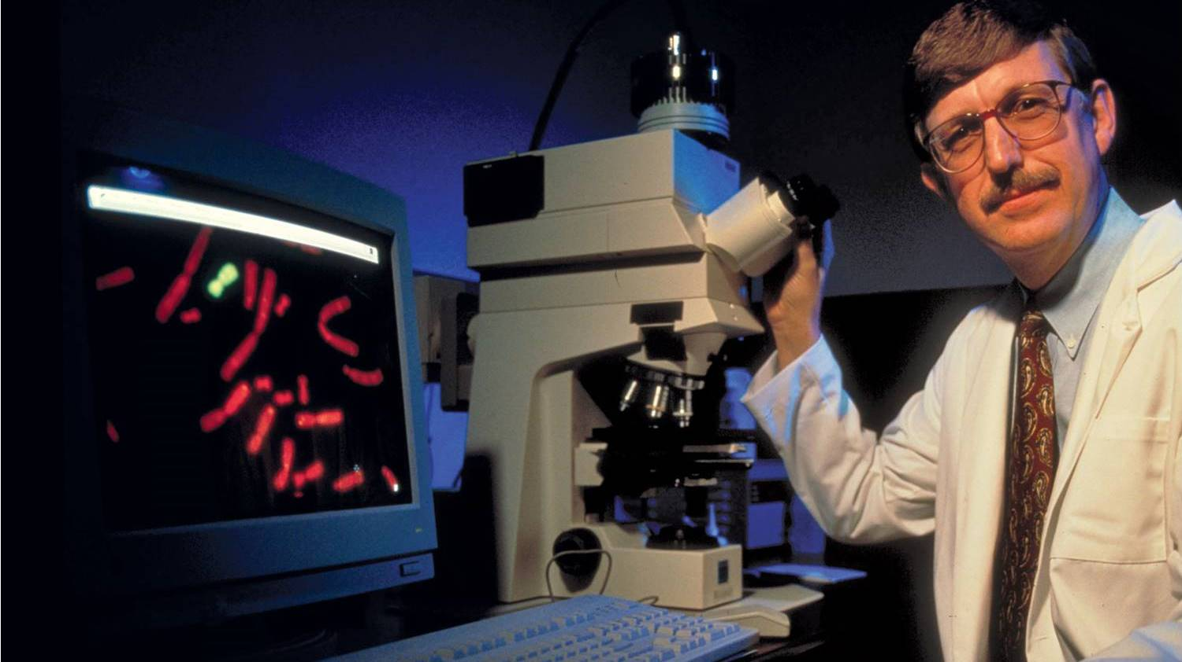
1. Rise of the small
Notes:
The rise of the molecular. Personalized medicine. Full base pair sequencing. Mars Curiosity lander. Nanotechnoloy. Metabolomics.

Slide 8
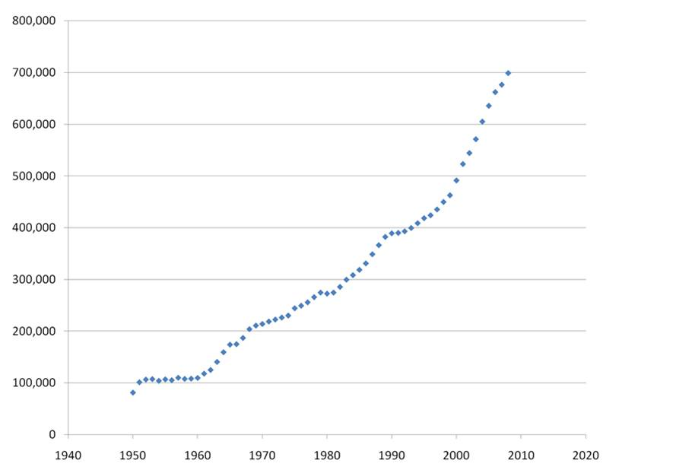
PubMed new publications per year
2. Increasing volume of science
Notes:
Rapid increase in volume of scientific output. Brazil, Russia, India, China.

Slide 9
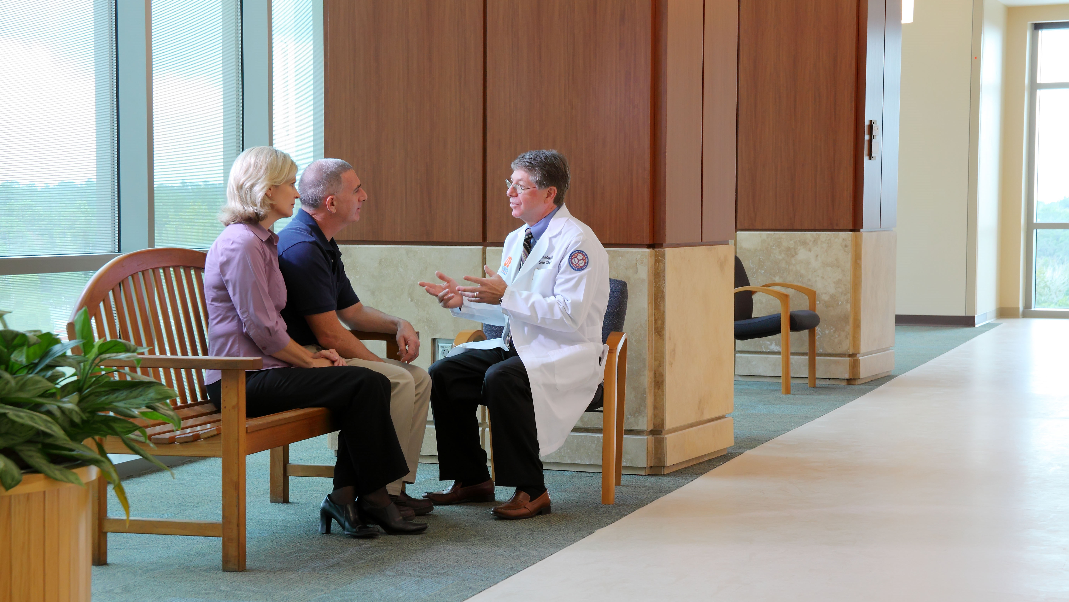
The Problems Got Hard
3. Increasing complexity of scientific problems
Notes:
More difficult problems. We work to cure cancer. Risk factors, genetics, metabolics, surgical procedures, radiology, chemotherapy, life style changes.

Slide 10
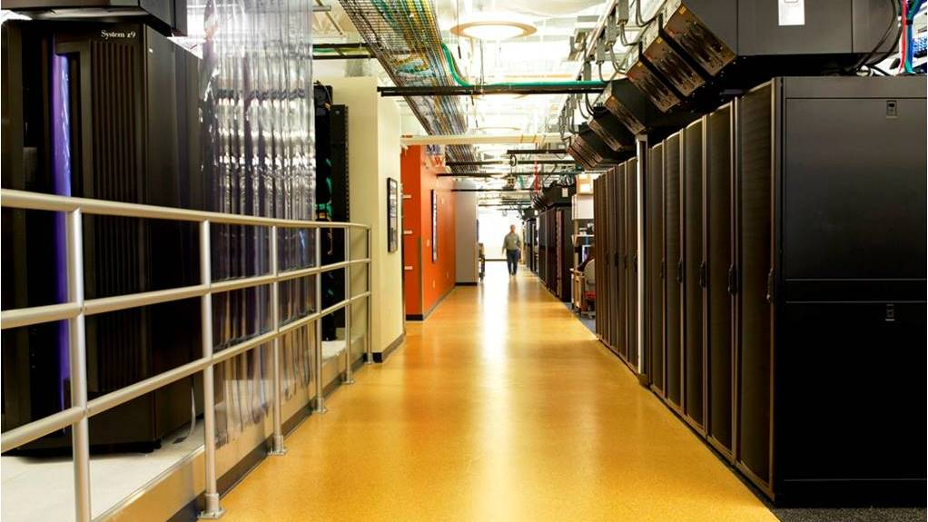
Data Got Big (IDR Slide)
4. Data reuse grows
Notes:
Data got big. Terabytes, Petabytes, Exabytes.

Slide 11
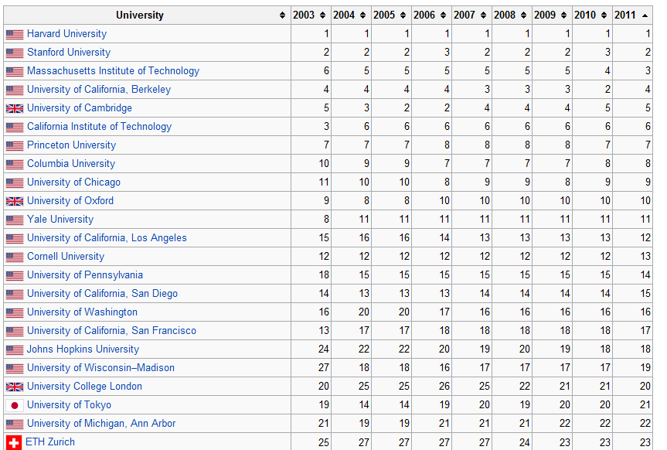
Lots of Competitors
5. Competition rises
2011 Shanghai ranking of world universities
http://en.wikipedia.org/wiki/Academic_Ranking_of_World_Universities
Notes:
Competition got stiffer

Slide 12

6. Internet disintermediation of science continues
Notes:
Internet speed and disintermediation. Expectations changing, openness, commonality, reuse, altmetrics (“downloads and citations”)

Slide 13
How can we know what is going on, build teams, solve data-driven problems?

Slide 14
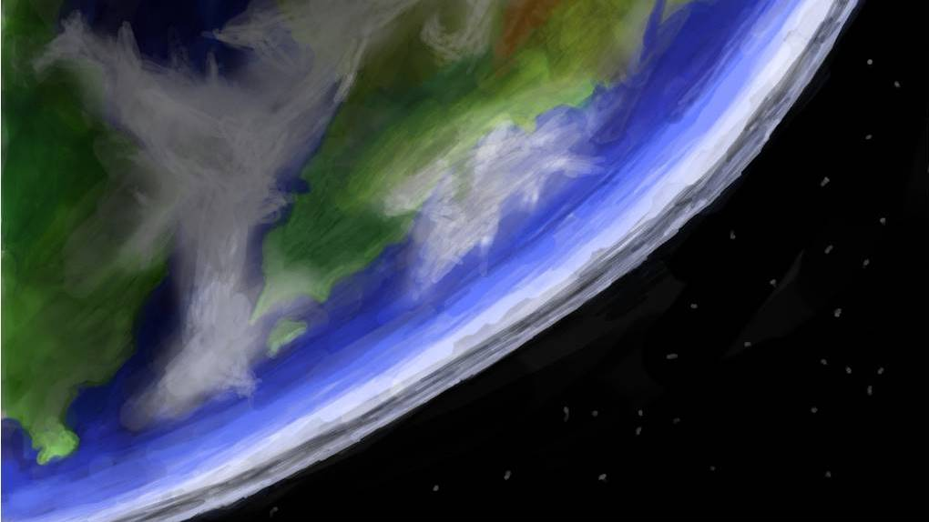
Research Discovery
Research
Discovery
Notes:
Research Discovery. What is going on? Where? By Whom?

Slide 15
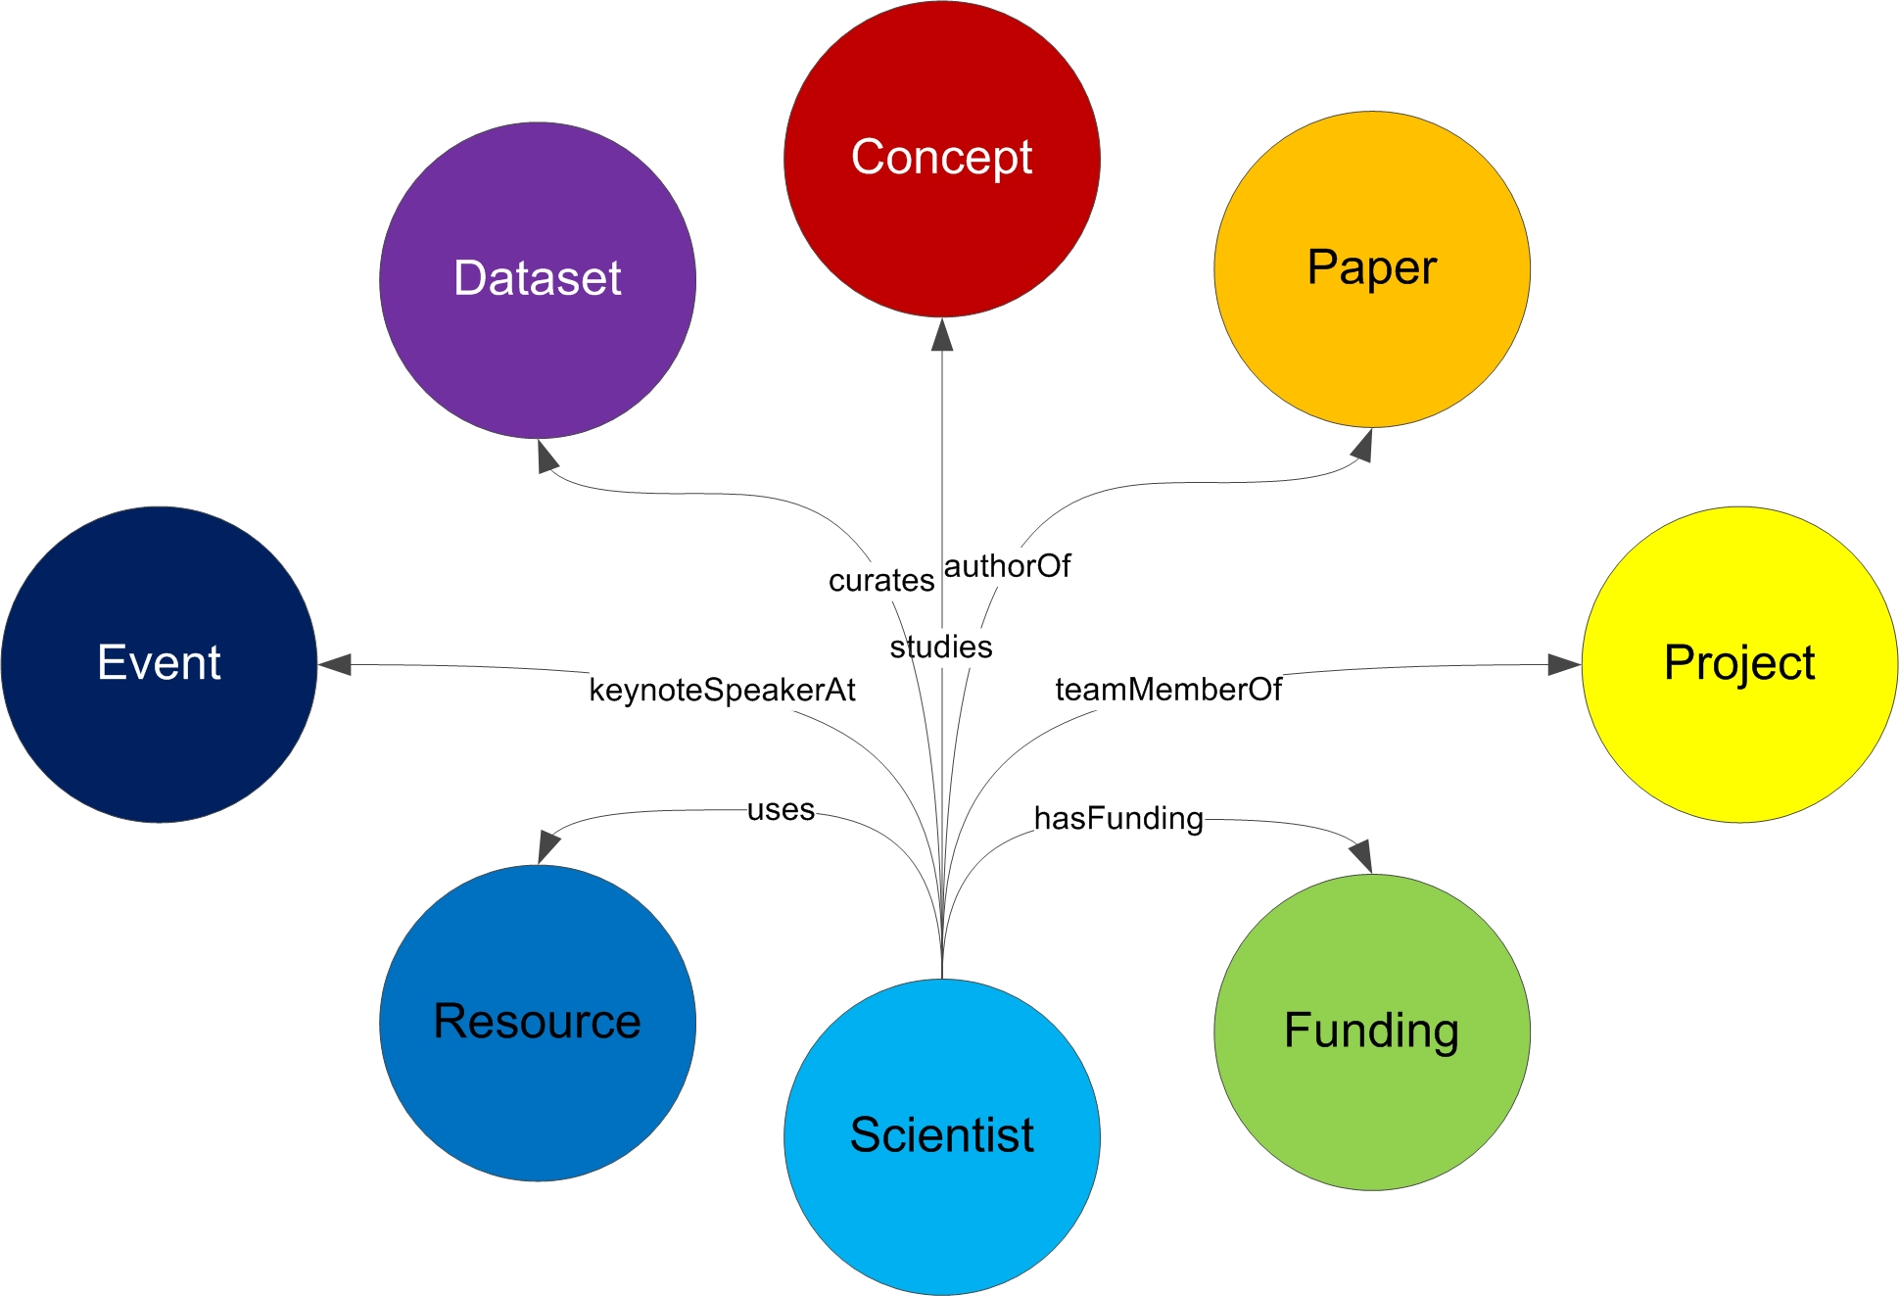
… And the connections between them
Notes:
Sounds, common data models for the things of science and the connections between them. Many kinds of connections between each type of object. Objects have significant complexity. What do we mean by “project” – a human subject study? A clinical trial?

Slide 16
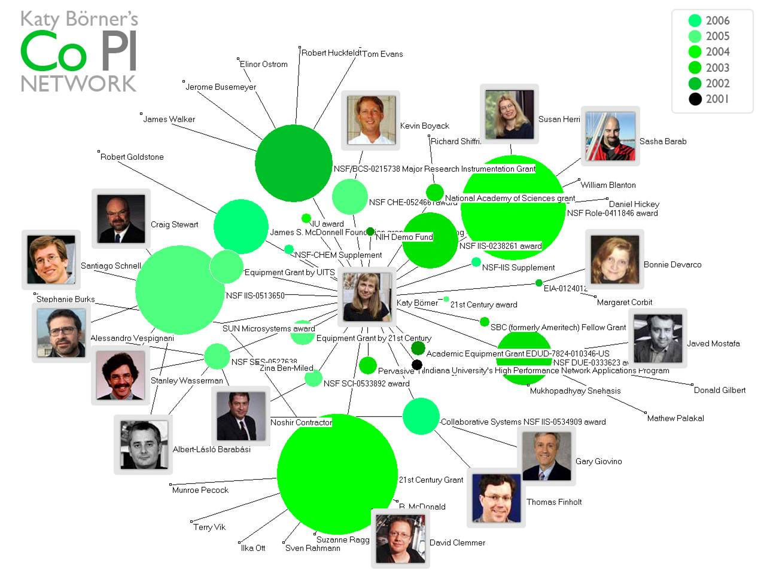
Notes:
Study science itself. Science of Team Science. Who publishes with who? Who is funded with who? Who has written a proposal with who? Who has created data with who? Who has mentored who?

Slide 17
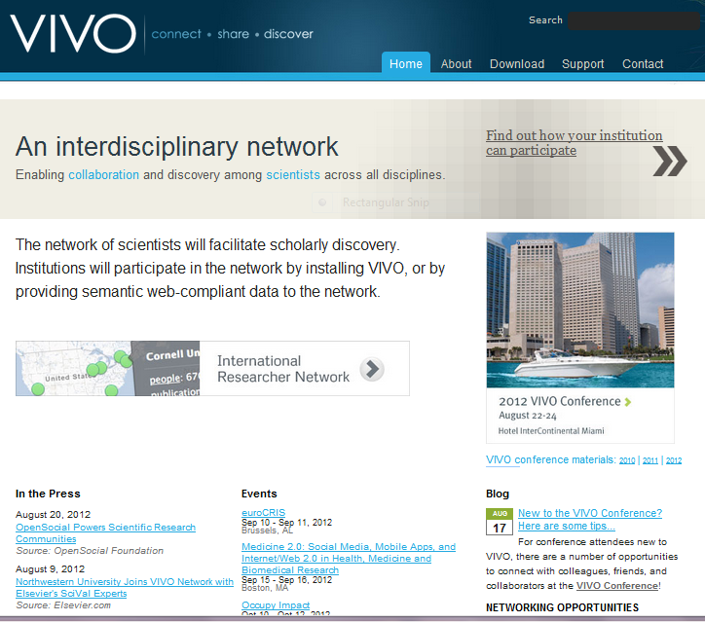
VIVO: Data, Tools and Community
Notes:
So that’s what we are doing. Open software, community and data model for research discovery. Model people, data, projects, papers, etc. Work across boundaries. Sponsor supported.

Slide 18
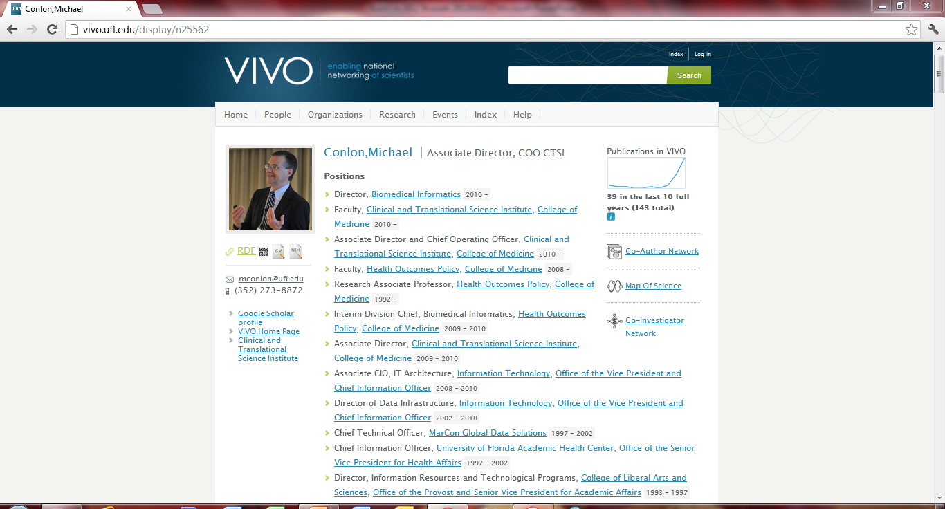
Simple tools for presentation, traversal, search
Notes:
So here’s the simple view – a faculty profile. Assembled by machines. Can be finished off by the faculty member. All links are to other objects in the semantic web. Positions, visualizations, organizations, people, web sites. Navigation via search, facets, link traversal. Note the RDF link for techno guys.

Slide 19
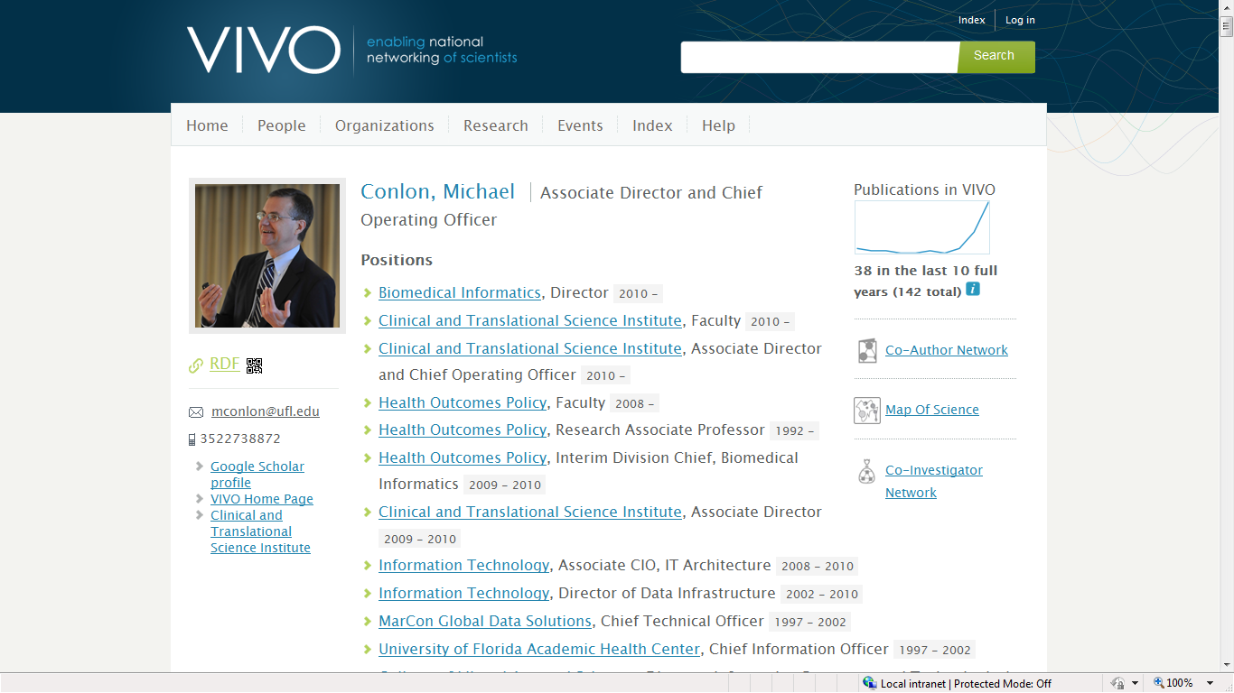
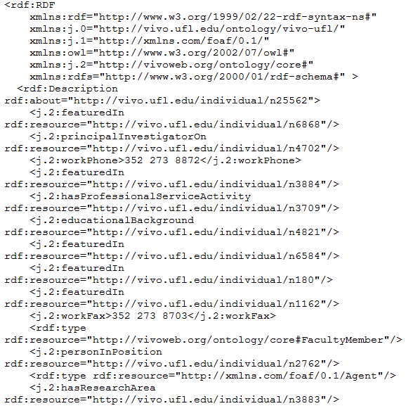
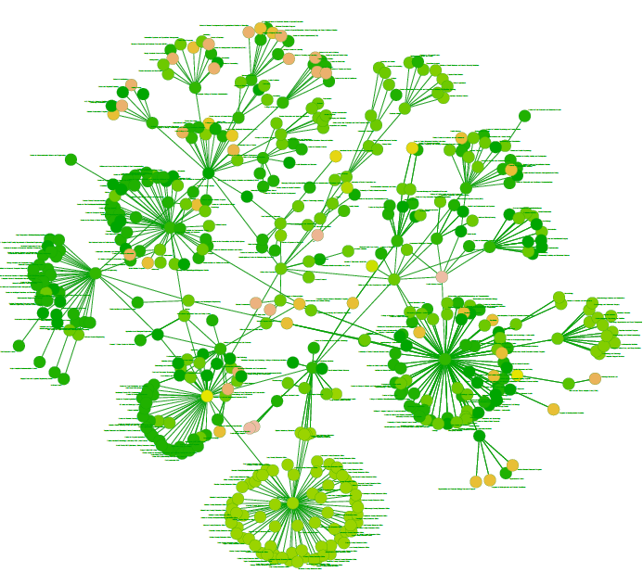
Software reads VIVO RDF and displays
processOrg<-function(uri){
x<-xmlParse(uri)
u<-NULL
name<-xmlValue(getNodeSet(x,"//rdfs:label")[[1]])
subs<-getNodeSet(x,"//j.1:hasSubOrganization")
if(length(subs)==0) list(name=name,subs=NULL)
else {
for(i in 1:length(subs)){
sub.uri<-getURI(xmlAttrs(subs[[i]])["resource"])
u<-c(u,processOrg(sub.uri))
}
list(name=name,subs=u)
}
}
VIVO produces both HTML and RDF
Notes:
The open architecture of VIVO and linked data supports development of applications outside VIVO that consume VIVO data. VIVO data is accessible via HTML (for humans) and RDF (for machines). Simple software can process the RDF resulting in powerful cross-site applications. The figure depicts the organization of the University of Florida.

Slide 20
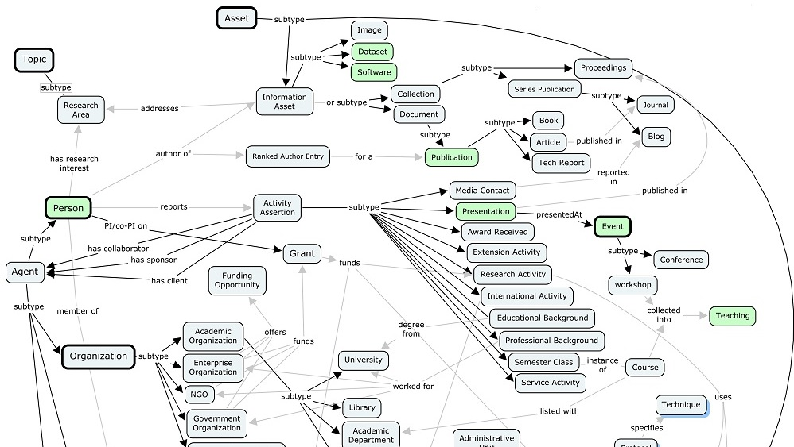
Ontology Process
Notes:
A fragment of the VIVO ontology. Open ontology process. Working group. Plug-in ontologies (BIBO, SKOS, FOAF) support local extension. Terminology extensions.

Slide 21
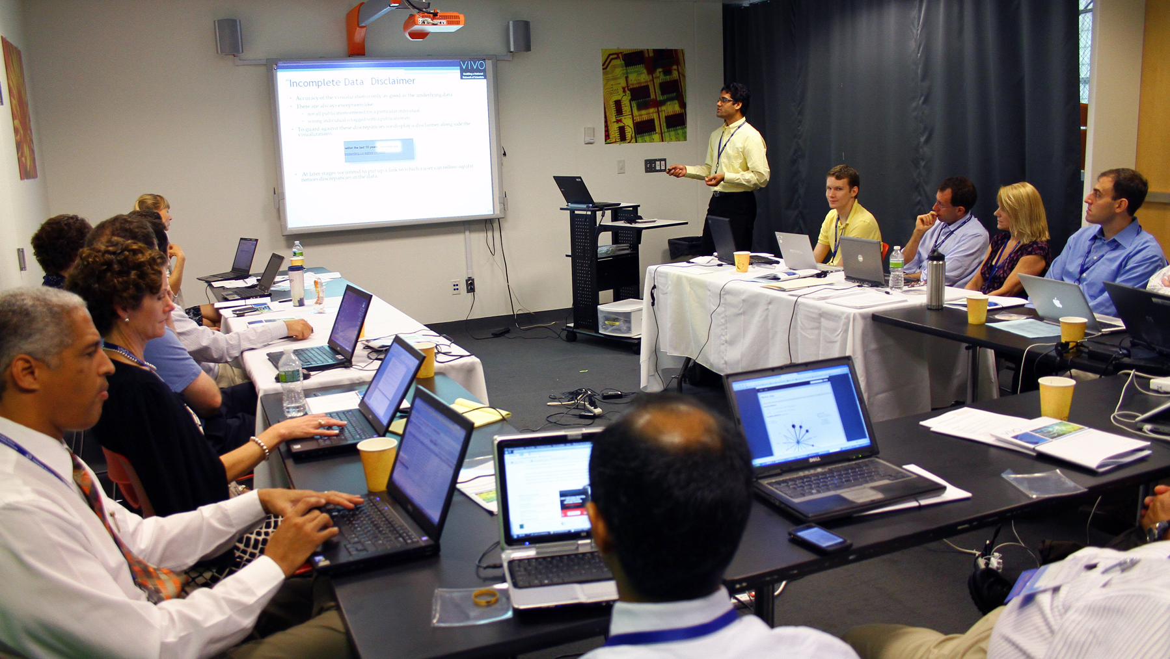
Community
Notes:
We are going to need a community of people who share a common interest in research discovery.

Slide 22
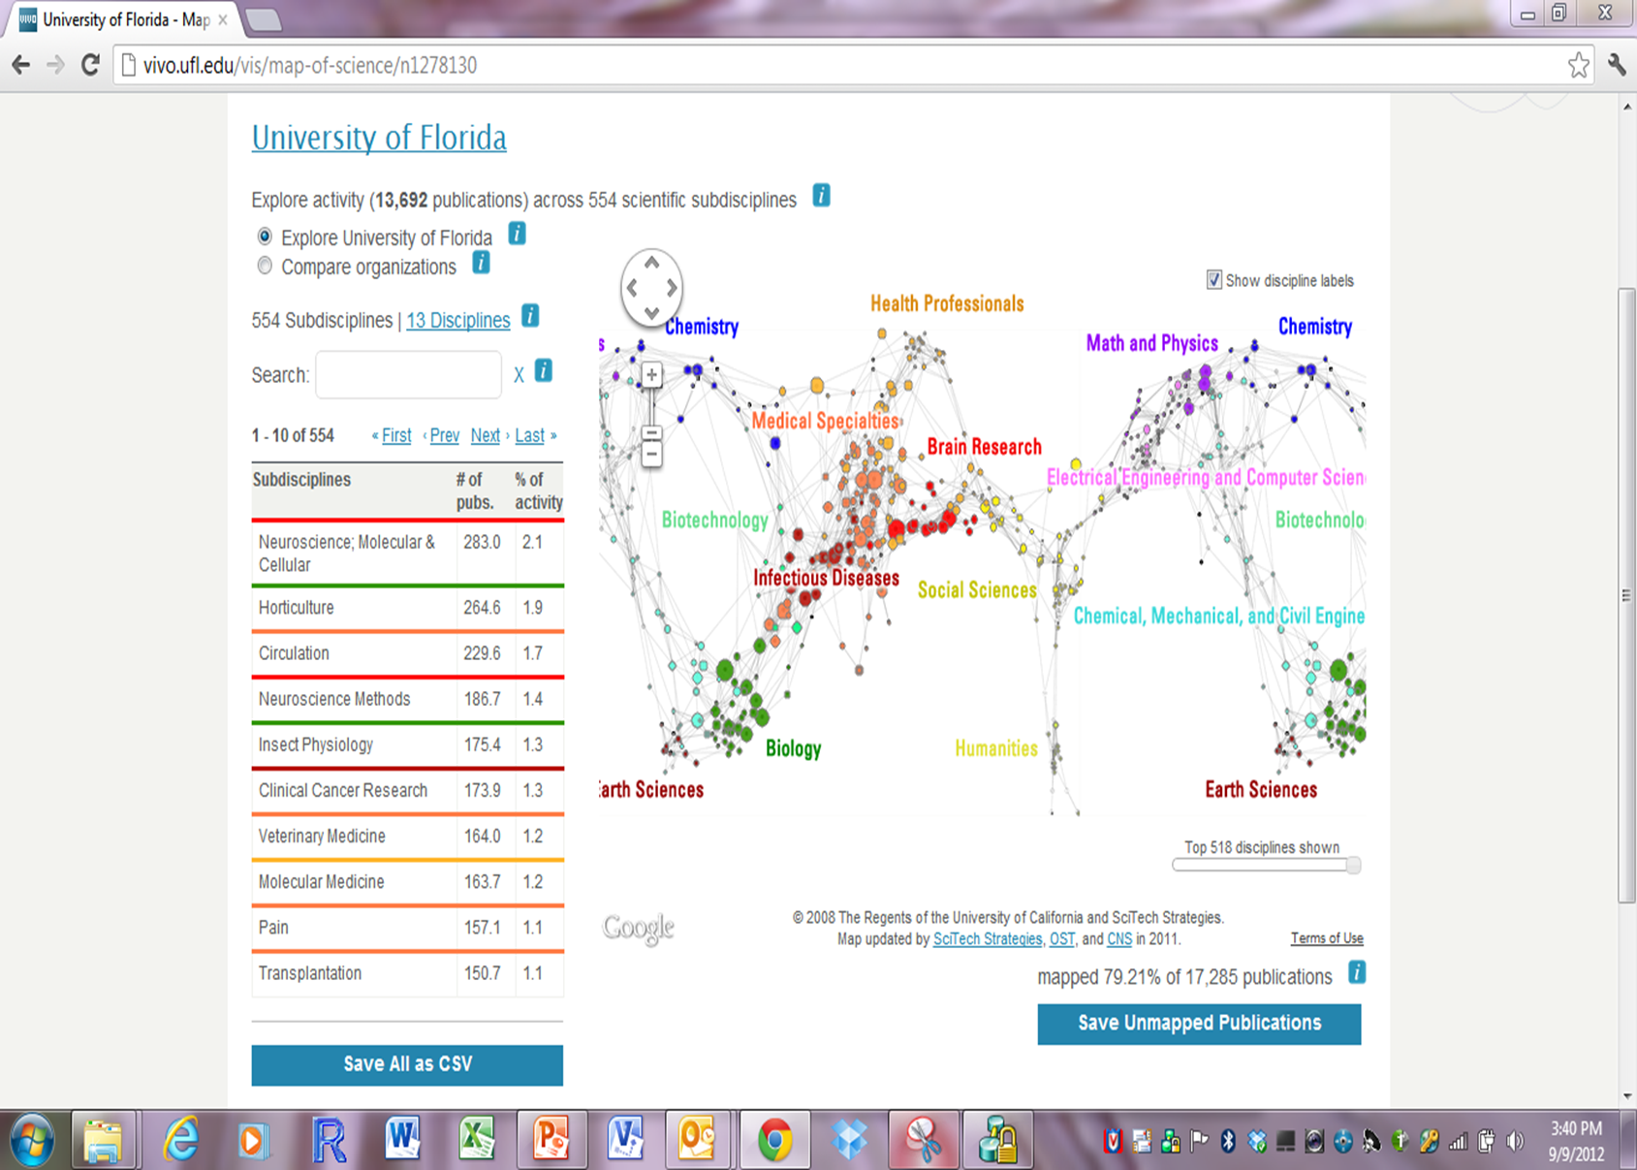
ScienceMap. Examine collections of publications for individuals, work groups, institutions
Notes:
Tools for discovering research. Here, sample of University of Florida publications plotted on the UCSD science.

Slide 23
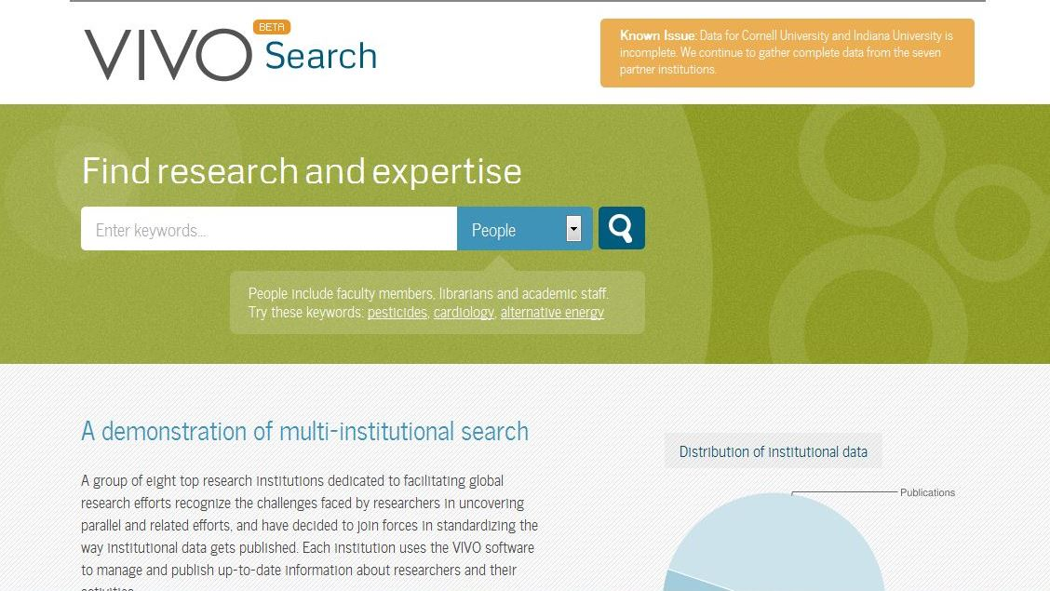
Augmenting data
Notes:
Vivosearch (beta) indexes vivo sites and provides faceted search across the collection with linking to individual objects

Slide 24
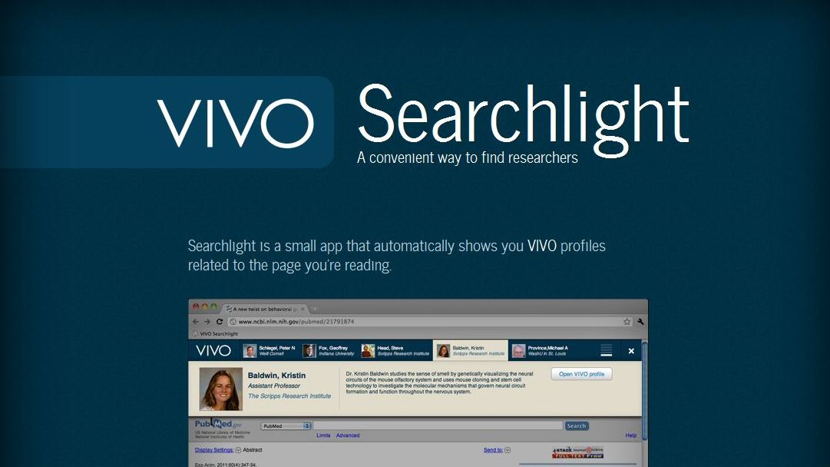
VIVO Searchlight
Notes:
VIVO searchlight. For any page on the web, find people whose work is similar to a page you are reading.

Slide 25
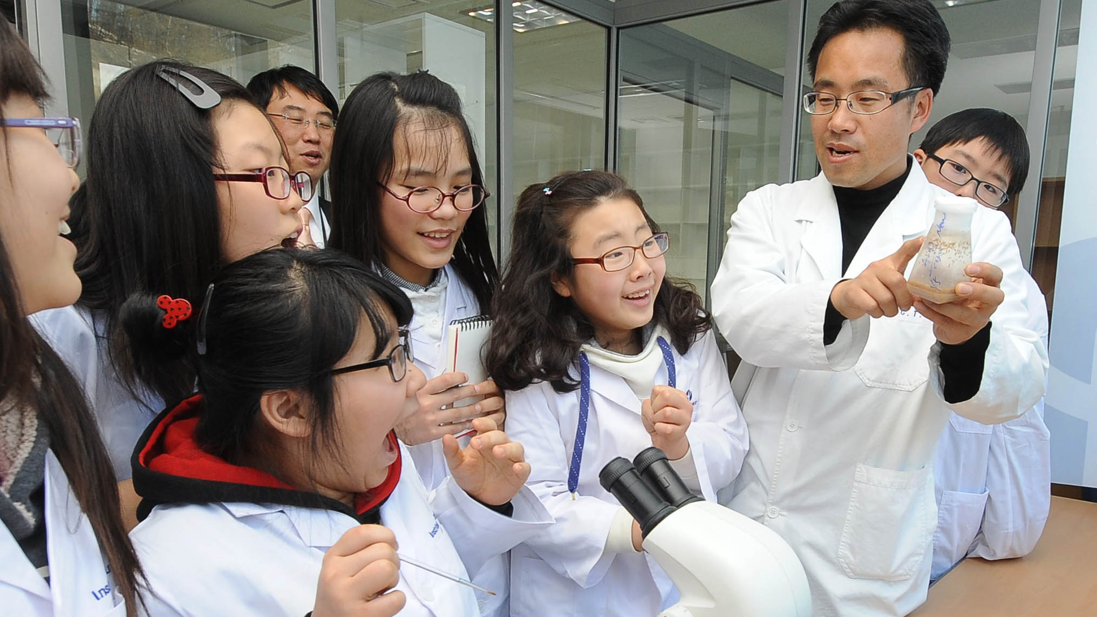
Mentoring
Notes:
Mentoring. Teach, shape, lead, build. While retaining the joy and excitement of science.

Slide 26
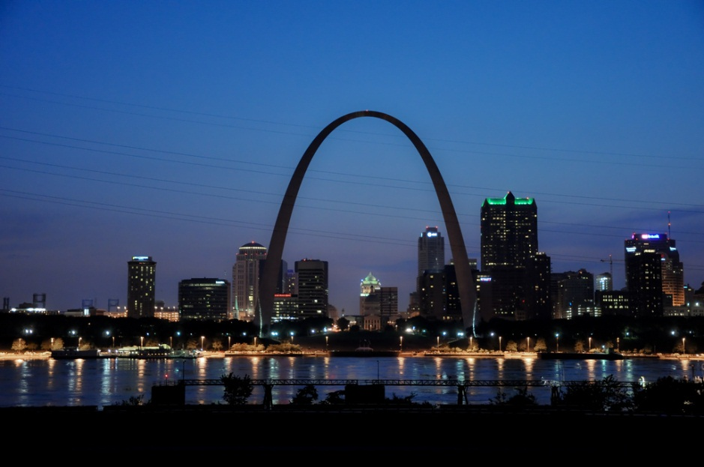
4th Annual VIVO Conference
August 14-15, 2013
St. Louis, Missouri, USA
http://vivoweb.org/conference

