Slide 1
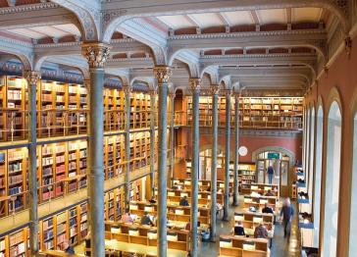
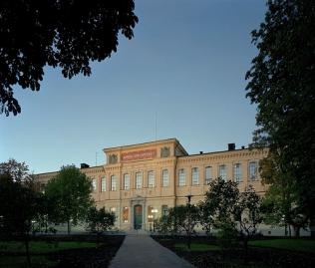
Research information systems in Sweden
Ulf Kronman
Coordinator of OpenAccess.se
The National Library of Sweden
EuroCRIS, Brussels 2012-09-10

Slide 2
Swedish CRIS history
2003 –The LIFT project
  Karolinska institutet, Avedas
  A prototype for an infrastructure for research information
2006 – Stockholm ScienceNet
  Karolinska Inst., KTH (Royal Inst. of Tech), Stockholm univ., Avedas, Vinnova
2008 – Sweden ScienceNet (SSN)
2012 – SSN to the Swedish Research Council

Slide 3
Stockholm ScienceNet (2006)
From project report: http://ki.se/content/1/c6/01/00/06/LIFT_Slutrapport.pdf

Slide 4
Sweden ScienceNet (2008)
A national infrastructure for managing research information
  Better tools for planning, analysis and reporting
  Make research competencies accessible
  Include project info from large funders
  Contribute to a more efficient grants process from application to awarding
Project manager: Stockholm Science City
Industry partner: Avedas

Slide 5
Sweden Science Net (SSN)
A joint initiative between ten leading Swedish universities
  Chalmers University of Technology
  Karolinska Institutet
  Linköping University
  Lund University
  Royal Institute of Technology
  Stockholm University
  Swedish University of
  Agricultural Science
  Umeå University
  University of Gothenburg
  Uppsala University
Answers to key questions
  What projects are ongoing in different areas?
  Which researchers are supported by which financing agencies?
  Which collaborations exist between researchers and organizations?
From Sweden Science Net website: http://www.sciencenet.se/converis/static/about

Slide 6
Sweden ScienceNet contains today
Information about grants-funded research conducted at Swedish universities
Ca 7 000 projects and 6 000 researchers
Projects starting 2008 and later
Data categorized according the Swedish standard for classification of research topics

Slide 7
Project data from funding agencies
Discussions are ongoing with
  Energimyndigheten
  Sida
  Strålsäkerhetsmyndigheten
  Mistra
  KK-stiftelsen
  Göran Gustafssons stiftelse
  Wallenbergsstiftelserna
  Handelsbanksstiftelserna
  Åke Wibergs stiftelse
  EU-kommissionen
  Nordiska ministerrådet
Project data are exposed from
  Vetenskapsrådet
  FAS
  Formas
  Vinnova
  Stiftelsen för strategisk forskning
  Riksbankens jubileumsfond
Test data have been provided by
  Ragnar Söderbergs stiftelse
  Naturvårdsverket
  Rymdstyrelsen
  Cancerfonden
  IFAU

Slide 8
Information gathered
Programme of funding organization
Project number
Project title
Abstract / Summary
Classification according to OECD’s Fields of Science
Date of project start
Date of project end
Funding per year
Project leader / Coordinator
Host institution for project leader
Collaborators in the project
Host institutions for collaborators

Slide 9
Sweden ScienceNet to the Research Council
The Ministry of Education and Research assigned the Swedish Research Council (SRC) to manage and further develop SSN
The Research Council started a pre-study
  PRIS – Public Research Information Sweden
  Planned to deliver a report in December 2012
SRC is planning to link research information to its new system for project funding applications (PRISMA)

Slide 10
Pre-study Plans for the Autumn 2012
IT architecture
Information Modelling
Adminisration/Economy
Communication
Statistics and Analysis

Slide 11
SSN/PRIS Objects within tree years
A complete, user friendly System for Swedish Research Information
Including scientists R&D organisations, contact information, ongoing research, results, statistics, news, web and mobile services
Open data base and smart connections to other sources – resuse!
A useful service in collaboration between universities, funders, business world and others – interested in Swedish research (The third assignment)

Slide 12

Information from The Swedish Research Council
PRIS – Pre Study
Agneta Ringaby agneta.ringaby [at] vr.se
PRISMA – Joint Application System
Torulf Lind torulf.lind [at] vr.se

Slide 13
Thanks for your attention!
Questions?
E-mail: ulf.kronman [at] kb.se
Twitter: @UlfKronman

