Slide 1

Integrating Data Management Plan functionality in the CRIS
Presentation by:
Ed Simons (ed.simons@ru.nl)
euroCRIS / Radboud University
euroCRIS Membership Meeting
Dublin, May 31st 2017
Ed Simons

Slide 2
What is a CRIS?
A CRIS is an information system that holds data about virtually all aspects of research:
  The researchers (ID, name, title, affiliation, ...) and their role.
  The projects (ID, title, description, key words, start- and enddate, ...)
  The organisations (institutes, universities,…) involved and their role (owner, funder, ...)
  The input invested in the research both in time (f.t.e.) and money.
  The results from the research (publications, datasets, software, patents, images, etc...)
  The equipment and services used.
  Cooperations with other projects, researchers, groups, organisations.
  Links to other systems (HRM, financial, external: ORCID, WoS, Scopus, ...)
  The domain or subject area of the research belongs to.
  The impact of the research, both in- and outside of academia (metrics, impact indicators,…).
  Semantic classifications of the research on various dimensions (typologies, controlled vocacbularies ...),
  Rights metadata: who is authorised or which conditions may apply to access (some of the) information in the CRIS
  Etc…
(meta)Data in a CRIS
And all these aspects related or linked to each other!

Slide 3
What is a CRIS: a bit of history
Evolution of
CRISs
CRIS’s first appeared around the end of the 80’s, early 90’s, closely linked to emerging policies of research assessment and control within some European countries (e.g. The Netherlands, Norway, Denmark,…).
So initially they more or less uniquely had an administrative purpose and were also as such conceived by the research community.
In the course of time, and especially the last decade, however the image has changed and CRIS nowadays are evolving into multifunctional instruments for a multitude of stakeholders among which research managers and, not the least, the researchers themselves.

Slide 4
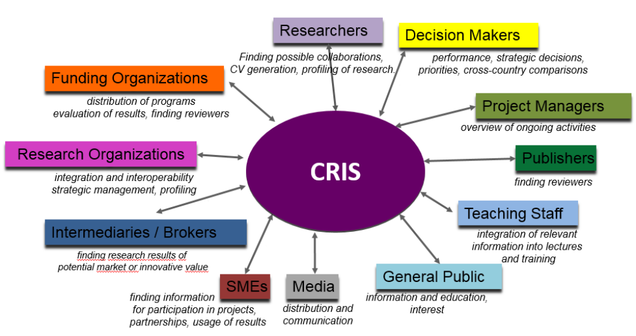
Functionality of CRIS
CRIS:
Multifunctional
Information
Resources

Slide 5
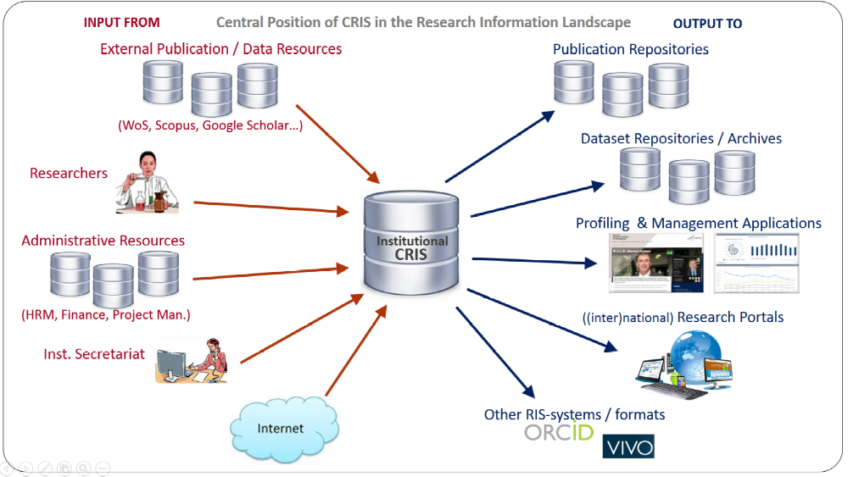
Functionality of CRIS
CRIS:
Multifunctional
Information
Resources

Slide 6


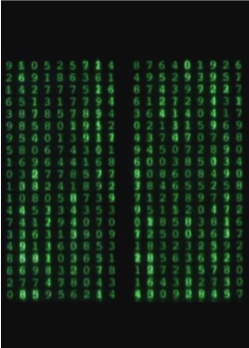

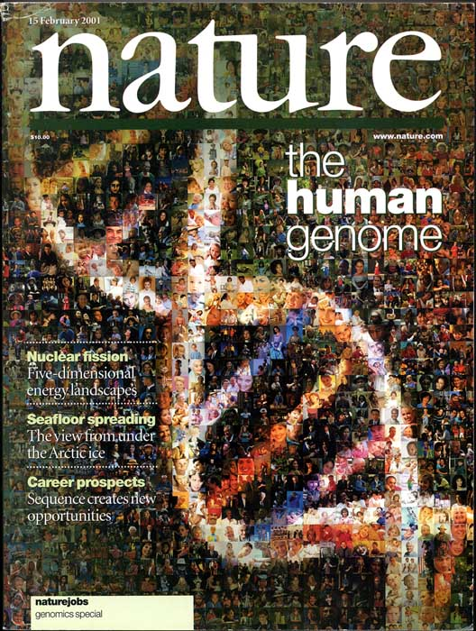




CRIS- new field of application: research data
selection
final dataset
articles
data life
cycle
management
analysis
temporary
storage
data collection
CRIS: linking publications to dataset + archiving of data.
CRIS: Data Management Plan
publication of results

Slide 7
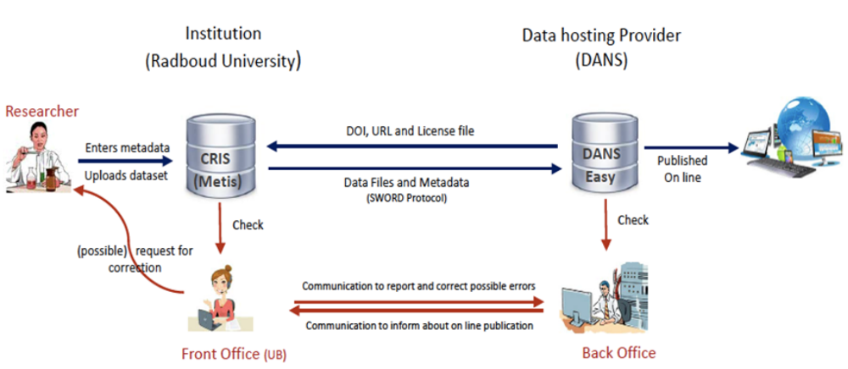
CRIS - new field of application: research data
The RIS/RDS project at Radboud University in cooperation with DANS (national data hosting organisation in NL)

Slide 8
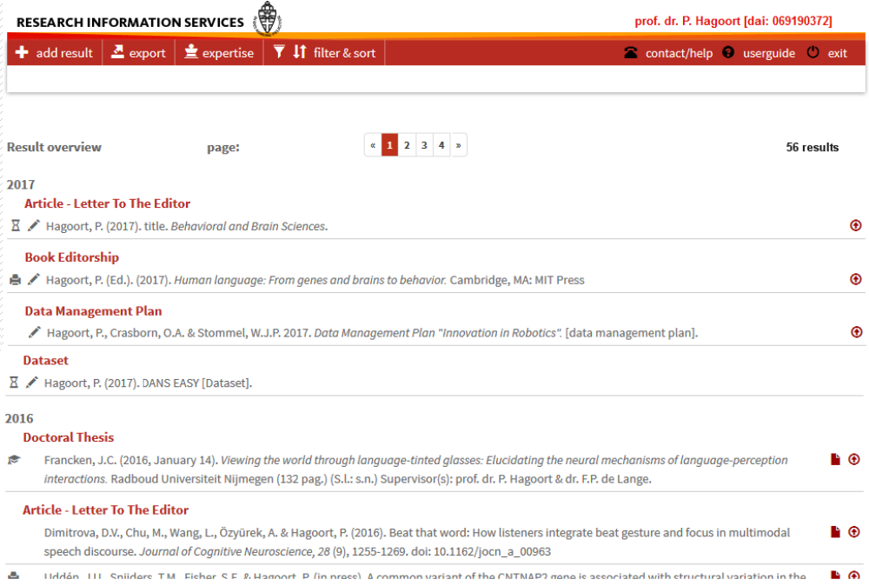
CRIS: Integrating Data Management Plan

Slide 9
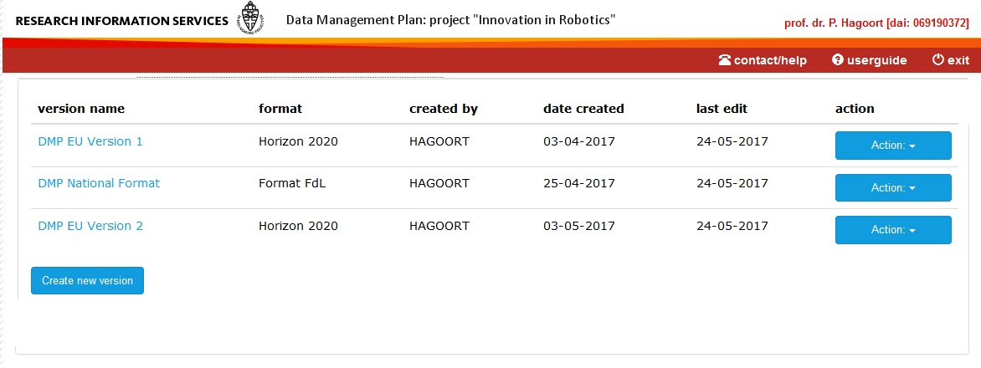
CRIS - Data Management Plan

Slide 10
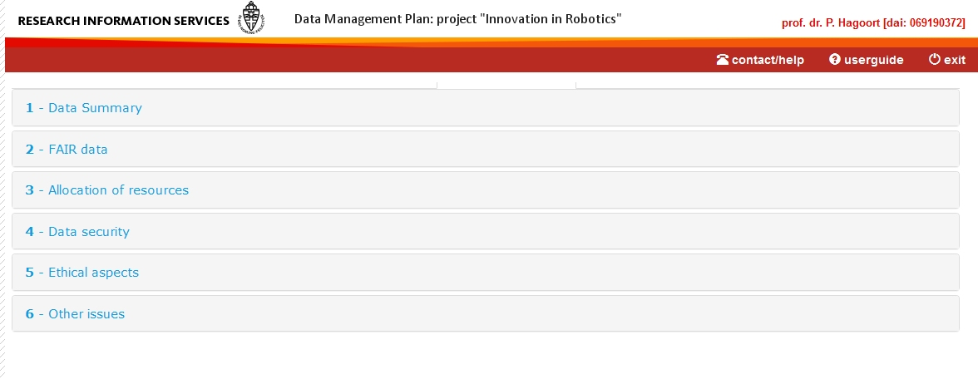
CRIS - Data Management Plan: Horizon2020 format

Slide 11
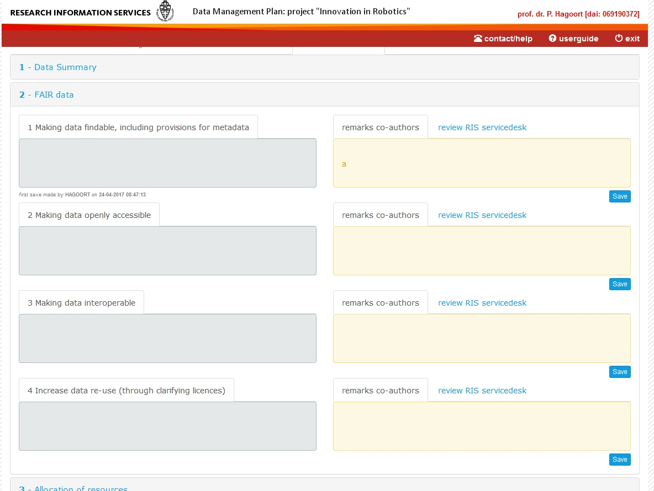
CRIS - Data Management Plan: Horizon2020 format

Slide 12
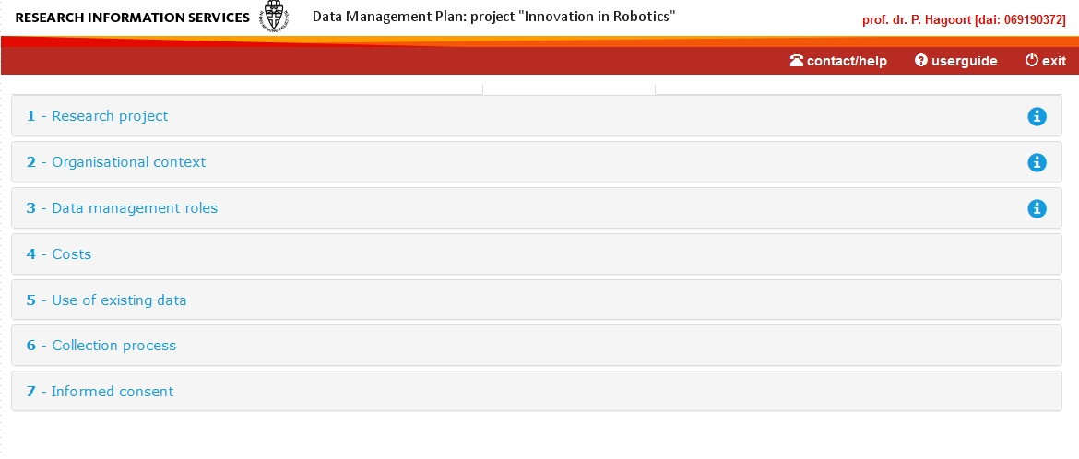
CRIS - Data Management Plan: National (NL) format

Slide 13
eurocris.org
Thank you very much for your attention!
Questions?

