Slide 1
euroCRIS strategic membership meeting Barcelona – 9-11 November 2015
Role of ISNI in research information management
Titia van der Werf-Davelaar
Senior Program Officer – OCLC Research
Notes:
Thank you very much for inviting me to give a talk about ISNI and OCLC in the context of euroCRIS and research information management.

Slide 2


acknowledgements
Janifer Gatenby
Karen Smith-Yoshimura
Notes:
Let me clarify from the start that i am not working on ISNI, at OCLC. However, both my colleagues Janifer and Karen are ISNI specialists and they have provided me lots of info, advice and slides, which i have re-used heavily in this presentation.

Slide 3
What is ISNI?
ISNI is the globally recognized and adopted international standard approved by ISO for the unique identification of the public identities of persons and organizations across all fields of creative activity, including researchers, inventors, writers, artists, visual creators, performers, producers, publishers, academic and other types of organizations, aggregators and more. ISNIs are neutral and international in scope.
ISNI is an identifier assignment service, offering identifiers that are managed and curated.
ISNI serves as a hub, to link local and global environments and acts as a bridging identifier, intended to provide interoperability between different identifiers for the same identity.
Notes:
How many of you know what ISNI is? (approx. half of the audience raised their hands).
Let me start with the what, the who and the why of ISNI.

Slide 4

cross-domain
bridging-domains
Text Rights
Trade Sources
Music Rights
Archives and Museums
Encyclopaedias
Libraries
Researchers & Professional
Granting organisations
Professional Societies
Article databases
Theses databases
Notes:
ISNI covers multiple domains. Academic research is a major domain within ISNI.
This global identifier is cross-domain in the sense that it links the same identity known under different names and identifiers in domain-specific databases. It is this bridging role that is most characteristic of ISNI. As such it serves as a name identity hub.
The cross-domain nature of ISNI is explained by the “who is ISNI”.

Slide 5








Who is ISNI?
ISNI-IA is a non-profit, community-driven network with contributors representing a broad range of domains such as libraries, rights agencies and publishers.
Notes:
The organisation behind ISNI is driven by its founding members, who are representatives of the different domains illustrated in the previous slide.
Confédération Internationale des Sociétés d´Auteurs et Compositeurs (CISAC),
the Conference of European National Librarians (CENL),
the International Federation of Reproduction Rights Organisations(IFRRO),
the Societies' Council for the Collective Management of Performers' Rights (SCAPR),
the Online Computer Library Center (OCLC)
and ProQuest.
A representative from each of these organisations is member of the ISNI international agency (ISNI-IA) and, in the case of CENL, both the Bibliothèque nationale de France and the British Library have been nominated as representatives in the IA. The Ifrro is the current chair.
Ifrro, SCAPR, OCLC, ProQuest and CENL are all contributing their data to the ISNI-database. The ISNI database is built from hundreds of datasets worldwide and holds public records of over 8.6 million identities, including 8.24 million individuals (of which 2.25 million are researchers) and 446,000 organisations.
OCLC is the infrastructure provider and the ISNI assignment agency.
Publishers, like ProQuest, and national libraries, such as the BL and BnF, are ISNI Registration agencies for their communities.
The BL and BnF form the ISNI Quality Team.
From this outline, it is immediately clear that all members in the ISNI-network are contributing and playing a role to make ISNI work.

Slide 6




52 performer rights management organisations
Who is ISNI?
89 text rights management organisations
60,000 member libraries
229 music rights management organisations
49 national libraries
Notes:
The ISNI organisation is a growing network: the founding members are networks themselves and attract their members to join ISNI (examples are La Trobe University Library and Bowker Idenfier Services).
But also other organisations and agencies join ISNI because they see the benefit of sharing identifiers with the ISNI-hub (examples are the ISSN international Centre and Ringgold).

Slide 7




Who is ISNI?
Partnerships
Notes:
Furthermore, ISNI is also growing through partnerships with related networks, such as: ORCID, Linked Content Coalition, CASRAI.
There is also een intention to close a partnership between ISNI and euroCRIS.

Slide 8
Why ISNI?
For sharing public information about identities online and in databases, across stakeholders, national borders and in the digital environment
Notes:
Who ISNI is explains what ISNI is-for: ISNI is for the stakeholders who participate in ISNI.
It is for sharing information between the members – sharing data about same identities, that sit in separate databases of the ISNI members. The purpose is to help each other with the management of identities and their associated metadata (rights; creative/scientific outputs; etc.) across national borders and in the digital environment.
Let me give you 2 examples.

Slide 9


Why ISNI?
Notes:
Organisations like La Trobe University are choosing to work with ISNI to get quick coverage. La Trobe loaded its research information data to ISNI and immediately half of its identities matched with the database and became assigned. They separated the other half into current and non current researchers and concentrated on the former. They then manually enriched them and disambiguated them and got them ISNI’s. They now have nearly 100% coverage for their 10.000+ scholars – and this result was achieved with relatively little effort.
La Trobe University also uses ISNI to solve the problem when reporting on research outputs in humanities. La Trobe is one of the strongest Humanities faculties in Australia. Creative works like art exhibitions, poems, books and dance performances do not often appear in citation indexes, such as Web of Science and Scopus, but they are in the ISNI database, because these outputs have been registered by museums, libraries, galleries and publishers of creative works.

Slide 10
Why ISNI?
Notes:
We heard another example yesterday, from João Moreiro, about the intention of FCT to work with ISNI and Ringgold, for batch assignment of ISNIs to research institutions in Portugal, but also for the continued maintenance of such org-identifiers and keeping the system up-to-date and useful.
He explained quite eloquently, the need for a global hub and a concerted effort for authority control. Keeping a national registry of research organisations is useful, but not good enough. Academia is international and researchers collaborate across institutions, borders and disciplines. They publish with co-authors from other universities, and they are extremely mobile: as visiting fellows, teachers and chairs of excellence, temporarily affiliated with other institutions than their own.

Slide 11
Why ISNI?
“With continuing collaboration and increasing interoperability between ISNI and ORCID, it is important to communicate clearly the balance between:
The quality of publication/output/results information in ISNI where multiple sources (…) have contributed to creating the resources
The immediacy, currency and ownership created by the claim and self-registration model of ORCID.”
KE-Report National approaches to ORCID and ISNI (July 2015)
Notes:
“Why ISNI?” is also explained by clarifying the (past) confusion around ORCIDs and ISNIs. The confusion arises because at first sight both identifiers seem to have the same purpose – but in fact ISNI and ORCID are quite complementary and potentially synergetic.
ORCID is focussed on the researcher claiming and maintaining his identifier. ISNI collects the public identity of persons and organisations (not only academic researchers) from its trusted sources.
ORCID are validated by ISNI and not the other way round. ISNIs are subject to Quality monitoring.

Slide 12
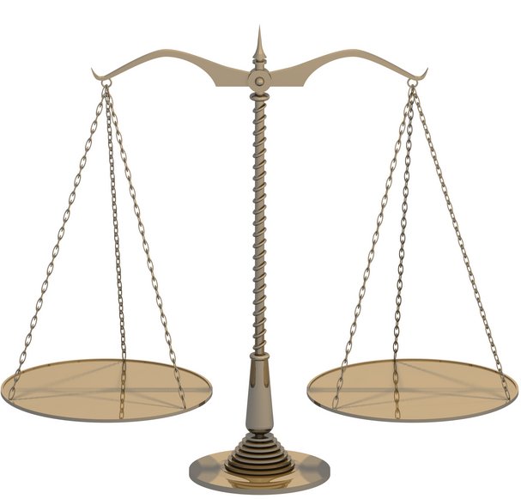

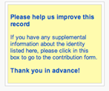
Data quality management
Algorithms
Notifications
Data fixing
Sampling
Data Policy
Enrichment
Correction
Curation
Crowd sourcing
ISNI Database
Harvested, Batch loaded; Online contributions
Members and Registration Agencies
Notes:
ISNI’s system has a focus on quality.
The system’s matching and disambiguation policies and the workflows of the ISNI service are geared towards the continuous quality improvement of the data.
The BL and the BnF check and evaluate ISNI assignment proposals and corrections and support members in reconciling identities.
Other national libraries and agencies are set to participate in this role for their own national identities (Netherlands, Luxembourg, etc.)

Slide 13
Sustainable business model
All stakeholders in ISNI have a business interest in using the assignment system
  Rights mngt agencies for rights mngt
  (National) libraries for bibliographic control
  (University) libraries/CRIS for research information mngt
  Publishers for mngt of authors/subscribers
Notes:
ISNI is built on a strong, sustainable and internationally well supported baseline. All stakeholders in ISNI have a business interest in using the system.
The ISNI business model is one of sharing the workload between all members, for the benefit of all the members.
OCLC provides the technical platform for ISNI and runs the assignment system . As long as libraries are major stakeholders in ISNI, OCLC will have an interest in providing this service.
And OCLC might be an interesting player for the ISNI community, from another perspective.

Slide 14
OCLC: transitioning from MARC to linked data
Notes:
OCLC’s core business and expertise area is metadata. In the past years, OCLC has invested much effort into developing Linked Data from bibliographic records and this transition is not only of importance to library data. Linking data into the web is also relevant for research information.
So let me explain which direction OCLC is taking with linked data and how ISNI can benefit from this and how ISNI can play an important role in linking data for research information.

Slide 15
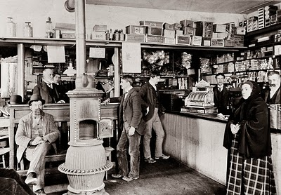

http://old-photos.blogspot.nl/2011_01_01_archive.html
From local catalogues ...
... to large metadata
aggregations.
http://upload.wikimedia.org/wikipedia/en/1/1e/T%26T_Supermarket.jpg
Notes:
In the past decennia, libraries have made the transition from local catalogues to large metadata aggregations – a development that was necessary to achieve efficiencies through sharing and reusing similar data, digitally. It was also an opportunity to better serve users, and offer them a larger variety of titles than just the ones held in local catalogues.

Slide 16
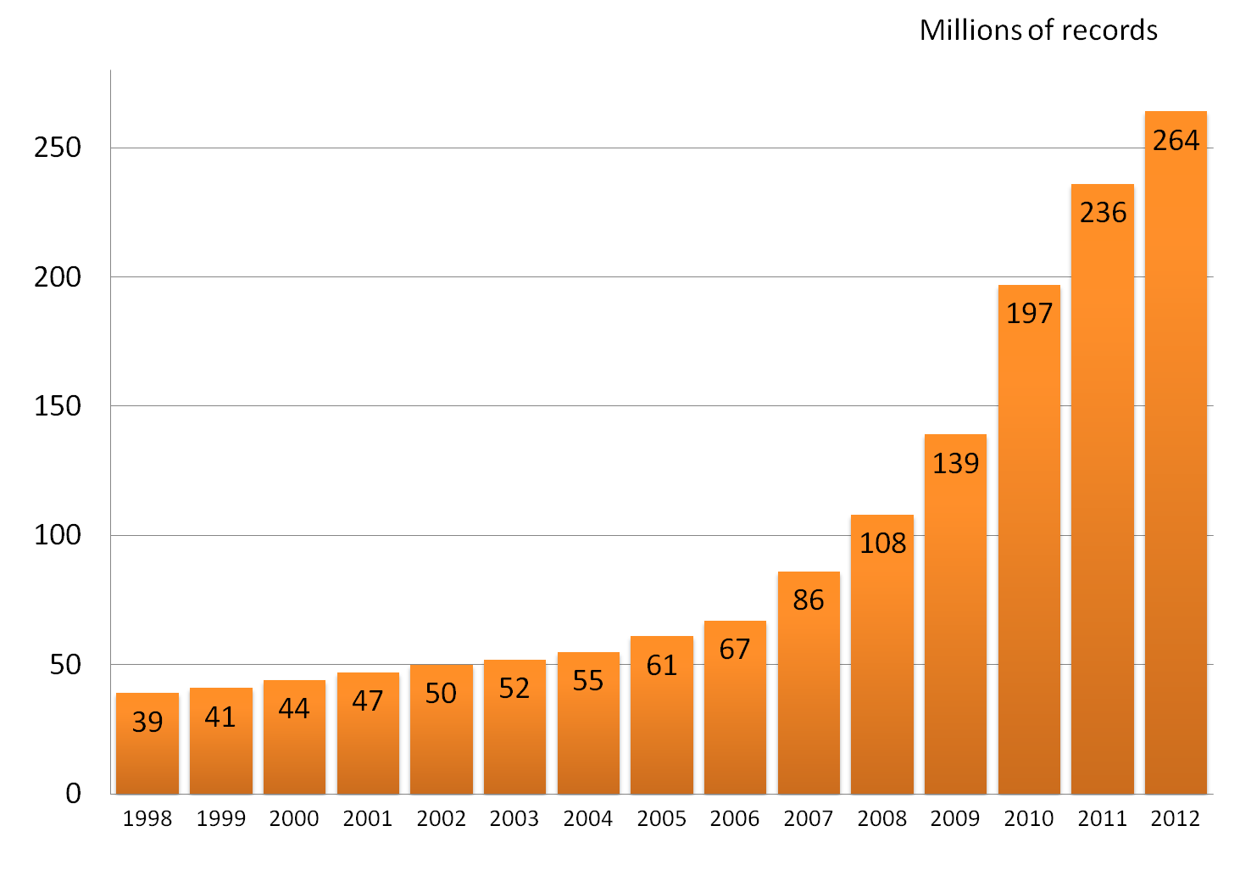
WorldCat growth since 1998
As of 27 April 2012
Notes:
16
WorldCat is an example of such aggregations, one of the biggest and fast growing library dataset in the world.
But there are several problems with aggregating data.

Slide 17
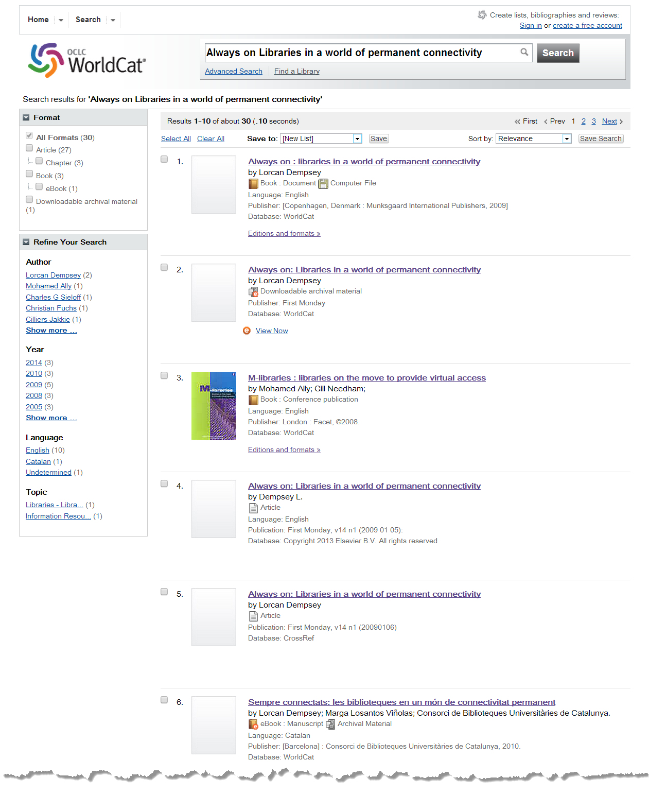
Cataloging error
Harvested – points to repository splash page
Analytic – essay in book
Loaded from Elsevier
Loaded from Crossref
Catalan translation
Notes:
Because even though the data are similar, they are still very different due to different cataloguing practices and languages. The data also increasingly come from heterogeneous sources – not just libraries. And the local/national authorities that used to make the data in local catalogues uniform, cannot be applied on this heterogeneous dataset without first aligning them.

Slide 18
Virtual International Authority File - VIAF
Merge of 24+ national level authority files
Cooperative program run by OCLC
Initiated by LoC, DNB, BnF and OCLC
29 million authority records
112 million bibliographic records
Migrated from an OCLC Research project to an
OCLC service in 2012
VIAF is available as linked data
Notes:
VIAF has been such an effort, of aligning and cross-linking authority files. Ensuring that identities across different national union catalogues could be matched.

Slide 19
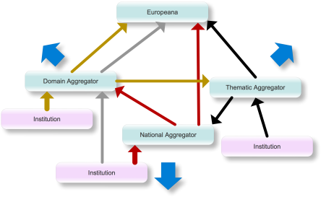
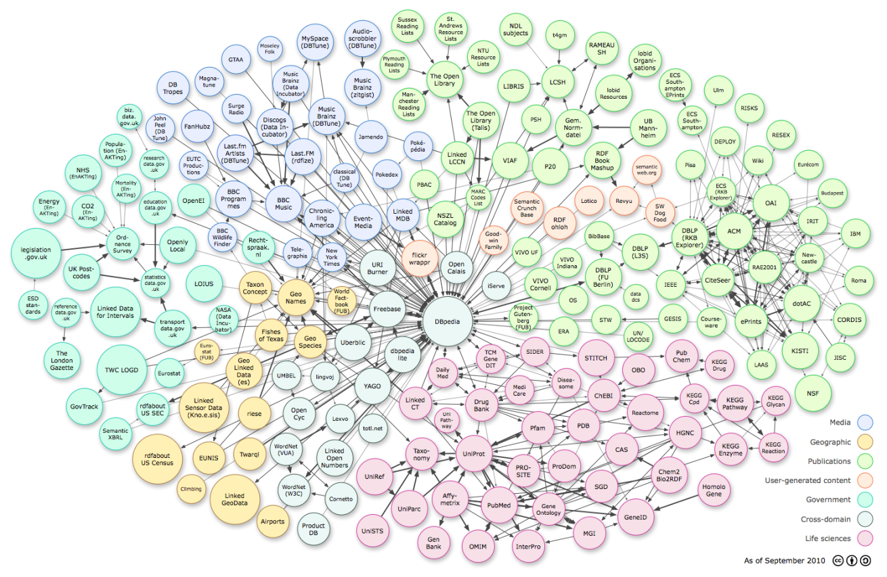
http://www.theeuropeanlibrary.org/confluence/display/wiki/A+Library+domain+aggregator
From an infrastructure
of aggregators ...
... to the web of data tapestry.
Linking Open Data cloud diagram, by Richard Cyganiak and Anja Jentzsch. http://lod-cloud.net/
Notes:
And, while libraries were busy developing the proper logistics and infrastructures for their supermarkets (metadata harvesting workflows, metadata conversion and harmonisation and enrichment procedures, etc.), developments on the Web are overtaking them.

Slide 20
Getting ready to move to the global aggregation: the semantic web
Linking Open Data cloud diagram, by Richard Cyganiak and Anja Jentzsch. http://lod-cloud.net/
Notes:
In the Web environment, libraries need to weave their metadata into the web tapestry.
Library data need to be linked to other, non-library data: data from publishers, wikidata, and data from other players in the field – like CRIS and IRs
In this linked data environment, identifiers play an important role, as URIs.
And ISNI, an authoritative global name identity service, is potentially an important identifier hub for linked data.
As part of its linked data strategy, OCLC is investing in the entity metadata model and naturally, opportunities for providing a global name identity service is part of its future planning.

Slide 21
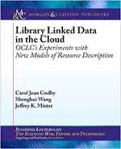
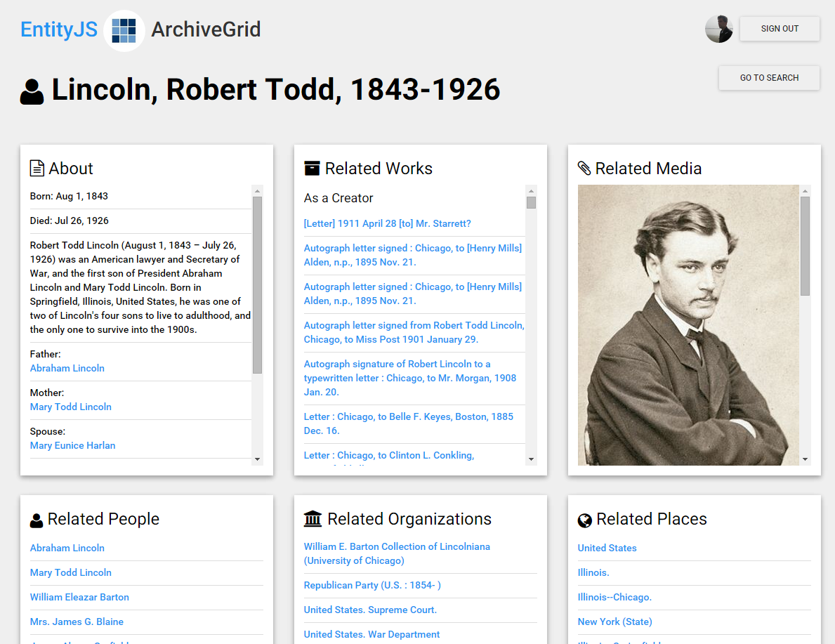
OCLC Research - Data Science
Linked Data
  Extracting entities from records and
  weaving library data into the web of data
  (Linked Data research)
  The EntityJS Research Project
  Person Entity Lookup Pilot
Notes:
If you are interested, you can find more information about OCLC’s Linked Data-related activities on the web.
OCLC Research is doing data modeling, contributing to best practices and standardization (W3C, BIBFRAME), publishing WC-dataset as linked data, surveying the field to explore how libraries are publishing and consuming linked data, prototyping new applications based on linked data.
The EntityJS project is a prototype effort, testing the process of transforming bibliographic records to triples and getting some real-life RDF experience.
As a result of OCLC Research’s work in this area, OCLC is piloting a person reconciliation services called the Person Entity Lookup Pilot.
ISNI is important in this context as a Name Identity Service.

Slide 22
Linking among identities in ISNI



G
Co-author, pseudonym…..
isMemberOf,
isAffiliatedWith…..
G

G
G
hasMember,
hasEmployee…..
hasUnit,
supersedes
acquired
hosts
isPartneredWith…..
Notes:
OCLC is applying its entity metadata modelling expertise to ISNI as well.
In ISNI, name entities and relationship types are used to express multiple things.
They can be used to express hierarchy, historical relationships, etc.
These links may have date ranges and can be used for both display and retrieval.

Slide 23

and creating new identity types
Links to supporting institutions
Links to member researchers
G

G
Research project
G

G
m
Links to funders
Notes:
Communities ask for new entities and relationships.
Last year, during a euroCRIS-ISNI meeting, Ed Simons recommended to add research project or research group as an organisation type to ISNI.
This action was immediately implemented.
(Research) project or a (research) group is a newly added organisation type. In a non-academic environment, you could think of a rock band, for example.
It can have multiple links to both persons and other organisations as well as links to funders.

Slide 24
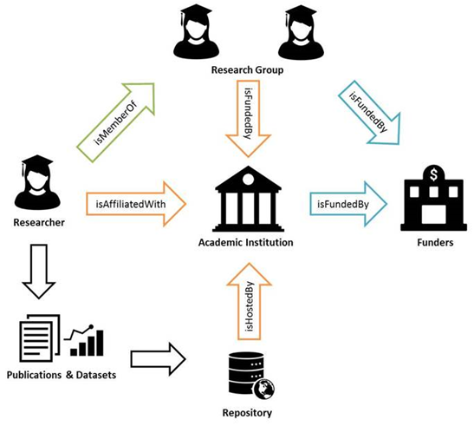
ISNI data element values
Notes:
For more info, see the ISNI documentation: ISNI Data element values doc.
These element values are supported by the ISNI-system – although not all are used yet.

Slide 25
euroCRIS strategic membership meeting Barcelona – 9-11 November 2015
we welcome your engagement
www.isni.org
www.oclc.org/research
Notes:
We are actively observing the RIM-field and welcome any discussion about the needs in that area from the various groups of users.

